Slide 1
Estate Planning with integrated Trust Systems
Presented by:
Ciara E. Lister, Esq.-- Staff Attorney Integrated Trust Systems
Notes:
I am chief counsel for integrated trust systems and a strategic partner and licensed agent with paragon tax advisory services. I work in the field with Paragon using the ITS system assiting and working closely with advisors to implement comprehensive estate planning for you their clients.

Slide 2
Insert YOUR INTRO
Identify yourself
Download this power point
EDIT IT!
Include contact information
Rebrand for your clients

Slide 3
Estate Planning with integrated Trust Systems
Presented by:
Ciara E. Lister, Esq.-- Staff Attorney Integrated Trust Systems
Notes:
I am chief counsel for integrated trust systems and a strategic partner and licensed agent with paragon tax advisory services. I work in the field with Paragon using the ITS system to generate qualified prospects but also servicing existing clients needs as well as working hand in hand with advisors to implement comprehensive estate planning with clients.

Slide 4
What is Estate Planning?
The act of preparing for the transfer of a person’s wealth and assets after his or her death

Slide 6
About 80% of estates do not have proper planning
Individuals do not plan to:
Manage assets
Control assets
Transfer assets
People further fail to plan for:
Avoidable estate taxes
Administrative costs
Legal fees
You want to be able to direct Where, When, and How your assets will be distributed upon your death.

Slide 7
Probate is the legal process of administering a deceased person’s estate. It resolves all claims while distributing all the deceased person’s property under a will. Probate can occur during life as well as upon death.
What is Probate Court?

Slide 8
Fees
Payment of Utilities, Taxes and Mortgages
Delays in Transfer
Publication of your Information
Contestability
Automatic Temporary Injunction
Who will pay for all of this and how long can they pay?
Probate Court Issues?

Slide 9
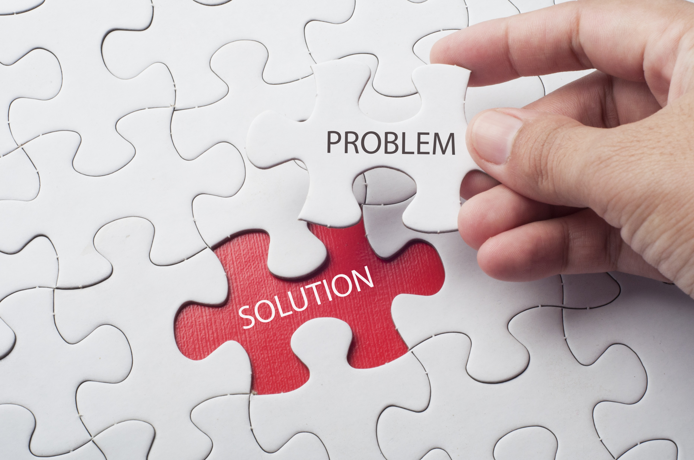
What are your options to avoid probate?
Do Nothing
Joint Tenancy
A Will
A living Trust

Slide 10
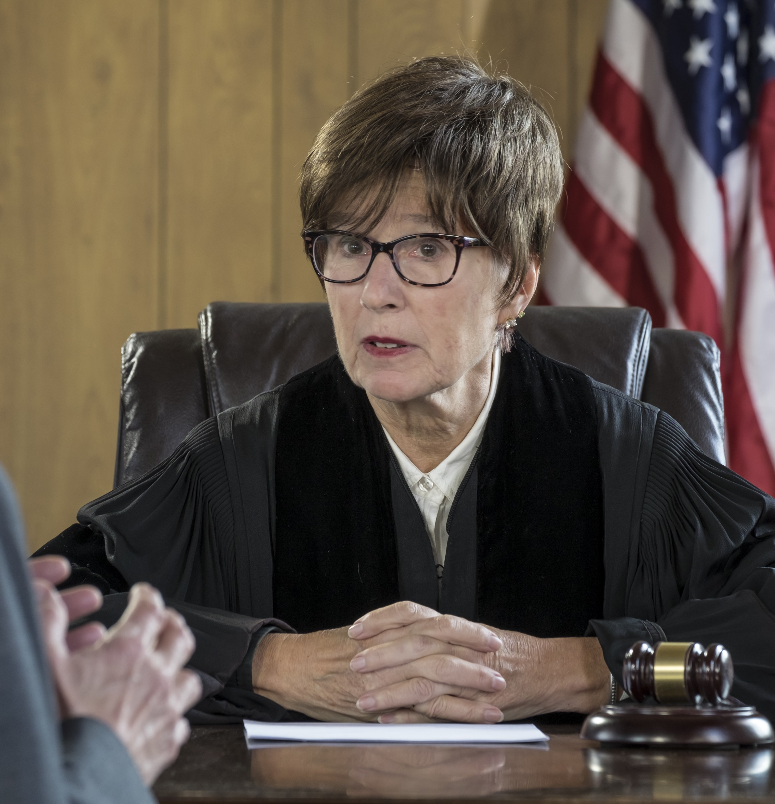
What if I do nothing?
Tax savings are not optimized
A person of your choice may not obtain the estate
Unless under minimum estate value, subject to probate proceedings
No automatic appointment of guardianship for dependents

Slide 12
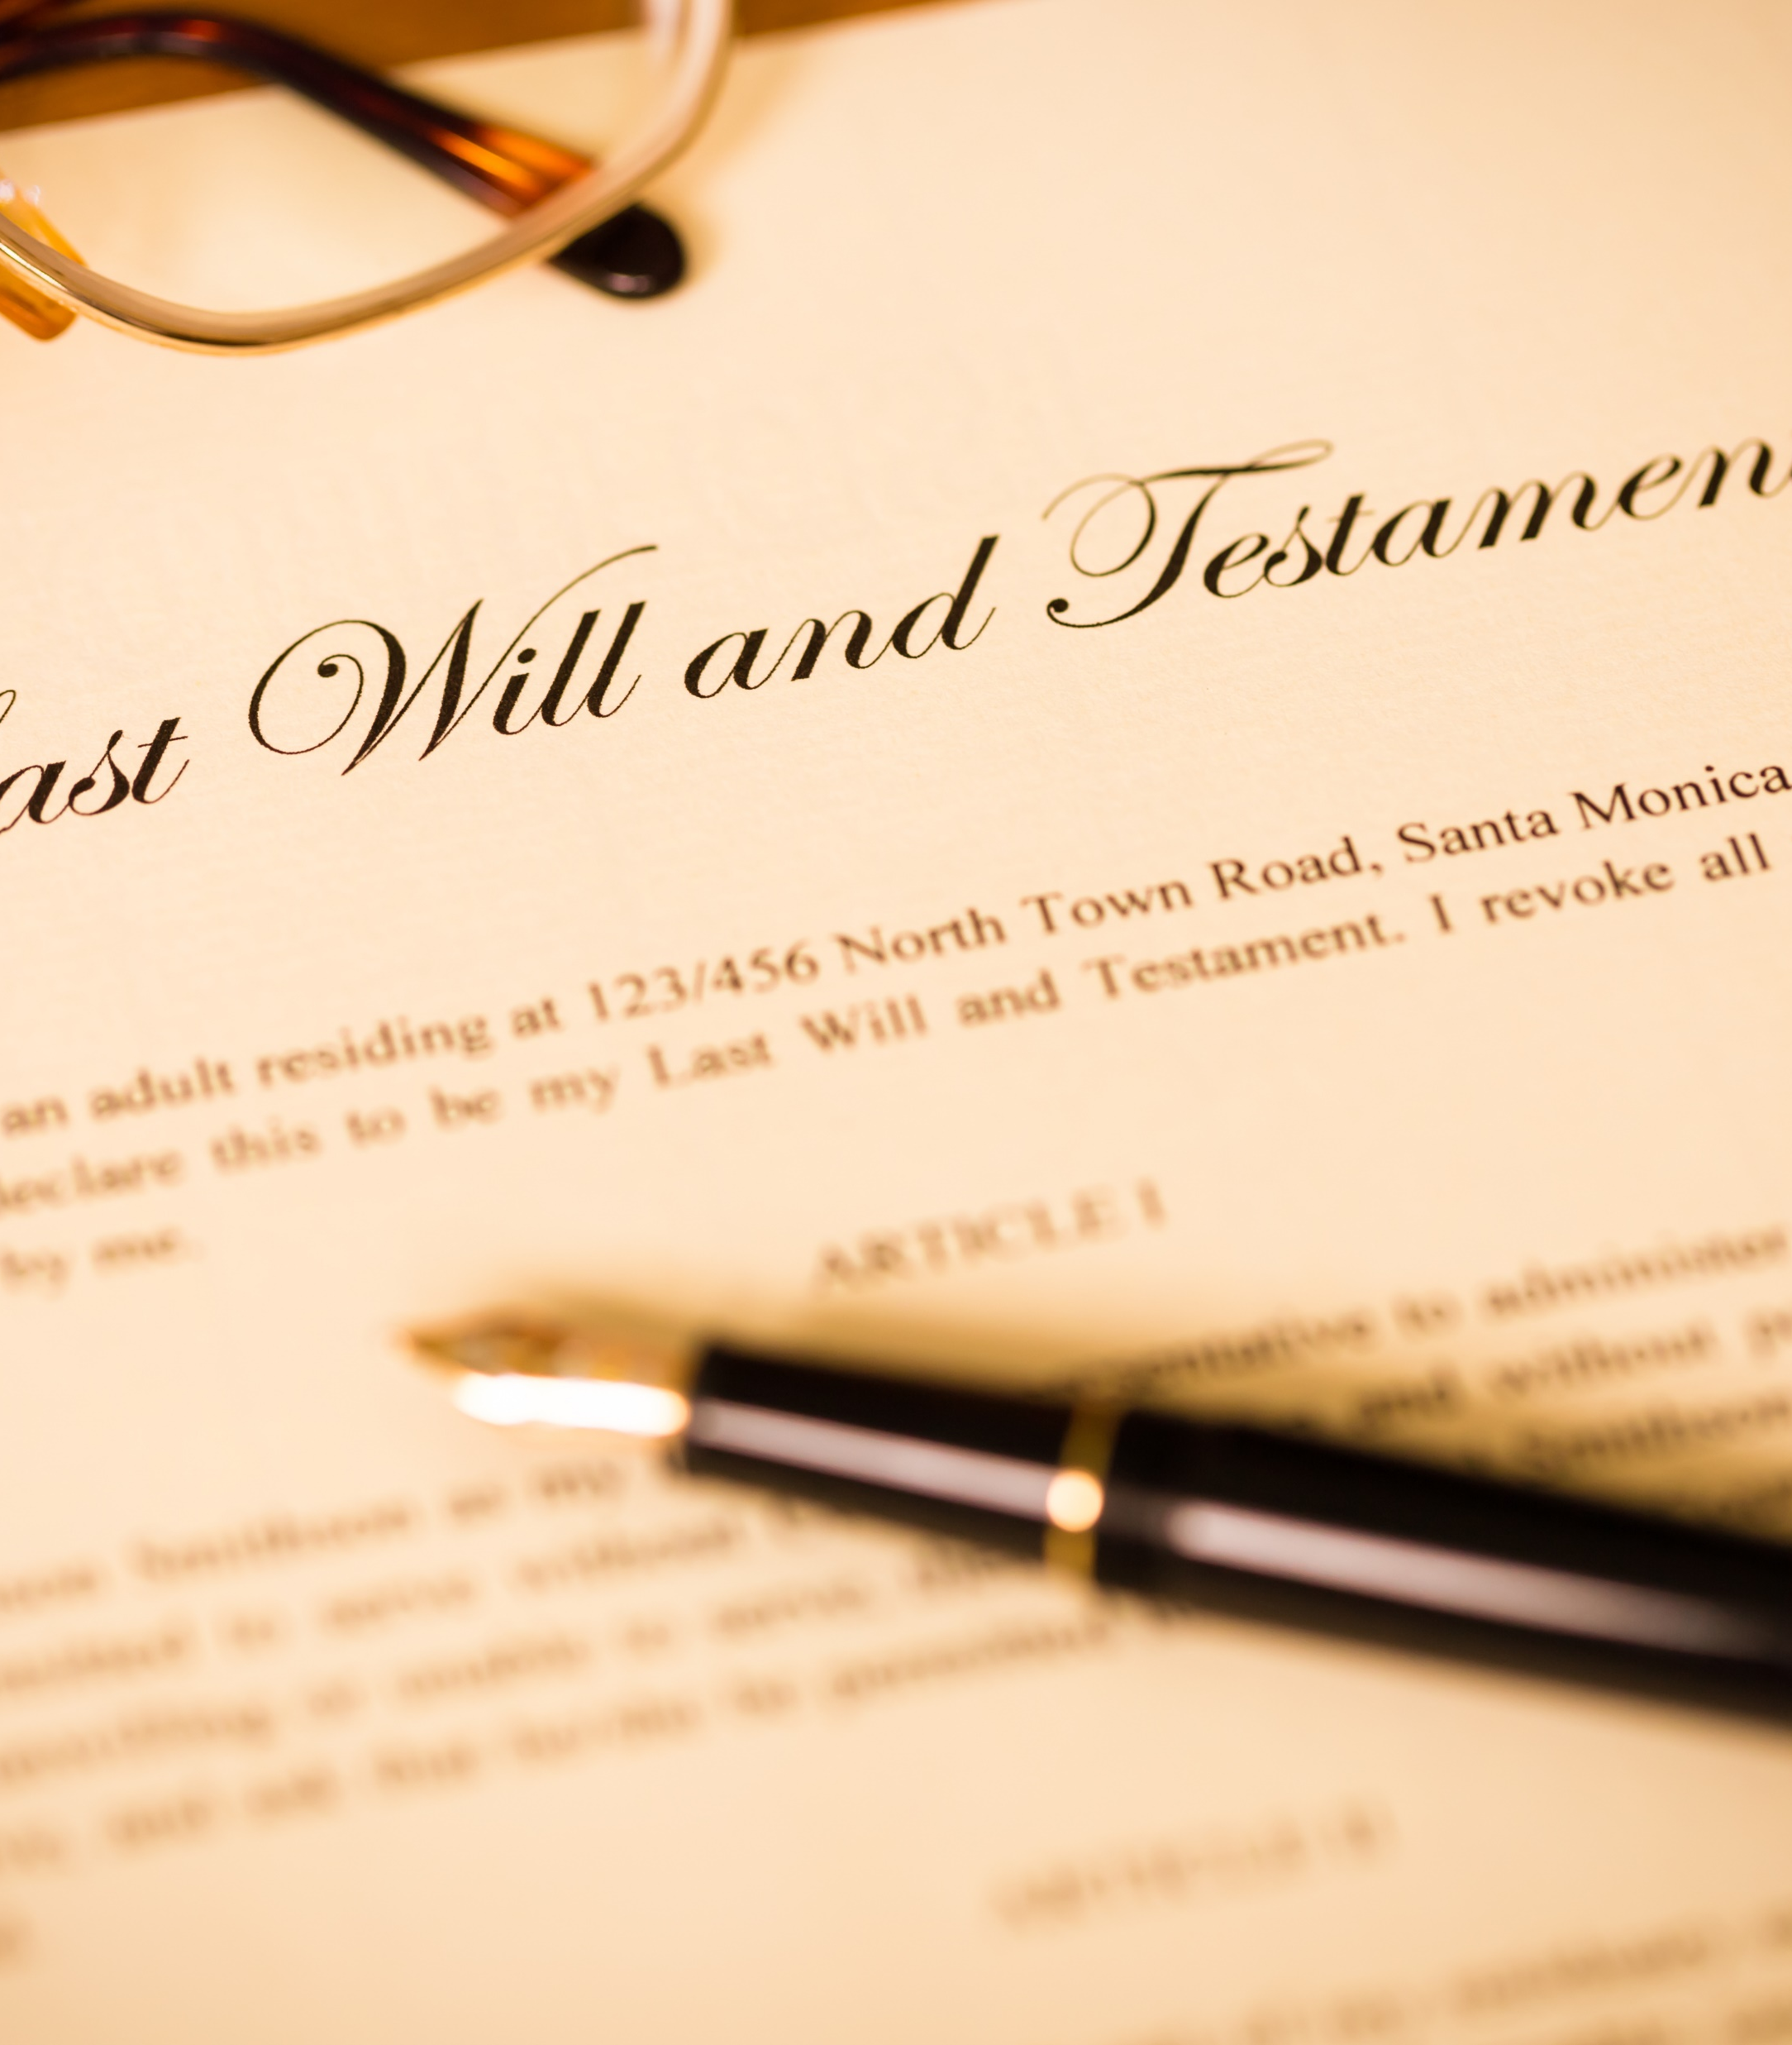
Last Will and Testament
A statement
A direction
Not a contract

Slide 13
A Simple Will: Disadvantages
Possible Conservatorship
Assets are frozen immediately
Loss of control- subject to judiciaries
No partial distribution of assets
May not optimize estate tax savings
Higher probability of being contested
The expense and time delays of probate

Slide 14
Will = Probate
Attorney Fees
Executor Fees
Accounting Fees
Potential taxes
A smaller % of your Estate goes to family

Slide 15
Revocable Living Trust
Attorney Fees
Executor Fees
Accounting Fees
Potential taxes
Small % of your Estate goes to family
= a greater % of your estate goes to your Family

Slide 16
A living trust is just like a safe
It can hold virtually all or be a recipient of all your assets
As the creator of the trust you can do as you wish with the contents of the Trust, just like a safe
At death your trustee will “open” the safe door and distribute your assets privately and directly to your beneficiaries
Avoids problems associated with improper planning, or just a will

Slide 17
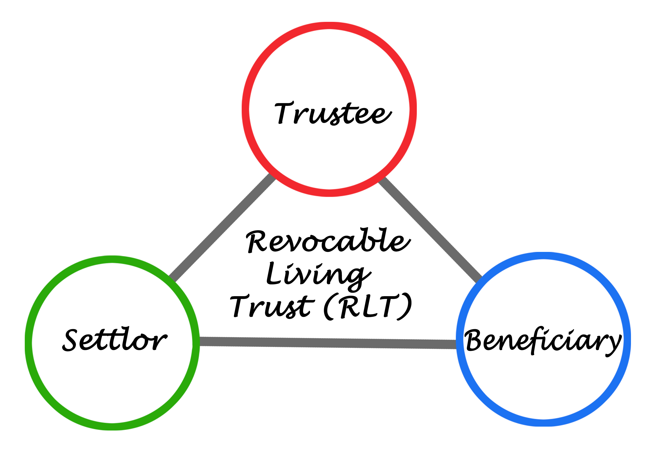
There are Three Parties to a Revocable Living Trust

Slide 18
Party 1: The Creator
The creator is also called the grantor settlor and trustor
When you establish a Living Trust you become the Creator/Grantor.
If you are married, you and your spouse can be co-creators of trust, or you can each create your own separate trusts. Only you, the creator, can make stipulations and changes to the trust.
You have complete control.

Slide 19
Party 2: The Trustee
The Trustee is the person and or corporate entity that is chosen to manage the assets in your trust. This can be anyone, including the creator.
Very often the successor trustee is a trusted family member such as a son or daughter.
If you are married, you and your wife can be co-trustees. This way if either of your become incapacitated or dies, the other instantly becomes the sole trustee. As written in the trust by operation of law.

Slide 20
The Third Party: The Beneficiaries
In a Living Trust, the people and/or organizations listed to received the trust assets when you die are the beneficiaries.
Most people leave their estate to relatives, but you can leave assets to virtually whoever you want.

Slide 21
Why a Living Trust:
Properly funded living trust avoids probate
Successor trustee shall, without court intervention, take title to the trust property as Trustee
The creator can design and mandate desired methods of distribution
Can protect your heirs inheritance from future claims
Financial information handled in complete privacy
Prevents from disinheriting your children from previous marriages
Intra-family legal agreement where the family makes the decisions

Slide 22
eStatePlan Portfolio:
Electronic Advance Medical Directive
Dynamic Revocable Living Trust
Last Will and Testament
Guardianship Appointment
Electronic Signature/Implementation
Utilization of Leading Trust Law (Nevada)

Slide 23
REVOCABLE LIVING TRUST
This is the "core" document of your plan allowing you to state who is to receive your stuff.
Our Trust provides privacy, convenience and control that everyone wants.
The cost savings and administrative efficiencies associated with a fully funded Revocable Living Trust are well established undisputed facts.

Slide 24
LAST WILL & TESTAMENT
Should you not place all your assets into your Trust, your Last Will, sometimes called a Pour Over Will, will accomplish this objective.
Your Will directs that any assets that are in your name when you die are to transfer to your Trust. This allows you to be sure that ALL your assets will flow through your Trust.
Additionally, your Will states your choice of a guardian for any appropriate beneficiary.

Slide 25
Your eStatePlan will also include:
DURABLE POWERS OF ATTORNEY
This document is designed so you can select a person to act on your behalf to make decisions for you if your become incapacitated.
HEALTH CARE DIRECTIVES
This document allows you to make multiple health care directives
SPECIFIC DIRECTIVE APPS
Directive Apps provide a variety of common choices concerning trust administrative and dispositive language [who gets what] that will auto populate into your trust document.

Slide 26
Membership Benefits:
Free & Unlimited Changes to your Documents
24/7 Online access
Online Access to your trust funding kit
Convenient ability to share console
Estate Settlement Package

Slide 27
Estate Planning with integrated Trust Systems
Presented by:
Ciara E. Lister, Esq.-- Staff Attorney Integrated Trust Systems
Notes:
I am chief counsel for integrated trust systems and a strategic partner and licensed agent with paragon tax advisory services. I work in the field with Paragon using the ITS system to generate qualified prospects but also servicing existing clients needs as well as working hand in hand with advisors to implement comprehensive estate planning with clients.

Slide 28
Schedule a complimentary appointment with us:

