Slide 1
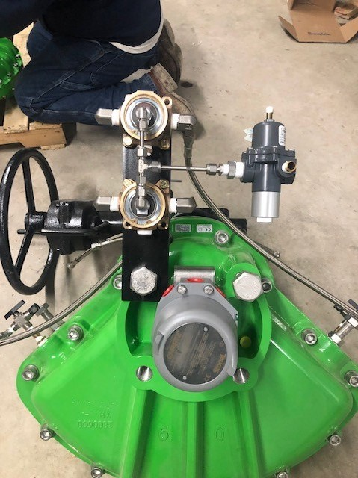
Standard-DD Damper Drives
Retrofit With ………
Standard-DD
Damper Drives

Slide 2
STANDARD-DD DRIVES ARE DESIGNED FOR THE FOLLOWING INDUSTRIES FOR PRECISE AND RELIABLE POSITIONING OF DAMPERS.
Electric Power Utilities
Oil and Gas Refineries
Chemical/PetroChemical
Steel, Aluminum, and other materials
Pulp and Paper Mills
Pharmaceuticals
Food and Beverages
Water and Waste Water Treatment
Co-Generation
Fluidized Bed Boilers
Glass Manufacturing
Cement and Lime Facilities

Slide 3
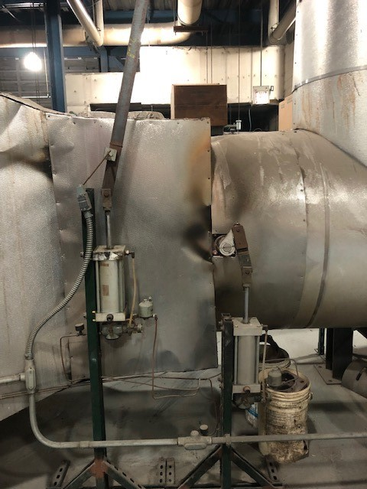
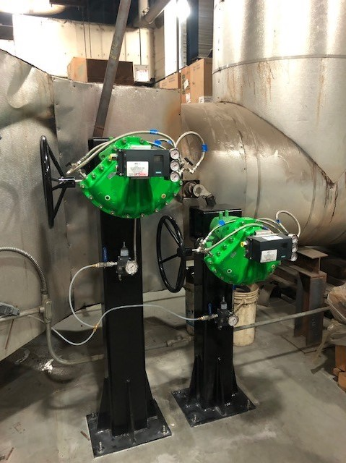
High Performance Damper Drives for Precision Damper Control
“Drop in Place” for Easy Retrofit Solutions of Existing Damper Drives

Slide 4
STANDARD-DD High Performance Damper Drives are the solution for Control of Combustion Air and Flue Gas thru a boiler.
Rotary vane actuator - one moving part Most reliable, efficient actuator design.
Linear - constant torque output for full 90° stroke Output torques range from 90 ft. lbs. to 10,416 ft. lbs. (122 to 14,131 Nm)
Master - Slave actuator option provides torque to 20,832 ft. lbs. (28,262 Nm)
Compact Rugged Design - Maximum environmental protection.
Wide range - of input control and feedback options Characterizable high-gain positioner with versatile signal conditions to interface with customers existing demand signal and feedback signals.
Durable - corrosion resistant internal and external finish.
High immunity - to shock and vibration.

Slide 5
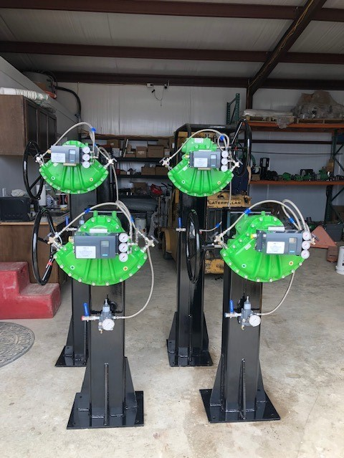
***Warranty***
Three (3) years or Two (2) million cycles
4 Million Strokes
Whichever occurs first after date of shipment.
Designed For Maintenance-Free Service. For operation in Harsh High temperature environments up to 300 F. (149 C.)

Slide 6
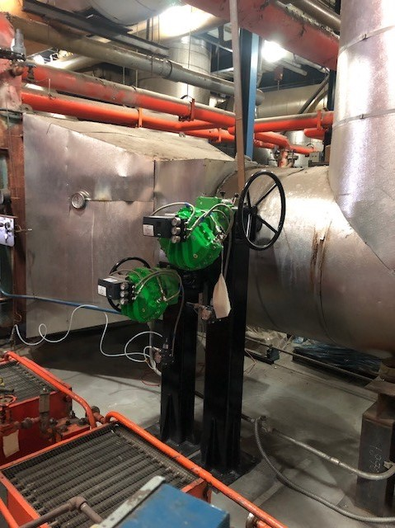
Standard-DD Field Service
Offering Full field service for:
Troubleshooting
Supervision of New installs
Retro Fitting old to new
Calibration
Full install and start ups

Slide 7
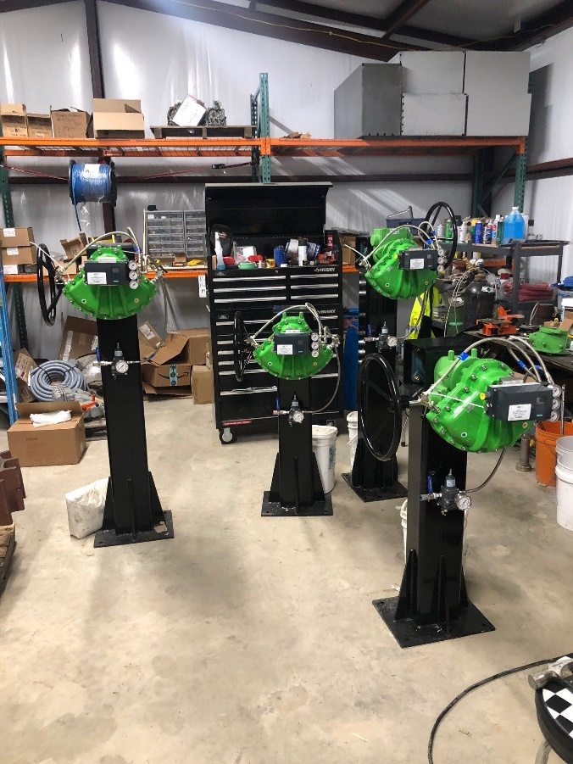
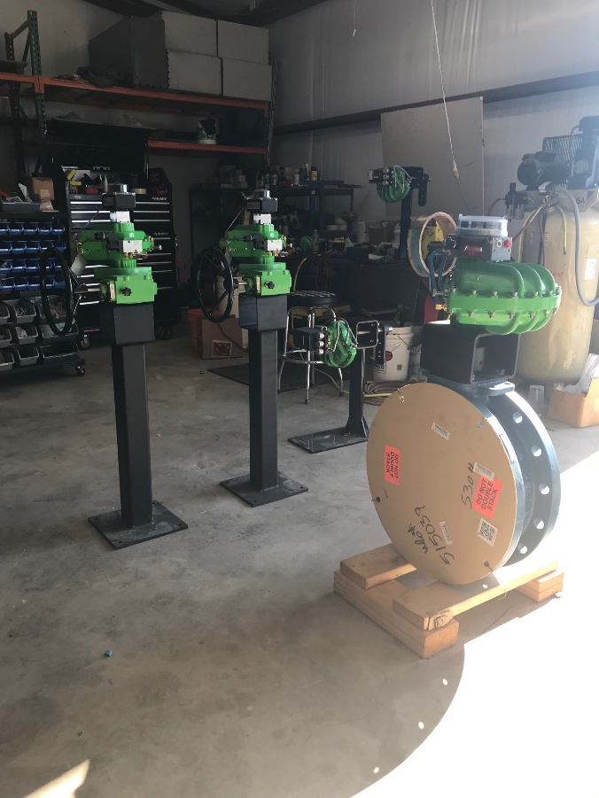
Full in house builds ready to drop in place for any application

Slide 8
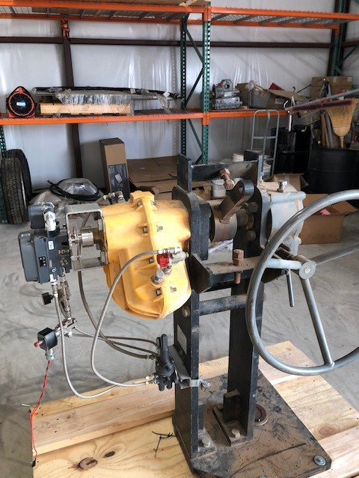
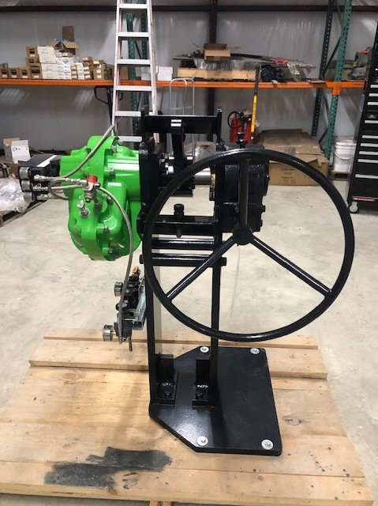
Refurbishing & Upgrades

Slide 9
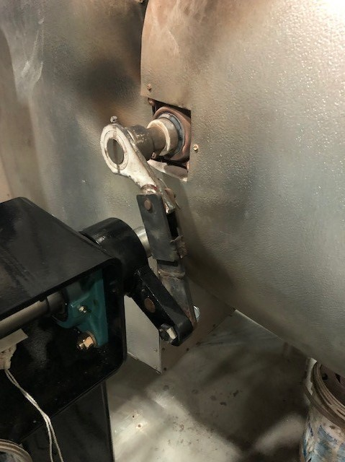
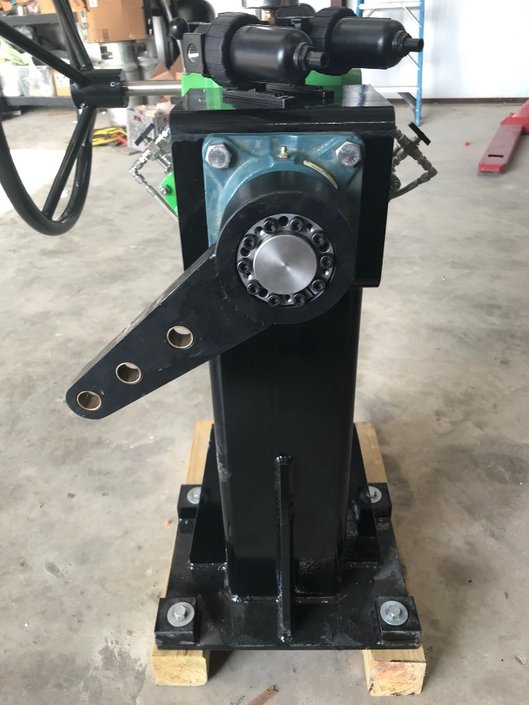
Quick and easy linkage adaption to existing linkage rods

