Slide 1
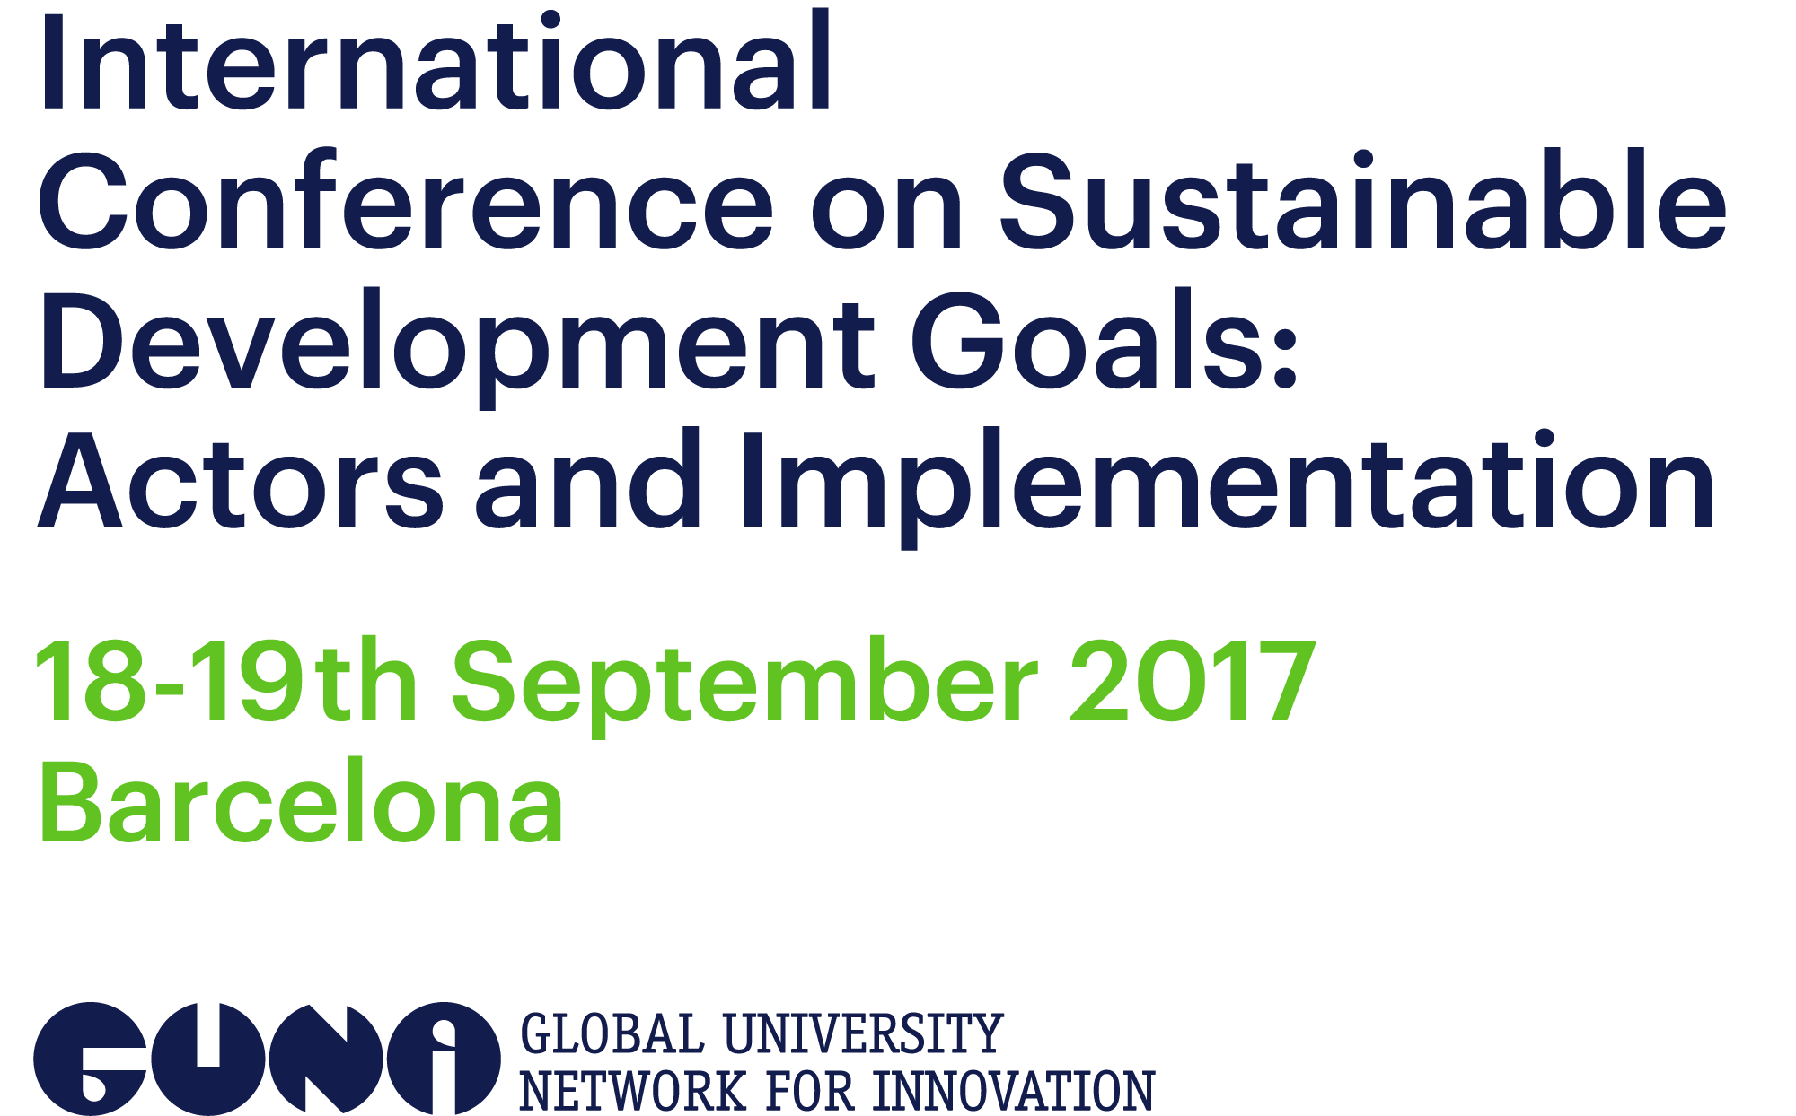

GUNi partners:

Slide 2
DR. CHARLES W. RICHARDSON, JR.
BOARD CHAIR – AASHE
DEAN, SCHOOL OF BUSINESS
CLAFLIN UNIVERSITY

Slide 3

Mission: to inspire and catalyze higher education to lead the global sustainability transformation
AASHE defines sustainability in an inclusive way, encompassing human and ecological health, social justice, secure livelihoods and a better world for all generations.
www.aashe.org
Notes:
AASHE is creating a platform to help institutions lead large-scale renewable projects

Slide 4

The Sustainability Tracking, Assessment & Rating System™(STARS) is a transparent, self-reporting framework for colleges and universities to measure their sustainability performance.

Slide 5

STARS Overview
Comprehensive
  STARS Categories
        Academics
    Engagement
    Operations
    Planning & Administration
Transparent
All data is publicly available
Positive Recognition
Institutions earn a rating

Slide 6
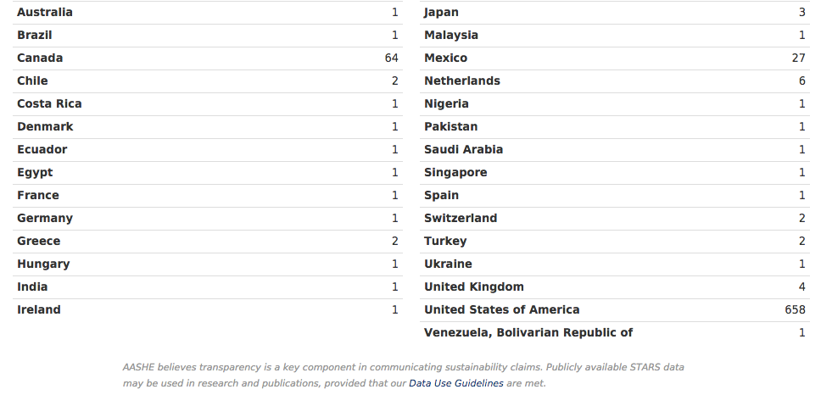
STARS Participants by Country

Slide 7
International Partners
Australasian Campuses Towards Sustainability Incorporated Association (ACTS)
ACTS is a nonprofit member based organisation representing higher and further education institutions within Australia and New Zealand.
The Environmental Association for Universities and Colleges (EAUC)
The EAUC is the environmental and sustainability champion within Further and Higher Education in the U.K.

Slide 8
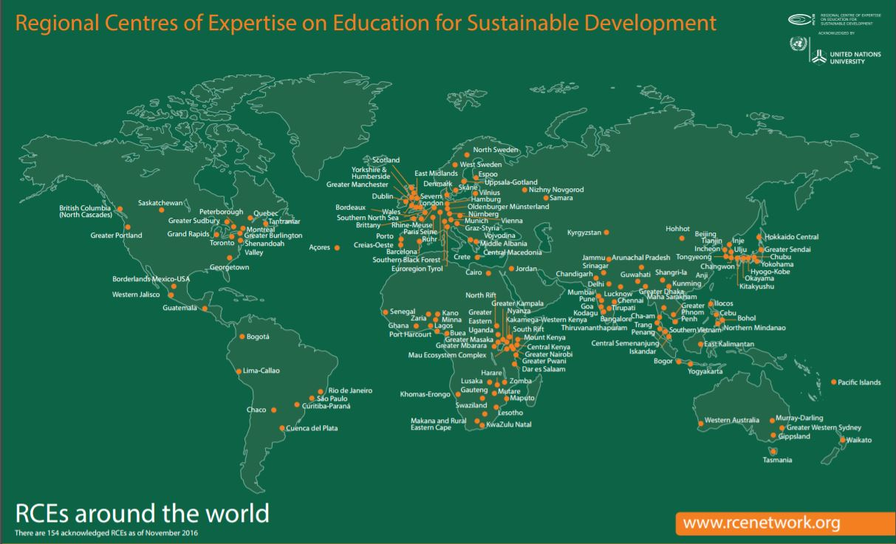

Slide 9
THE POTENTIAL:
HIGHER EDUCATION IN THE US:
~ 4000 INSTITUTIONS
HIGHER EDUCATION IN THE WORLD:
~ 26000 INSTITUTIONS
AASHE MEMBER INSTITUTIONS:
US: 820 UNIVERSITIES & COLLEGES
CANADA: 68 UNIVERSITIES & COLLEGES
INTERNATIONAL: 27 UNIVERSITIES & COLLEGES
Notes:
So, I want to start at the 30,000 foot level. I work within the higher education space, primarily in the US, and that includes about 4000 colleges & universities. It also translates to more than 17million students. The impact that sustainability in higher education can have is tremendous. Not only is it important to have institutions operating sustainably but equally as important is incorporating sustainability into the curriculum. We want to make sure that every students, no matter their coursework or career path, once they graduate, has the knowledge, tools and skills they need to understand sustainability and implement sustainable solutions. We’re talking about the future leaders of all companies, organizations and governments so the potential for higher education to be a driving force to a sustainable society is huge.

Slide 10
MOVING FORWARD
TOO INSULAR
  OPERATIONAL NOT THEORETICAL
  NOT INTEGRATED
  REMOVE THE NEED FOR A SUSTAINABLITY “GROUP”
  THE DANGER OF “WE TRIED THAT”

Slide 11


Slide 12
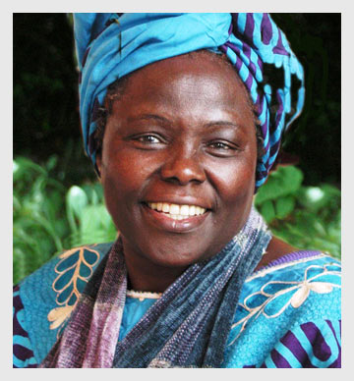
“Education, if it means anything, should not take people away from the land, but instill in them even more respect for it, because educated people are in a position to understand what is being lost.
The future of the planet concerns all of us, and all of us should do what we can to protect it.”

Slide 13
NEW EDUCATIONAL PARADIGMS
SHIFT EMPHASIS FROM TEACHING TO LEARNING
SHIFT RESPONSIBILITY FROM LEARNERS TO INSTRUCTORS
THE PROCESS, NOT THE FACTS
EXPERIENTIAL/SERVICE LEARNING
LIFE LONG LEARNERS

Slide 14
PREAMBLE
The General Education Core is a significant corpus of knowledge and skills focusing on student learning outcomes and the expectation that the knowledge and skills acquired will be integrated and enhanced throughout the core curriculum and co-curricular experiences. As a result, our graduates will continue learning, adapt to change, and become global citizens who make wise and ethical choices and contribute to their communities.

Slide 15
CORE CURRICULUM
Purpose
  Embrace the Liberal Arts
  Operationalize a foundation for general knowledge and educational competencies
  Expose students to intellectual challenges and opportunities
  Provide a global perspective
  Awareness/integration of sustainability

Slide 16
IN THE CORE
Environmental Stewardship – A multidisciplinary course that examines the multiple issues involved for maintaining a sustainable lifestyle. Particularly addresses decision making as consumers, and the impact of same, personally and for the immediate and extended community. Students will engage in multidisciplinary teams to document and reduce the impact of consumption.

Slide 17
MASS MEDIA
Advocacy Through Media - Discussion of nonprofit information campaigns, social issues marketing and other forms of advocacy through contemporary mass media.

Slide 18
SOCIAL WORK
Building Social Capital - Introduction to the role of social capital in building sustainable organizations and communities. Examines the concept of social and environmental justice.

Slide 19
EDUCATION
Curriculum Development - Integration of sustainability topics in courses delivered to K through 12 students.

Slide 20
BUSINESS
Ecopreneurship - Business models that move away from the tradition of generating social value as a by-product of economic value and embrace an approach that generates economic value as a result of providing social value. Also, these businesses do not limit measures of success to traditional financial goals, but incorporate considerations of restored natural world integrity, and the emergence of vibrant and stable communities. (Triple Bottom Line)

Slide 21
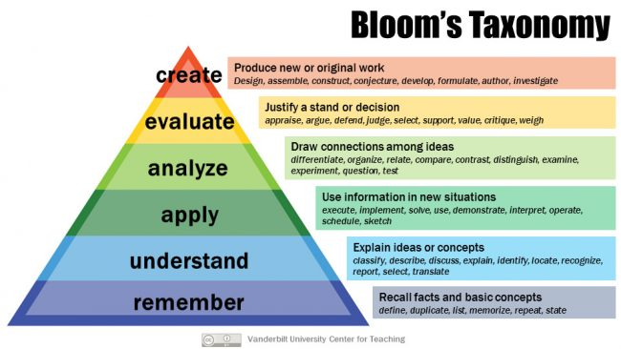
LEARNING

Slide 22
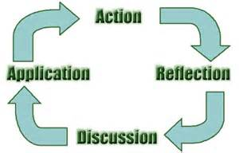
EXPERIENTIAL LEARNING

Slide 23
SERVICE LEARNING
Service-Learning connects the campus with the community through capacity-building partnerships in order to enhance student learning, address critical community issues, and encourage students to be active citizens in their local, national and global communities.

Slide 24
SERVICE LEARNING
A method of encouraging student learning and development through active participation in thought-fully organized service that is conducted in, and meets the needs of, a community.
It is integrated into, and enhances, the academic curriculum in which the participants are enrolled.
It helps foster civic responsibility.

Slide 25
SERVICE LEARNING
Service-learning goes beyond what is learned in the classroom. It is a hands-on experience. Students gain new skills by working directly with the community. Service-learning enhances students’ valuable academic skills, including communication, team-building, and critical thinking; builds their self-esteem; and develops their sense of responsibility for decision-making.

Slide 26
EXPERIENTIAL AND SERVICE NEXUS
Service-learning programs are distinguished from other approaches to experiential education by their intention to equally benefit the provider and the recipient of the service as well as to ensure equal focus on both the service being provided and the learning that is occurring.
To do this, service-learning programs must have some academic context and be designed in such a way that ensures that both the service enhances the learning and the learning enhances the service.

Slide 27
SCIENCE OR CULTURE?
DENIAL OF THE SCIENCE IS CULTURAL!
  LIKE-MINDEDNESS
  INGROUP VS OUTGROUP BEHAVIOR
  THE ASPIRATONAL CUSTOMER
  COGNITIVE DISSONANCE AND COGNITIVE CONSISTENCY

Slide 28
University Sustainability Initiative
Government
Policy
Community
Economic Development
Industry
Corporate Social responsibility

Slide 29
WORKING MODEL
YALI (WASHINGTON MANDELA FELLOWS)
  BUSINESS AND ENTRPRENEURSHIP
  CIVIC LEADERSHIP
  PUBLIC MANAGEMENT

