Slide 1
CLASS OF 2023 FRISCO HIGH SENIOR PARENT MEETING
8/22/2023

Slide 2
WHAT ARE THE FHS SENIOR PARENT BOOSTERS?
The FHS Senior Parent Committee is a 501c (3) organization that follows FISD Booster Club guidelines.
All senior parents are automatically members and there are no dues.
Our goal is to plan and fully fund memorable, fun events for the Class of 2023.
Our budget for each year is based solely on the results of your participation.

Slide 3
2023 FHS PARENT BOOSTERS BOARD
PRESIDENT – KATIE HOBBS
VICE PRESIDENT – JILL LACY
TREASURER – AMY HOWARD
SECRETARY – TRACY CONSTANTINO
FHS ADVISOR – MR. ERIC MINYARD, ASSISTANT PRINCIPAL

Slide 4
FROM FHS ADMINISTRATION MR. ERIC MINYARD, ASSISTANT PRINCIPAL
$100 SENIOR FEES BILLED EACH YEAR COVER PROM, YOUR SENIOR’S PROM TICKET AND THE SENIOR DAY CEREMONY.
PAYABLE THROUGH WWW.ONLINESHOOLFEES.COM
**This is NOT the same as the SENIOR PASS or related to the Senior Boosters.

Slide 5
GRADUATION
May 21, 2023
8:30am
FORD CENTER @ THE STAR

Slide 6
TRADITIONAL SENIOR EVENTS
SPONSORED BY SENIOR PARENTS*
SENIOR SUNRISE/BREAKFAST, Oct. 3
SENIOR CAMPFIRE, November 13
SENIOR SUNSET/TAILGATE, March 26
POWDERPUFF GAME, April 16
BACCALAUREATE, April TBD
SENIOR DAY ACTIVITY, May 15
SPONSORED BY FHS
SENIOR PROM
SR AWARDS NIGHT
SR DAY CELEBRATION
GRAD PRACTICE
GRADUATION
*DATES OF PARENT SPONSORED EVENTS ARE SUBJECT TO CHANGE*

Slide 8
FINANCIALS AND BUDGET
presented by:
AMY HOWARD

Slide 9
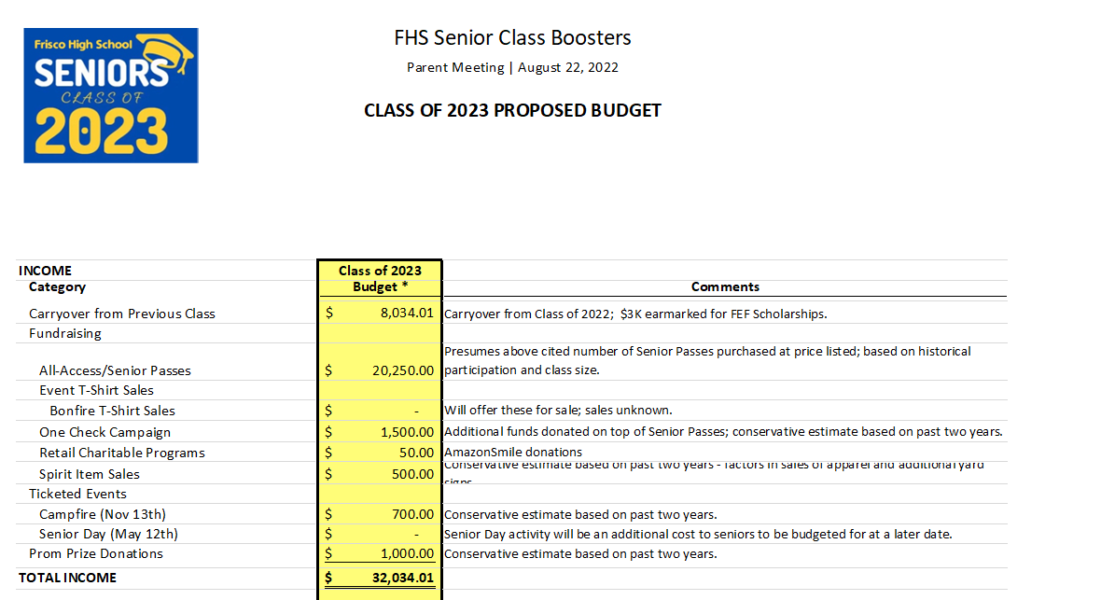

Slide 10
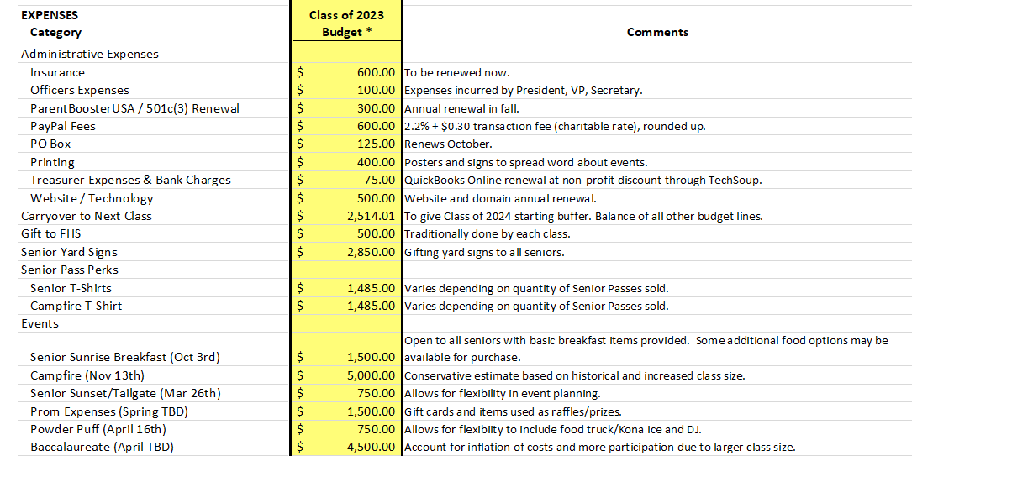

Slide 12
ONLY YOU CAN MAKE THIS HAPPEN!!! JOIN US IN OUR ONE CHECK FUNDRAISER
WE ARE A NON-PROFIT ORGANIZATION SOLELY DEPENDENT ON YOUR CONTRIBUTIONS!
YOU CAN CONTRIBUTE BY PURCHASING YOUR SENIOR PASS NOW!
CONTRIBUTION FOR THE SENIOR PASS IS $150 WHICH INCLUDES ADMISSION TO ALL PARENT BOOSTERS SPONSORED EVENTS* -AND GET A FREE SENIOR T-SHIRT, And a CAMPFIRE SHIRT
You are able to contribute an amount of your choice and purchase individual event tickets separately. Excess donations go to cover a yard sign for all 527 graduatings seniors and towards Scholarships!
*Additional Fees May apply to Senior Day

Slide 13
HOW DO I CONTRIBUTE?
PURCHASE YOUR STUDENT’S SENIOR PASS ONLINE @ WWW.RACCOONSENIORS.ORG
OR
REACH OUT TO
FRISCOHIGHSCHOOLSENIORPARENTS@GMAIL.COM FOR ANY QUESTIONS
THE DEADLINE TO PURCHASE THE ALL ACCESS PASS IS
Wednesday, September 14th

Slide 14
GIFT CARD DONATIONS
IN ADDITION WE NEED DONATIONS OF GIFT CARDS AND ITEMS AS GIVEAWAYS FOR SENIORS DURING EVENTS.

Slide 15
WE LOVE VOLUNTEERS!!
THANK YOU TO OUR EVENT CHAIRS!
SENIOR SUNRISE/BREAKFAST- WREN OVARD, JAMIE HEIT, AND MELANIE ROYER
CAMPFIRE -BRIDGETTE PEARCE AND TAMMY ARY
POWDERPUFF – CHRISTINA CRAWFORD, KIM DINOTA, AND DIONNE DICKSON
SUNSET/TAILGATE –JULIE BATTAGLIA, TARA HERMUNDSON, AND MARTHA PINEIRO
BACCALAUREATE –SHARON NAUKAM AND AMY ANDREWS
PHOTO/VIDEO - SANDRA GORDON
FUNDRAISING – LISA MAGILL AND CATHERINE NIHEM
SENIOR DAY - LAURA LESTER AND TASHA FERGUSON
WEBSITE/COMMUNICATIONS- ETHEL DELGADO

Slide 16
HOW CAN I HELP?
VOLUNTEER!!!
ALL EVENTS NEED VOLUNTEERS!
FILL OUT THE VOLUNTEER FORM ON THE CLASS OF 2023 WEB PAGE
WWW.RACCOONSENIORS.ORG
DON’T FORGET TO COMPLETE THE FISD BACKGROUND CHECK. LINK IS ALSO ON THE CLASS OF 2023 HOME PAGE.

Slide 17
SENIOR T-SHIRTS
AND YARD SIGNS
Senior 2023 T-shirt and Campfire T-Shirt are included with the Senior Pass. The booster is also providing then Senior Class of 2023 yard sign to all seniors!
Shirts will be available for order individually through Rowdy Rags as well as an additional design that can be purchased as Crew Neck Sweatshirt or Hoodie.
The Link for SENIOR PASS and Rowdy Rags can be found on the senior website www.raccoonseniors.org

Slide 18
FOLLOW US!
FRISCO HIGH SENIOR WEBSITE
WWW.RACCOONSENIORS.ORG
<<<>>>
LINKS TO ALL SOCIAL MEDIA ACCOUNTS, SR. CALENDAR AND ALL THE LATEST UPDATES FOR THE CLASS OF 2023!

