Slide 1

Class of 2021
Frisco High Senior Parent Meeting
10.19.2020

Slide 2

What are the fhs senior parent boosters?
The FHS Senior Parent Committee is a 501c (3) organization that follows FISD Booster Club guidelines.
All senior parents are automatically members and there are no dues.
Our goal is to plan and fully fund memorable, fun events for the Class of 2021.
Our budget for each year is based solely on the results of your participation.

Slide 3
FHS Parent boosters board
PRESIDENT – LISA GERRISH
VICE PRESIDENT – SHARON NAUKAM
TREASURER – AMY HOWARD
SECRETARY - DEBI MEURET
FHS ADVISOR – MELVIN OWENS, ASSISTANT VICE PRINCIPAL

Slide 4
FROM FHS ADMINISTRATION
MELVIN OWENS, ASSISTANT PRINCIPAL
$100 SENIOR FEES BILLED EACH YEAR COVER PROM, YOUR SENIOR’S PROM TICKET AND THE SENIOR DAY CEREMONY.
PAYABLE THROUGH WWW.ONLINESHOOLFEES.COM
FEES ARE DUE BY FEB 19TH
PLEASE HAVE YOUR SENIOR COMPLETE THE SURVEY REGARDING GRADUATION
JOSTEN’S CAP AND GOWN ORDERS WILL BE DONE ONLINE.
ORDERS WILL BEGIN AFTER FALL BREAK (THANKSGIVING). FHS WILL NOTIFY SENIORS AND PARENTS OF ORDER DATES.
CAPS AND GOWNS WILL BE DELIVERED IN THE SPRING.

Slide 5
FHS YEARBOOK toni Mitchell, yearbook advisor
SENIOR AD DEADLINE, OCT. 30TH FOR GUARANTEED AVAILABILITY.
SENIOR ADS CAN BE DONE PROFESSIONALLY OR BY PARENTS. ADS NEED TO BE IN 300 DPI OR BETTER TO BE PRINT READY.
NEW DEADLINE TO PURCHASE YEARBOOKS AT $75 IS NOV. 13TH.
SENIOR ADS AND YEARBOOKS CAN BE PURCHASED IN 3 INSTALLMENTS.
CHOOSE THE J-PAY OPTION AT CHECKOUT.

Slide 6
Yearbook pictures needed
This has been a challenging time for yearbook staff with limited opportunities to take pictures although the yearbook staff if working all year.
A link for parents and students, in person and virtual, to submit photos has been set up. Photos can be uploaded privately – only yearbook staff will see them – for consideration in the yearbook.
The more pics they receive, the better the yearbook!!
https://images.jostens.com/415513974

Slide 7

Graduation
SATURDAY,
May 22, 2021
7PM
FORD CENTER @ THE STAR

Slide 8

SENIOR SCHOLARSHIPs
FRISCO EDUCATION FOUNDATION
FEF 2021 Scholarship Applications
Application Opens:
Monday, November 30, 2020 at 10am
Application Closes:
Friday, December 18, 2020 at 4pm NO EXCEPTIONS!
Scholarship application will be available on FEF Website: www.friscoeducationfoundation.org

Slide 9
TRADITIONAL SENIOR EVENTS
SPONSORED BY FHS
SENIOR PROM, 4/10/2021
SR AWARDS NIGHT, 5/2021
SR DAY CELEBRATION, 5/2021
GRAD PRACTICE, 5/19/2021
GRADUATION, 5/22/2021
SPONSORED BY SENIOR PARENTS*
SENIOR BONFIRE, 2/2021
COLOR THROW, 3/21/2021
POWDERPUFF GAME, 4/18/2021
BACCULAUREATE, 5/8/2021
SENIOR GRAD PARADE, 5/2021
SENIOR DAY ACTIVITY, 5/2021
*DATES OF PARENT SPONSORED EVENTS ARE SUBJECT TO CHANGE*

Slide 10







Slide 11
Financials and budget presentation amy Howard

Slide 12
Only You can make this happen!!!
JOIN US IN OUR One check fundraiser
WE ARE A NON-PROFIT ORGANIZATION SOLELY DEPENDENT ON YOUR CONTRIBUTIONS!
YOU CAN CONTRIBUTE BY PURCHASING YOUR ALL-ACCESS PASS NOW.
CONTRIBUTE AN AMOUNT OF YOUR CHOICE AND PURCHASE EVENT TICKETS INDIVIDUALLY.
SUGGESTED CONTRIBUTION FOR THE ALL- ACCESS PASS IS $125 WHICH INCLUDES ADMISSION TO ALL PARENT BOOSTERS SPONSORED EVENTS* -AND GET A FREE LONG SLEEVE BONFIRE T SHIRT FOR YOUR SENIOR.
*DOES NOT INCLUDE SENIOR DAY - SENIOR DAY TICKETS WILL BE SOLD SEPARATELY AT A LATER DATE ONCE FHS CONFIRMS THE DATE.

Slide 13
HOW DO I CONTRIBUTE?
PURCHASE YOUR STUDENT’S ALL-ACCESS PASS ONLINE @ WWW.RACCOONSENIORS.ORG/CLASS-OF-2021
<<OR>>
OR SIMPLY PRINT AND COMPLETE THE FUNDRAISING FORM AND MAIL CASH OR CHECK TO:
FHS SENIOR BOOSTERS, INC.
PO BOX 51
FRISCO, TEXAS 75034
THE DEADLINE TO PURCHASE THE ALL ACCESS PASS IS
FRIDAY, OCTOBER 30TH.

Slide 14


spirit nights & gift card donations
THERE WILL BE OCCASSIONAL SPIRIT NIGHTS AT LOCAL BUSINESSES TO SUPPORT THE SENIOR CLASS.
IN ADDITION WE NEED DONATIONS OF GIFT CARDS AND ITEMS AS GIVEAWAYS FOR SENIORS DURING EVENTS.

Slide 15

WE LOVE VOLUNTEERS!!
THANK YOU TO OUR EVENT CHAIRS!
BONFIRE - KAY GEORGE & KIM FRAME
COLOR THROW – JULIE PARKER
POWDERPUFF – KIM DINOTA & ALEXIS ANSAY
GRAD PARADE – GINGER TARBET
BACCULAUREATE – KRISTIE LIPPER / CO-CHAIR OPEN
T SHIRTS – LEIGH GIBSON
FUNDRAISING – NANNETTE MANZI & JESSA WATERMAN
SENIOR DAY - OPEN

Slide 16

HOW CAN I HELP?
VOLUNTEER!!!
\ALL EVENTS NEED VOLUNTEERS!
FILL OUT THE VOLUNTEER FORM ON THE CLASS OF 2021 WEB PAGE
WWW.RACCOONSENIORS.ORG/CLASS-OF-2021
DON’T FORGET TO COMPLETE THE FISD BACKGROUND CHECK. LINK IS ALSO ON THE CLASS OF 2021 HOME PAGE.

Slide 17
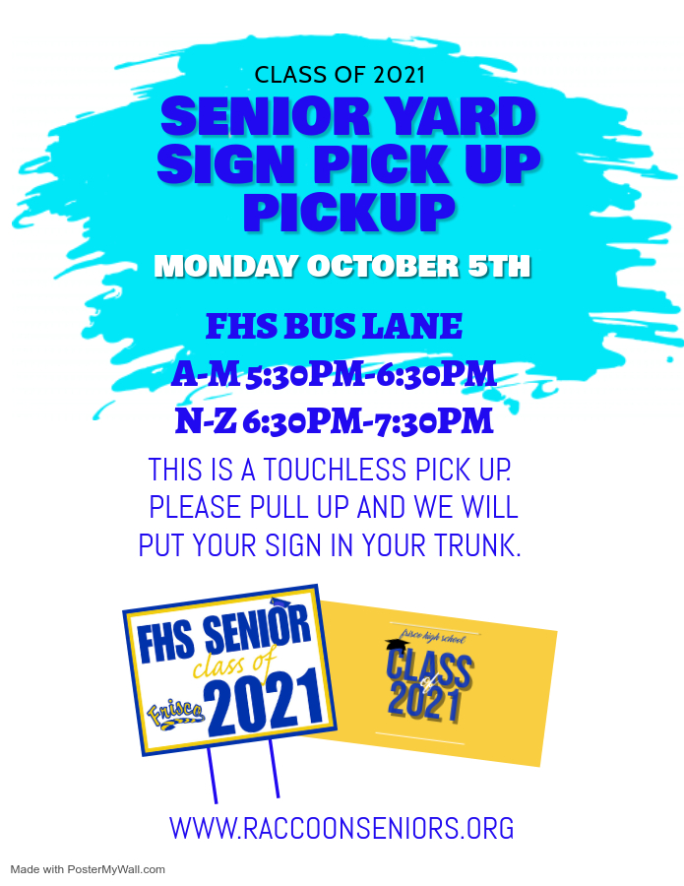
Senior YARD signs
EVERY SENIOR GETS A SIGN!
INFO COMING SOON ON
AN ADDITIONAL PICK UP DAY!

Slide 18

Follow us!
FRISCO HIGH SENIOR WEBSITE
WWW.RACCOONSENIORS.ORG
<<<>>>
LINKS TO ALL SOCIAL MEDIA ACCOUNTS, SR. CALENDAR AND ALL THE LATEST UPDATES FOR THE CLASS OF 2021!

