Slide 1
Today In Prophecy
July 21, 2020
Presented by Gene Dahler

Slide 2
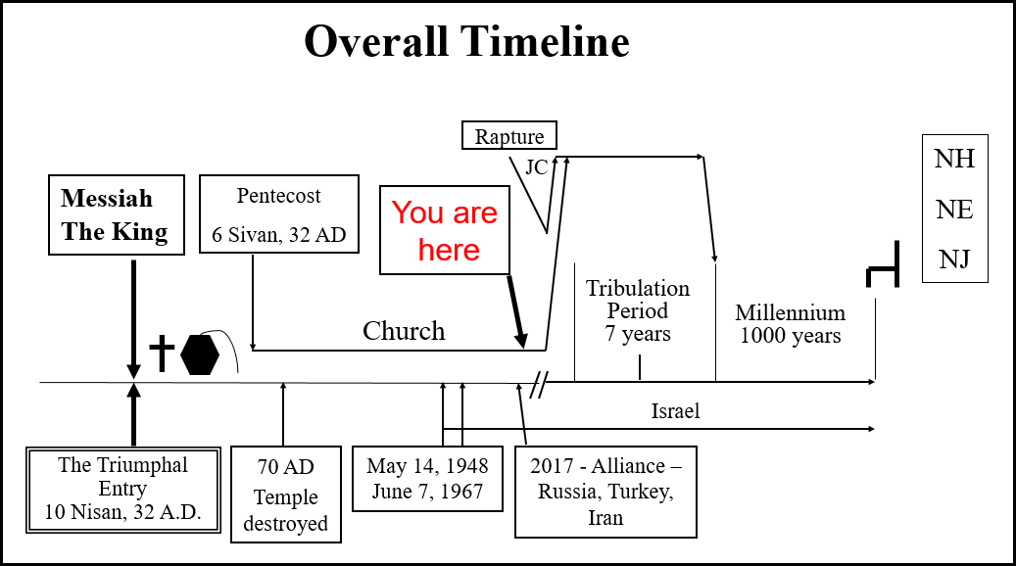

Slide 4
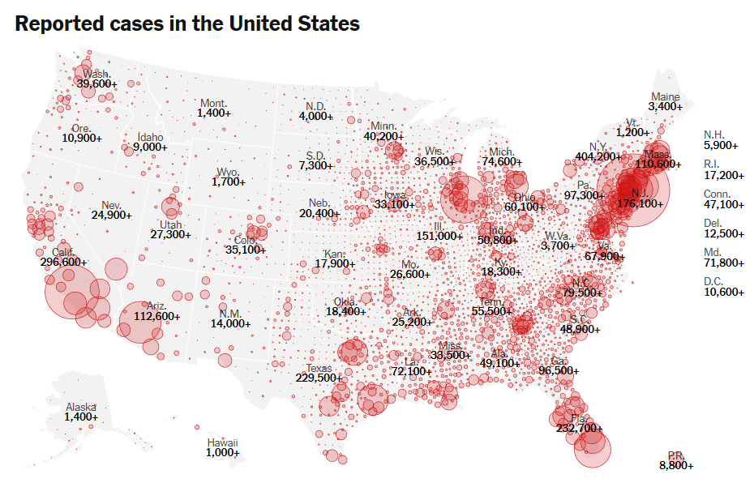

Slide 15
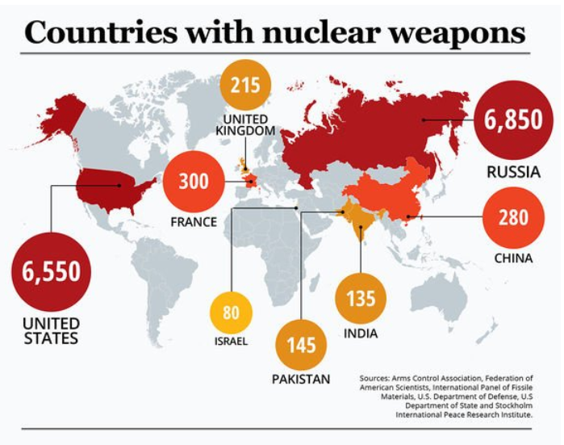

Slide 29
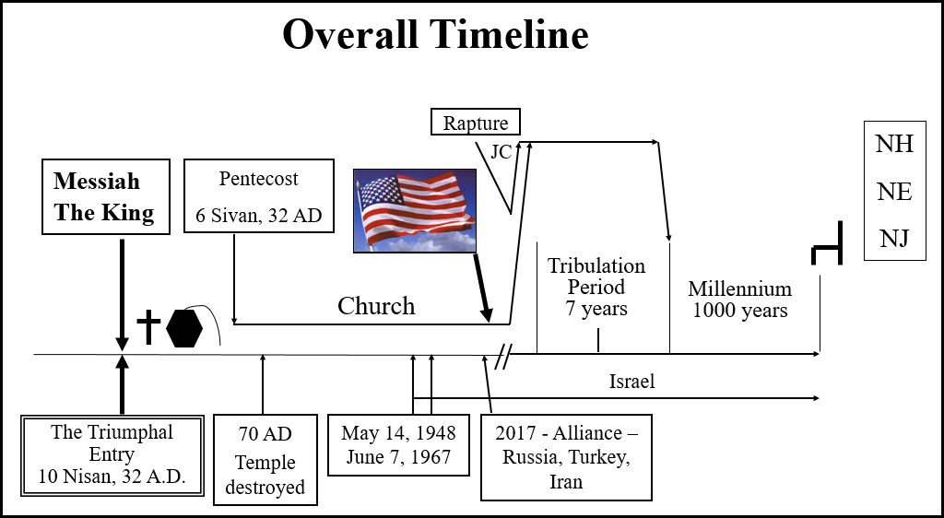

Slide 43
Prophetic Perspective News Sources
Rapture Ready News - http://www.raptureready.com/rapnews_db.php
Koenig World Watch Daily - http://www.watch.org/
His Channel – World News Briefing & Breaking News - http://www.hischannel.com/
Israeli Middle East Conflict News - https://www.debka.com/

