Slide 1
Today In Prophecy
July 21, 2020
Presented by Gene Dahler

Slide 2
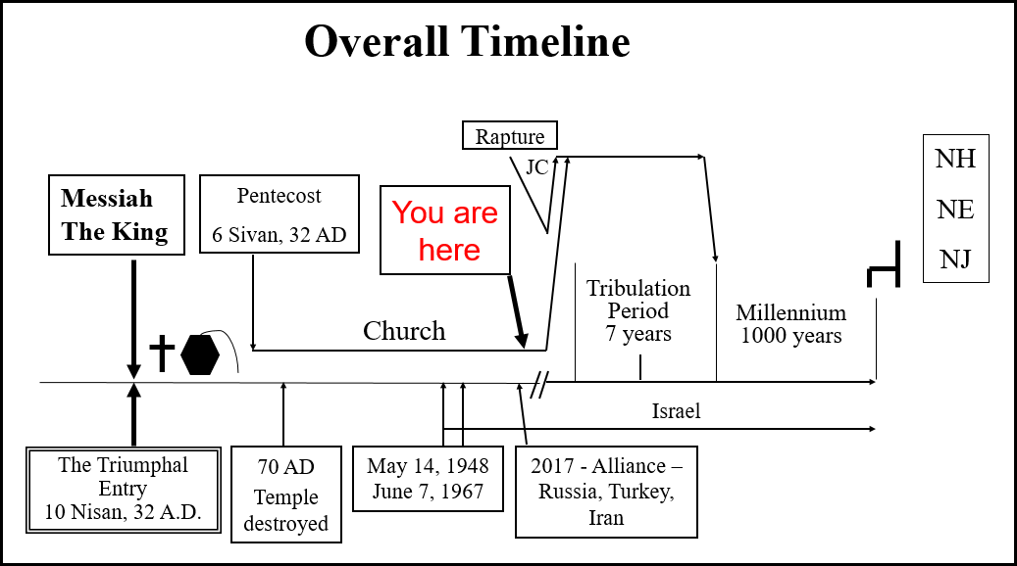

Slide 4
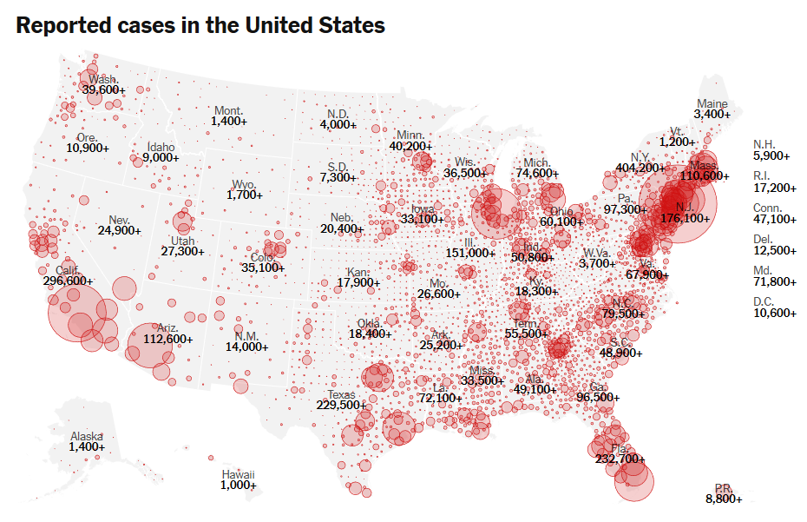

Slide 6


Slide 7


Slide 9


Slide 11


Slide 12


Slide 14


Slide 15
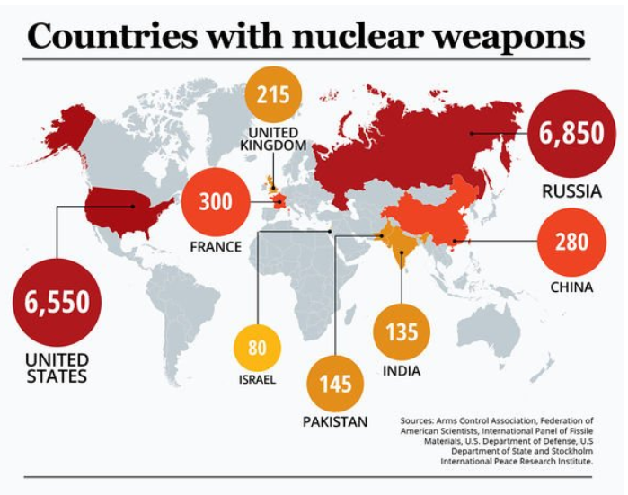

Slide 16


Slide 18


Slide 19


Slide 20


Slide 22


Slide 24


Slide 25


Slide 27


Slide 29
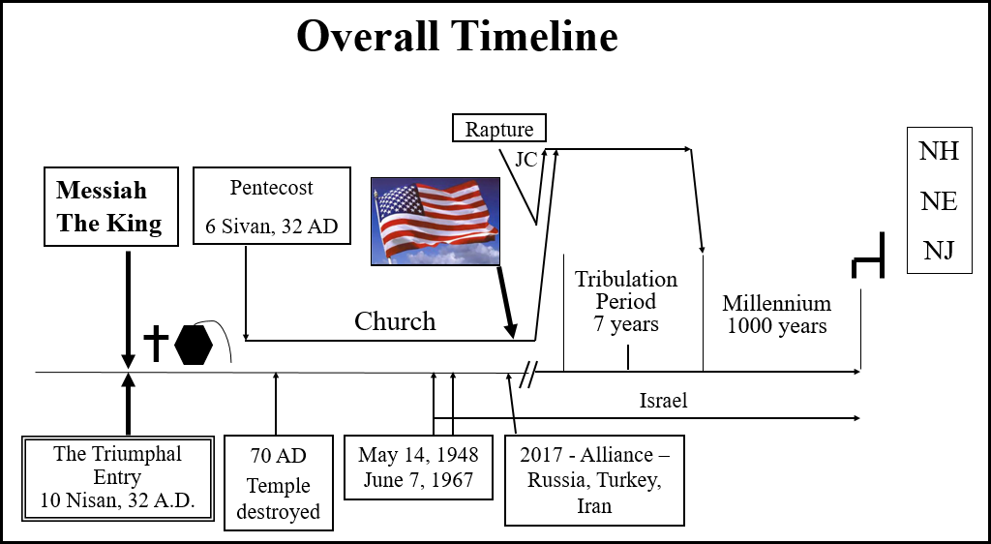

Slide 31


Slide 33


Slide 36


Slide 37


Slide 39


Slide 43
Prophetic Perspective News Sources
Rapture Ready News - http://www.raptureready.com/rapnews_db.php
Koenig World Watch Daily - http://www.watch.org/
His Channel – World News Briefing & Breaking News - http://www.hischannel.com/
Israeli Middle East Conflict News - https://www.debka.com/

