Slide 1
Today In Prophecy
August 17, 2021
Presented by Gene Dahler

Slide 3
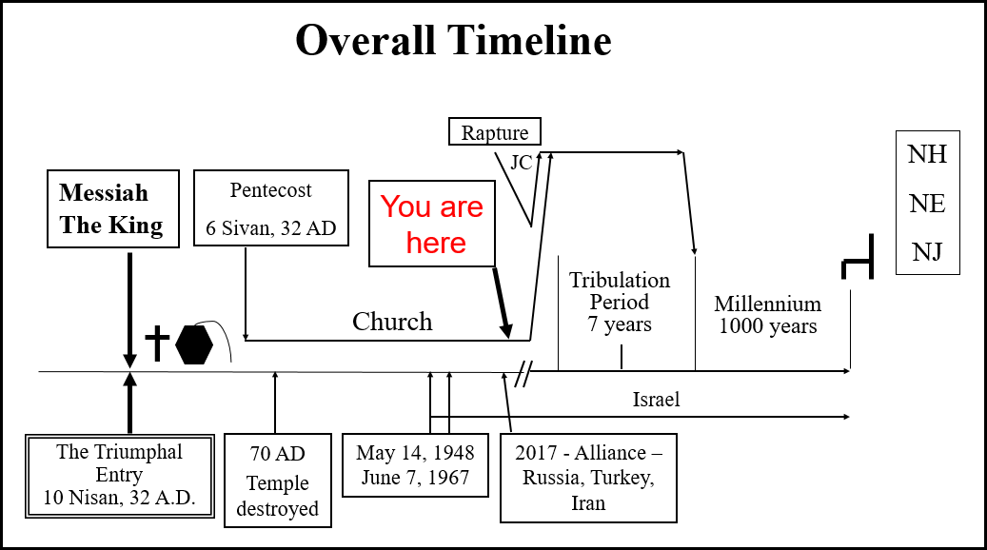

Slide 5
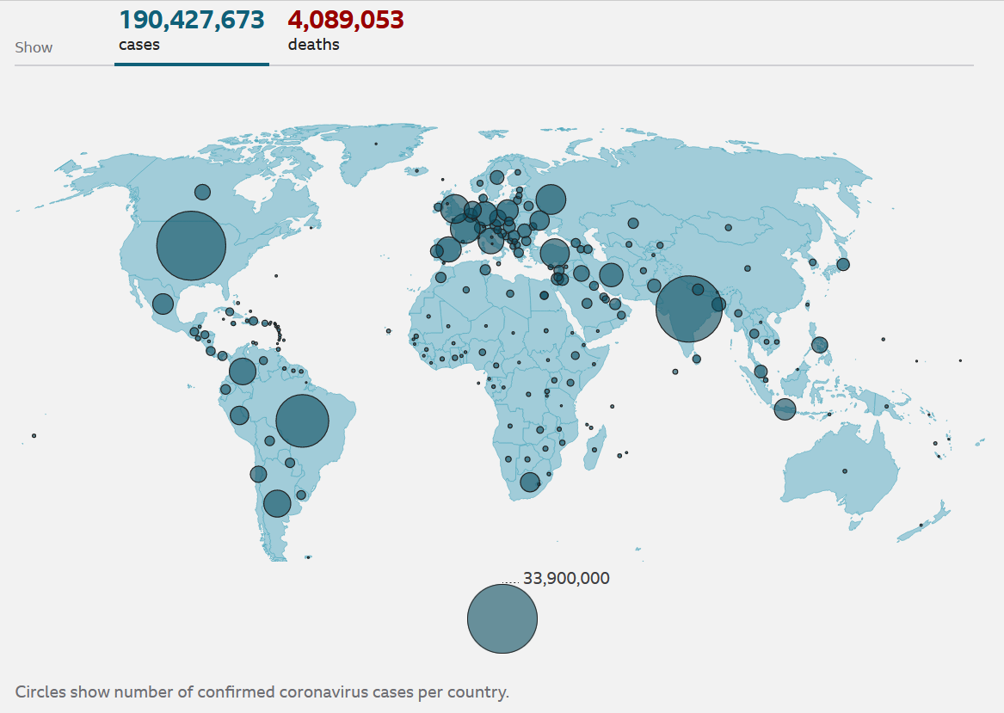


Slide 7


Slide 9


Slide 13
CDC just admitted that 74% of those infected in Massachusetts covid outbreak were “fully vaccinated”
Tuesday, August 03, 2021

Slide 14
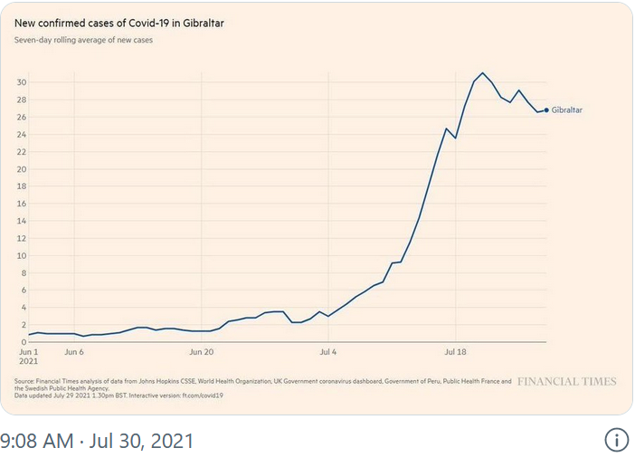
8/8/21 – naturalnews.com
“Fully vaccinated” Gibraltar sees 2,500 percent increase in
“covid” cases, prompting new lockdowns
By June 1st, over 99% of Gibraltar's population was fully
vaccinated. Since that time, new COVID cases per day have
increased more than 2500%

Slide 16

Mapping coronavirus anti-lockdown protests around the world

Slide 18


Slide 19


Slide 20


Slide 21


Slide 22


Slide 23
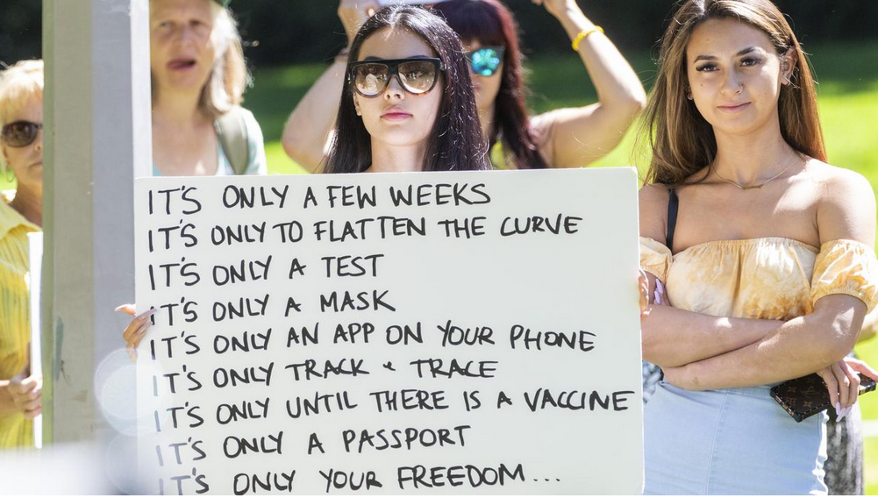

Slide 24


Slide 25
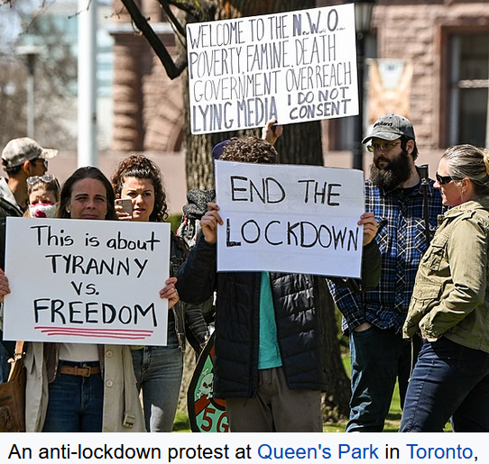

Slide 26


Slide 28

Ron DeSantis Is Defending Freedom
By 'Getting In The Way' Of COVID
Authoritarians

Slide 30

May, 2021 - Portland police
declare riot, arrest 5, as marchers
break windows on anniversary
of George Floyd’s murder

Slide 31
George Soros Gives $1 Million To Group Trying To "Defund The Police" Amid Surge In Crime

Slide 32


Slide 34

Russia announces successful test of 5,000mph hypersonic missile

Slide 35

Russia Producing Two New 'Doomsday Planes' As Mobile Command Centers In Event Of Nuclear War

