Slide 1
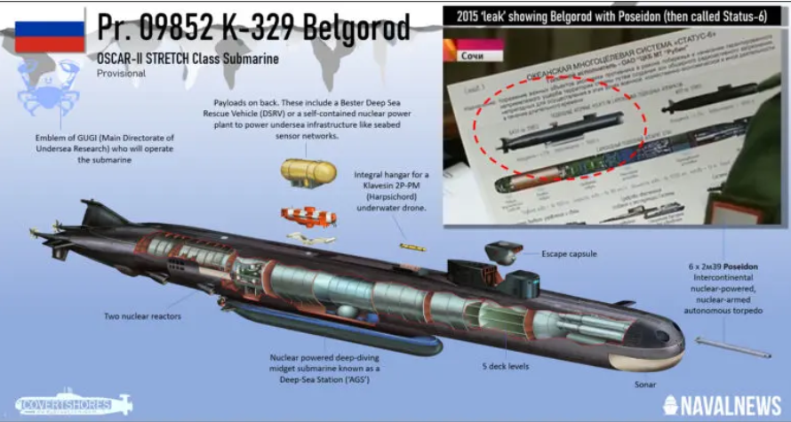
Russia’s Gigantic Submarine, Belgorod, Sails For The First Time

Slide 2
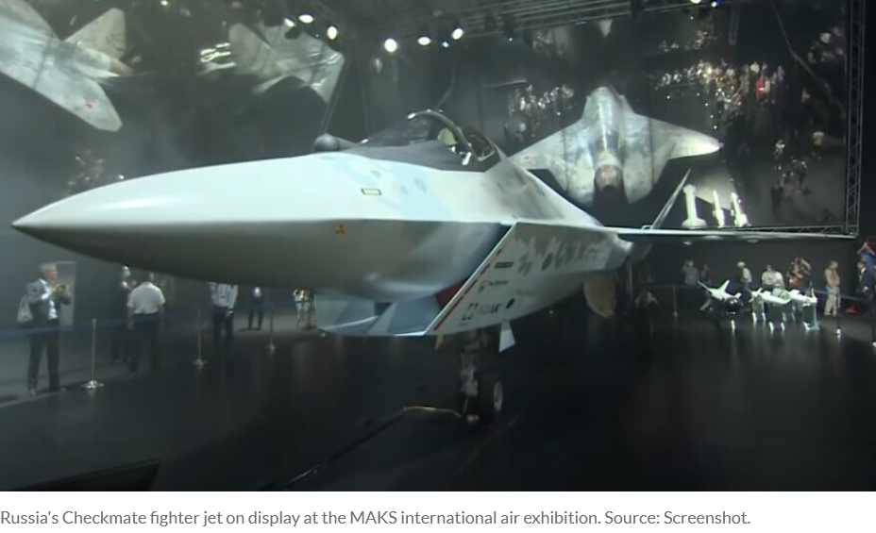
Russia’s new ‘Checkmate’ stealth jet expected to arrive in Mideast

Slide 3
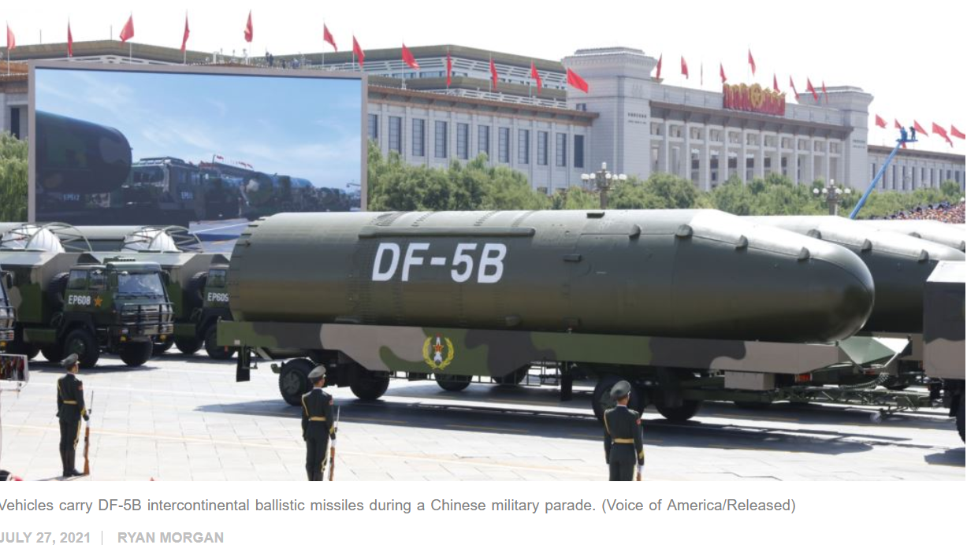
Researchers find 110 more secret Chinese nuclear missile silos under construction
americanmilitarynews

Slide 4
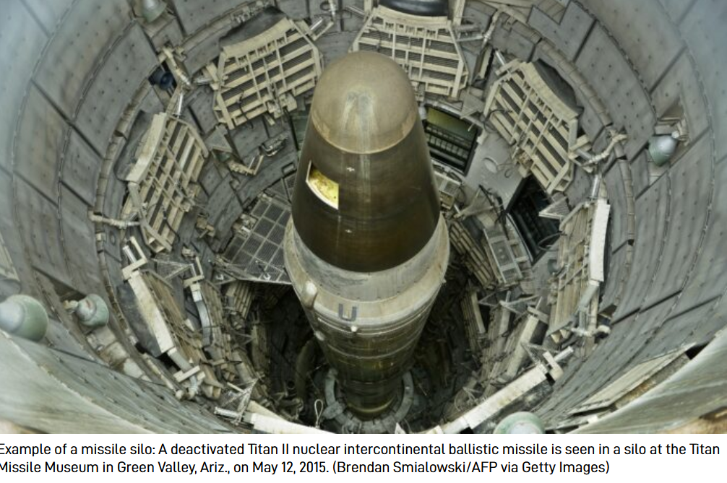

Slide 5
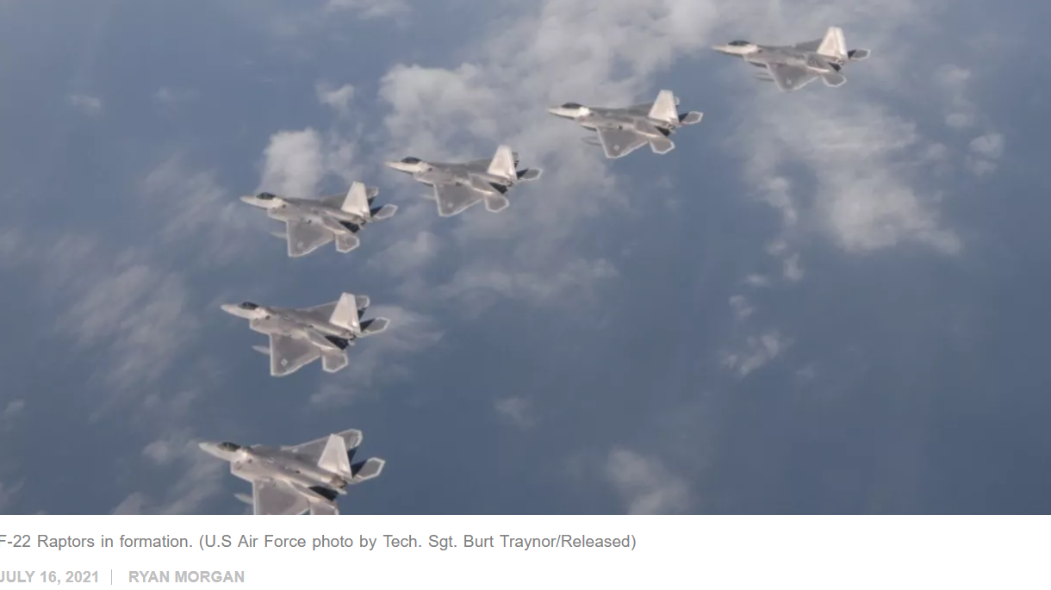
US moves 35 fighter jets closer to China for attack drills
americanmilitarynews.com

Slide 6
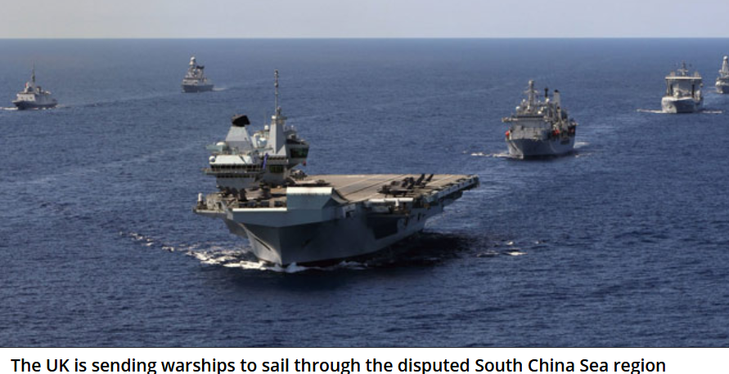
UK Defies Chinese Communist Party, Deploys Warships to Disputed South China Sea

Slide 7
German warship heads for South China Sea amid tension with Beijing
Reuters - August 2, 2021

Slide 8
israel365news.com
Russia, China hold joint military exercise for first time hosted on Chinese soil.

Slide 9

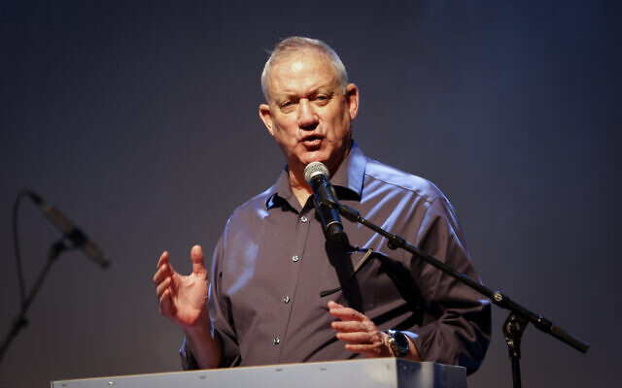
Defense Minister Benny Gantz.
Gantz: Iran is 10 weeks from breakout to a nuclear weapon

Slide 10
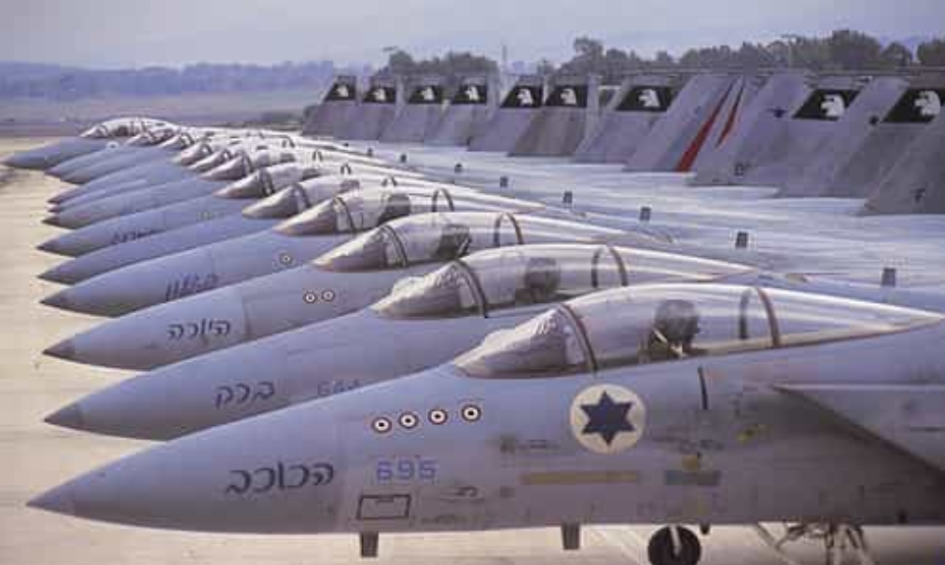
The Clock Is Ticking - Countdown To Conflict Between Israel And Iran

Slide 11
IDF requests funding for a potential strike on Iran, reports say
7/15/21 – ynetnews.com

Slide 12
USA
Top General Pushes Military CRT
The head of the Joint Chiefs of Staff, General Mark Milley. Our service members need to be "open-minded and widely read," especially, he argued, on issues like racism.
June 25, 2021 Tony Perkings – Washington Watch

Slide 14
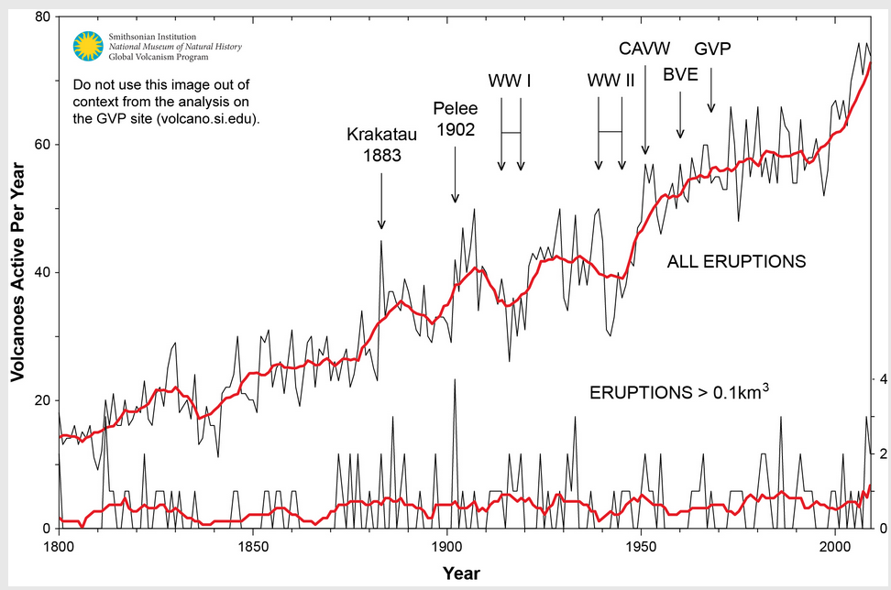

Slide 15


Slide 16


Slide 17


Slide 18
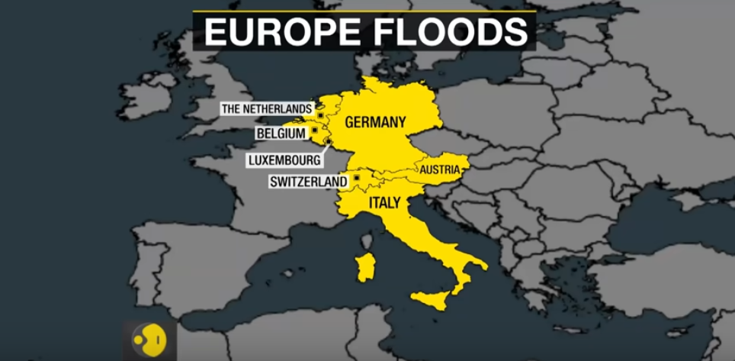

Slide 19
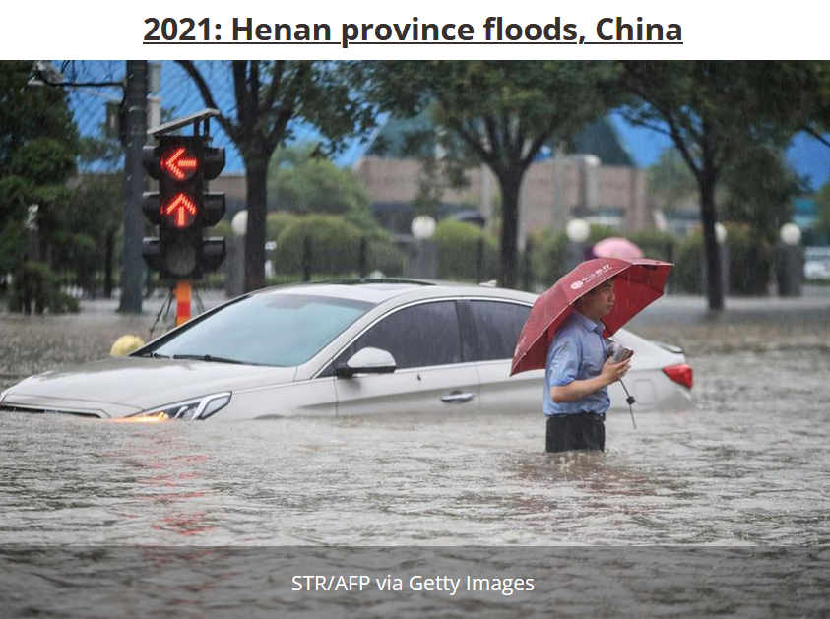

Slide 20
