Slide 1
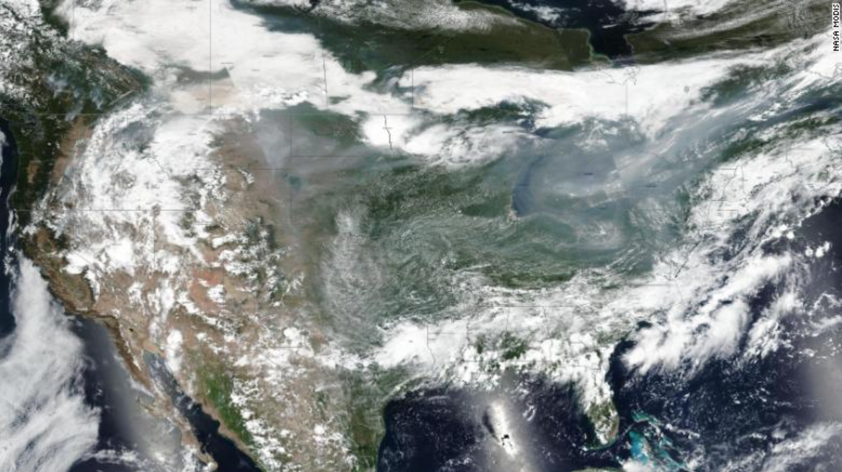
‘We didn’t expect a monster like this’: Dixie Fire grows to single largest in Calif. history

Slide 2
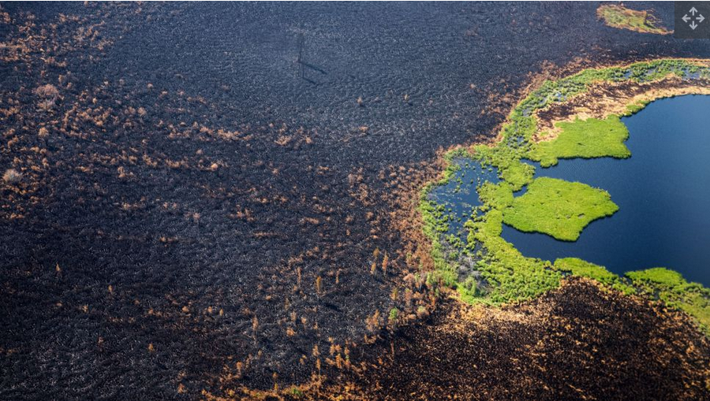
Siberian wildfires dwarf all others on Earth combined
Smoke from massive wildfires in Russia's Siberia region has reached the geographic North Pole "for the first time in recorded history," according to NASA — while the forest blazes themselves are bigger than all the other wildfires currently burning in the world combined, one expert said.

Slide 3
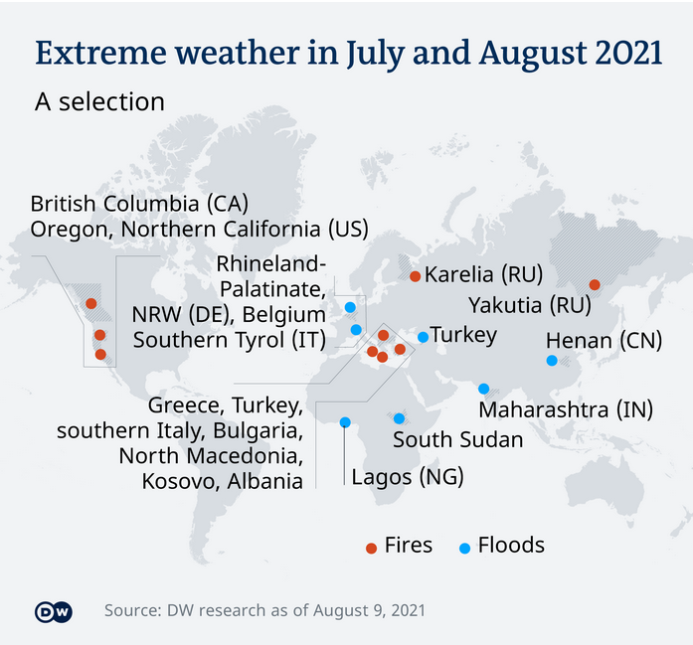
Fires to floods: Extreme weather is occurring worldwide

Slide 4
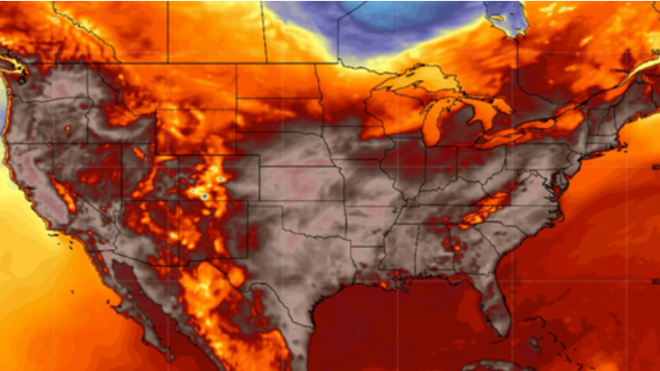
American as multiple heat domes scorch the Pacific Northwest, Central states, and East Coast.
Dangerous heat and humidity in the Northwest, Northeast, and central portions of the CONUS have prompted Excessive Heat Warnings and Heat Advisories.

Slide 5
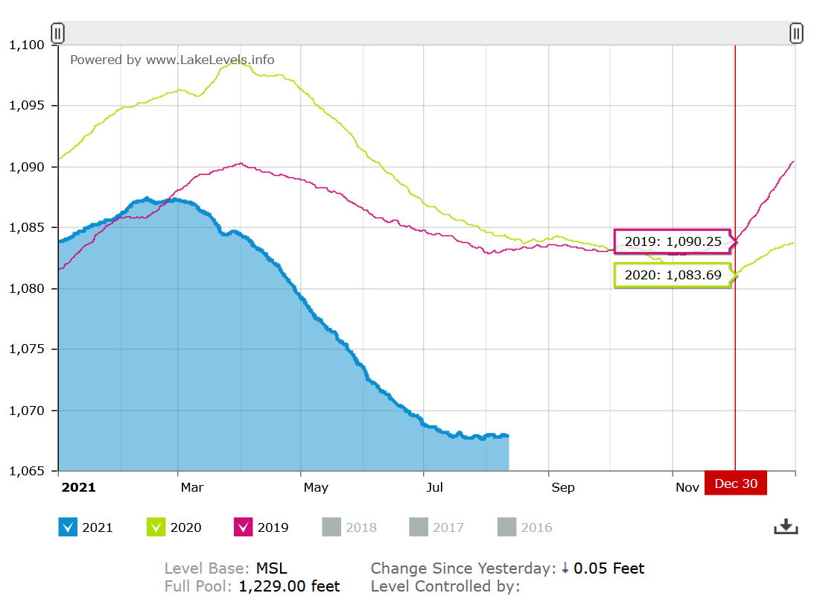
LAKE MEAD 8/11/2021

Slide 6
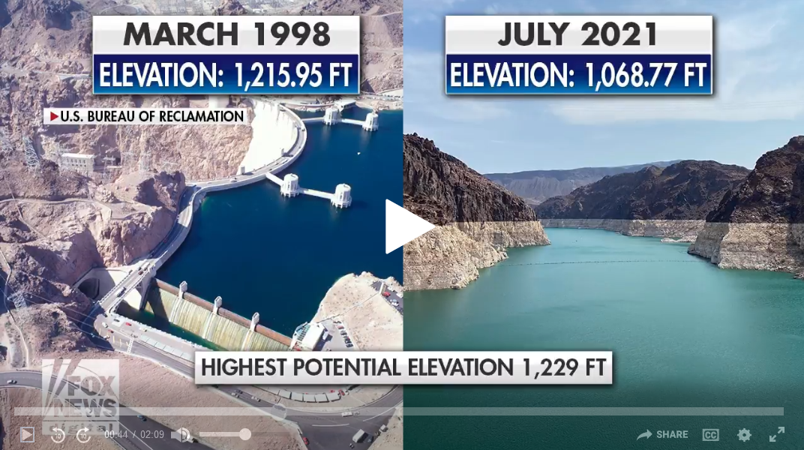

Slide 7
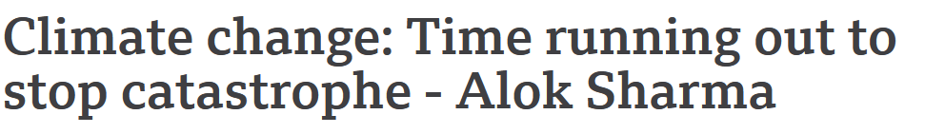
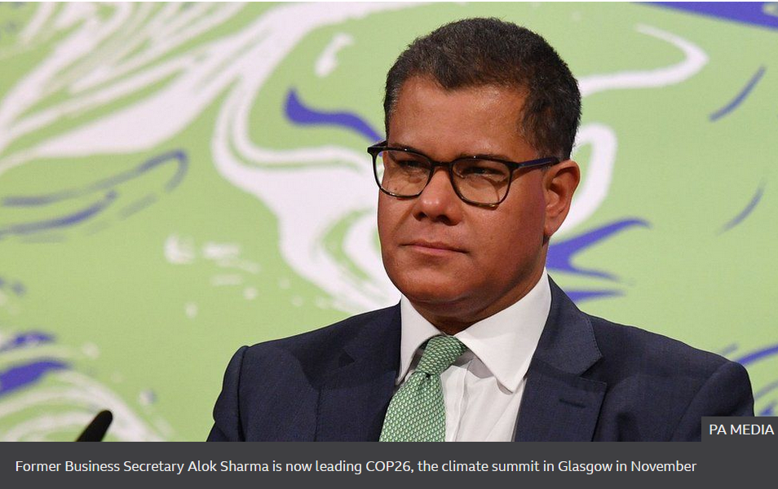
The world is "dangerously close" to running out of time to stop a climate change catastrophe, the UK government's climate chief Alok Sharma has said.

Slide 9
Critical Race Theory
What is Critical Race Theory?
Critical Race Theory is a perspective on modern life—a worldview—that believes all the events and ideas around us in politics, education, entertainment and the media, the workplace, and beyond must be explained in terms of racial identities.

Slide 11
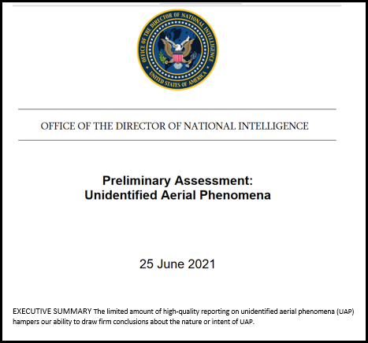

Slide 12
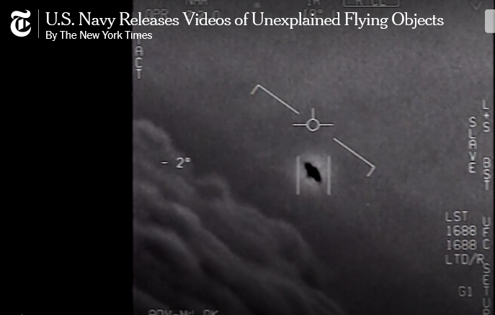

Slide 14
2021 – What are the major news
media issues in the world?
Covid-19
Lawlessness
War
Global Warming - Climate control
Critical Race Theory
UFO – Unidentified Flying Objects

Slide 16
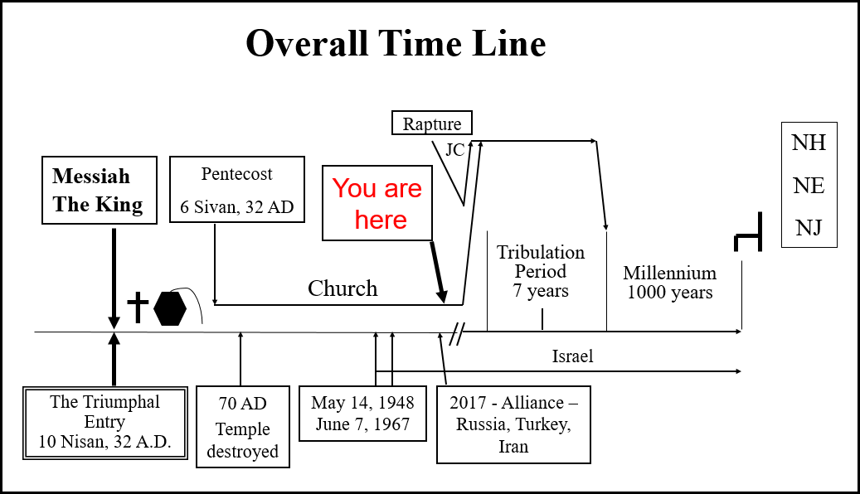

Slide 18
Prophetic Perspective News Sources
Rapture Ready News - http://www.raptureready.com/rapnews_db.php
Koenig World Watch Daily - http://www.watch.org/
His Channel – World News Briefing - http://www.hischannel.com/
Israeli Middle East Conflict News - https://www.debka.com/
Olive Tree Views – Jan Markell – News Headlines and Radio Complete Archives - https://olivetreeviews.org/

