Slide 1

Today In Prophecy
August 19, 2025
Presented by Gene Dahler

Slide 2
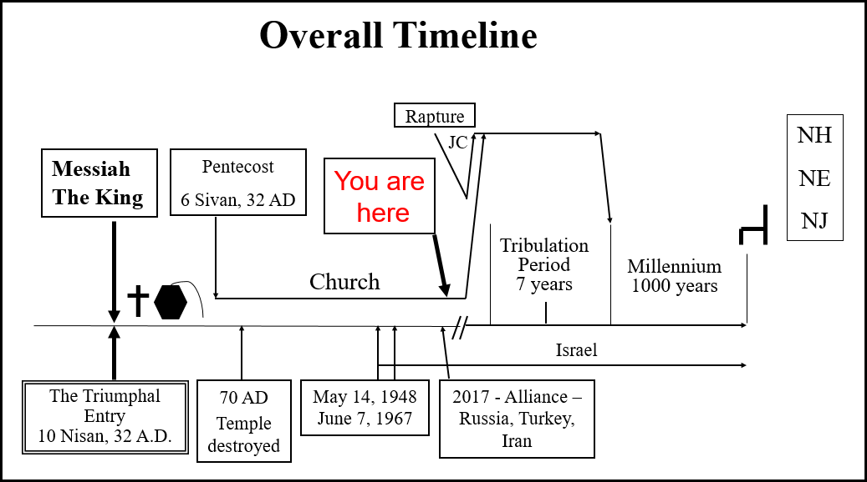

Slide 3


Slide 4


Slide 6
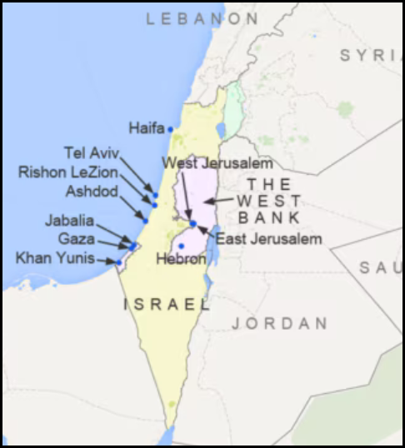

Slide 7


Slide 8


Slide 9
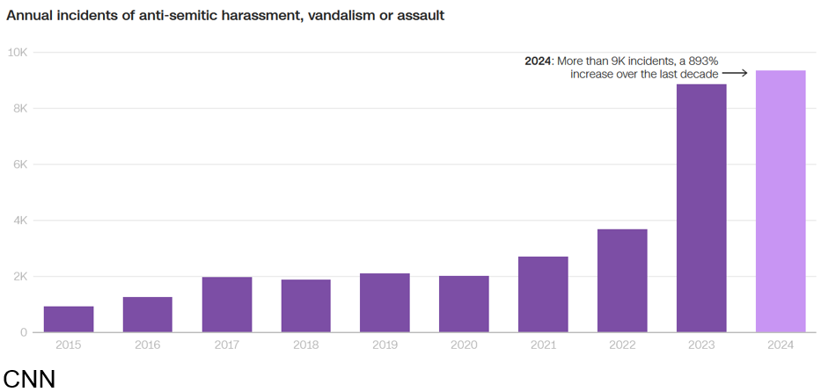

Slide 10


Slide 12


Slide 14


Slide 15


Slide 16


Slide 17


Slide 18
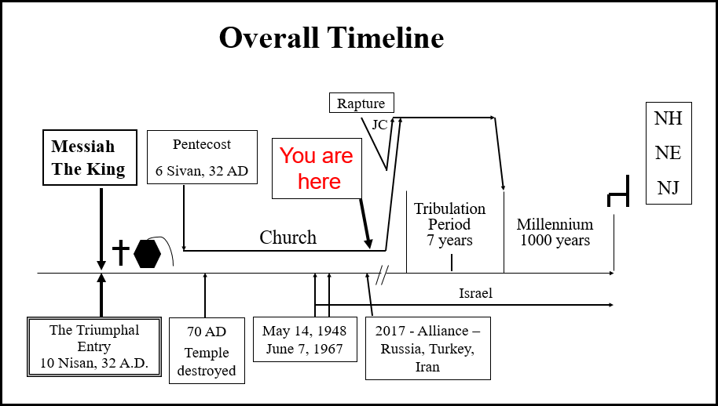

Slide 19
Prophetic Perspective News Sources
Rapture Ready News - http://www.raptureready.com/rapnews_db.php
Koenig World Watch Daily - http://www.watch.org/
Olive Tree Views – Jan Markell – News Headlines and Radio Complete Archives - https://olivetreeviews.org/
Washington Watch - https://www.tonyperkins.com/

