Slide 1
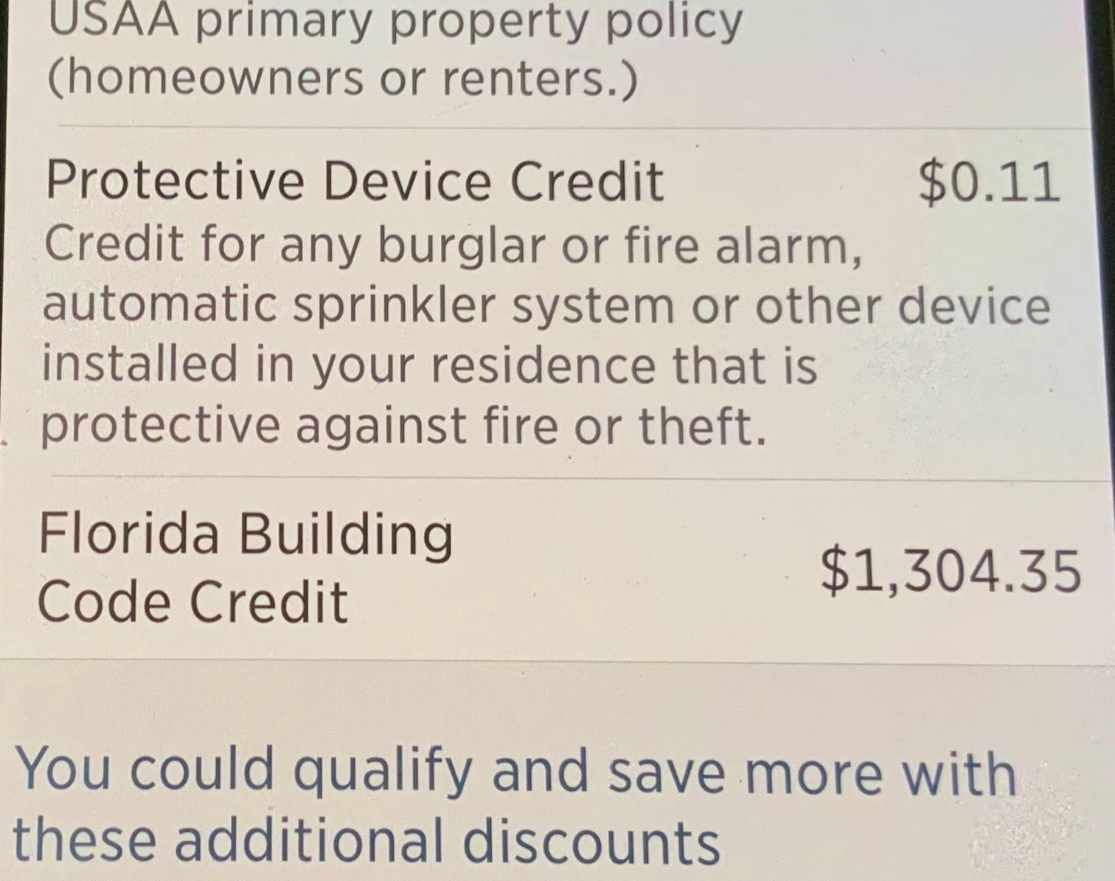
Next Topic: Wind Mitigation and Insurance Discounts
FEMA only discounts for elevation.
Home insurance discounts for wind mitigation building code upgrades.
Wind mitigation survey (ours was $125) provides a punch list of potential upgrades. Wind mitigation survey also provides documentation for your insurance company.
Largest discount is for 3rd nail , we used 3rd Nail Guy and paid $1,600. This included an independent wind mitigation survey that verified his work.
If your insurance doesn’t have a line for BUILDING CODE CREDIT you are not getting the discount!

Slide 2
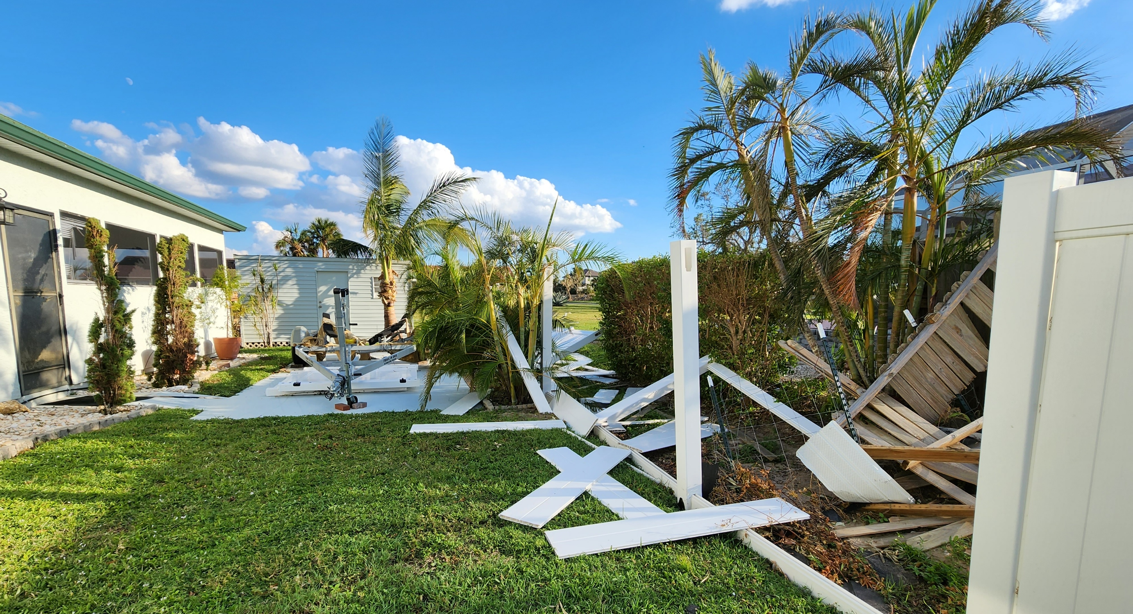
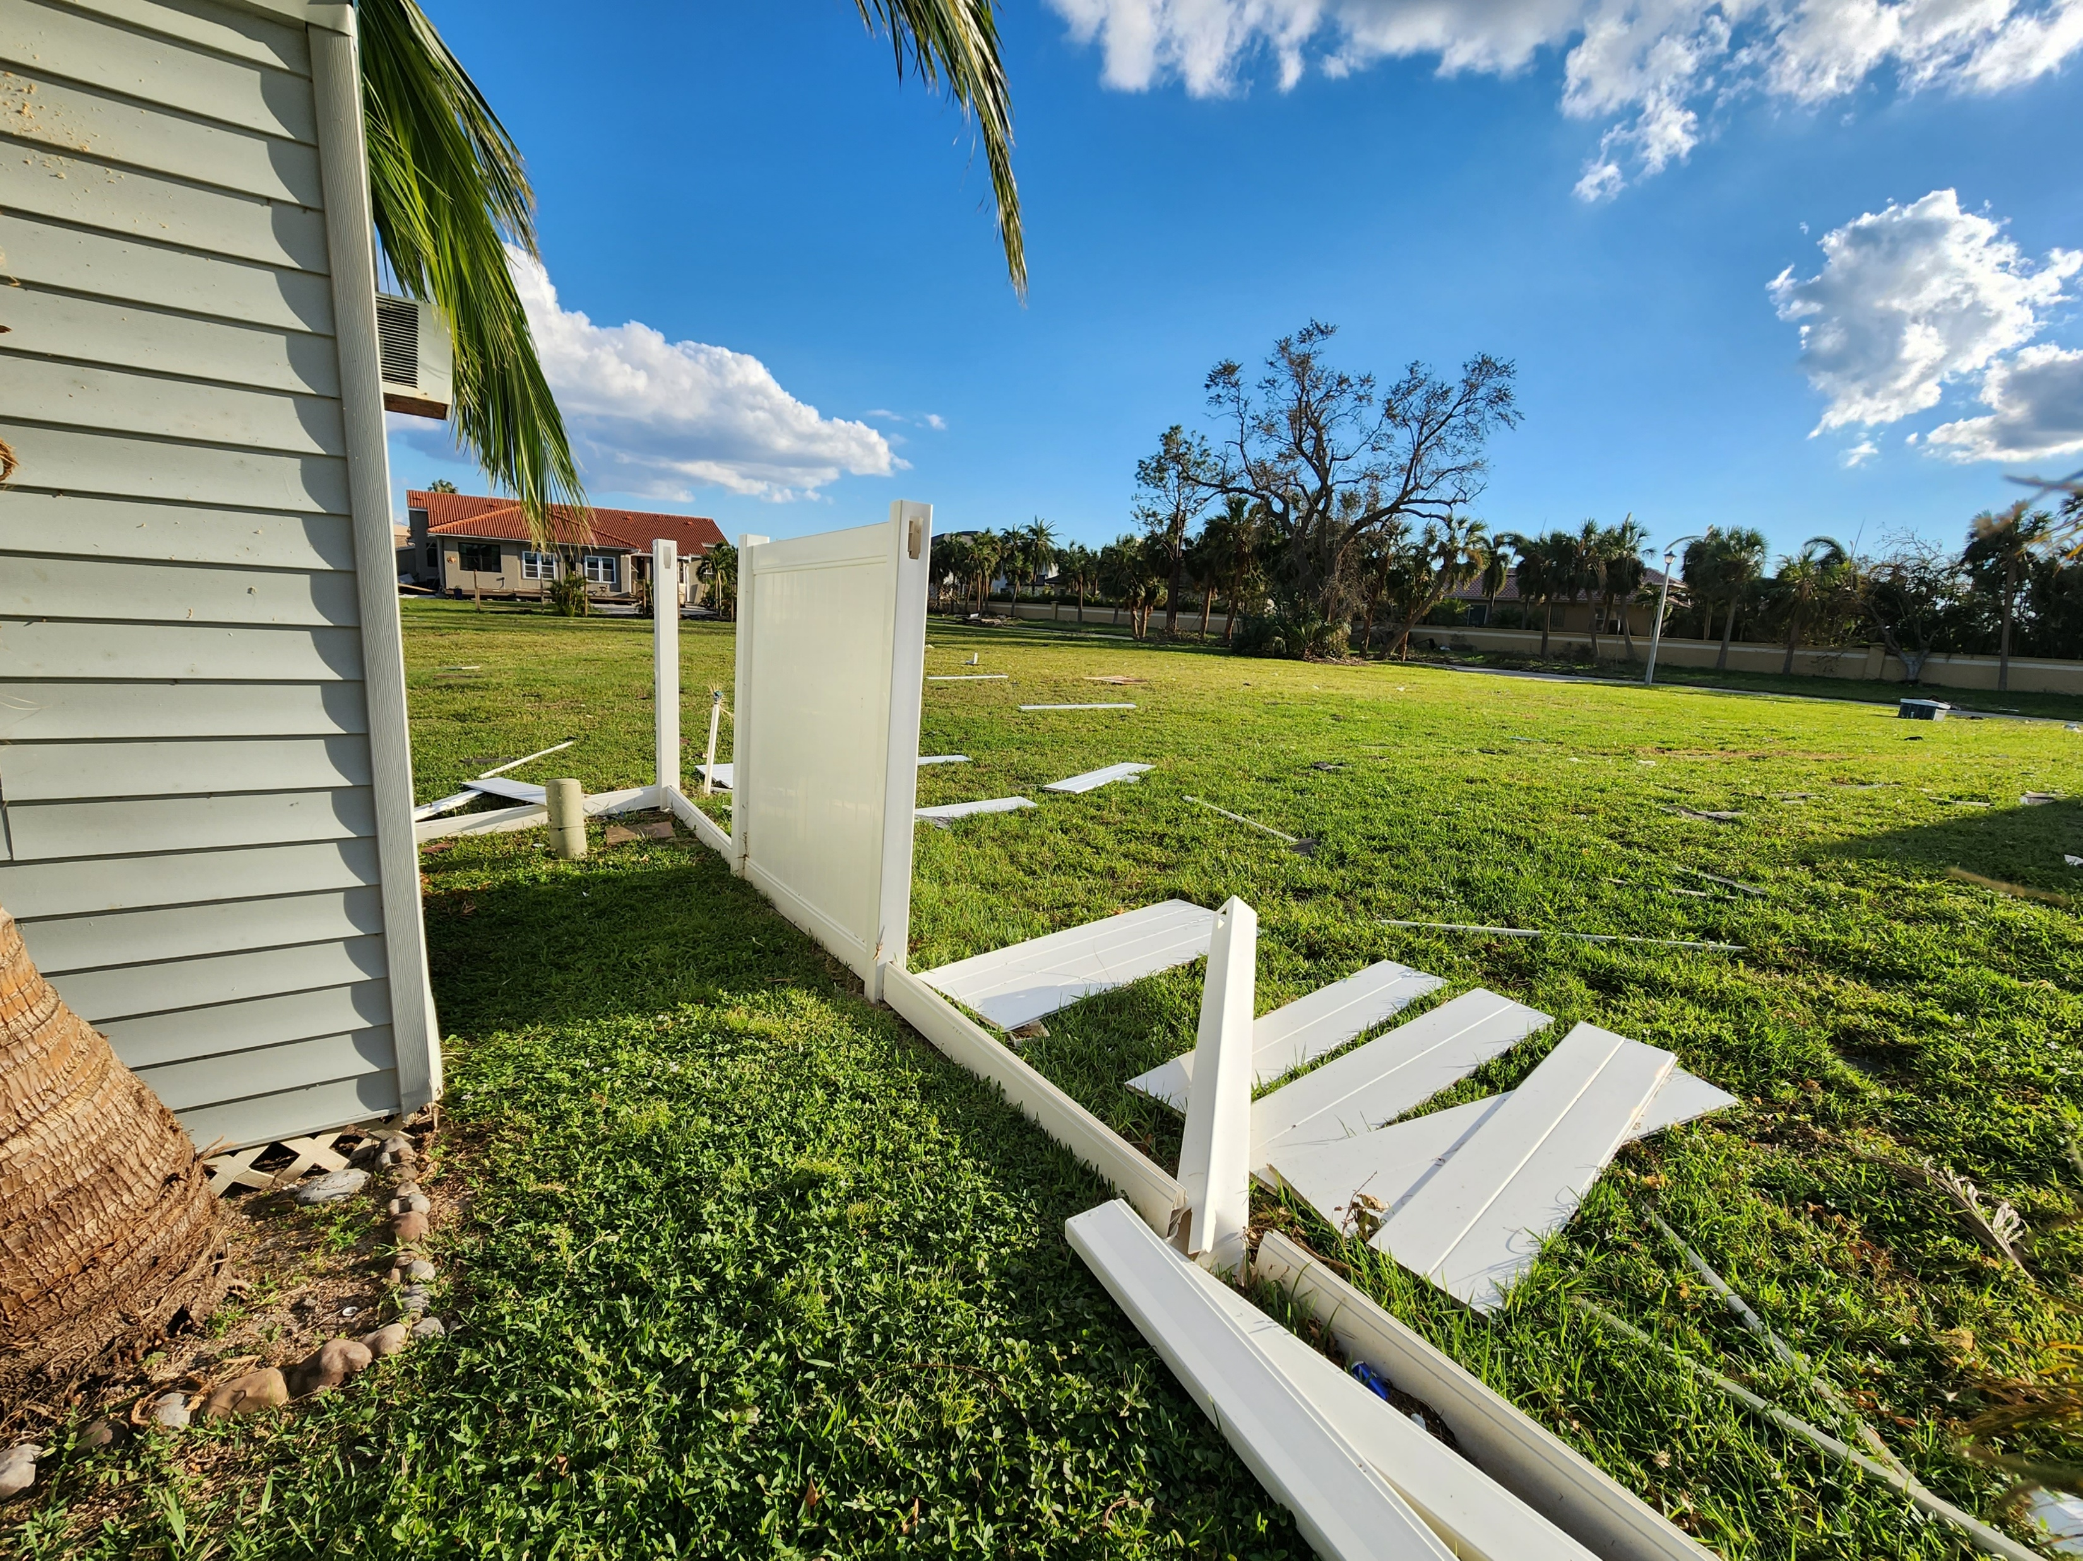
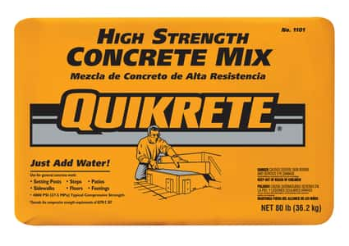
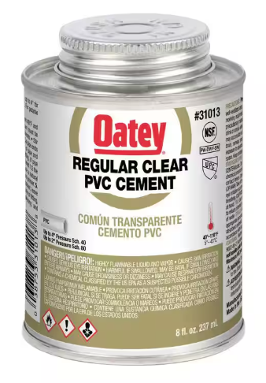
Wind mitigations to avoid yard damage
Like everyone else’s, our vinyl fence did not do well during Ian; largely because of shoddy construction.
We literally picked up the pieces and had the fence rebuilt by a private contractor; this time making sure that he added a lot more concrete to every post. He did a fair job, but the corner section was damaged during Milton.
We’ve just dug a 3-foot hole around the fence post, and added 2 bags of high-strength Quickcrete concrete mix.
We also removed all the post caps, cleaned them and pasted them on the posts with PVC cement.

Slide 3
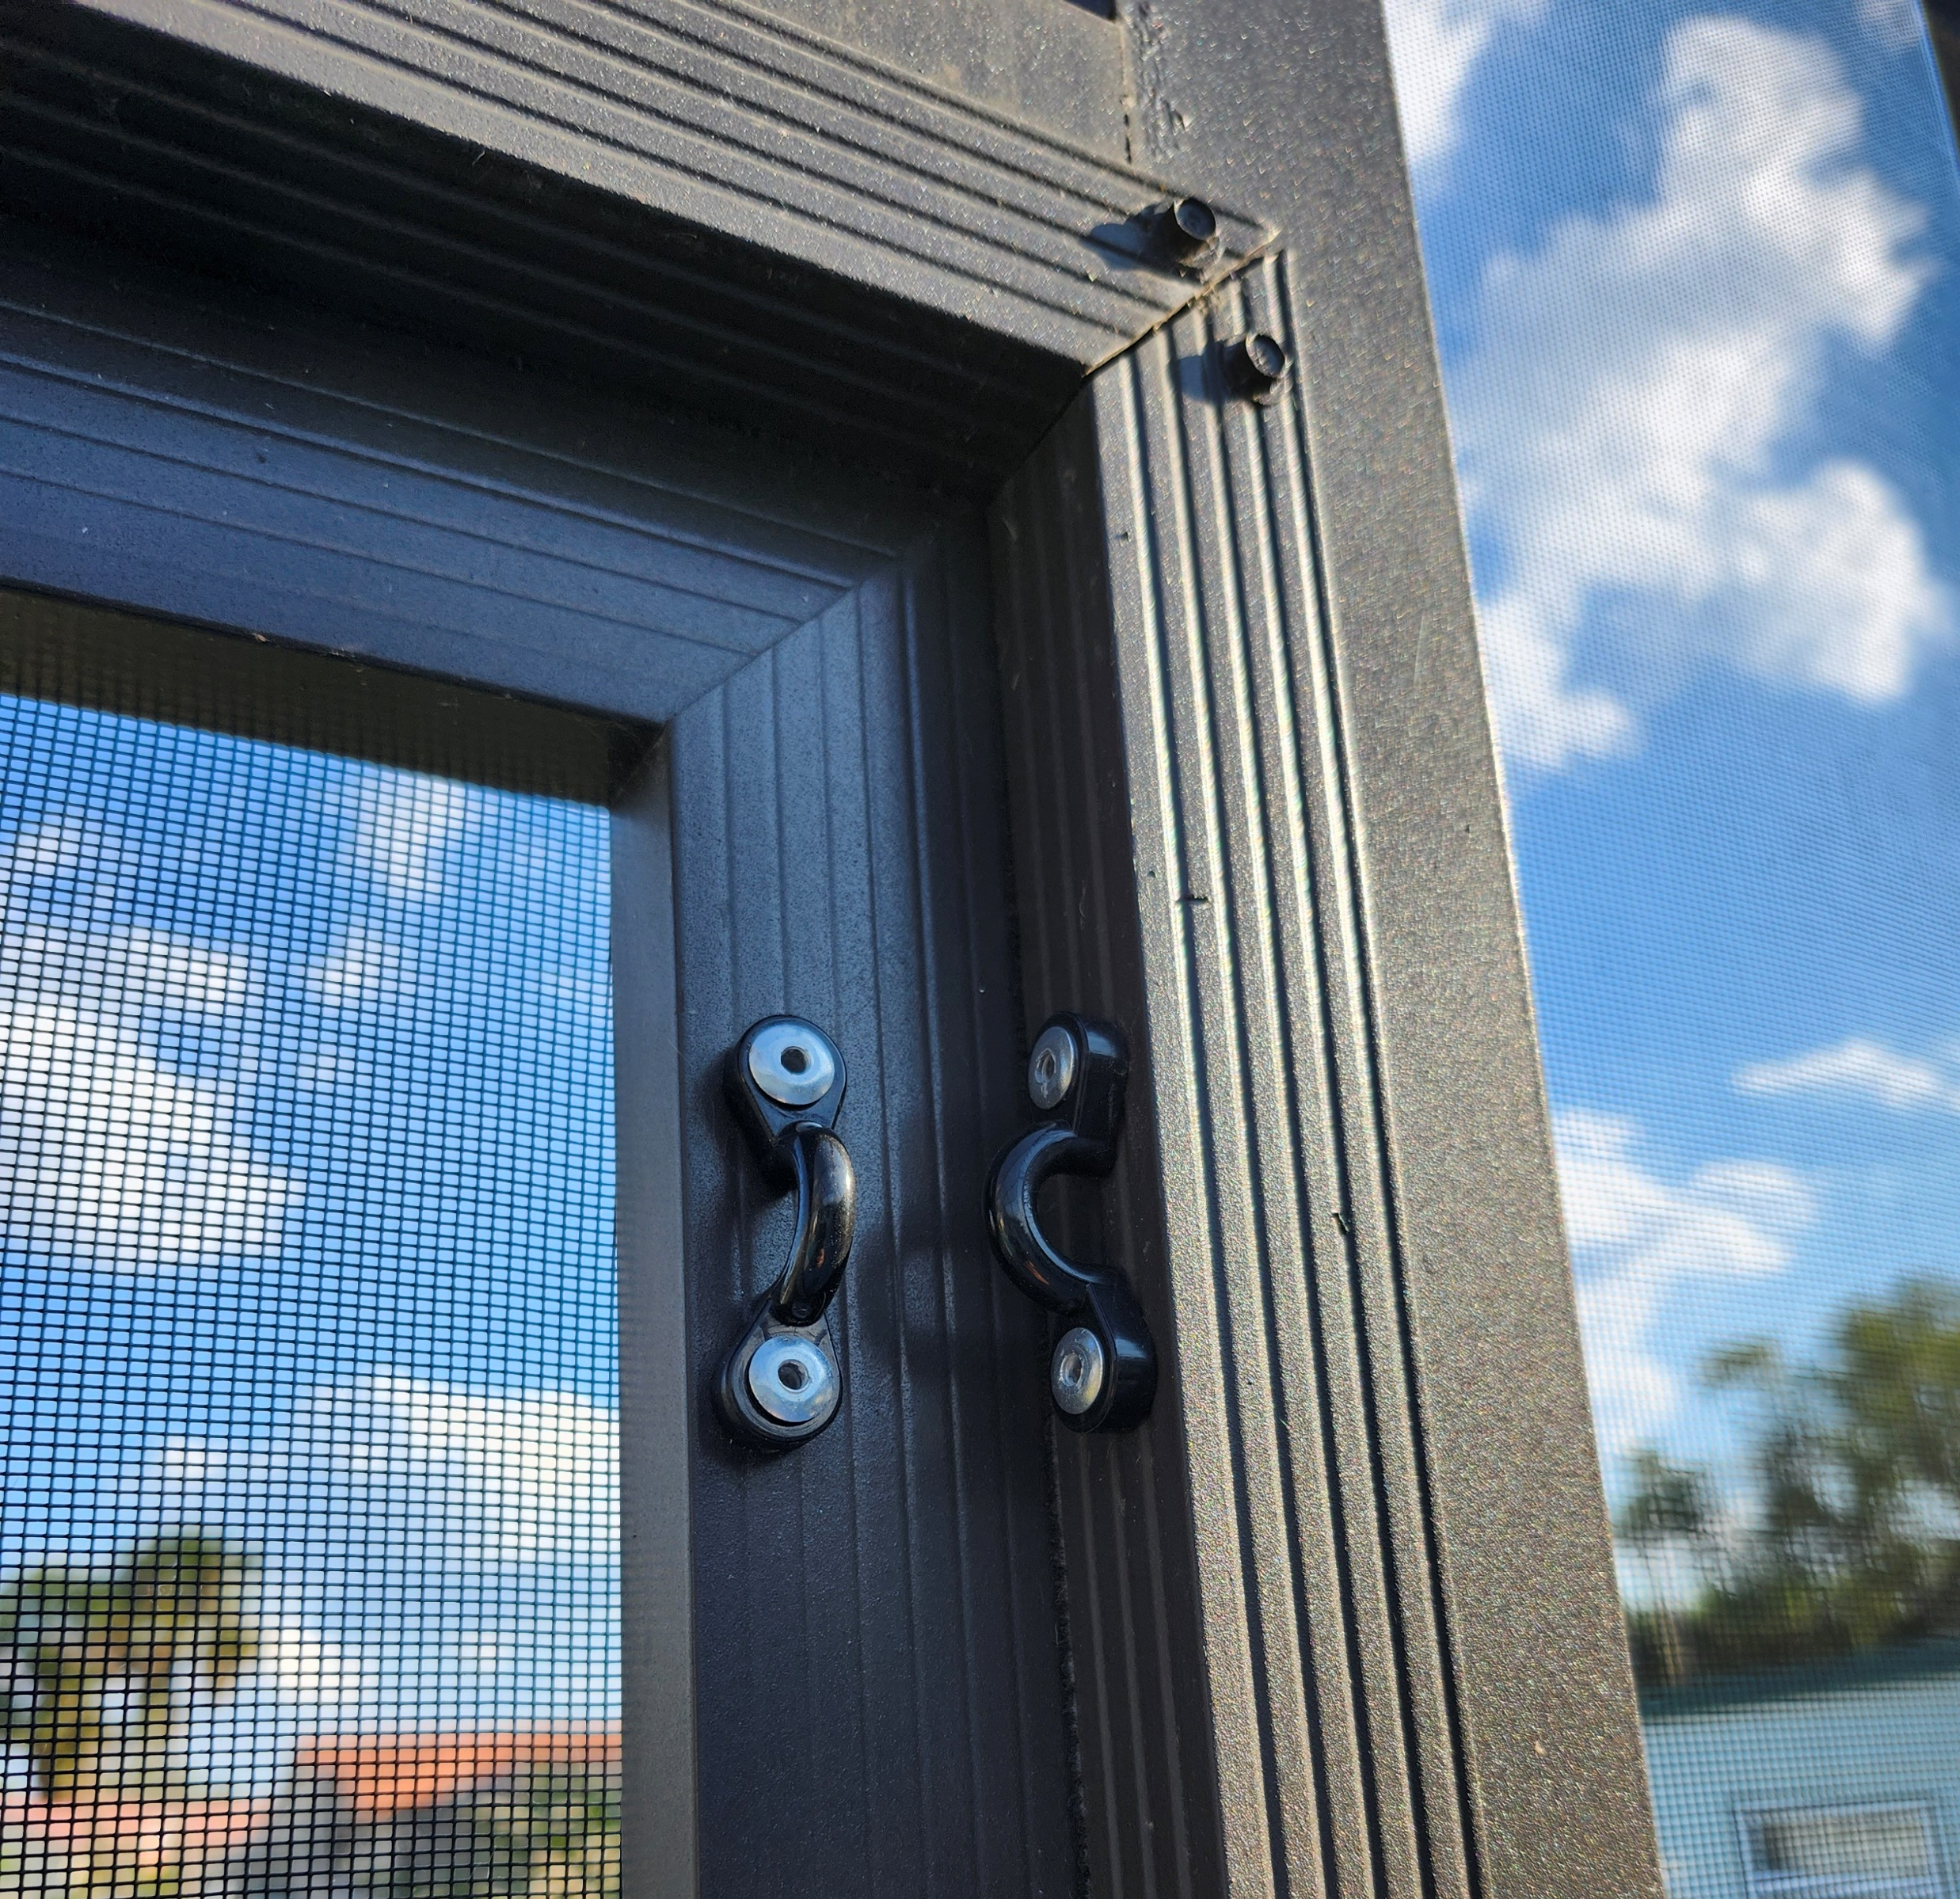
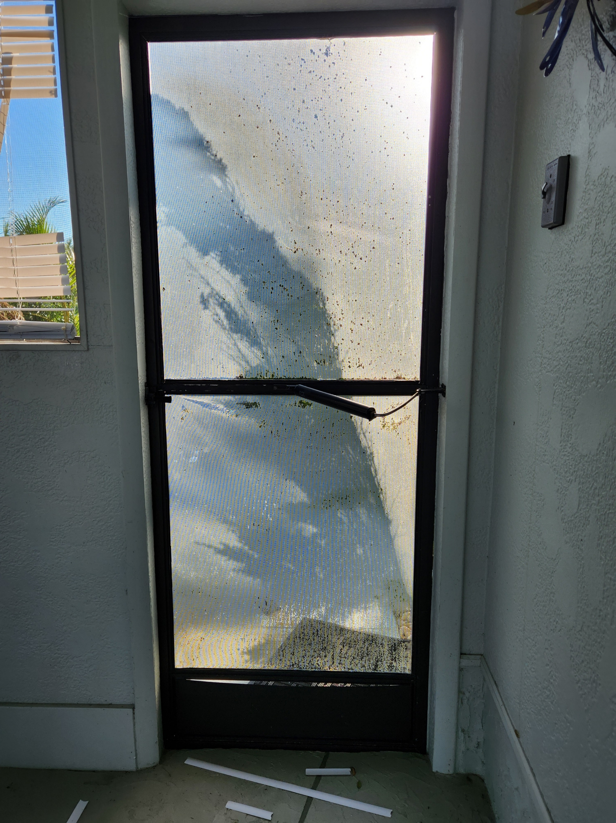
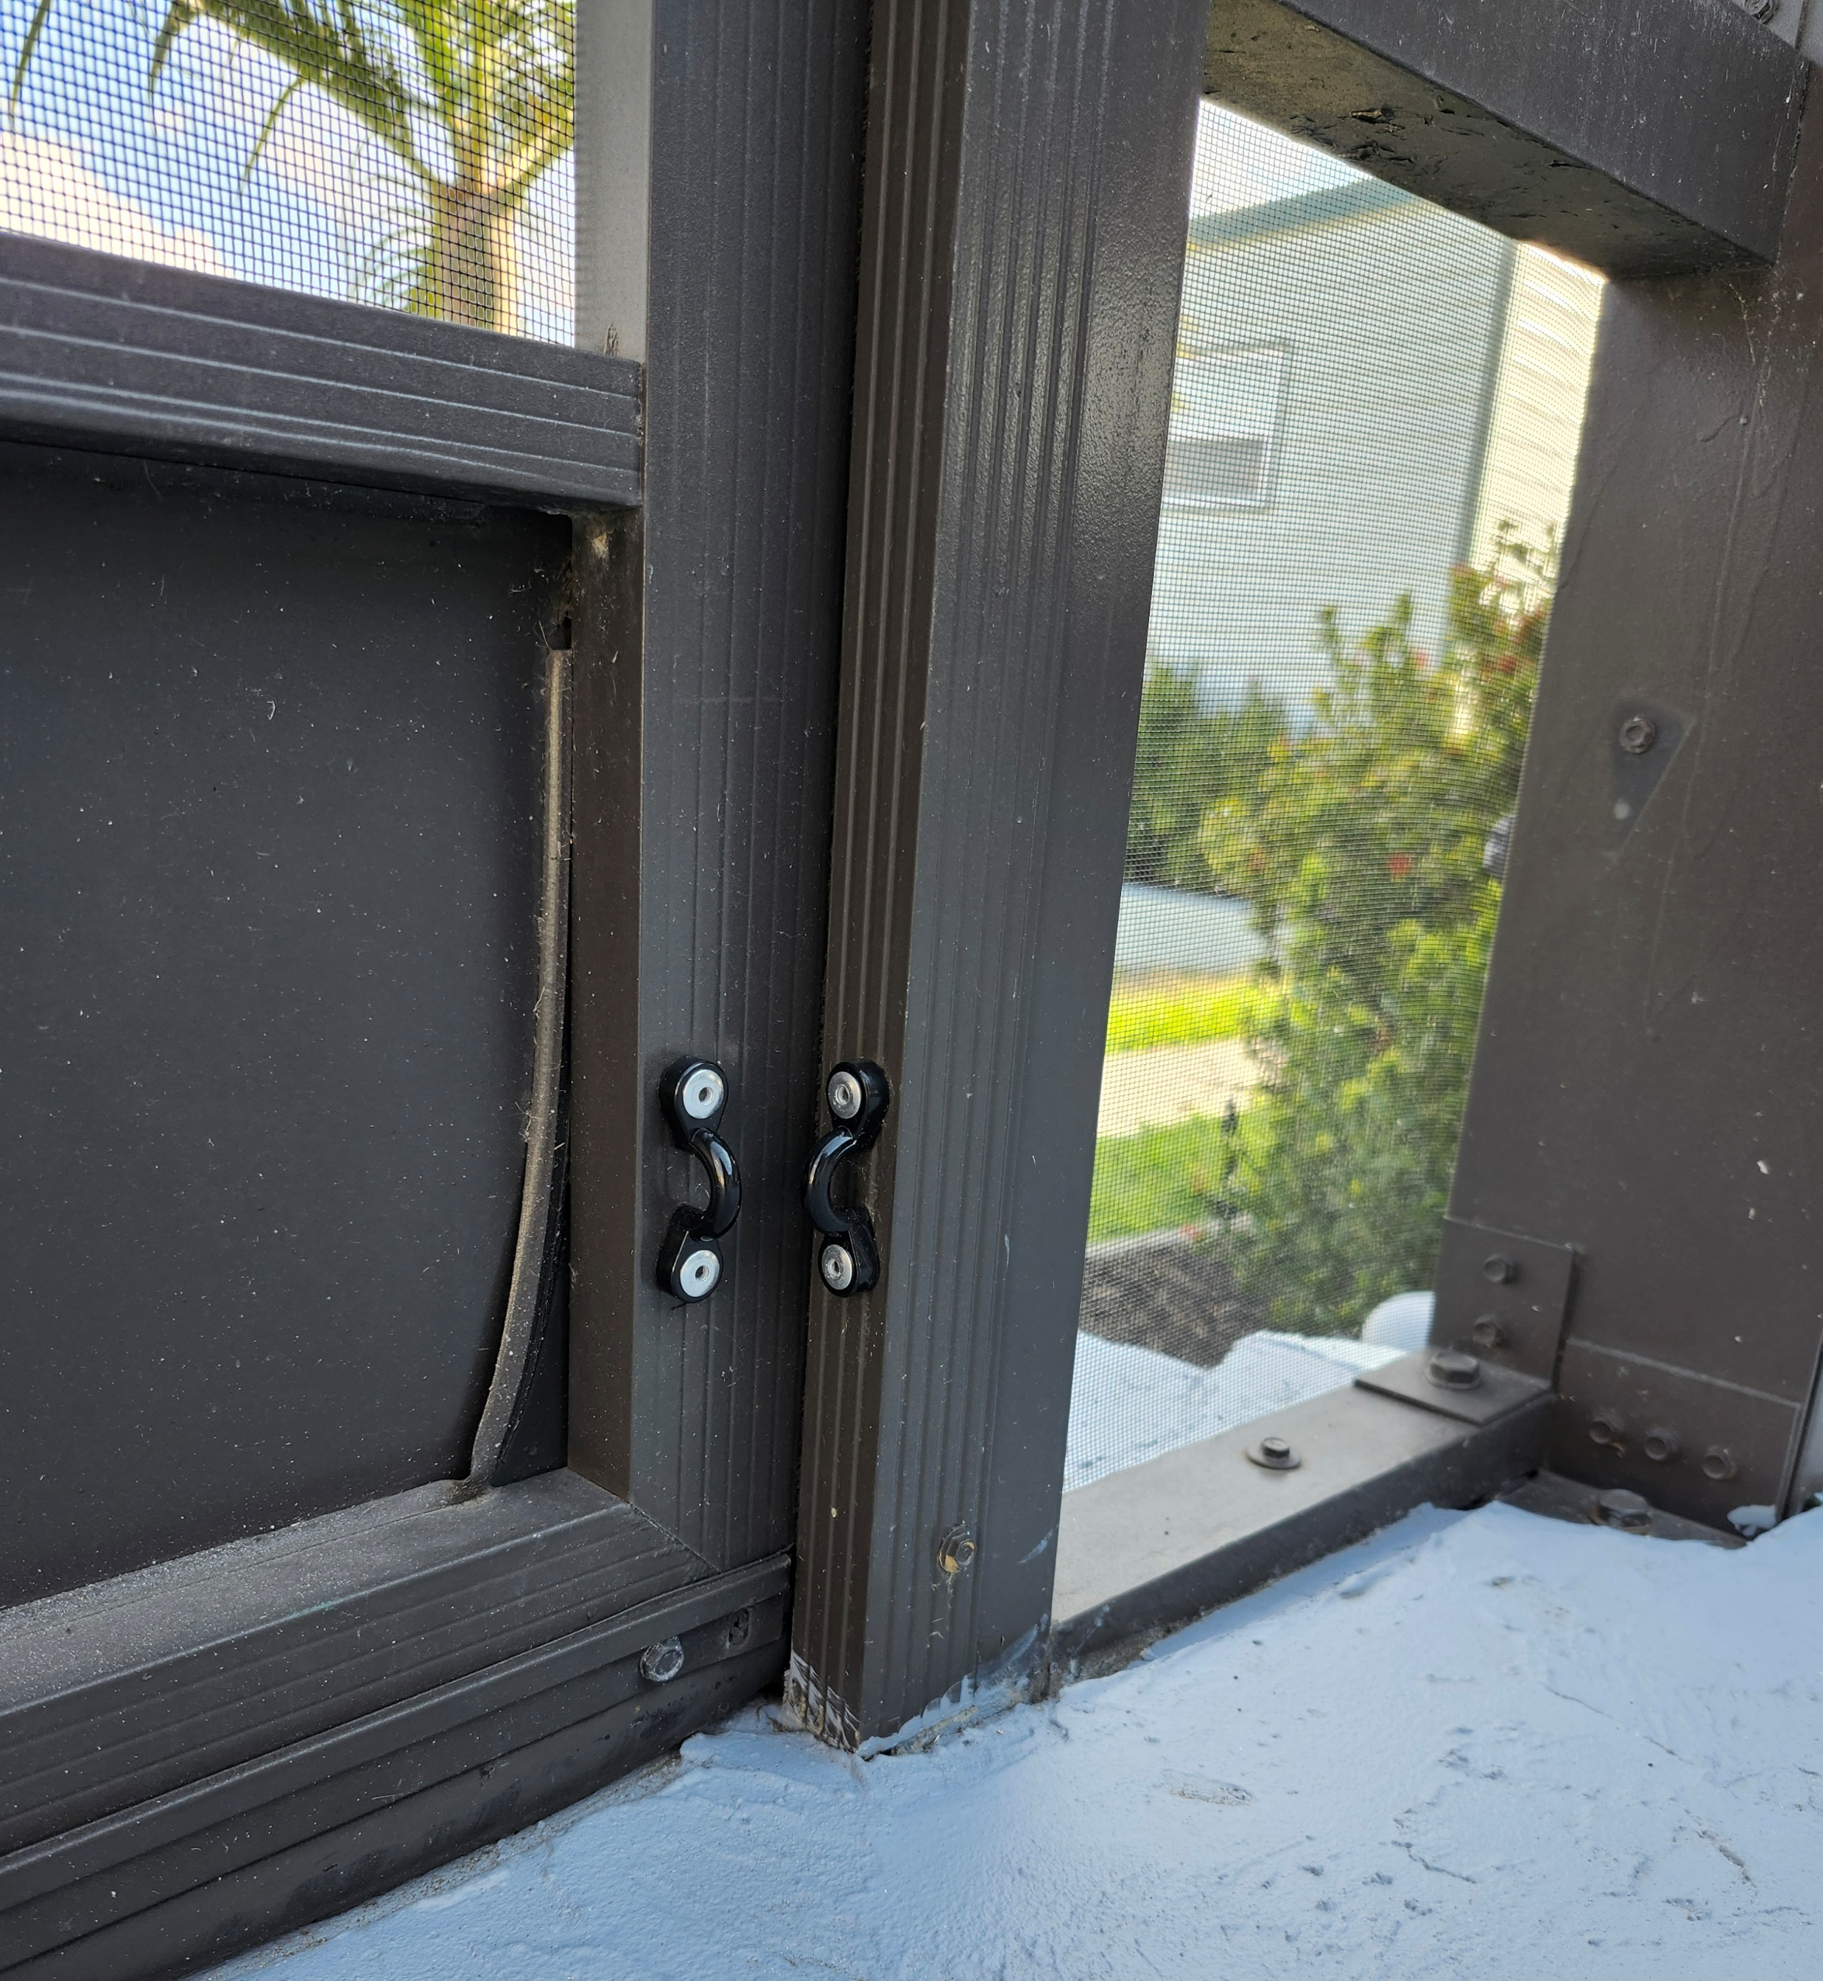
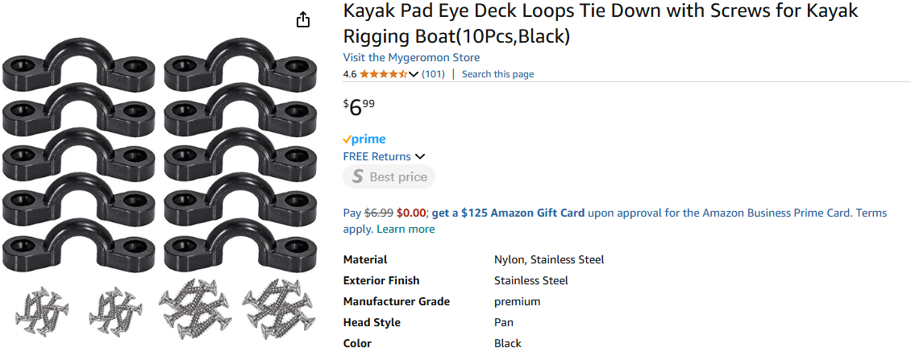
Wind mitigations to avoid lanai damage
We lost a few screens during Ian and had those replaced. However, since our pool cage is pretty old, we had the entire structure resprayed and rescreened early in 2024.
The contractor advised that we check the tension cables regularly, especially for rusted bolts and chain plates which may give way. We now make sure to do that before we leave for an extended period of time during hurricane season.
Our one lanai screen door blew out during Ian. Since the locking mechanisms on the latches are not particularly efficient, we installed plastic loops (from Amazon) at the top and bottom of each door, which allows us to secure the doors with cable ties. We, however, always leave one unsecured in case anyone needs to access the pool deck/house while we are gone.
If you have wind pressure build up in pool cage, removing screen doors for the storm protects the doors and keeps the pool cage screens from being blown out.

Slide 4
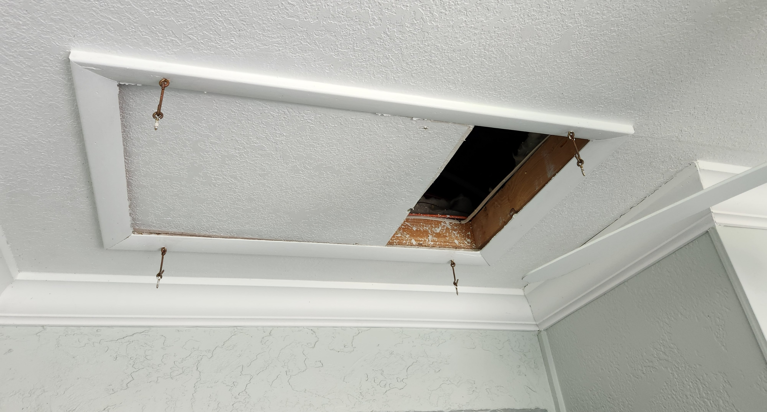
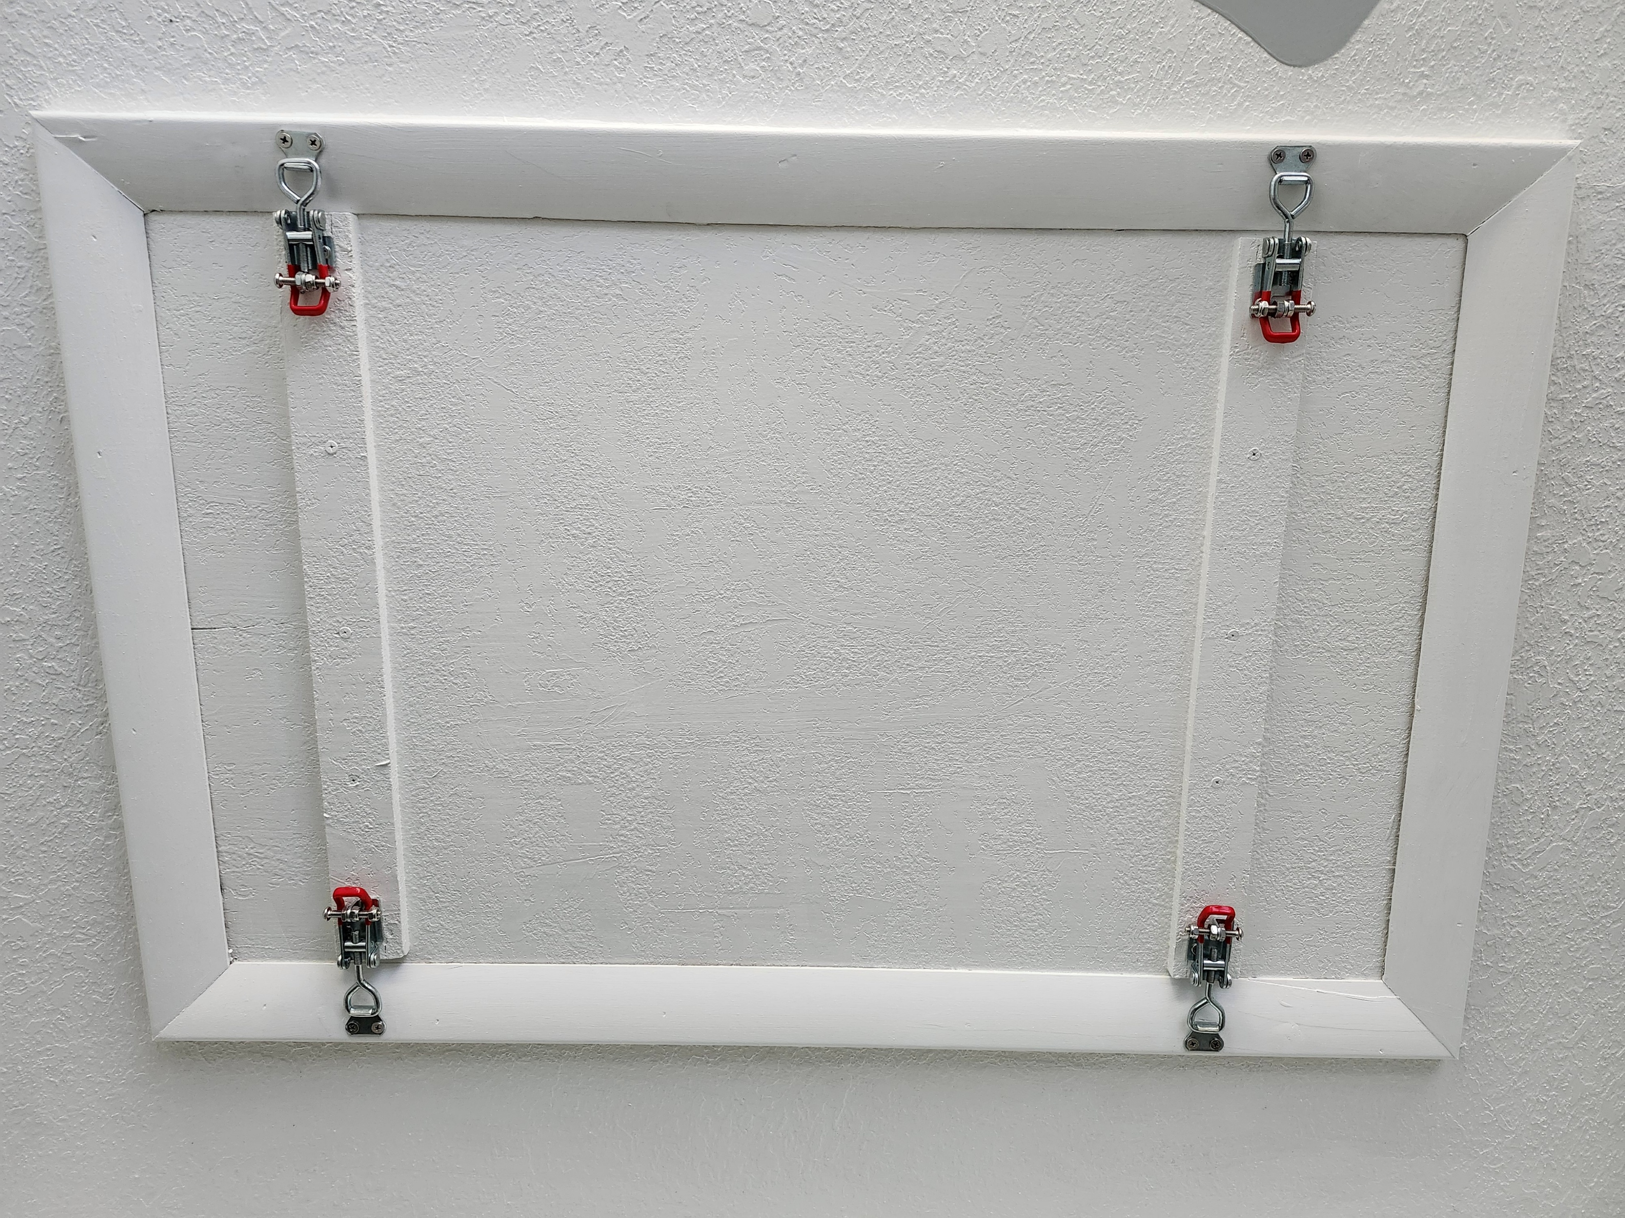
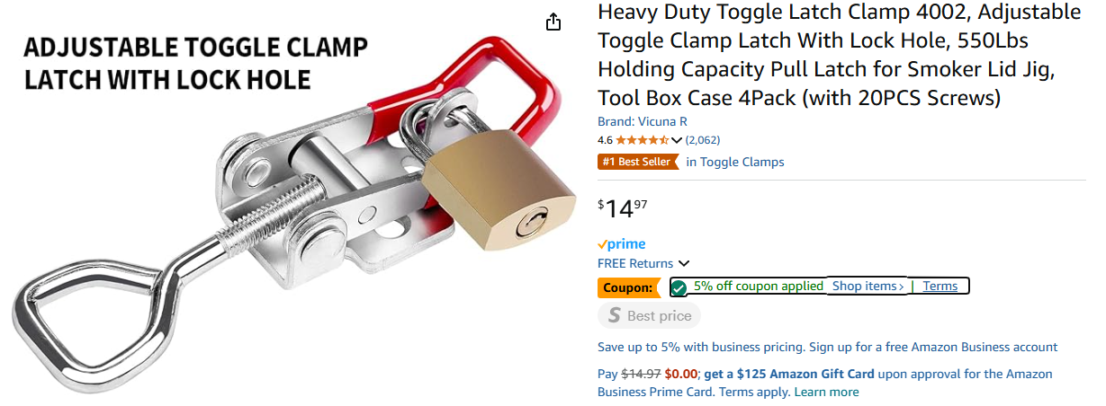
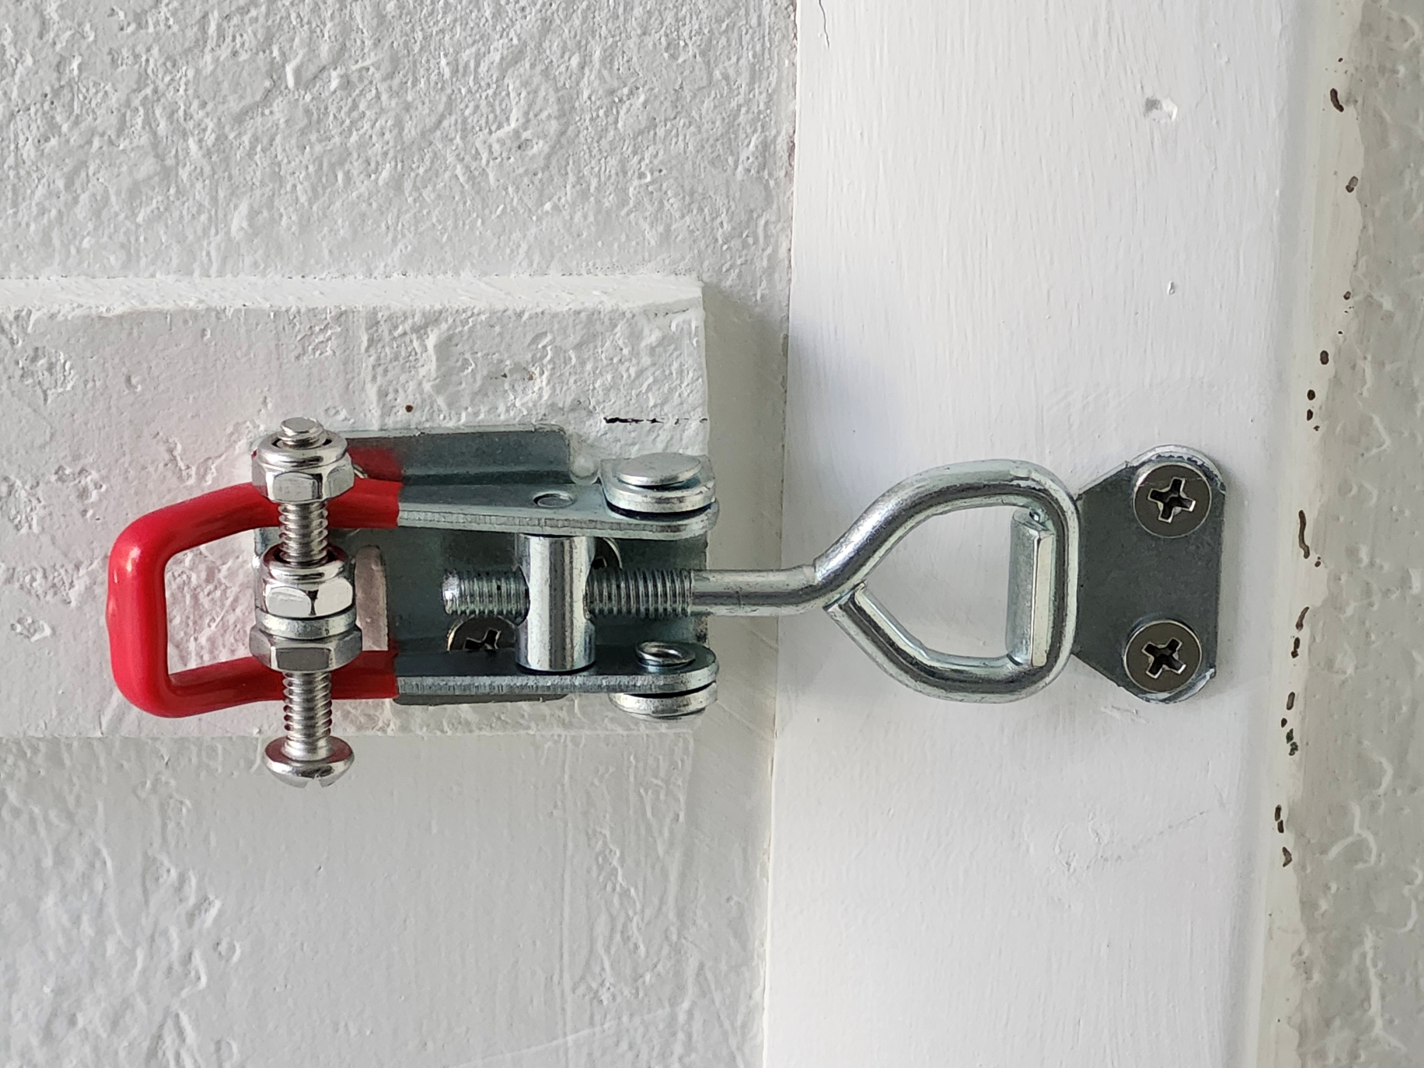
Wind mitigations to avoid roof damage
We have two crawlspace hatches, one in the garage and one for the covered part of the lanai.
The previous owner secured the latter with hooks, which were ripped out by the force from Ian (we were lucky to not have damage from this).
We have subsequently secured both hatches with proper latch clamps (from Amazon). Remember to insert a bolt with a nylock nut to ensure the latches can’t open up from vibrations caused by the wind.

Slide 5
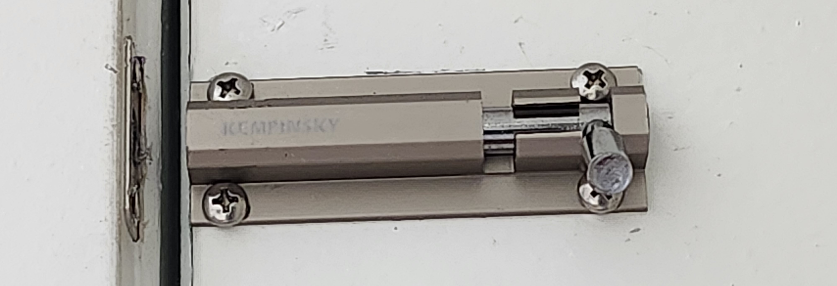
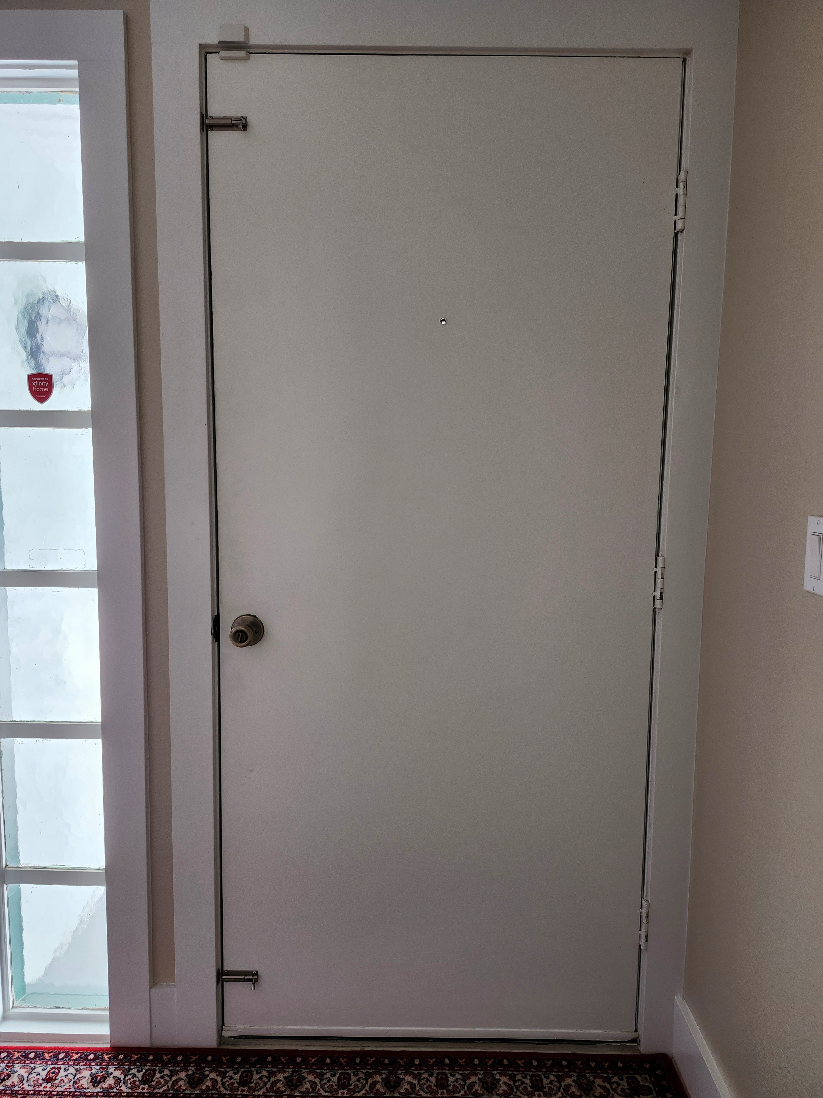
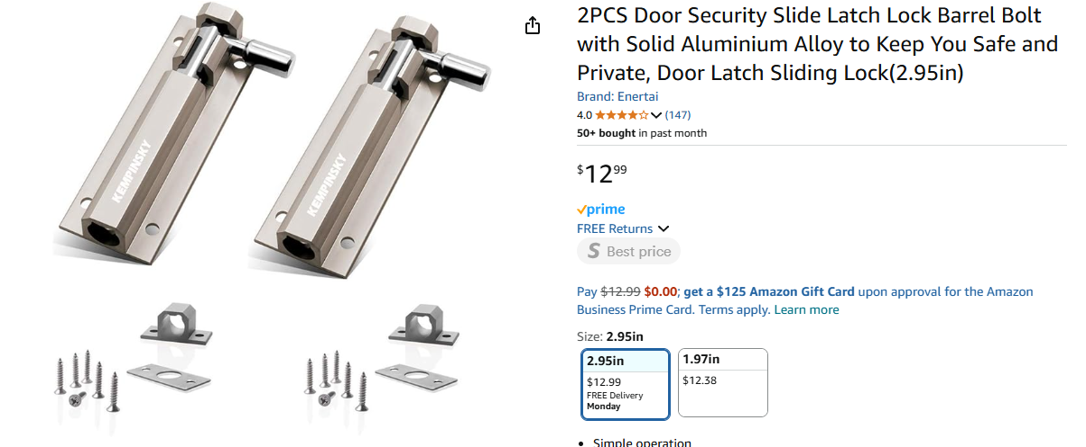
Wind mitigations to avoid door damage
Our front door is not hurricane proof, but survived Ian without damage, even though it faces north.
We have metal shutters for the door, but don’t like to install these when we leave for long periods of time (too obvious that someone isn’t home).
Instead, we have installed lock barrel bolts (from Amazon) at the top and bottom of the door to reduce the risk of it being blown inward.
A slider with a metal base plate is recommended, as this provides a stronger recess for the bolt than the wood of the door jamb alone.

Slide 6
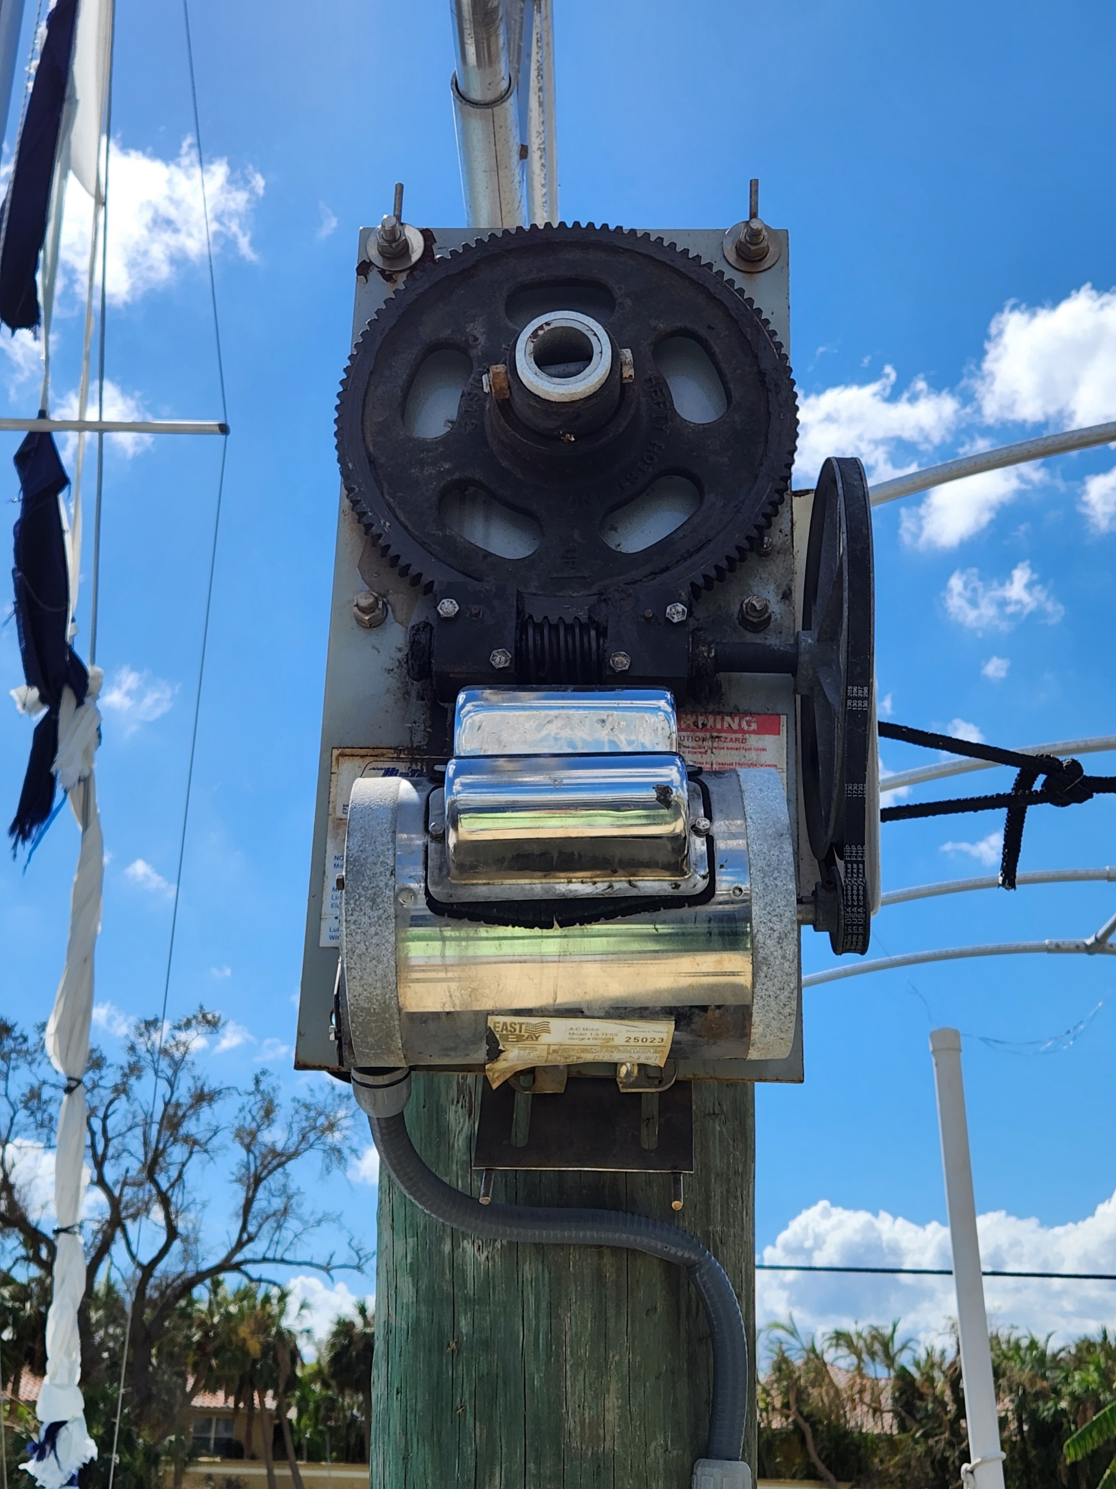
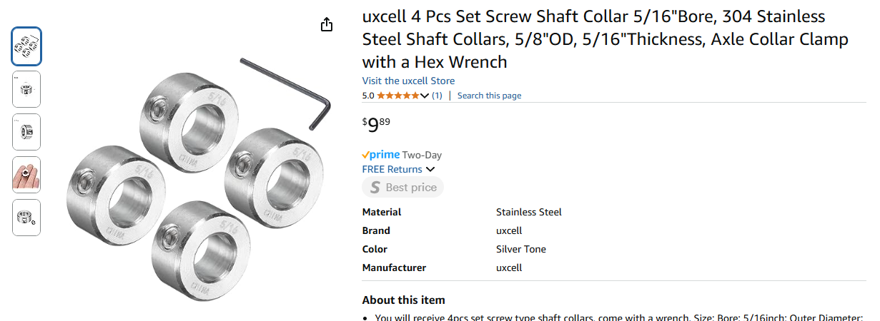
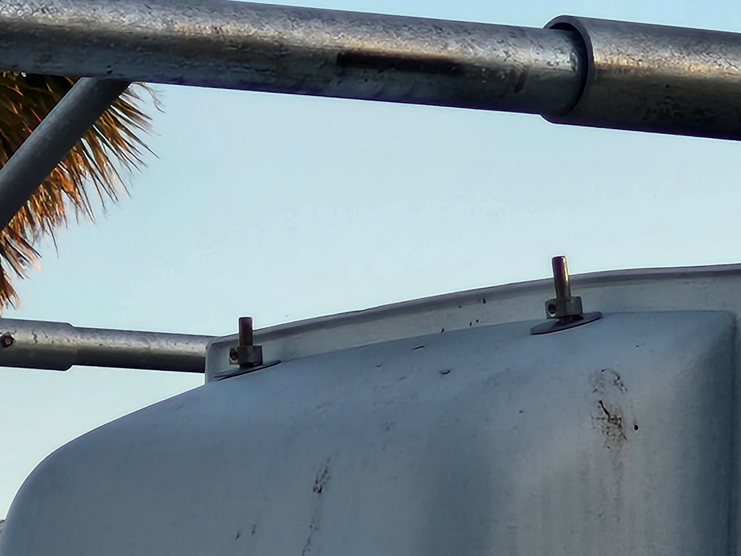
Securing boat lift motor covers
We lost one of our boat lift motor covers during Ian, and another during Milton.
It took a while (and two tries on Amazon) to figure a simple way to secure these – shaft collars.
Make sure the cover is pushed down as far as possible on the bottom base plate, then insert the shaft collars at the top.

Slide 7
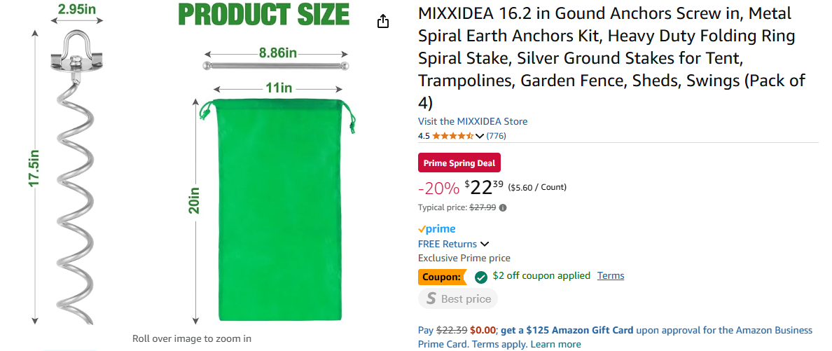
Securing trailers and other yard items that can’t be stowed away
Most folks are aware of ground anchors used for trailers, irrespective of whether there is something on the trailer.
We have a light kayak trailer that we tie down properly when we leave on extended trips during hurricane season.
We have found these to be very handy for securing large pots containing small trees. If tying the ropes to the plant itself, make sure to protect the plant from rope burns.

Slide 8
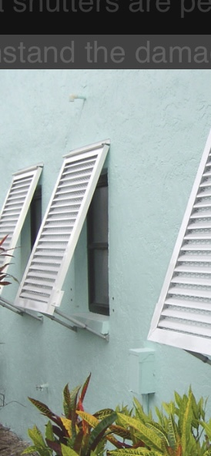
Bahama shutters can now be purchased as Maimi Dade Certified
*Bahama shutters now can have updated latches and design for hurricane force winds
*Some neighbors use plastic ties on older shutters to keep them tied down so they won’t be ripped away by the wind.

