Slide 1
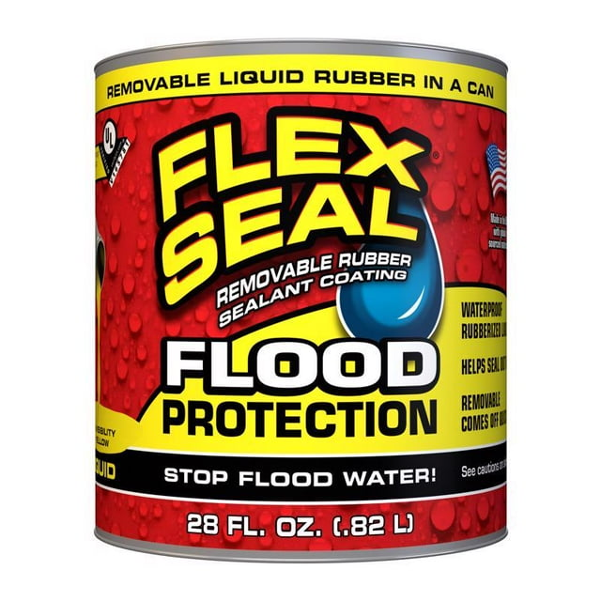
Storm surge mitigation
In 2023 we painted all the doors on the water side of the property with Flex Seal paint. Although that proved completely unnecessary, we are convinced that the paint would withstand prolonged exposure to surge (as advertised). However, this is an experiment we won’t repeat, as it took a lot of effort to get the doors open again (especially the sliding door), and many hours of toil to remove all the bright yellow rubbery residue. You are supposed to be able to peel it off cleanly, but that only worked in places where we painted it quite thick. At the price, this is not feasible.
Not recommended!

Slide 2
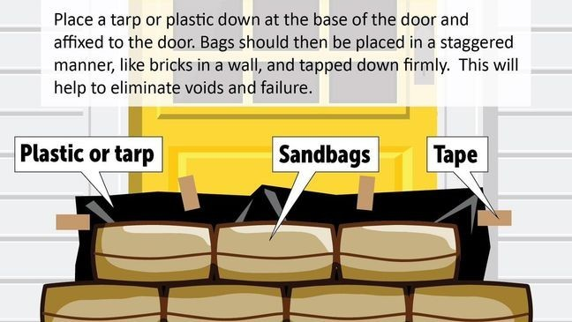
DYI FLOOD PROTECTION
Carmen Rose had water 4in above door entry
Traditional sandbags aren’t ideal but worked
Amazon sells plastic sandbags that can be filled with water but some suggested they aren’t heavy enough for floods
Instead of taping like this image, waterproof tape should be applied over all edges of tarp to form a seal while bags keep tarp in place
Tape may remove paint
Neighbors had issues with black water activated sandbags

Slide 3
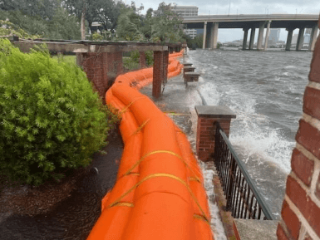
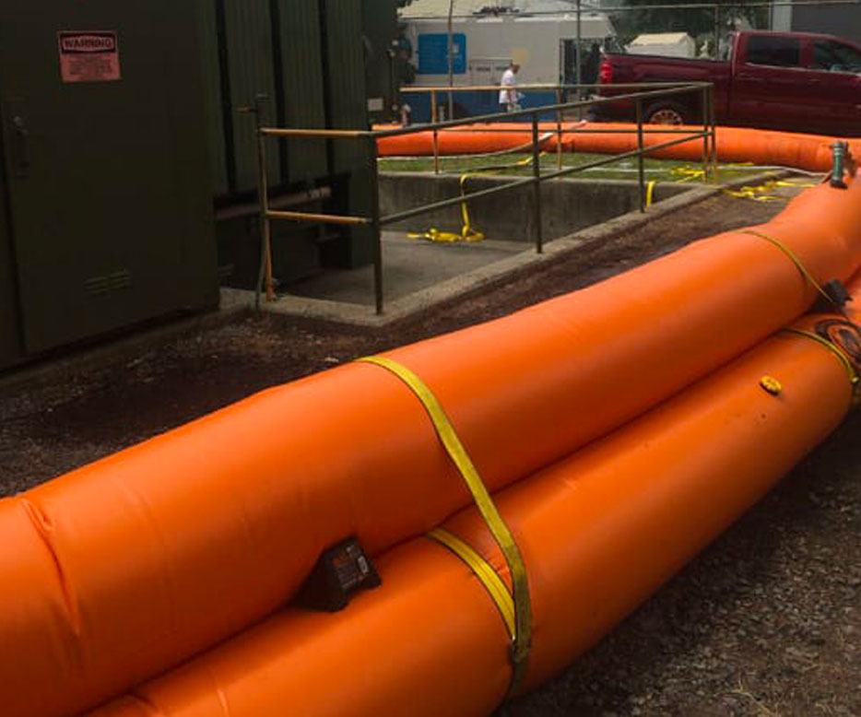
US FLOOD CONTROL TIGER DAM
Rapid Deployment
Product can be filled with water or concrete

Slide 4
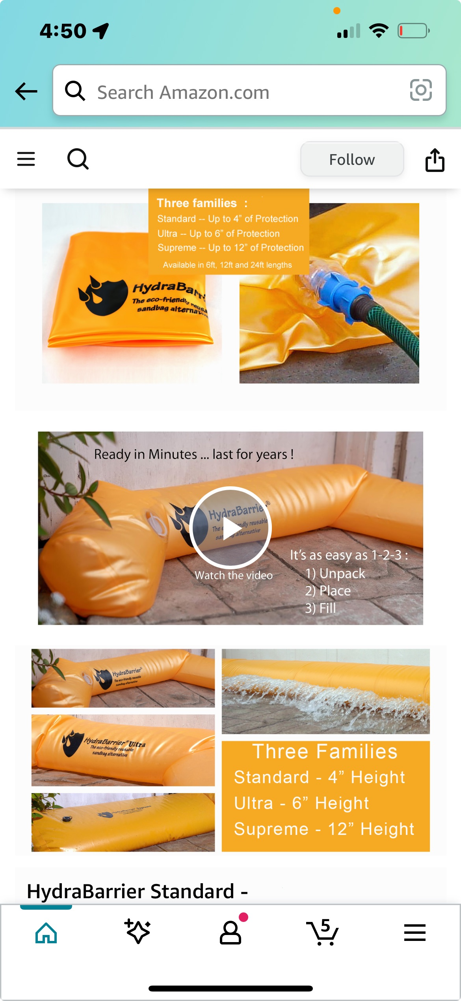
AMAZON KNOCKOFF Barrier Damn
Not as strong of material, but still strong
Doesn’t allow concrete filling
Much easier for home use
Water barrier links
24ft
https://amzn.to/4iVQ9HS
12ft
https://amzn.to/42gF64O
4pk 4ft
https://amzn.to/4iWqLSl
Garden Hose Adapter
https://amzn.to/4iUqdfO

Slide 5
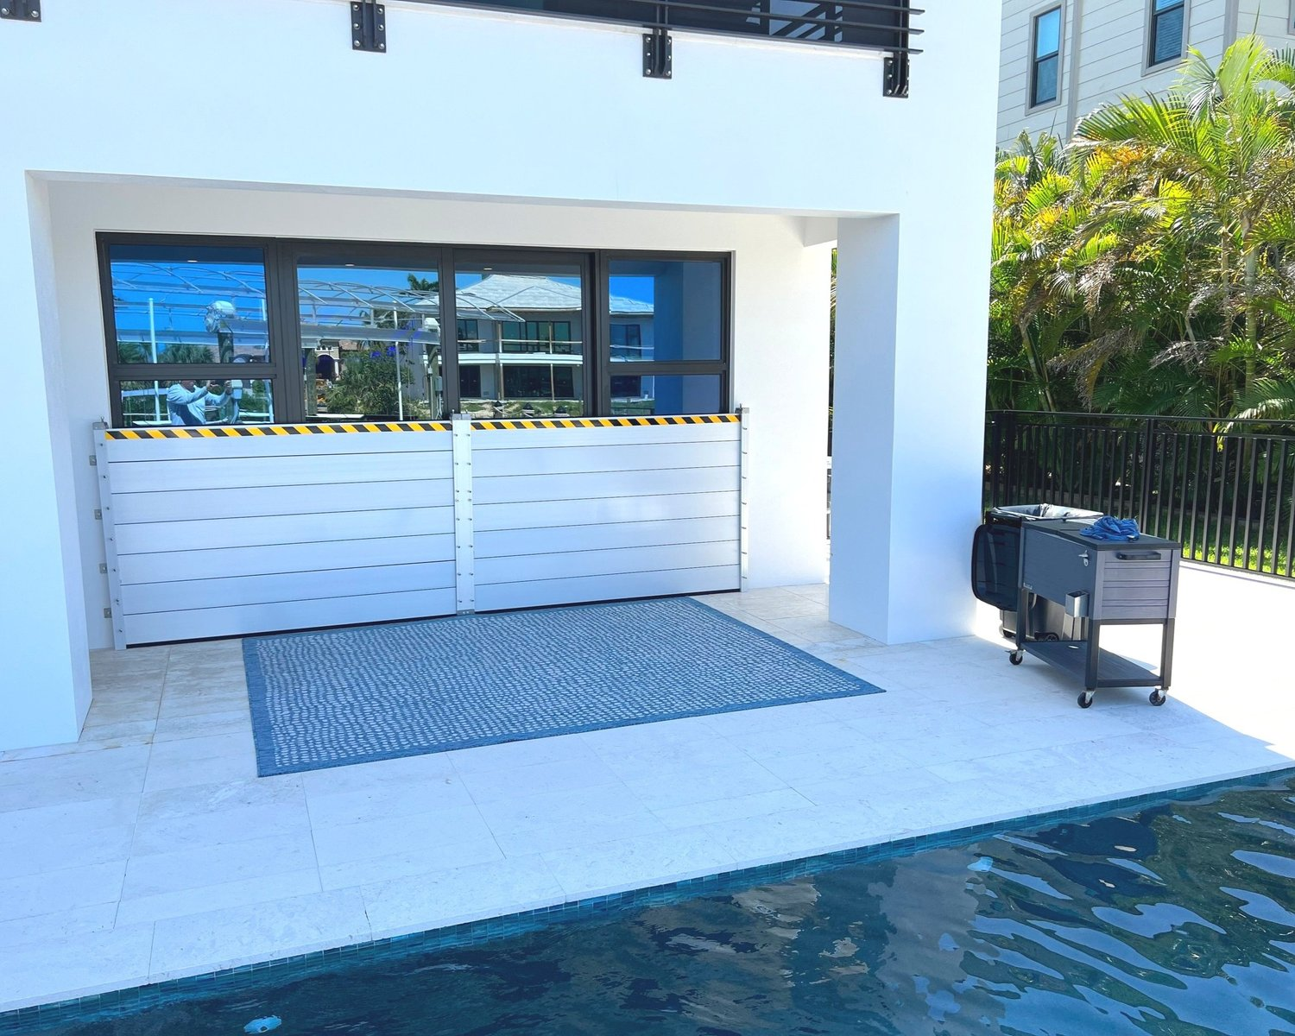
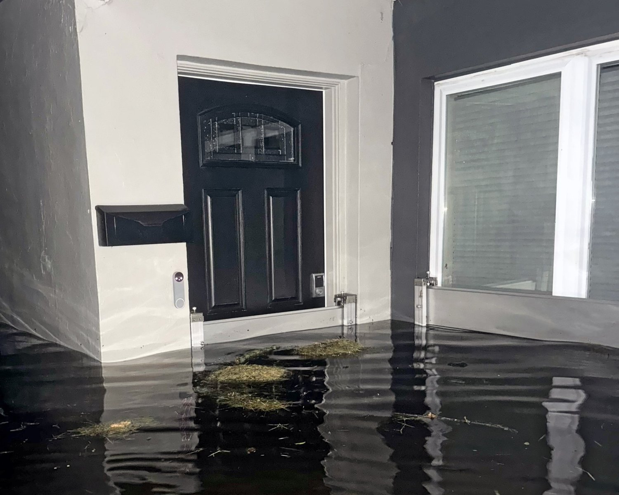
Neal Synder: Aluminum Flood Barrier

Slide 6

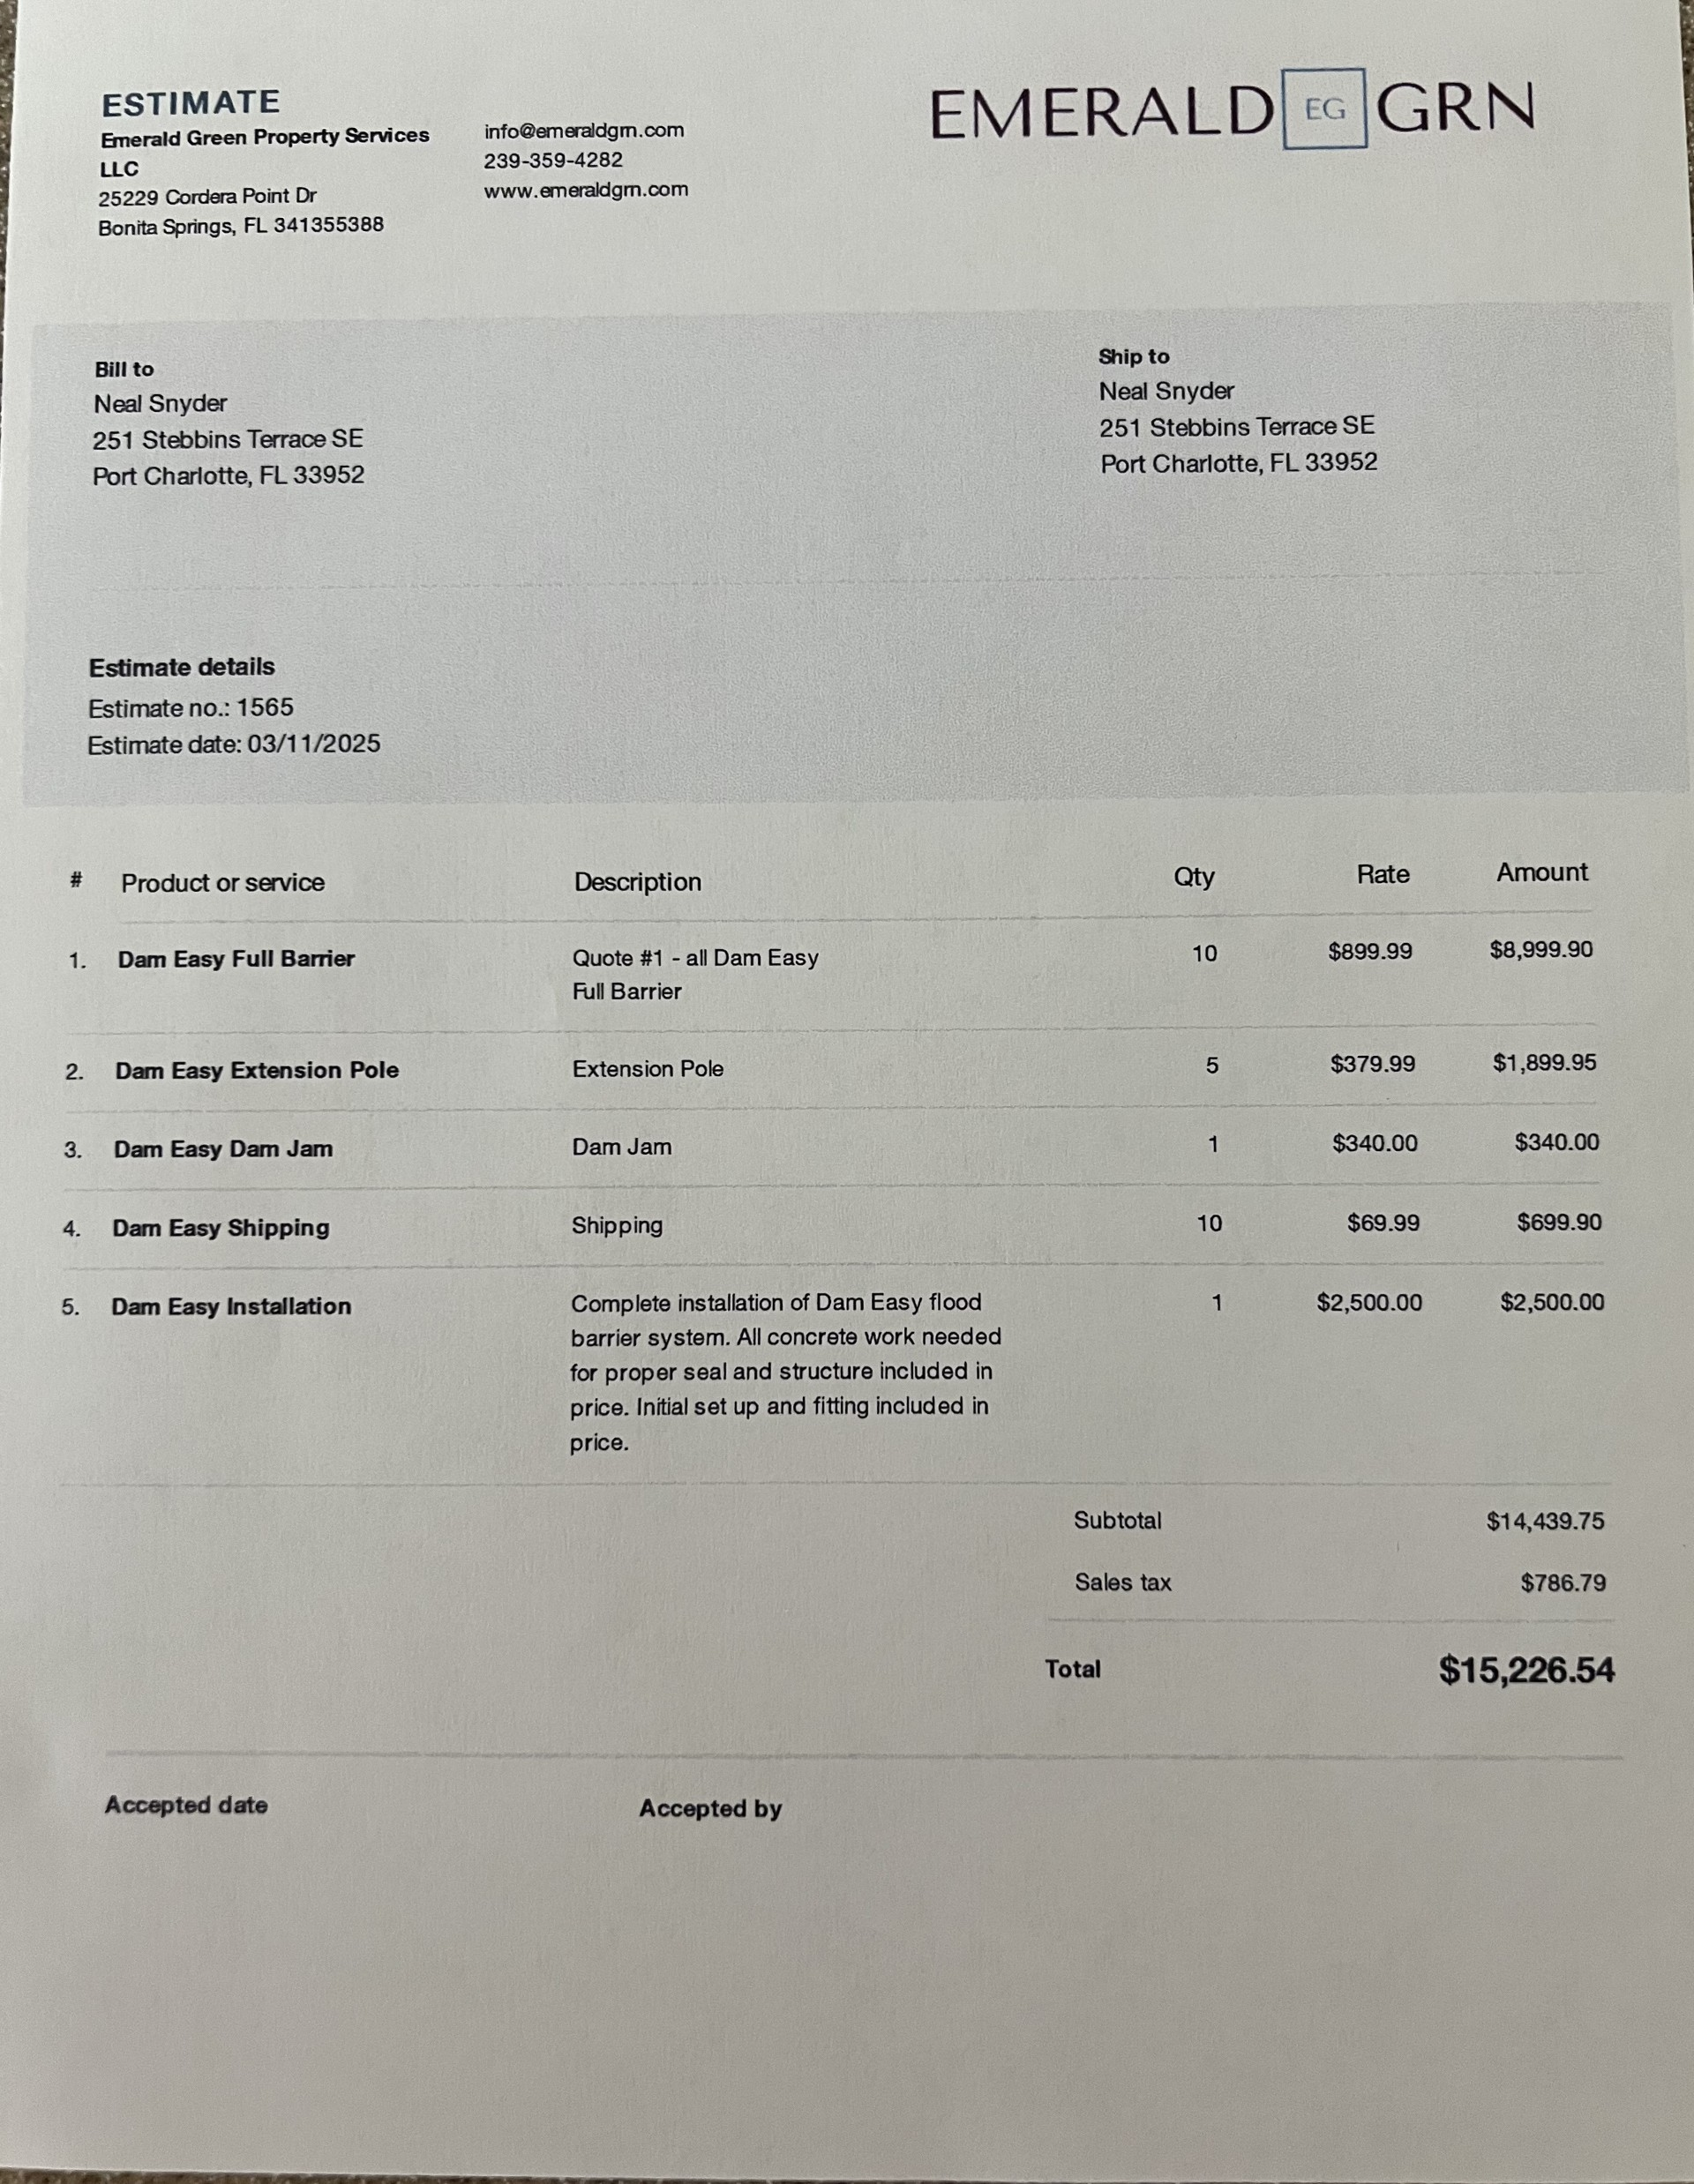
Estimates Neil Received, if chosen for installing product this company will set up flood barrier when storm is approaching
Another Option:

Slide 7
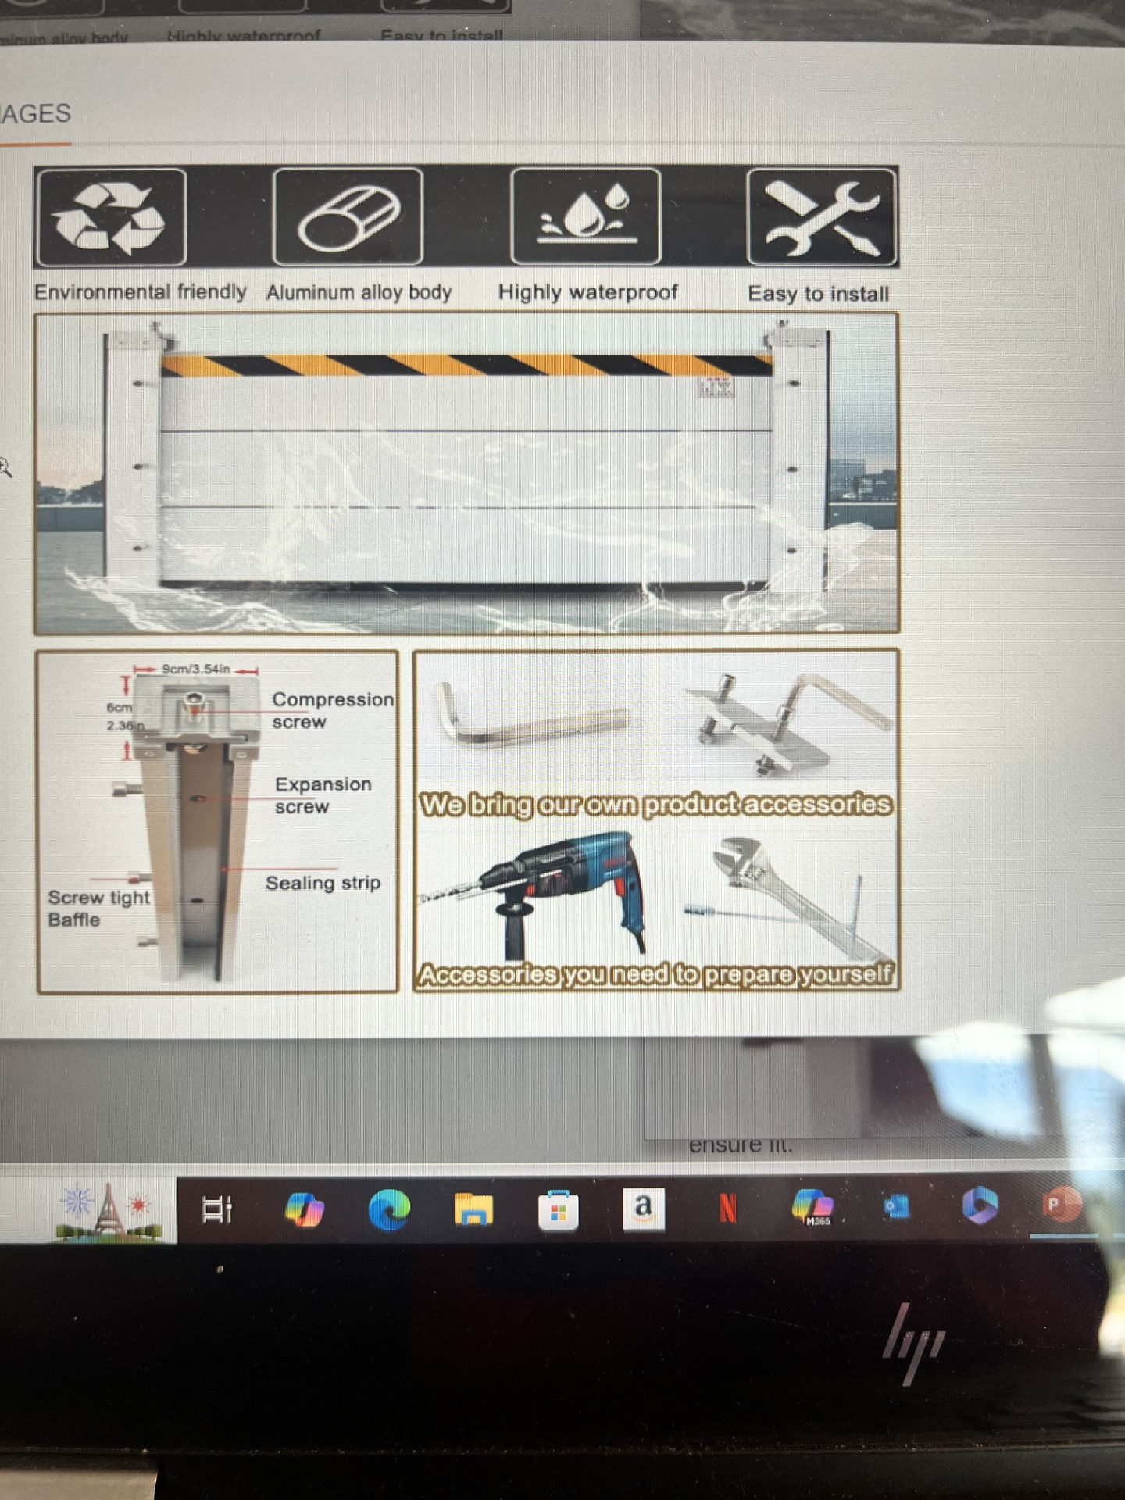
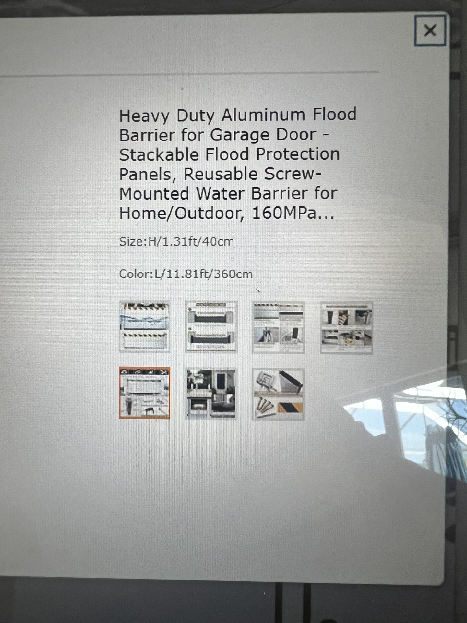
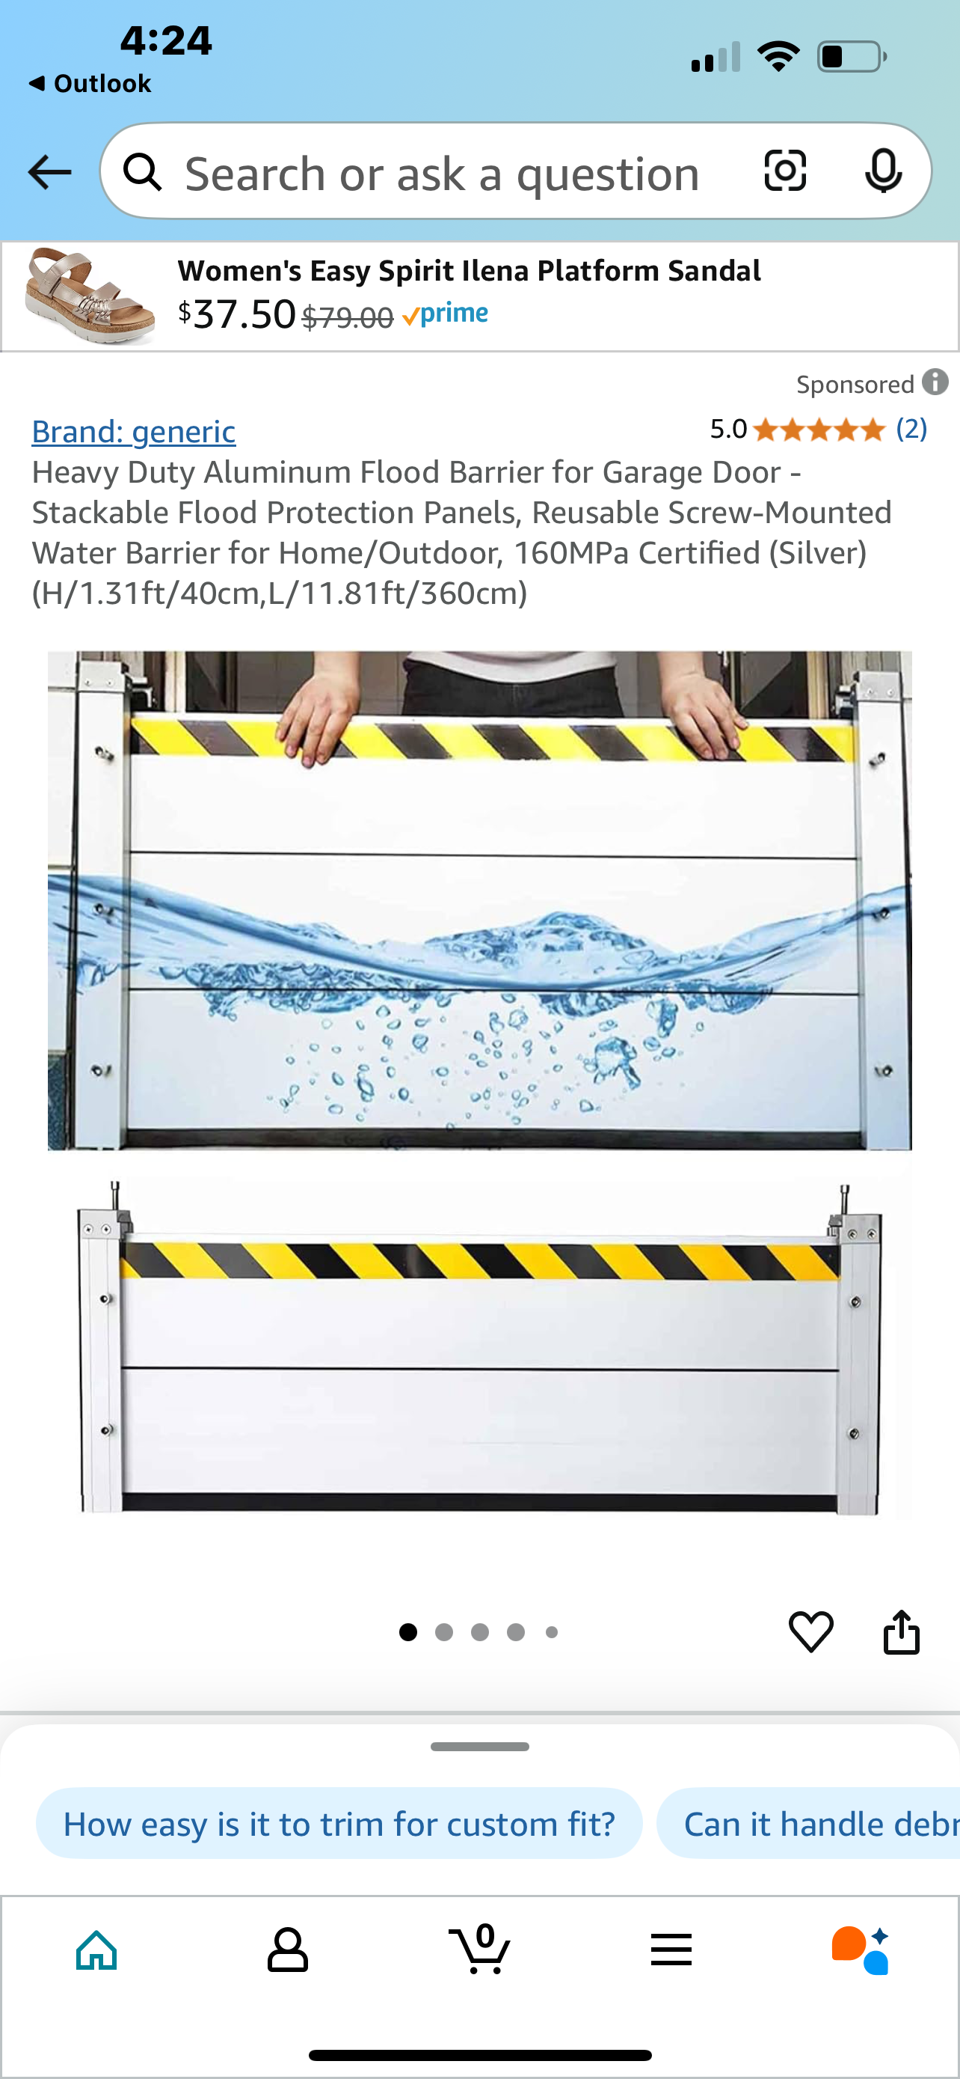
Amazon Aluminum Flood Barrier Knockoff
Does not ship over 7.5 feet so product will be cut if longer than that.

Slide 8
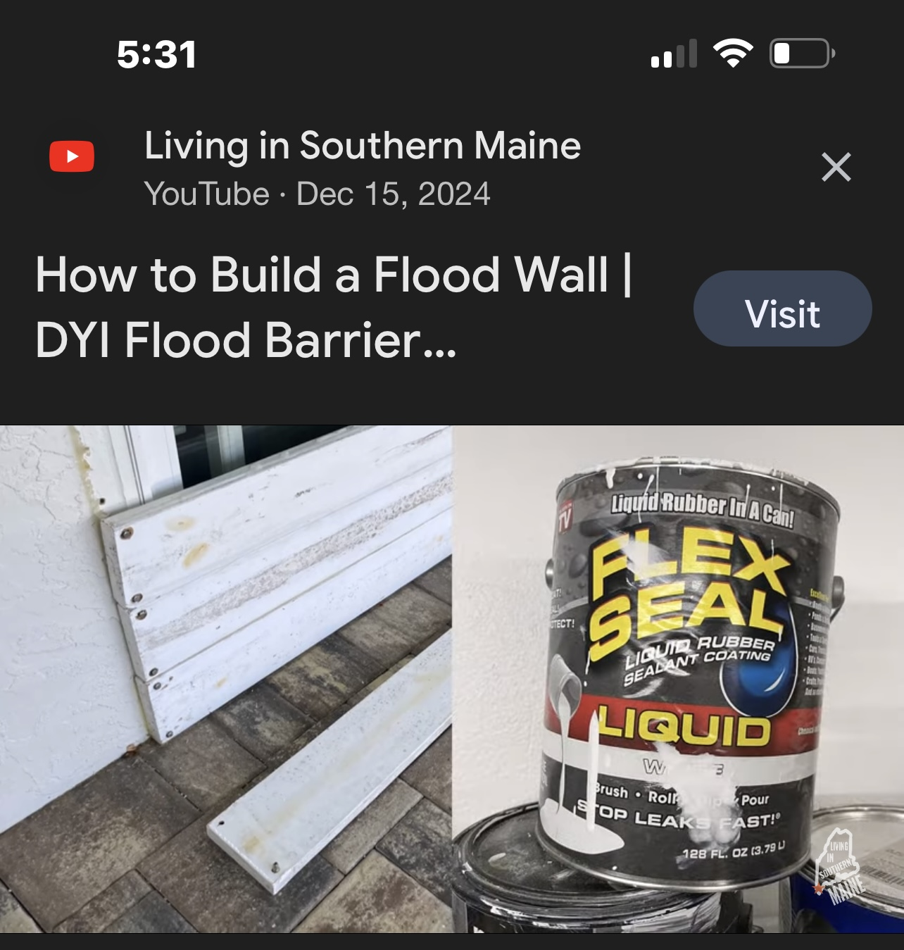
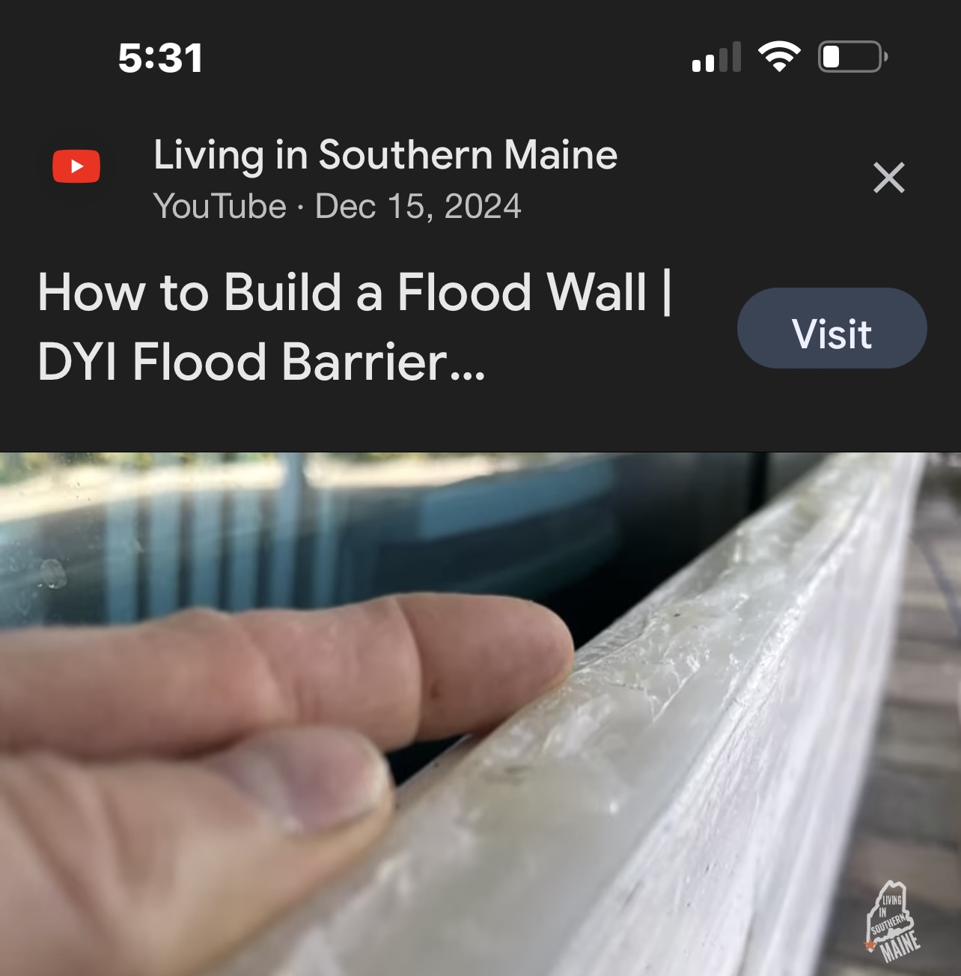
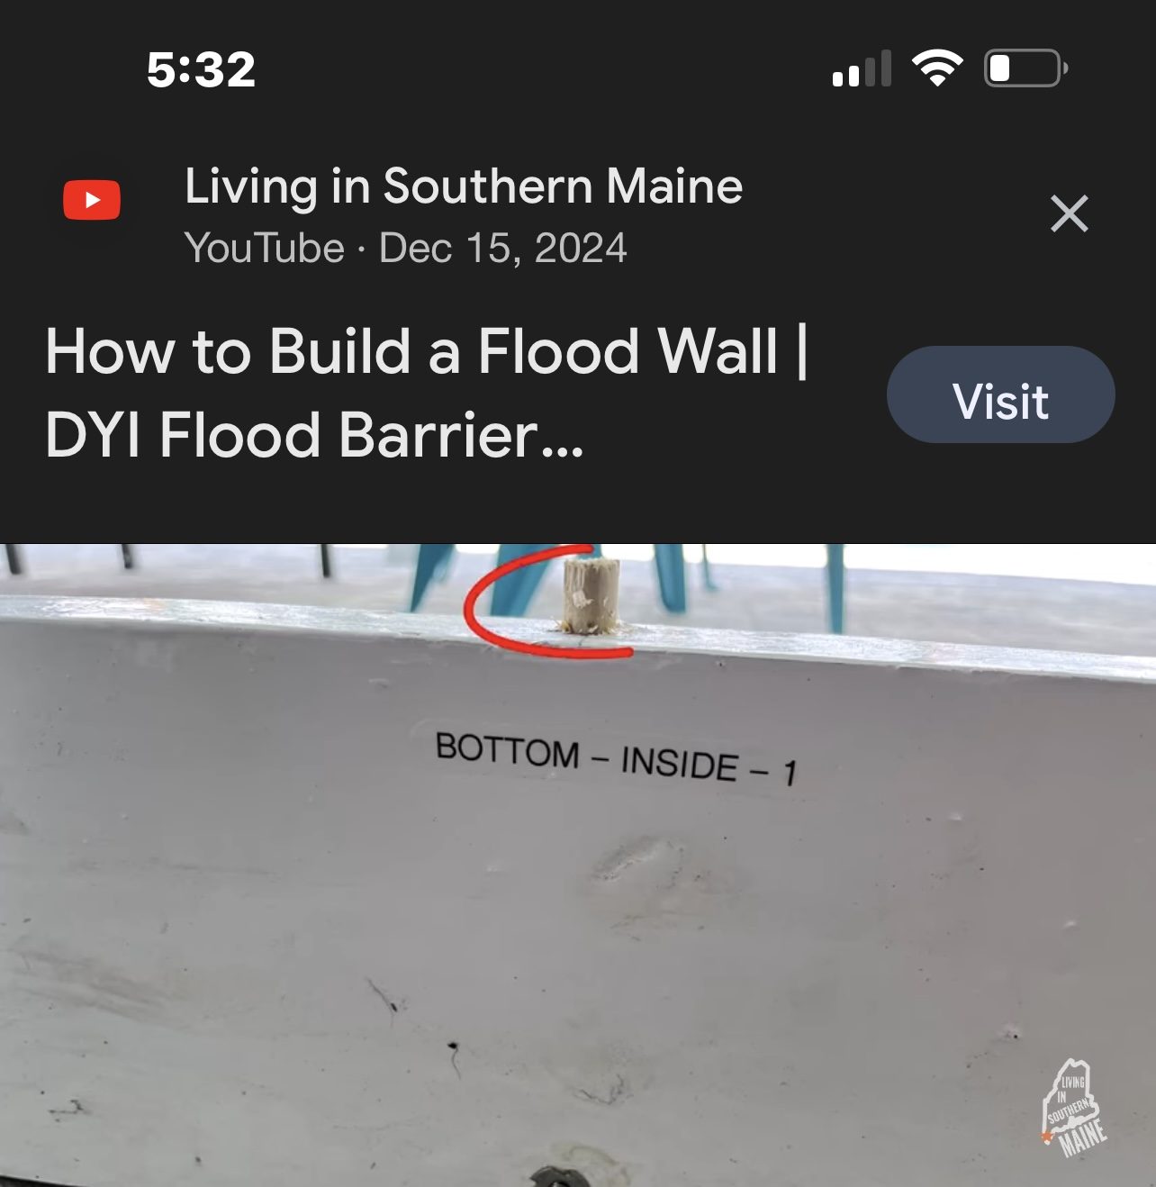
DYI Flood Wall, caulk between boards, connect with dowl rods; visit Living in Southern Maine YouTube

Slide 9
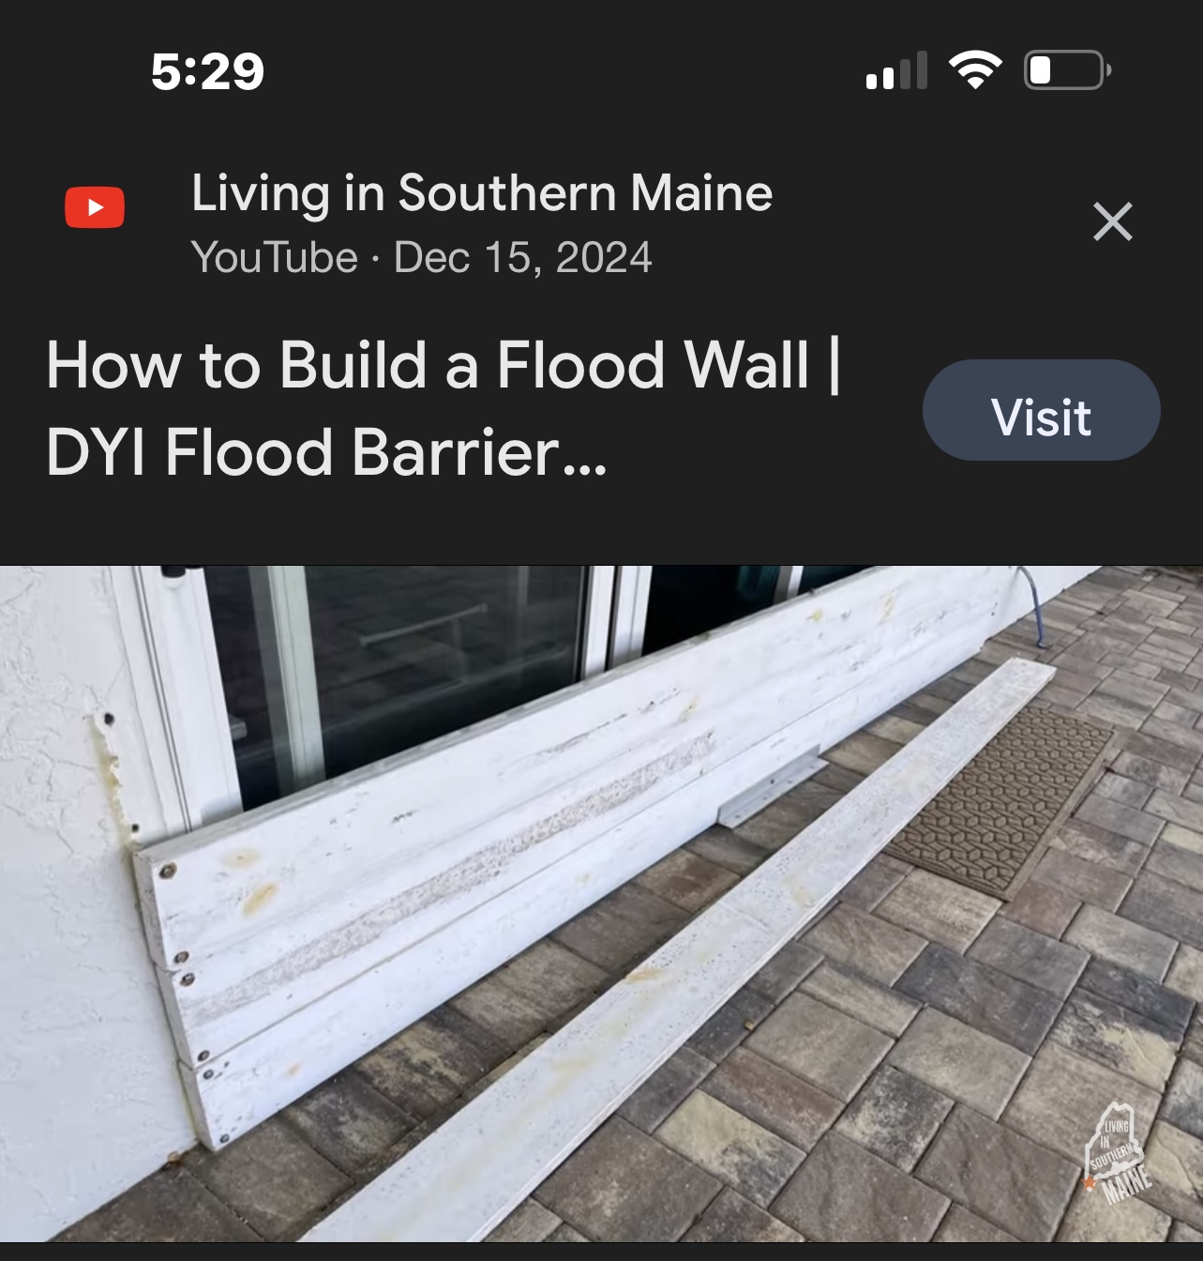
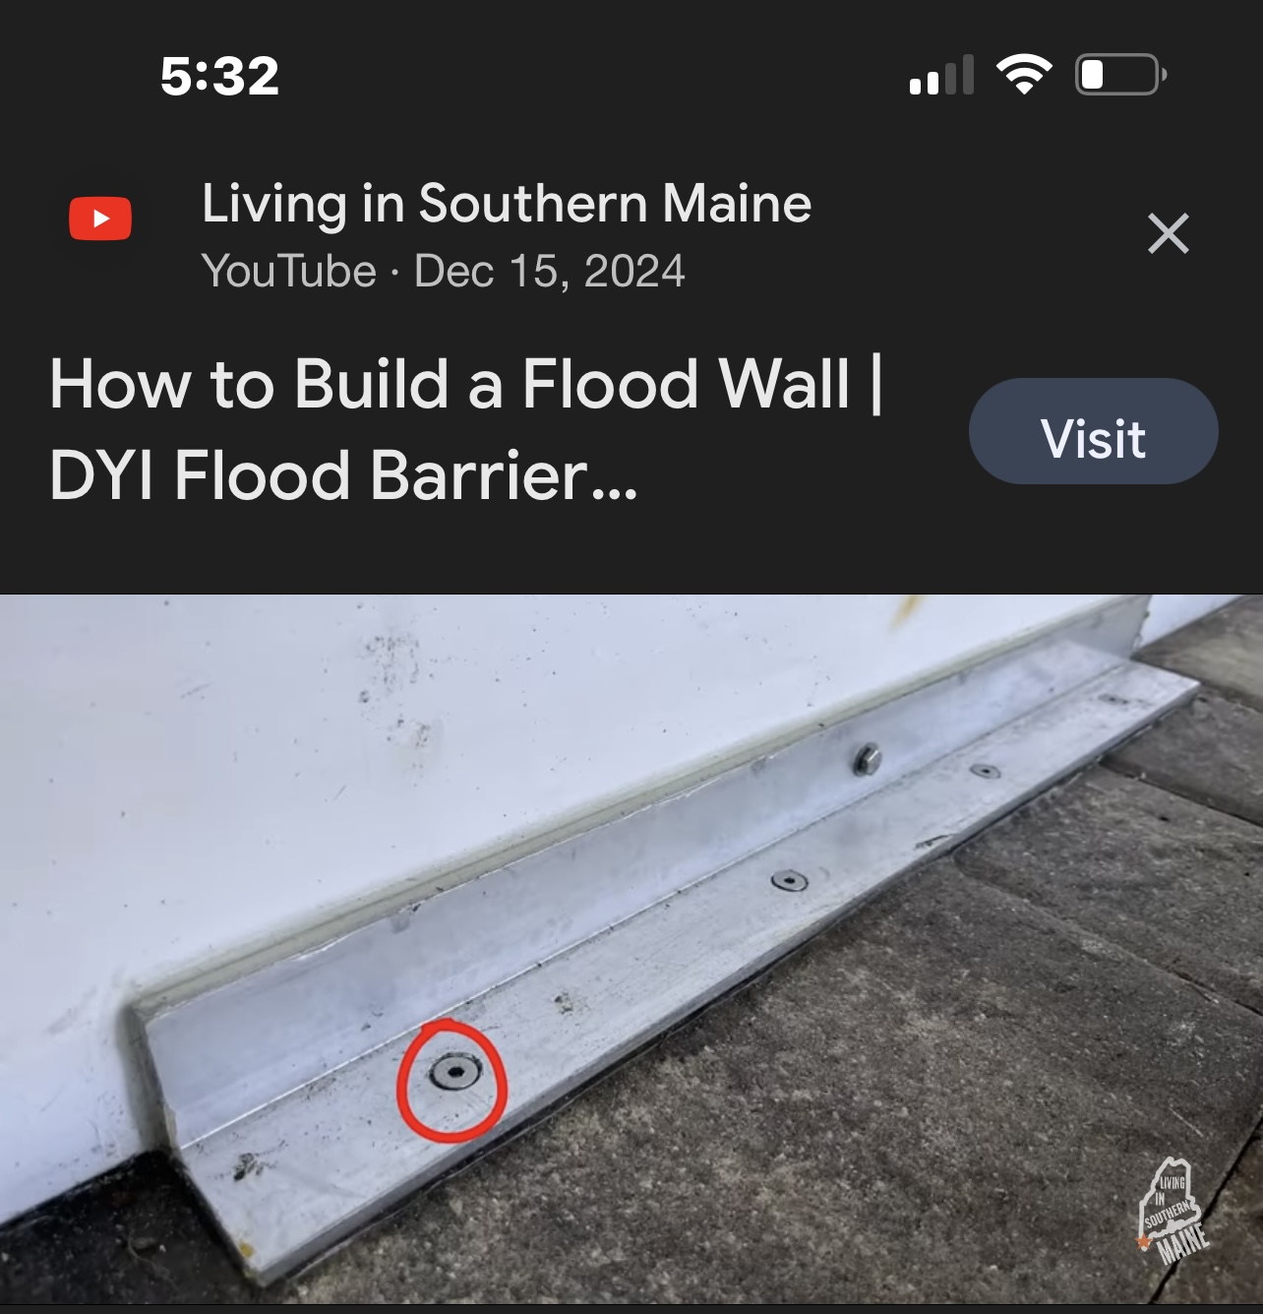
DYI Flood Barrier, attach to wood and reinforce boards

Slide 10
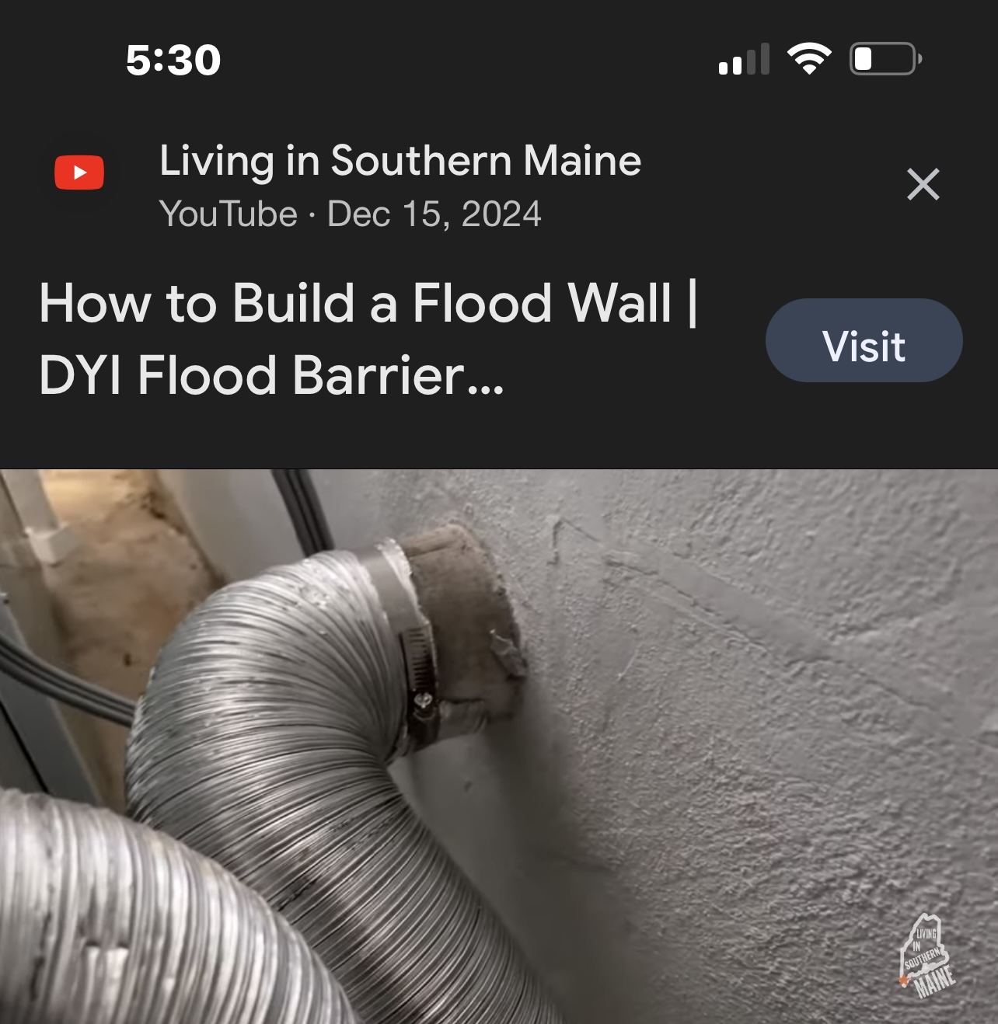
Make sure to caulk any openings

Slide 11
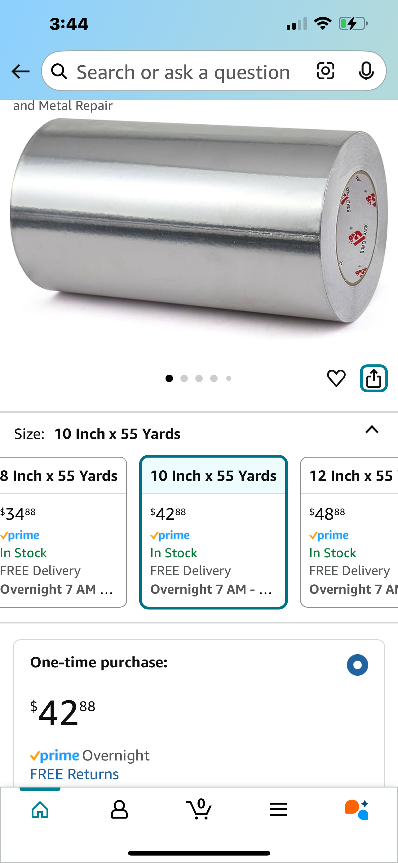
Another option
Aluminum tape
Neighbor created tight seals around patio doors using 2 inch aluminum (same as used on airplanes) tape with some caulk
Water was significantly higher than bottom of the door
No water entered the house

Slide 12
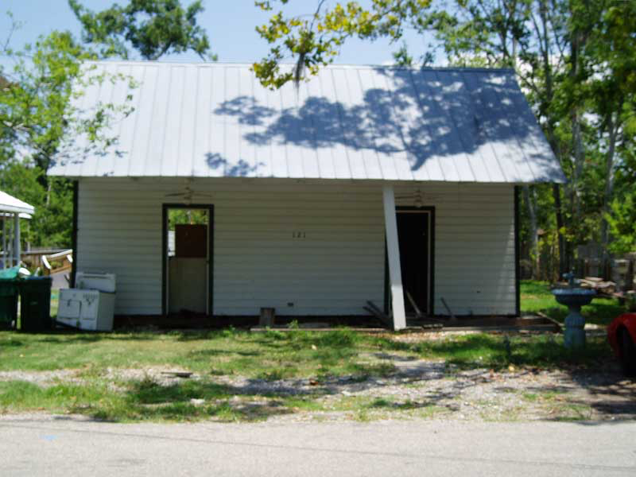
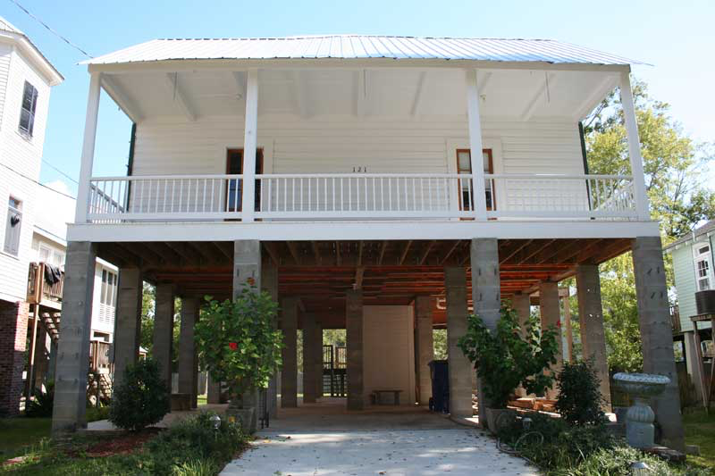
The only way to receive a discount from FEMA is to elevate your house:
Example of Raised Slab House

Slide 13
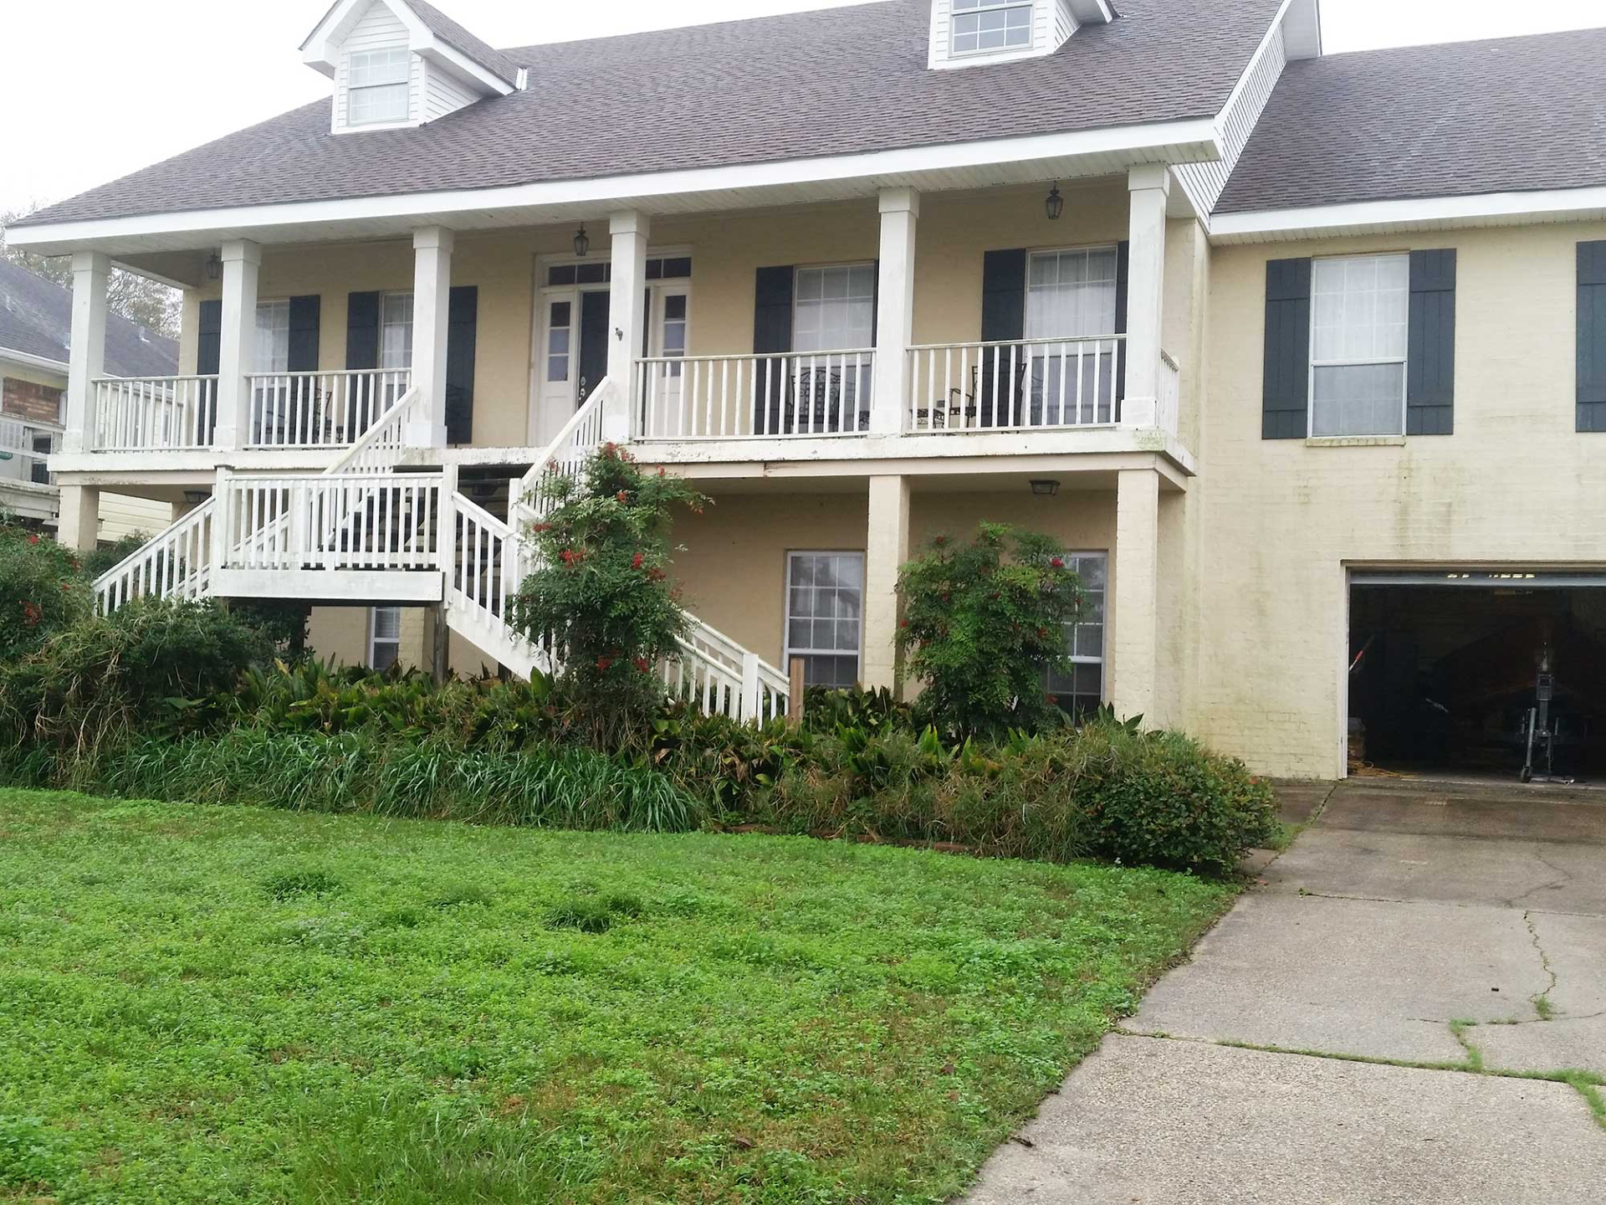
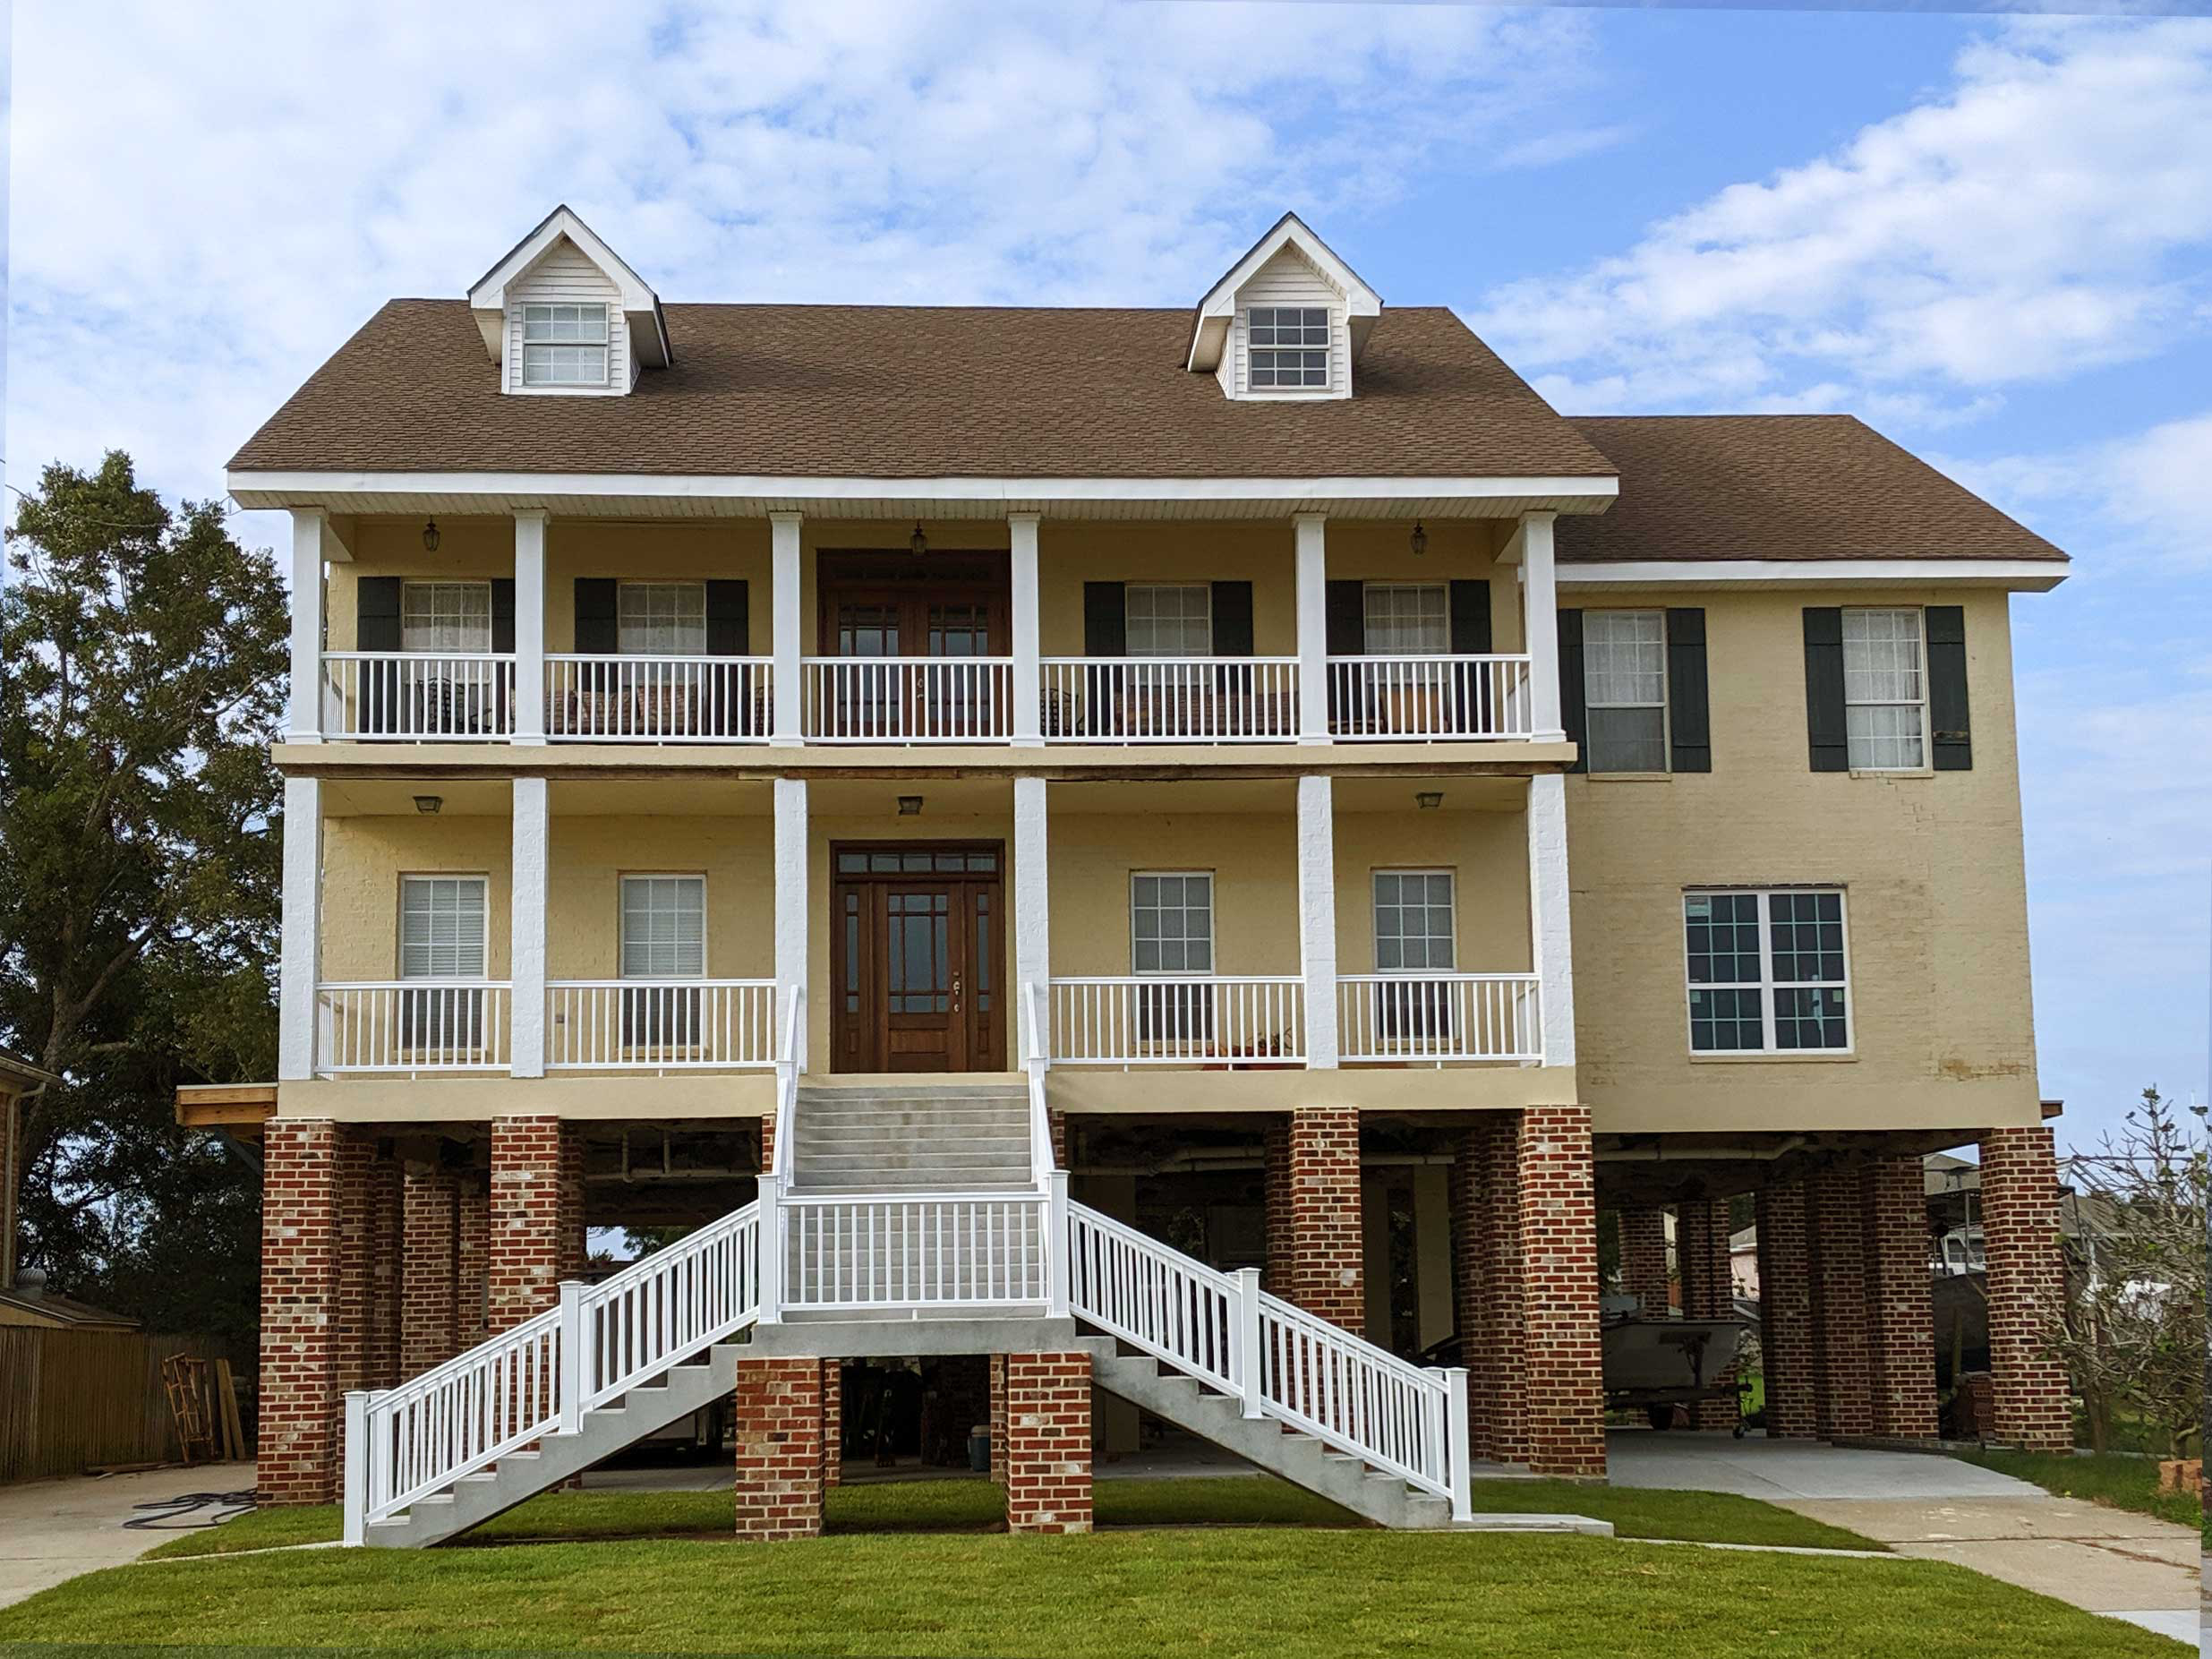
Another Raised Slab House

Slide 14
Final Thoughts
Group IO significantly helped with communication immediately after the storm. You have to sign up to join. Please just request by email.
Elevate Florida grant is for both wind mitigation home improvements and also elevation for storm surge; funds are also available for tear down of damaged structures. This grant will not reimburse for work already done.
Elevate Florida is only for US residents, grant applications close April 11, 2025

