Slide 1
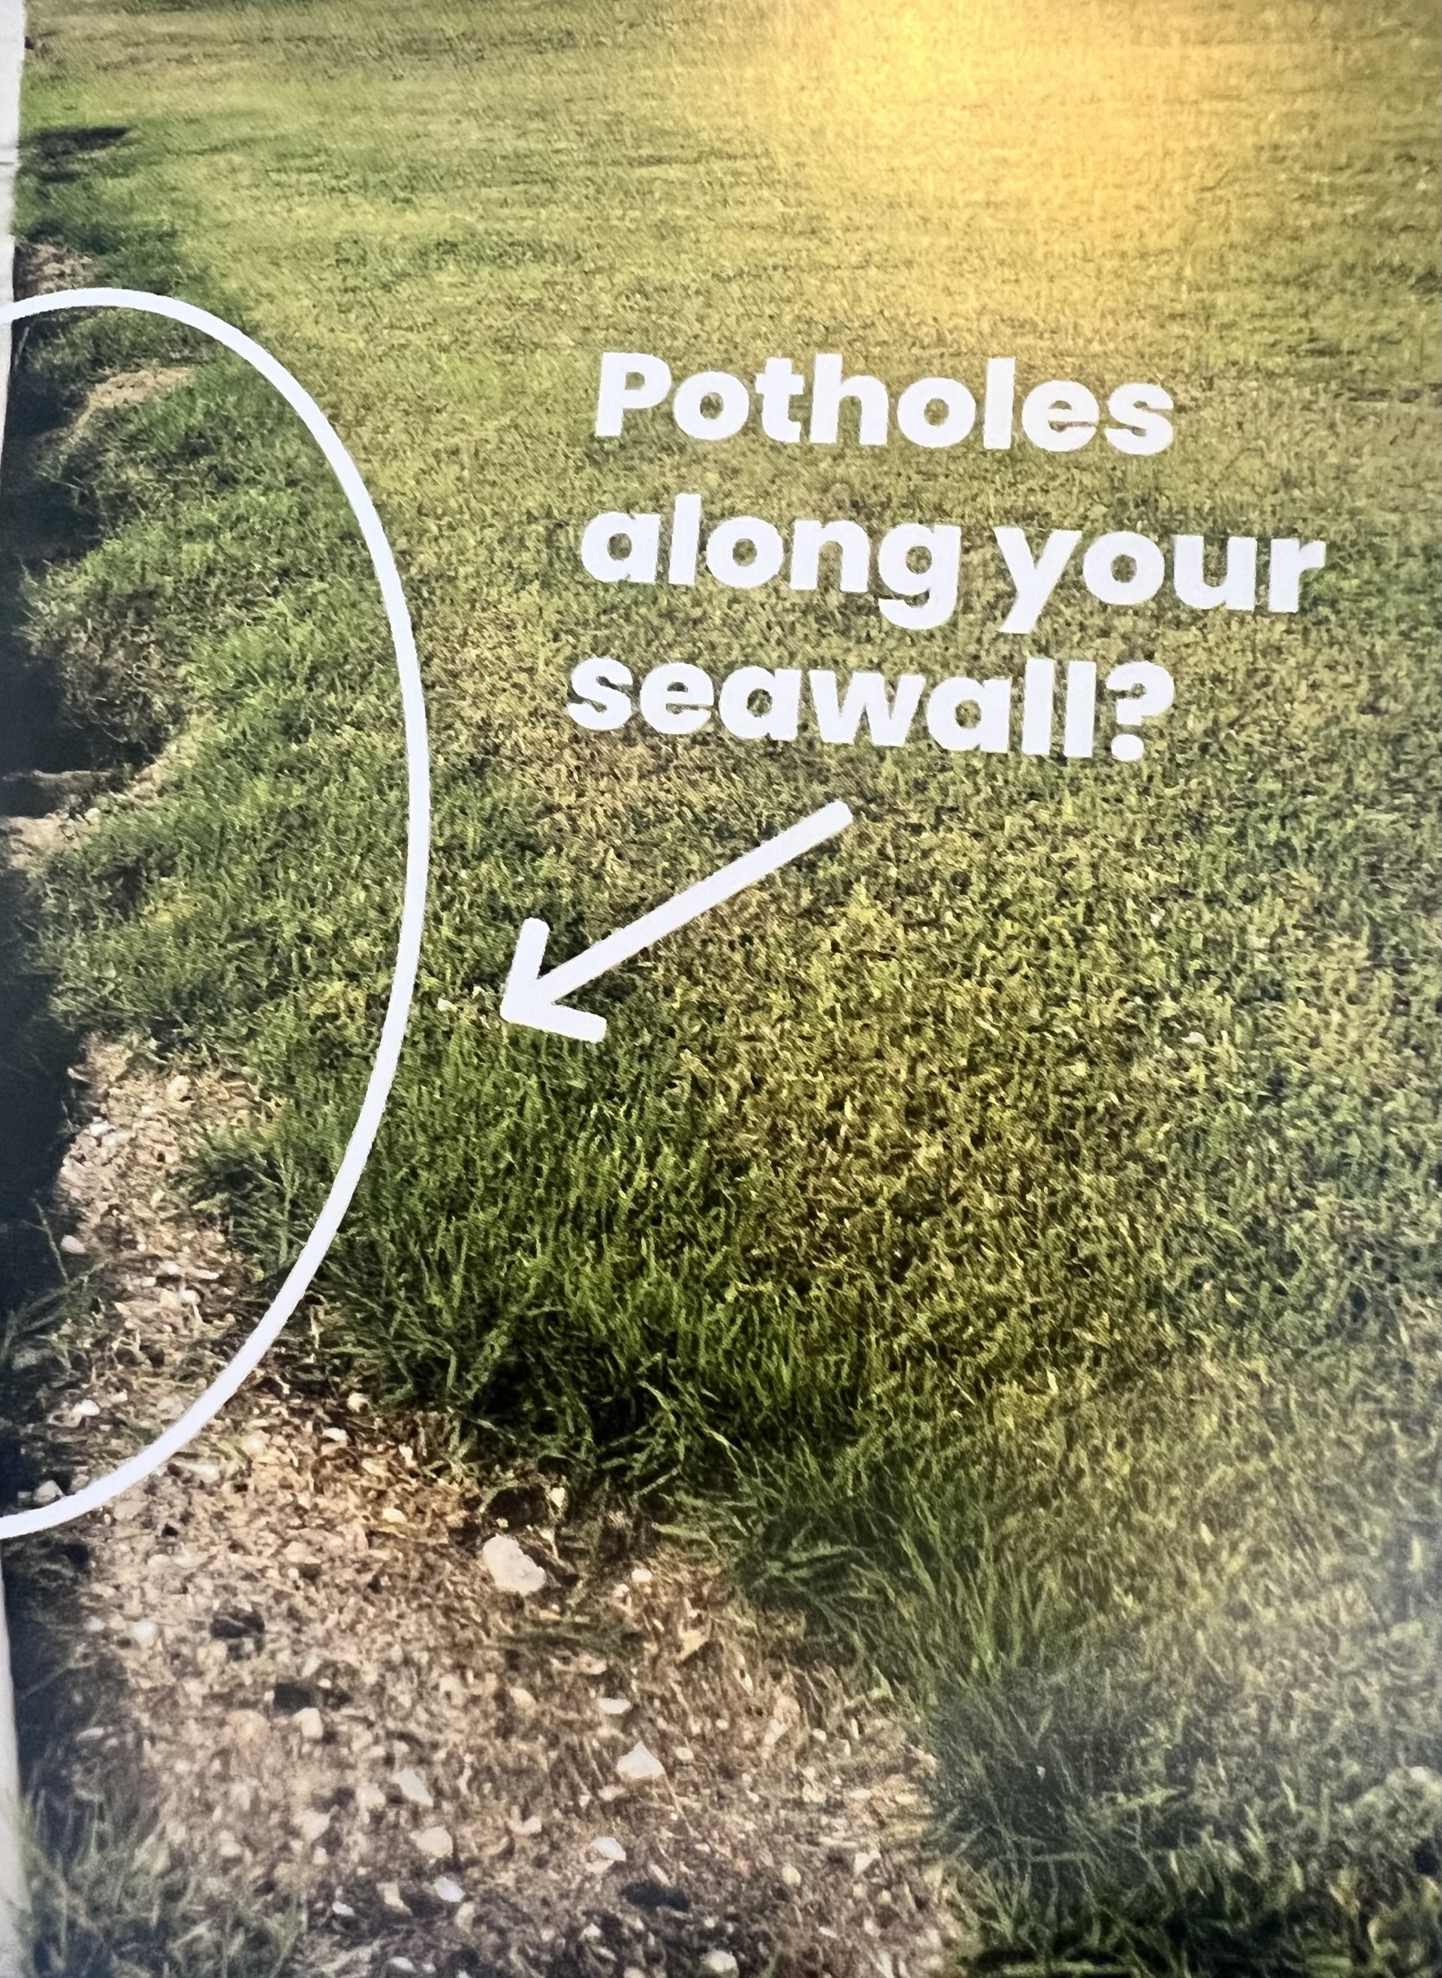
SEAWALL VOIDS
Seawalls are not meant to function as dams, but rather to retain dirt.
John Derr
Charlotte County Emergency Coordinator from 1977 to 1987
Since 1977 uses 1 Inch limestone from Butwell Stone ($5 per bag)as voids develop
John’s seawall is 3.21 MSL, House 6.1 MSL; Milton 7 ft flood. Water flowed from gated community as well as rising from the canal.

Slide 2
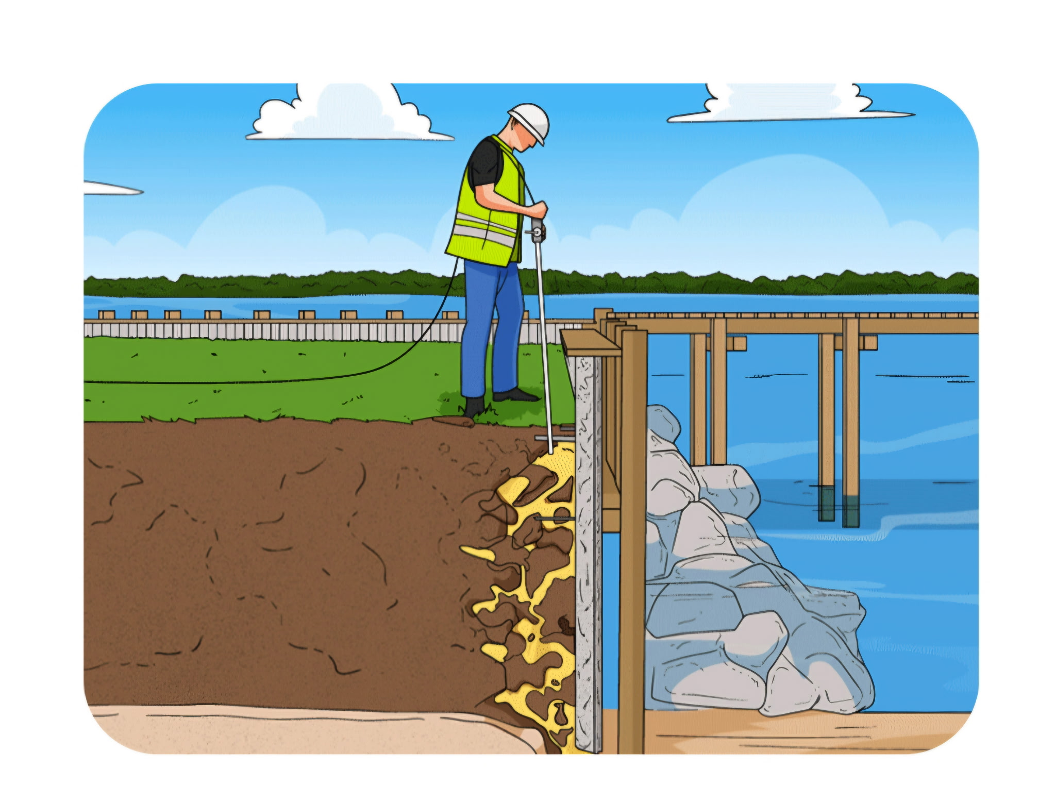
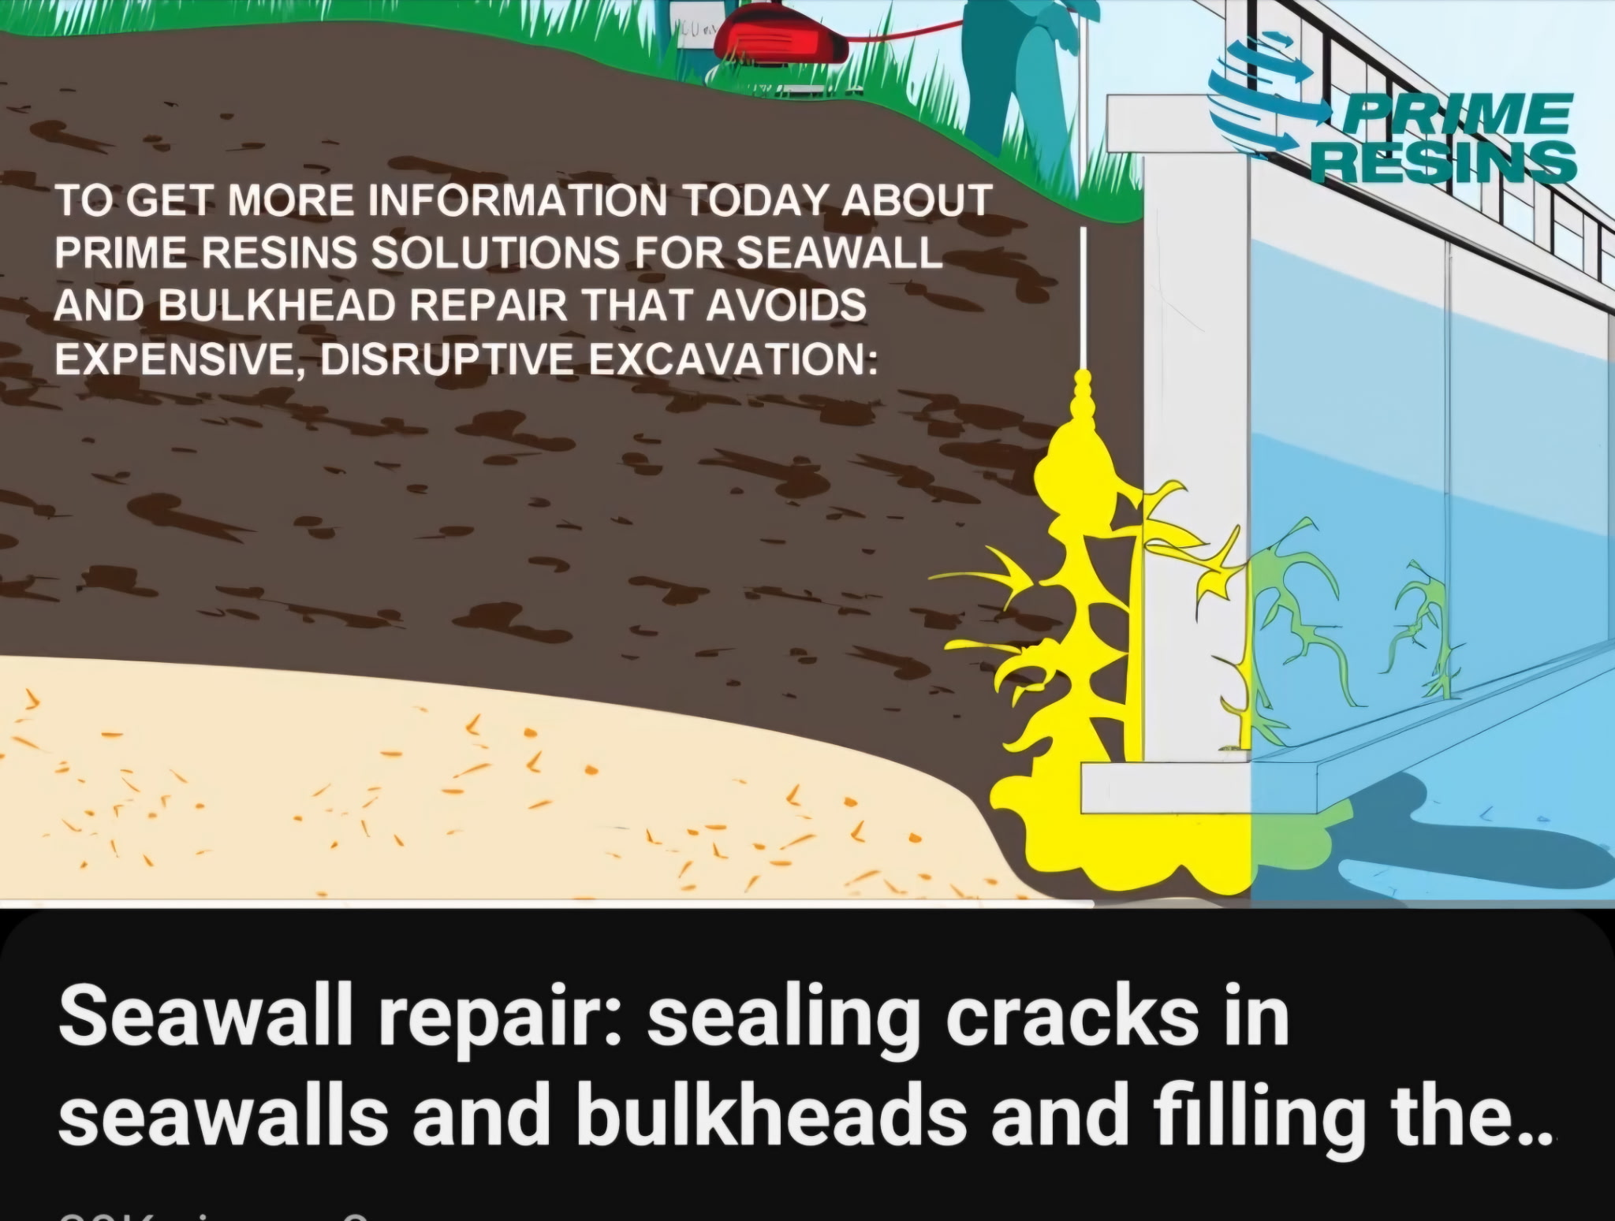
SEAWALL VOIDS, professional resin is APX. $8,000

Slide 3
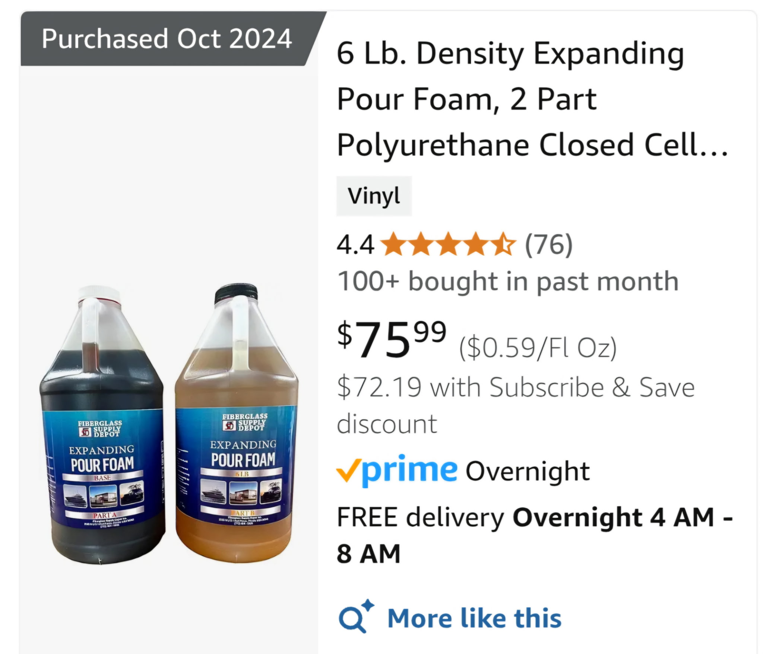
SEAWALL VOIDS
Ralph Thomson: Used a contractor to fill ten holes with resin.
Voids continue to spread over time
Found this foam on Amazon
Uses it to fill any additional voids

Slide 4
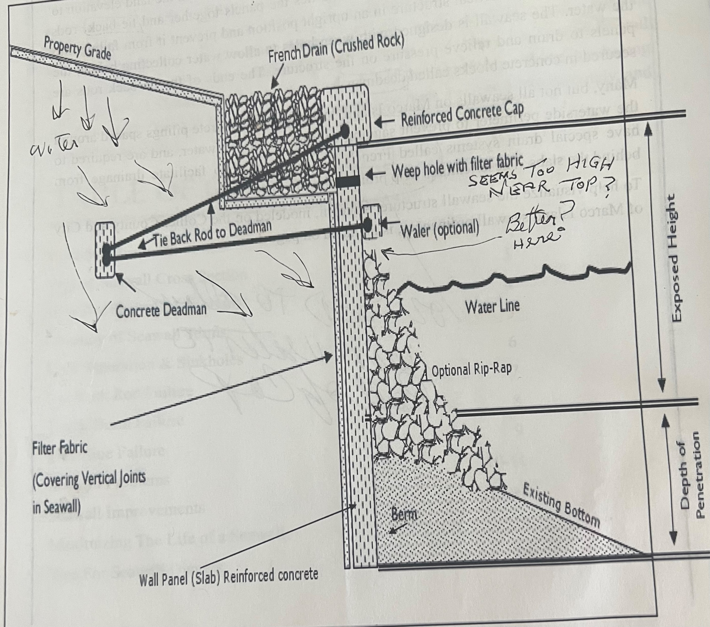
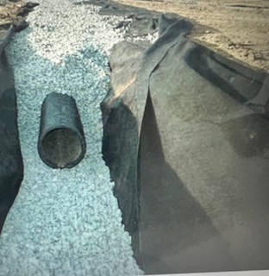
Another option: GEOTEXTILE FABRIC FOR SEAWALL VOIDS, can include tiebacks

Slide 5
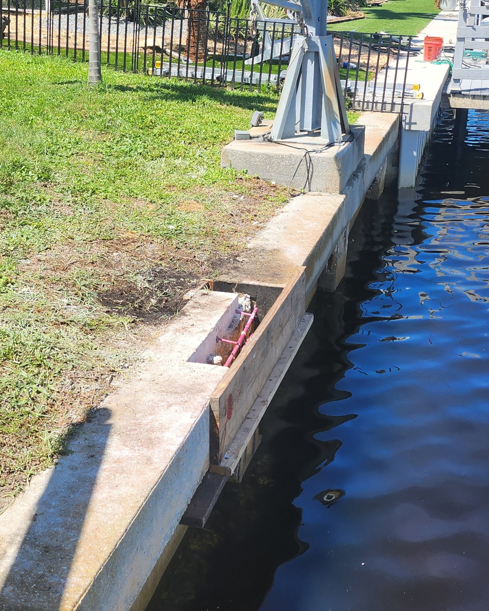
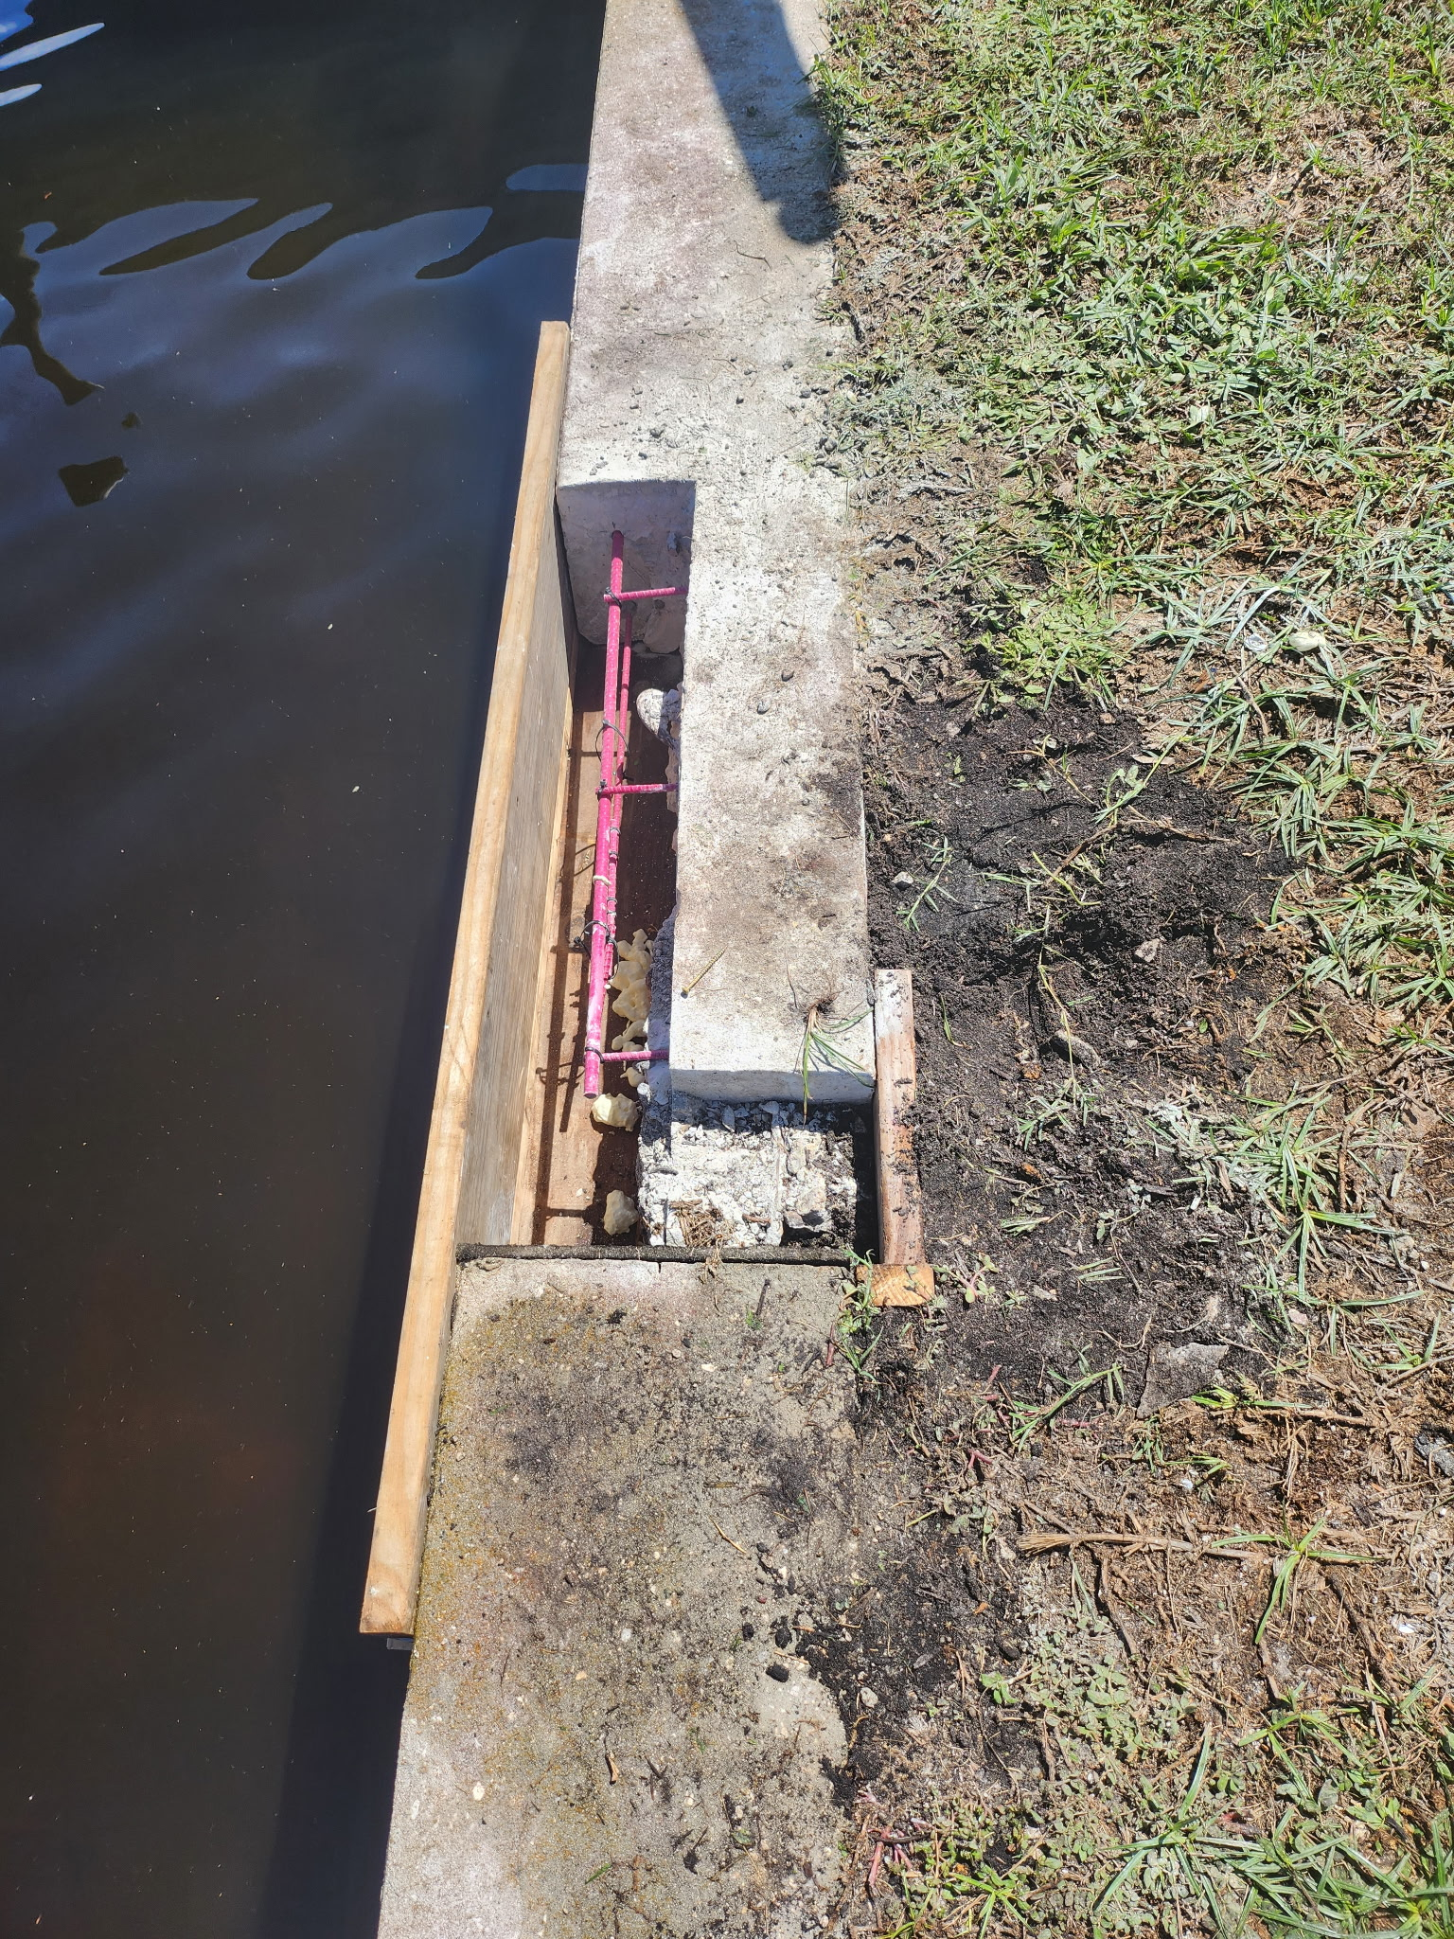
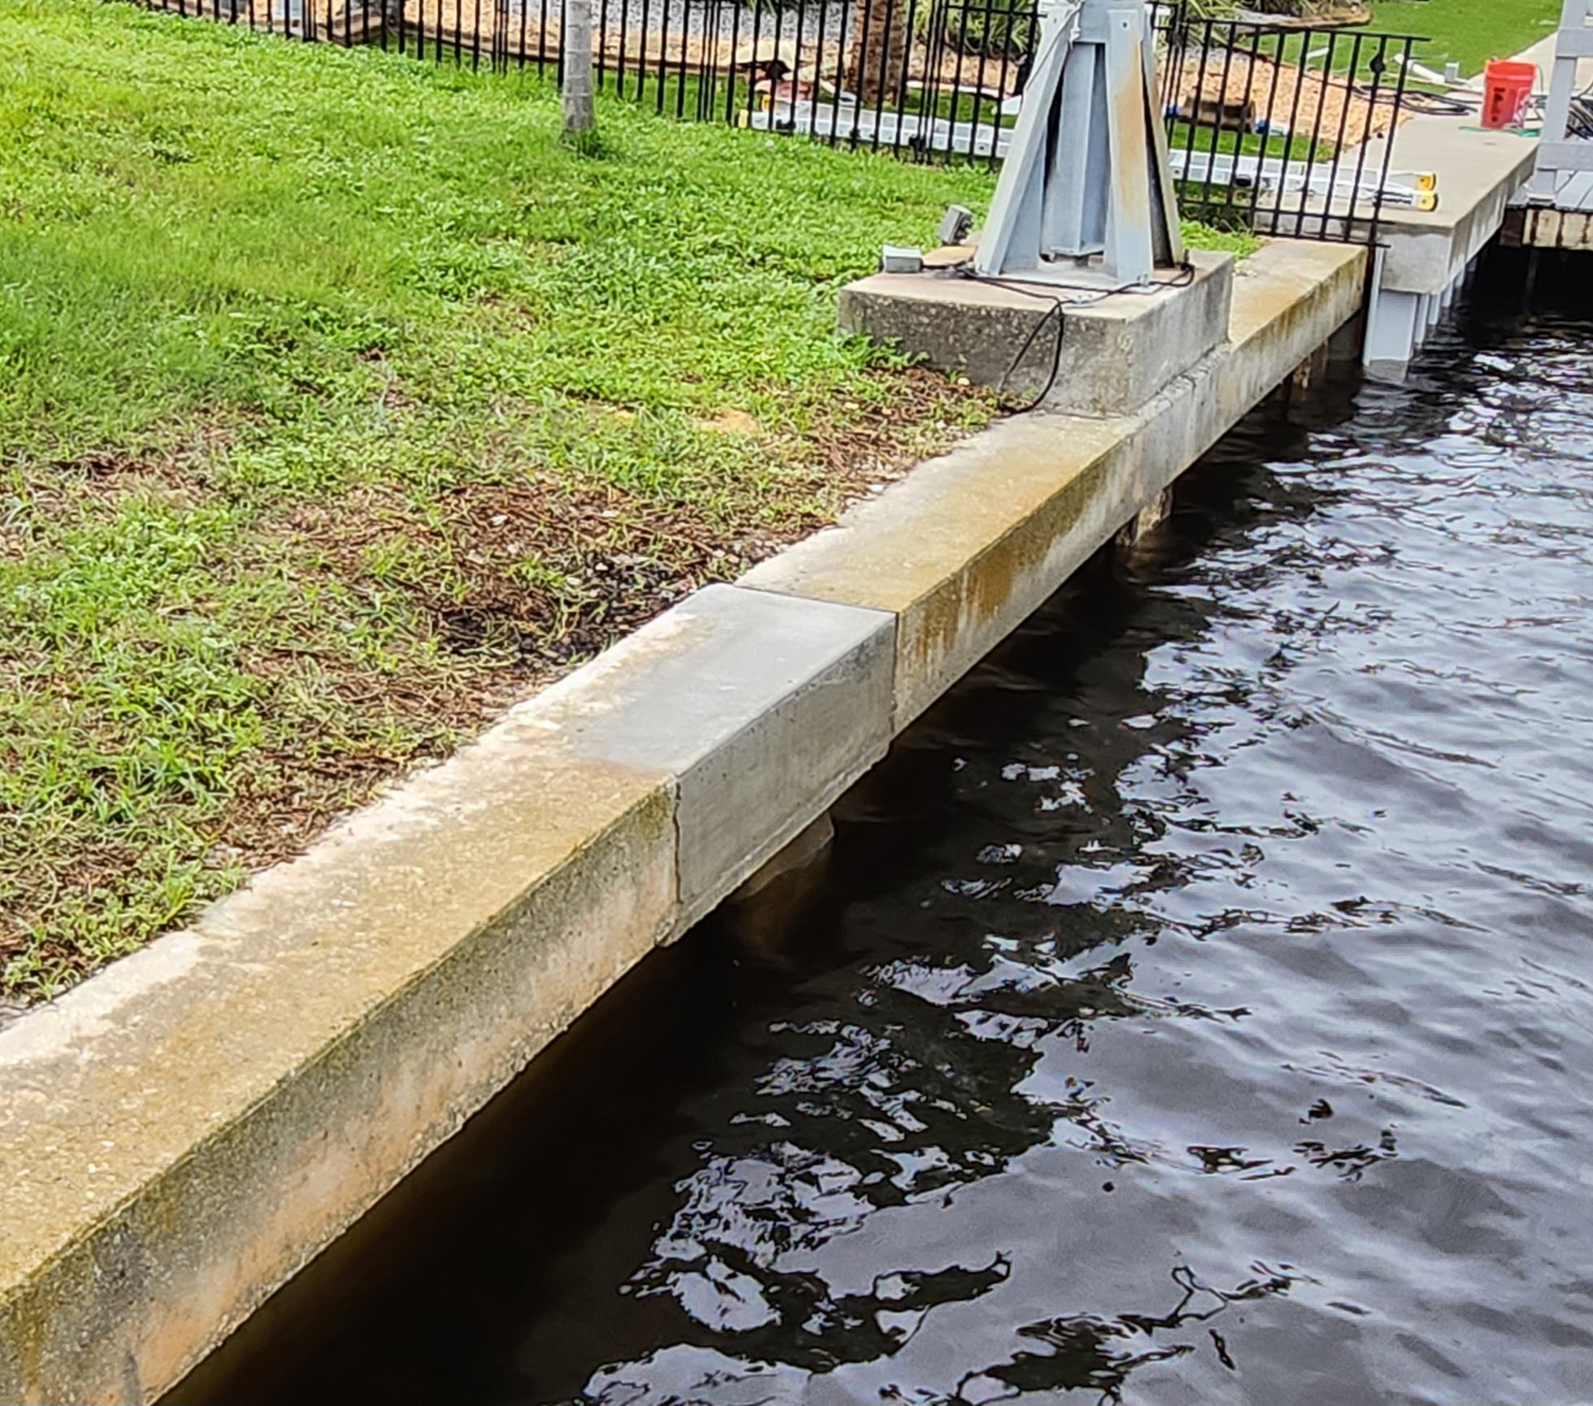
SEAWALL CAP REPAIR discounted from $2,000 to $1,500 because another neighbor had a repair at the same time. Repairs were arranged by Jay at Florida Seawall (239) 994-7551.

Slide 6
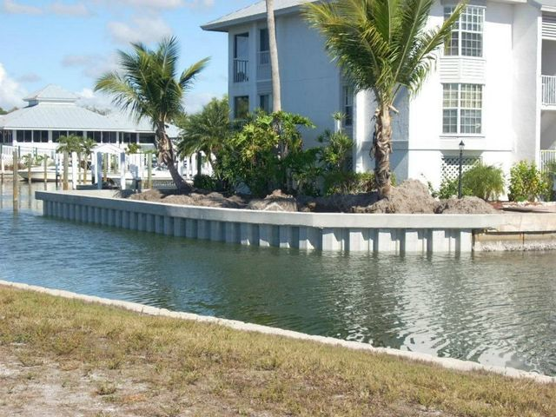
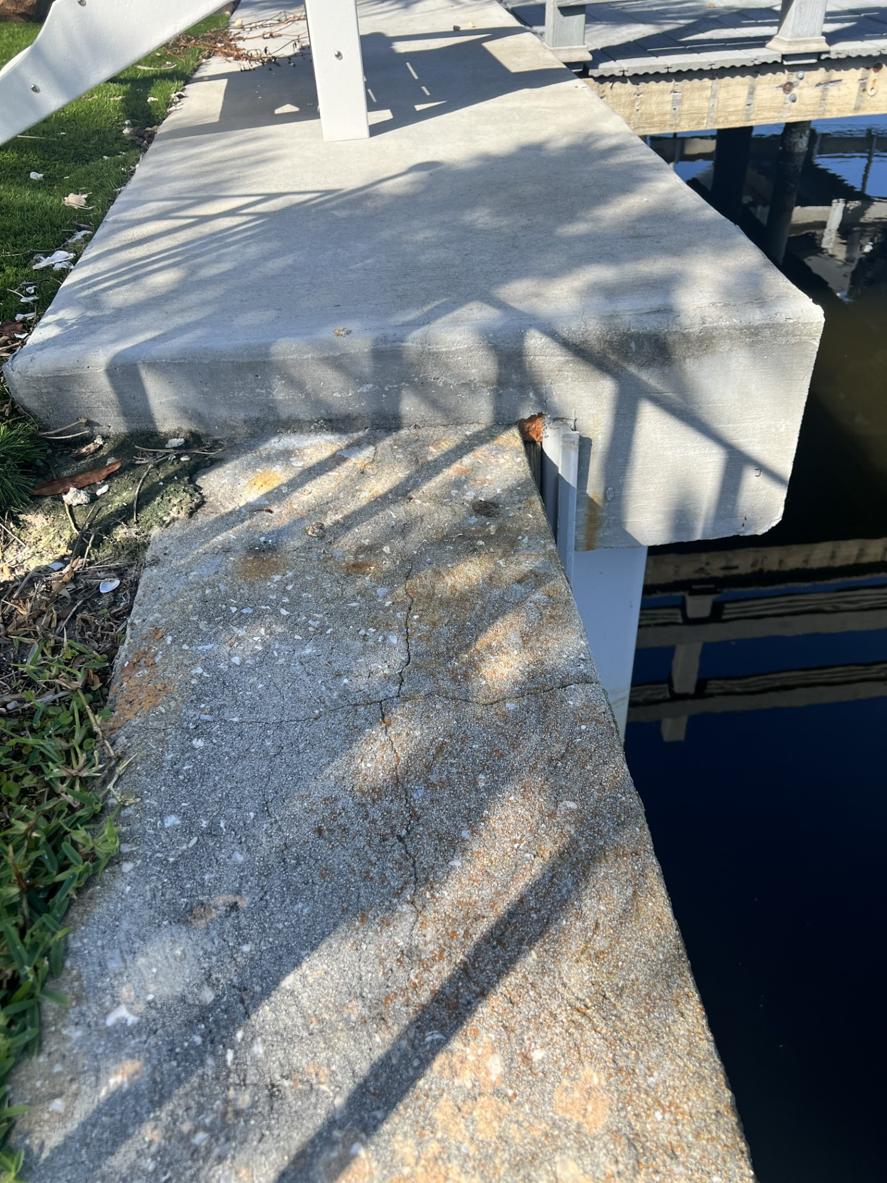
NEW SEAWALL CAP
New seawall cap costs $45 to $100/ft
New seawall cap adds height, width and new tiebacks

