Slide 1
Celebrating Billy’s 13th Birthday
Join Us Saturday January 1st 2018
From 4:30 pm - 6:30 pm
1234 Gaming way
Colton, Ca 92324
RSVP: 123-456-7890
Mobile Video Game Truck Party
www.advancedvideogames.com

Slide 2
Celebrating Billy’s 13th Birthday
Join Us Saturday January 1st 2018
From 4:30 pm - 6:30 pm
1234 Gaming way
Colton, Ca 92324
RSVP: 123-456-7890
Mobile Video Game Truck Party
www.advancedvideogames.com

Slide 3
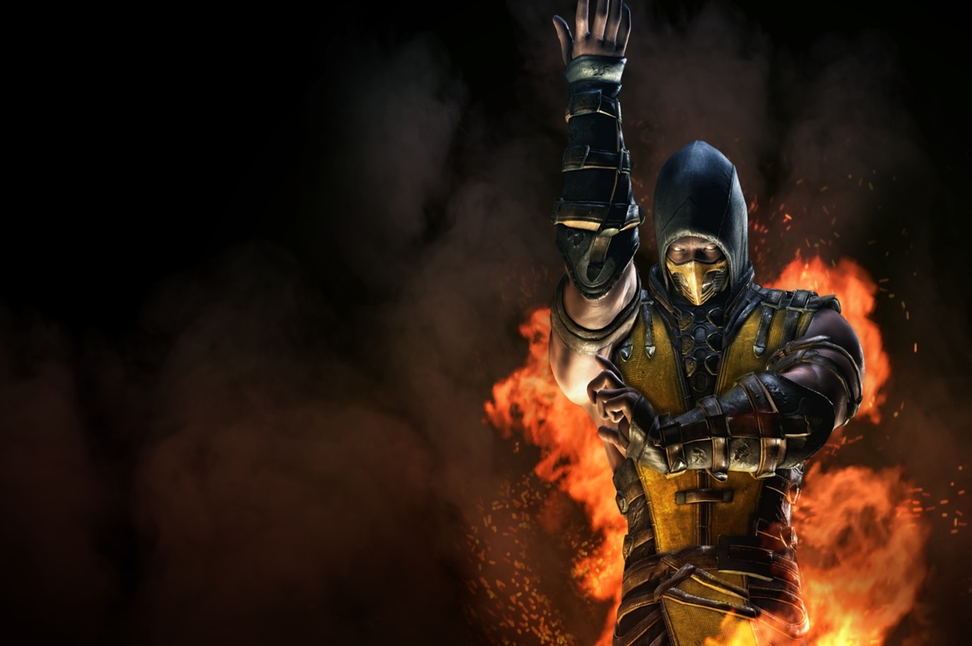
Celebrating Billy’s 13th Birthday
Join Us Saturday January 1st 2018
From 4:30 pm - 6:30 pm
1234 Gaming way
Colton, Ca 92324
RSVP: 123-456-7890
Mobile Video Game Truck Party
www.advancedvideogames.com

Slide 4
Celebrating Billy’s 13th Birthday
Join Us Saturday January 1st 2018
From 4:30 pm - 6:30 pm
1234 Gaming way
Colton, Ca 92324
RSVP: 123-456-7890
Mobile Video Game Truck Party
www.advancedvideogames.com

Slide 5
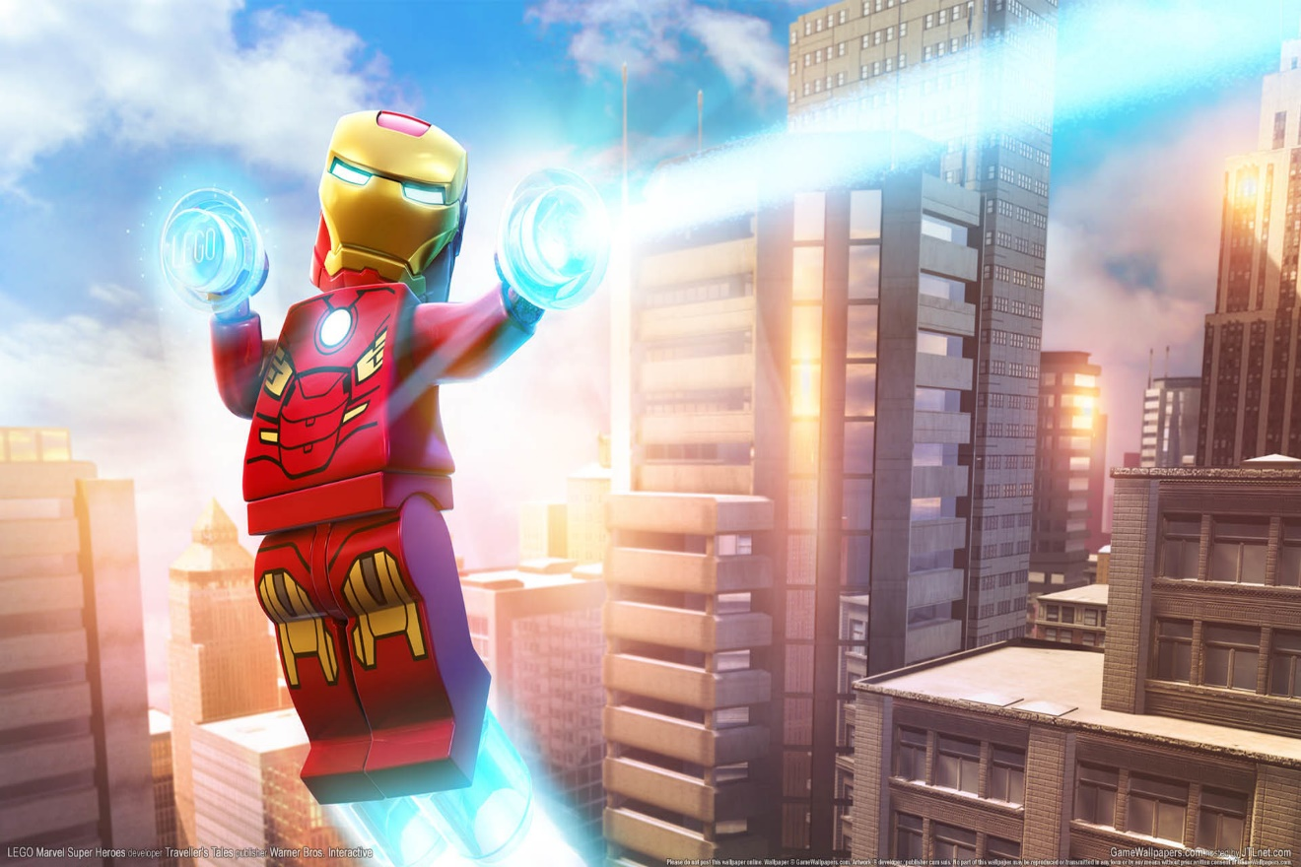
Celebrating Billy’s 13th Birthday
Join Us Saturday January 1st 2018
From 4:30 pm - 6:30 pm
1234 Gaming way
Colton, Ca 92324
RSVP: 123-456-7890
Mobile Video Game Truck Party
www.advancedvideogames.com

Slide 6
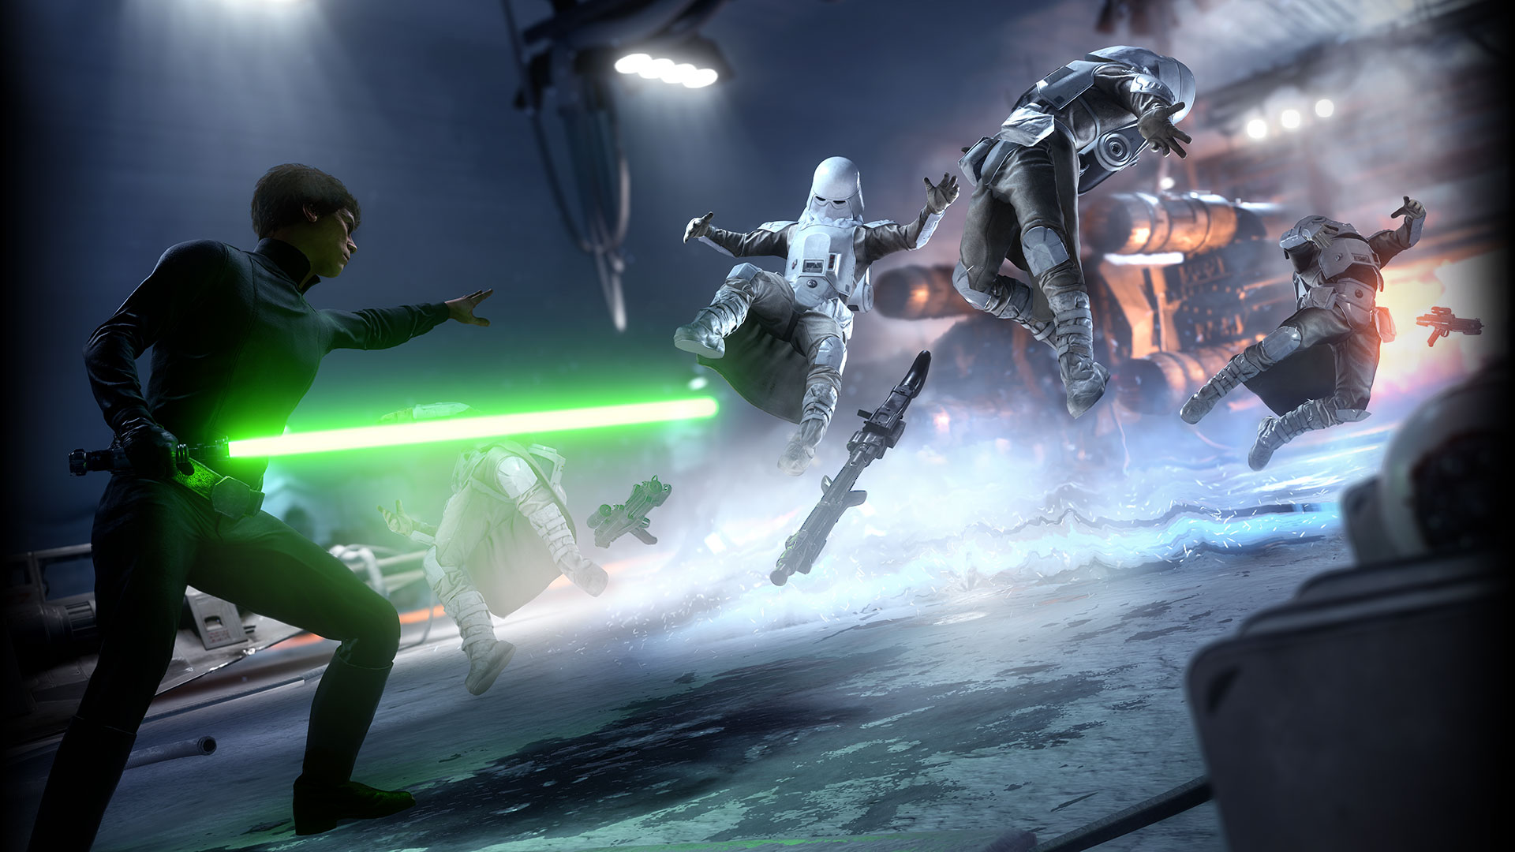
Celebrating Billy’s 13th Birthday
Join Us Saturday January 1st 2018
From 4:30 pm - 6:30 pm
1234 Gaming way
Colton, Ca 92324
RSVP: 123-456-7890
Mobile Video Game Truck Party
www.advancedvideogames.com

Slide 7
Celebrating Billy’s 13th Birthday
Join Us Saturday January 1st 2018
From 4:30 pm - 6:30 pm
1234 Gaming way
Colton, Ca 92324
RSVP: 123-456-7890
Mobile Video Game Truck Party
www.advancedvideogames.com

Slide 8
Celebrating Billy’s 13th Birthday
Join Us Saturday January 1st 2018
From 4:30 pm - 6:30 pm
1234 Gaming way
Colton, Ca 92324
RSVP: 123-456-7890
Mobile Video Game Truck Party
www.advancedvideogames.com

Slide 9
Celebrating Billy’s 13th Birthday
Join Us Saturday January 1st 2018
From 4:30 pm - 6:30 pm
1234 Gaming way
Colton, Ca 92324
RSVP: 123-456-7890
Mobile Video Game Truck Party
www.advancedvideogames.com

Slide 10
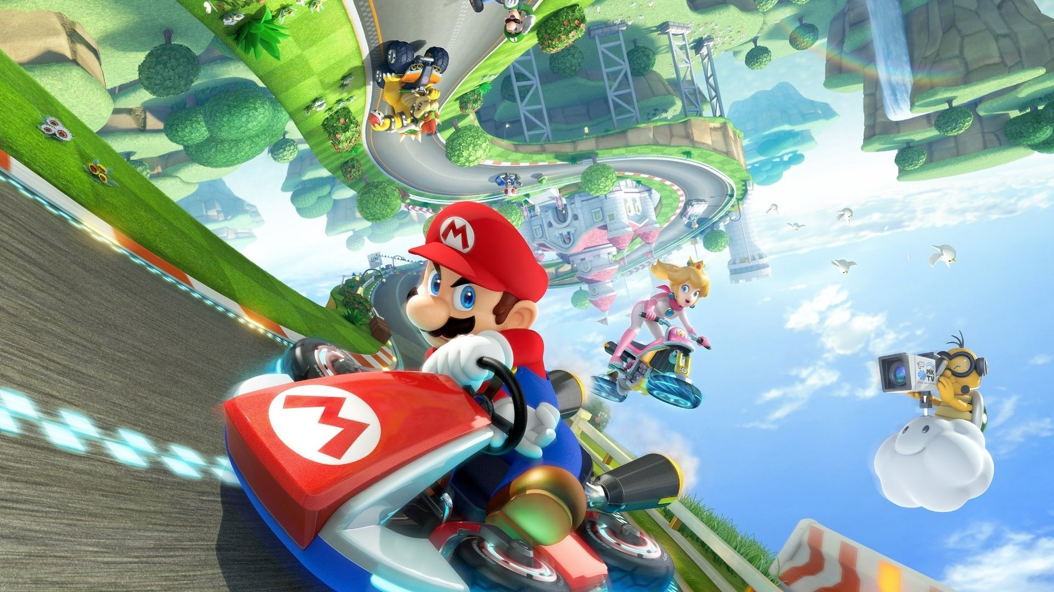
Celebrating Billy’s 13th Birthday
Join Us Saturday January 1st 2018
From 4:30 pm - 6:30 pm
1234 Gaming way
Colton, Ca 92324
RSVP: 123-456-7890
Mobile Video Game Truck Party
www.advancedvideogames.com

Slide 11
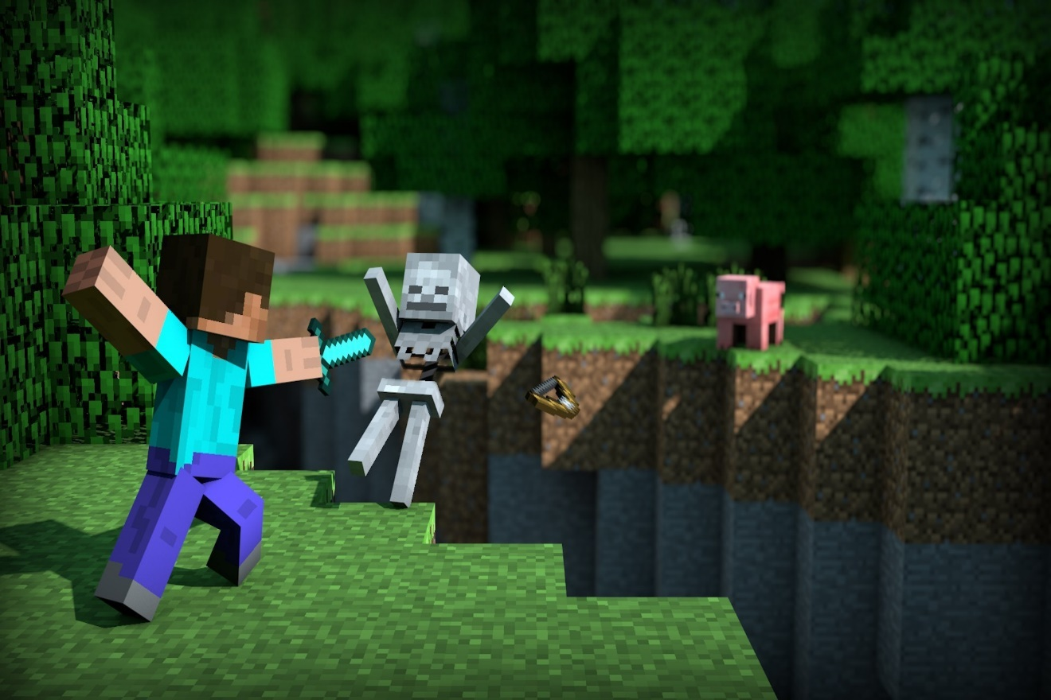
Celebrating Billy’s 13th Birthday
Join Us Saturday January 1st 2018
From 4:30 pm - 6:30 pm
1234 Gaming way
Colton, Ca 92324
RSVP: 123-456-7890
Mobile Video Game Truck Party
www.advancedvideogames.com

Slide 12
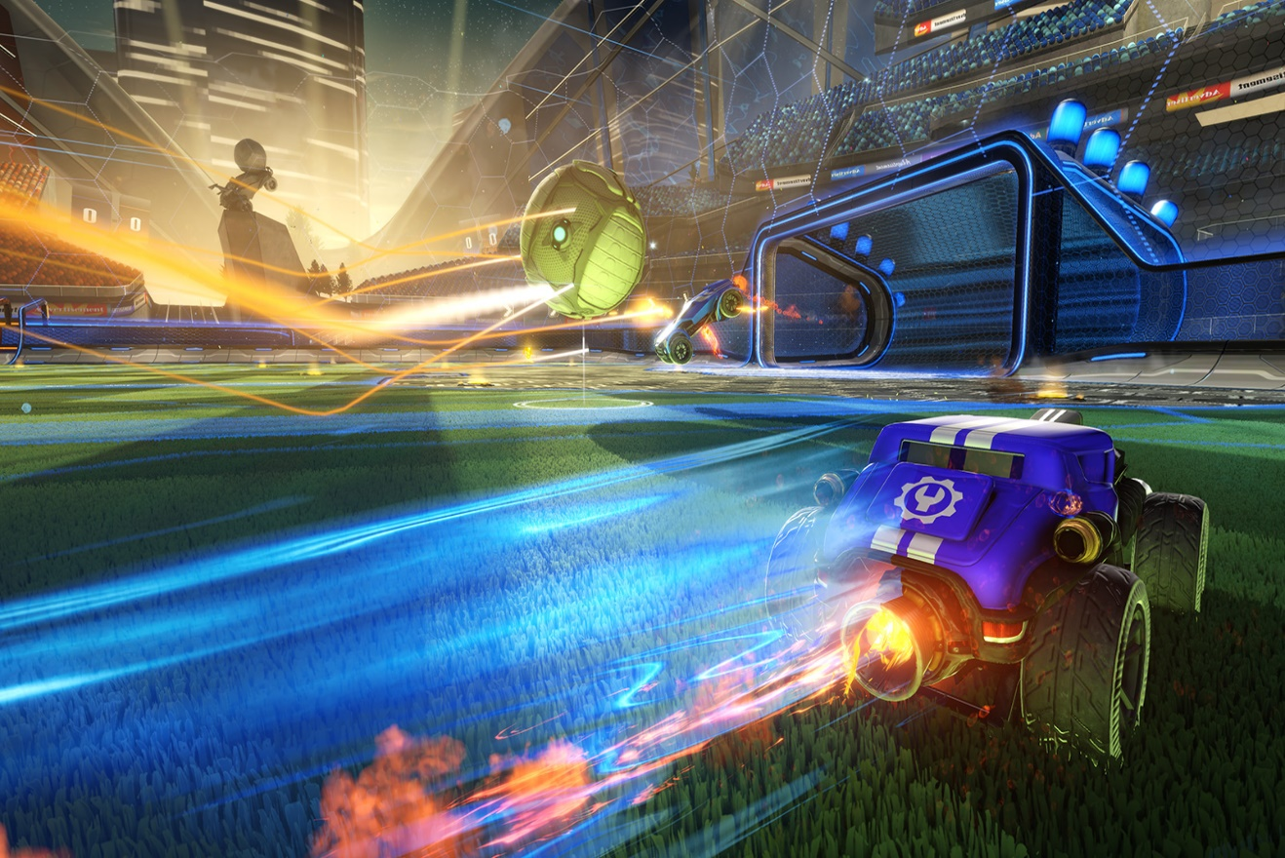
Celebrating Billy’s 13th Birthday
Join Us Saturday January 1st 2018
From 4:30 pm - 6:30 pm
1234 Gaming way
Colton, Ca 92324
RSVP: 123-456-7890
Mobile Video Game Truck Party
www.advancedvideogames.com

Slide 13
Celebrating Billy’s 13th Birthday
Join Us Saturday January 1st 2018
From 4:30 pm - 6:30 pm
1234 Gaming way
Colton, Ca 92324
RSVP: 123-456-7890
Mobile Video Game Truck Party
www.advancedvideogames.com

Slide 14
Join Us Saturday January 1st 2018
From 4:30 pm - 6:30 pm
1234 Gaming way
Colton, Ca 92324
RSVP: 123-456-7890
Celebrating Billy’s 13th Birthday
Mobile Video Game Truck Party
www.advancedvideogames.com

Slide 15
Celebrating Aleyna’s 13th Birthday
Join Us Saturday January 1st 2018
From 4:30 pm - 6:30 pm
1234 Gaming way
Colton, Ca 92324
RSVP: 123-456-7890
Mobile Video Game Truck Party
www.advancedvideogames.com

Slide 16
Celebrating Billy’s 13th Birthday
Join Us Saturday January 1st 2018
From 4:30 pm - 6:30 pm
1234 Gaming way
Colton, Ca 92324
RSVP: 123-456-7890
Mobile Video Laser Tag Party
www.advancedvideogames.com

Slide 17
Celebrating Billy’s 13th Birthday
Join Us Saturday January 1st 2018
From 4:30 pm - 6:30 pm
1234 Gaming way
Colton, Ca 92324
RSVP: 123-456-7890
Mobile Video Laser Tag Party
www.advancedvideogames.com

Slide 18
Celebrating Billy’s 13th Birthday
Join Us Saturday January 1st 2018
From 4:30 pm - 6:30 pm
1234 Gaming way
Colton, Ca 92324
RSVP: 123-456-7890
Mobile Video Laser Tag Party
www.advancedvideogames.com

