Slide 1
WSDOT Megaprograms Overview
2021 Regional Contracting Forum
Online Virtual Meeting via Zoom
September 22, 2021
Julie Meredith, P.E.
Assistant Secretary, WSDOT – Office of Urban Mobility and Access
Regina Glenn (Emcee)
Diversity and Inclusion Manager, WSDOT Megaprograms, Meeting Emcee
Omar Jepperson, P.E., DBIA
Program Administrator, SR 520 & AWV Program
Lisa Hodgson, P.E., DBIA
Program Administrator, I-405/SR 167 Corridor Program
John White, P.E.
Program Administrator, Puget Sound Gateway Program
1
Notes:
Regina Glenn
Good morning, everyone. I’m Regina Glenn. I serve as the Diversity and Inclusion Manager for the Washington State Department of Transportation’s Central Puget Sound megaprograms.
I’ll be the emcee and facilitator for our presentation today.
Thank you for being with us!

Slide 2
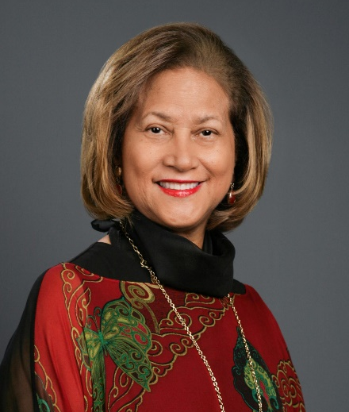
Agenda
Welcome – Regina Glenn
WSDOT Urban Mobility and Access (UMA), and Puget
Sound Megaprograms & WSDOT inclusion goals
overview – Julie Meredith
SR 520 & Alaskan Way Viaduct (AWV) Program
overview – Omar Jepperson
I-405 / SR 167 Corridor Program overview – Lisa Hodgson
Puget Sound Gateway Program overview – John White
Additional resources and contact information – Regina Glenn
Brief Q&A time – facilitated by Regina Glenn
Adjourn session
Regina Glenn
Diversity and Inclusion Manager, Megaprograms
Notes:
Regina Glenn
Here is our planned agenda for the next 30 minutes.
You’re going to hear brief remarks from WSDOT assistant secretary Julie Meredith, and then from the administrators of WSDOT’s four big Central Puget Sound megaprograms … all listed on this slide.
Our primary goal this morning is to introduce these programs to you and provide contact information where you can learn about inclusive contracting opportunities with our prime contractors.
If you have any questions after the presentation, please put them in the chat. We’re covering a lot of ground in this meeting. But we will try to save time for a Q&A session near the end.

Slide 3
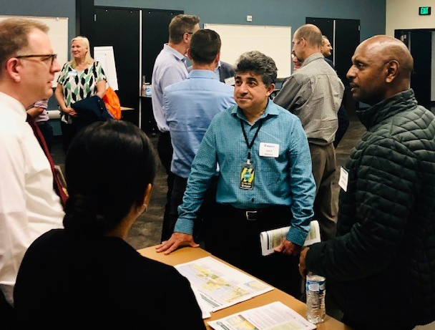
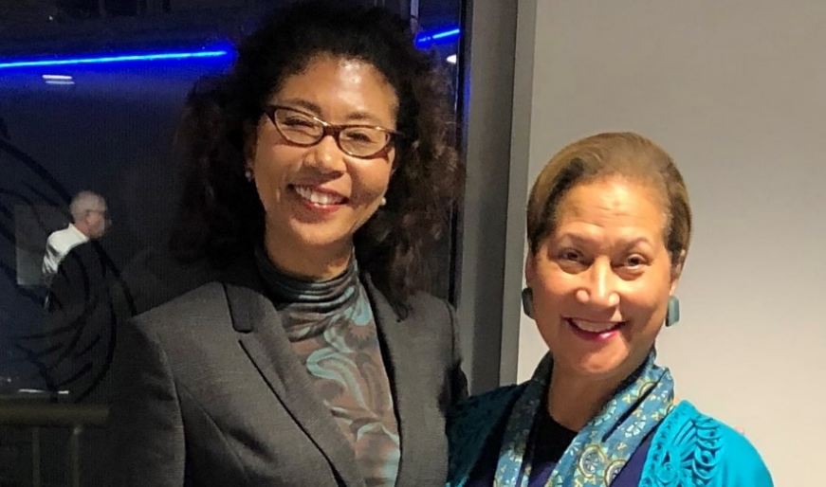
WSDOT’s commitment to diversity and inclusive contracting
WSDOT’s inclusive contracting goals:
10% for minority-owned firms
5% for small businesses
5% for veteran-owned firms
6% for women-owned firms
MSVWBE resources:
WSDOT Office of Equal Opportunity
Washington State office of Minority & Women’s Business Enterprises
Usman Naushab
Naushau@consultant.wsdot.wa.gov
Mobile: 206-240-1704
Notes:
Julie Meredith
Thank you, Regina, and good morning, everyone. I’m WSDOT’s Assistant Secretary of Transportation for Urban Mobility, Access, and Megaprograms. In addition to overseeing our Puget Sound megaprograms, I’m responsible for WSDOT’s Toll Division, Regional Transit Coordination team, and Management of Mobility team. The latter team coordinates mobility efforts throughout the region’s large urban areas.
We closely coordinate with our partners to help improve mobility on our regional transportation networks. Through our megaprograms’ infrastructure work, we are replacing aging bridges and structures to enhance public safety, connecting ports, and creating multimodal connections.
The four Megaprograms we’ll discuss today are:
The SR 520 Bridge Replacement and HOV Program
The Alaskan Way Viaduct Replacement Program
The I-405/SR 167 Corridor Program
And the Puget Sound Gateway Program
I’ve listed my contact information on this slide, should you have additional questions or wish to speak with me later about these programs.

Slide 4
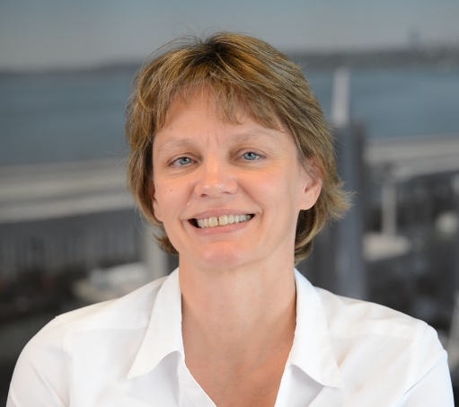
WSDOT Urban Mobility and Access and the Megaprograms Complex projects move the region forward
WSDOT manages a series of Urban Mobility and Access programs and efforts, including:
WSDOT Toll Division
Regional Transit Coordination
Management of Mobility
WSDOT is also building several large-scale Puget Sound Megaprograms to help meet the transportation needs of our rapidly growing region.
This includes the following programs:
SR 520 Bridge Replacement and HOV Program
Alaskan Way Viaduct Replacement Program
I-405/SR 167 Corridor Program
Puget Sound Gateway Program
Julie Meredith, P.E.
Assistant Secretary,
UMA & Megaprograms
Stay in touch:
Email: MeredJL@wsdot.wa.gov
Phone: 206-465-4989
Notes:
Julie Meredith
Thank you, Regina, and good morning, everyone. I’m WSDOT’s Assistant Secretary of Transportation for Urban Mobility, Access, and Megaprograms. In addition to overseeing our Puget Sound megaprograms, I’m responsible for WSDOT’s Toll Division, Regional Transit Coordination team, and Management of Mobility team. The latter team coordinates mobility efforts throughout the region’s large urban areas.
We closely coordinate with our partners to help improve mobility on our regional transportation networks. Through our megaprograms’ infrastructure work, we are replacing aging bridges and structures to enhance public safety, connecting ports, and creating multimodal connections.
The four Megaprograms we’ll discuss today are:
The SR 520 Bridge Replacement and HOV Program
The Alaskan Way Viaduct Replacement Program
The I-405/SR 167 Corridor Program
And the Puget Sound Gateway Program
I’ve listed my contact information on this slide, should you have additional questions or wish to speak with me later about these programs.

Slide 5
WSDOT Agencywide Strategic & Voluntary Goals
Notes:
Julie Meredith
As Regina mentioned a moment ago, Inclusion is one of WSDOT’s three Strategic Goals. The other two are Workforce Development and Practical Solutions.
Within Inclusion, we have the following key goal areas:
Inclusive Workforce - listening to every voice and considering different perspectives
Diverse Workforce – continuing to build a workforce that reflects the communities we serve
Diverse Business Spending - meeting our state and federal diversity business goals while increasing awareness of the need for a DBE program
Create Opportunity - increasing the transportation industry’s workforce capacity by promoting apprenticeships and mentoring programs
Community Engagement - engaging stakeholders during all phases of our projects to develop and maintain relationships with WSDOT

Slide 6
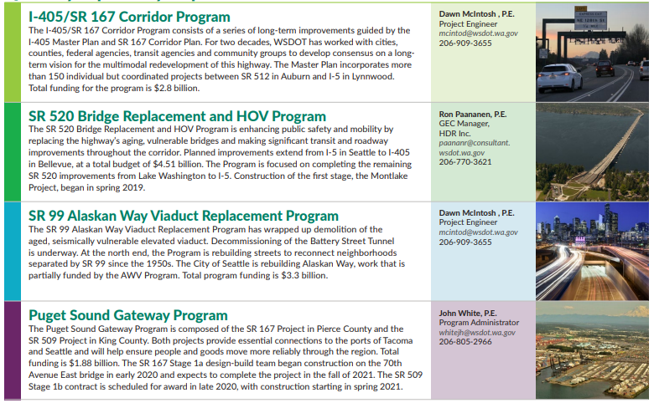
WSDOT Megaprograms Overview
Notes:
Julie Meredith
This slide gives a brief overview of the four Megaprograms and a point of contact for inquiries about contracting opportunities.
If you’ve not seen this slide’s content before, don’t worry … we’ll email everyone a copy of this presentation.

Slide 7
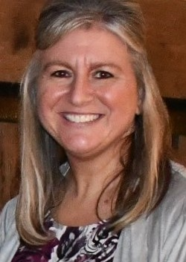
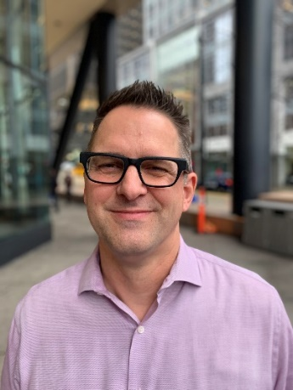
Introducing today’s speakers from WSDOT
Omar Jepperson, P.E., DBIA
SR 520 & AWV
Program Administrator
Lisa Hodgson, P.E., DBIA
I-405 / SR 167 Corridor Program Administrator
John White, P.E.
Puget Sound Gateway
Program Administrator
Notes:
Julie Meredith
I’ve asked our Megaprogram leadership to give you some background on their projects and a high-level preview of what’s ahead. So let me introduce the speakers you’re about to hear from.
Omar Jepperson is the Program Administrator for the SR 520 Bridge Replacement and HOV Program and for the Alaskan Way Viaduct Replacement Program.
Lisa Hodgson is the Program Administrator for the I-405 / SR 167 Corridor Program.
And John White is the Program Administrator for the Puget Sound Gateway Program.
I am pleased to be here today with these WSDOT leaders. They bring a wealth of knowledge about our large-scale, multibillion-dollar projects.
And now I’d like to hand the presentation over to Omar. He’ll provide an overview of the SR 520 and Alaskan Way Viaduct programs.

Slide 8
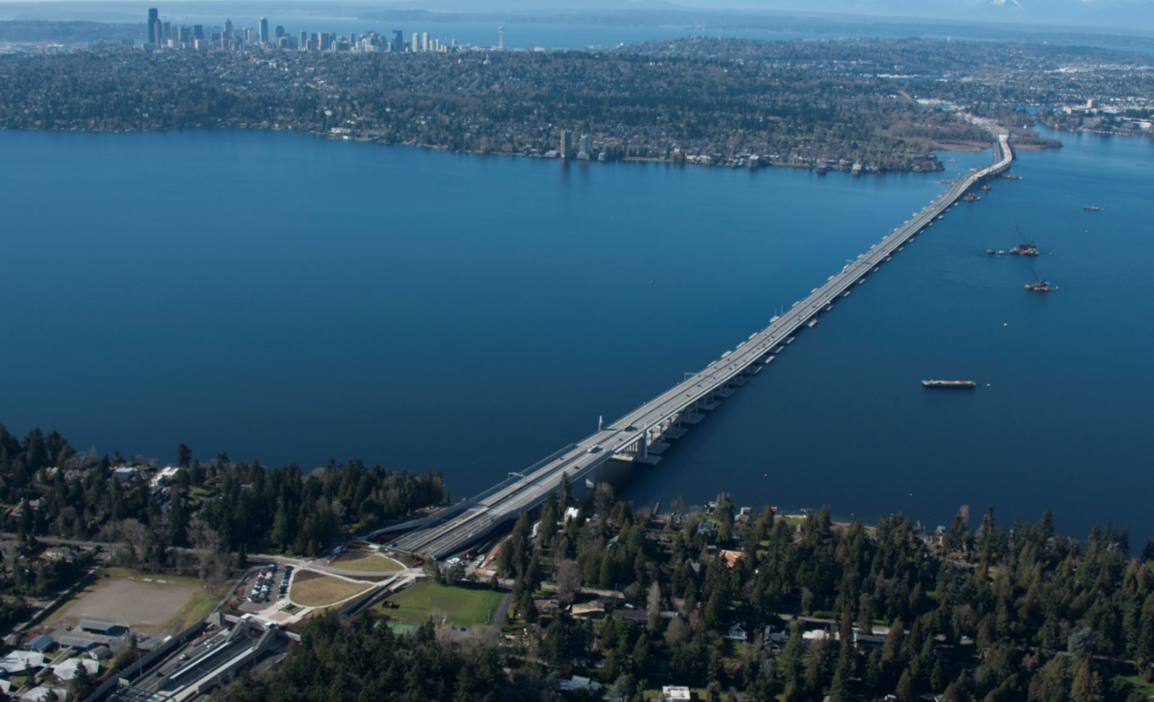
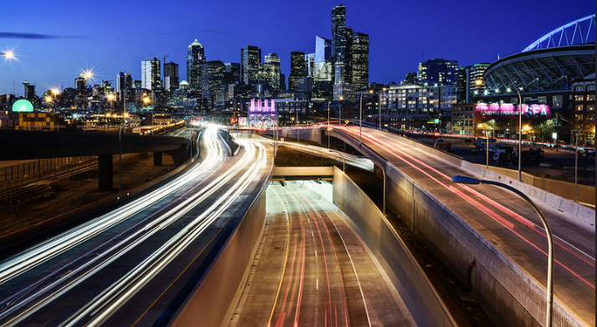
SR 520 & Alaskan Way Viaduct (AWV) Replacement Programs
Programs to improve safety and mobility by:
Replacing the SR 520 corridor from the Eastside, across Lake Washington, and to I-5.
Replacing the Alaskan Way Viaduct with a deep-bored tunnel with improved surface street connections to the north and south.
Omar Jepperson, P.E., DBIA
SR 520 & AWV
Program Administrator
To learn more:
Web:
SR 520: www.wsdot.wa.gov/project/sr520bridge
AWV: www.wsdot.wa.gov/projects/viaduct
Email: JepperO@wsdot.wa.gov
Phone: 206-419-6961
Notes:
Omar Jepperson
Thanks Julie. And hello everyone. I too want to thank you for joining us this morning.
One thing all our WSDOT megaprograms have in common is that we’re making important safety and mobility enhancements to our region’s multimodal transportation system. And to help us do that, we all seek the skills and expertise of small, diverse businesses.
On the SR 520 program, we are replacing the highway's aging, vulnerable bridges – including the old floating bridge on Lake Washington – and constructing significant transit and roadway improvements throughout the corridor … from I-405 on the Eastside to I-5 in Seattle.
On the Alaskan Way Viaduct Program, or AWV for short, we removed the old, seismically vulnerable Highway 99 viaduct, and replaced it with a deep-bored tunnel underneath downtown Seattle. We’re now in the home stretch of this program with some surface street improvements that I’ll touch on in a moment.

Slide 9
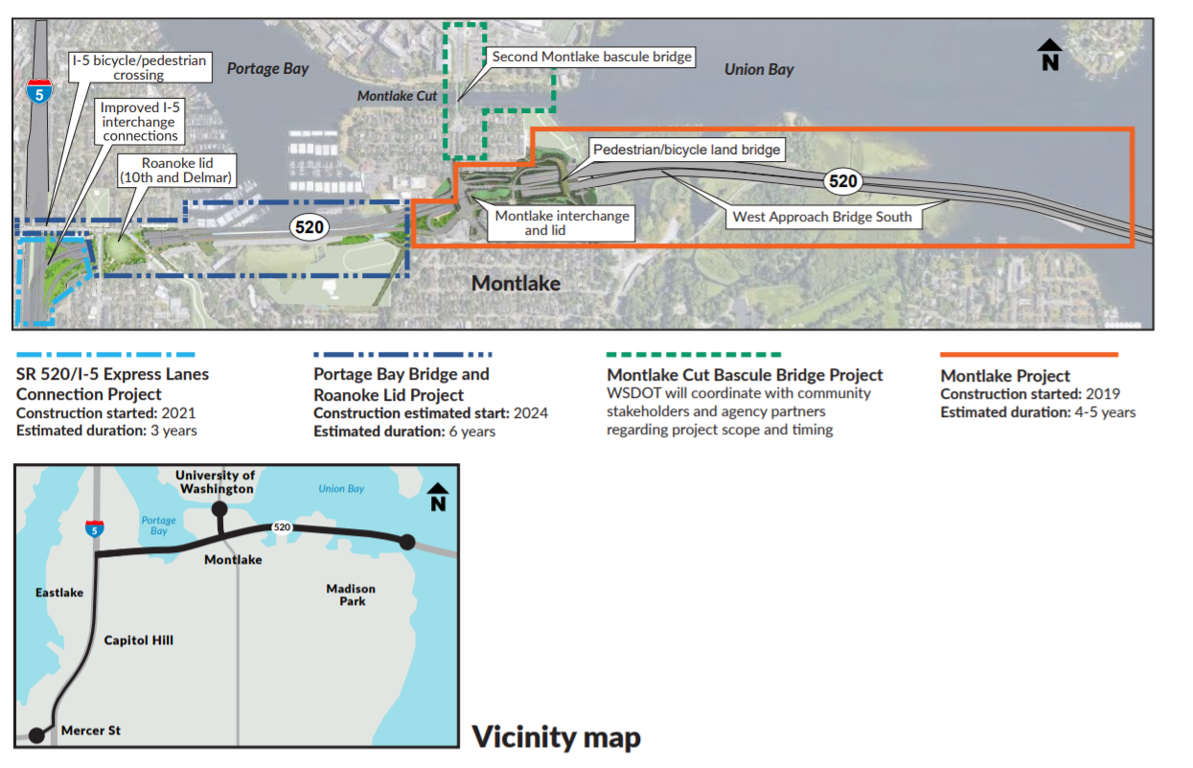
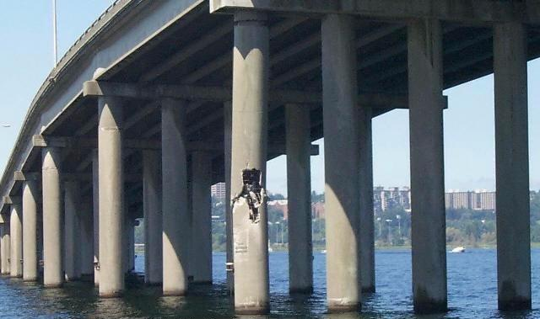
SR 520 “Rest of the West” Overview
FUNDED
Photo of old, hollow concrete columns for original SR 520 bridge structure.
Notes:
Omar Jepperson
On the SR 520 program, we’re reconstructing the corridor with a series of projects … each one quite large on its own. We’re basically moving from east to west. Our projects also include some significant environmental enhancements, such as large, fish-friendly culverts and innovative systems for capturing and treating the highway’s stormwater runoff.
So far, we’ve completed:
The Eastside Transit and HOV Project, which opened to traffic in 2014.
The new SR 520 floating bridge, which opened to traffic in 2016.
And the West Approach Bridge North, which opened to drivers in summer 2017. Also worth noting: The bridge’s cross-lake bicycle and pedestrian trail opened in late 2017.
Our SR 520 team is now focused on completing the corridor’s improvements in Seattle … with several projects we collectively call the “Rest of the West.” Two of our Seattle projects are now under construction.
One is the Montlake Project.
The other is the SR 520/I-5 Express Lanes Connection Project.
Two other projects not yet in construction make up the Rest of the West.
One, the Portage Bay Bridge and Roanoke Lid Project, is scheduled to begin construction in 2024 and continue for approximately 6 years.
The other is the Montlake Cut Bascule Bridge Project, which involves building a second drawbridge across the Montlake Cut. This project’s scope and schedule haven’t been set, pending additional coordination with agency partners and community stakeholders.

Slide 10
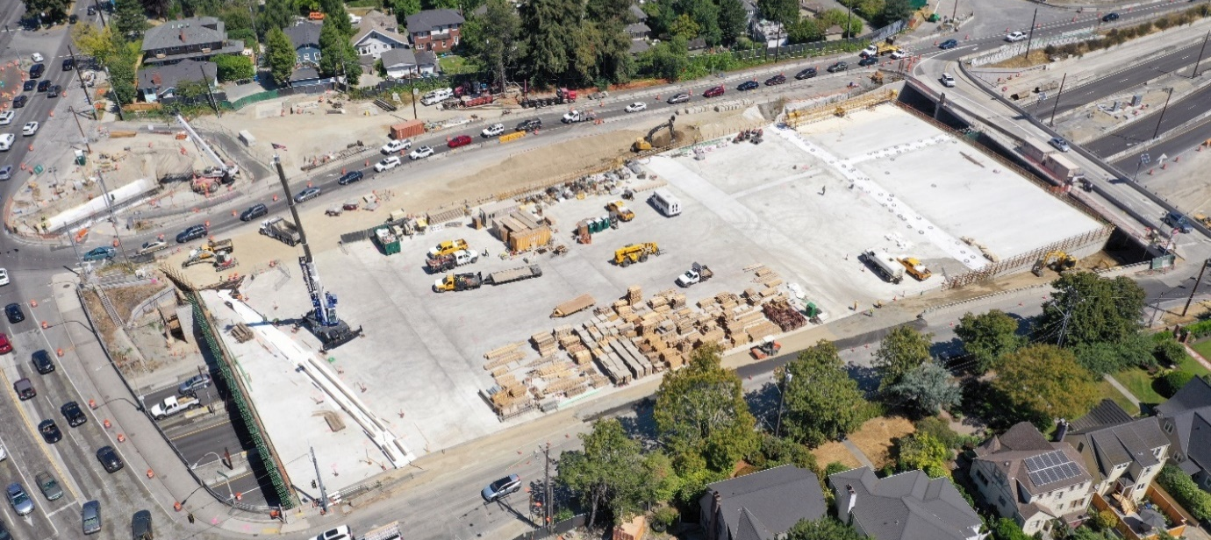
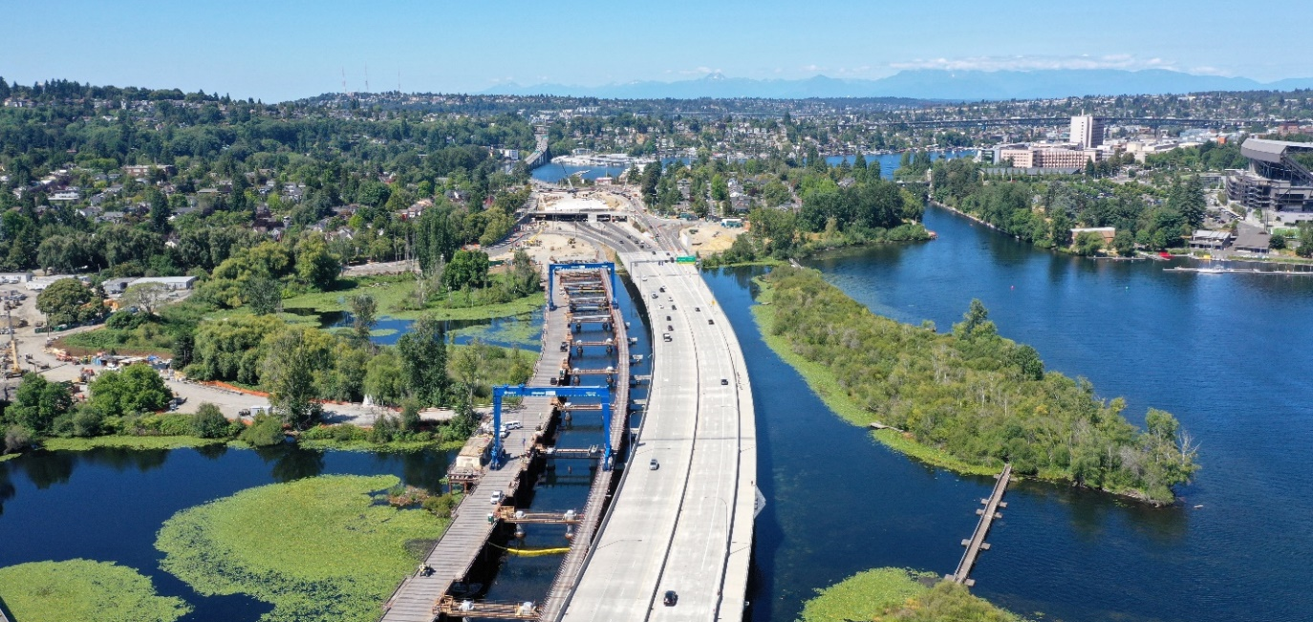
Montlake Project (in construction) Design-Build Project
Montlake Project contacts:
Tom McMillan, Graham
Procurement Manager
tom.mcmillan@grahamus.com
425-410-0993
Suzanne Arkle
Inclusion Manager
suzanne@zanninc.com
720-324-8580
Darling Nava
Inclusion Resource Specialist
Darling@zanninc.com
813-947-8586
Notes:
Omar Jepperson
The Montlake Project involves several major improvements:
A new, seismically stronger West Approach Bridge South, parallel to the completed West Approach Bridge North. The south bridge will carry three lanes of eastbound traffic from Montlake to the new floating bridge.
A rebuilt SR 520 / Montlake Boulevard interchange
A three-acre, community-connecting highway lid and transit hub in Montlake
And a bicycle-pedestrian “land bridge” over SR 520, east of the Montlake lid, connecting the Arboretum and points northward, including the University District
This is a design-build project. Graham is the prime contractor. The contract bid price was $455 million. Construction started in 2019 … and is expected to wrap up in 2023.
We are proud of our inclusive contracting on the SR 520 program. To date, we’ve enlisted 132 MSVWBE firms , with contract values totaling more than $228 million.
We expect to bring on more MSVWBE businesses going forward. Listed on this slide are the points of contact with our prime contractor, Graham. Graham is responsible for subcontracting opportunities on the design-build Montlake Project.

Slide 11
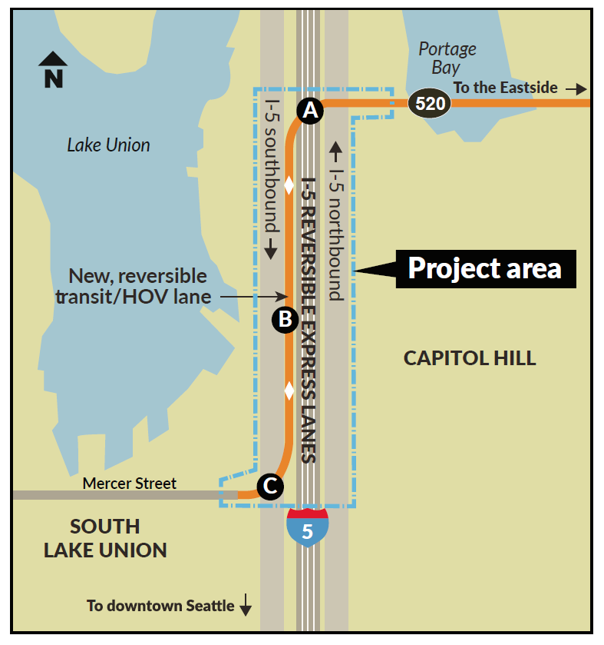
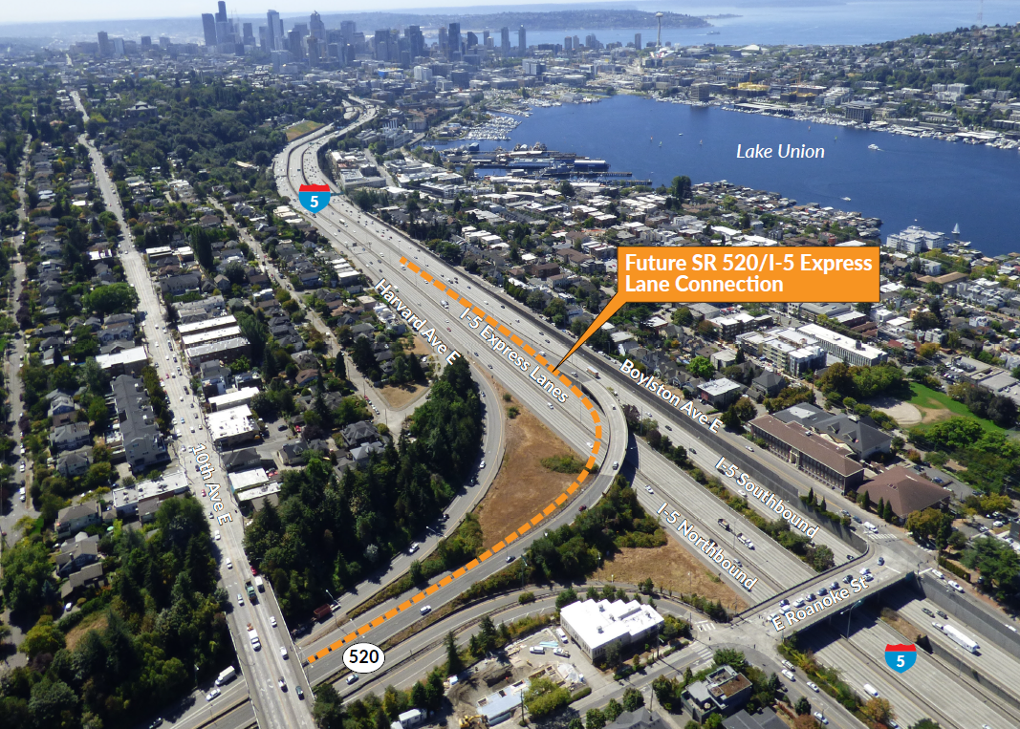
SR 520/I-5 Express Lanes Connection Project (in construction) Design-Bid-Build Project
I-5 Connection Project contact:
Ethan Kaufman
Project manager, Walsh Construction
ekaufman@walshgroup.com
Work: 206-394-7300
Mobile: 206-579-3856
Notes:
Omar Jepperson
The SR 520/I-5 Express Lanes Connection Project is building an improved transit/HOV link between SR 520 and Seattle’s bustling South Lake Union neighborhood via the I-5 express lanes.
This new reversible connection alongside the four I-5 express lanes will open initially only to buses. Later, when we’ve completed the Portage Bay project, the new lane and ramps will open to carpools as well.
We began construction in August with our prime contractor, Walsh Construction. We expect this project to take approximately three years.
While construction began only a few weeks ago (August 2021), the project team already has secured commitments to award 21% of the contract value to MSVWBE companies.
This is a design-bid-build project. Contact information for Walsh is on this slide.

Slide 12
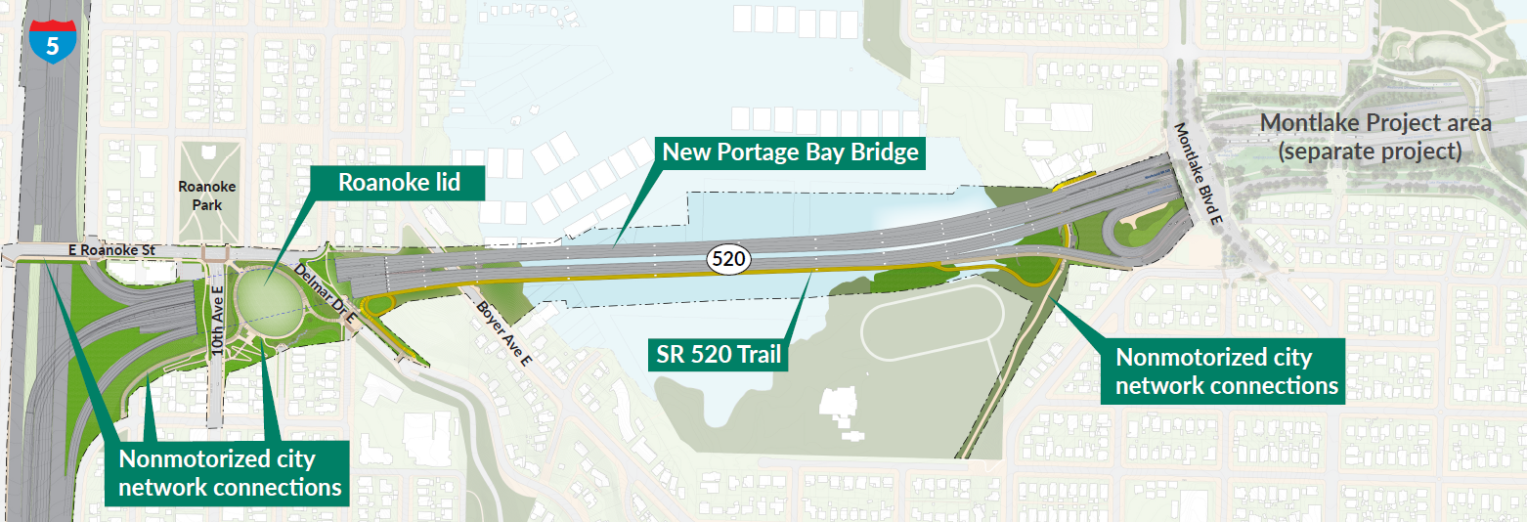
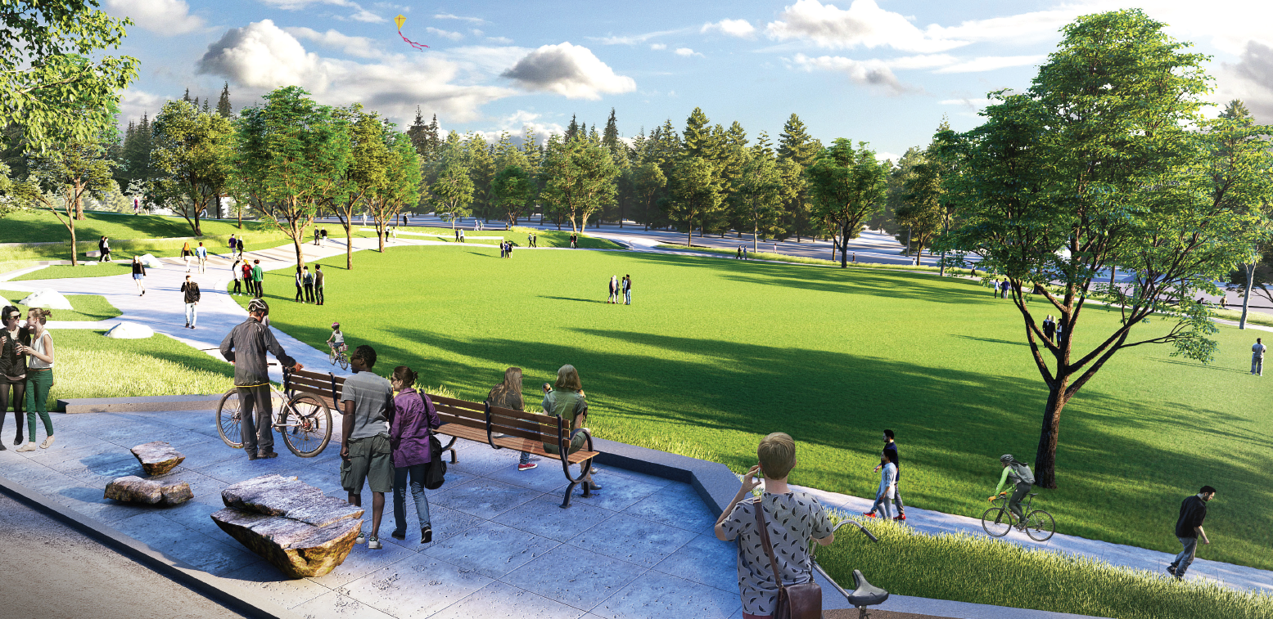
Portage Bay Bridge and Roanoke Lid Project | Design-Build Project
Project schedule
Publish RFQ: September 2022
Publish RFP: January 2023
Award contract: summer/fall 2023
Begin construction: 2024
Future Roanoke lid. Note: concepts under refinement, subject to change.
Notes:
Omar Jepperson
The Portage Bay Bridge and Roanoke Lid Project includes replacement of the existing Portage Bay Bridge with a new, seismically resilient, six-lane structure to carry SR 520 traffic between Montlake and I-5.
We’ll also construct the fifth and final SR 520 lid in the corridor, located in the Roanoke neighborhood between 10th Avenue East and Delmar Drive East.
We expect construction to start in 2024 and last approximately 6 years.

Slide 13
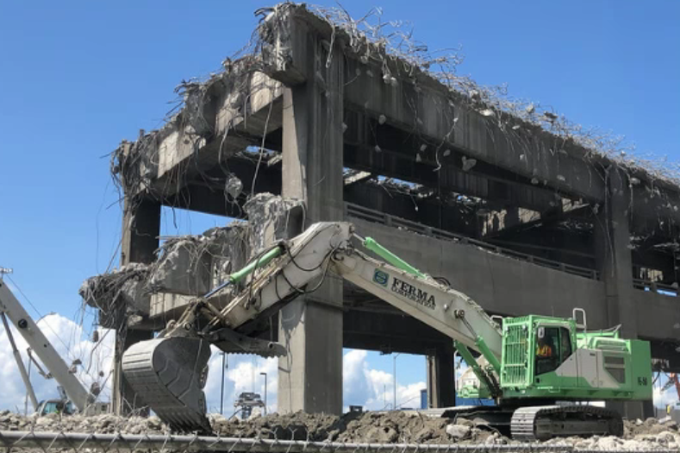
AWV Program Overview SR 99 Demolition, Decommissioning and Surface Street Project
Diversity and inclusive contracting:
Substantially complete – Summer 2021
MSVWBE goal attainment (7/21/21)
Category | Goal | Current | # Firms
M | 10% | 9.22% | 24
S | 5% | 16.03% | 43
V | 5% | 0.01% | 1
W | 6% | 3.00% | 5
Apprenticeship
15% Labor Requirement
19.2% attainment, thru 7/21/2021
Notes:
Omar Jepperson
As I mentioned earlier, the old Highway 99 Alaskan Way Viaduct is now history, and the deep-bored tunnel beneath downtown Seattle is open to traffic. So, the $3.3 billion AWV program is winding down, with 28 of 30 projects now complete.
Our second-to-last project is the Viaduct Demolition, Decommissioning, and Surface Streets project. This project is nearly complete. We are in the final punch-list phase to wrap up the remaining work items.
Working with our prime contractor, Kiewit, we’ve had positive results in contracting with MSVWBE firms on this project.
This slide shows the project’s inclusive contracting performance.

Slide 14
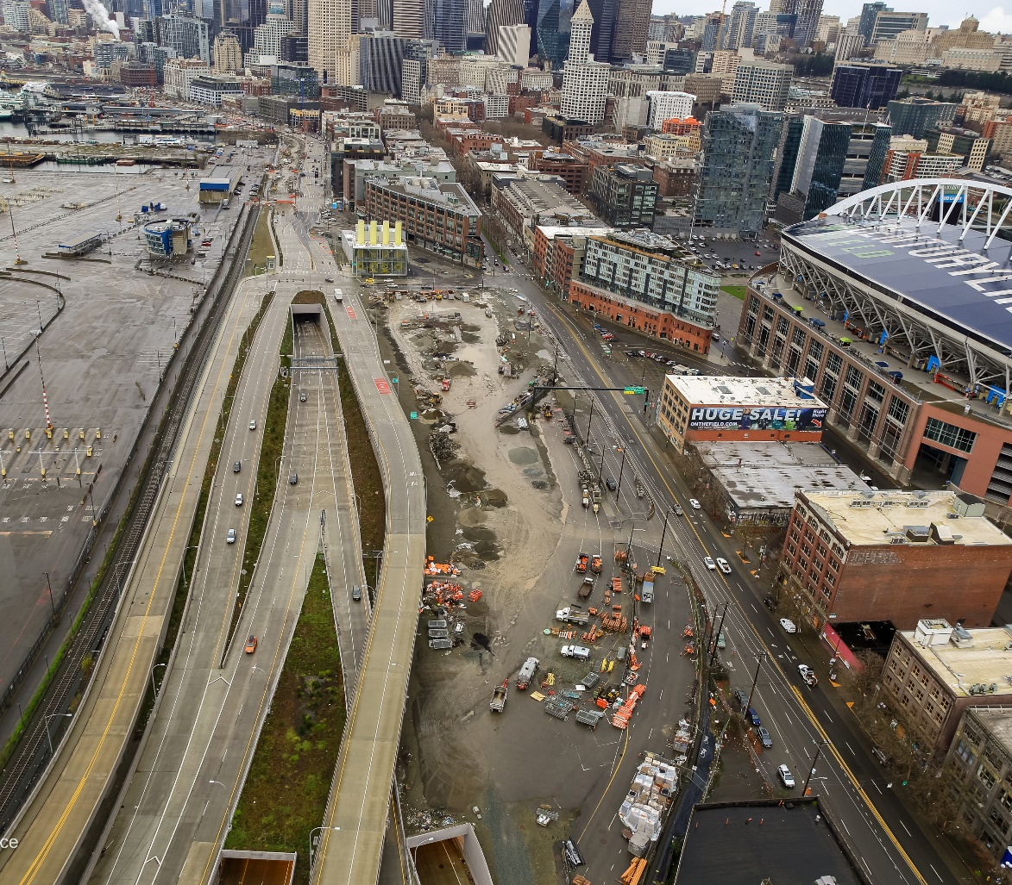
South Access – Surface Streets Connections Project
Final of 30 projects in Alaskan Way Viaduct Replacement Program
Completes final roadway work related to SR 99 Tunnel and viaduct demolition
$24.9 million project awarded to Scarsella Brothers, Inc. on May 11, 2021, and executed June 21, 2021
First working day July 19, 2021, beginning 18 months of expected construction
Project elements include:
Drainage, sewer, paving on S. Dearborn St
Pedestrian plaza
Paving 1st Ave S
Bike / ped trail
Project contact:
Nick Rawlins
Project mgr., Scarsella Brothers
nick.r@scarsellabros.com
253-226-9932
Notes:
Omar Jepperson
Our final AWV project is the South Access Phase 2.
This slide’s aerial photo captures most of the SA2 project work area. The work involves:
Concrete paving on First Avenue South and South Dearborn Street
A new pedestrian plaza where Railroad Way once ran between Alaskan Way and First Avenue South.
A garage facility to hold tunnel-maintenance equipment.
New sidewalks, illumination, landscaping, a bicycle-pedestrian trail, and fencing.
Construction started in July and is scheduled for completion in fall 2022.
The slide has contact information for the contractor, Scarsella Brothers.
I’ll now hand the presentation over to Lisa Hodgson to discuss the I-405/SR 167 Program.

Slide 15
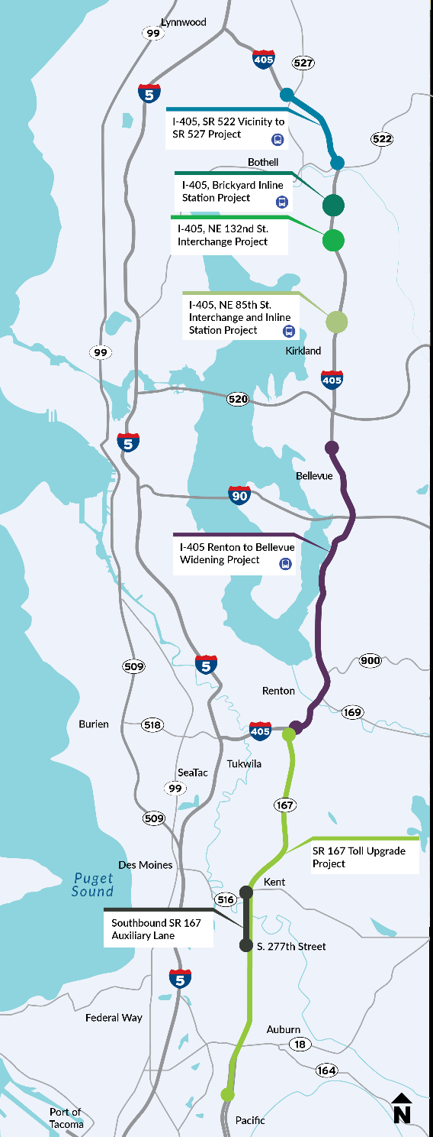
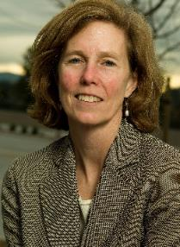
I-405/SR 167 Corridor Program
A long-term, multi-agency multimodal program to bring increased reliability and mobility to the Interstate 405 and State Route 167 corridor
Future Projects (Design-Build unless otherwise noted):
I-405/NE 85th St Interchange and Inline BRT Station Project (funded by Sound Transit)
SR 522 Vic. to SR 527 Express Toll Lanes and Brickyard Improvements
SR 167 Corridor Improvements
I-405/124th Ave NE Interchange Improvements (design only)
Ripley Lane Stream Connection (Design-Bid-Build)
Lisa Hodgson
I-405/SR 167 Corridor
Program Administrator
HodgsoL@wsdot.wa.gov
Wendy Taylor
I-405/SR 167 GEC Manager
TaylorW@consultant.wsdot.wa.gov
To learn more: www.wsdot.wa.gov/Projects/I405/
Notes:
Lisa Hodgson
Hello, my name is Lisa Hodgson and I serve as the Program Administrator for the I-405/SR 167 Corridor Program.
Program overview
For those who are new, I-405/SR 167 Megaprogram has collaborated for more than 20 years with stakeholders to deliver a long-term, multimodal vision for I-405 and SR 167 based on the I-405 Master Plan and SR 167 Corridor Plan as guiding documents.
The Master Plan was developed in early 2000, and we have been working toward delivery of that Master Plan.
In 2010, we transitioned to focus on not just I-405 but SR 167 as well. This 50+ mile corridor is really a North-South companion to I-5.
Projects listed on screen – these are future projects that are currently in design.
What’s to come this year
In the following slides I will provide status updates on our active construction project: the Renton to Bellevue Widening and Express Toll Lanes Project, as well as the NE 132nd Street Project, which we recently awarded.
We continue to move the other projects listed here toward construction readiness. Our active projects/ones we’re currently working on. Can see others on our website.

Slide 16
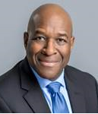
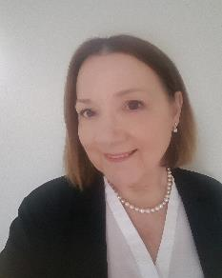
Under Construction: Renton to Bellevue Widening & Express Toll Lane (ETLs)
Design-Build Project overview
New dual ETLs and BRT infrastructure to complete the missing link between SR 167 in Renton and NE 6th Street in Bellevue; improves key interchanges.
Builds two new southbound auxiliary lanes at Coal Creek and Kennydale Hill.
Construction on the corridor is slated to continue through approximately 2024.
Upcoming opportunities
The project contractor, Flatiron-Lane, Joint Venture (FLJV), and their electrical subcontractor, Valley Electric, are recruiting for ongoing and near-term contracting opportunities.
FLJV’s next quarterly event is being planned for late Oct or early Nov. Learn more at https://fljvwa405project.com.
George Frost
Flatiron-Lane Joint Venture Inclusion Manager
george@gwfrost.com
Dawn McIntosh, P.E.
I-405/SR 167 Diversity
and Inclusion Manager
mcintod@wsdot.wa.gov
WSDOT
Notes:
Lisa Hodgson
Renton to Bellevue update The Renton to Bellevue project is designed to reduce congestion and improve safety performance along one of the state’s most congested sections of highway.
The project will add new capacity to create a two-lane express toll lane system between SR 167 in Renton and Northeast 6th Street in Bellevue.
In general, the project will add one new lane in each direction. The existing HOV lane will be combined with this new lane to create a dual express toll lane system.
The new express toll lanes will connect to the existing express toll lane system between Bellevue and Lynnwood, as well as the SR 167 HOT lanes via the I-405/SR 167 Interchange Direct Connector, to create a 40-mile system of express toll lanes.
Our design-builder on the I-405 Renton to Bellevue Project, Flatiron-Lane Joint Venture, started construction in 2020 and continued this past year, with the continued focus on utility relocations, pile driving at May Creek, and headwall formwork and rebar work at the Newport Hills Park and Ride. In May 2021, WSDOT and King County opened approximately 1.5 miles of the King County Eastrail to the public.
The I-405/SR 167 Megaprogram will continue to work with Flatiron on MSVWBE contract opportunities on the Renton to Bellevue Project. The project contractor FLJV and their electrical subcontractor, Valley Electric, are recruiting for ongoing and near-term contracting opportunities with a focus on professional services and construction subcontracts.
FLJV holds quarterly outreach events for subcontracting opportunities and the next one is coming up in late October or early November. Learn more at the website linked to on the slide.

Slide 17
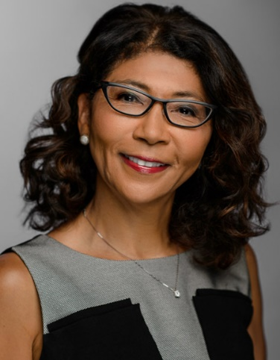
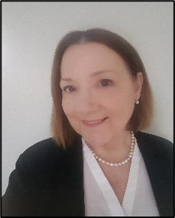
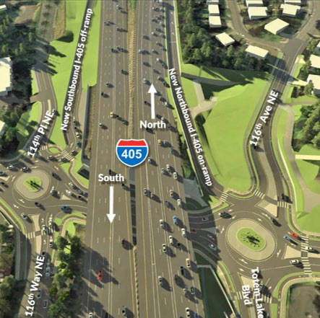
Notice to Proceed Issued: I-405/ NE 132nd St Interchange Project
Project overview
Builds a new half-diamond interchange.
Replaces signals with roundabouts optimizing movement and reducing long-term maintenance.
Adds ped/bike infrastructure through the interchange.
Corrects fish barrier, improves water quality, and addresses seismic retrofit.
Project news
WSDOT executed the $50.4 million design build contract with Graham Contracting, Ltd. (Graham) on August 27.
WSDOT issued notice to proceed (NTP) on Sept. 6.
Subcontracting opportunities to be determined. Reach out to Suzanne Arkle for more information.
Early construction activities start in 2022.
Suzanne Arkle
Inclusion Manager
ZANN
suzanne@zanninc.com
Dawn McIntosh, P.E.
I-405/SR 167 Diversity
and Inclusion Manager
mcintod@wsdot.wa.gov
WSDOT
Notes:
Lisa Hodgson
405/NE 132nd Update
This project will construct a new on-ramp to northbound I-405 and a new off-ramp from southbound I-405 at Northeast 132nd Street in Kirkland. This type of interchange is known as a half-diamond.
Constructing the new interchange at Northeast 132nd Street:
Improves access to the Totem Lake regional growth center and surrounding neighborhoods in Kirkland
Provides a new option to access I-405, creating an alternative to using local streets
Reduces pressure on heavily congested Northeast 124th Street and Northeast 160th Street interchanges
Builds local street improvements, including roundabouts at two intersections
Improves pedestrian and bicycle connections in the area
Makes environmental enhancements, including fish passage and stormwater improvements
Project news
WSDOT executed the design build contract with Graham on Friday, Aug. 27.
This state funded project includes voluntary MSVWBE goals. Subcontracting opportunities are still to be determined, but you can reach out to Suzanne Arkle, the Inclusion Manager, for more information about opportunities.
Construction is expected to begin in early 2022 and be completed by fall 2023.
And now I’d like to hand the presentation over to John White, to cover information on the Puget Sound Gateway Program.

Slide 18
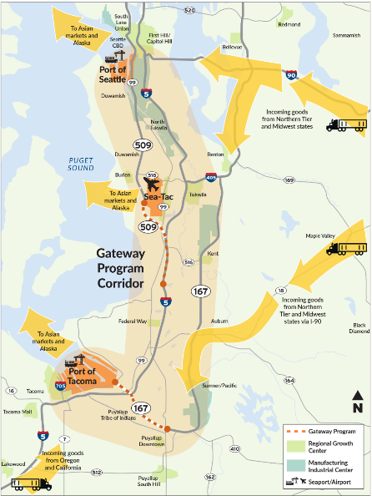
Puget Sound Gateway Program
One program to deliver both the SR 167 and SR 509 Corridor Completion Projects
The program is projected to be completed in two stages, over approximately 13 years. It is currently comprised of 6 design-build contracts, one of which is led by Sound Transit performing work for WSDOT
Owner’s team MSVWBE subcontracting opportunities through the GEC contracts
John White, P.E.
Puget Sound Gateway
Program Administrator
Notes:
John White
Hello, I’m John White and I am the Program Administrator for the Puget Sound Gateway Program with WSDOT.
The Puget Sound Gateway Program is composed of two projects: the completion of SR 167 in Pierce County, and the completion of SR 509 in King County.
These projects provide essential connections to the ports of Tacoma and Seattle and will help ensure people and goods move more reliably through the Puget Sound region.
WSDOT plans to deliver the Program through six construction contracts. Construction activities will continue through 2028.
We currently have two active D-B construction contracts and one in the final phase of procurement:
SR 167 Stage 1a – a $41 million design-build contract awarded to Atkinson Construction that broke ground in February 2020 and is scheduled for completion in 2021.
SR 509 Stage 1b – a design-build contract valued at $320 million, awarded to Atkinson in December. We’re scheduled to break ground in late 2021 and to be completed in 2025.
SR 167 Stage 1b – a design-build contract valued at $330 million. In first phase of procurement. Announced shortlist in February and proposal due tomorrow. Scheduled to begin construction in 2022 and be complete in 2026.

Slide 19
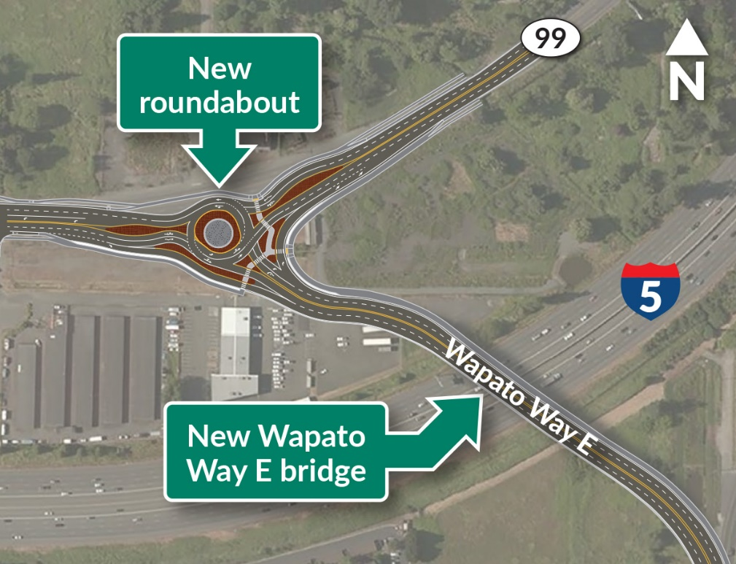
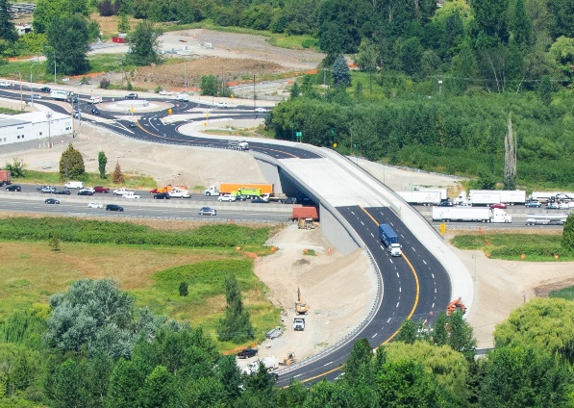
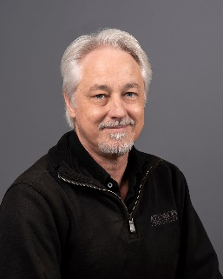
Under Construction: SR 167 70th Avenue East Bridge Replacement Project
Project overview
Atkinson construction is building this $41M state funded project
Replaces existing two-lane bridge with four-lane bridge with 12-foot-wide shared use path
Builds two-lane roundabout designed to accommodate large trucks
Builds new Interurban trail parking lot and several hundred feet of new trail
Project status
New bridge, roundabout, and shared use path fully opened in August 2021
Project completion: early 2022
Inclusion Manager: Geoff Shook Geoff.shook@atkn.com
425-255-7325
43 MSVWBE firms have been utilized to date
Projected $4M in payments to MSVWBE firms
Notes:
John White
The design-build contractor is Atkinson
Achieved full operational completion in August 2021
Contract is state-funded with WSDOT voluntary MSVWBE goals and a required Inclusion Manager and task force
43 MSVWBE firms have been involved to date, providing services that include surveying, geotechnical explorations, and signage design
We forecast approx. $4M in MSVWBE payments at completion, representing 21% stacked participation
Inclusion Manager: Geoff Shook, Geoff.shook@atkn.com, 425-255-7325

Slide 20
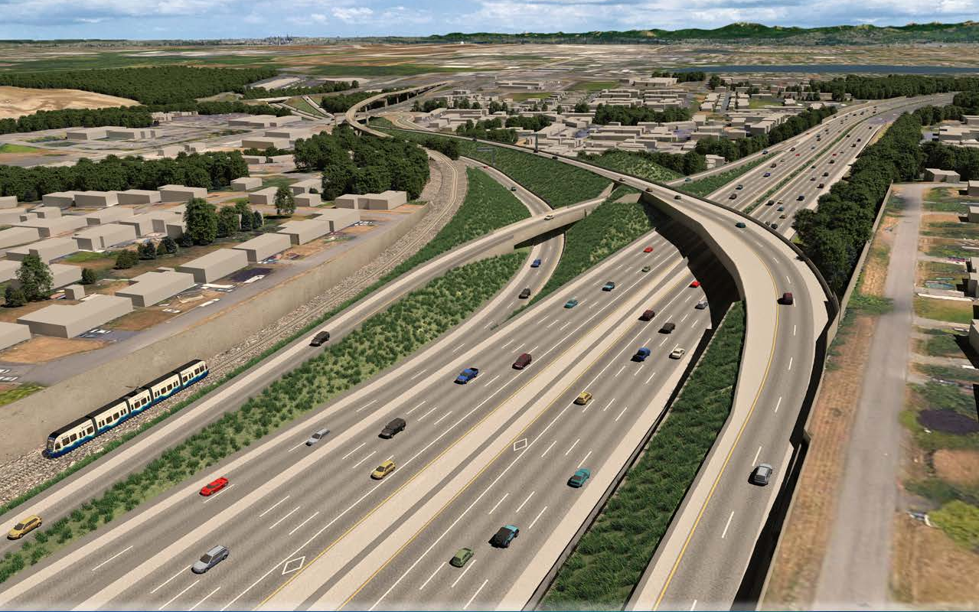
Executed: SR 509 I-5 to 24th Avenue South New Expressway Project
Project Overview
Atkinson construction is the design-builder, with Jacobs Engineering as lead designer
Reconstructs the I-5/SR 516 interchange
Builds a new roadway that connects SR 509 to Veterans Drive
Builds a new South 216th Street bridge
Builds new and extends existing noise walls
Constructs new ramps that connect I-5 and SR 509
Constructs a new interchange at 24th Avenue South
Upcoming Opportunities
The $264M federally funded contract is currently in the final design phase and has UDBE and FSBE requirements for design and construction:
UDBE Design 8%, Construction 10%
FSBE Design 8%, Construction 13%
DBE Program Administrator: Geoff Shook
Geoff.shook@atkn.com
425-255-7325
Notes:
John White
The design-build contractor is Atkinson, contract value is $264 million
Substantial completion scheduled for late 2025
Final design is well underway: 2021-2022
Begin construction: late 2021
The contract is federally funded and has the following requirements for underutilized disadvantaged businesses (UDBE) and federal small businesses (FSBE) for both design and construction:
UDBE Design 8%, Construction 10%
FSBE Design 8%, Construction 13%
Atkinson has a DBE Performance Plan with current commitments to over 20 firms, with approx. $3.5M in design and $7.5M in construction commitments identified so far
Kicked off formal DBE outreach efforts in early 2021

Slide 21
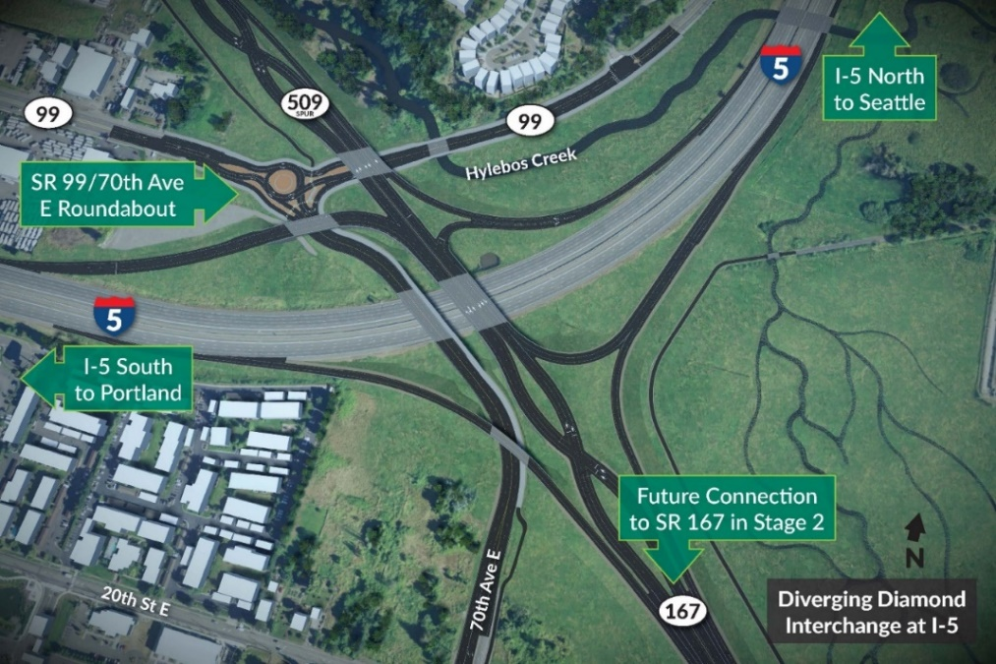
In procurement: SR 167 I-5 to SR 509 New Expressway Project
Project Overview
Constructs new SR 167/I-5 Diverging Diamond Interchange
Constructs two miles of new highway between I-5 and SR 509
Builds 149-acre Riparian Restoration Program
Constructs 54th Avenue East Half Interchange and Roundabout
Constructs Half Interchange at SR 509
Demolishes existing 70th Avenue East Bridge
Project Status
Shortlisted teams submitting proposals on September 23:
Atkinson (Contact: Brandon Dully, Brandon.Dully@atkn.com)
Graham (Contact: Greg Ritke, Greg.Ritke@grahamus.com)
Kiewit (Contact: Justin O’Brien, Justin.OBrien@kiewit.com)
Upcoming Opportunities
This federally funded contract is valued between $325M and $375M, and includes DBE participation goals: 15% for design and 21% for construction
Notes:
John White
Proposals are due Sept. 23 from 3 teams: Atkinson, Graham and Kiewit. See the slide for the primary team contacts
Current schedule:
Proposals due: September 23, 2021
Begin final design: January 2022
Begin construction: mid-2022
Complete construction: mid-2026
The contract is federally funded and includes the following DBE participation goals: 15% for design and 21% for construction
And now I’d like to turn the presentation back over to Regina Glenn to guide us through a brief Q&A time, and share a few additional resources for attendees.

Slide 22
Additional resources on the web
1. Visit the WSDOT Contract Ad and Award website: https://www.wsdot.wa.gov/biz/contaa/
Sign up for email alerts regarding WSDOT contracting opportunities
Visit the WSDOT Consultant Services Office website: https://www.wsdot.wa.gov/Business/Consulting/
Learn about A&E consulting opportunities
Visit the WSDOT Office of Equal Opportunity (OEO) website: https://www.wsdot.wa.gov/EqualOpportunity/default.htm
Find resources such as OEO’s newsletters, policies, announcements and our Megaprogram diversity and inclusion quarterly reports.
4. Visit the WSDOT SR 520 Diversity and Inclusion website:
https://www.wsdot.wa.gov/Projects/SR520Bridge/About/DBE.htm
Learn about SR 520 diversity details
FUNDED
Notes:
Regina Glenn
Here are links to a few resources to find up-to-date information from WSDOT.

Slide 23
Additional resources on the web
5. Contracting Tips and Tools newsletters
Small business self-identification vs. OMWBE certification
Design-bid-build vs. design-build
6. Veterans Folio
How to register as a veteran business owner on WEBS to work with state
7. Quarterly Diversity Reports
https://wsdot.wa.gov/equalopportunity/news-reports-studies
8. Design Build information
https://wsdot.wa.gov/construction-planning/project-delivery/design-build
Notes:
Regina Glenn
And here are links to a few additional resources.

Slide 24
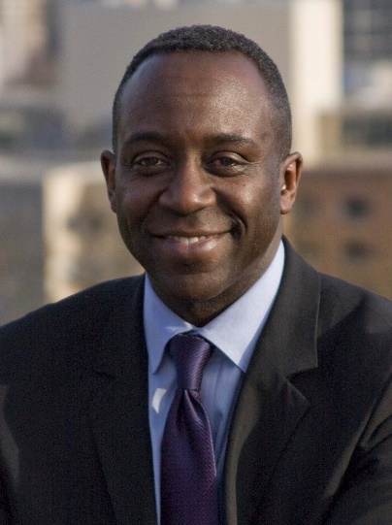
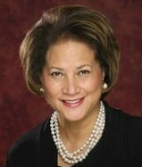
Contact information – how to be in touch
Bobby Forch
DBE/MSVWBE Compliance Inclusion Administrator, Megaprograms
ForchB@consultant.wsdot.wa.gov
Regina Glenn
Diversity and Inclusion Manager, Megaprograms GlennRe@consultant.wsdot.wa.gov
Phone: 425-503-7212
Notes:
Regina Glenn
Here are good points of contact for you if you have additional questions about our diversity and inclusion program activities for the Megaprograms.

Slide 25
Questions about the Megaprograms?
FUNDED
Notes:
Regina Glenn
We’d now like to have some time for Q&A for the Megaprograms group.
Are there any questions you’d like to ask us? We will start with any questions in the chat.

Slide 26
Adjourn
Have a wonderful rest of your day!
FUNDED
Notes:
Regina Glenn
Thank you again for spending this time with us. We hope you found this information useful!
Have a great rest of the day at today’s virtual event.

