Slide 1
WASHINGTON EQUITY NOW ALLIANCE (WENA)
Executive Order 22-02 Implementation Presentation to:
SOLICITOR GENERAL NOAH PURCELL
for
WASHINGTON STATE ATTORNEY GENERAL BOB FERGUSON
March 8, 2022

Slide 2
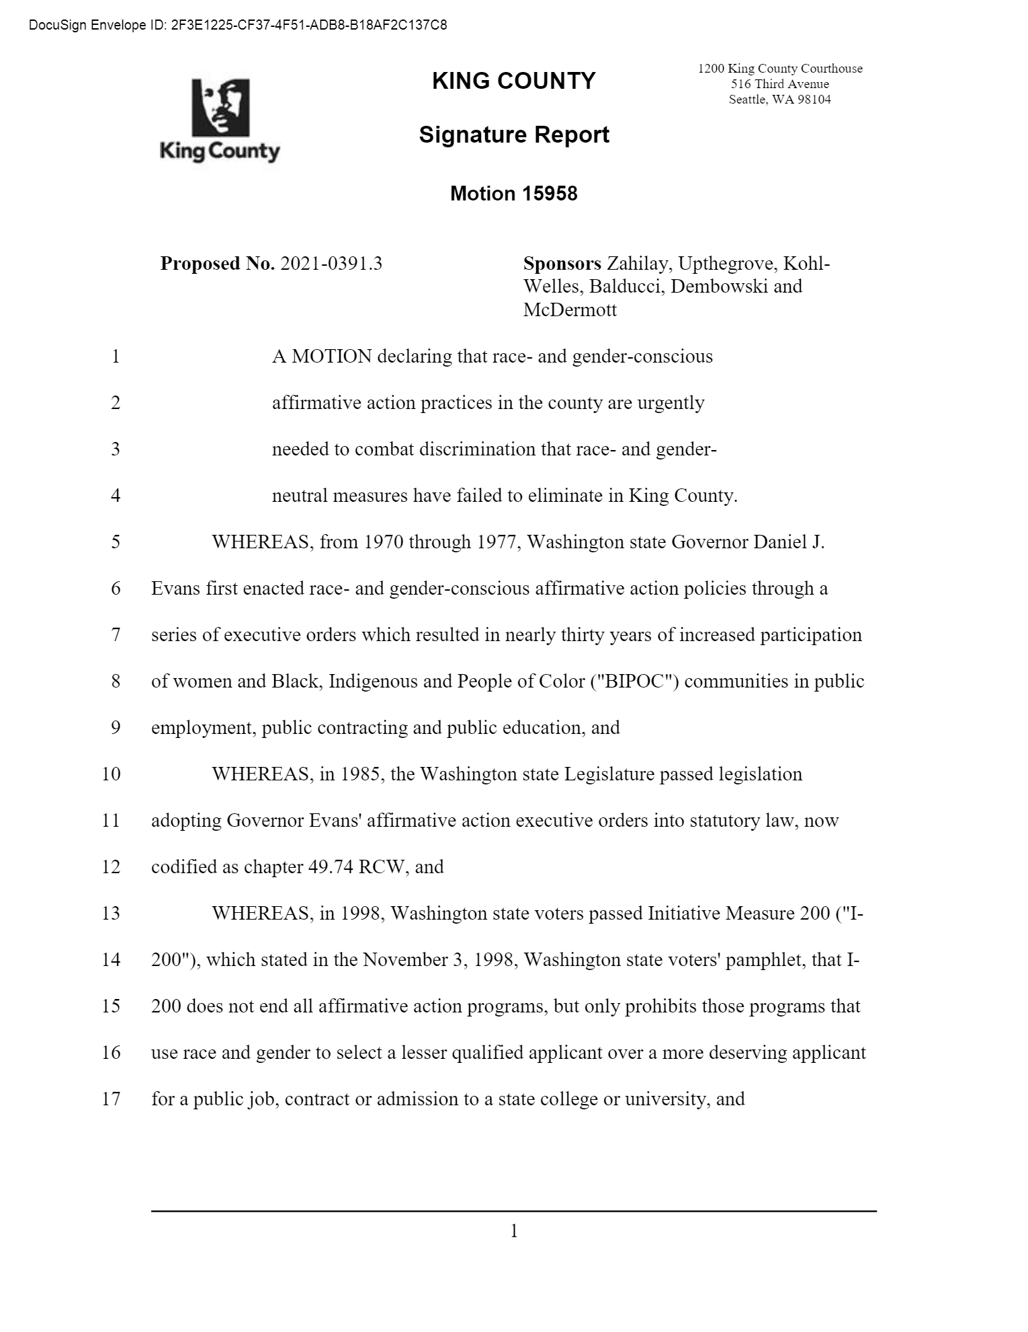
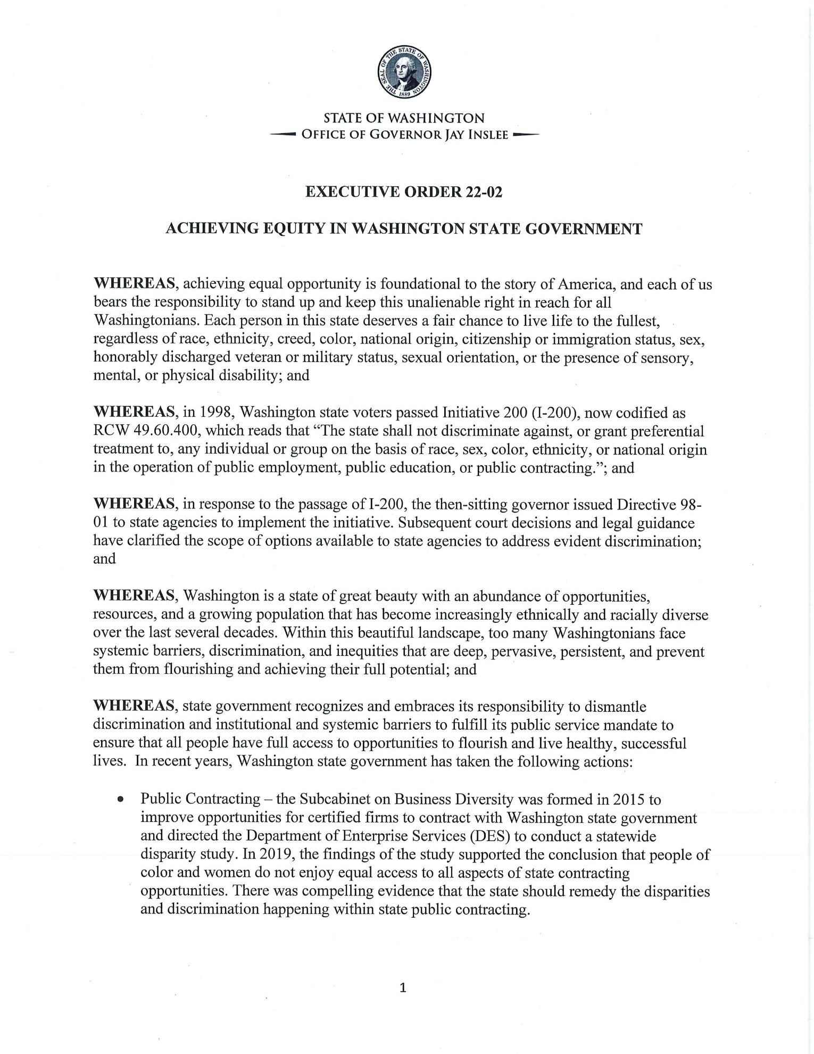
WHO IS WENA?
THE WASHINGTON EQUITY NOW ALLIANCE!
WASHINGTON EQUITY NOW ALLIANCE: WENA is a statewide antI-racist, non-partisan, non-profit organization, dedicated to Diversity, Equity & Inclusion (DEI). WEBSITE: Washington Equity Now! (waequitynow.com)
MISSION: “To replace systemic racism and sexism in Washington’s laws with systemic equity and justice.”
In 2021, WENA successfully led the passage of Motion #15958, bi-partisan legislation restoring race & gender conscious Affirmative Action for women and BIPOC communities in King County.
In 2022, WENA culminated a year-long successful statewide campaign urging Governor Inslee to rescind Governor’s Directive 98-01, which Governor Inslee did on January 17th by signing Executive Order 22-02.
The WENA alliance includes:
Association of Washington Cities (AWC)
INDIVISIBLE-WA
Muslim Association of Puget Sound -AMEN
NAACP
NW Minority Suppliers Council
Faith Action Network
Washington State African-American Cannabis Association (WSAACA)
Washington Democratic Central Committee
Church Council of Greater Seattle
Tacoma-Pierce County Black Collective and many other civil rights, business & social justice organizations.
EXECUTIVE ORDER 22-02
KING COUNTY COUNCIL
MOTION #15958

Slide 3
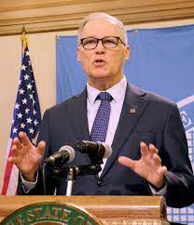
OFFICE OF THE ATTORNEY GENERAL IS THE LEAD LEGAL AUTHORITY ON EXECUTIVE ORDER 22-02
Solicitor General Purcell: On behalf of the Washington EQUITY NOW! Alliance (WENA), we thank you and Attorney General Bob Ferguson for your consistent leadership on racial and gender equity. We are encouraged Governor Inslee has made your Office the lead legal authority for all state agencies as Washington state implements Executive Order 22-02.
EXECUTIVE ORDER 22-02
“As agencies implement this Executive Order, they are directed to consult with the Office of the Attorney General, SHR and the Office of Equity.”
Governor Jay Inslee
Executive Order 22-02 – January 17, 2022

Slide 4
DUTIES OF THE OFFICE OF THE ATTORNEY GENERAL:
WHAT THE ATTORNEY GENERAL’S OFFICE DOES DO:
• Advises the Governor, members of the Legislature, other state officers, and county prosecutors on all legal issues.
Protects the public by upholding the Consumer Protection Act and enforcing laws against anti-competitive business practices.
• Proposes legislation to further protect families and children and provide clear, just and enforceable laws.
• Conducts education campaigns consistent with the policy goals of the office, including Operation: Allied Against Meth, Identity Theft, Senior Fraud Prevention and the 2016 Sunshine Laws.
• Pursues civil commitment of sexually violent predators to keep them out of your community until they are no longer a threat.
• Represents the State of Washington before the Supreme Court, the Court of Appeals, and trial courts in all the cases involving the state’s interest and defends in court state officers or employees ethically acting in their official capacities.
• Investigates and prosecutes persons accused of crimes at the request of the Governor or a county prosecutor.
• Gives formal written attorney general’s opinions on constitutional or legal questions at the request of designated public officials.
• Represents the public interest in utility matters and energy facility siting.
Source: https://www.atg.wa.gov/roles-office#:~:text=Represents%20the%20State%20of%20Washington,acting%20in%20their%20official%20capacities.

Slide 5
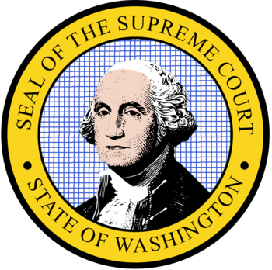
WA SUPREME COURT & ATTORNEY GENERAL AGREE: RACE & GENDER CONSCIOUS AFFIRMATIVE ACTION IS PERMISSIBLE IN WASHINGTON STATE!
WENA stands ready to work with the Attorney General’s Office or the Courts, if necessary, to finally implement I-200 as the voters passed it, and as both the Washington State Supreme Court and the Washington Attorney General have interpreted it:
Race & gender conscious Affirmative Action is permissible in Washington state… as long as the programs “…prohibit a lesser qualified candidate from being selected over a more qualified candidate for a public job, public contract or a seat in a public college, based on race or gender.”

Slide 6
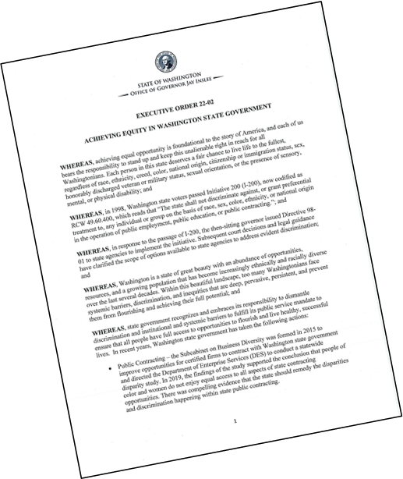
EXECUTIVE ORDER 22-02 DOES NOT CHANGE CURRENT STATE & FEDERAL AFFIRMATIVE ACTION LAWS
All current affirmative action laws are protected. Executive Order 22-02 does not change I-200, nor does it change any of Washington state’s current affirmative action laws.
“The recission of Directive 98-01 does not alter other state and federal legal requirements applicable to affirmative action measures.”
Governor Jay Inslee
Executive Order 22-02 - January 17, 2022

Slide 7
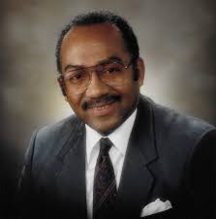
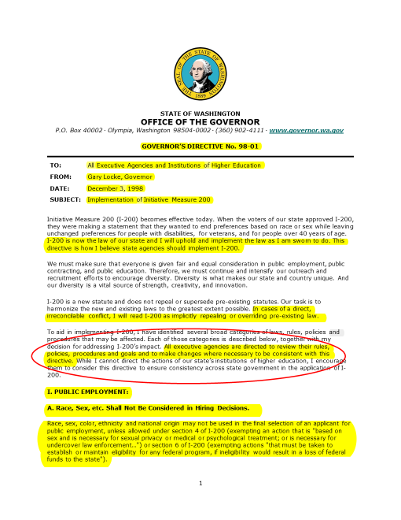
ESSSB 3230 – Revised Code of Washington (RCW) 39.19: SPONSOR: SENATOR GEORGE FLEMING (1983 & 1987) “RACE & GENDER CONSCIOUS” OMWBE
OFFICE OF MINORITY & WOMEN OWNED BUSINESSES (OMWBE)
“The purpose and intent of this chapter are to provide the maximum practicable opportunity for increased participation by minority and women-owned and controlled businesses in participating in public works and the process by which goods and services are procured by state agencies and educational institutions from the private sector.”
Source: Engrossed 2nd Substitute Senate Bill 3230
Enacted: April, 1983
RCW 39.19 is current statutory law. Neither statute has ever been repealed, rescinded or amended.
Former Washington State Senator
George T. Fleming

Slide 8
ESSB 3346 – Revised Code of Washington (RCW) 41.06; 49.74: SPONSOR: SENATOR GEORGE FLEMING (1985) “RACE & GENDER CONSCIOUS” AFFIRMATIVE ACTION
Revised Code of Washington (RCW) 41.06:
“RCW 41.06.020 (1) "Affirmative action" means a procedure by which racial minorities, women, persons in the protected age category, persons with disabilities, Vietnam-era veterans, and disabled veterans are provided with increased employment opportunities. It shall not mean any sort of quota system.”
Source: Engrossed Substitute Senate Bill 3346
Enacted: April, 1985
RCW 41.06 and 49.74 are current statutory law. Neither statute has ever been repealed, rescinded or amended.
Former Washington State Senator
George T. Fleming

Slide 9
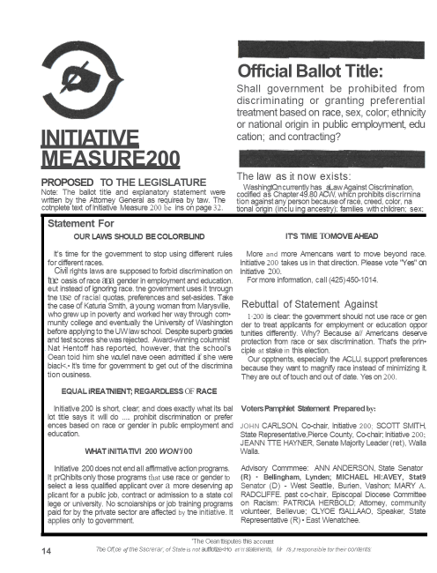
1998’S INITIATIVE 200 (I-200) DID NOT KILL AFFIRMATIVE ACTION IN WASHINGTON STATE!
WHAT INITIATIVE 200 WON’T DO
“Initiative 200 does not end all affirmative action programs.
It prohibits only those programs that use race or gender to select a less qualified applicant over a more deserving applicant for a public job, contract or admission to a state college or university.”
Washington State Voters Pamphlet, Page 14
November, 1998

Slide 10
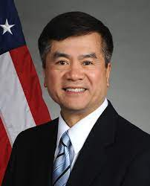
GOVERNOR’S DIRECTIVE 98-01 MANDATED STATEWIDE “RACE & GENDER NEUTRAL” AFFIRMATIVE ACTION POLICY
GOV. LOCKE’S STATEWIDE DIRECTIVE:
“All Executive Agencies are directed to review their rules, policies, procedures and goals and to make changes where necessary to be consistent with this directive.”
Governor Gary Locke’s Directive 98-01
Page 1, Paragraph 4
December 3, 1998
GOVERNOR’S DIRECTIVE
98-01

Slide 11
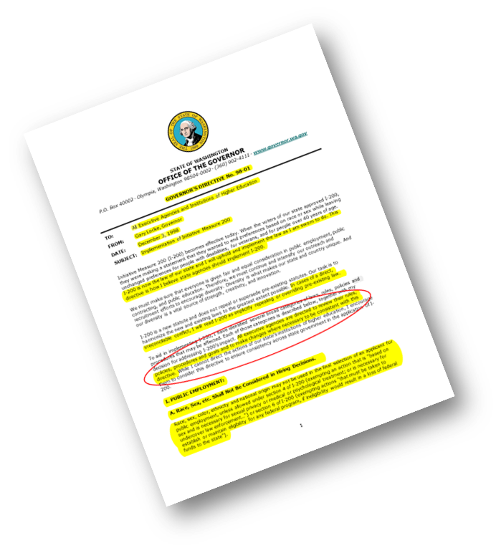
GD 98-01’s 1998 RACE & GENDER NEUTRAL POLICIES HAVE BEEN EMBEDDED THROUGHOUT STATE, COUNTY AND LOCAL GOVERNMENT FOR NEARLY A QUARTER OF A CENTURY
GOVERNOR’S DIRECTIVE 98-01
“Passage of Initiative 200 in 1998 eliminated mandatory goal setting for locally-funded projects...”
“Affirmative action plans prohibit hiring or employment preferences based on gender or race.”
"Affirmative action plans may not include hiring or employment preferences based on gender or race, including color, ethnicity or national origin." "...under state law racial minorities and women may not be treated preferentially in public employment."

Slide 12
Office of Minority & Women Business Enterprises (OMWBE)
Since GD 98-01’s 1998 implementation, small, women and minority owned businesses have lost an estimated…
$3.5 BILLION DOLLARS
in job generating
state contracting opportunities!
Source: Office of Minority & Women Business Enterprises (OMWBE)

Slide 13
WASHINGTON STATE SUPREME COURT Parents Involved in Community Schools v. Seattle School District #1 (2003) 18 YEARS AGO, THE WASHINGTON SUPREME COURT ISSUED THE FINAL INTERPRETATION OF I-200, WHICH HAS NEVER BEEN CHALLENGED, APPEALED OR OVERTURNED.
WASHINGTON ’S HIGHEST COURT RULED:
“After examining Washington history, our constitution, and RCW 49.60.400, we conclude that the act (Initiative 200) prohibits some, but not all, race-cognizant government action.”
“Subsection (3) (of RCW 49.60.400) unequivocally states that some government action within the subject area of the initiative would not be affected, and thus strongly suggests to the average voter that some race conscious action by the government is permissible.”

Slide 14
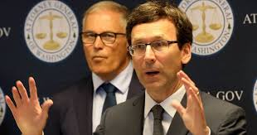
WASHINGTON SUPREME COURT I-200 RULING APPLIES TO PUBLIC EDUCATION, PUBLIC EMPLOYMENT & PUBLIC CONTRACTING “Nonetheless, the reasoning of Parents Involved applies more broadly than the educational context, because ultimately the Court’s task was to construe the language of RCW 49.60.400. By its terms that statute applies to “operation of public employment, public education, [and] public contracting” without distinction.” MARCH 20, 2017
WASHINGTON STATE ATTORNEY GENERAL BOB FERGUSON ADVISORY OPINION 2017, NO. 2:

Slide 15
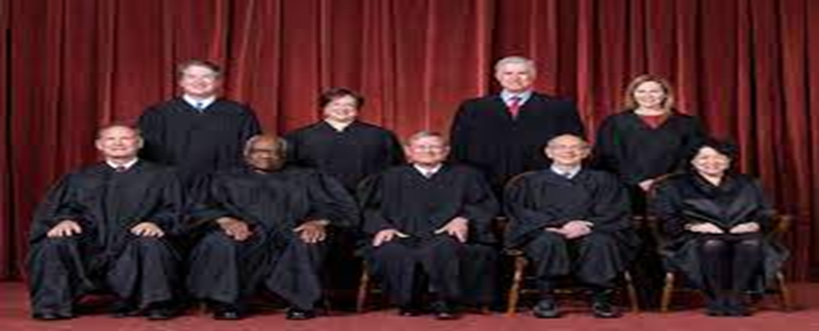
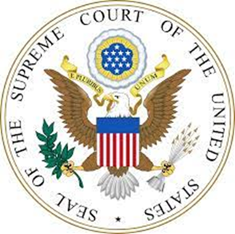
UNITED STATES SUPREME COURT City of Richmond vs. Croson (1989)
UNITED STATES SUPREME COURT
APPLIES TO ALL OR PARTIALLY FEDERAL FUNDED STATE & LOCAL GOVT. PROGRAMS;
MUST PASS THE STRICT SCRUTINY TEST OF FEDERAL CONSTITUTIONALITY;
COMPELLING STATE INTEREST:
MUST SHOW THAT RACE & GENDER NEUTRAL POLICIES HAVE BEEN TRIED BUT FAILED TO ACHIEVE COMPELLING STATE INTEREST (DISPARITY STUDY)
RACE & GENDER CONSCIOUS PROGRAMS MUST BE NARROWLY TAILORED and the LEAST RESTRICTIVE WAY TO ACHIEVE ASPIRATIONAL GOALS.

Slide 16
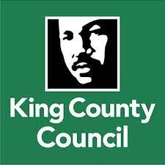
BI-PARTISAN MOTION 15958 – PASSED UNANIMOUSLY! King County Council Democrats & Republicans declared that “…race and gender-conscious affirmative action practices in the county are urgently needed to combat discrimination that race and gender-neutral measures have failed to eliminate.”

Slide 17
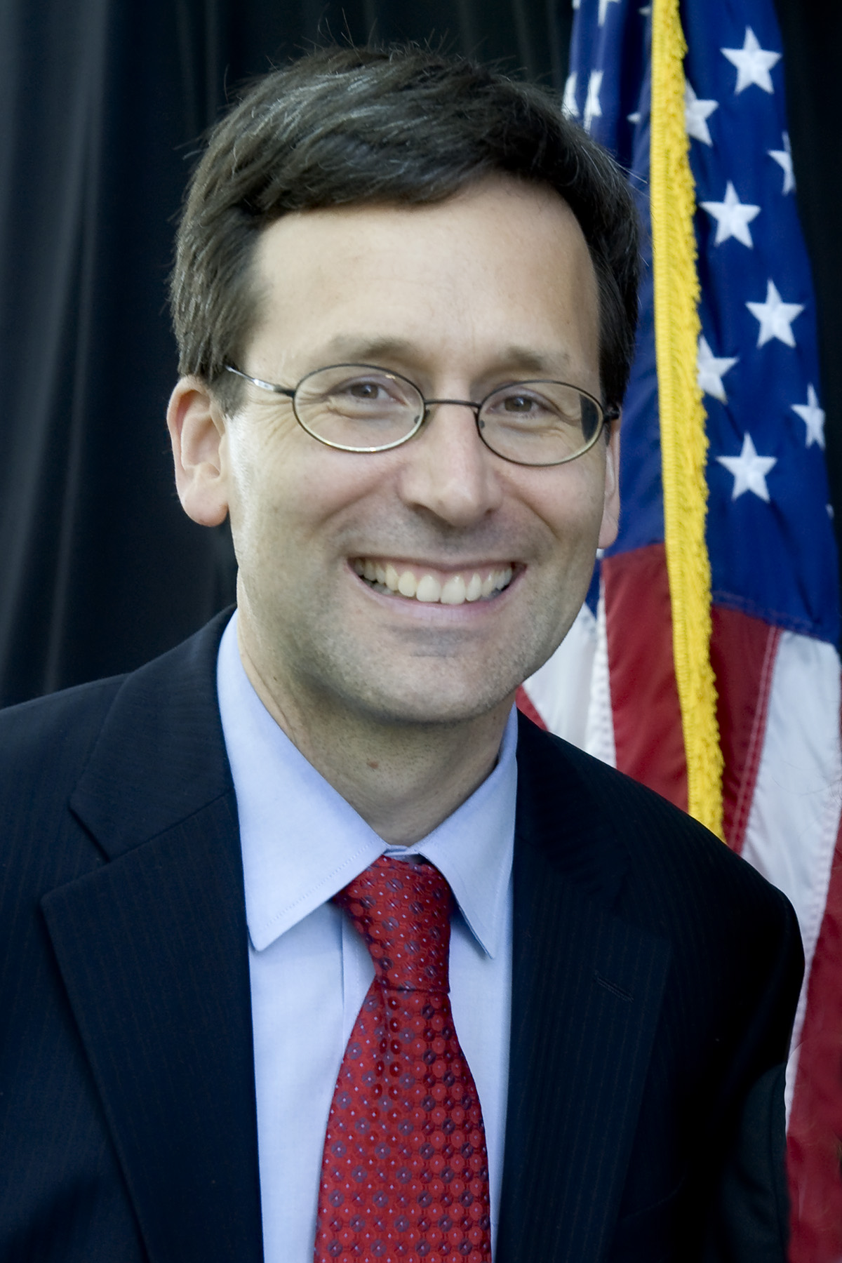
EXECUTIVE ORDER 22-02 IMPLEMENTATION WENA proposes to underwrite a public-private partnership with the Attorney General’s (AG) Office, similar to the 2016 Sunshine Laws’ public awareness campaign the AG’s office conducted in partnership with the WA Coalition for Open Government (WCOG). GOAL: Diversity, Equity & Inclusion (DEI) Education & Training on the lawful implementation of race & gender conscious affirmative action in accordance with the following legal authorities: 1. Washington State Supreme Court’s 2003 ruling in Parents Involved in Community Schools; 2. Attorney General Bob Ferguson’s AGO Opinion 2017, No. 2; 3. Washington statutory laws, rules & regulations; 4. U.S. Federal Laws. TIMETABLE: March-October, 2022. (To coincide with Office of Equity’s March, 2022 strategic plan release.)
WENA’S REQUESTS of ATTORNEY GENERAL

Slide 18
Thank You! Q & A

