Slide 1
How to do business with Washington state
Regional Contracting Forum
September 22, 2021

Slide 2
Department of Enterprise Services
DES provides variety of services that strengthen the business of government
Public works contracting
Master contracts for goods and services
Facilities and leasing
Information technology contracting assistance
Technology leasing
Small agency financial and human resource solutions
Print and mail services
Fleet operations and Surplus operations
Notes:
Enterprise Services provides a variety of support services to Washington State agencies and residents.
Basically, you can think of us as the centralized agency that leverages resources and expertise to conduct centralized procurements for goods, services, and construction.
We also provide other support services such as real estate services, managing buildings and grounds at the state capitol, computer hardware and network infrastructure leasing, printing, small agency finance and human resources, mail services, fleet, and surplus.

Slide 3
DES Contracting
Good and services contracting: DES oversees state master contracts with more than 1,200 private vendors who provide more than $1 billion worth of goods and services each year. DES purchases over $100 million a year in goods and services for DES operations.
Public works contracting: Across the state, DES manages nearly 400 design and construction projects worth more than $290 million each year.
Notes:
Good and services contracting: DES oversees state master contracts with more than 1,200 private vendors who provide more than $1 billion worth of goods and services each year. DES purchases over $100 million a year in goods and services for DES operations.
Public works contracting: Across the state, DES manages nearly 400 design and construction projects worth more than $290 million each year.

Slide 4
Goods and Services – State Agencies
Type of Contract | Competed and posted in WEBS | Size of opportunity | Access to information
Master Contract | Yes | $0 to $120 million | Contract information is on our website Sales data is quarterly posted on data.wa.gov
Agency Contract | Yes | Usually over the direct buy limit | Awarded contracts are annually posted on data.wa.gov Contract information can be requested
Direct Buy | No | Under $30,000 ($40,000 for small and certified veteran owned businesses) | Scopes with contracts are posted annually on data.wa.gov Purchases made by check are posted in open checkbook
There are some exceptions to this such as emergency purchasing and sole source contracts.
Notes:
Washington State Agencies do goods and services procurements mainly in these three areas. There are some exceptions to these areas, such as emergency and sole source opportunities.
Master contracts:
If a master contract exists and meets a state’s needs, then they are required to use this contract.
These procurements are done by DES and solicitations are required, under state law, to be posted in WEBS.
These opportunities do not have a minimum spend value and can be as high as $120 million or more.
Information about each contract is centralized on our website and sales data is posted publicly quarterly on data.wa.gov.
If you follow the hyperlink, it will take you to our contracts page and you can look up all of our contracts.
Agency Contracts
DES and other state agencies, may also do their own procurements just for their agency.
These are also required to be posted in WEBS when over the direct buy limit.☺
Data about these procurements is posted annually on data.wa.gov.
Contract information can be requested, but isn’t usually publicly posted.
Direct Buy
These are smaller needs and are if there isn’t already a master contract or agency contract in place.
These are not posted in WEBS.
These are only for opportunities under $40,000 for small or veteran owned businesses, and $30,000 for other entities.
If there is a contract, it should be included in agencies annual contract reporting posted on data.wa.gov.
All payments are posted in open checkbook (http://www.fiscal.wa.gov/Checkbook.aspx), but if the payment was with a credit card, the payment will be recognized as the credit card company.
This is the only area we cover currently in BDAG, public works is in a different division.

Slide 5
Register in WEBS
Register in the Washington’s Electronic Business Solution (WEBS)
If you plan on bidding to the state or other entities that use WEBS to post solicitations.
State agencies are required to post solicitations above the direct buy limit in WEBS (increased to $30,000 and $40,000 for small or certified veteran businesses).

Slide 6
Other benefits of webs
Identify as a Washington Small Business or start the certification process for Veteran business certification.
Help prime contractors find you for state inclusion plans.

Slide 7
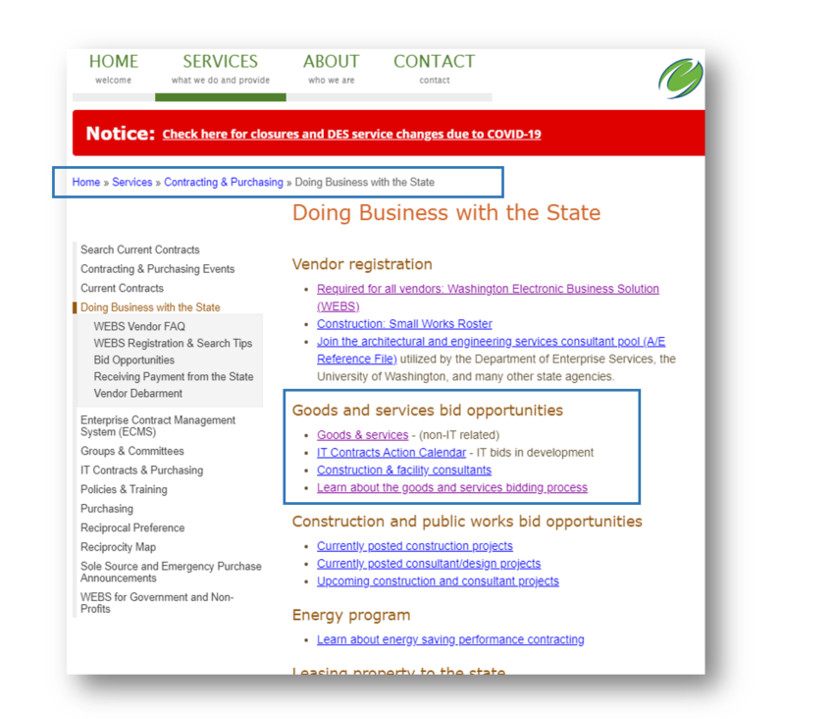
Planned Procurements
We post this process publicly
We list anticipated dates and duration of each phase
Transparency
Master Contracts: Planned Procurements
Agency Contracts: Forecasts
Public Works: Forecasts
Notes:
I’ve included the links to our planned procurement page that shows where we are in the process and our agency forecasts.
This is listed for master contracts, those centralized contracts. Our DES goods and services contracts. Our public works division also posts forecasts. This happens with the state capital budget, versus continuous like master contracts.

Slide 8
Public works– State Agencies
Type of Work | Agency Lead | Posted in WEBS | Information
Vertical Construction | DES | Yes | DES builds and maintain buildings for the state. DES manages vertical construction projects for state and local agencies.
Civil Construction | WSDOT | Depends | WSDOT is responsible for buildings, highway systems, and ferries for the state. WSDOT partners to maintain local roads, railroads, airports, and alternatives to driving.
Other | Multiple | Depends | Other agencies, to include four year universities, with construction authority may manage their own construction and design projects.
Notes:
Washington State Agencies do goods and services procurements mainly in these three areas. There are some exceptions to these areas, such as emergency and sole source opportunities.
Master contracts:
If a master contract exists and meets a state’s needs, then they are required to use this contract.
These procurements are done by DES and solicitations are required, under state law, to be posted in WEBS.
These opportunities do not have a minimum spend value and can be as high as $120 million or more.
Information about each contract is centralized on our website and sales data is posted publicly quarterly on data.wa.gov.
If you follow the hyperlink, it will take you to our contracts page and you can look up all of our contracts.
Agency Contracts
DES and other state agencies, may also do their own procurements just for their agency.
These are also required to be posted in WEBS when over the direct buy limit.☺
Data about these procurements is posted annually on data.wa.gov.
Contract information can be requested, but isn’t usually publicly posted.
Direct Buy
These are smaller needs and are if there isn’t already a master contract or agency contract in place.
These are not posted in WEBS.
These are only for opportunities under $40,000 for small or veteran owned businesses, and $30,000 for other entities.
If there is a contract, it should be included in agencies annual contract reporting posted on data.wa.gov.
All payments are posted in open checkbook (http://www.fiscal.wa.gov/Checkbook.aspx), but if the payment was with a credit card, the payment will be recognized as the credit card company.
This is the only area we cover currently in BDAG, public works is in a different division.

Slide 9
Des distinct public works units
1. Engineering & Architectural Services (E&AS) is the Public Works authority serving:
State Board of Community Technical Colleges (SBCTC) Washington’s (34) Community and Technical Colleges and other agencies
Capital Planning & Development at the Department of Corrections (DOC)
The Office of Capital Programs at the Department of Social and Health Services (DSHS)
Notes:
Engineering & Architectural Services (E&AS) for state facilities in Washington are managed by the Facility Professional Services (FPS) division of the Department of Enterprise Services. E&AS serves an incredibly diverse group of clients providing a variety of essential program services.
As the needs of our clients have changed over time, DES has developed into three distinct work units:
E&AS is the Public Works authority serving:
SBCTC Washington’s (34) Community and Technical Colleges and other agencies
Capital Planning & Development at the Department of Corrections (DOC)
The Office of Capital Programs at the Department of Social and Health Services (DSHS)
The Planning and Project Delivery (PPD) Program at DES provides long range planning and capital project management on the State Capitol Campus and other DES-managed facilities.
Energy Program providing energy project management services to help customers reduce operational costs, and make Washington a better place to live, learn and work.

Slide 10
Construction contracting methods
Job Order Contracting (JOC)
  $6 million annually
  Individual work orders can not exceed $500,000
  Must subcontract out 90% of the work
  6 JOCs across the state
Projects over $300,000 are bid individually
Small Works - $350,000 or less
Limited Public Works – $50,000 or less
Notes:
For Public Works Contracting, DES uses the below types of contracting methods.
Job Order Contracting (JOC)
Which is for up to $6 million annually
Individual work orders can not exceed $500,000
JOCs must subcontract out 90% of the work
There are 6 JOCs across the state
Projects over $300,000 are bid individually
Small Works - $350,000 or less
Limited Public Works – $50,000 or less
Professional Design Contracts include:
On-call Professional Services for $350,000 or less
Project Specific Selection with no size limit

Slide 11
Professional design contracting
On-call Professional Services - $350,000 or less
Project Specific Selection – no limit
Notes:
Professional Design Contracts include:
On-call Professional Services for $350,000 or less
Project Specific Selection with no size limit

Slide 12
Distinct unites focus on long range planning and energy
2. The Planning and Project Delivery (PPD) Program at DES provides long range planning and capital project management on the State Capitol Campus and other DES-managed facilities.
3. Energy Program providing energy project management services to help customers reduce operational costs, and make Washington a better place to live, learn and work.

Slide 13
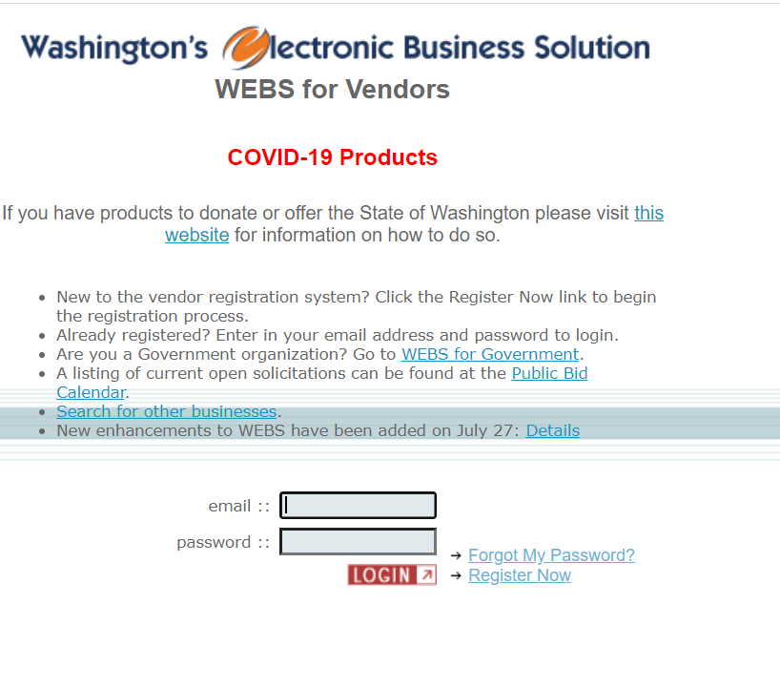
We are here to help
WEBS Customer Service
(360) 902-7400
WebsCustomerService@des.wa.gov
WEBS Registration Link
Notes:
Contact our customer service team with all things WEBS
Our team is also a great resource for our division, central contact, and quick responses

Slide 14
Contact US
Public Works, Facilities, Leasing
(360) 407-2220
FacilitiesandLeasing@des.wa.gov
Contracting & Purchasing
(360) 407-2210
ContractingandPurchasing@des.wa.gov
WEBS Customer Service
(360) 902-7400
webscustomerservice@des.wa.gov
Enterprise Policy
(360) 407-2210
DESmiEnterpriseProcurementPolicy@des.wa.gov

