Slide 1

A Response and Details
Regarding the Video
By Caitlin Knight
and Path of Hope
Rescue
on
June 8, 2023

Slide 2
As many of you may already know,
Caitlin Knight, the Executive Director for
Path of Hope Rescue
went live in a video on the
Path of Hope Rescue's Facebook
Page.
During this video, Caitlin made some very
eregious claims, statements, and insinuations.
Here is our responses, with proof, that her
video claims, statements, and insinuations
are outright fabrications.

Slide 3
  Caitlin claims the information being posted about SCRAPS is “hard to believe” and that she had trouble “finding out the facts”.
The facts are not hard to believe when the claims regarding the wrongs are being backed by actual SCRAPS records, public interviews with SCRAPS leadership, and recorded proof of their dishonesty. If Path of Hope Rescue and Caitilin Knight were more involved with helping the animals of Spokane rather than flying in additional dogs from Texas, then she would have a bit more knowledge on what these facts are.
2. She has access to the actual people at SCRAPS. You guessed it, the ones that are continuous lying to the community, killing animals, the ones that do not meet the minimum requirements for their positions, and let us not forget; the ones who adopted a SCRAPS dog under the agreement to have her spayed and then bred her multiple times for a profit claiming a shelter dog had AKC puppies.
3. Caitlin states she heard this from SCRAPS themselves and the Animal Welfare Community. Then she goes on to state “this is not I heard, she heard, I read”. You really need to get your story straight Caitlin, you said “you heard” and now it’s not “I heard”. So which is it?
4. Caitlin mentions the population increase in our area and if she is speaking of the animal population increase, she is directly contributing to this by flying in Texas dogs instead of helping the local shelter she so boldly defends.
5. Caitlin then states that Jesse Ferrari and Nick Hobbs Doyle are openly and actively learning the dog side of rescue but have the people side down. Does having the people side down include erroneously firing the last member of the SCRAPS dog behavior team, firing volunteers for speaking up, creating a hostile work environment, retaliation and discrimination, and not meeting the minimum jobs requirements for the positions they hold?
6. Caitlin states that when talking about “behavior dogs” they are talking about dogs with bite histories, have bit children, that there is one dog that ripped open a volunteer's entire arm and required major surgery. She claims these behavior dogs, are dogs that are major community risk. We have so much to add to this statement. Please see the attached public records for Cooper and Rudy. Two “behavior dogs” whose shelter status was changed from “Available for Adoption” to “Awaiting Behavior Assessment” just minutes after Stephanie Hayden, the last member of the SCRAPS dog behavior team, was erroneously fired. These statuses were changed without any incident, bite, or aggression from either dog. To dive a bit deeper, there are a few dogs that have a history of biting and yes, some to children, yet the Animal Control Officers who completed an extensive investigation into the bites themselves, did not deem the dog dangerous. You read the right; The Animal Control Officers deemed the dog to be safe for placement as outlined by law. The dog Caitlin is referring to, who“ripped open a volunteer's entire arm” was named Oatmeal. We say was, because Oatmeal was deemed to be dangerous and was humanely euthanized due to this bite. If you take notice, we have never questioned or even brought up Oatmeal because the protection of people is a duty to everyone in animal welfare and even though we are deeply saddened by his life being lost, we understand that is the reality when you have a truly dangerous dog. We are not anti-euthanasia; but we are anti-kill without due diligence. However, many of these dogs have no incident or bite history on their records and have had their status changed to Behavior. A common factor for most of them is the length of their stay at SCRAPS.

Slide 4
7. She goes on to mention the budget restrictions upon the municipality and that they cannot be dumping $10,000 into each of these dogs and that they need to be euthanized. First, the SCRAPS Hope Foundation pays for most medical and the funds can also be utilized for behavior care. The Hope Foundation is funded by donation from people who believe in true no kill and that every life matters. Lastly, the municipality has a contract that states an animal must be “determined by an animal behavior specialist to be an untreatable threat to other animals or people.”, so thankfully for these dogs she is claiming are a bite risk, they are not to be killed unless they specifically meet these requirements. There were community organizations and community members who offered services, to which SCRAPS Leadership declined. This wouldn't have taken anything from the budget. Statistics prove that only 1-2 % of dogs have untreatable aggression.
8. Caitlin states that the community is in an uproar over dogs that are dangerous. To prove this inaccurate statement; three separate behavior dogs, two adopted and one in a rescue, all have separately stated that the statements and accusations about these dogs are unfounded, and they have had no major concerns with these dogs' behaviors. Once again, I will remind you, that many of these behavior dogs have no bite history or incident albeit if Caitlin spreads that narrative without fact, it must be true.
9. Caitlin begins stating they have euthanized one dog and his name was Domino which is a dog with a serious bite history. This is beyond false, there are more dogs that one that have been killed. Domino never bit anyone. He has no bite record with Spokane County Regional Health nor with SCRAPS. He has no incident at all. This is a flat-out dishonest statement. See the attached screenshots of Domino’s profile within Shelter Buddy, the system used by SCRAPS to document legal records for every animal in their care. The full records of Domino have been requested but since an employee who was currently employed at SCRAPS was with him when he was killed even though she advocated for him proving progress, we know with absolute certainty, there was no bite ever.
10. Caitlin’s blatant tale of Domino biting up the catch pole and that they took him outside never happened. Stephanie Hayden, a former SCRAPS employee and advocate, was present during his killing and she attests he never once bit at the pole, nor growled until he was pinned between the wall and the door to be given a sedative prior to his killing. Dr. O’Keeffe killed Domino in the back room by the crematorium, where he could smell the corpses of other animals who had their lives taken. The only kind things that were done for Domino, are not as Caitlin is portraying, were a door to the outside was opened so he could also see and smell the outdoor air. As well as allowing the few people, like Stephanie Hayden, who actually cared about this dog be with him while they killed him. Caitlin said his last moments were on the grass which is completely inaccurate, he was indoors near a refrigerator with animal bodies and the crematorium to turn them to ash.
11. Caitlin then states there are “a lot of other dogs on this list” but previously she said there was no list. Clearly there is some sort of list as she continues to mention it.
12. She calls out Bryanna’s name “for yelling” or “being upset” because she used all caps in regard to the lies being told by Caitlin about Domino biting someone. Caps is a tool that can be utilized to emphasize a point not “yelling”, hopefully in the future Caitlin can recognize this use and take emphasis into consideration before making accusations.

Slide 5
13. Caitlin then claims she is telling facts directly from the organization but has yet to show any proof of these so called “facts”. This is not creating transparency or a fact-based discussion.
14. She claims the rest of the dogs are being evaluated for safety by a behavioral trainer and then decisions from there. At this time, SCRAPS does not have a behavioral trainer and these dogs are sitting in the kennels waiting for SCRAPS to find a behavioralist. They have moved them into their D Pod and other areas where they are no longer accessible to all of the volunteers to walk them and will receive hardly any interactions. This is beyond detrimental to their mental wellbeing and will create a situation when they finally can be assessed, and they have endured further stress and regression thus setting them up for failure when being assessed. This does not help the dogs in ANY way.
15. Caitlin states SCRAPS is Animal Control but they are not an adoption center. That they are supposed to be a safe place for stray dogs and to return loose dogs back to their homes. If this is the case, why are they not accepting dogs? Why are they telling people to let the dogs go where they find them? This in dangerous and only happening because they are full and refuse to release adoptable dogs. Also, her statement is counterfactual, SCRAPS is a community service, and their services are further defined below. Then she goes on to state that this is the mission of SCRAPS, to be a safe place for dogs that are loose on the streets to go and to be returned to their owner.
Per the contract with the City of Spokane Attachment “1”
Animal Protection Services shall include:
ITEM 1: Enforcement of the CITY’S Animal Control Ordinance presently in effect and/or as hereafter amended by the CITY consistent with this Restated Agreement;
ITEM 2: Enforcement of Chapter 16.08 RCW (Dogs)
ITEM 3: Enforcement of Chapter 16.52 RCW (Prevention of Cruelty to Animals); and
ITEM 4: Enforcement of Chapter 16.54 RCW (Abandon Animals)
Animal Protection Services also includes: (1) Protections and Enforcement Services, (2) Shelter Services, (3) Special Program Services, (4) Animal Control Oridinance/License/Fees/Penalties Services, (5) Veterinary Services, (6) Citizen Complaint Services, (7) Citizen Complaint Reporting Services, (8) Activity Specific Reporting Services, and (9) Miscellaneous Services.
The attachment goes on to better define each service above. See pages 14-20 of the Contract attached.

Slide 6
16. Caitlin then states that the National average for a dog that is out, loose in the community, 7 out of 10 times has a home and needs to be returned to it. Where are these statistics? Do you have peer reviewed research to back this claim? We have been unable to confirm these statistics at this time.
17. Caitlin states SCRAPS is full. They have 89 kennels total and 86 are full and they have to have 3 open for Isolation and other “legal” reasons. The isolation pod has 5 dog kennels. Why would they keep 3 of 5 kennels open to place contagious animals? You wouldn’t want to be housing contagious animals with seemingly healthy animals. There is no WA RCW, law, or ordinance that states a kennel must be left empty.
18. Caitlin references a hierarchy for transferring animals which is non-existent. Any rescue can request to pull or transfer in animals.There is not a Standard Operating Procedure regarding a hierarchy for Transfer
19. Caitlin states they have had 2 or 3 meetings now with leadership. Why weren’t all rescue partners invited or included in these meetings? Why is it that the major collective of the rescues in attendance have personal relationships and connections with the SCRAPS Veterinarian. These meetings should have been all inclusive of any rescue organization, shelter, or transfer partner that had any interest in attending.
20. Caitlin claims that SCRAPS Leadership “jumped into a sinking ship or hornets’ nest” and are dealing with repercussions left behind from previous Leadership and working through legal issues left behind. This would be the first time we have heard of legal issues outside of the legal consequences from the wrongs committed. That being said, one would think that pending litigation matters would not be brought up with community partners as a matter of privacy and the chance for compromising an investigation.
21. Caitlin once again states “there is no euthanasia list at SCRAPS” yet previously she mentions a list of dogs. This list of dogs is comprised of dogs labeled as “Awaiting Behavior Assessment”. A previous statement from Caitilin confirms said list and she claimed the dogs are being evaluated for safety by a behavioral trainer and then decisions (will be made) from there. These dogs that were previously listed as “Available for Adoption”, had no incident or concern to warrant a change in status to “Awaiting Behavior Assessment”. Most of these dogs also have the longest length of stay in the shelter. To sum this up, longest stay in the shelter and no active incident of aggression, bite, and/or safety concern yet they are now being considered to need a behavioral assessment. This is baseless. They are not performing behavior assessments on every dog in their care so why are they assessing these dogs with no cause? To further solidify this, any dog who has a history of a bite that is a Behavior Dog, Dog Team, PD, Supervision Required, etc, has already been investigated, reviewed, and deemed safe by the Animal Control Officers who conducted their investigation per the actual law. This “list” may not be called a euthanasia list, a long term stay list, or any other term to place a title to the obvious actions of SCRAPS Leadership but they are stating “Awaiting Behavior Assessment” with no active incident of aggression, bite, and/or safety concern and as Caitilin states, “then decisions from there”.

Slide 7
22. Caitlin claims to be working toward the same goal and that when you “go after an organization like SCRAPS”, you’re hurting the dogs. “If you’re not willing to be part of the solution then you’re part of the problem”. “Ask yourself, is what you’re doing, helping the dogs or hurting the dogs” “If you’re not willing to volunteer or foster or donate, then do you need to be involved?” The advocates speaking out against the wrongs of SCRAPS not only have the First Amendment right to speak out against inhumane practices committed by a governmental entity, he or she also has a constitutionally protected right to demand that the government correct the wrongs that are identified. As the Supreme Court has stated, a government entity “may not deny a benefit to a person on a basis that infringes his constitutionally protected interests—especially, his interest in freedom of speech.” Claims that these advocates are harming the animals by speaking out against a government entity and that it is not helping the animals in an opinion. The people who are holding our Municipal Animal Protection accountable for their contract breaches, dishonesty, and retaliation are not the problem. It is a ridiculously unethical practice to blame and attack the advocates for shining a light on the issue and to consistently gaslight their experiences, knowledge, and factual documentation. It is also worth noting that we were all fostering, volunteering, and donating to SCRAPS and had requested multiple times to continue to help the animals at SCRAPS, which was denied multiple times by Jesse Ferrari.
23. Once again, Caitlin claims her statements expressed while clearly representing Path of Hope Rescue “are the facts”. To date, she has not been able to provide any documentation or solid proof of her claims, statements, and insinuations despite request for such proof.
24. States SCRAPS will be holding a public Q&A. Why hasn’t SCRAPS announced this to allow the public to plan for said meeting and ensure they can be present?
25. Caitlin states there “are people on here that disagree with facts” and again claims “these are the facts”. She is then states she “stands behind SCRAPS and what they are doing and she will personally vouch for them.” This disregard for evidence of the claims being spread to her via hearsay and the defamation, insinuations, slander, and dishonesty that Caitlin Knight, as a representative for Path of Hop Rescue has committed will not be tolerated. She has proved to disregard the actual proven facts and continues to spread dishonest narratives about the actions of SCRAPS Leadership.

Slide 8
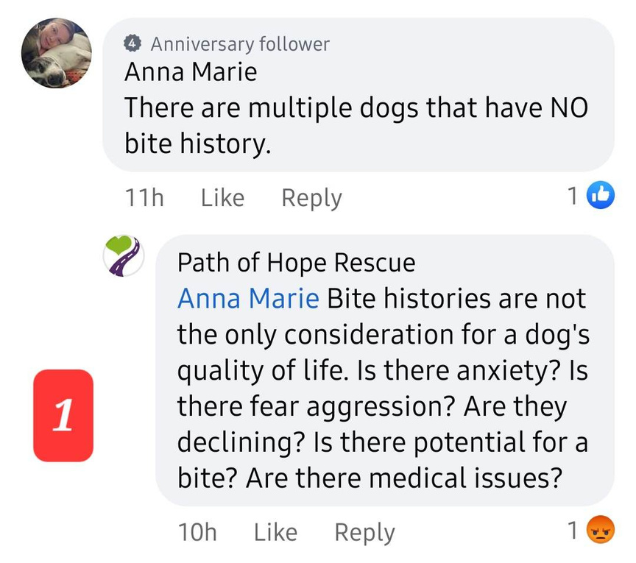
Screen Shot 1
Caitlin states considerations for Quality of Life such as anxiety, fear aggression, declining, potential for a bite, medial issues. In a stressful shelter environment, things such as anxiety, fear, declining, and medical issues are factors. Those types of behaviors should be addressed by a qualified behaviorist and medical issues by a veterinarian. SCRAPS has refused to work with behaviorists that support the true no kill model. They have also refused to reach out to rescues other than the ones who support the narrative. We can only venture to say that since Caitlin is bringing up “Quality of Life” that SCRAPS Leadership must not have provided her with the contract requirements they have with the City of Spokane which state,
·Attachment 1, 2-Shelter Services: “The operating policy of SCRAPS will be to restrict euthanasia to only those cases in which an animal in the care of the facility is found to be in the process of dying or determined by a licensed Veterinarian or Animal Behavior Specialist to suffer from an irremediable prognosis. No euthanasia will be performed without the express approval of the SCRAPS Director. Animals in the care of SCRAPS will not be sent to or exchanged with any other animal shelter, care facility or rescues with policies that do not meet this standard."
·Section No. 2, F, defines “irremediable prognosis” as: "An animal determined by a licensed veterinarian to be suffering by a severe, unremitting physical pain with prompt, necessary and comprehensive veterinary care and/or an animal deemed by applicable law or determined by an animal behavior specialist to be an untreatable threat to other animals or people."
Let’s get one this straight, any animal has the potential for a bite regardless of history.
Any animal.

Slide 9
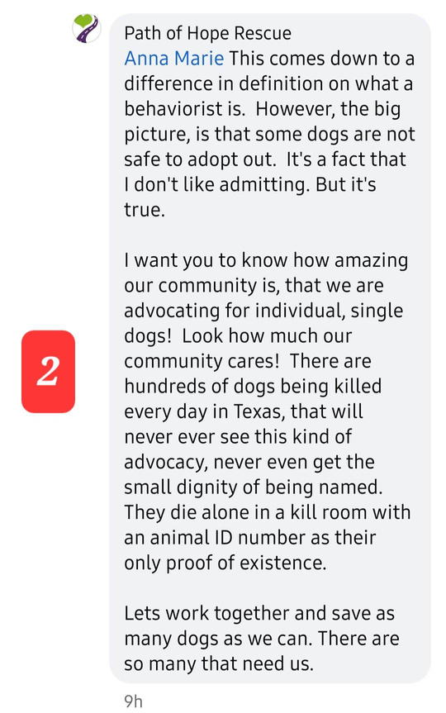
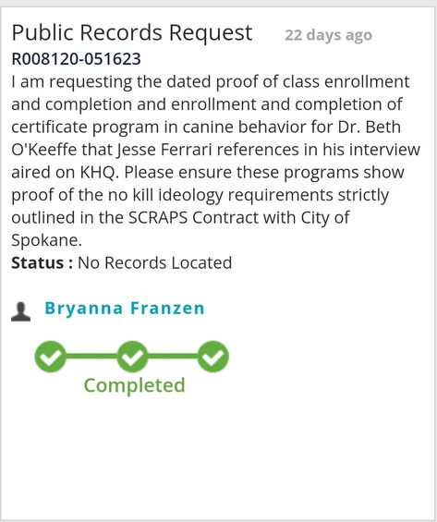
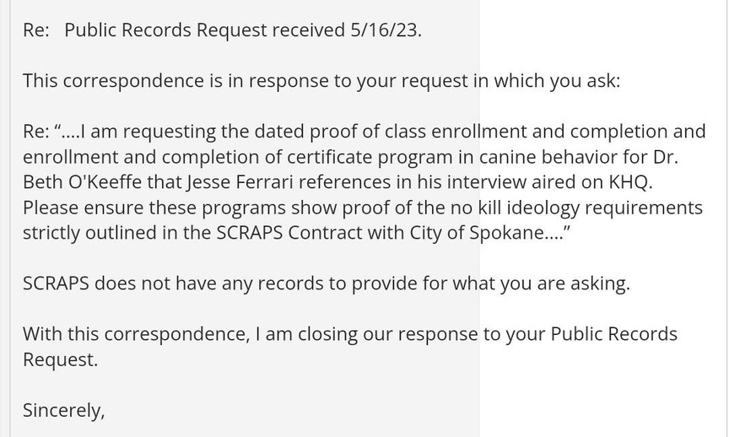
Screen Shot 2
Caitlin states some dogs are not safe to adopt out and this all comes down to the difference in definition of what a behaviorist is. Caitlin likes to consistently bring up Texas in this video and the comments, which is not surprising as many rescues receive substantial payments for transferring in dogs from Texas. What is she doing for the local dogs in jeopardy of losing their lives? You must clean up your own home before taking on others. While we would love to see every animal be saved, we need to take care of our community who is clearly struggling first.
While we can agree that some dogs are not safe to be adopted, they should be properly evaluated by a certified and or highly educated behaviorist with many years of hands-on experience working with behavior dogs. SCRAPS Director Jesse Ferrari claimed the SCRAPS Veterinarian was taking classes to become a “certified vet” and a “behaviorist” yet when we requested the public records to support his claim, we were told there were no records to fulfill this request. (See attachments- PRR No Records)
It has already been confirmed by WSU that their Veterinary School of Medicine curriculum does not include any behavior courses. This is the school Dr. O’Keeffe graduated from.

Slide 10
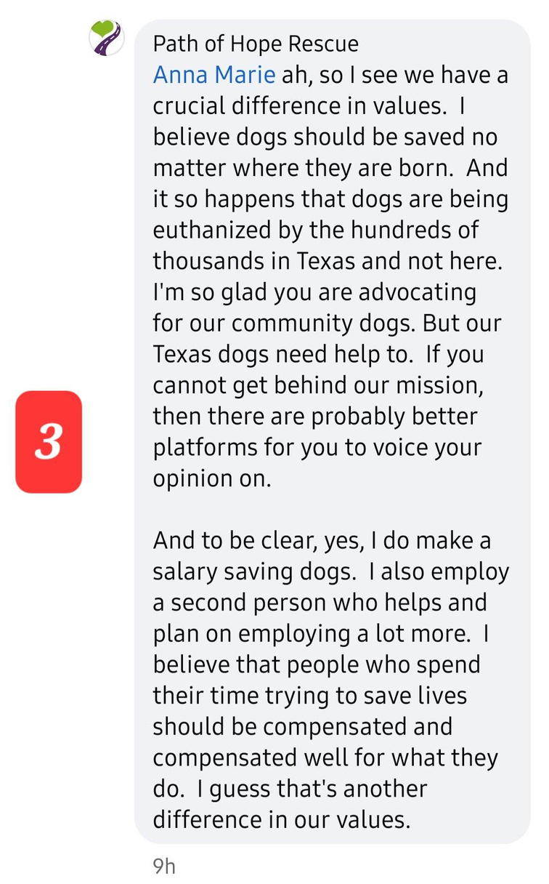
Screenshot 3
Caitlin states she believes dogs should be saved no matter where they are born and continues to bring up Texas.
Yet, in previous comments she states that dogs who have behavioral issues which are rehabilitative such as abuse and trauma should be considerations for their death, make it make sense.

Slide 11
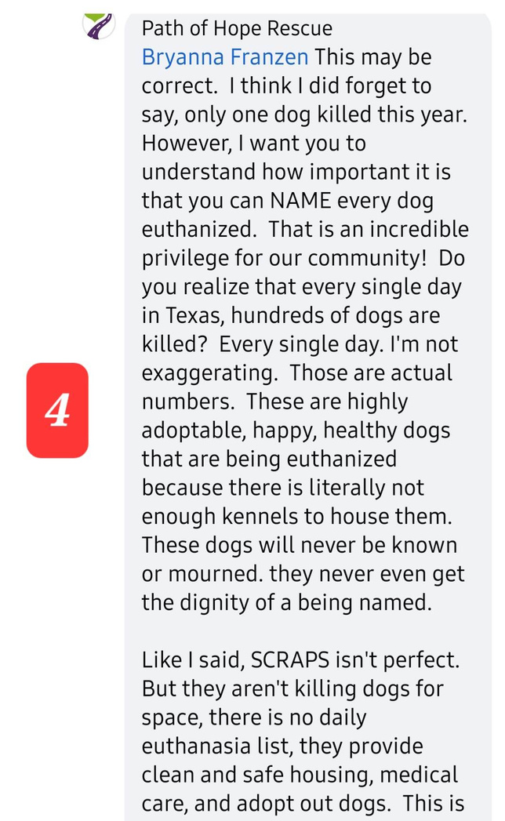
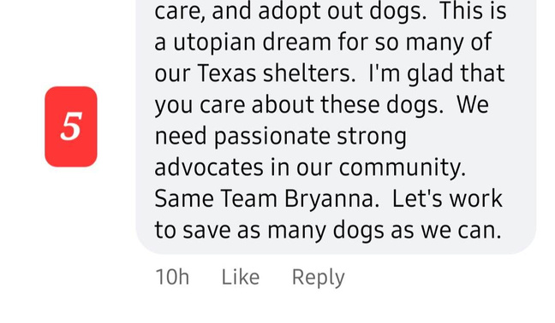
Screen Shot 4 & 5
Caitlin claims only 1 dog has been killed this year. Again, brings up Texas. States SCRAPS is not killing for space, there’s no daily euthanasia list, medical care, and adopt out dogs.
We would be happy to clear this up as well. The dogs that we can prove at this time that have been killed this calendar year are Mavis and Domino.
The dogs that we can prove were killed within the last 365 days are Amelia, Mavis, Domino, and Biscuit.
This does not include dogs deemed dangerous by law, in the process of actively dying or in severe unremitting pain, or as deemed by a behavior specialist to be an untreatable threat to other animals or people.
We believe there are more and are working diligently to get the records to either confirm or remove suspicion.
Regardless, if you count calendar year or the last 365 days, every single one of those dogs did not meet the euthanasia requirements outlined in the contract between SCRAPS and the City of Spokane as they were not “determined by an animal behavior specialist to be an untreatable threat to other animals or people as well determined by a licensed veterinarian to be suffering by a severe, unremitting physical pain "

Slide 12
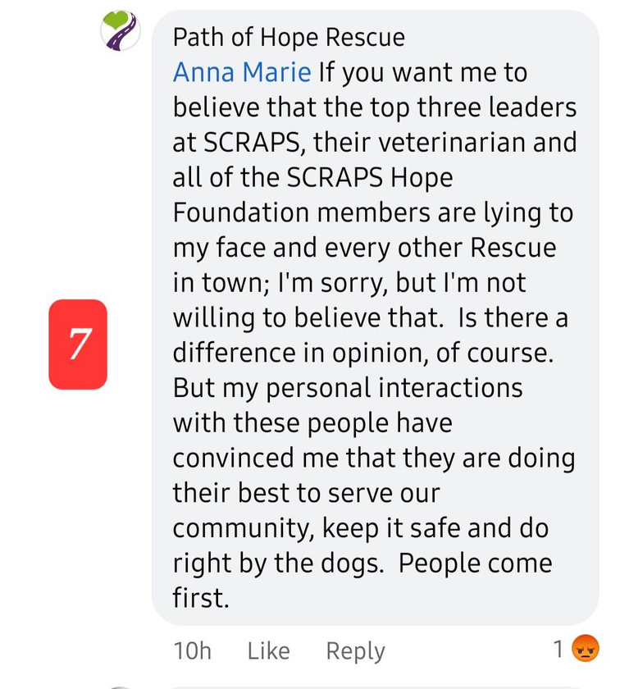
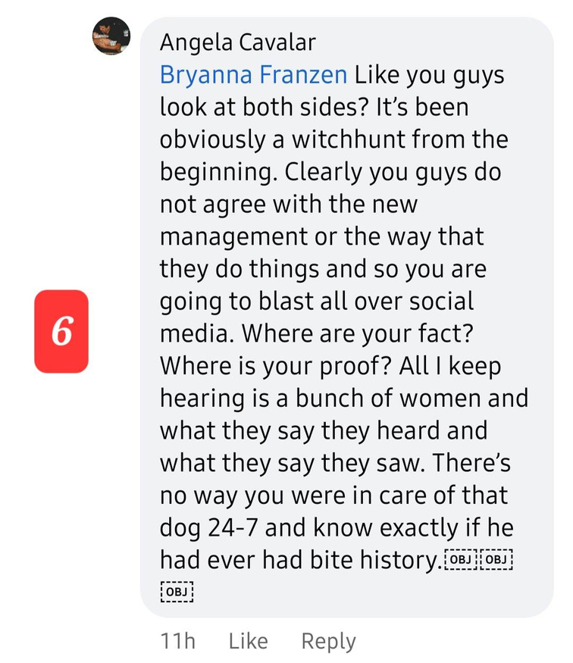
Screen shot 6
A supporter of Caitlin, Angela Cavalar, states there’s no way we were in care of that dog 24-7 and know exactly if he ever had a bite history.
Due to SCRAPS being Animal Control, if an animal bites someone and breaks the skin, they are required by law, to fill out and file a Bite Report with Spokane County Regional Health District as well as have an Animal Control Officer complete a detailed investigation with photos which would all be part of Domino’s SCRAPS record.
To date, there are no documented records of a bite nor an investigation on Domino’s record meaning no bite ever occurred.
Screen Shot 7
Caitlin then states the top three leaders of SCRAPS, the SCRAPS Veterinarian, and all of the SCRAPS Hope Foundation were at said meeting. She states her “personal interactions with these people have convinced” her.
To date, she has not reviewed the extensive number of public records disproving her personal interactions. Caitlin has shown no interest in checking the fable she is now spreading which is legally risky for her own rescue as well as risky for her as an individual.

Slide 13
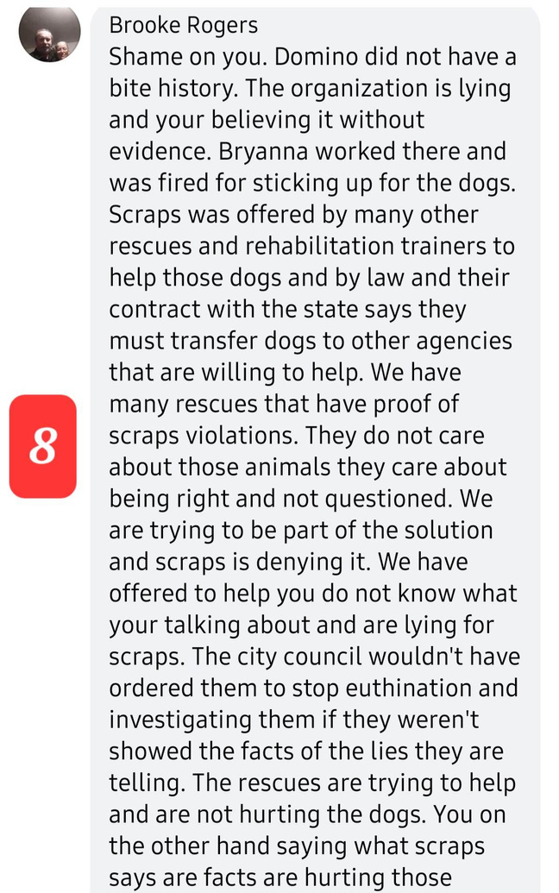
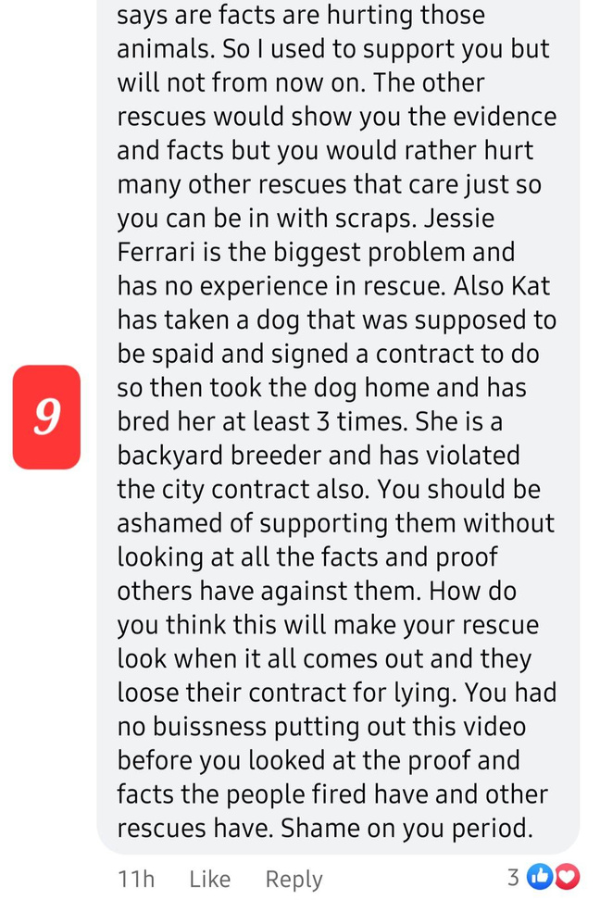
Screen Shot 8 & 9
Just a clarification/correction to information shared by another incredible advocate:
Brooke had commented stating Bryanna used to work there and was fired for sticking up for the dogs.
However, Bryanna wanted it to be known, she used to be employed by SCRAPS but was not fired from employment but had resigned.
She was later fired as a volunteer and a foster after expressing disagreement with Jesse Ferrari about declawing cats.

Slide 14
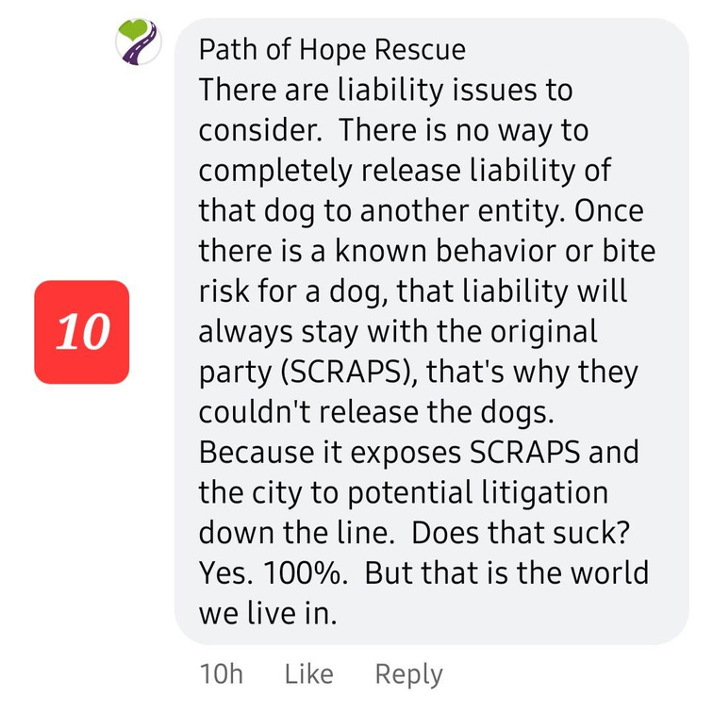
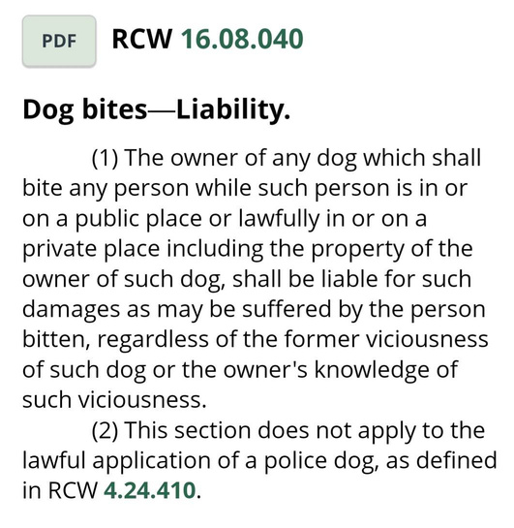
Screen shot 10
Caitlin states there are liability issues to consider and states there is no way to completely release liability of that dog to another entity. That once there is a known behavior or bite risk for a dog, that liability will always stay with the original party (SCRAPS) and this is why they couldn’t release the dogs. This is once again, inaccurate and baseless.
Per RCW 16.08.040, Dog bites—Liability.
(1) The owner of any dog which shall bite any person while such person is in or on a public place or lawfully in or on a private place including the property of the owner of such dog, shall be liable for such damages as may be suffered by the person bitten, regardless of the former viciousness of such dog or the owner's knowledge of such viciousness.
(2) This section does not apply to the lawful application of a police dog, as defined in RCW 4.24.410.
This RCW would further prove that a transfer of ownership would remove SCRAPS as the owner of the animal therefore SCRAPS would no longer hold liability in the event a bite was to occur, regardless of the former viciousness of such dog or the owner's knowledge of such viciousness. Further proof that this is a false claim would be that SCRAPS recently adopted out two dogs with confirmed bite on their record. Peety and Castiel. If they were truly a risk, why did they allow them to be adopted out?

Slide 15
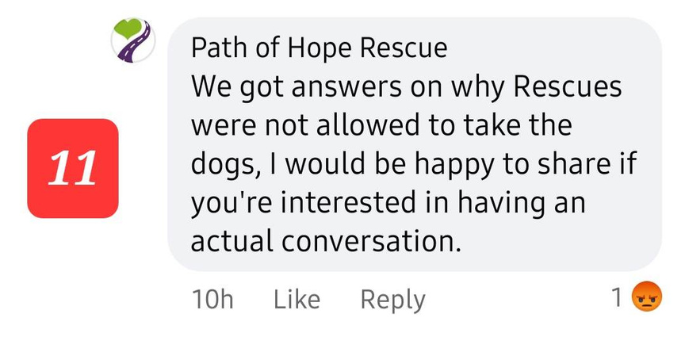
Screen Shot 11
Caitlin states she got answers on why rescues were not allowed to take the dogs and that she’d be happy to share if an actual conversation was had.
Bryanna asked her to share this privileged information and has yet to receive a response even though Caitlin claims to be fully transparent.
Transparency does not involve stipulations; it is honest and clear
Now we have some questions we would love for Caitlin to answer as Caitlin claims transparency to be her Number One core value, personally and withing Path of Hope Rescue. Since integrity is her Number 2, we fully expect her to respond.
1. What was the reason given that rescues are not able to pull behavior dogs?
2. What are your financial benefits of pulling dogs from Texas?
3. What is your aversion to the facts and proof that the advocates for SCRAPS dogs are trying to provide you with?
4. Why were all local rescue organizations, shelters, and partners within the Animal Welfare Community not invited to this meeting if the need for help is so great?
5. Why is SCRAPS leadership not allowing local behaviorists and trainers to assess and rehabilitate these dogs?
6. Can you please provide documented proof for any and all facts you are claiming?
Lastly, while we have been disappointed with Caitlin's refusal to meet with us to discuss further, we still extend the invitation to sit down and go over our proof with her, should she change her closed mind to an open one.
Considering the evidence provided has proven the false claims, accusations, statements, and insinuations by Caitlin Knight, Executive Director of Path of Hope Rescue, she has been sent an informal Cease and Desist demand. See next slide for details.
If Caitlin chooses to comply and meet the demands within the Cease and Desist demand, this response will be deleted as the claims of Caitlin Knight and Path of Hope Rescue will no longer need to be responded to.

Slide 16
CEASE AND DESIST
June 9, 2023
Ms. Caitlin Knight
Including any Representatives of Path of Hope Rescue
Dear Ms. Caitlin Knight:
You are hereby directed to
CEASE AND DESIST ALL DEFAMATION OF CHARACTER AND REPUTATION, FOR THE NAMED PARTIES BELOW INCLUDING BUT NOT LIMITED TO ANY CLAIMS, COMMENTS, FALSITIES, AND INSINUATIONS.
Named Parties:
Bryanna Franzen
Stephanie Hayden
The above individuals are educated, advocates, rescue organizations, and respected professionals in the community who have spent years serving the community and building a positive reputation. The individuals have learned via a public Facebook video and the comments on referenced video that you have engaged in spreading false, destructive, and defamatory statements or insinuations about them and the services provided by a Public Services entity in their community.
It is unlawful to engage in defamation of another’s character and reputation. Defamation consists of
(1) a statement that tends to injure reputation;
(2) communicated to another; and
(3) that the speaker knew or should have known was false.
Your defamatory statements were involving the above named parties.
According to RCW 7.96.040, we demand that you (A) immediately cease and desist your unlawful defamation of the above names parties and (B) provide us with prompt written assurance within ten (10) days via email at truthaboutscraps@gmail.com that you will cease and desist from further defamation of the above names parties' character and reputation. Further, we demand the removal of the video posted unless able to provide documented proof of any and all of the claims, allegations, and insinuations. Additionally, this is a violation of the constitutionally protected right of the above names parties to demand the government correct the wrongs that have been identified.
If you do not comply with this cease and desist demand within this time period, the above named parties are entitled to seek monetary damages and equitable relief for your defamation. In the event you fail to meet this demand, please be advised that the above parties will pursue all available legal remedies, including seeking monetary damages, injunctive relief, an order to have you removed from Path of Hope Rescue, and an order that you pay court costs and attorney’s fees. Your liability and exposure under such legal action could be considerable.
Before taking these steps, however, the named parties wish to give you one opportunity to discontinue your illegal conduct by complying with this demand as detailed above within ten (10) days.
Sincerely,
Bryanna Franzen
Stephanie Hayden

