Slide 1
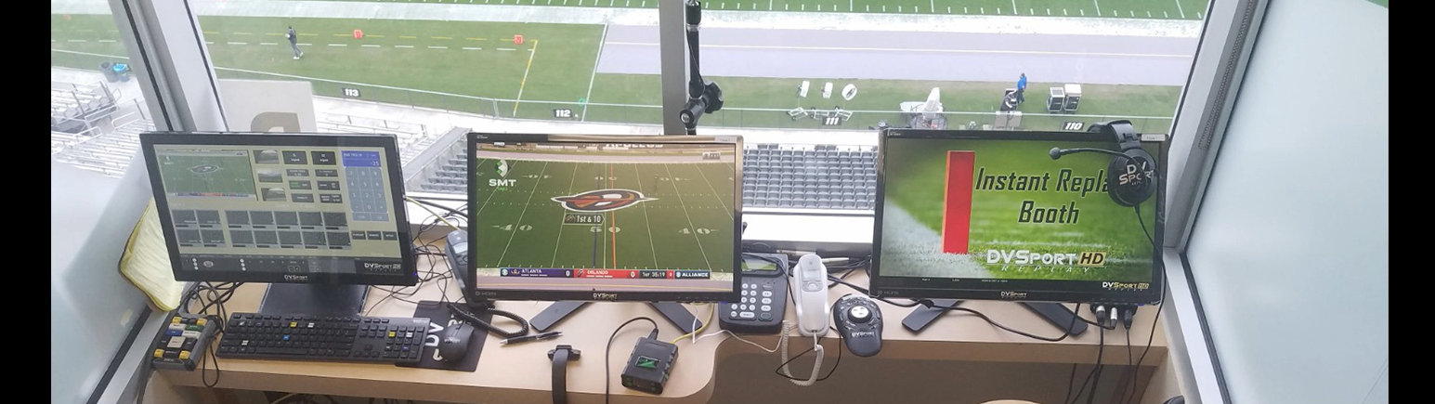
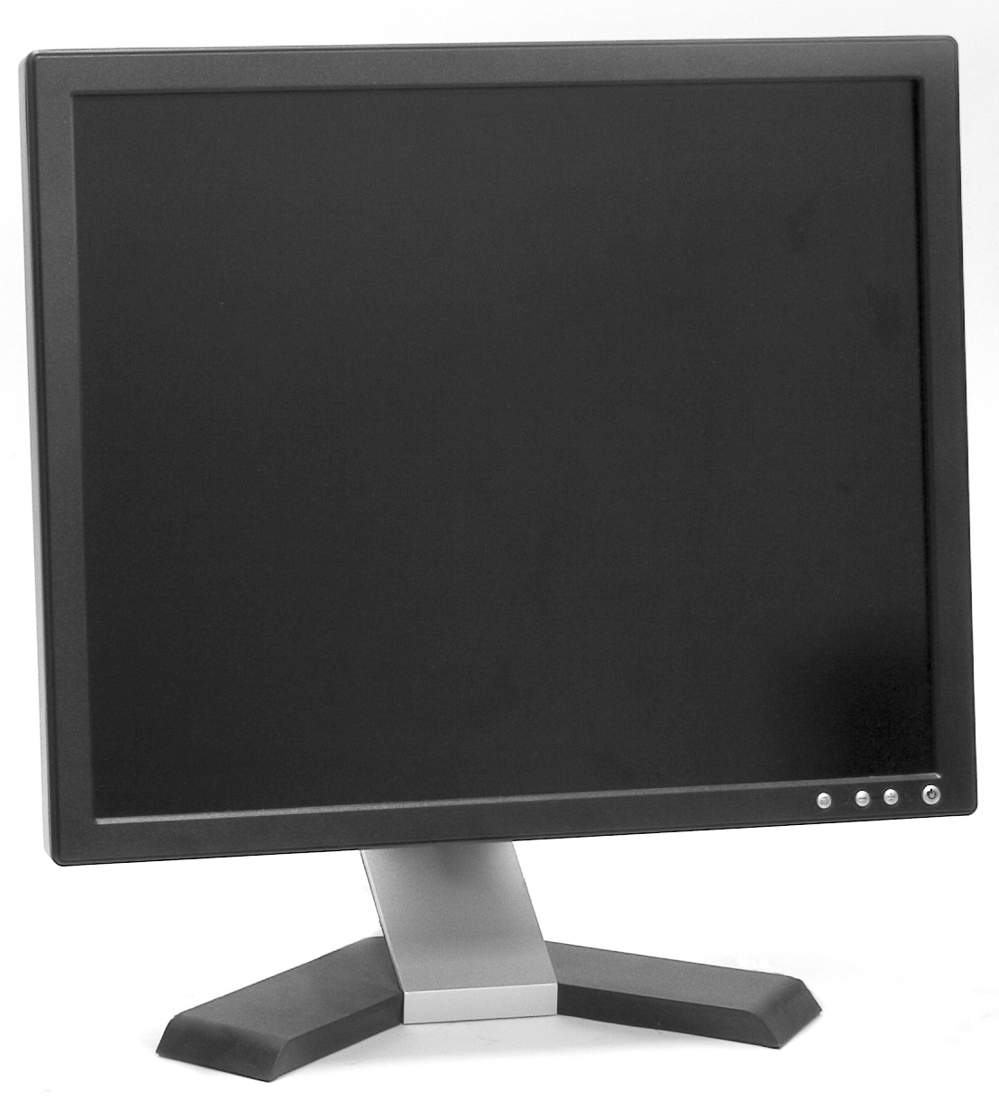

Booth Set Up
Technician Communicator Replay Official

Slide 2
Replay Official
Coordinate operation of replay booth
  Communicate responsibilities and ensure protocol followed
  Ensure proper system set up and communication checks
Responsible for all decision making
  Stopping the game
  Confirm, overturn, or stands
Communication with Referee and Collaborative (if applicable) during review
  Establish ruling on the field and reason for review
  Articulate thought process
  Communicate proper administrative information following review

Slide 3
Communicator
Eyes to the field
  Alert Replay Official when next snap/kick is imminent
Communicate game situation prior to each play
Communicate points of interest during each play
Communicate ruling on the field after each play
Monitor program feed and identify pertinent angles for RO
Assist RO with administrative information
Communication with TV truck
Operate O2O communication

Slide 4
Collaborative Replay
Follow same replay process and mechanics as replay booth
Actively listen to RO and Communicator
Provide input when necessary:
  Confirming score or turnover
  Stopping the game
  Identifying relevant angles
  Information relevant to outcome of review
  Administrative information

Slide 5
Assistant Communicator
Eyes to the field
  Alert Replay Official and communicator when next snap/kick is imminent
Record administrative information for each down
  Give to RO following a replay review
Record foul information
Assist with ruling on the field or other pertinent information

Slide 6
Technician
System set up and operation
Marking play and replays into system
Communication when new information becomes available
  Alert RO every time new play and replay comes up
  Describe replay angles - camera location, enhancement
  Be prepared to send angle at direction of RO
Input play information into system
Time replay reviews

Slide 7
Sideline Replay Assistant
Responsible for Referee review headset throughout game
  Keep headset on throughout game
  Be available for communications checks
  Hand headset to Referee during review
  Be prepared to stop game if necessary - especially at end of half/game
Scoring play/turnover confirmation
  Stand at numbers and give visual signal at direction of replay booth

