Slide 1
Our Mission
1

Slide 2
blood stem cells treatable diseases
Be The Match currently covers the US, Puerto Rico, and Mexico. There are @ 50 National databases around the world.
70+ blood diseases & blood cancers can be treated/cured by blood stem cell transplant, including:
leukemia and lymphoma
sickle cell disease
severe aplastic anemia
inherited immune disorders
2

Slide 3
How matching works
Matching is much more complex than blood types. It's your heritage or ancestry.
It’s based on genetic typing involving the Human Leukocyte Antigen (HLA).
You inherit these from your parents.
Patients are most likely to match a donor who shares their ethnic heritage.
Currently, not all patients have an equal chance of finding a donor.
3

Slide 4
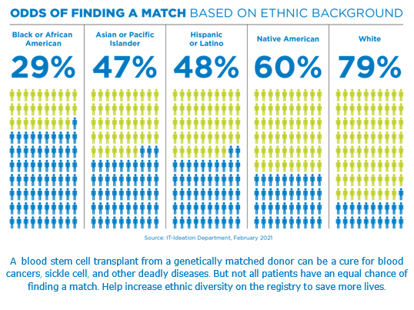
The health disparity
4

Slide 5
Most Asked Questions
What are the odds of getting contacted?
1 in every 430 people who register will go on to donate. That could happen anytime before you are removed before the age of 61.
Why can’t I join after 40 but still will be in the registry until I’m 61?
If you are the only match doctors can adjust treatment for patients.
Will It Hurt? Each of the two types of donation have different side effects
What if I already joined? Do I need to sign up again?
No you only need to sign up once. Please update your contact information at:
BeTheMatch.org/update
5

Slide 6
Why Does Age Matter?
18-40 years old is our age range
6

Slide 7
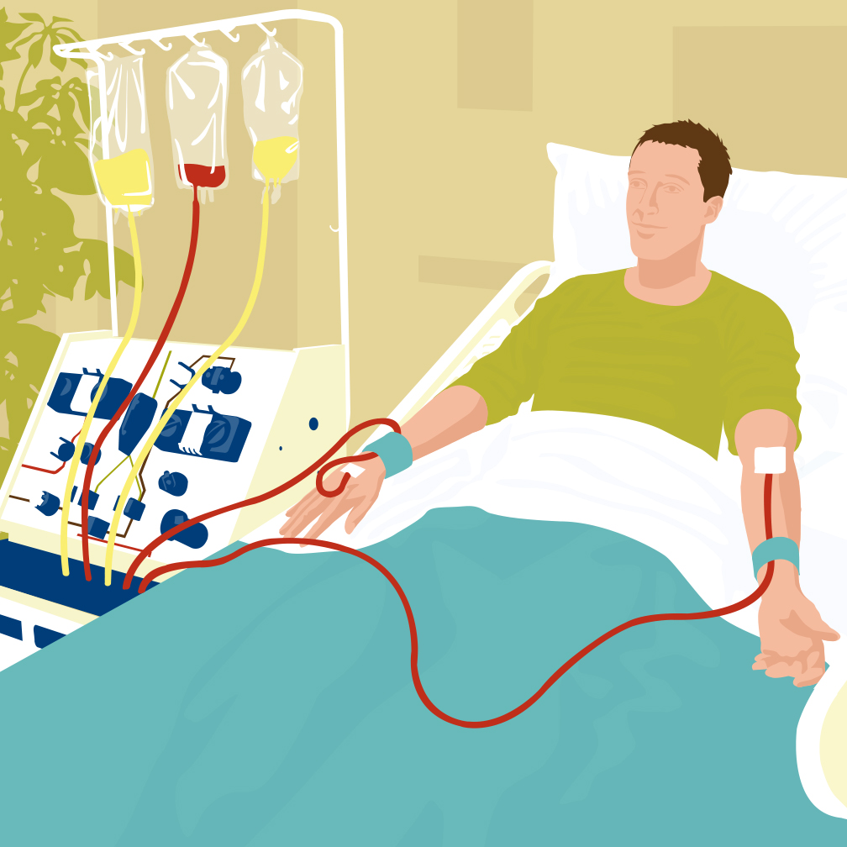
Peripheral Blood Stem Cell donation
80% of donors give PBSC
Similar to donating platelets
Injections for 5 days (4 days before collection & 1 the day of collection)
A machine filters out stem cells and returns remaining blood to the donor
Most donors visit with friends or watch TV during the procedure
7
Notes:
Most donors (77%) are asked to provide blood stem cells collected from the circulating blood. This is called a peripheral blood stem cell donation, or “PBSC donation.”
PBSC is a nonsurgical procedure, called apheresis. It’s similar to donating platelets.
For five days leading up to the day of donation, the donor is given shots of a drug called filgrastim that increases the number of blood-forming stem cells in the bloodstream. On the fifth
day, blood is drawn from one of the donor’s arms and circulated through a machine that filters out the stem cells and returns the remaining blood to the donor.
Most donors visit with friends or binge watch TV during the procedure.

Slide 8
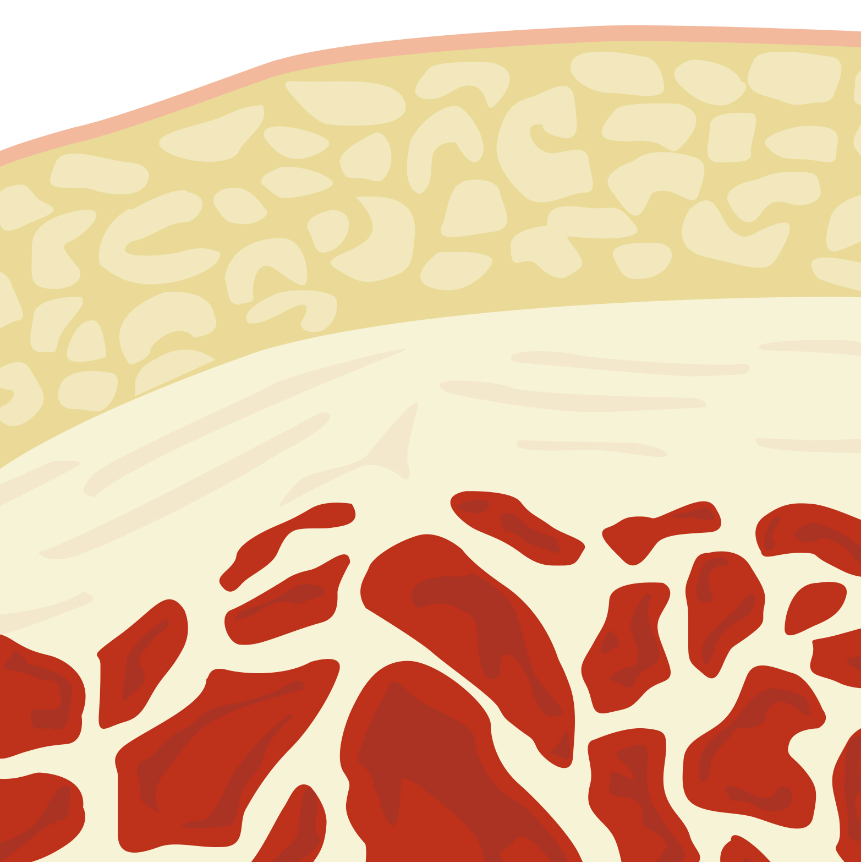
Marrow donation
20% of donors give blood stem cells collected from bone marrow.
Surgical procedure
Anesthesia = no pain during the procedure
Same day, usually outpatient
Doctors withdraw blood stem cells from back of the pelvic bone
Your cells replenish themselves in 4-6 weeks
8
Notes:
Some donors (23%) are asked to provide blood stem cells collected from bone marrow.
Marrow donation is a surgical procedure that takes place in a hospital operating room. The donor receives anesthesia and feels no pain during the procedure.
Doctors withdraw blood stem cells from small punctures in the back of the donor’s pelvic bone.
Doctors often request marrow for pediatric patients.

Slide 9
It doesn’t take long to save a life
The total donation process is 20-30 hours, over a four-to-six-week period
Health History Screening & Collection of blood samples
Physical Exam
Collection or donation of lifesaving cells
We make every effort to schedule donation to work for the donor and the patient.
Be The Match advocates for our donors. We do our best to ensure a safe and rewarding experience for all donors.
9

Slide 10
There is NO out of pocket expenses to save a life
NO out of pocket expenses
Be The Match covers travel, meals and hotel for you and one companion
All medical costs are covered by patient’s insurance or Be The Match
Be The Match will also cover any tolls, parking, mileage, daycare and pet care. Even possible hourly wage coverage.
10

Slide 11
Commitment Matters
We want to ensure that we are adding committed donors to the registry.
We want quality; not quantity
Education is key
Keep your contact information up to date on our website
11

Slide 12
Join Be The Match
Text-to-join: Text Racing4Ryder to 61474(no spaces)
Website: https://my.bethematch.org/Racing4Ryder
12

Slide 13
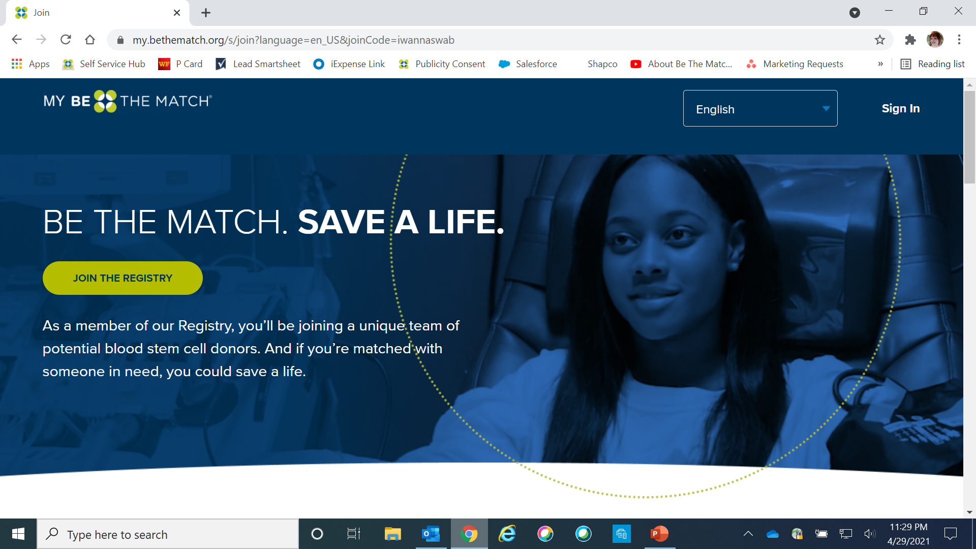
This is the registration website home page
13

Slide 14
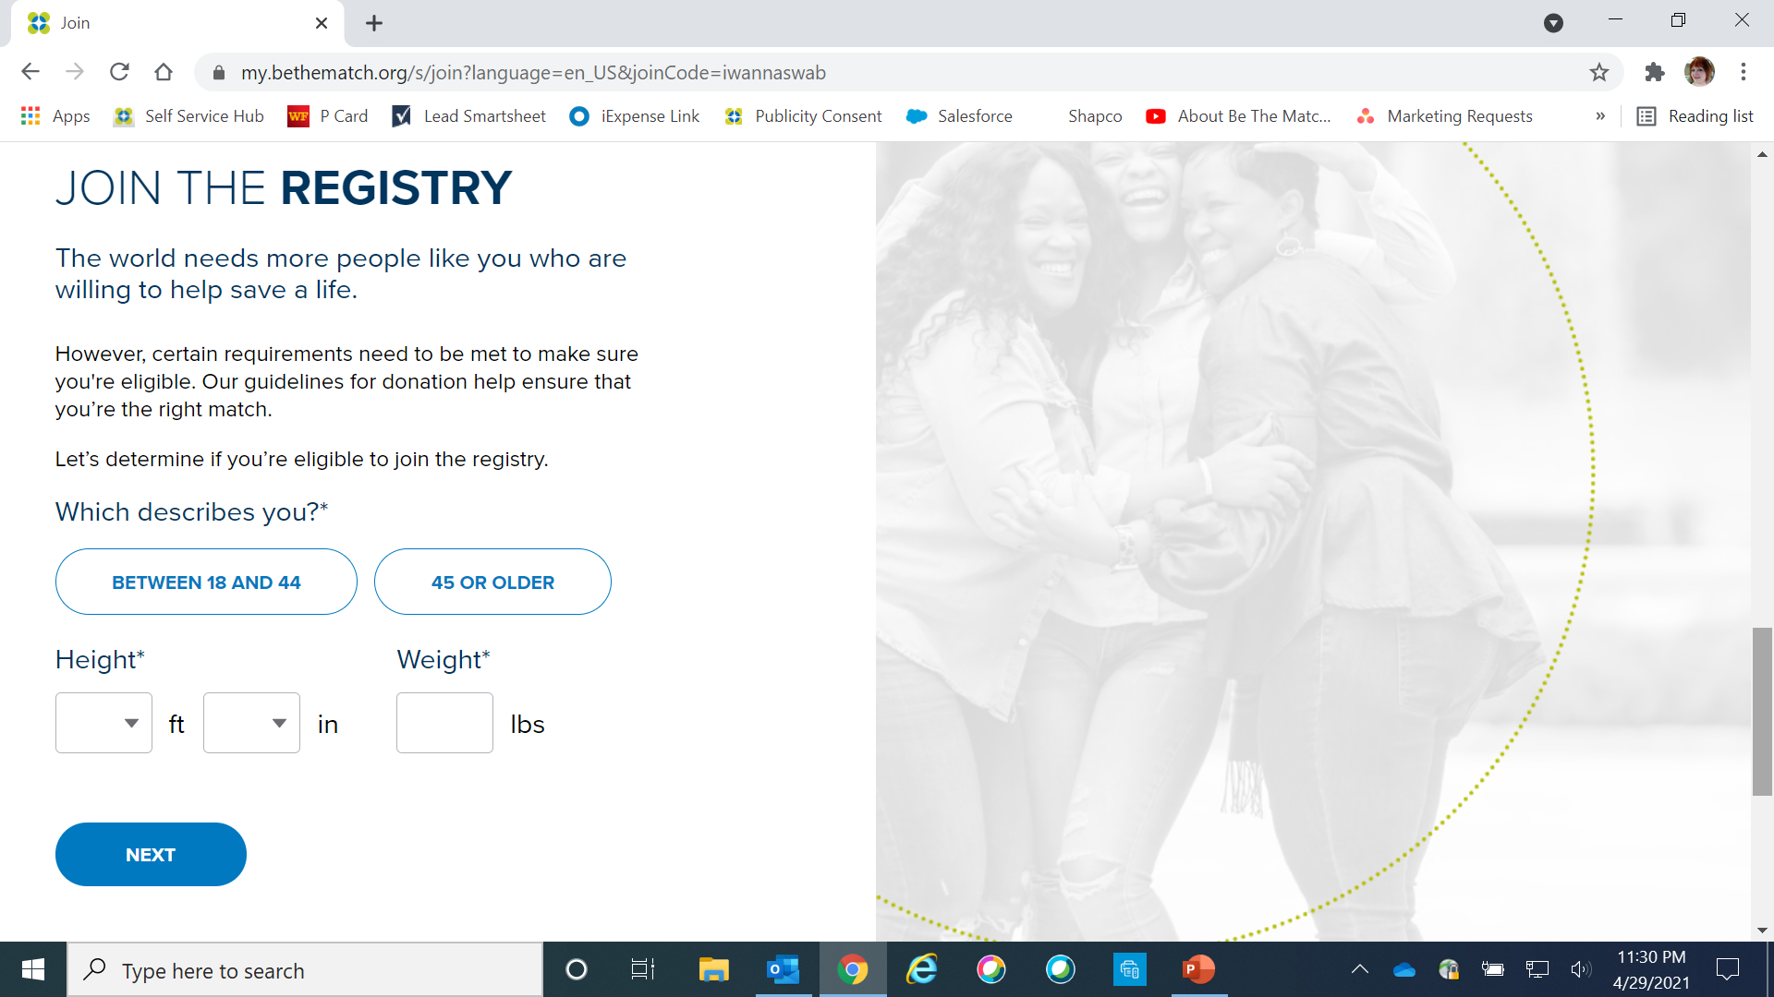
40
14

Slide 15
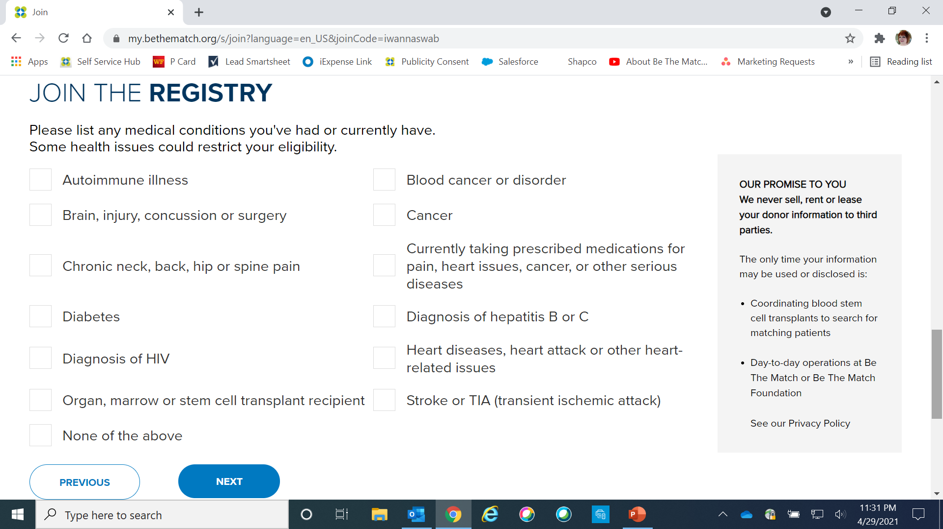
Please answer all questions
15

Slide 16
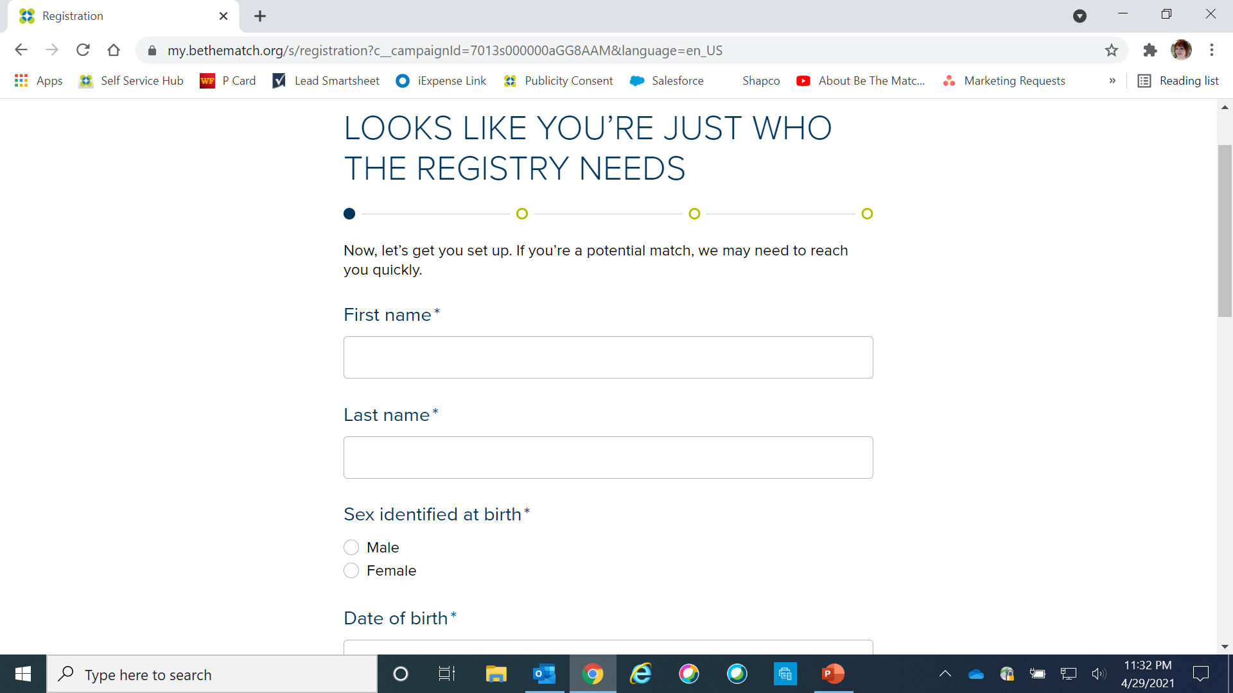
16

Slide 17
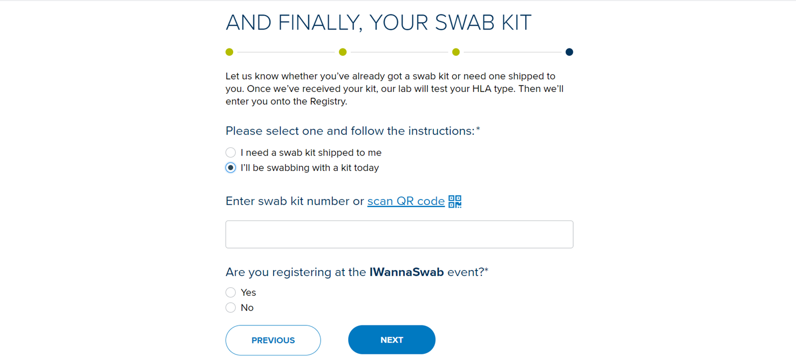
17

Slide 18
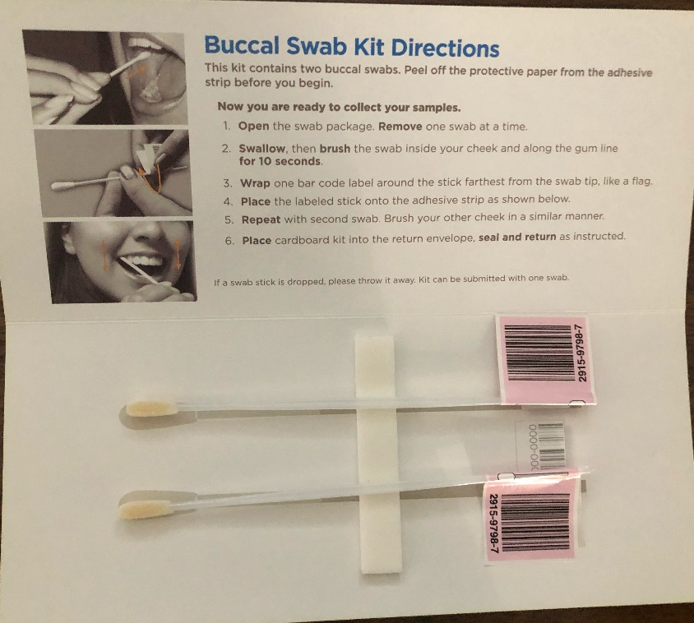
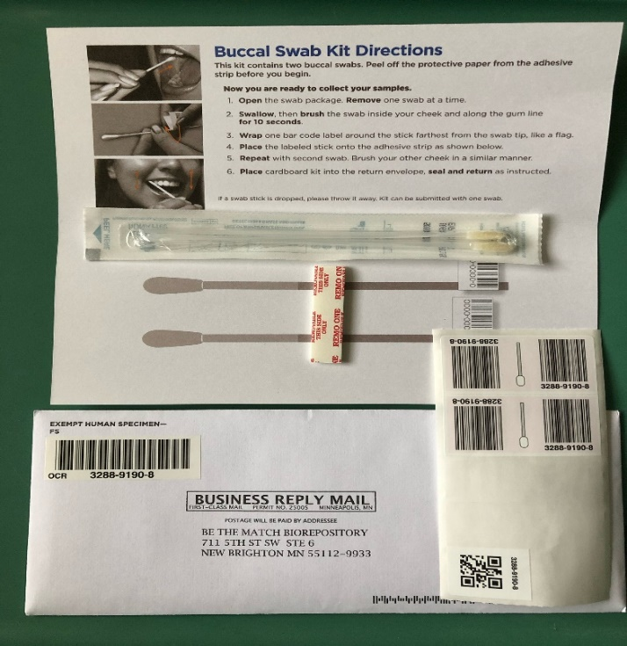
Live event buccal swab kit
Brush the swab inside your cheek and along the gum for 10 seconds
18
Notes:
Have donor swab on a flat surface. Follow the instructions on the inside of the folder. Wrap one bar code label around the stick farthest from the swab tip (like a flag)

Slide 19
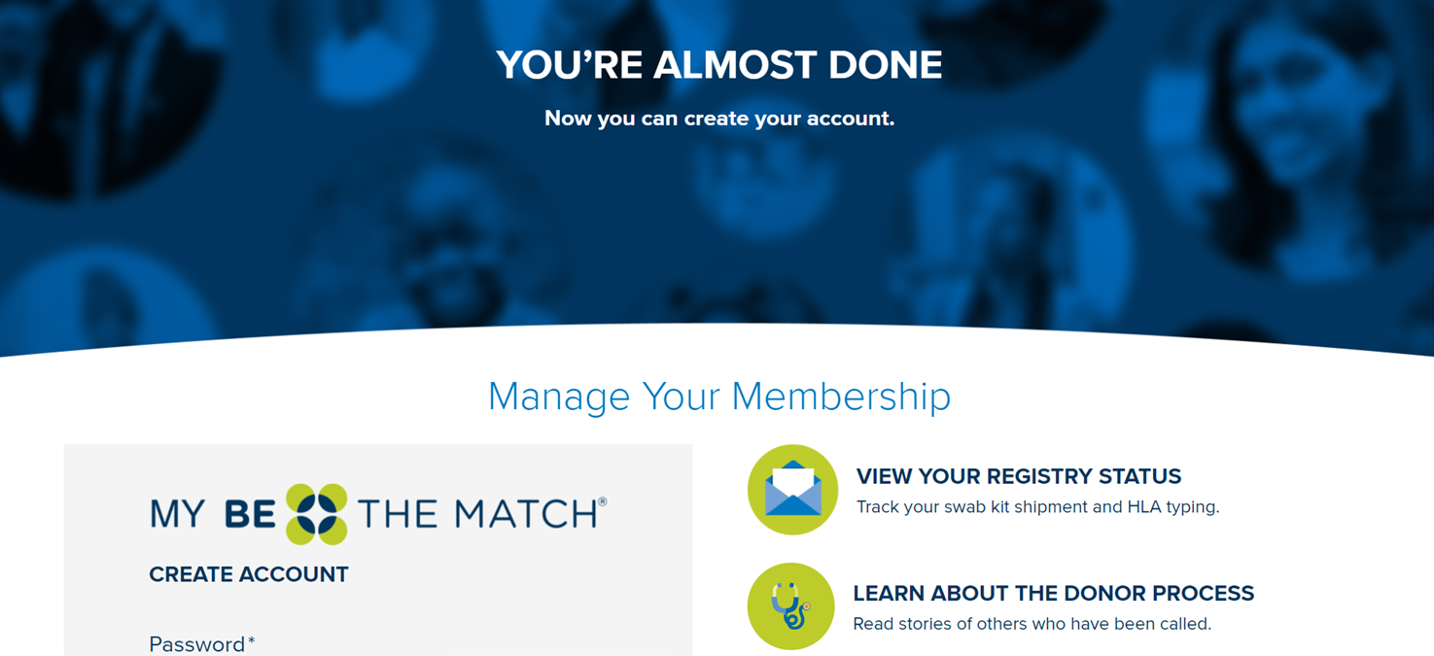
19

Slide 20
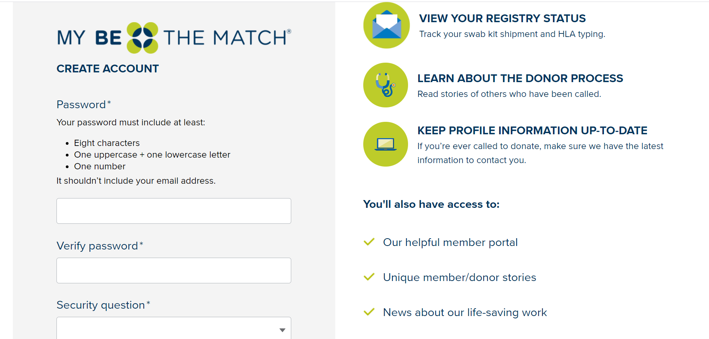
20

Slide 21
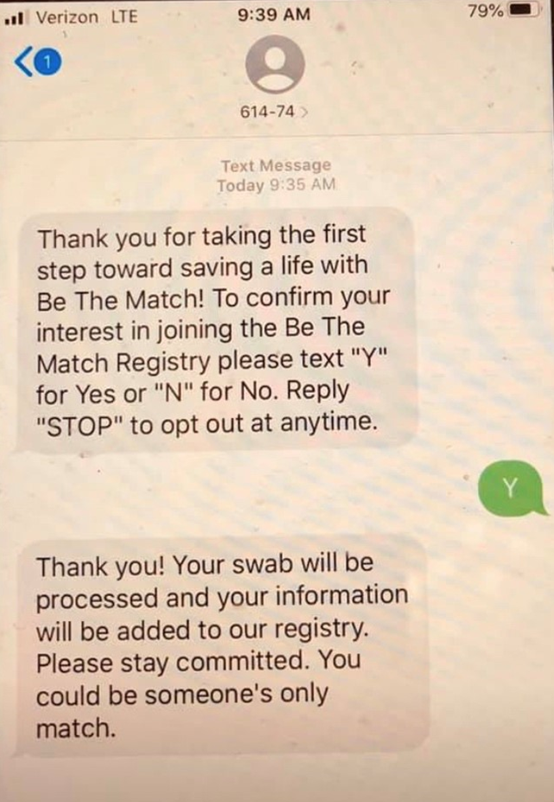
Commitment Text
This TEXT will arrive approximately one hour (or sooner) after the digit registration is complete.
The text will go to the registrant’s cell phone provided during the online registration process.
21

Slide 22
Event Day Steps
Step ONE – Welcome
Thank people for coming, make certain they are between the ages of 18 and 40, ask if they have any questions.
Step TWO – Registration
Have people join through your Text to Join, QR Code.
Have them notify a volunteer when they are ready to swab
Step THREE - Swab
Give instructions on the swabbing process.
Make certain they seal their completed cheek swab when finished.
Have them place their completed swab kit in Be The Match box. (keep box in a secure location)
Step FOUR – Thank You
Thank them for making a difference today
Remind them that staying committed is important
Make certain they know the last step is to confirm their participation through text
22

Slide 23
Questions?
Contact:
Be The Match
Public Response team
1-800-627-7692
Local Representative:
Tarita Gibson, Account Manager
Call or text: 313-802-1044
Camille,
searching patient
2

