Slide 1
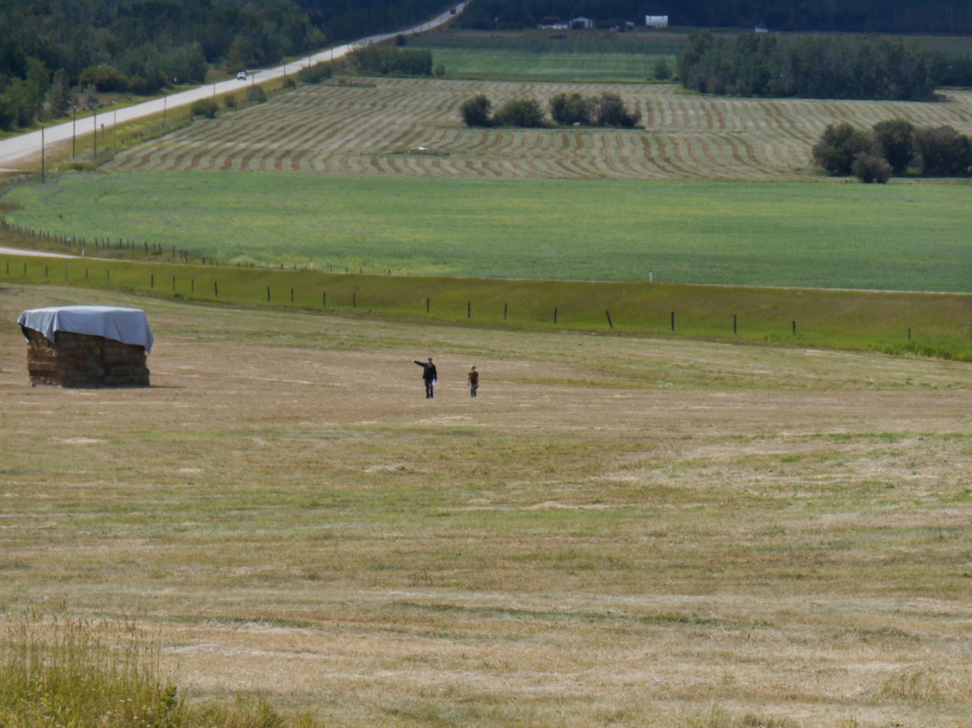
NUVISTA ENERGY LTD. INFORMATION NIGHT
TUESDAY JUNE 19TH 5:30 -8:30PM
YOU ARE INVITED
Please join NuVista Energy at the Philip J Currie Dinosaur Museum for an update on our Pipestone Development in the Wembley area
    5:30 pm Doors open
    6 – 7:15pm Presentations in Theater, Q & A
    7:15 – 8:30pm Sandwiches, beverages, dessert in Museum
  NUVISTA ENERGY LOOKS FORWARD TO SEEING YOU

