Slide 1
Orientation #1
Claremont Area Chapter
Membership Committee

Slide 2
Welcome and Linkspiration
Prayer and Inspiration
Expectations of the Candidate Orientation Process
History of the Links, Incorporated
History of Claremont Area Chapter
Introduce the Service Project and Service Delivery Model
Review Song, Pledge, Symbols, Colors
Review information about the Links Test, Next Sessions, Induction Ceremony
Q and A

Slide 3
Expectations of the Candidate Orientation Process
Attendance at all sessions is expected
Knowledgeable about The Links, Incorporated and The Claremont Area Chapter
Understands the service expectations and committee participation
Can recite the Links Pledge and Links Song from memory
Knows the current Chapter Officers and members by name
Clearly understands the social media standards
See page 4

Slide 4
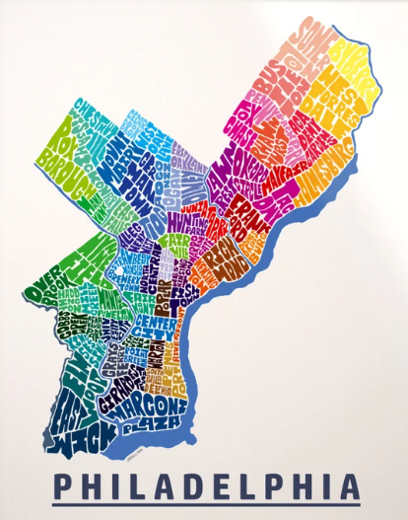
Areas
Eastern
Southern
Central
Western
Assemblies/Conferences
National Assembly (even years)
Area Conferences (odd years)
Leadership Summits
Governance Council/Committees
Governing Documents
Constitution & Bylaws
Manual of Operating Procedure
Ethics & Standards
Founded: November 9, 1946
Founders: Margaret Rosell Hawkins and Sarah Strickland Scott
Facets
Service to Youth
National Trends
International Trends
The Arts
Health and Human Services
See pages 5-13

Slide 5
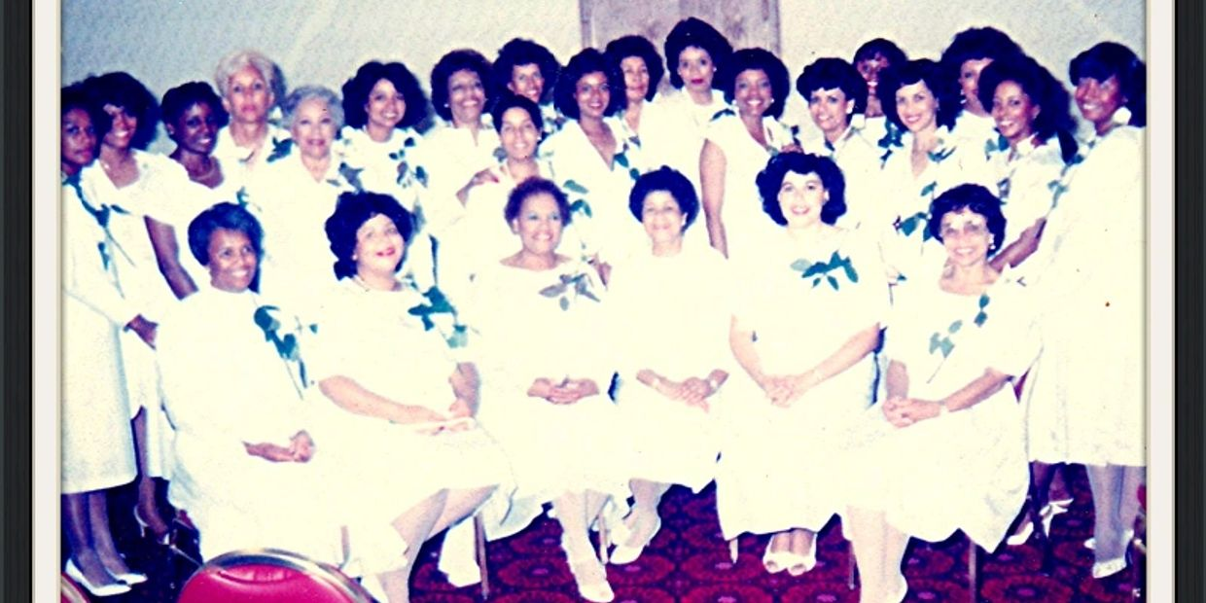
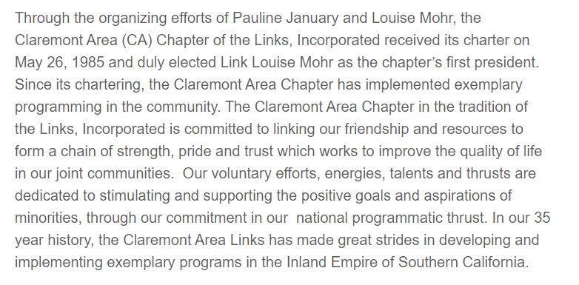
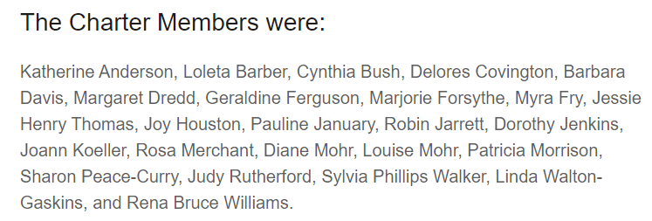
History of Claremont

Slide 6
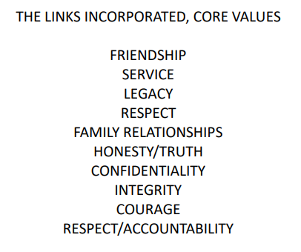

Slide 7
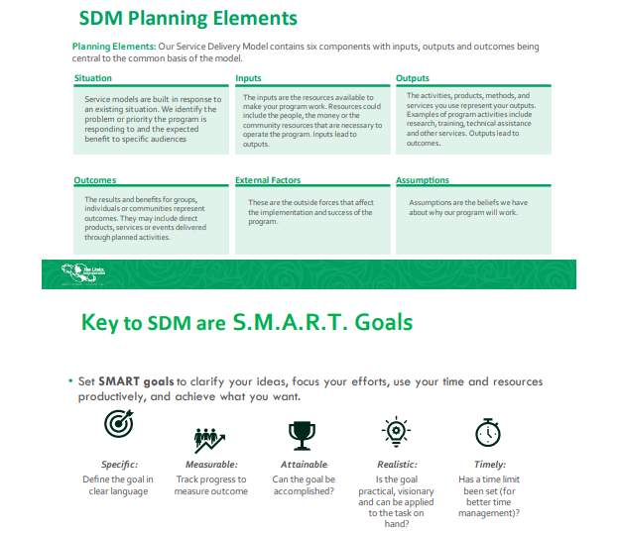
Service Project and Service Delivery Model
See pages 32-34

Slide 8
Service Project and Service Delivery Model
Candidate Orientation I
Saturday, March 9, 2024
Link Deborah Davis, Program Coordinator
Notes:
Greetings: Good morning candidates.
As Program Coordinator for the Claremont Area Links. I lead the Program Team which is made of the five programmatic facets of the Links, Incorporated.
There are a number of requirements on the road to becoming a Link and one of those is the completion of a Service Project.
Since service is the Heart of Linkdom new candidates complete a service project to honor the meaning of our founders Sarah Strickland Scott and Margaret Roselle Hawkins as well as the charter members who were dedicated to working together as friends to help others.

Slide 9
Service Project

Slide 10
It’s recommended that the service project be an extension or expansion of current Chapter programming/events in one or more of the facets.
Services to Youth
Linking for Success Mentoring Program – Cal Poly Pomona
College Connection (Scholarship Recipients)
National Trends and Services
Linking for Success Mentoring Program – Cal Poly Pomona
Foothill Family Shelter (Food and Housing Insecurity)
House of Ruth (Domestic Violence)
Voter Engagement – Get Out the Vote!
International Trends and Services
LinksHelp for Humanity (Serving Haiti and Jamaica)
The Arts
Linking for Success Mentoring Program – Cal Poly Pomona
Youth and Family Club of Pomona Valley
National Poster Arts Contest
Health and Human Services
Walk for Healthy Living (Impact Day)
Black Family Wellness Expo (Impact Day)
Mental Health Awareness

Slide 11
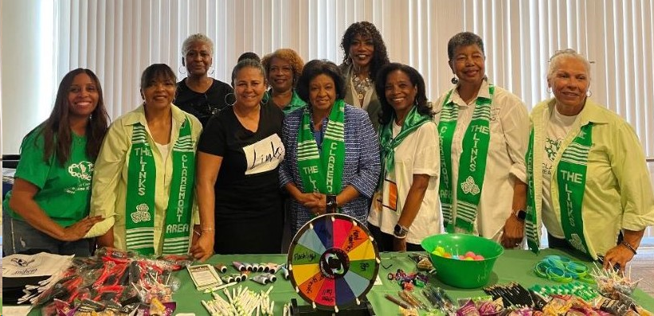
New Candidate Service Project
Candidates are responsible for the:
Organization, development, scheduling, implementation and evaluation of the project with minimal assistance
If you decide to do an expansion of what the chapter is currently doing, you will need to contact the facet chair
The Membership Committee will be available for guidance
National website www.linksinc.org is an excellent resource to see what programs are under each of the five facets.
On the national website under Community Engagement there is a list of all the National Partners of the Links, Incorporated. There are 22 partners that play a crucial role in helping to support the overall work and mission of our organization.
New Candidate(s) service project must be submitted to the Chapter President and the Membership Vice President.
The service project must be written up in the Service Delivery Model format.
Service project must be completed by April 30, 2024.

Slide 12
Service Delivery Model
What is a Service Model?
The National Program Committee adopted a service delivery model in order to build a common language for accountability and evaluation across the organization. A service delivery model is the tool used to plan and evaluate programs, committee work and other collaborative projects.

Slide 13
Service Delivery Model
Planning Process
The SDM planning process revolves around The Links, Incorporated’s
basic definition of programming. Simply defined, a program is a comprehensive
approach to solving a problem or addressing a need or issue within a community.
A program is not a one time event or single activity.
It includes a series of related activities focused on achieving a predetermined setof goals or objectives.

Slide 14
The Service Delivery Model contains six components with inputs, outputs and outcomes being central to the common basis of the model.
Situation: Service models are built in response to an existing situation. Identify the problem or priority the program is responding to and the expected benefit to specific audiences.
Inputs: The inputs are the resources available to make the program work. Resources could include the people, the money or the community resources that are necessary to operate the program. Inputs lead to outputs.
Outputs: The activities, products, methods, and services used represent the outputs. Examples of program activities include research, training, technical assistance and other services. Outputs lead to outcomes.
Outcomes: The results and benefits for groups, individuals or communities represent outcomes. They may include direct products, services or events delivered through planned activities.
External Factors: These are the outside forces that affect the implementation and success of the program.
Assumptions: Assumptions are the beliefs we have about why the program will work.
Evaluation: Measures and targets that indicate program success.

Slide 15
Service Delivery Model
Key Questions for Developing Your Service Delivery Model
What is the community-level impact (change) that our chapter would like to create as a result of our program?
2. What are the long-term outcomes or behaviors we would like our clients to achieve?
3. What are the short-term outcomes we would like our clients to achieve?
4. What programs, strategies, or services do we need to achieve the short and long term outcomes?
5. What are the resources or inputs needed to support strategies or service implementation?
6. What is going on in our community or in our clients’ lives that we have no control over but will affect the quality or success of the program?

Slide 20
S.M.A.R.T. Goals
Specific: Clearly and simply defines what you are going to do
Measurable: Includes ways to measure whether goal has been accomplished
Achievable: Identifies access to resources needed to accomplish goal
Realistic: Are goals attainable in the time frame possible in the time frame?
Time-bound: Sets specific time/date for completion
bjecReduc
SMART Goal: By December 31, 2024, reduce the percent of 9th grade students attending Upland Jr. High who have a BMI of 30 or higher from 8% baseline to 7%.

Slide 21
Questions

Slide 22
See page 14

Slide 23
See page 14

Slide 25
New Member Schedule
Description | Date | Time
Meet and Greet | Monday 2/19/24 | 6:30pm
Orientation 1 | Saturday 3/9/2024 | 12:30pm
Orientation 2 | Saturday 3/23/2024 | 12:30pm
Orientation 3 | Saturday 4/13/2024 | 1:30pm
Test/Rehearsal | Monday 4/22/2024 | 6:30pm
Membership Induction Ceremony | Sunday 5/5/2024 | 9:30am
Chapter Meeting | Sunday 5/5/2024 | 10:30am
New Member Luncheon | Sunday 5/5/2024 | 11:30am

Slide 26
Membership Committee
Link Juanita Dawson
VP and Chairman
Link Kim Britt
Link Michelle Anderson
Link Muriel Poston
Link Jackie Jones

