Slide 1

Underhill School and Children’s Centre
Understand * Uplift * Unite
Year 6
Notes:
Insert year please :)

Slide 2
Meet the team
Class | Teacher | Support staff working within the year group
6 Ash | Sophia Tsiaparis | Mrs Olive Michelle Kirsty Alice Abul Christo
6 Elm | Elizabeth Walter UKS2 Phase Leader
6 Hawthorn | Koula Christofides
Notes:
Insert class names and teacher names.

Slide 3
The Underhill Way
At Underhill, we have 4 BE words;
Be Caring
Be Confident
Be Curious
Be Cooperative
These enable all children to become happy, successful 21st Century learners both while they are in school and in their future.
We also instill a positive and determined attitude though our school chant:
I can, you can, we can.
If you are ever visiting the school, it is likely that you will hear this chant coming from the classrooms to energise the children for their learning.
Notes:
We will have half termly themes - this half term ‘Future Me’ . We will discuss our own ambitions.
Each half term will have a quest - will we inform you half termly. .

Slide 4
Curriculum

Slide 5
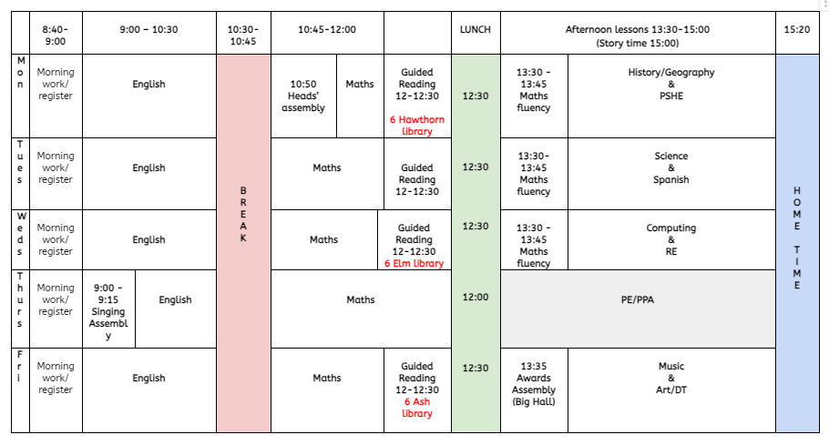
The School Day
Early morning work - Don’t miss out!
5 x 20 minutes = an hour of lost learning time
Notes:
Insert your weekly timetable.
Discuss what the day looks like and what topics are taught each day. Explain importance of being on time - wasted learning time!
Year 1 - for you this is slightly different as you line up outside (so no wasted learning time) - you could get rid of this message.
NOte - Year 1

Slide 6
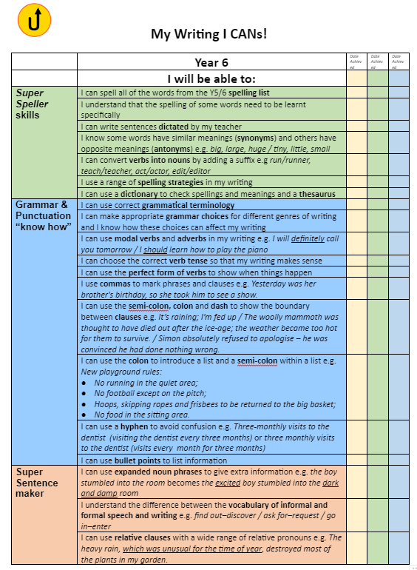
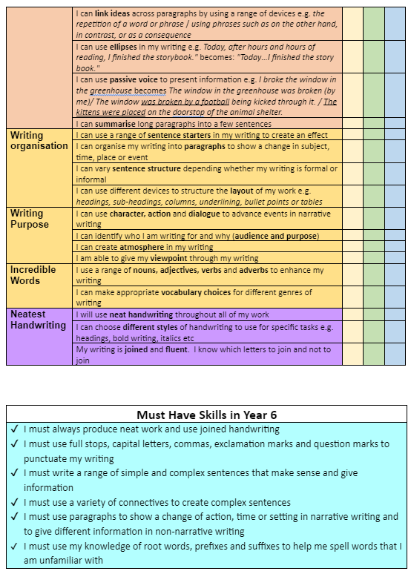
Year 6
Expectations in writing
Notes:
Insert your year groups I CANs here. No need to read them all out as they will be on the website.
English work in classrooms is based on these.

Slide 7
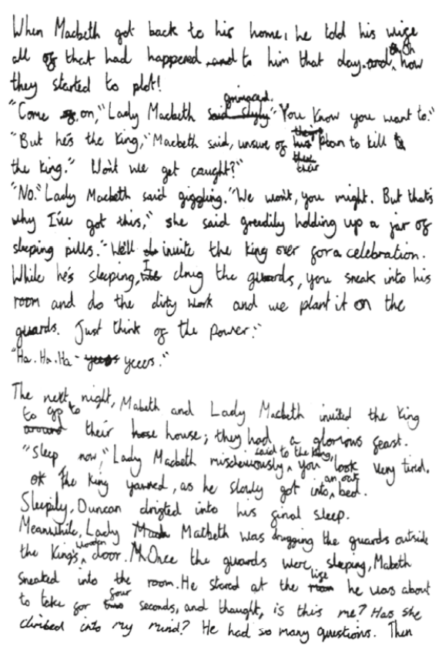
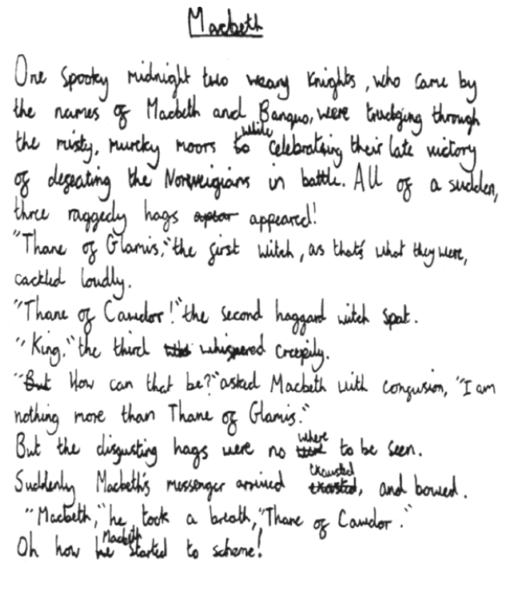
Writing
Year 6
Example
Notes:
Insert examples of writing here - don’t worry if it is too small, parents will have access to this document on the website.

Slide 8
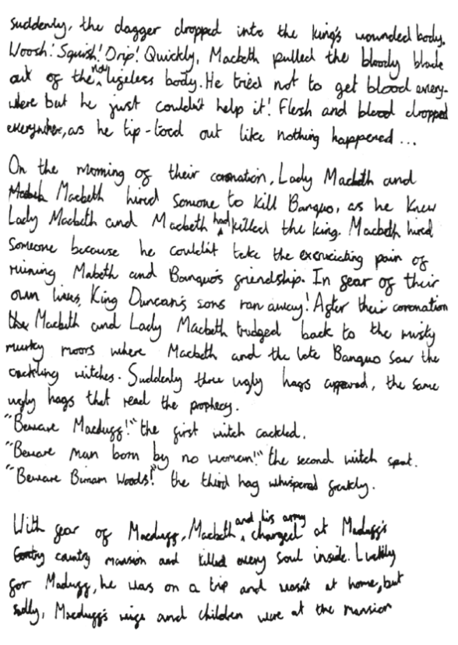
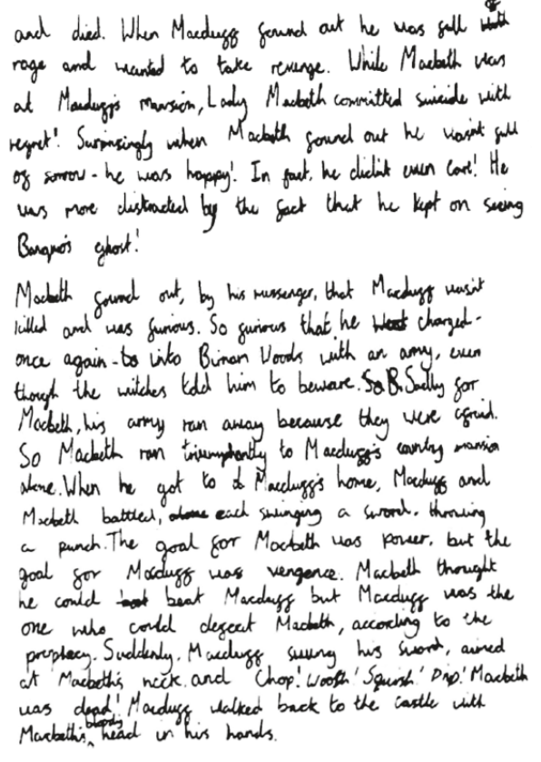
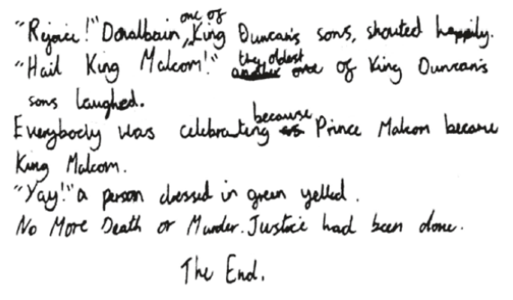

Slide 9
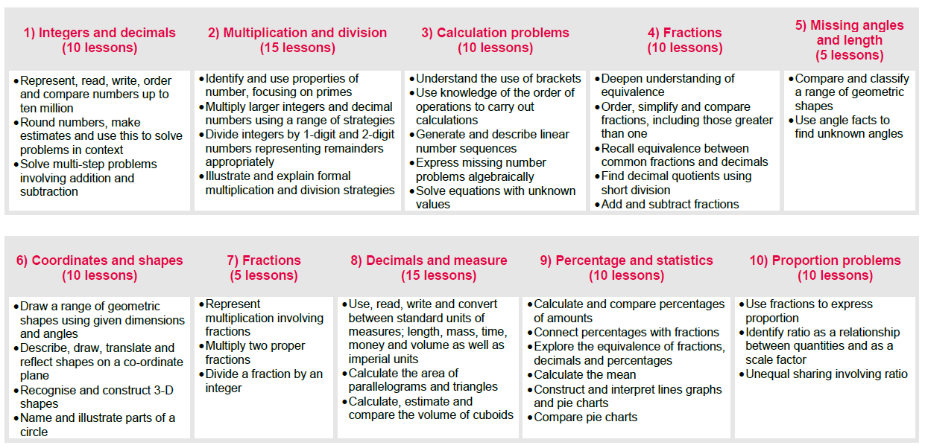
Maths
Year 6
Expectations in maths
Notes:
Insert the curriculum overview for your year.
Mention there is no streaming this year.
Only if asked why - research says that is only benefits the higher achieving children, does nothing to support low ability or lower income families. Our higher achieving children will be supported by adapted , more challenging tasks.
Maths is taught daily.
Discuss structure :
Mental maths , vocabulary, new teaching, talk task, independent work.

Slide 10
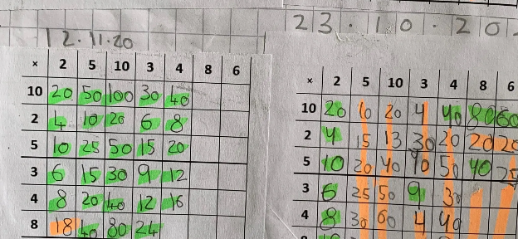

Maths
Please practise times tables on Times Tables Rock Stars regularly.
It is part of pupils’ home learning and we expect pupils to practise for at least 15 minutes a week.
https://ttrockstars.com/
Notes:
Remind parents to use TTRS.
Remind parents that children get certificate to celebrate achievements.

Slide 11
PSHE
As a part of your child’s education at Underhill, we promote personal wellbeing and development through a comprehensive Personal, Social, Health and Economic (PSHE) education programme.
PSHE education is the curriculum subject that gives children the knowledge, understanding, attitudes and practical skills to live safe, healthy, productive lives and meet their full potential.
PSHE lessons cover a range of topics such as keeping safe, health, friendships, growing and changing and RSE (Relationships and Sex Education).
Notes:
Tell parents that they will be informed of their PSHE topic every half term.

Slide 12
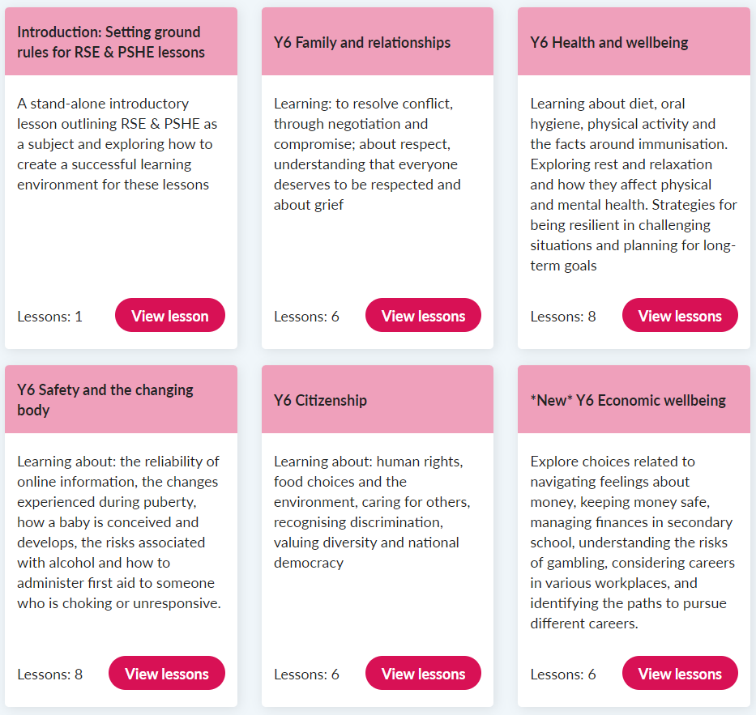
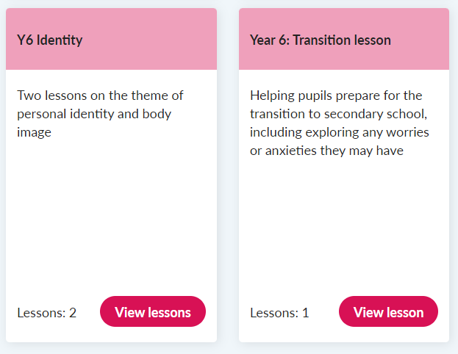
PSHE
Notes:
Tell parents that they will be informed of their PSHE topic every half term.

Slide 13
School Trips
All classes will go on at least three school trips per year. Please look out for any emails regarding these as we will need parental permission for your children to attend.
We try to ensure that all trips are free.
We also have visitors and workshops throughout the year.
Notes:
Other classes get rid of Year 6 bit.

Slide 14
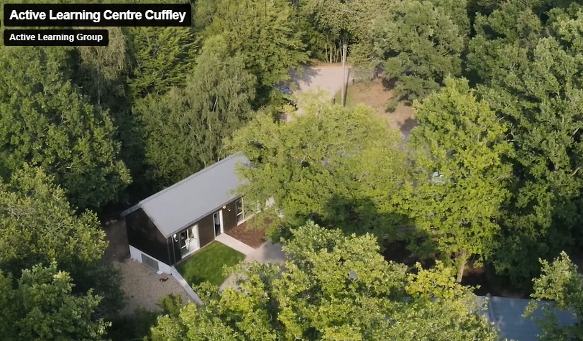

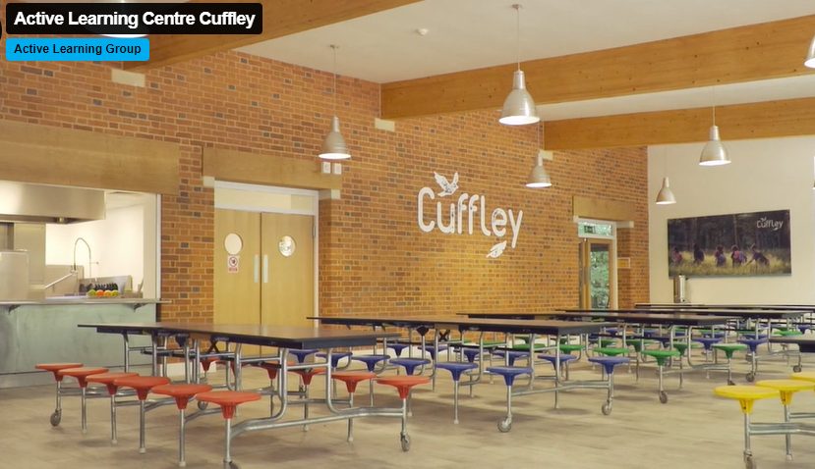
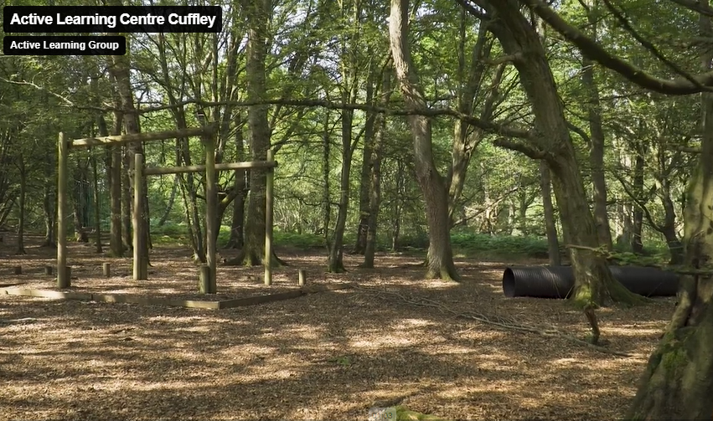
Year 6 residential
Monday 19th May - Friday 23rd May 2025
Year 6 have an opportunity to go away on a residential trip after the tests in May. There is a cost for this trip (if your child would like to go, but finances won’t allow it - please speak to the office or head teachers to see if there is help we can offer).
Notes:
Other classes get rid of Year 6 bit.

Slide 15
Assessment

Slide 16
Assessments
Children are assessed throughout the year in all areas of the curriculum.
Last two weeks of each half term are assessment weeks.
Children will be assessed in:
Reading comprehension
Maths: arithmetic
Maths : reasoning
Spelling
Grammar
We always analyse assessment results and will use the data to inform our practice.

Slide 17
Statutory assessments
In May, Year 6 children sit the end of key stage two assessments (commonly called SATs). Your children will be ready and prepared for these.
The test week will look like this:
Monday 12th May - Spelling, Punctuation and Grammar (SPaG)
Tuesday 13th May - reading comprehension
Wednesday 14th May - arithmetic and mathematics reasoning paper 1
Thursday 15th May - mathematics reasoning paper 2

Slide 18




Assessment of reading
In school, children read levelled books.
Children may move up book levels at any point of the year. Teachers assess both fluency and comprehension before pupils move up a book level.

Slide 19
Behaviour

Slide 20
Underhill Behaviour
I can, You can, We can… | This means that we…
BE Caring | Look after ourselves and others, are kind, are honest, look after our school and our things, respect each other, stand up for what’s right, show good manners, are tolerant and show compassion, support each other, understand different feelings
BE Confident | Solve problems, use our voice, ask questions, have a go, are organised, are honest when things go wrong, take responsibility for making a mistake, feel proud, are brave, try to do our best every day, are active learners
BE Curious | Know our learning style and how to do our best, challenge ourselves to see how far we can go, are resilient, understanding the learning pit, know how to help ourselves achieve, listen, ask questions
BE Co-operative | Work together, are a team, follow instructions, share, support others, are responsible citizens, understand our community and our world.

Slide 21
Underhill Rewards
We have 4 houses at Underhill
Balmoral * Sandringham * Holyrood * Windsor
Rewards
House Dojos (EYFS - House Stickers)
Star of the Week
Marbles and marble parties
Golden tickets
Our Unsung Heroes
Yes Days

Slide 22
Underhill Sanctions
While all children work to the Underhill Way, there are times where children will not meet our behaviour expectations and it is important that the children are supported to have a clear understanding of the consequences if they do not work within the Underhill Way.
We understand that behaviour is communication and we ensure that we try to understand why a child’s behaviour is not meeting the expectations and that the appropriate support is put in place.
We run a warning behaviour system where if children have not met the behaviour expectations, they will lose minutes of their playtimes. All orange and red card behaviours are recorded on School Pod and parents will be informed.

Slide 23
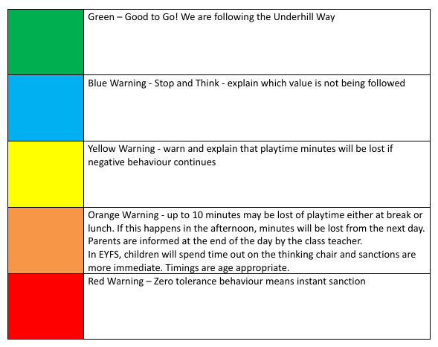
Underhill Sanctions

Slide 24
Parents as Partners

Slide 25
Parents as Partners
Parent partnership and communication is very important so that we are all working on the same page.
Parents evening will take place both this term and in the Spring term, please look out for more information about how to book nearer the time.
Parents evening this half term will be on Wednesday 23rd and Thursday 24th October 2024.
Each class will have a class assembly this year (watch out for the dates on the webpage)
Please make sure you read the newsletter , there is lots of important info.
Please make sure you come and talk to us if you have any problems or concerns.

Slide 26

Google Classroom
Weekly homework
Maths Unit Narratives at the beginning of a unit.
Half termly topic grid
Celebration of work
A reminder letter with all your child's logins will be coming soon!
Notes:
Please emphasise how this needs to be accessed regularly - it can be downloaded to phone.

Slide 27
Home learning
Given out every Friday via Google Classroom.
Children complete work in Homework Books.
Return to school by Wednesday.
Homework will be acknowledged and sent home.
Maths - a worksheet linked to what children have been learning about.
English - grammar and reading comprehension
Spellings - 10 spellings per week
You do not have to print work out!!!!
Notes:
KS 1 - can you change this to SeeSaw.
Re: marking. Misconceptions will be addressed. Try not to use the work ‘marked’ as the feedback will not be very detailed. No need to bring this up though.
Tell parents : Homework will NOT have to be printed at home. Children can see it on google classroom and write answers in the homework book (which is then returned to school).
NOTE:Homework books are new to most children so explain how they work.

Slide 28
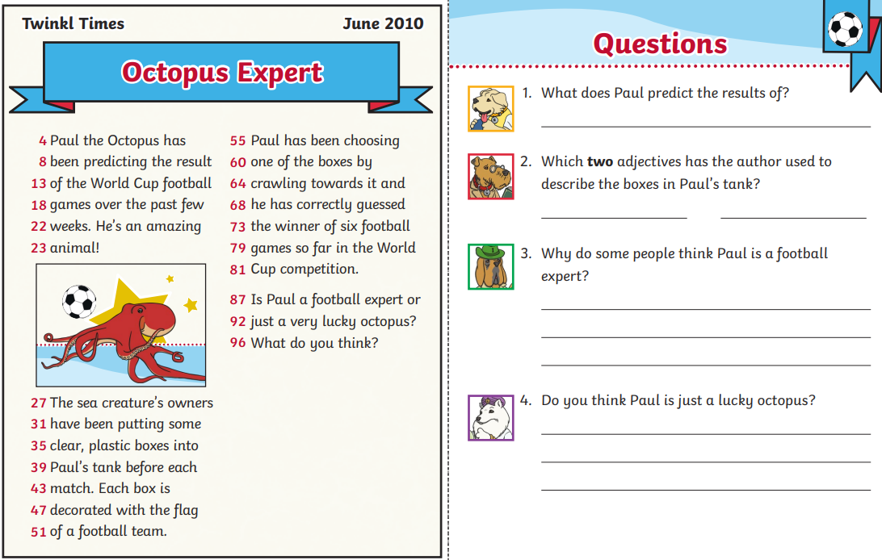
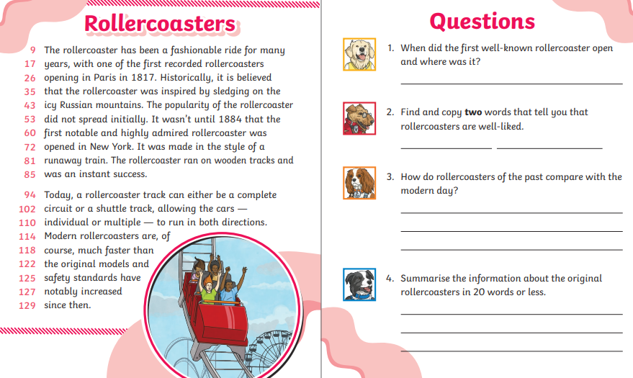
Home learning
Reading homework
Focus on fluency, reading speed and comprehension
Notes:
KS 1 - can you change this to SeeSaw.
Re: marking. Misconceptions will be addressed. Try not to use the work ‘marked’ as the feedback will not be very detailed. No need to bring this up though.
Tell parents : Homework will NOT have to be printed at home. Children can see it on google classroom and write answers in the homework book (which is then returned to school).
NOTE:Homework books are new to most children so explain how they work.

Slide 29
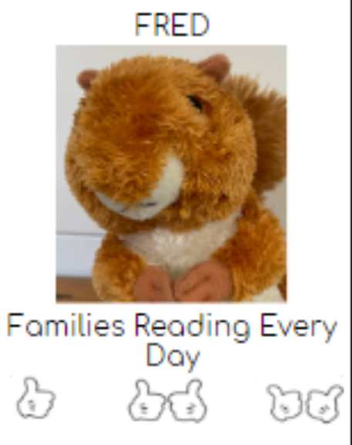
FRED - Reading at home
Children need to read at home every night. This can be any book that children enjoy reading (they will get one from the school library every week).
KS 1 - Please can parents initial reading record.
KS 2 - Children write down pages they have read.
Bring this to school every morning and show to class teacher. When children collect 10 000 ‘reads’, they will get a reward.
If home reading is not happening, a class teacher or Reading Lead will be in contact.
YES DAY!!!
Notes:
Talk about reading speed. Reading regularly is the only way to get faster.
By year 6 120 words per minute. If they don’t read regularly, they won't be fast enough to finish their SATs papers.

Slide 30
Notices:

Slide 31


Uniform
Order though Schoolmoney.
Children should also wear black skirts, trousers or pinafores and black shoes.
Find more information here:
https://underhillschool.co.uk/uniform

Slide 32
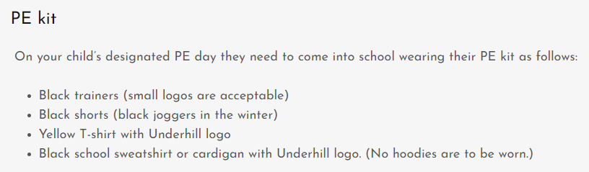
Uniform
Notes:
Add PE day.

Slide 33
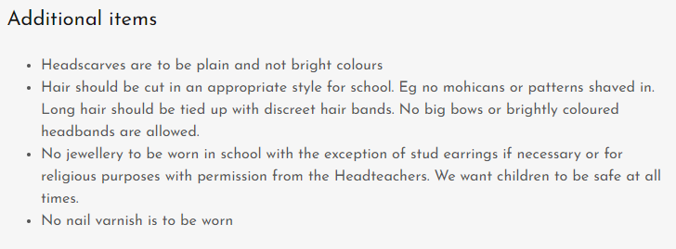
Uniform
Notes:
Add PE day.

Slide 34
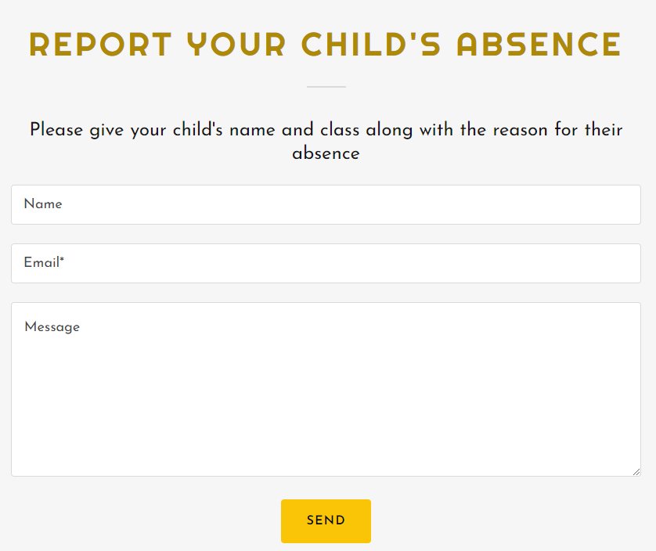
Absences
If your child in unwell, please inform the office in the morning.
https://underhillschool.co.uk/report-an-absence
Or you can call 020 8449 2423

Slide 35
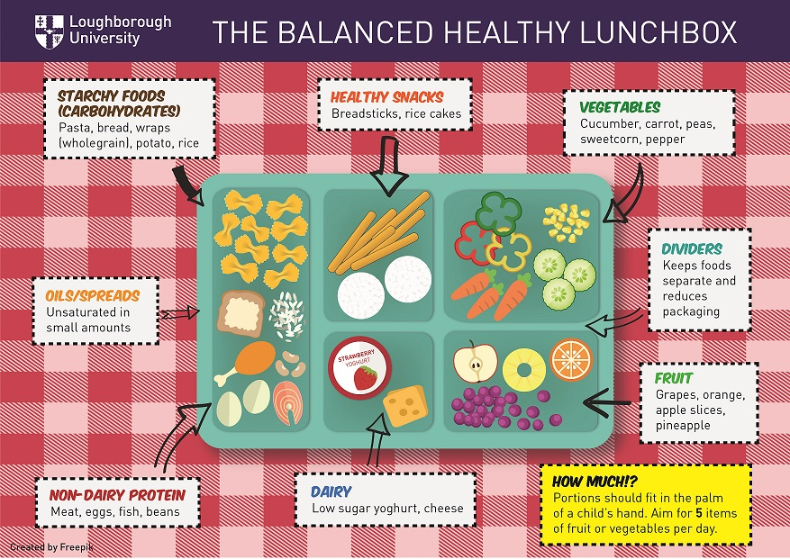
Snacks and Lunch
We are a healthy, nut free school. Children should bring in fruit or vegetables (e.g. cut up carrot, pepper or cucumber (not dried fruits please) to eat at break time. They are not permitted to bring in anything else.
ALL CHILDREN ARE ENTITLED TO A FREE SCHOOL MEAL.
If your child has packed lunch, please
ensure that it is healthy and nutritious.
Please do not give your child any sweets,
chocolate or fizzy drinks.
All lunch boxes should be named.
Please send your child into school
everyday with a named water bottle.

Slide 36
Independent Travel
Only children in Year 6 can be independent travellers.
Mobile phones should not be brought into school.
If a sibling is collecting your child, please arrange with the office (unless the sibling is a grown up).

Slide 37
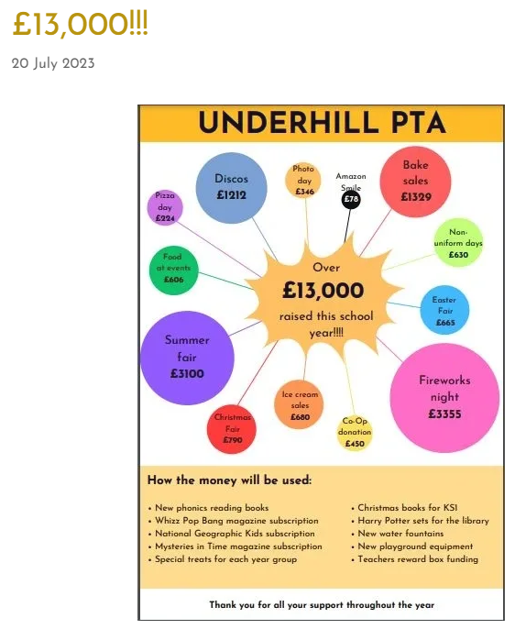
PTA
If you are interested in supporting the PTA, please talk to the school office or Anna in Nursery.
Notes:
We want to build on the last year’s success of PTA. Discuss some of the events.
We need parents to support. We will ask volunteers to sign up . Any events that do not have enough volunteers, need to be cancelled.
Summer Fair turn up was amazing.
Cake sales were very popular - these will be run by parent volunteer and class teachers.

Slide 38
Any questions?

Slide 39
Underhill School and Children’s Centre
Understand * Uplift * Unite
Thank you for coming!

