Slide 1
Maths Curriculum At Underhill

Slide 2
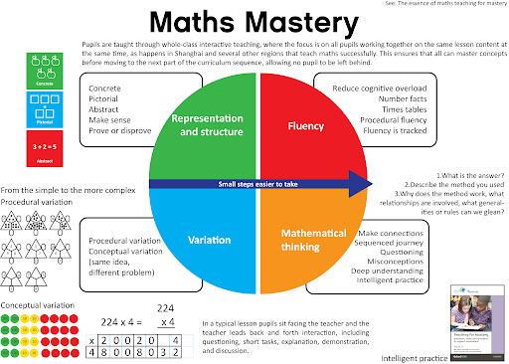
What is ‘True Maths Mastery’?
Fluency
Representation and Structure
Variation
Mathematical Thinking
Coherence

Slide 3
Maths Mastery – Reception to Y6
Coherent – shows clear progression across the school
Reasoning, Problem Solving including Word Problems built in
Plan for Accelerators (those that cannot access the curriculum and need to learn the fundamental skills) according to their needs.

Slide 4
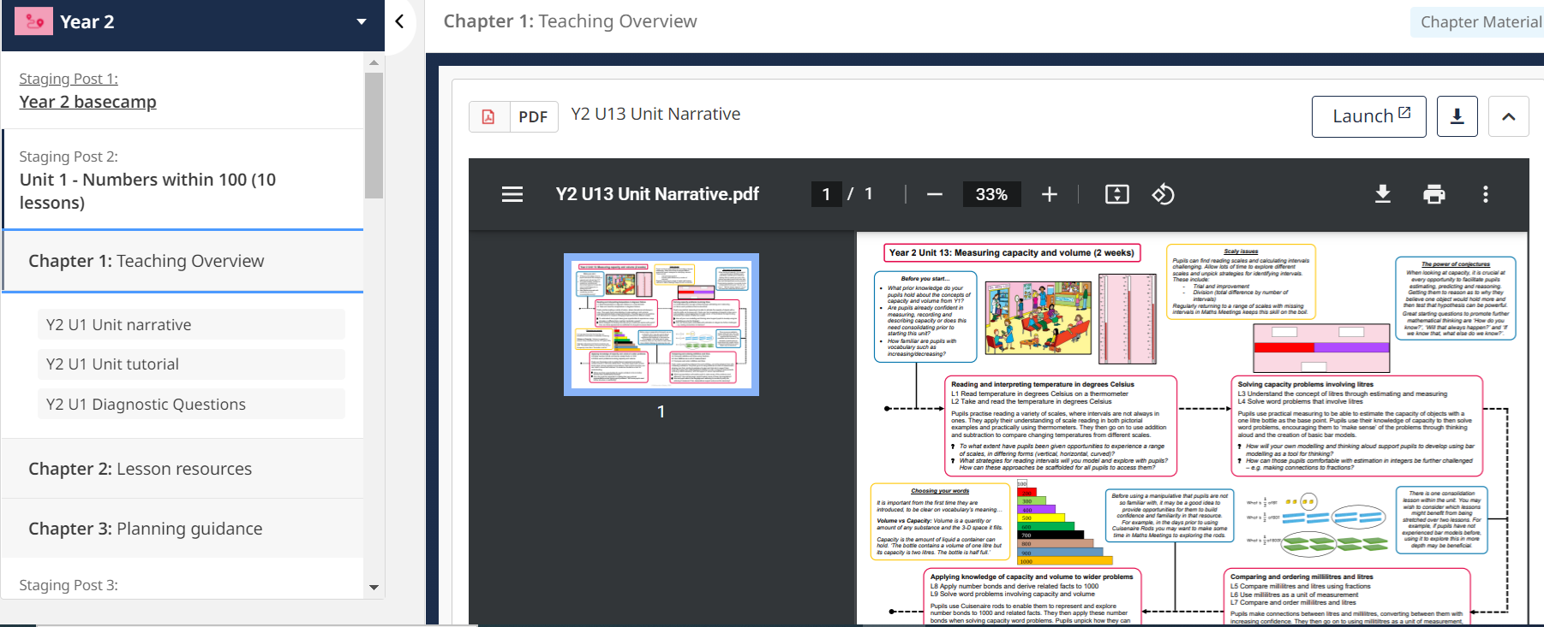
MM Unit Narrative Sheets (for parents too)
Maths Unit Summary Sheets to be shared with parents on See Saw/Google Classrooms (This way parents are informed about what has been, is currently being and is going to be taught).
Includes:
Prior Learning, Future Learning, Possible Misconceptions, Outcomes and National Curriculum Objectives

Slide 5
Maths Meetings
Maths Meetings are a vital part of the Mathematics Mastery programme.
Their purpose is to consolidate key areas of mathematics and develop fluency in recall of key knowledge.
A Maths Meeting should cover several curricular areas, broken down into short segments; each segment should take approximately 2 – 3 minutes.
Teachers to share these with parents on Google Classroom/SeeSaw

Slide 6
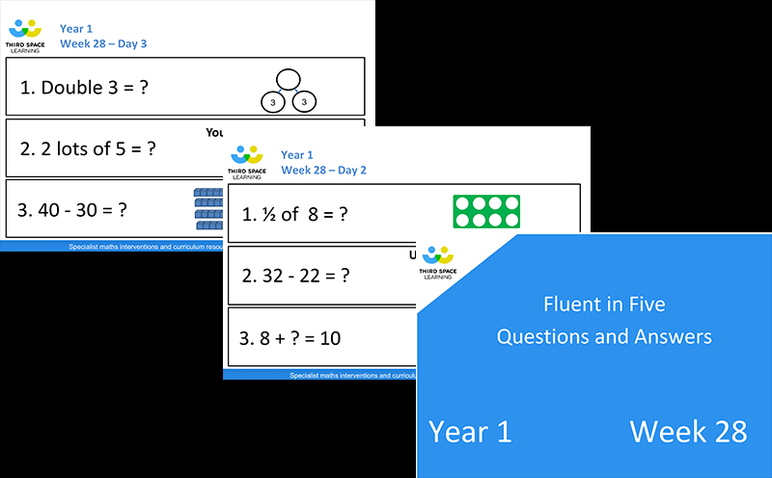
Fluent in Five (Y1-Y6)
Children at Underhill are becoming more fluent in arithmetic.
Fluent in Five:
5-10 minute daily practice
Structured with clear progression across the whole school
Can be done at the start of the Maths Lesson or as an early morning task/ straight after lunch etc.
Children to mark their own Fluency with green pens (Self-Assessment)
Progressive and systematic throughout the year and across the year groups

Slide 7
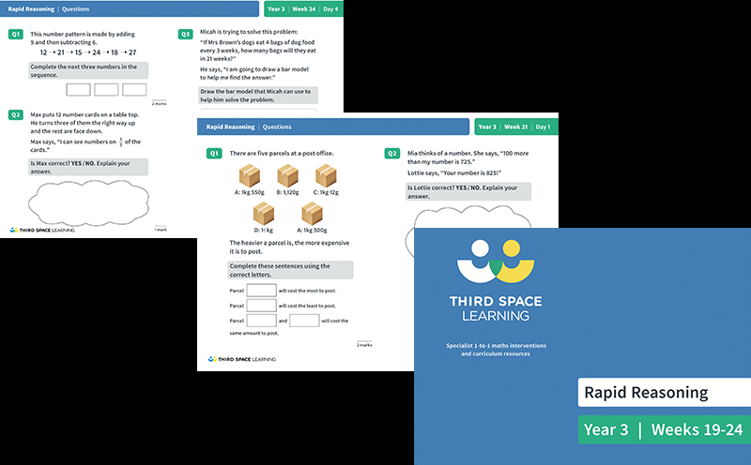
Optional Daily Rapid Reasoning (Y3-Y6)
5-10 minute daily rapid reasoning practice
Can be carried out during early morning task/ straight after lunch etc.
Can also be added at the end of the Maths Lesson (optional)

Slide 8
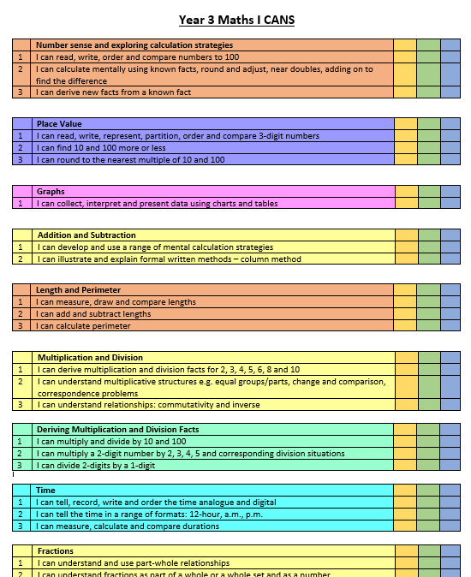
Maths I CANS
Adapted from the Maths Mastery Reception to Y6
Clearly ordered for easy access

Slide 9
Times Tables Assessments
Times Tables knowledge is also something Underhill children are accelerating rapidly with across the school.
End of KS2 (Year 4) Times Table Assessments
Times Tables Test Grids made for each year group
Green and orange highlighter for clear strengths/areas for improvement.
Times Tables Resource sheets in school (TTRS outside of school)
Progression to the next grid when children consistently get all greens (no ceiling/threshold)

Slide 10
Maths Data & Assessment at Underhill
Optional Pre Unit Assessment: At the beginning of a new Unit, carry out the Pre Unit Assessment and add results to your Maths Assessment Data. These will help to inform you who needs to be added to Intervention Groups or needs extra pre-teaching of the unit concepts.
Optional Post Unit Assessment: As above but at the end of each Unit.
Half-Termly Assessments: These are carried out at the end of each half term.
Use the End of Year Test at the start of the year as a baseline, and again at the end of year to show clear progress. Add all results to Maths Assessment Data.
Assessments - We are responsible in helping children to prepare for Secondary School. These results will be passed on to the next teacher of the class giving them a much greater understanding of where their new class are currently at and any particular topics a child needs extra support with.

Slide 11
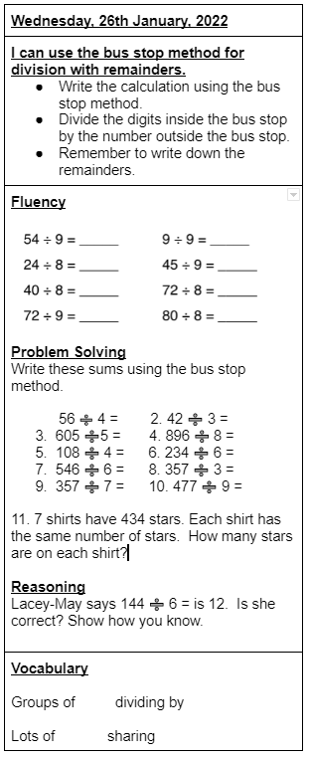
Accelerators
Accelerator Aims
Pupils regularly go back over concepts that they have learned in the past.
Teachers explain new ideas clearly so that pupils understand them.
Teachers have high expectations of pupils with SEND.
They provide just the right equipment and support to pupils who need extra help.
Teachers check frequently what pupils know.
They adapt learning and provide additional explanations if pupils need them.
Accelerator Activity Sheets
• Date and I CAN displayed at the top of the sheet
• Success Criteria Choices: Write the steps to success on the sheet and/or write the steps to success off the sheet
• Fluency based on the I CAN being taught
• Problem Solving Activity based on the I CAN being taught
• Reasoning Activity based on the I CAN being taught
• Key Maths Vocabulary at the bottom of the sheet
Assessments
Same format as Accelerator Activity Sheets
Repeat the Pre-Test (Verbal and/or written) at the end of the unit to assess progress/retention of knowledge/concepts taught.
Times Tables/Number Bond Independent Starters/Early Morning Work
Times Tables/Number Bonds independent starters – Can be carried out as early morning work – See resources in Accelerator Starters Folder
Other useful websites:
Times Tables Generator:
http://www.timestables.me.uk/printable-pdf-quiz-generator.htm
Woodlands Trust Interactive Maths Resources:
http://www.primaryhomeworkhelp.co.uk/maths/index.html

Slide 12
Interventions
Focused Intervention Groups are put into place to enable the lowest achieving 20% to narrow the gap and accelerate learning.
Same Day Interventions/Post-Lesson Follow-up/ Pre-Teach for future lessons
We aim for 3x per week.
Teachers to check out MM Ready To Progress Documents for a clear and planned Intervention Programme
Also check out Power of Maths and Maths No Problem for some great Mastery Intervention Materials.
Optional Greater Depth Group at least 6 times per year - to help challenge the Greater Depth (gives those children that special time).

Slide 13
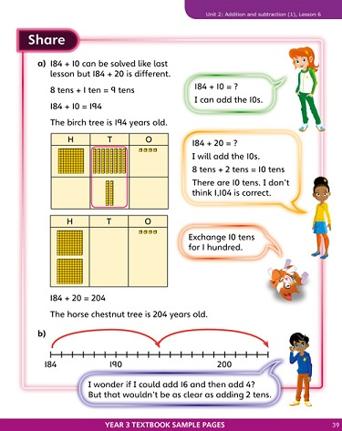
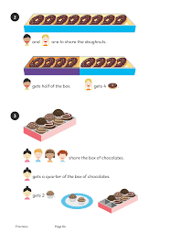
Homework
One piece of Maths Homework per week (based on the current Unit or in preparation for the next Unit).
Can use resources from Maths Mastery
Power of Maths (KS1)
Maths No Problem (Y1-Y6)
Really easy to set and both really visual
TTRS (3 minutes per day for rapid x tables knowledge)

Slide 14
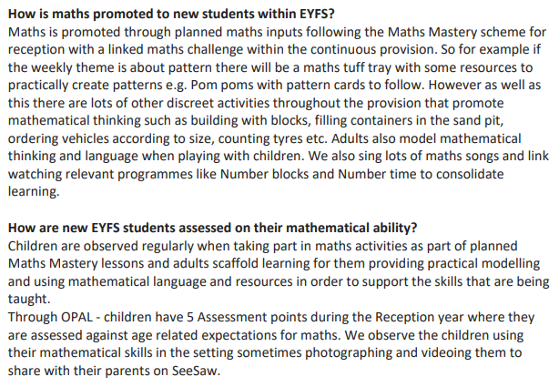
Maths in EYFS

Slide 15
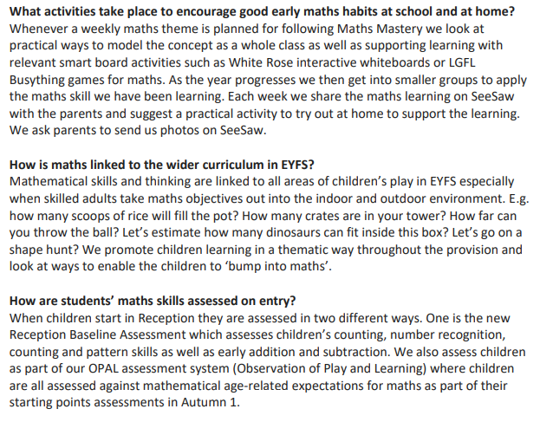

Slide 16
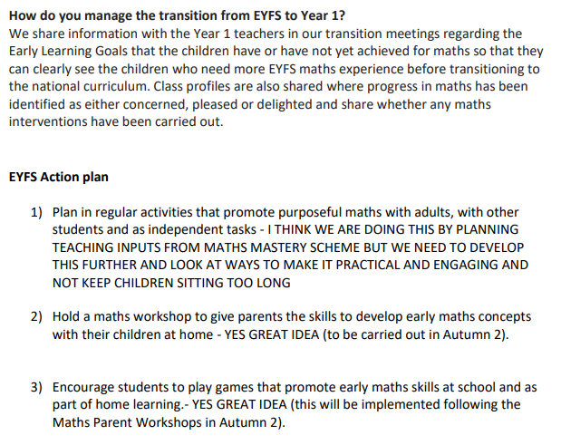

Slide 17
SMSC and Cultural Capital in Mathematics
Spiritual development in Mathematics
The study of mathematics enables students to make sense of the world around them and we strive to enable each of our students to explore the connections between their numeracy skills and every-day life. Developing deep thinking and an ability to question the way in which the world works promotes the spiritual growth of students. Students are encouraged to see the sequences, patterns, symmetry and scale both in the man-made and the natural world and to use maths as a tool to explore it more fully.
Moral development in Mathematics
The moral development of students is an important thread running through mathematics. Students are provided with opportunities to use their maths skills in real life contexts, applying and exploring the skills required in solving various problems.
Social development in Mathematics
Problem solving skills and teamwork are fundamental to mathematics through creative thinking, discussion and explaining ideas. Students are always encouraged to explain concepts to each other and support each other in their learning. In this manner, students realise their own strengths and feel a sense of achievement which often boosts confidence. Over time they become more independent and resilient learners.
Cultural Capital and development in Mathematics
With our firm belief that knowledge is transferable, our pupils are given every opportunity to participate in a wide range of learning experiences beyond their classroom. These experiences include trips to museums, theatres and community projects in and around London. They are also given regular opportunities to participate in school and national competitions to encourage more positive attitudes towards Mathematics. Cultural Capital is the essential knowledge that children need to prepare them for their future success – in the world of work, in relationships forged throughout life and as a valued contributor to society. When beginning their primary school journey in the EYFS, many children arrive to school with different and sometimes more limited experiences than others. Therefore, our aim is to give children the knowledge and skills to prepare them for what comes next in their lives. This includes the relevant vocabulary needed throughout their education and the opportunity to link maths to real-world problem solving.

Slide 18
Intent
At Underhill, we believe that children should leave primary education as confident (BE CONFIDENT), curious (BE CURIOUS), co-operative (BE CO-OPERATIVE) and caring (BE CARING) mathematicians with a deep conceptual understanding of the skills required to approach any maths problem. Our mission is to enable all learners to enjoy and succeed in mathematics. We want learners to think about maths beyond what is tested in national examinations and to be equipped with an understanding of mathematics that will be relevant and useful in their future studies and in the world of work. We understand that a deep grasp of mathematics is essential to enabling greater social equity and mobility.
We want our pupils to be successful not only in their schooling career, but throughout their adult lives. Through carefully designed lessons, our teachers are able to make meaningful connections between content with a high emphasis placed on problem solving. The Mathematics Mastery programme has been designed on principles to provide learners with a deep conceptual understanding of mathematical principles, the ability to confidently communicate in precise mathematical language, while becoming mathematical thinkers.
The programme can be delivered with confidence in the knowledge that if a student understands the core principles, they will be able to remember more and do more maths, in whatever context they encounter it.

Slide 19
Implementation
To ensure whole-school consistency and progression, Mathematics at Underhill is planned and sequenced using Mathematics Mastery. This is fully aligned with the National Curriculum and the school’s ongoing engagement with the Mathematics Mastery team continues to ensure that staff at all levels understand the pedagogy of the approach.
New concepts are shared within the context of an initial related problem or ‘Big Picture’, which children are able to discuss in partners. This initial problem-solving activity prompts discussion and reasoning, as well as promoting an awareness of maths in relatable real-life contexts that link to other areas of learning.
In EYFS, KS1 and KS2, these problems are almost always presented with objects (concrete manipulatives) and pictorial representations.
The programme uses a six-part lesson designed to test conceptual and procedural knowledge and assess children regularly to identify those requiring intervention, so that all children keep up. Each lesson phase provides the means to achieve greater depth.
Independent work provides the means for all children to develop their fluency further, before progressing to more complex related problems. The large majority of children progress through the curriculum content at the same pace.
Differentiation is achieved by emphasising deep knowledge and through individual support and intervention. Mathematical topics are taught in blocks, to enable the achievement of ‘mastery’ over time. Practice and consolidation play a central role. Carefully designed variation within this builds fluency and understanding of underlying mathematical concepts.

Slide 20
Impact
The school has a supportive ethos and our approach supports the children in developing their collaborative and independent skills, as well as empathy and the need to recognise the achievement of others. Students can underperform in Mathematics because they think they can’t do it or are not naturally good at it.
The Mathematics Mastery programme addresses these preconceptions by ensuring that all children experience challenge and success in Mathematics by developing a growth mindset. It is imperative that the children have a secure understanding of each mathematical concept before moving on.
At Underhill, we ensure that the children have mastered the maths in every lesson, by ensuring that teachers are expertly using assessment for learning, identifying and addressing any misconceptions as and when they arise. Where possible, teachers and teaching assistants deliver targeted focus groups, interventions and boosters based on assessment of the work produced to ensure that all children are ready to move on.
As well as assessment for learning during lessons, regular and ongoing assessment of the pupils’ outcomes informs teaching, as well as intervention, to support and enable the success of each child.
We use a variety of strategies to evaluate the knowledge, skills and understanding that our children gain as they progress from Nursery to Year 6.
By the end of Year 6, pupils should be fluent in written methods for all four operations, including long division and multiplication, and in working with fractions, decimals, and percentages. They should be able to read, spell, and pronounce mathematical vocabulary correctly.

Slide 21
School Improvement Plan
1 & 2: MM, Fluent In Five
3: We now have access to more high-quality Maths Mastery Resources than any other school that I know
4: Fluent In Five, MM (progressing within each year and then across each year group), Star Words for Key Vocab etc., Times Tables Assessments, TTRS, Daily Rapid Reasoning.

Slide 22
Teacher Achievements Well done everyone for…
Adjusting
Adjusting to the new style of Mastery Curriculum
Competing
Competing with your fellow teachers (friendly competition) and encouraging your children to practise their times tables at home (TTRS)
Inspiring
Inspiring the children with your fantastic acting in the TTRS Battle of The Bands Videos
Taking part
Taking part, dressing up and inspiring the children for the NSPCC Numbers Day

Slide 23
But this is just the start!
We want to develop a way of teaching and learning Maths that is truly consistent across the school setting the highest of standards.
Maths I CANS (Reception-Y6)
A clear, progressive Curriculum Map (Reception-Y6)
Fluent In Five (Y1-Y6)
Maths Mastery (Reception-Y6)
Extra Challenge for the GD (Y1-Y6)
Weekly Times Tables Knowledge and Assessment (Y1-Y6) – ready for the Y4 Times Tables Assessments
Optional Extra Daily Reasoning (KS2)
Sharing the Unit Narrative Sheets with parents to keep them up to date with what has, is currently being and is going to be taught
Maths Meetings – Regularly revisiting key concepts each term.
Maths Homework being set consistently to set high-expectations for children outside of school
TTRS
Interventions targeting the lowest achieving 20% (post teaching and pre teaching) as well as targeting the Greater Depth at least 6x per year
Clear and Consistent Data & Assessment Across The School (MM End of Term, End of Half-Term and Baseline)

Slide 24
