Slide 1

Underhill School and Children’s Centre
Understand * Uplift * Unite
Reception

Slide 2
Children’s Centre
Please sign up for our Children’s Centre, there are so many services and groups available for families of children with Under 5s to support you!
Notes:
We will also be organising a welcome coffee morning for parents in nursery and reception classes.

Slide 3
Meet the team
Class | Teacher | TAs
Beech Class | Clare Hallam | Laura O’Sullivan Alex Nicolaou Simona Pomian
Maple Class | Louise Maley

Slide 4
The Underhill Way
At Underhill, we have 4 BE words;
Be Caring
Be Confident
Be Curious
Be Cooperative
These enable all children to become happy, successful 21st Century learners both while they are in school and in their future.
We also instill a positive and determined attitude though our school chant:
I can, you can, we can.
If you are ever visiting the school, it is likely that you will hear this chant coming from the classrooms to energise the children for their learning.

Slide 5
Curriculum

Slide 6
Early Years Foundation Stage
In the EYFS we promote learning in the following areas;
Communication and Language
Physical Development
Personal, Social and Emotional Development
Literacy
Maths
Understanding the World
Expressive Art and Design

Slide 7
EYFS Curriculum Aims
Broaden the children’s understanding of the world. (Be Caring)
Spark their curiosity and imagination (Be Curious)
Teach the children how to work collaboratively (Be Cooperative)
Prepare them for life after Underhill (Be Confident)
Make them lifelong readers
Increase and improve their oracy skills (and in EYFS their storytelling skills)
Build on their physical and mental fitness

Slide 8
Reception curriculum
 | Autumn 1 | Autumn 2 | Spring 1 | Spring 2 | Summer 1 | Summer 2
Topics linking to children’s interests | Feelings | Autumn | Journeys | Food and Growing | Minibeasts | Seaside

Slide 9
Developing a love of Reading in EYFS
ERICA time everyday
Phonics lessons- helping children to learn to read
Story telling
Reading and loving stories at home and school - we will be sending reading books and stories home. Reading with your child is essential!

Slide 10
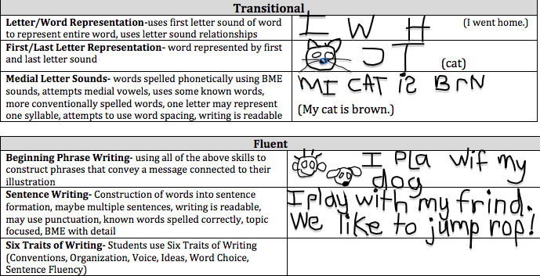
Developmental stages of Writing

Slide 11
PSED
Children’s personal, social and emotional development (PSED) is crucial for children to lead healthy and happy lives, and is fundamental to their cognitive development.
In Reception this year we will be teaching lessons related to the following topics;
My Feelings
Special Relationships
Taking on challenges
Listening and following instructions
My family and friends
My wellbeing

Slide 12
Assessments and SeeSaw
In Reception we will be making observations of your child during their play and learning. Each child will have two Spotlight Months during the year (these months occur in relation to where their birthday falls) During these months we will be observing them closely and will share these observations with you on SeeSaw.
We will use these observations to assess your child’s development and progress.
We will share this information with you during the parent consultations that will happen during the year in a rolling programme.

Slide 13
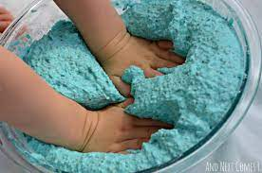
Messy/Sensory Play
In Early Years there are lots of activities that we provide for children to explore that can be messy that help them develop important skills. Children are of course supervised by adults but they can get very messy when they are playing in the mud kitchen or with sensory materials!

Slide 14
Behaviour

Slide 15
Underhill Behaviour
I can, You can, We can… | This means that we…
BE Caring | Look after ourselves and others, are kind, are honest, look after our school and our things, respect each other, stand up for what’s right, show good manners, are tolerant and show compassion, support each other, understand different feelings
BE Confident | Solve problems, use our voice, ask questions, have a go, are organised, are honest when things go wrong, take responsibility for making a mistake, feel proud, are brave, try to do our best every day, are active learners
BE Curious | Know our learning style and how to do our best, challenge ourselves to see how far we can go, are resilient, understanding the learning pit, know how to help ourselves achieve, listen, ask questions
BE Co-operative | Work together, are a team, follow instructions, share, support others, are responsible citizens, understand our community and our world,

Slide 16
Underhill Rewards
We have 4 houses at Underhill
Balmoral * Sandringham * Holyrood * Windsor
We have 6 Expectations
We are kind and helpful
We try hard with our learning
We look after property
We listen well
We are honest
We are gentle
Rewards
Star of the Week
Marbles and marble parties
Our Unsung Heroes
Treasure Charts
In Reception 10 stickers for good behaviour = Treasure!

Slide 17
Parents as Partners

Slide 18
Parents as Partners
You are your child’s most important educator!
We will develop a partnership with you through;
Weekly home learning activities to support your child
Seesaw - our online journal
School Newsletter
Please don’t hesitate to let us know if you have any worries or concerns. We want to build your trust and work in partnership with you so that your child can be happy and successful!

Slide 19

SeeSaw Expectations
SeeSaw is the main way that we can communicate with each other so please….
Download the SeeSaw app and log in as a ‘Family Member’
Do like and comment on what we post about your child.
Do send photos and videos in response to the home learning each week.
Do send us messages and we will respond during working hours.
Don’t worry about your own grammar and spelling!

Slide 20

Reading in Reception
We want to develop a love of reading in our children so you can support this by reading with your child everyday.
Library books - The children will choose a book to bring home and share with you every Wednesday
Reading books - In a few weeks we will be sending reading books home for your child to practise their decoding skills.

Slide 21
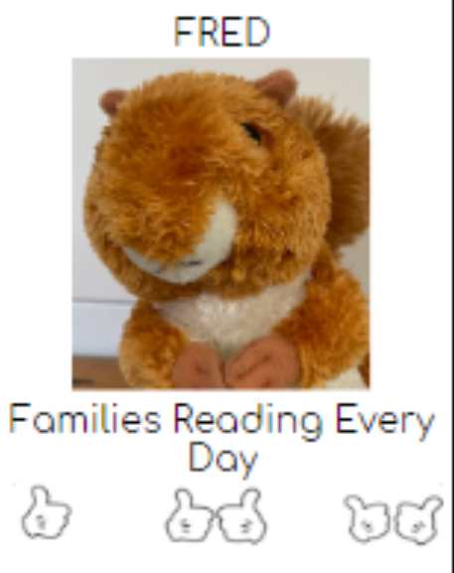
FRED - Families Reading Every Day
(at home)
Children need to read at home every night.
This can be any book that children enjoy reading (they will get one from the school library every week).
Parents need to initial the FRED after their child has read for 10-15 minutes.
Bring this to school every week and show to class teacher.
If home reading is not happening, a class teacher or Reading Lead will be in contact.
When children collect ‘reads’, they will get a reward.

Slide 22
Home Learning in Reception
Each week on a Thursday on SeeSaw we will send home learning activities to support the children’s learning in;
Reading
Phonics
Maths
Our topic

Slide 23
Notices

Slide 24
The School Day
The Reception day starts at 8.40 a.m. and finishes at 3:20 p.m.
We will collect the children in the Reception drop off zone, please enter the playground by the gate opposite the main office.
Please be on time for dropping off and picking up your child.

Slide 25

Saying goodbye in the morning…
Please do say a prompt goodbye and leave your child in the line.
Please don’t wait to wave to your child as it can unsettle them and the other children. Please leave the school premises as soon as you can.
Please do get on with your day and be proud that you got your child to school on time!

Slide 26
Collecting your Child
If you are going to be delayed please let the school know as soon as possible- please note charges may be applied for late collection.
If you need someone else to pick up your child please let the office or the teacher know as soon as possible. The person collecting will need to know the password that you have created.
We will dismiss the children in the same area as the morning drop off zone. Please allow us time and space to get the whole class outside before we start dismissing the children. We will hand your child to you so please be patient while you are waiting.

Slide 27


Uniform
If you need to order any items of uniform, you can order through school money.
Children should also wear black skirts, trousers or pinafores. They should also wear black shoes with velcro.
Please can you make sure you do purchase the book bag.
Find more information here:
https://underhillschool.co.uk/uniform

Slide 28
Uniform
Please ensure that all items of uniform are clearly named including shoes and coats.

Slide 29
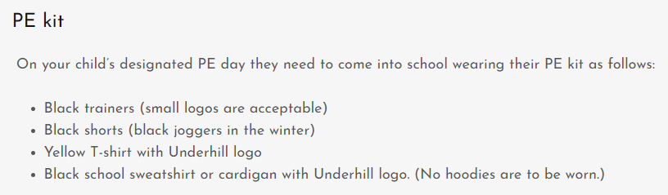
Uniform
Your child will have PE on Mondays - No tights should be worn on PE days.

Slide 30
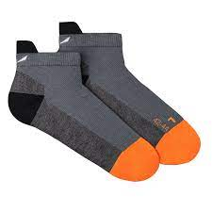
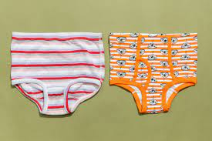


Spare clothes
Please can we have a set of spare clothes for your child to keep at school.

Slide 31


Water Bottles
Please can water bottles not be put in the black book bags as they can leak and damage the books. Please make sure your child’s water bottle is named.

Slide 32

Snacks and Lunch
We are a healthy, nut free school. Children under the age of 5 are entitled to a carton of milk for free. They are also entitled to a piece of fruit each day too.
Children are entitled to a free, healthy, hot lunch at school up until the age of 7.
If your child has packed lunch, please
ensure that it is healthy and nutritious.
Please do not give your child any sweets,
chocolate or fizzy drinks.
All lunch boxes should be named.
Please send your child into school
everyday with a named water bottle.
Donations of plain crackers and breadsticks
Will be gratefully received for an additional afternoon snack!

Slide 33

Toys
Toys are not allowed at school.

Slide 34
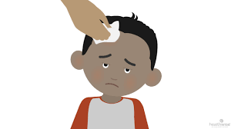
Head Bumps
If your child bumps their head at school, it is our policy to phone you to let you know. Please do not worry as this is just our procedure.

Slide 35
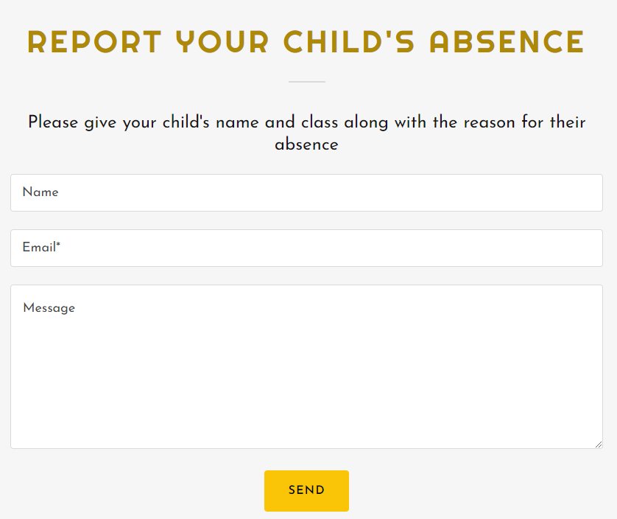
If your child in unwell, please inform the office in the morning.
https://underhillschool.co.uk/report-an-absence
Absences
Or you can call 020 8449 2423

Slide 36
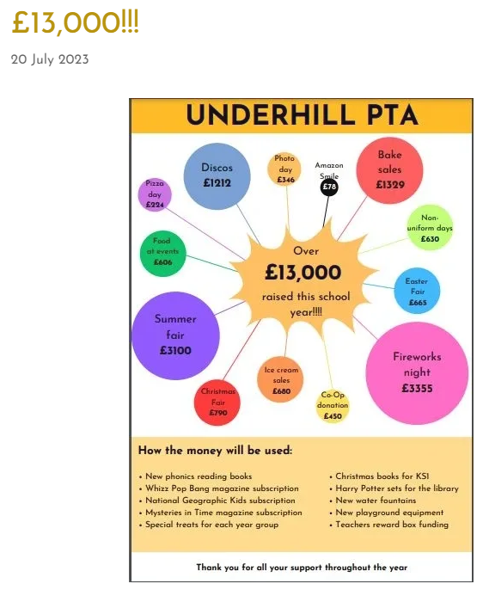
PTA
If you are interested in supporting the PTA, please talk to our Reception rep or Anna in Nursery.

Slide 37

Clubs
Breakfast and after school club.
Other enrichment clubs.

Slide 38
Any questions?

Slide 39
Underhill School and Children’s Centre
Understand * Uplift * Unite
Thank you for coming!

