Slide 1

Pensacola Athletic Cheer and Dance Season 3

Slide 2

WELCOME TO PENSACOLA ATHLETIC CHEER AND DANCE
THANK YOU for your interest in our 2025-2026 all-star cheer program. We are extremely excited to be starting Season 3. Hard work, positive reinforcement and dedicated families will make our gym a unique place to enjoy. We strive to create athletes that are not only the best on the competition floor but also amazing individuals in everyday life, creating leaders and building self confidence in all our athletes while making it a fun and enjoyable experience.
This packet includes all the information that you will need for all-star cheerleading. Including, tryout dates, policies for both athletes and parents, financial obligations, as well as other important information. Please take the time to read through every section and if you have any questions, please feel free to contact us.

Slide 3

TABLE OF CONTENTS
                TRYOUT INFORMATION
                FINANCIAL OBLIGATIONS
                PRACTICE AND ATTENDANCE POLICY
                IMPORTANT DATES
                GENERAL GYM RULES
                COMPETITION RULES

Slide 4
TRYOUT INFORMATION
We have teams for ages 3 – 18+, welcoming all skill levels. No experience is necessary to try out. The try out process is casual and fun! The athletes will demonstrate jumps and tumbling skills. Following the tryout athletes will be placed onto a practice team at their current skill level until the end of July/August to demonstrate their stunting abilities. At the end of July/August, coaches will determine and make final decisions for team placements. All athletes are placed on a team.
TRYOUT DATES
(Levels based on tumbling skill – see levels below)
Monday, May 6th – 8th, 5:30pm to 7:30pm
Call, email, or message us for makeup dates and times.

Slide 5
TRYOUT ATTIRE
              Athletic top with appropriate fit. (No oversized t-shirts)
              Sports Bra
              Athletic spanks/shorts
              Hair pulled up in a ponytail, pulled back from face
              Athletic shoes
LEVELS
Please attend the tryout level based on the tumbling skill below. Every skill is not needed to tryout but must be able to do at least one listed skill without a spot (except for level 1 beginners).
TRYOUT CHECKLIST:
              Wavier
              Tryout Information Form
              Financial Agreement
              $60 Tryout Fee
Level 1 | Forward/Backwards Roll, cartwheel, roundoff, backbend kickover, front/back walkover
Level 2 | Single BHS, BWO BHS, Cartwheel BHS, RO BHS, BHS series, FWO BHS, Bounder, FHS
Level 3 | BHS series, jump-BHS, BHS step out to BHS tuck, roundoff BHS tuck, roundoff tuck, punch front
Level 4 | Standing tuck, BHS tuck, CHS to layout, jump BHS tuck, roundoff BHS layout, whips, punch front
Level 5 & 6 | Standing full, series to full or double, jump tuck, RO BHS full or double

Slide 6

FINANCIAL OBLIGATIONS
All-star competitive cheer requires financial commitment. Please read and understand all obligations. We want to do our best to make this as affordable as possible.
TUITION
Tuition payments includes the team practices each week plus 1 tumbling class each week.
Tuition is not prorated due to absences or gym closures.
Payments are due on the 1st of the month. If payment is not received by the 3rd, a late charge of $50 will be added to your account.
Everyone must provide correct and complete credit or debit card information. This will be used either as a primary source of payment or as a backup if you choose to pay by cash or check.
All tuition must be current before an athlete may compete, practice, or collect any clothing, uniform, or other accessories.
PACD reserves the right to adjust any price stated in this packet due to any unforeseen price increases. We will notify you if this occurs.
NO refunds will be given for ANY reason.
In the instance that an athlete quits, or gets dismissed from a team, a $350 cancellation fee will be processed immediately (before choreo, after choreo it’s $450).
TUITION & ASSESSMENTS MONTHLY PAYMENT
Assessments are fees that the gym pays to outside vendors that include competition fees, music fees, choreography, coaches travel. These fees are non-discounted fees.
Families are responsible for all travel expenses.
Any events that are at the end of the season are separate fees and not included in assessment fees. We will communicate assessment fees to these events once we receive a bid or have chosen which of the season event the gym will attend.

Slide 7
Tiny Novice $130 3 competitions
Tiny & Mini Full Year (elite or prep) Tiny $150 Mini $190 4 competitions
Youth, jr. and Sr Full Year (elite or prep) $250 5-6 competitions
All Star Prep (half season) $190 3 competitions
Cheerabilities $35 3-4 competitions
Dance Team $160 3-5 competitions
Crossover Fee $50
Tuition Fees are paid the 1st of every month
FAMILY DISCOUNTS & ADDITIONAL CLASS PRICING
  Tuition for additional athletes in the same immediate family participating in program (except Tiny Novice) is $30 off 1st sibling and $10 for each sibling after that.
  Athletes that are crossing over and competition two teams will be responsible for the 2nd team entry fees. These are not included in the monthly tuition.
  In addition to team practices, you may choose to attend a designated tumble class within your skill level. The monthly price for cheer athletes will be $25 for each class.
  We offer a pre-pay and referral discount. Please see a staff member for pricing.
ADDITIONAL MANDATORY ESTIMATED EXPENSES
          Annual registration fee $100
          Practice wear $160
          Practice bow $25
          Make up kit $65
          Uniform Fee $300 (includes bow)
          Cover up $65
          Warmup $90
          Backpack $100
          Cheer Shoes $130
          Choreography Fee $100 (Tiny Novice) $130 (Tiny, Mini, Youth, Jr, Senior)
          Music Fee $100 (Tiny Novice and Tiny) $120 (Mini, Youth, Jr, Senior)
          Hotel and Travel to competitions (Family’s responsibility)
          End of year competition events (includes the comp and coaches fee)

Slide 8
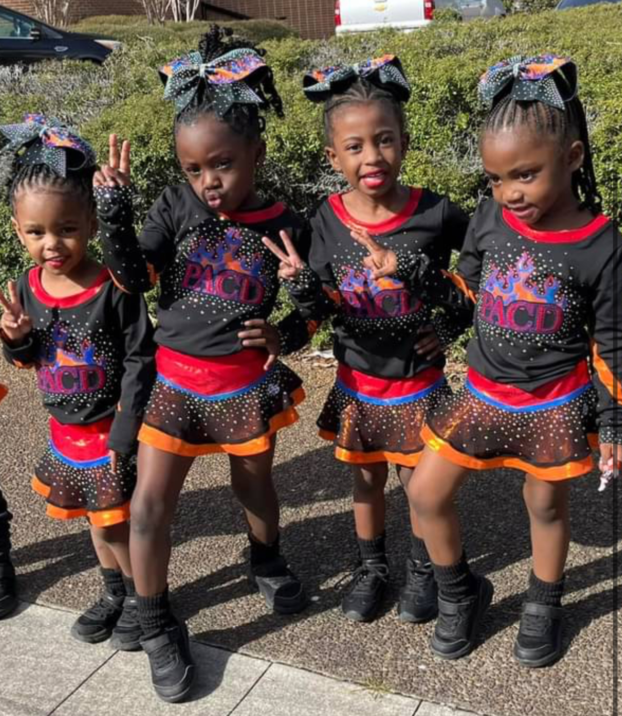
FUNDRAISING
PACD offers fundraising. Fundraising is done at the individual level and credits will go directly to your account (minus 10%). We strongly suggest you participate in fundraising.
Fundraising may be applied to tuition classes, uniforms, or gym fees
Refunds cannot be issued for fundraising
COMMUNITY ACTIVITIES
PACD will do community activities, including parades, from time to time. We encourage everyone’s involvement.
SCHEDULE OF FEES DUE
                Annual registration: Due at the time of registering
                PACD Shirt: May 30th
                1st Tuition due: June 1st
                Practice Wear and bow: June 20th
                Choreo Fee: July 11th
                Uniform and Socks: August 15th
                Shoes: September 12th
                Cover up: September 26th
                Warmup due: October 17th
                Make up Kit: November 7th

Slide 9
IMPORTANT DATES
        Tryouts: May 6th – 8th
        Temporary Team Placements: May 19th
        Gym Closed: May 19th – June 1st
        Practice Begins: June 2nd
        Practice/Uniform/Shoe Fittings: June 2nd – 5th
        Season Parent Meeting: June 16th
        Gym Closed: June 19th
        Gym Closed: July 4th
        Final Team Placements: July 20th
        Choreography: July/August/September (TBD)

Slide 10

PRACTICE AND ATTENDANCE POLICY
ATTENDANCE
Attendance is crucial to the success of any team. We understand there are circumstances that may be unavoidable, but keep in mind this is a team sport that is unlike any other because there are no back-ups. All practices are mandatory. Once teams are formed you will receive the practice schedule. Practices may be changed and/or added throughout the season at any time. If practice is altered, you will be notified of any changes. If any athlete is continuously tardy, lack of desire, communication, or commitment, PACD reserves the right to implement disciplinary actions.
EXCUSED ABSENCES
        Contagious
        Graded school function
        Family emergency
        Family vacations
UNEXCUSED ABSENCES
      Traffic
      Too much homework
      Feeling tired
      No ride
      School dance or game
      Birthday parties
ABSENT REQUEST FORM
An absent request form should be submitted two weeks prior to missing any practice. Please see a staff member for an absent request form.

Slide 11
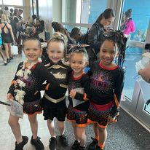
VACATIONS
Please plan your family vacations around the gym schedule, we will work as much as we can to accommodate vacations. If you plan to take vacation during spring break, please plan to do so the days that we are closed for spring break. This will be the same for Thanksgiving and Christmas holidays as well.
COMPETITION SCHEDULE
Competition season begins in June and ends in May. Competitions are mandatory. Competitions are held or Saturdays and Sundays with the possibility of Friday and Monday. Once we release the competition schedule, we will release our Black Out Weeks (two weeks before competition). Any athlete that misses during those two weeks will not be able to attend competition of that week.
SUMMER PRACTICE
The summer months are June-August and will be used as a time for athletes to improve their skills and learn choreography. We know families use the summer as a time for relaxing and fun. We will work hard to work with summer vacations but please remember practices are mandatory. Summer is when the most important skills are learned for team placements. Choreography practices/camps are mandatory and can’t be missed.
INJURIES
Unfortunately, injuries can occur in this sport. If an injury happens, it is the responsibility of the parent to seek professional help. After seeing a physician, please provide PACD with an evaluation of the injury and status. The athlete will be expected to participate in practice unless a doctor’s note is provided. An athlete will not be able to return to the team until he/she has been released from the doctor, healed 100%, and can perform the necessary skills in the routine. We ask that athletes still come to practice even if they can’t physically participate. There is a possibility the athlete’s spot in the routine could be changed.

Slide 12

GENERAL GYM RULES
Only cheerleaders and coaches are allowed in the practice areas.
No food, drink, or gum is allowed in the gym area
No cell phones will be allowed in the gym area.
No playing on the equipment before or after practice.
Fingernails should be kept short for safety reasons.
Team members are expected to arrive on time for practice and in the proper attire with hair pulled back away from the face.
For the safety of the athlete and the other team members, all jewelry must be taken off prior to the beginning of practice. This includes all body jewelry.
All athletes are expected to behave in a respectful manner and always uphold PACD’s rules and policies. Unsatisfactory acts during practice may result in his/her removal from practice and/or the program.
There is absolutely no unsupervised spotting in the gym or at an event we are taking part in. This includes cheerleaders spotting each other and parents spotting their children.

Slide 13
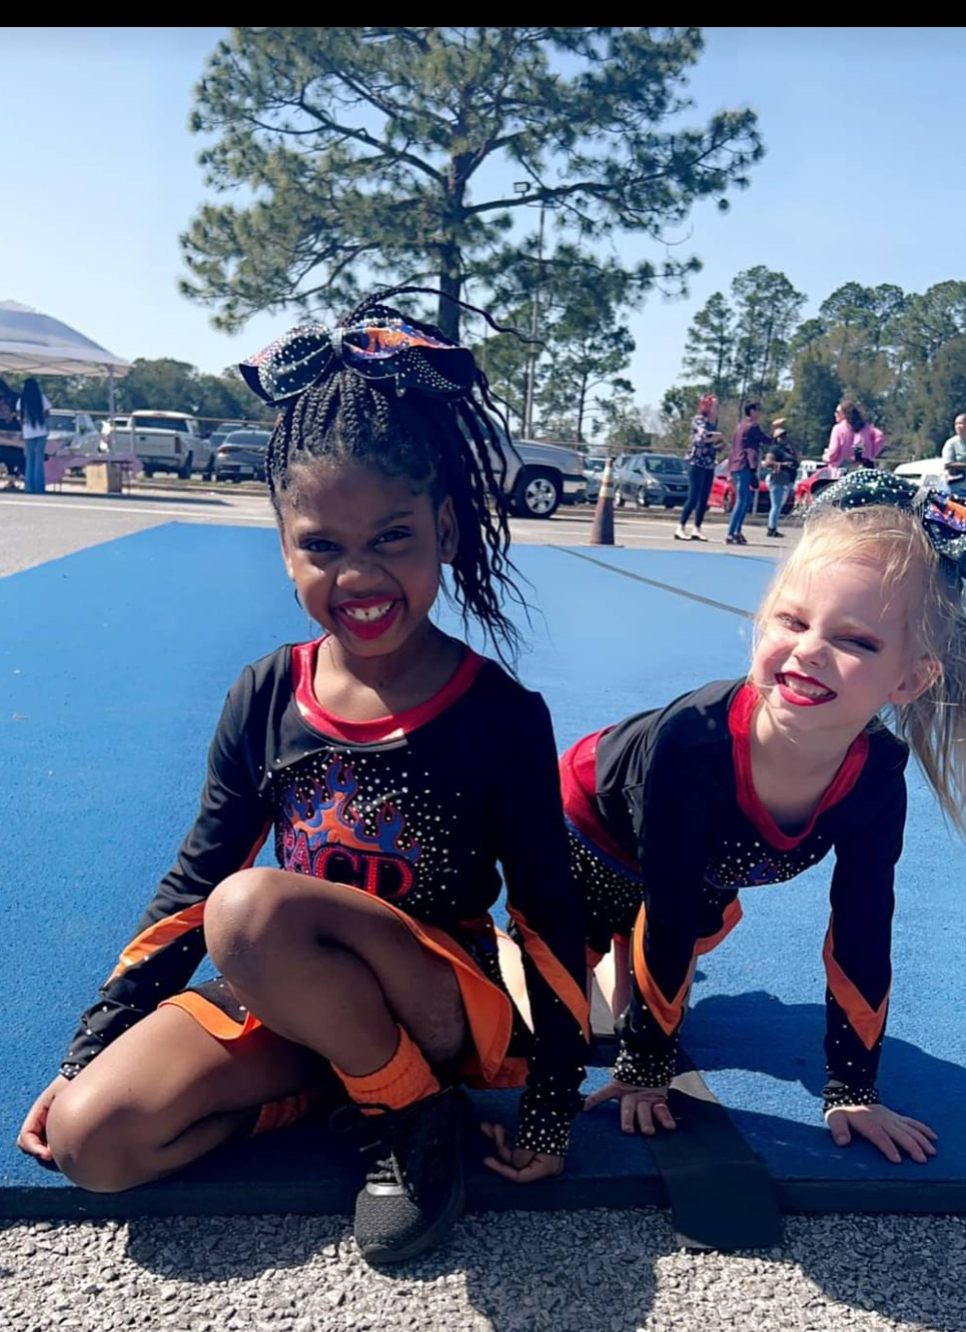
UNIFORMS AND ATTIRE
Our uniforms a used for a 3-year cycle; we are on year 3. Please keep all clothing and uniforms in good clean conditions. Please report any lost or damaged uniform items to your coach. The cost of replacement will be the responsibility of the athlete/parent.
DISCIPLINE
If any rules are broken, the following actions will occur:
1st violation – meeting with parent(s)
2nd violation – meeting with athlete and parent
3rd violation – Athlete may be removed from team and/or program
LOGO COPYRIGHT NOTICE
The logo belongs to the owners of PACD. It cannot be sold or created on your own clothing or other items. Please get permission from the owners if you feel the need to use the logo on an item for the athletes

Slide 14
PARENT INVOLVEMENT AND POLICIES
We want every parent to feel comfortable and informed about his/her child, therefore; we make every effort to keep the lines of communication open. It is the parents’ responsibility to know what is always going on with the program. E-mail is our primary source of communication so please make sure to check it daily. Several methods we use to communicate important information are:
Email
Text
Notes/Handouts
Website
Facebook
Parent meetings
Band App
Please follow these procedures for communication unless there is an emergency that requires immediate attention. Interruptions during practice are unacceptable and can distract the athletes from concentrating on the task at hand. No parents, family members, or friends are allowed in the gym for any reason unless enrolled in a class. If your child is hurt, we will notify you if needed.
The gym is a place for coaches and students only. It is a liability if a parent goes out into the gym because of the risk of someone (including the parent) getting injured. Throughout the year, there will be times when we allow the parents to come in and watch the routines.
Parents are not allowed to spot anyone including their own children on PACD property. It is also unsafe to do so at home. There is also absolutely no unsupervised tumbling allowed in the gym without a coach present.

Slide 15
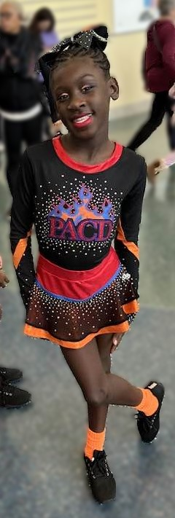
Perfection before progression is the key to great technical skills. We will not allow students to learn advanced skills without perfecting the basics, and both students and parents need to be patient and remember that you are paying for the process of achieving goals.
As a parent you will not agree with every decision we make. The staff and owners make decisions for the interest of the entire team and program. All rules and regulations will be strictly enforced. You must be willing to trust in the program and the staff. We hope our philosophies will give you confidence while being a part of the PACD family.
GOSSIP AND PRACTICE AREA
Siblings are not to be left unattended in the facility nor are they to be running around.
Our gym is a positive environment. As a parent, it is your job to love and support your child, leave the coaching to us.
If there are issues with parents in the gym of PACD or any event that we attend, they will be asked to leave or could be removed from the program permanently.
No gossiping will be allowed at PACD. You will be asked to leave or could be removed from the program permanently.
All audio and video are being recorded in our facility. By registering to be a part of our program you understand and agree to this.

Slide 16
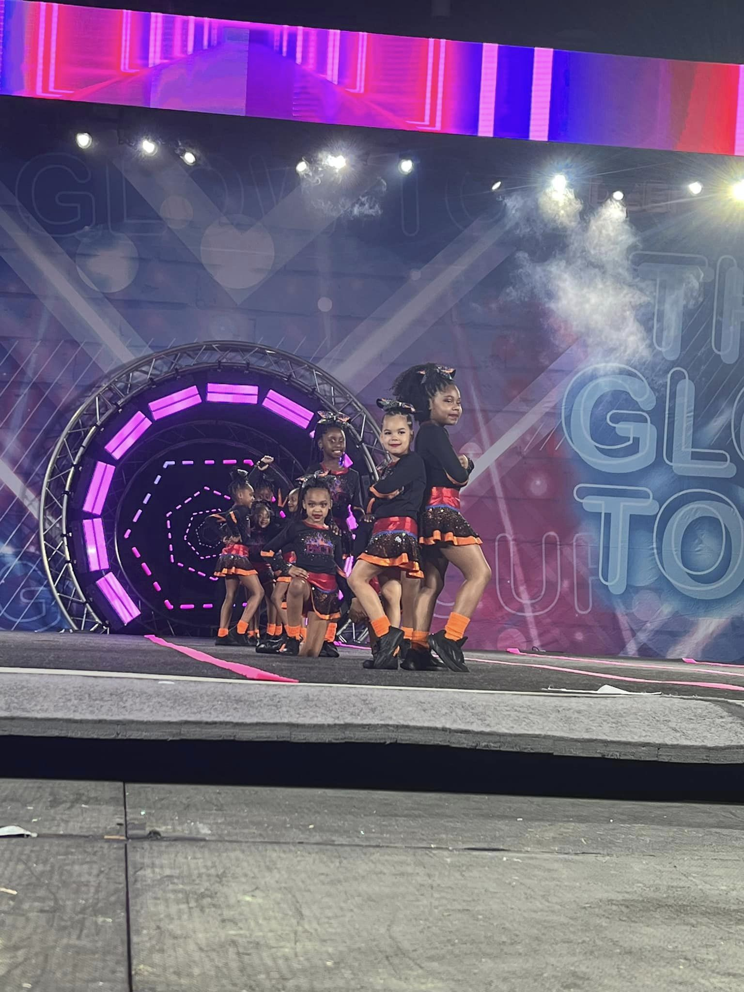
COMPETITION RULES
Competition season is one of the most fun times during the year. Every competition we attend is hosted and run by several different companies. These companies have information on their websites about their competitions and will have staff present at each of their events. Please refrain from calling the companies or approaching competition staff and officials. The PACD staff will have all information needed, and we will share it as soon as possible.
No fingernail polish is allowed at competitions.
No gum, food, or drinks in the warm-up area or on the competition floor.
Hair must be worn exactly as instructed.
Make-up should be worn and applied exactly as instructed. Only make-up given by PACD can be worn.
All cheerleaders must be in full uniform at awards. No pants, jackets, or flip-flops are allowed. Every cheerleader should look exactly the way he/she performed.
All athletes and parents should be respectful to the competition staff and other athletes, coaches, and parents from other gyms.
Itineraries will be given out prior to the competition. Everyone is expected to adhere to the competition itinerary given by PACD. Please pay close attention to the arrival times, and either arrive with enough time to get ready or arrive with everything already done.
If scheduling permits, each team will be asked to cheer on other PACD teams at competitions. We would love to have everyone there all day. A bigger cheering section helps the teams perform better! All the athletes and parents are a direct reflection of PACD and should always conduct themselves appropriately. Disrespectful or abusive behavior, dishonesty, or any form of negative behavior are grounds for immediate removal from the PACD program.
Let’s have a great season!

