Slide 1
2020 ECS Bunfight

Slide 2
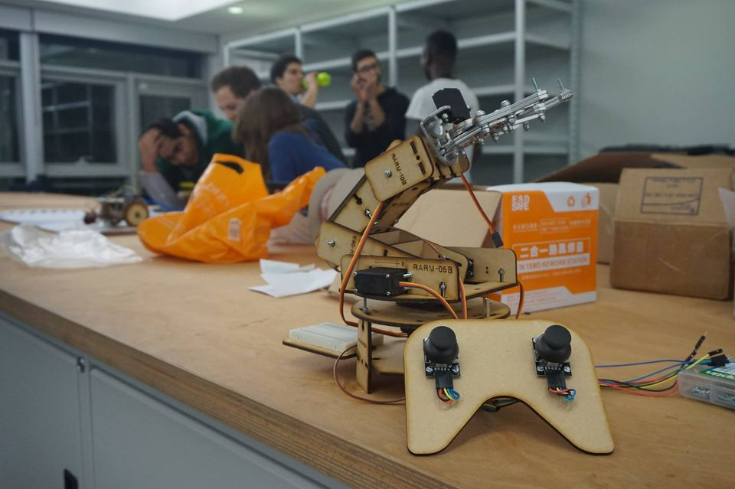
Building robots for fun!
RoboSoc is a society for people who want to build robots for fun
You choose your team and what you want to build
You and your team go at your own pace

Slide 3
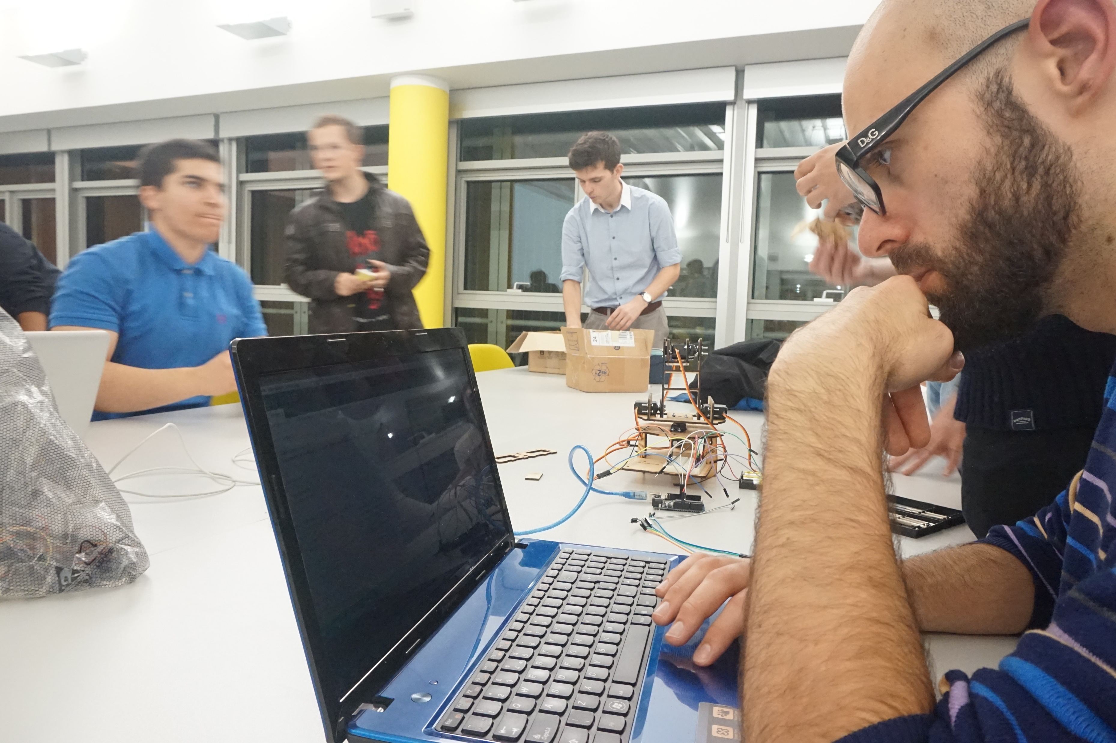
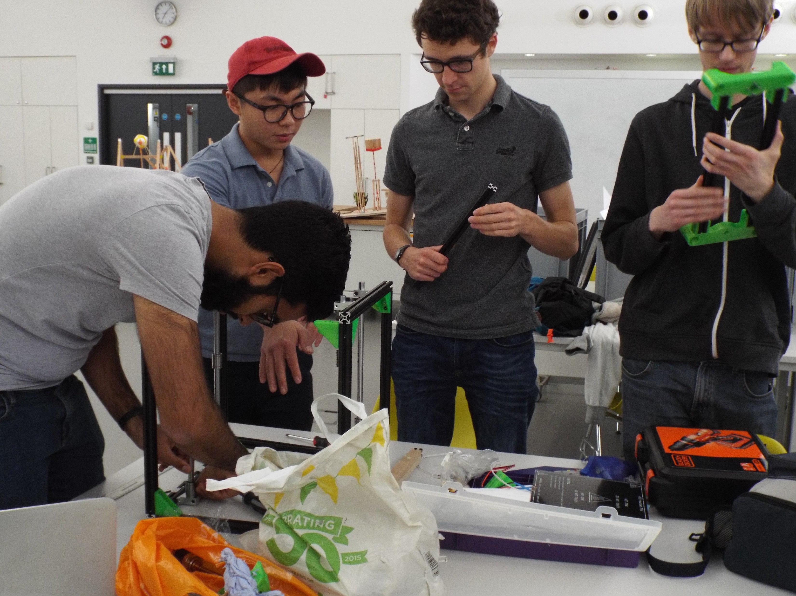
Projects
Ongoing projects include a solar powered UAV and a homemade 3D printer. In the past, members have also worked on line-following robots and robotic arms, but we would love to start new projects with your fresh ideas!

Slide 4
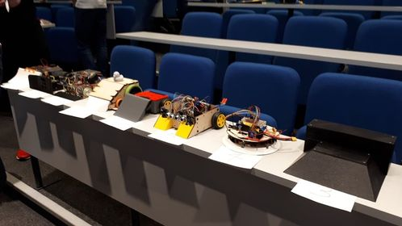
Events
One of our favourite things to do is enter robotics competitions. Our favourites include Sumobot (left) and Eurobot(right). Again, if you see an event you want to go to and gather a team to build a robot, we are all for it!

Slide 5
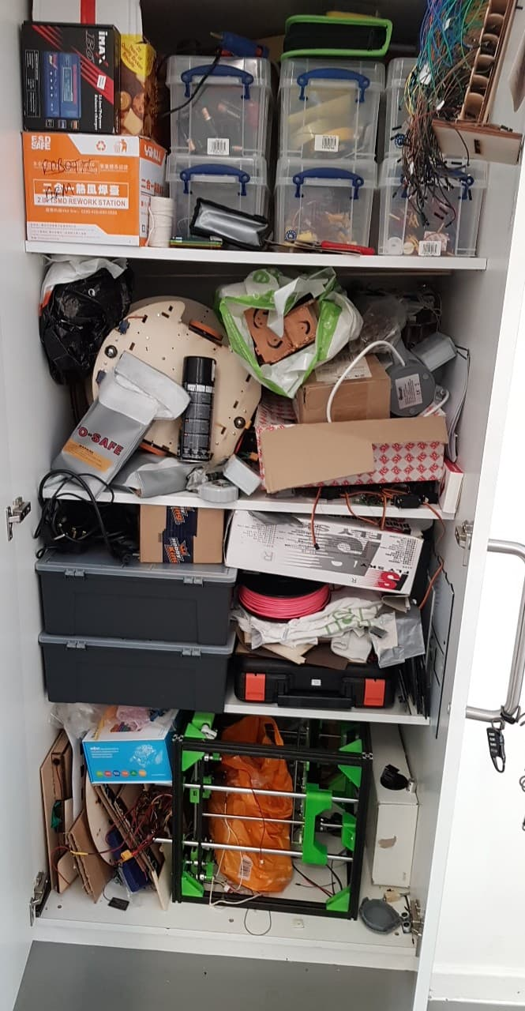
Normal meetings
For this year, meetings will be a little different to follow COVID guidelines
We will be starting with a few online social events, so that we everyone can get to know each other and come up with project ideas. Once you’ve decided what robot you want to build, you and your team do it at your own pace, meeting up whenever is easiest for you.
Current COVID guidelines mean that we can’t all meet up in our usual weekly meetings for the time being. Instead, we will have online catch-ups weekly on Tuesdays from 6:30-8:30pm.
Access to our cupboard of many things (left) for equipment and components being arranged on a case by case basis. We have tools, a 3D-printer, motors, servos and other components ready for when you need.

Slide 6
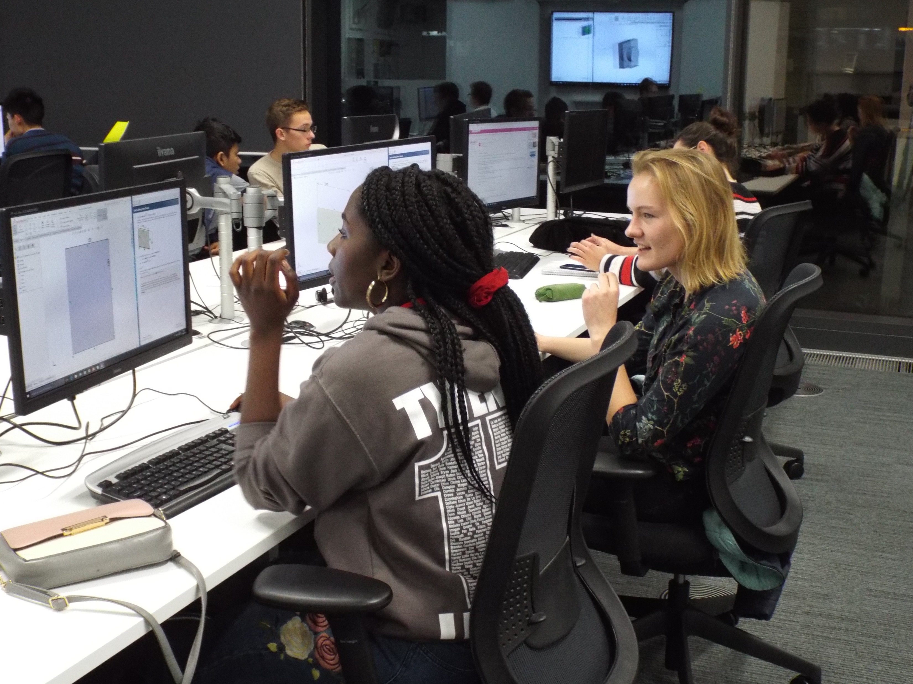
Tutorials
New to robotics? No worries! We will be running online tutorials during semester 1. We will have different rooms open where we will be running exercises key skills such as:
Coding and remote control
CAD and design
Wiring and power
You can join as you please to learn all the skills you need quickly to build your first robots.
Notes:
In the first semester, the committee will be putting on tutorials for new members to learn the skills required to make a robot. They are not mandatory and you do not need to attend all of them if you are already confident with your skills. However, it is highly recommended that new members attend the tutorials before starting a competition or project team.

Slide 7
Membership
Only members can use our equipment and be entered into competitions. Our membership fees are:
£15 for a one-year membership
These fees help us buy new equipment and components. Memberships can only be bought through the SUSU system.
SUSU Link: https://www.susu.org/groups/robosoc (note, SUSU put on an extra 50p booking fee 😠)
If you want to, you can buy memberships now!
However, don’t worry about membership for the first few weeks.

Slide 8
Contact us
You can follow along with us
On our Facebook www.facebook.com/UoSRoboSoc/
On our website www.robosoc.uk
Email us at robosoc@soton.ac.uk
Or join our Discord https://discord.gg/PYu7Y6
We will have a live meet and greet for the Big SUSU Online fair on 30th Sept between 3pm and 6pm. Feel free to pop along at any time and have a chat. Link:
If you want to be notified of our first events, you can also join our mailing list at: https://docs.google.com/forms/d/e/1FAIpQLSdZDx8ueo2zvHaU0ObXGJHpHTopCSgbujpWPQr8nSyfhZQe-A/viewform
(note mailing list will only be used for the first few events)
We will be putting this presentation up on both the Facebook page and the website if you need to reference anything
Notes:
If you are using components (servos, motors etc.) check with a committee member first (so we can keep track of them)
For some of the tools, you will need to prove to us that you know how to use them safely (Soldering iron, Drill, Saw, Glue gun). Training will be provided if needed
If we see you using these in a dangerous way, we will revoke your right to use them
You may use our stuff for any of your coursework as you need, but you must ask a committee member first.
If you take stuff out of the cupboard, it is your responsibility to put it back where it came from. Please try to keep the cupboard tidy and organised.

Slide 9
The Committee
Benedict Allen - President
Tia Burden – Secretary (https://www.facebook.com/tia.burden.9)
Charlie Mullings-Wong – Social Secretary (https://www.facebook.com/charlie.mw.5)
Andrew Woods – Treasurer
Jamie Hughes – Marketing Officer

