Slide 1
Welcome to RoboSoc
RoboSoc Introduction Session 2019

Slide 2
The Committee
Benedict Allen - President
Jamie Hughes – Marketing Officer
Tia Burden – Secretary
(facebook.com/tia.burden.9)
Charlie Mullings-Wong – Social Secretary
(facebook.com/charlie.mw.5)
Andrew Woods - Treasurer

Slide 3
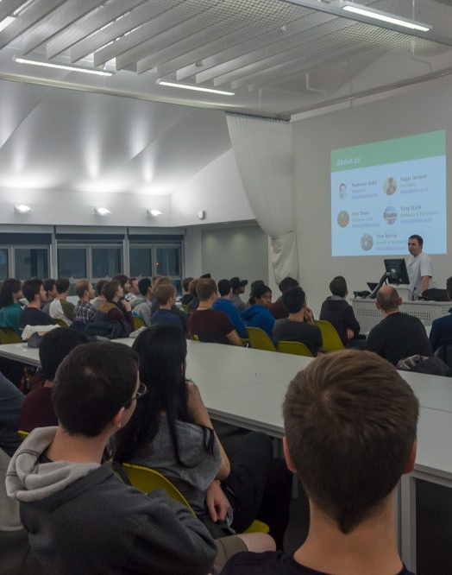
Boulderwood design studio
6:30pm- 8:30pm
3rd floor of building 177
Bring your laptop
What we do
Tutorials
Competitions
Projects
Notes:
Be there or be square

Slide 4
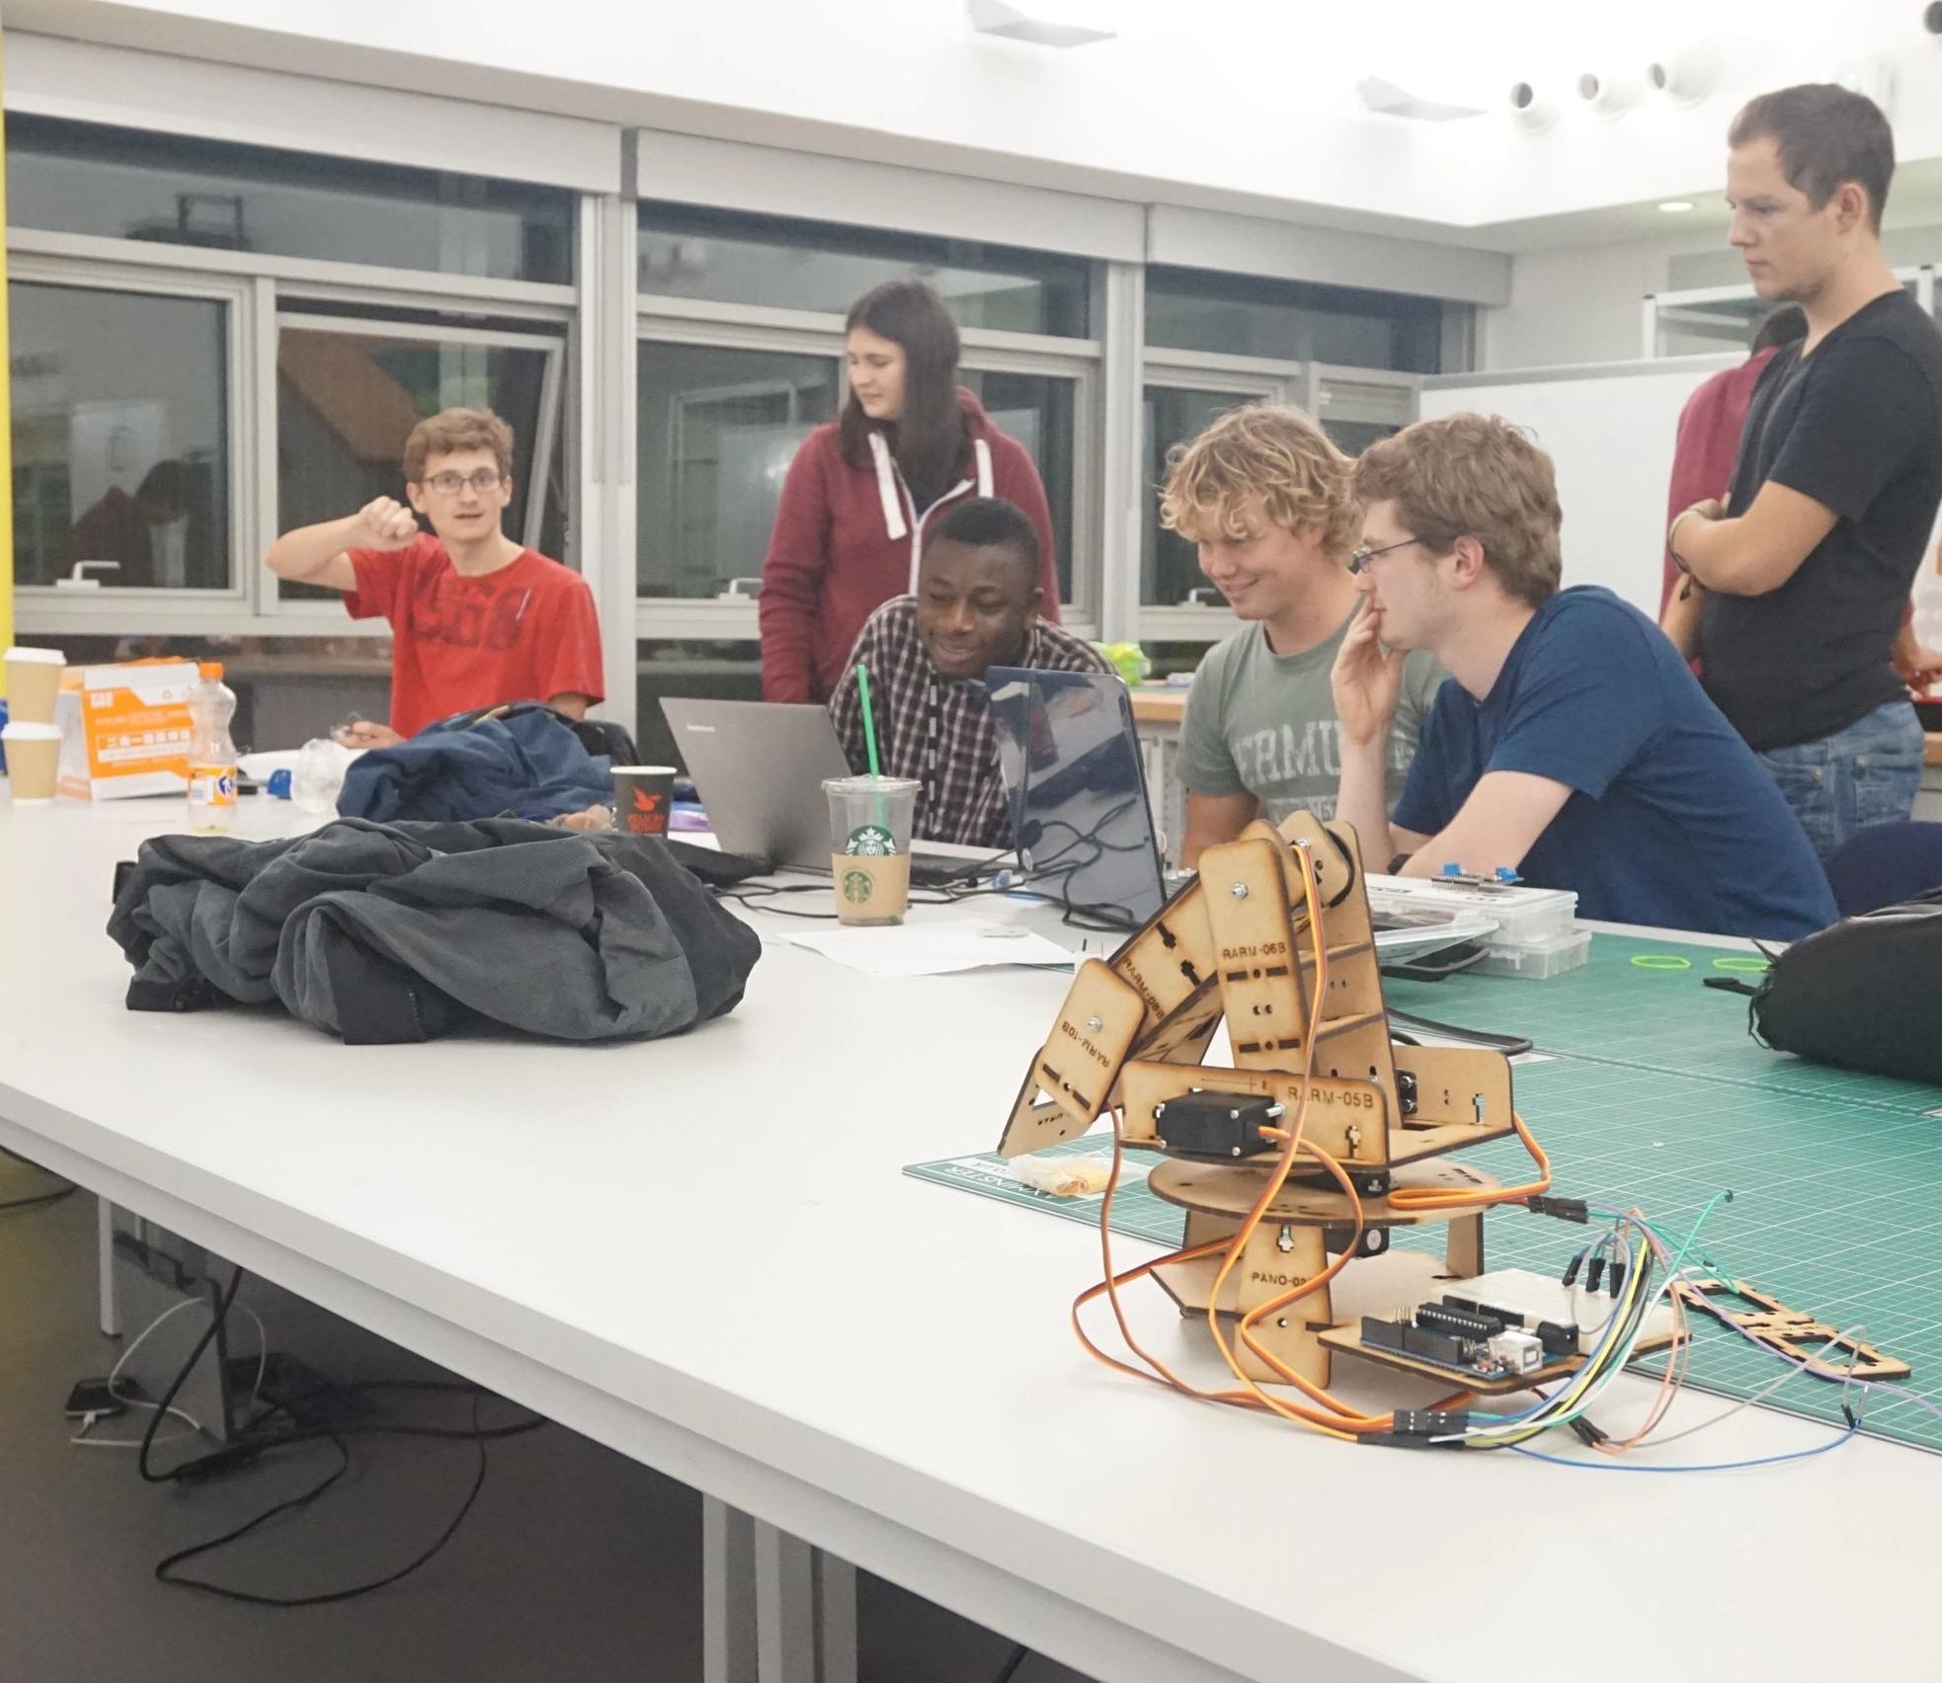
Tutorials
Topics covered:
Electronic components
Coding and remote control
CAD and design
Wiring and power
For a tutorials, you’ll…
Get set up with parts
Go through activities and challenges
Have us walking around giving help and tips
Notes:
In the first semester, the committee will be putting on tutorials for new members to learn the skills required to make a robot. They are not mandatory and you do not need to attend all of them if you are already confident with your skills. However, it is highly recommended that new members attend the tutorials before starting a competition or project team.
Yo well talk in the sessions about

Slide 5
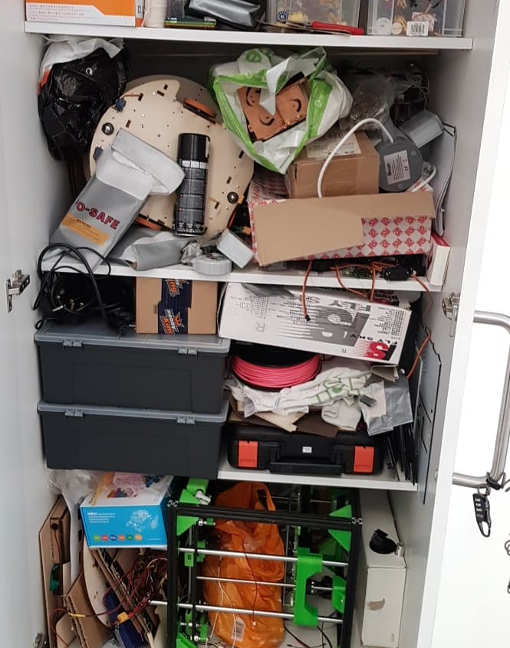
Normal meetings- The Cupboard
This is where we keep:
components
tools
robots
generally everything related to the society.
Members can use our cupboard as needed.
Notes:
Get out your robots
Get/ask for anything you need
Get cracking
If you are using components (servos, motors etc.) check with a committee member first (so we can keep track of them)
For some of the tools, you will need to prove to us that you know how to use them safely (Soldering iron, Drill, Saw, Glue gun). Training will be provided if needed
If we see you using these in a dangerous way, we will revoke your right to use them
You may use our stuff for any of your coursework as you need, but you must ask a committee member first.
If you take stuff out of the cupboard, it is your responsibility to put it back where it came from. Please try to keep the cupboard tidy and organised.

Slide 6
Membership
Our membership allows you to use our equipment and enter competitions
£15 for a one-year membership
SUSU Link:osoc
susu.org/groups/robosoc
Don’t worry about membership for the first few weeks.
Notes:
Things Tia removed:
Memberships can only be bought through the SUSU system.
note, SUSU put on an extra 50p booking fee 😠)
If you want to, you can buy memberships now!
However,

Slide 7
Final things
We’ll be posting our updates on our Facebook page at
facebook.com/UoSRoboSoc/
@UosRoboSoc
Alternatively, you can keep up to date with our meetings and events at
robosoc.com
We will be putting this presentation up on both the Facebook page and the website if you need to reference anything
Notes:
If you are using components (servos, motors etc.) check with a committee member first (so we can keep track of them)
For some of the tools, you will need to prove to us that you know how to use them safely (Soldering iron, Drill, Saw, Glue gun). Training will be provided if needed
If we see you using these in a dangerous way, we will revoke your right to use them
You may use our stuff for any of your coursework as you need, but you must ask a committee member first.
If you take stuff out of the cupboard, it is your responsibility to put it back where it came from. Please try to keep the cupboard tidy and organised.

Slide 8
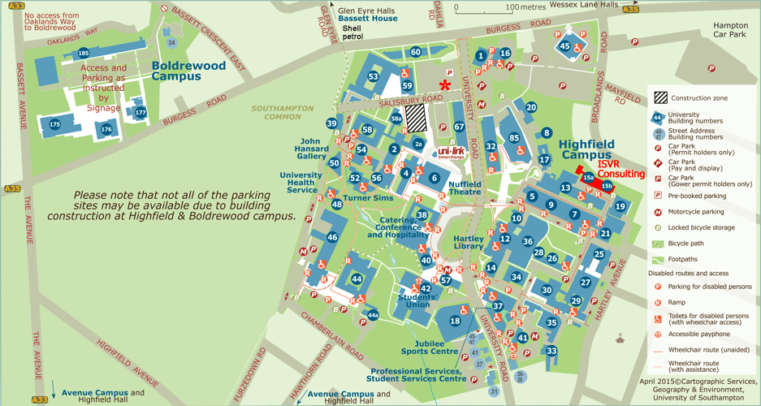
Normal meetings- How to find us
(a roughly 10-minute walk from Highfield).

