Slide 1
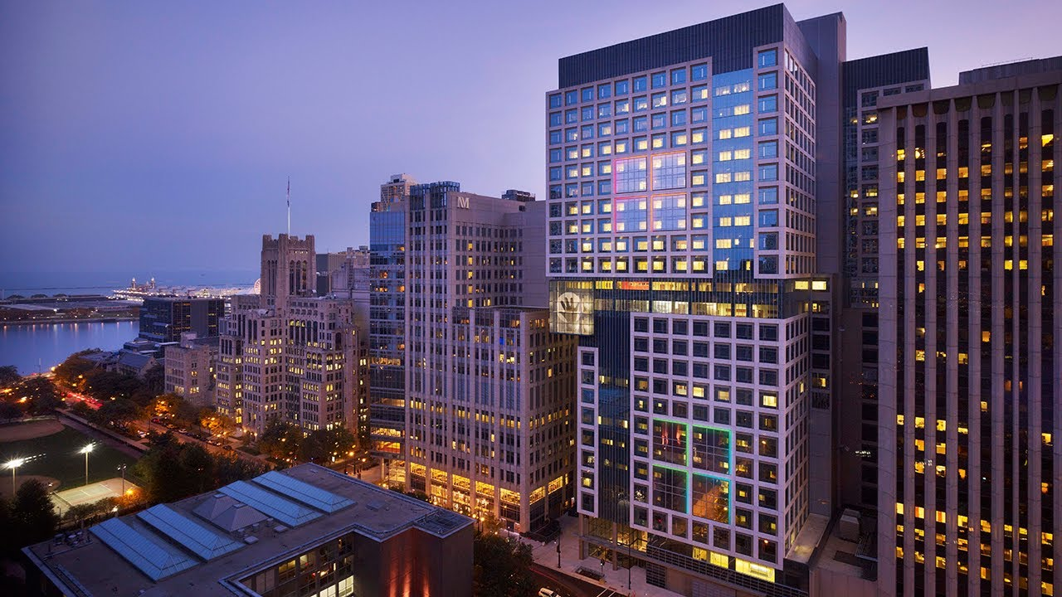
Sterile Processing Department
Design for Success

Slide 2
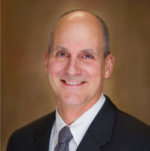
Senior Director –
Surgical & Procedural Services
John Olmstead, MBA, MSN, CNOR, FACHE joined Lurie Children's in 2020 as Senior Director, Surgical & Procedural Services. In his role, he directs the provision of procedural services at the main hospital and serves as Administrator for both the Northbrook and Westchester Ambulatory Surgical Treatment Centers.
Previously, John served for 15 years as Administrative Director for Surgical & Emergency Services for Community Health Systems in Northwest Indiana. Prior to that, he served in various management & staff capacities in Indianapolis. He has earned Master's in Nursing from Indiana University, a Master's in Business Administration from City University of Seattle; he is a Certified Nurse - Operating Room, and a Fellow in the American College of Healthcare Executives.

Slide 3
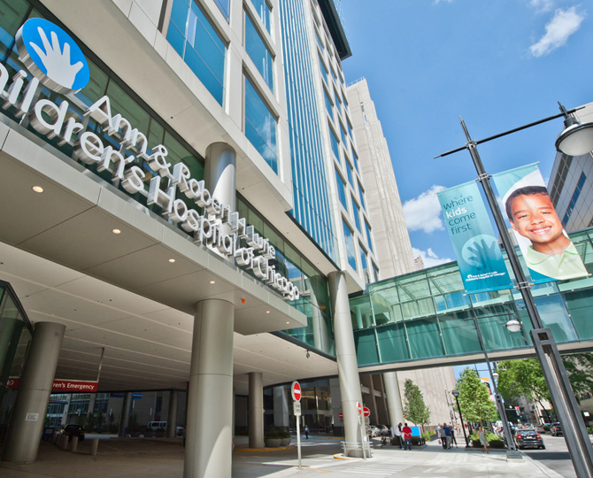
Non-famous quote from a mentor
Don’t talk to me about BUDGETS; Talk to me about SERVICE.
Get your SERVICE to where it needs to be; then we can talk about efficiencies.
If you don’t get your SERVICE where it needs to be you won’t have to worry about efficiencies, that will take care of itself - when the patients leave.

Slide 4
The “Three P” approach to Dept improvement
People | Do you have the people in place to provide adequate services?
Provisions | Do the people have the tools and materials (equipment & supplies) needed to be successful?
Processes | People needed to perform Tools and materials needed to be successful THEN you can enact performance improvement projects!

Slide 5
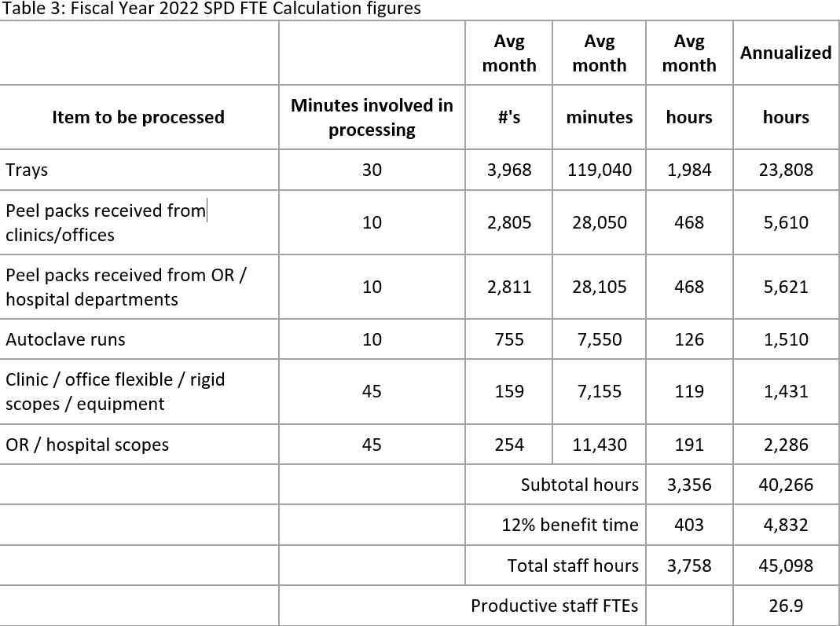
FY22 FTE calculation model
Common mistake:
8 hours calculation
45,098 ÷ 2,080 = 21.6 FTEs
6.5 hours calculation
45,098 ÷ 1,676 = 26.9 FTEs

Slide 6
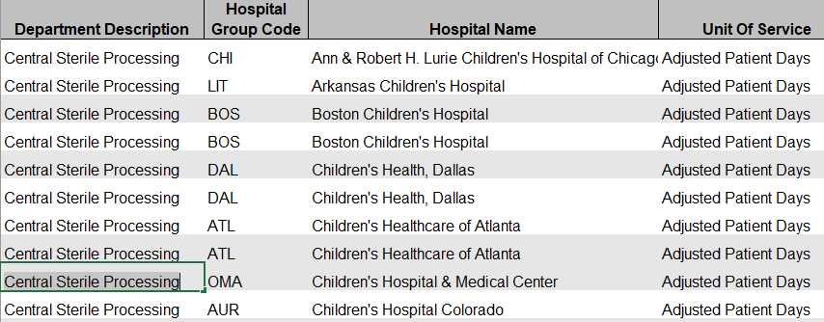
In Search of: Benchmarks
CHA Benchmarks

Slide 7
In Search of: Benchmarks
Item | Time needed (min) | Source | Fixed or Variable workload?
Instruments: Decontamination | 15 – 30 sec | STERIS SPM reference | Variable
Instruments: Prep & Pack | 1 min | STERIS SPM reference | Variable
Peel packs | 2 min | Personal observation | Fixed
Case carts | 10 min / case | Personal observation | Mild variation
Scopes (rigid & flexible): decontamination | 20 min | Personal observation | Fixed
Scopes (rigid & flexible): Disinfection / restocking | 20 min | Personal observation | Fixed

Slide 8
Work-in-progress: FY24 revised calculation model
 | Minutes used | Avg month | Avg month | Avg month | Annualized
Item to be processed |  | #'s | minutes | hours | hours
Trays - decontamination | 10 | 7,433 | 74,330 | 1,239 | 14,866
Trays - Pre & Pack area | 15 | 7,433 | 111,500 | 1,800 | 21,600
Peel packs received from clinics/offices | 30/hr | 2,500 |  | 83 | 1,000
Peel packs received from OR / hospital departments | 30/hr | 2,500 |  | 83 | 1,000
Autoclave / Low temp sterilizer runs | 10 | 880 | 8,800 | 147 | 1,760
Clinic / office flexible / rigid scopes / equipment | 20 | 190 | 3,800 | 63 | 1,140
OR / hospital scopes | 20 | 190 | 3,800 | 63 | 760
Case carts - per case | 10 | 920 | 9,200 | 153 | 760
 |  |  | Totals | 3,632 | 43,600
Adding 12% benefits |  |  | Adding 12% benefits |  | 48,832
# FTEs using 6.5 hour days |  |  | # FTEs using 6.5 hour days |  | 29.0
Adding Manager position |  |  | Adding Shift Supervisors |  | 1
Adding Liaison |  |  | Adding Runners |  | 2
Total FTEs needed |  |  | Total FTEs needed |  | 32.0

Slide 9
SPD FTE budget – Fixed or Variable?
Arguments for Fixed
  Workload that has little variability
  Staff that don’t “pick up” extra hours (so, hours really aren’t “variable”)
  Lesser-pressing workload can be reserved to be completed when time permits
  Cutting hours too dramatically risks losing the staff that were just recruited
Arguments for Variable
  In instances of very low surgical cases the dept will need to flex down hours anyway
  In busier periods, overtime is justified with no variance statement needed
  As volume grows, the argument for adding staff is easily justified

Slide 10
Aspects of the Staffing Calculation
Variable work tasks
  Trays: Decontamination + Pre & Pack area
  Peel packs: received from clinics/offices & hospital depts
  Scopes - flexible/rigid: Clinic & hospital
  Autoclave/Low temp sterilizer runs
  Case carts - per case
Fixed commitments
  Shift supervisors
  Educator
  Customer service (liaisons / runners)
  Stationary assignments
    Decontamination
    Decentralized locations

Slide 11
Aspects continued: Quality Program
Location | Quality Measure | Measured by
Decontamination | Trays/instruments received coated with pre-cleaning spray | SPM
 | Bioburden removal in known risky instruments | Inspection: rate TBD
Assembly | Productivity expectations met | SPM
 | Tray completion accuracy | Inspection: 100 trays / week
Sterilization | Indicator placement accuracy | Inspection: 100 trays / week
 | Log completion | SPM
 | Daily testing expectations completed | SPM
Storage & distribution | Tray storage confirmation | Manual performance
 | Peel Pack inventory checks performed | Inspection: rate TBD
 | Case cart completion productivity expectations met | Supervisor report: daily
 | Tracking of instruments requiring turnover | Supervisor report: daily

Slide 12
SPD staffing formula:
Measurable workload
Fixed commitments
Quality Program
Ideal Staffing
+
+
=

Slide 13
SPD staffing formula:
Measurable workload hours
Fixed commitments:
  “liaisons”, department / clinic services
  Scope cleaning located in Decontamination area
  Orientation / Student reservations
    Response to 20% turnover
Quality review efforts
  Tray inspections
Current model:
  1 Manager
  3 Resource Coordinators (shift supervisors)
  25 Certified Sterile Processing Technicians
  3 orientees
Total: 32 FTEs
Service provided (annually)
  19,000 Surgical procedures
  4,500 scopes (rigid & flexible)
  72,000 clinic peel packs

Slide 14
The SPD Staffing Calculation:
Fixed FTEs | FTEs | Variable FTEs | FTEs
SPD Manager | 1 | Prep & Pack assembly - am | 2
Equipment testing | 0.5 | Prep & Pack assembly - am | 3
Resource Coordinator – 1st shift | 1 | Prep & Pack assembly - am | 3
Resource Coordinator – 2nd shift | 1 | Case carts – pm | 1
Resource Coordinator – 3rd shift | 1 | Case carts – noc | 1
OR Liaison – 12 hours | 1.5 | OR Liaison – 12 hours | 1
Scope handler – day shift | 1 | Scope handler | 1
Decontamination shifts – am | 2 | Decontamination shifts – am | 1
Decontamination shifts – pm | 2 | Decontamination shifts – pm | 1
Decontamination shifts – noc | 1 | Decontamination shifts – noc | 1
Total | 12 |  | 15

Slide 15
Current test budget: 32.0 FTEs
Manager, Resource Coordinators + staff
Dept tasks | Sun | Mon | Tues | Wed | Thurs | Fri | Sat
Peel packs (min) | 0 | 390 | 390 | 390 | 390 | 390 | 0
Decontam (min) | 225 | 1,800 | 1,800 | 1,975 | 1,775 | 1,625 | 125
Prep pack (min) | 900 | 7,200 | 7,200 | 7,900 | 7,100 | 6,500 | 500
Case carts (min) | 90 | 720 | 720 | 790 | 710 | 650 | 50
Scope room (min) | 0 | 520 | 520 | 520 | 520 | 520 | 0
total min / work | 1,215 | 10,630 | 10,630 | 11,575 | 10,495 | 9,685 | 675
total hours / work | 20 | 177 | 177 | 193 | 175 | 161 | 11.25
# FTEs @ 6.5/person | 3 | 27 | 27 | 30 | 27 | 25 | 1.7
# FTEs scheduled | 6 | 27 | 26 | 28 | 27 | 23 | 6

Slide 16
SPD Staffing request for WHPUOS
 | Sun | Mon | Tues | Wed | Thur | Fri | Sat | Total
Manager | 0 | 1 | 1 | 1 | 1 | 1 | 0 | 5
Assistant Manager | 0 | 1 | 1 | 1 | 1 | 1 | 0 | 5
Dayshift | 1 | 8 | 7 | 8 | 8 | 7 | 1 | 40
Evening shift | 2 | 8 | 8 | 9 | 9 | 9 | 2 | 47
Night shift | 3 | 9 | 9 | 9 | 8 | 5 | 3 | 46
Totals | 6 | 27 | 26 | 28 | 27 | 23 | 6 | 143
8 hr shift | 48 | 216 | 208 | 224 | 216 | 184 | 48 | 1,144
Expected cases | 9 | 72 | 72 | 79 | 71 | 65 | 5 | 373
WHPUOS | 5.33 | 3.00 | 2.89 | 2.84 | 3.04 | 2.83 | 9.60 | 3.07

Slide 17
SPD PI Physical improvement summary
People:
  Enhance staffing to generate service excellence
Provisions:
  Enhance physical environment to support high reliability service
Processes:
  Enact a Quality Program to support continued high levels of service
Projects: 11/2020 – 4/2024
  Blue Wrap replacement
  Tray Storage Shelving
  Instrument wall construction
  Dept office reconstruction
  Lighting enhancement
  Locker room re-design
  Hi-purity water installation
  Prep/pack Workstation redesign
  Additional washer
  Additional sink installation
  Medivator High-Level Disinfection system installation

Slide 18
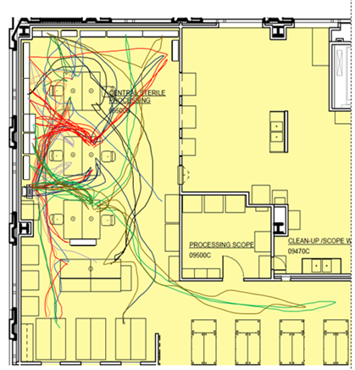
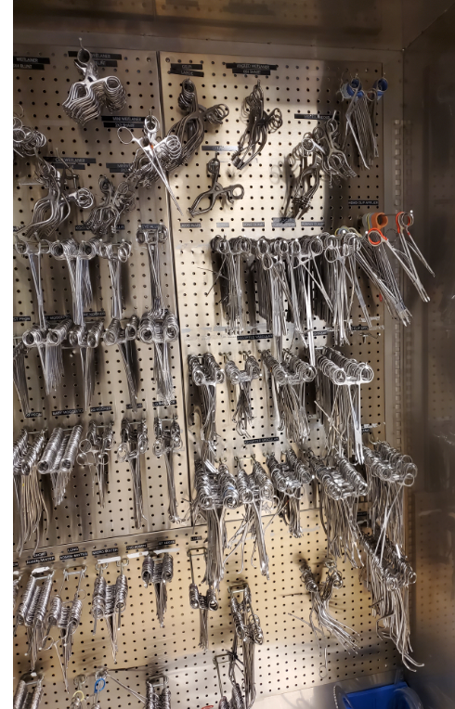
Provisions review: Instrument replacement
Notes:
Feb 4th project! Current storage for common replacement instruments used in trays

Slide 19
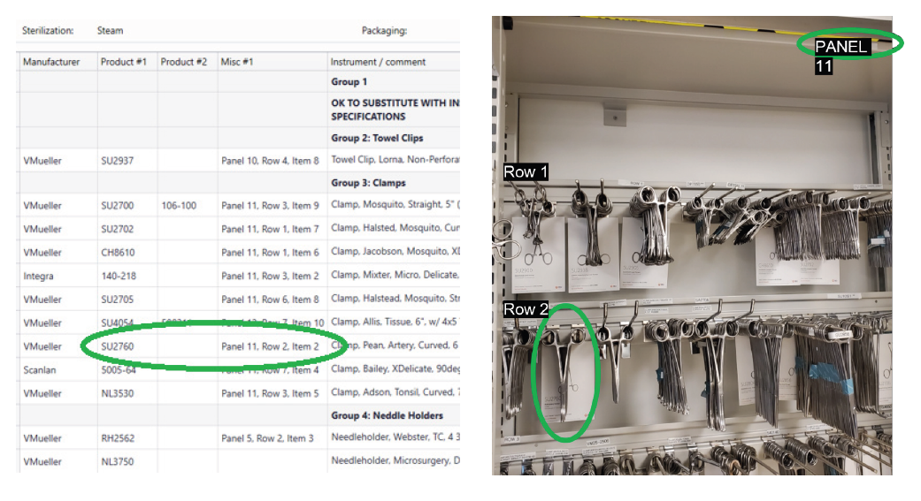
SPM linking instrument to back-wall location

Slide 20
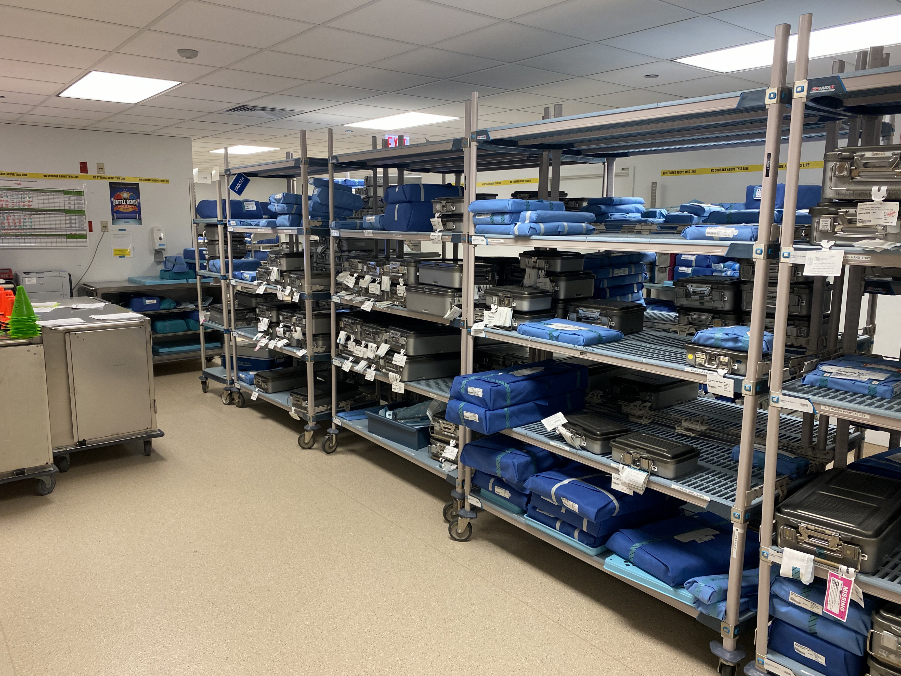
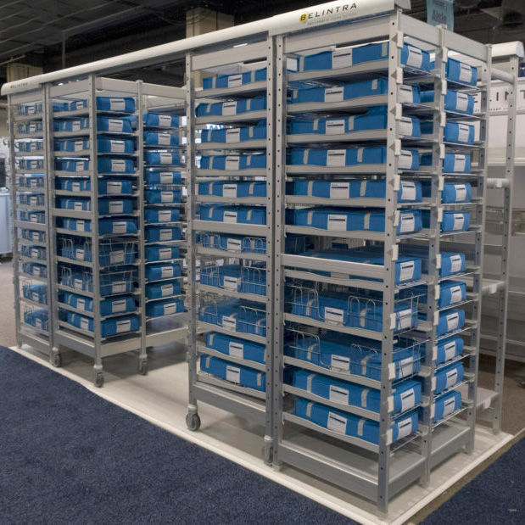
Dept Storage: Past vs Present
Notes:
Making the most out of our real estate; new shelving installed in December, increased storage so that the department DOES NOT need more space (previous plan was to consume much larger footprint on the 9th floor)

Slide 21
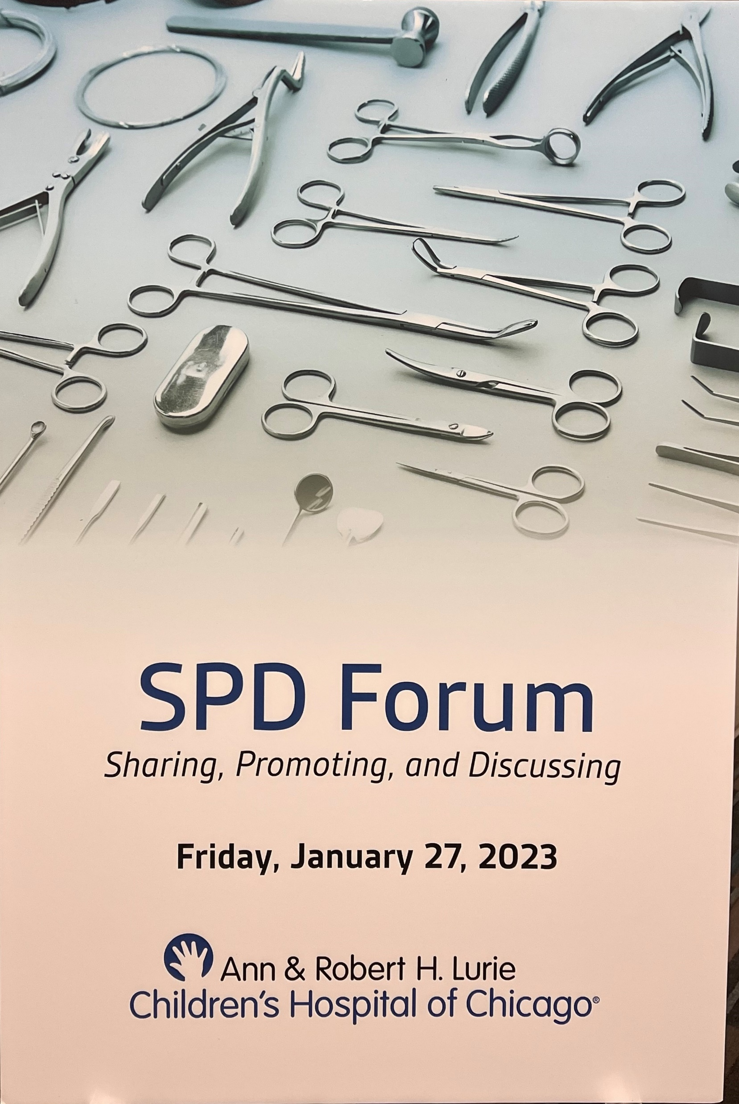
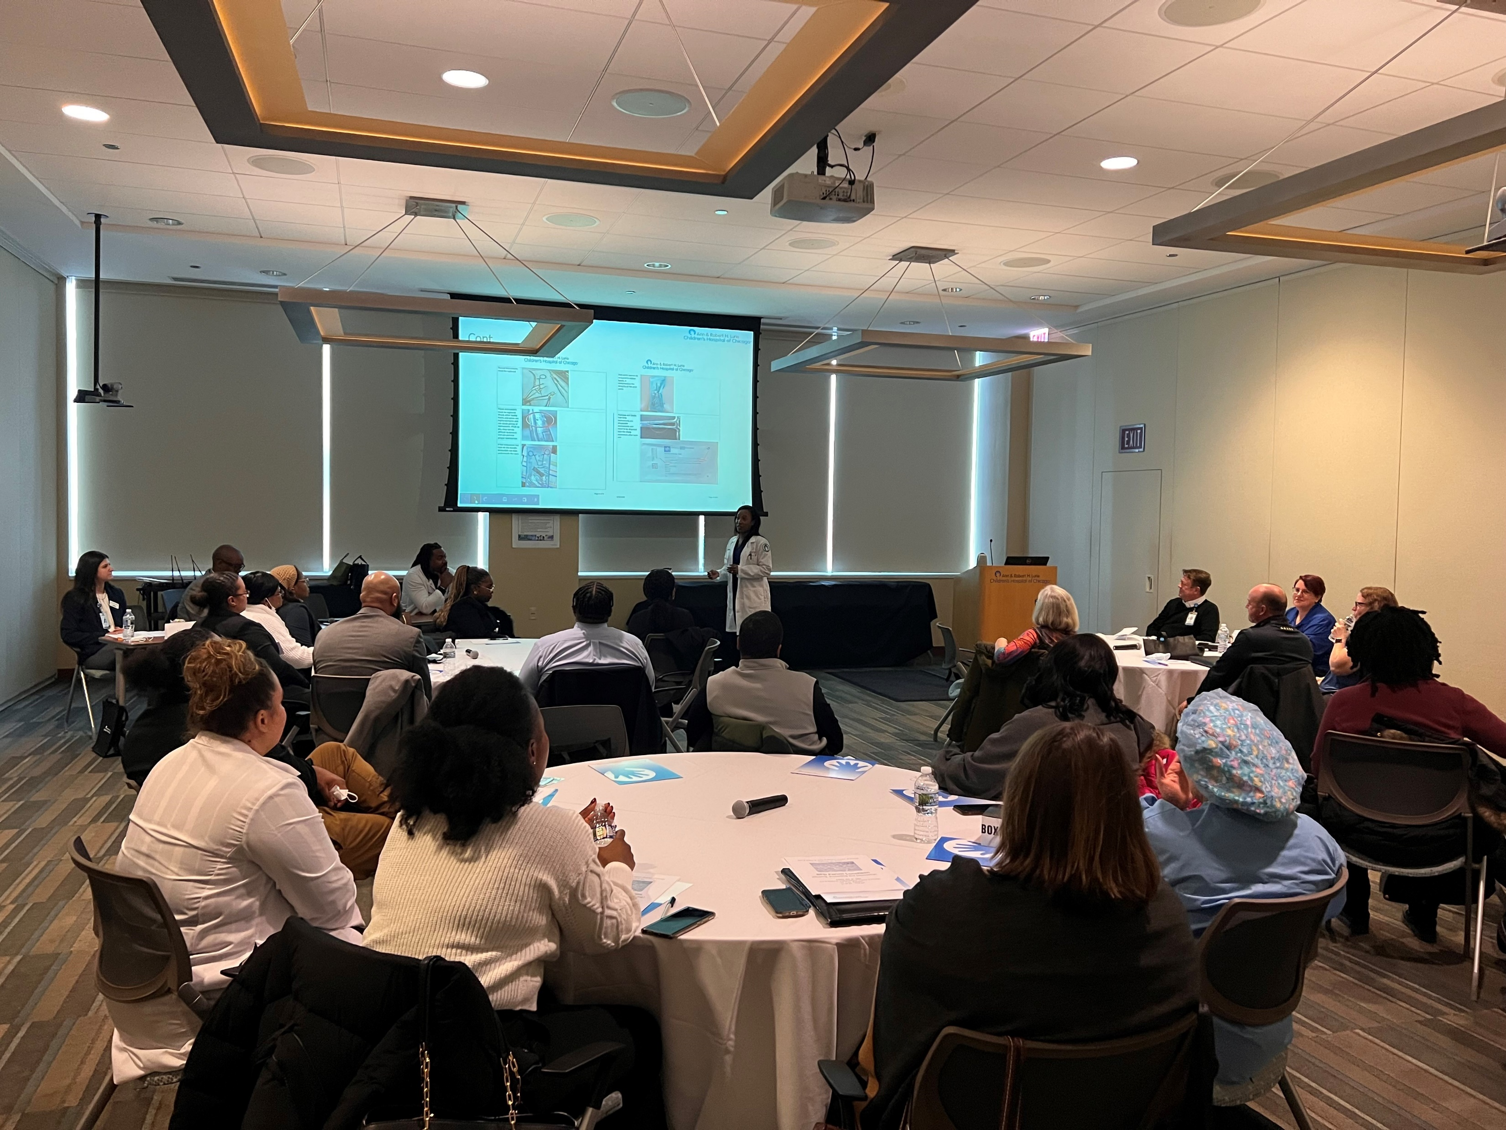
Chicago SPD Forum

Slide 22
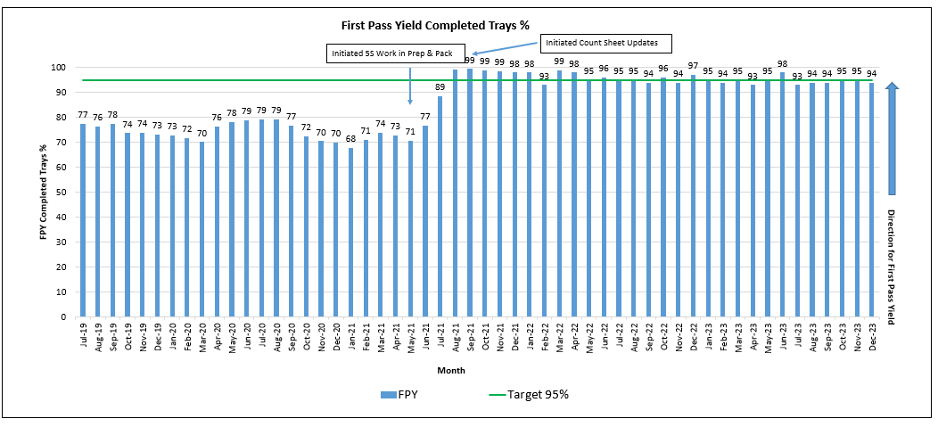
SPM Data: First Pass Yield Of Completed Trays (Last 3 Years)
Data Source: SPM: First Pass Yield = number of "good" trays with no missing instruments

Slide 23
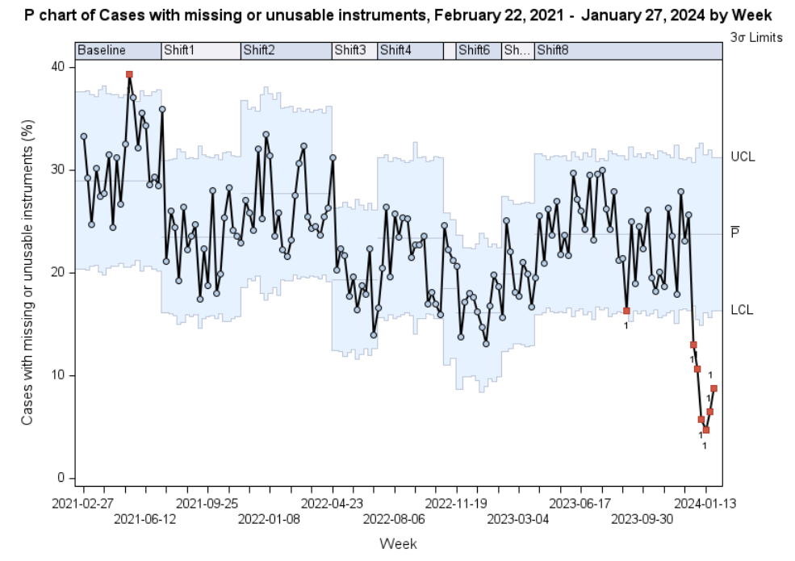
Epic Report: Cases delayed by Missing/Unusable instrument

Slide 24
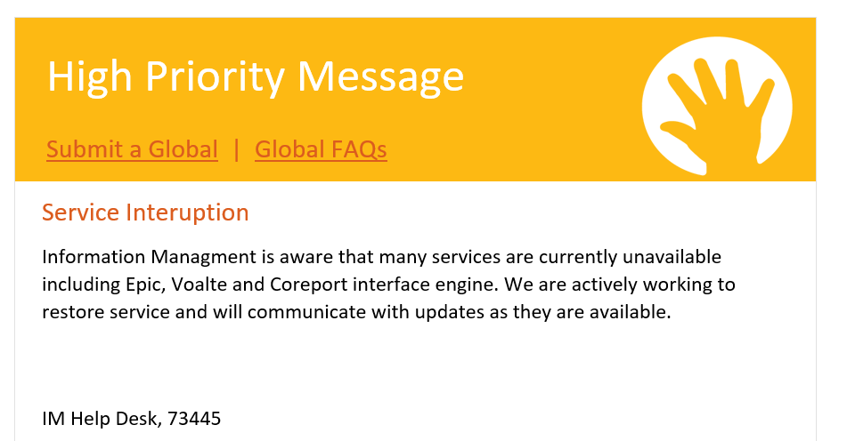
Day 1 – Started as an annoying interruption

Slide 25
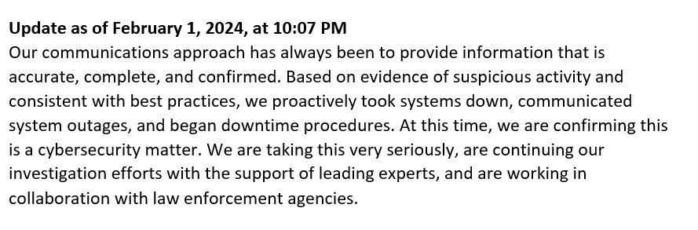
Day 2 – Not just an interruption…

Slide 26
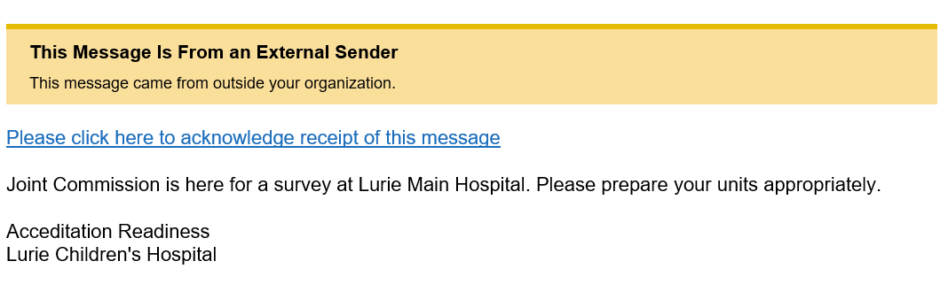
Day 17 – We actually expected this

Slide 27
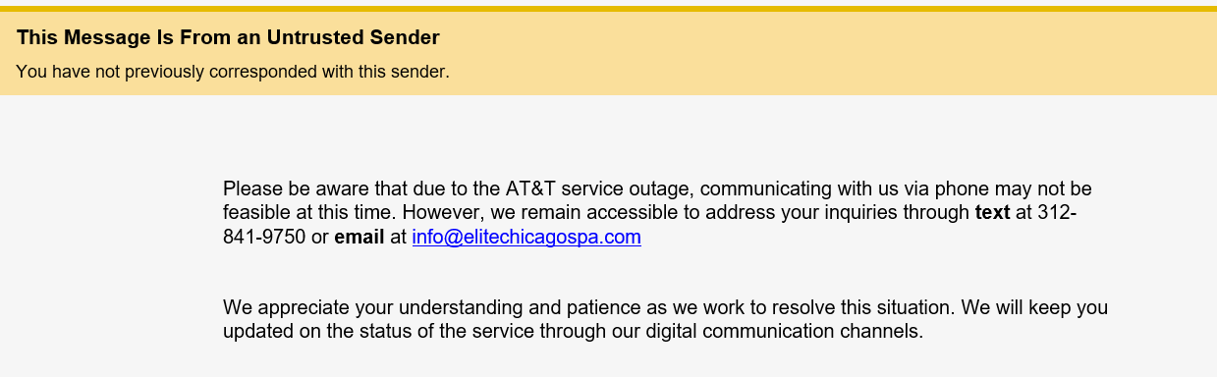
Day 24 – the gift that keeps on giving

Slide 28
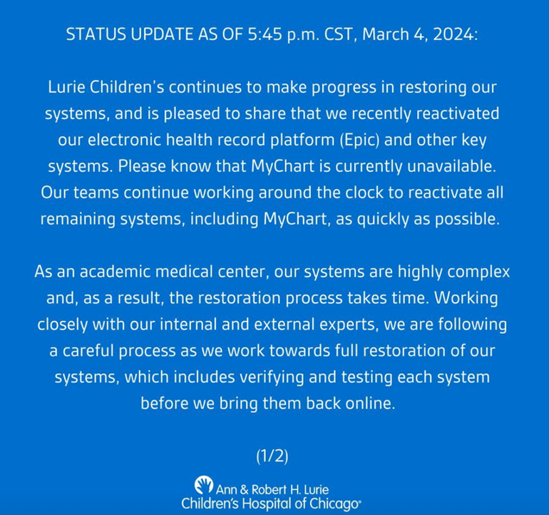

Day 35 to 60 – slow & steady….

Slide 29

Immediately implemented:
Process to fill case cart needs minus the EPIC-SPM Preference Cards
External access IFU information
Printed copies of policies
Series of paper logs to record all testing to demonstrate sterility
Outcomes:
No delays due to SPD provision failures
No instances of IUSS or One-Tray usage
Complete preparation for:
  Trauma
  Cardiac / ECMO emergencies
  Back-to-back transplant procedures

