Slide 1
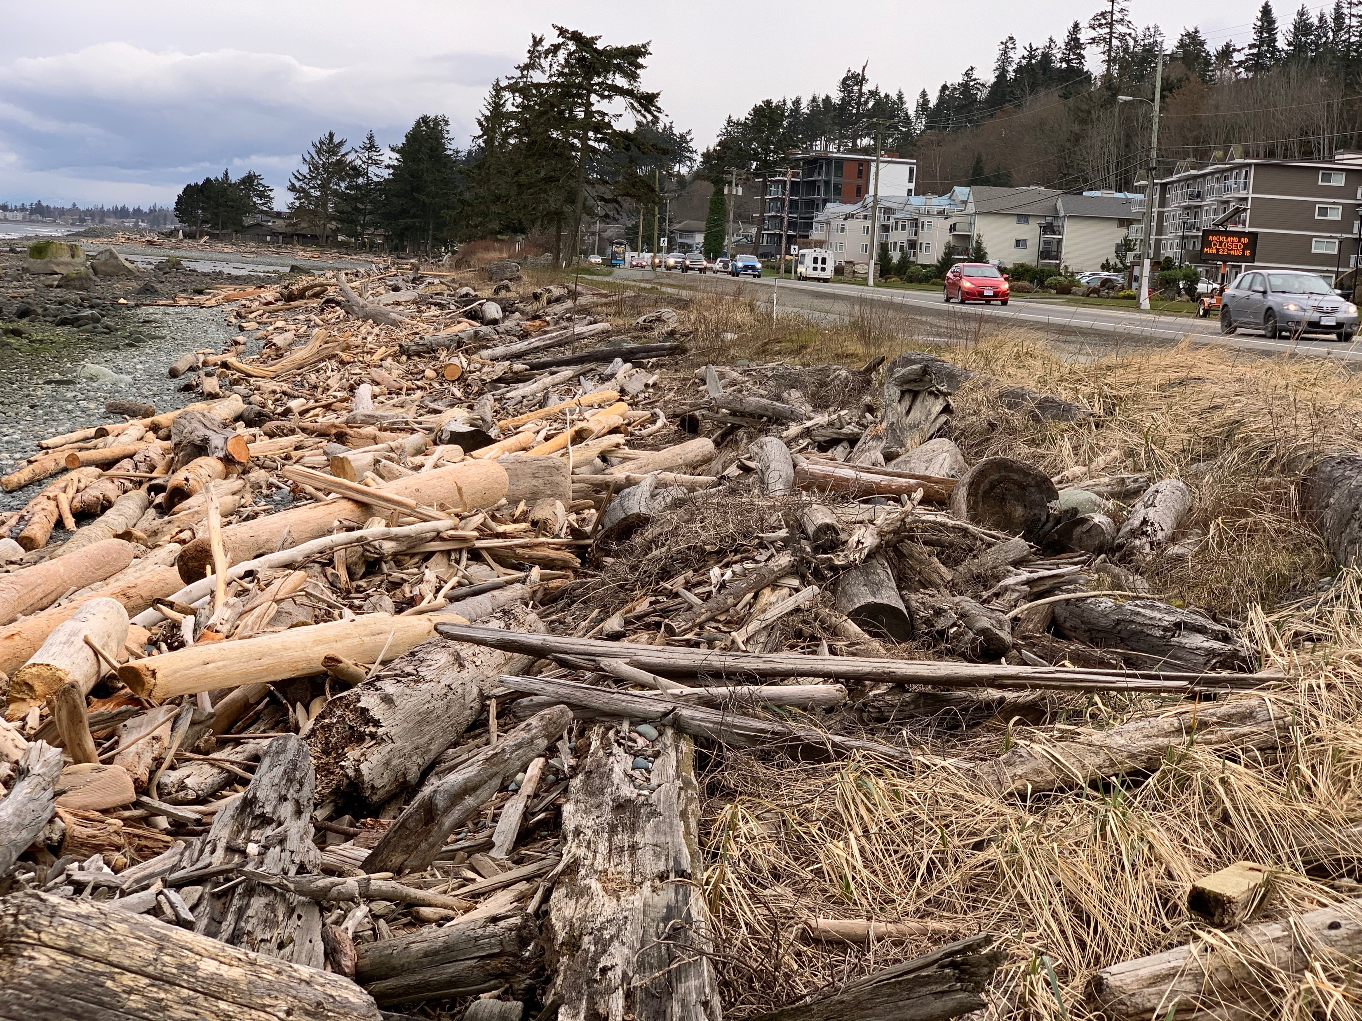
Coastal Flood Mitigation for Economic Development
April 26th, 2021
Organic Shoreline Nutrification for enhanced shoreline ecology and recreation while supporting local forest industry.

Slide 2
Introduction
Bruce Bradley – Owner of BC Timber Goats
Moved to Campbell River in 2013 for commercial dive school
Worked as diver in local aquaculture and Commercial Fishing before starting BC Timber Goats in 2019
Discovered Thatching for Sand Dunes or “Organic Shoreline Nutrificaton” on first Goat Project and this presentation highlights the benefits of applying this concept to the Campbell River Shoreline.

Slide 3
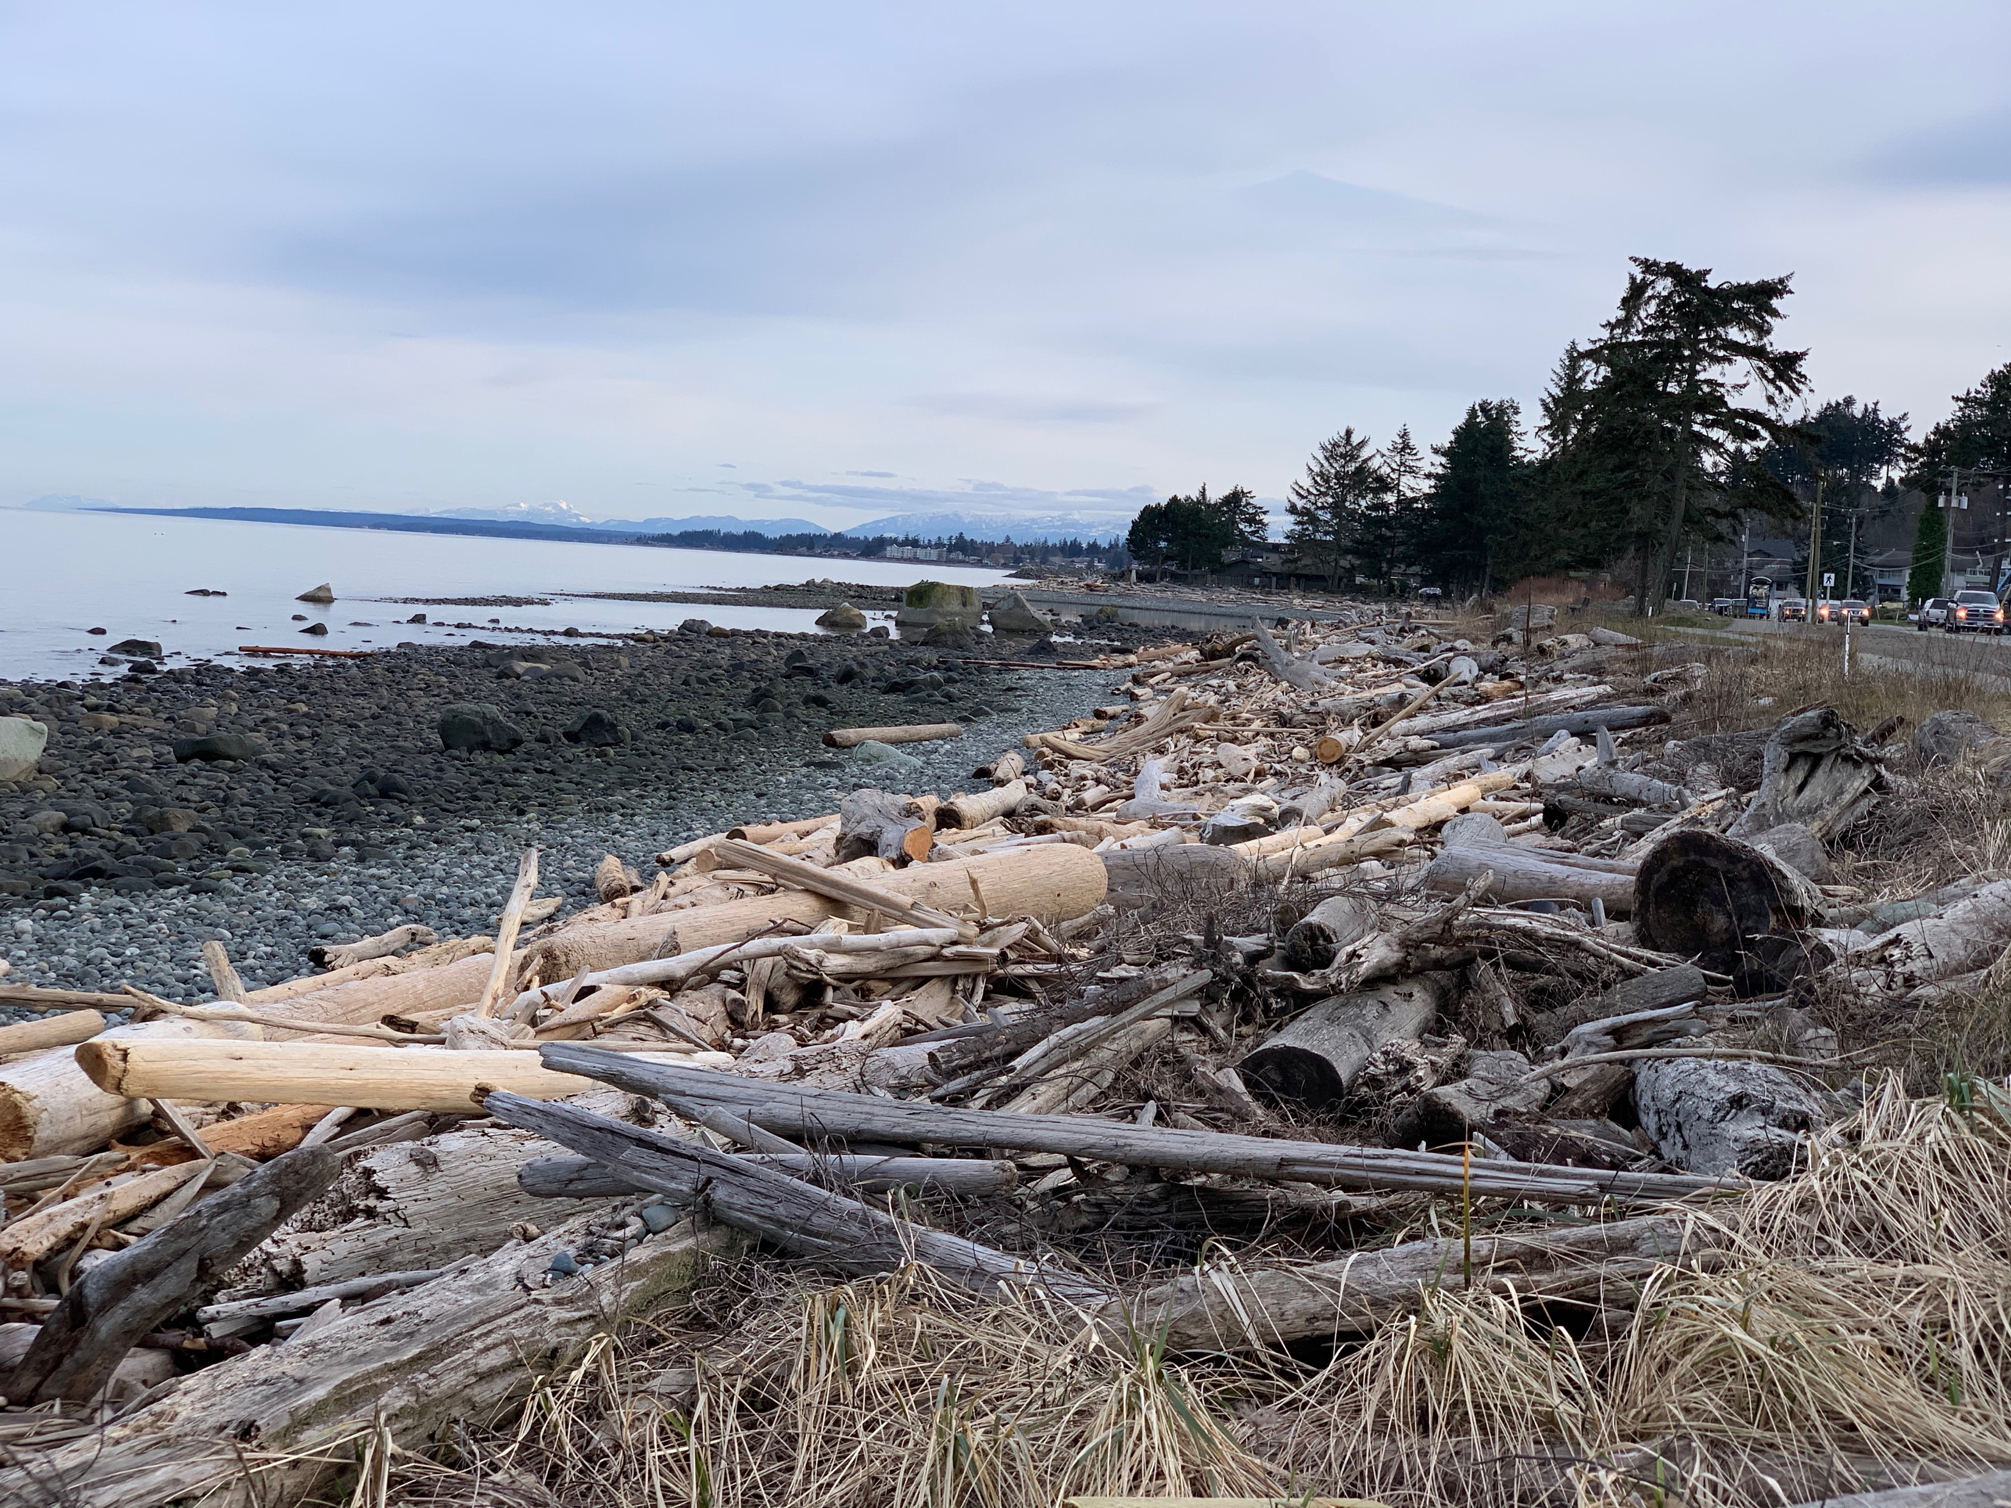
The Emergency Management Strategy for Canada: Toward a resilient 2030 (2019)
Priority 3: Increase focus on whole-of-society disaster prevention and mitigation activities
The most effective EM activities are proactive prevention/mitigation measures that are used to eliminate, reduce or adapt to risks. These activities include structural mitigation measures (e.g. construction of floodways and dykes)
The return-on-investment for these activities, while dependent on hazard type and location, would generate savings of $6 for every $1 invested in prevention.^{Footnote6}

Slide 4
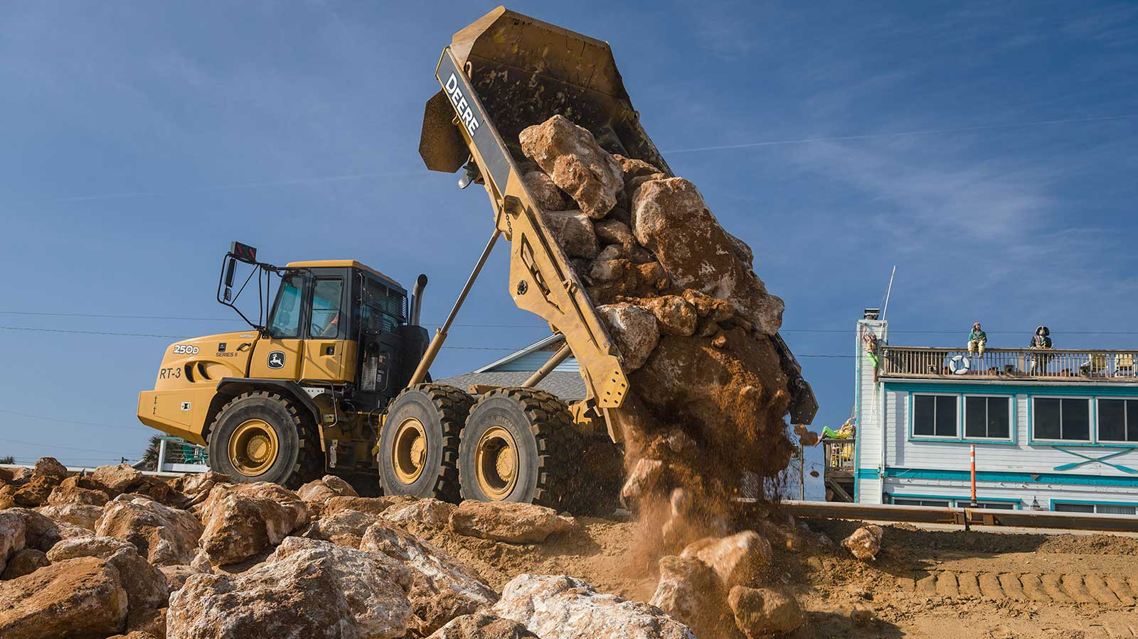
What is Shoreline Nutrification?
Traditionally Shoreline Nutrification describes the process of adding aggregate material to the shoreline as a means to raise and armour the shoreline from encroaching waves. This is traditionally done with rocks, sand and gravel.

Slide 5
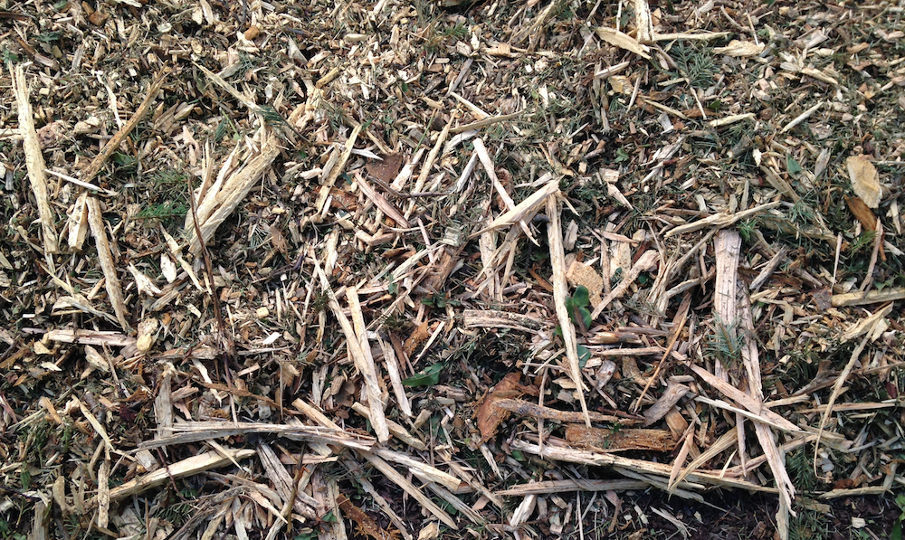
What is Organic Shoreline Nutrification?
Organic Shoreline Nutrificaton is the same thing but using organic material instead. Organic material can have strong matrix/filtering qualities to trap and hold sediment from waves on windy days.
Matrix Nutrificaiton Example:
BC Timber Goats:
Thatching For Sand Dunes

Slide 6
Current State of the Shoreline
High Erosion – evidence of wave height near walking path
Shallow angle of Shoreline Approach – Provides little resistance to incoming waves
Low productivity of Habitat Zone – lack of organic material and Driftwood berm act to suppress/eliminate any possible vegetative growth.
Uneven Terrain - Large rocks and rugged driftwood berm limit recreation opportunities and restrict access.

Slide 8
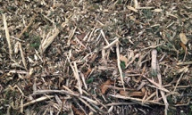
What happens when we apply wood mulch to the shoreline?

Slide 9
Contour of mulched shoreline
Lower side of berm regularly tossed and mixed with sand and aggregate

Slide 10
Campbell River Shoreline – Post Nutrification
Heavily armoured to prevent erosion – shoreline level with walking path a few extra meters
Steep angle of Shoreline Approach – slows momentum of incoming waves
Improved Habitat Zone – wood mulch layer can provide foundation for vegetative growth
Even Terrain - Large rocks and rugged driftwood berm are buried to create more inviting area for public recreation.
Lower side of berm regularly tossed and mixed with sand and aggregate

Slide 11
Economic Development
Enhanced beach areas for recreation – Increased value of shoreline for residents
Increased value of shoreline for tourism
Increased attractiveness of CR as business location
Supports Forest industry through sourcing materials

Slide 12
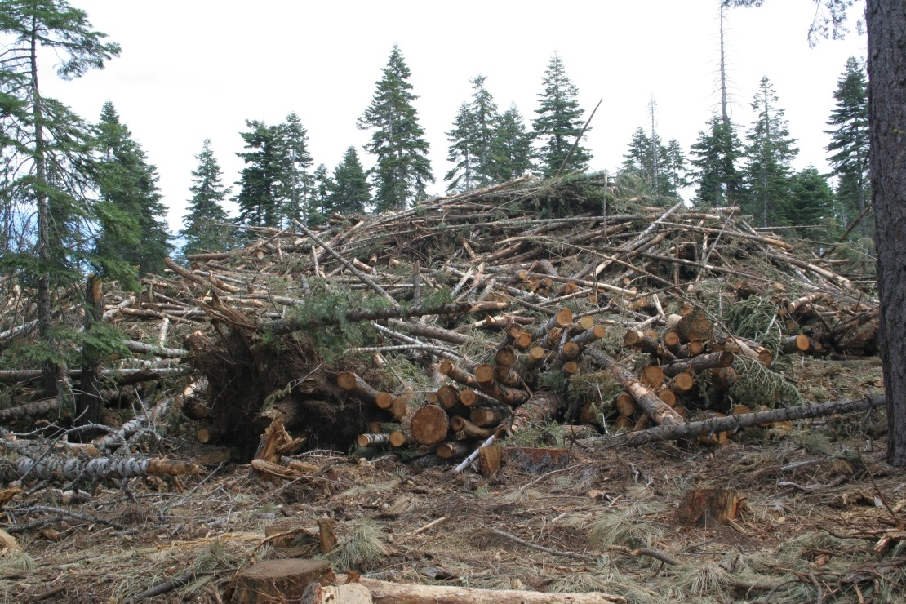
Residual Wood Fibre Utilization (wood chips/mulch)
Residual Wood Fibre refers to the fibre that is left behind on a site after primary harvesting operations have been completed.
This fibre includes smaller and poor quality logs, pieces of logs, branches and other woody biomass. It has historically been called waste or residue and is often burned to reduce the fire hazard that exists on site post harvest.

Slide 13
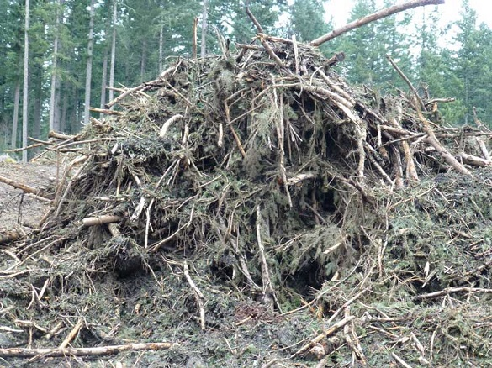
Residual Wood Fibre Utilization (wood chips/mulch)
Wood Fibre utilization is a major priority for the government of BC and a number of federal, provincial and municipal programs exist that provide financial and other resources to activities that increase the use of residual wood fibre.
Residual Fibre Utilization Funding Programs
Forest Enhancement Society
Forest Carbon Initiative
Low Carbon Economy Fund
Forests For Tomorrow
Community Resiliency Investment

Slide 14
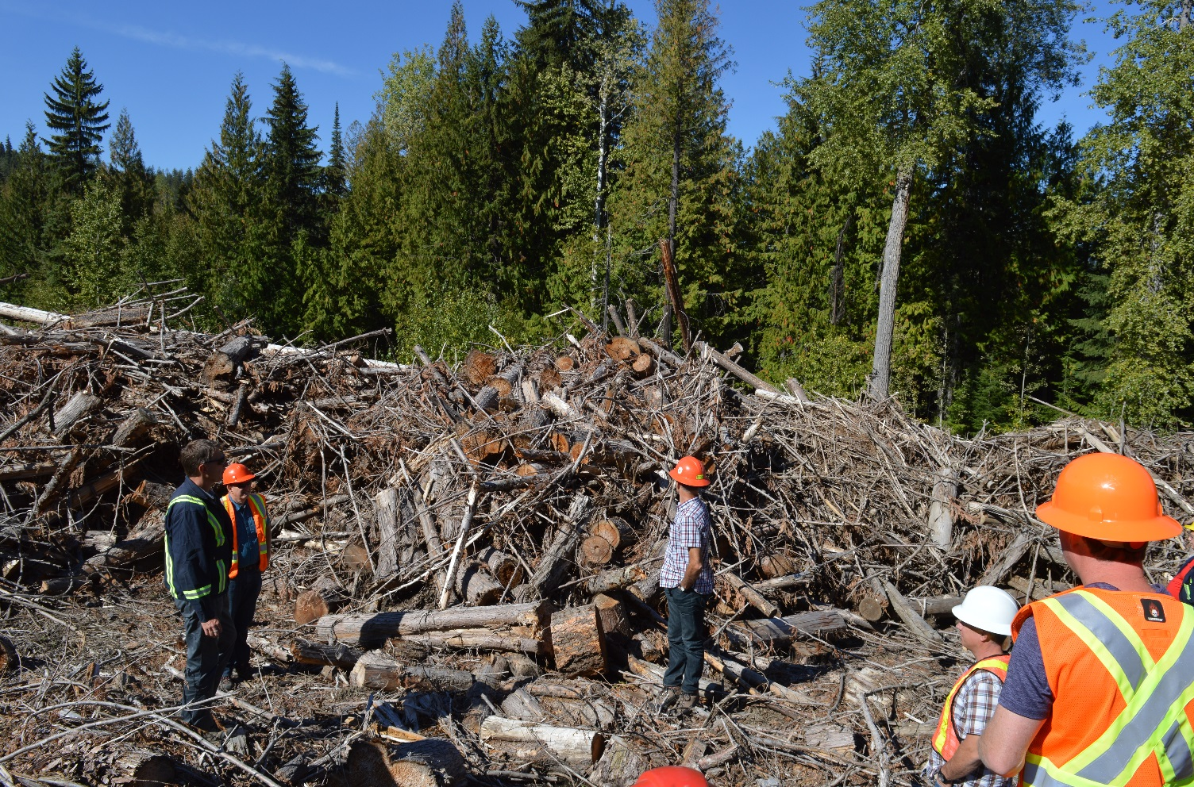
Benefits to Campbell River from Utilizing Wood Chips in Coastal Flood Mitigation:
Can source 168,000 – 300,000 cubic meters of wood chips from local forest operators
This provides local forest industry jobs
Reduces local wildfire fuel/risk
Reduces need for control burn
Improves air quality

Slide 15
Advantages to Wood Fibre Shoreline Nutrificaiton
Subsidized material cost by leveraging grant funding for wood fibre utilization
High matrix value to trap sand and aggregate enhancing quality and ecology of beach
Some of that material will likely disperse throughout intertidal zone, getting trapped between rocks further improving sediment retention.
Over time this increase in substrate will improve intertidal zone habitat for invertebrates

Slide 18
Conclusions
Organic Shoreline Nutrification for Coastal Flood Mitigation provides Economic Development through enhanced beach areas. This raises the value of the CR shoreline for residents, tourism and the ability of the community to attract businesses.
Utilizing Residual wood fibre as the Nutrficiation material is economic development by engaging local forest operators to supply 168,000-300,000 cubic meters of wood chips
Return on investment for flood migration alone is 6:1 and considering the economic benefits from organic shoreline nutrification that ratio can only increase providing extremely good value for the city.

Slide 19
Actions
In light of compelling economic benefits and to capitalize on existing funding available, I request that City Council introduce and approve a resolution to prioritize Organic Shoreline Nutrificaton as part of Coastal Flood Mitigation by including this method in an application to the Union of BC Municipalities for 2021 program funding.

Slide 20
Questions?
Bruce Bradley
BC Timber Goats
info@bctimbergoat.ca
250-203-3534

Slide 21
**Cut for Time
Pilot Project:
Intertidal Zone Thatching for Sediment Capture

Slide 22
Pilot Project:
Intertidal Zone Thatching for Sediment Capture
Question: Will thatching between rocks with straw promote sediment capture and retention in intertidal zone?
Action: Thatch suitable areas in different parts of intertidal zone and monitor for sediment capture and retention.
Benefit: Capturing and retaining sediment in intertidal zone improves habitat, access and stages material to eventually supply shoreline.
Success: can result in submission to Union of BC Municipalities for funding.

Slide 23
Pilot Project:
Intertidal Zone Thatching for Sediment Capture
Budget < $5000
Seek Permission/Permit from DFO
Work with Students from NIC
Source and apply straw/hay
Monitor over next 2-3 months

Slide 24
Actions
City Council introduce and approve a resolution to initiate a Pilot Project to study the potential for “Thatching” to provide intertidal zone sediment capture and retention.

