Slide 1
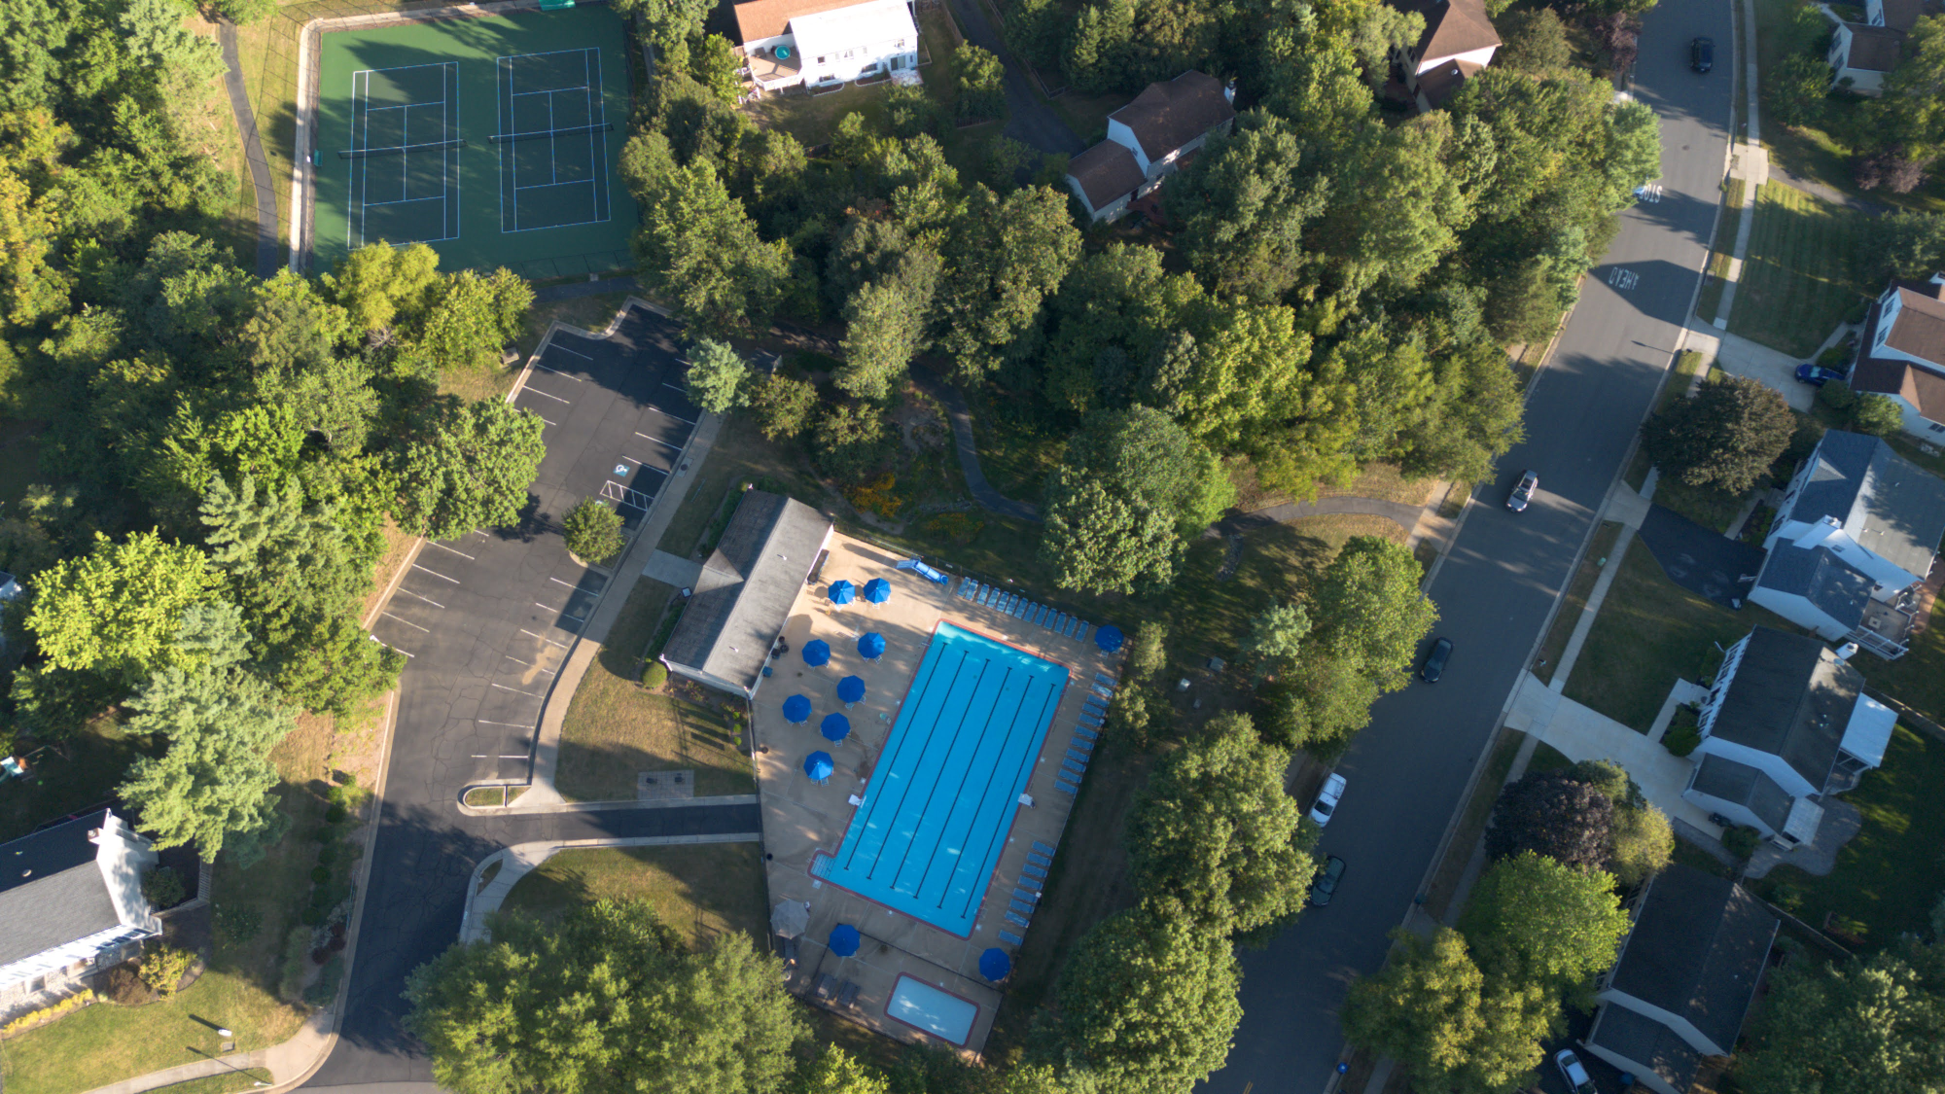
Kingstream Community Council Annual Meeting
April 16, 2026
7:00 PM

Slide 2
2025 Headline Accomplishments
Community Asset Repairs / Improvements
Resurfaced tennis courts.
Trail repairs.
Shingled pool house roof.
Minor pool equipment repairs.
Basketball court caulk.
Soil erosion prevention on trail 2.
Remove several dead trees along trails.
Basketball court and playground cleaning.
Retired pool slide (safety)
Removed stationary Lifeguard stand (safety)
Kingstream Drive Traffic Calming Study
Finance
Signed new 3-year pool contract.
Completed new reserve study.
Completed a successful 2024 audit.

Slide 3
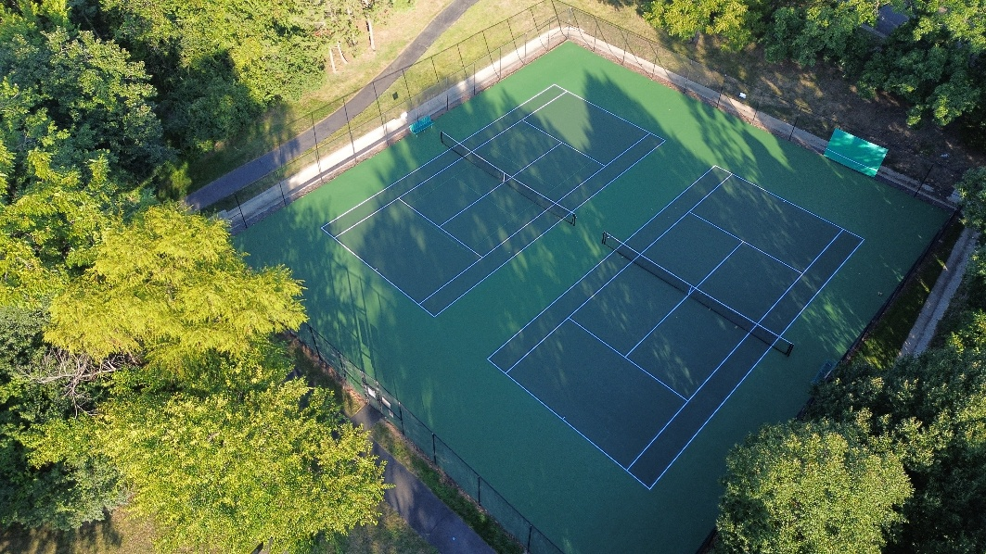
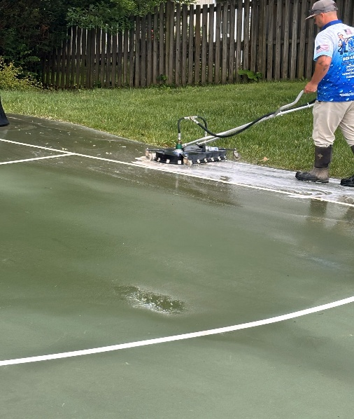
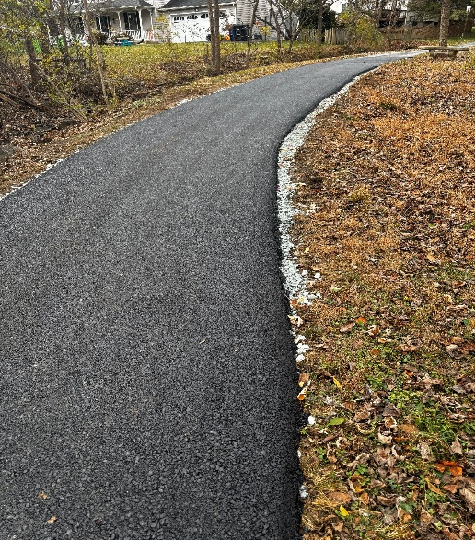
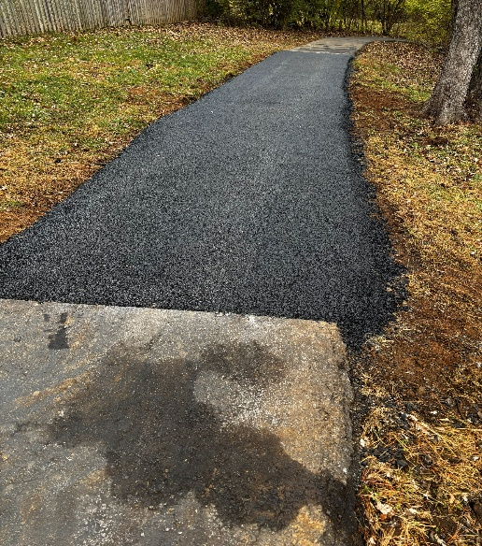
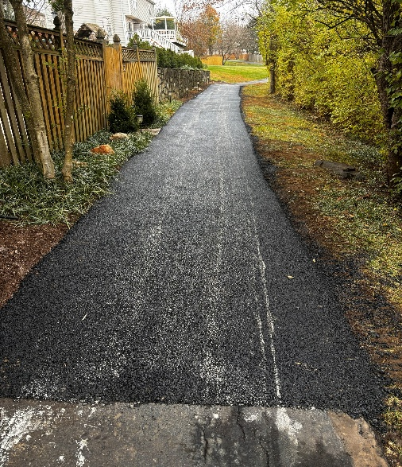
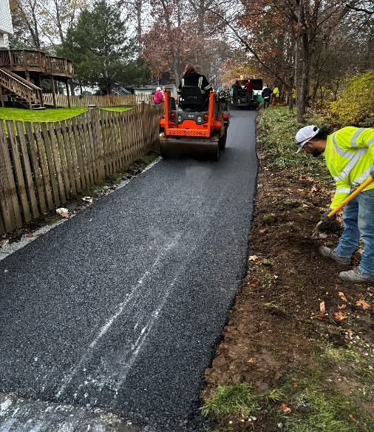
2026 Headline Accomplishments
Tennis Court Repairs /New Color
Basketball Court Cleaning
Repairs to Trails: 2, 4,6,8 & 10 Approx 395 ft

Slide 4
2026 Headline Goals
Finance
Assess new reserve study results for impact to community finances
Propose dues increase
Complete 2025 audit with new firm
Pool
Instruct lifeguards on Board’s expectations
Possible upgrade to pool amenities
Community Asset Repairs
Playground maintenance (mulch both)
Continuous efforts
Board Member Development
Ongoing knowledge sharing among board members
Improving documentation for future boards use
Creating standard operational procedures
Developing knowledge turnover process
Develop Maintenance Program for Community Assets
Align operating expense budget to fund program
Routine maintenance key to extending asset lives between major repairs

Slide 5
2025 KCC Committees
ARC – Mike Wei, Stephanie Palmer, Ken Neumann
Landscape – Peter Mech, Ken Neumann,
Pool – Chris Bollerer, Steve Fast, Ken Neumann,
Communication – Stephanie Palmer, Chris Bollerer
Outreach/Activities – Sharon Kessler (volunteer)
Finance – Larry Kaplan, Steve Fast, Chris Bollerer, Ken Neumann
Traffic Calming – Jim Roewer, volunteers – Beth Bollerer, Sharon Kessler, Josh Wixom

Slide 6

Community Appearance
Lisa Cornaire
Annual property inspections
Scheduled for April/May timeframe
Violation letters will include a photo when possible
Timeframe to correct will be provided in letter
Periodic follow up inspections will be performed
Reminder of commonly cited items
Trash receptacles stored in view of the street
Power wash dirty/moldy siding
Landscape tools/materials, other items stored in view of the street.
Mailboxes and fences in need of repair.
Wood trim, doors or shutters in need of fresh paint.
Driveways in need of repair. (Reminder, pipestems are a shared driveway and are not HOA common area, homeowners on pipestems as a group, need to maintain their pipestem driveways to support property values)
Landscape maintenance.
Remove low hanging tree branches over sidewalks. Shrubs should also not obstruct sidewalks.
2025 Inspection
65 Letters Sent

Slide 7
Traffic Calming Committee
Jim Roewer; Beth Bollerer, Sharon Kessler, Josh Wixom (volunteers)
Working to increase safety in the neighborhood by supporting efforts, mechanisms, or physical devices that result in vehicular traffic obeying posted speed limits and all traffic signs
Met with Fairfax County Police regarding traffic concerns
Coordinated with Fairfax County DOT (FCDOT) on Traffic Calming Study
Community Outreach/Review/Comment on proposed FCDOT Traffic Calming Plan
Balloted proposed Plan to affected property owners
Vote of 95 – 34 (~74% support for Plan) failed to reach required threshold of eligible voters (only 52% voted)
Committee intends to explore other options with FCDOT & others to achieve goals

Slide 8
Architectural Review Committee (ARC)
Mike Wei, Ken Neumann, Stephanie Palmer
The Architecture Guidelines are a living document with a goal to maintain the aesthetic and architectural harmony within the community.
An ARC application is required for all exterior modifications. The applications should document the scope of work, materials to be used, plat map in some cases, colors of materials, and any other necessary information.
This application is maintained in the community records. When selling a home, this information is released to the purchaser.
The ARC committee will conduct a site visit to help with the planning for a project.
There were 47 applications in 2025 with 34% approved in 2 days or less. Two applications were retroactive.
The most frequent requests involved roofs, fences, doors, sheds, and decks. There were only three solar panel requests.
The average number of days to approve an application was 4 days in 2025.

Slide 9
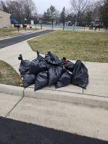
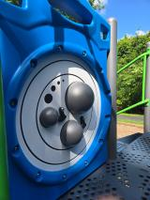
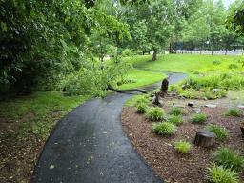
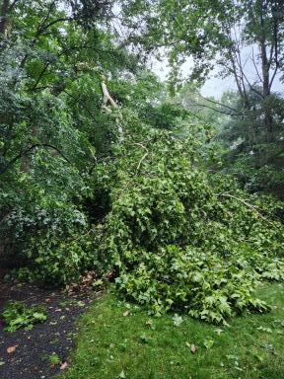
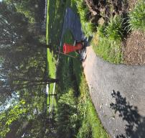
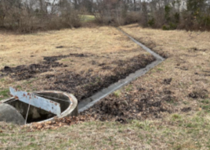
Landscape Committee
Peter Mech, Ken Neumann
Annual community clean up (March)
Year of downed, dead & damaged tree removal
Playground cleaning
Pond maintenance (FFX County Support)

Slide 10
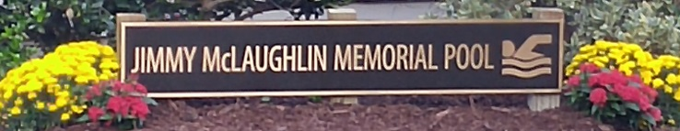
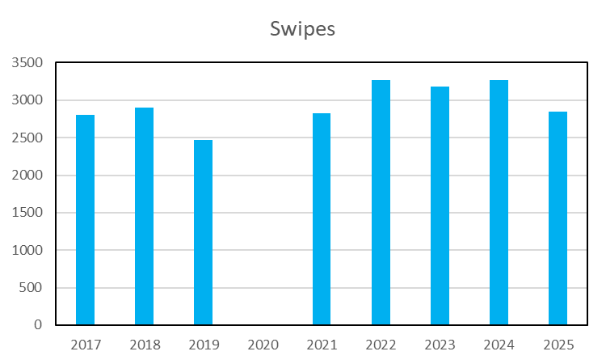
Kingstream Pool
Chris Bollerer, Steve Fast, Ken Neumann
Implemented third year of the three-year, $202k contract for 2023-2025 with NVPools.
A new 3-year contract for $231k was signed with
NVPools for 2026-2028.
The pool operated successfully and safely this last
summer.
Updates & repairs shown on next slide.
The Kahunas swim team had 105 children (58 families)
participating for a successful season.
Fairfax Water and the county continue to raise their quarterly service charges and usage charges. Service & commodity charges will increase as of 1 April 2026.

Slide 11
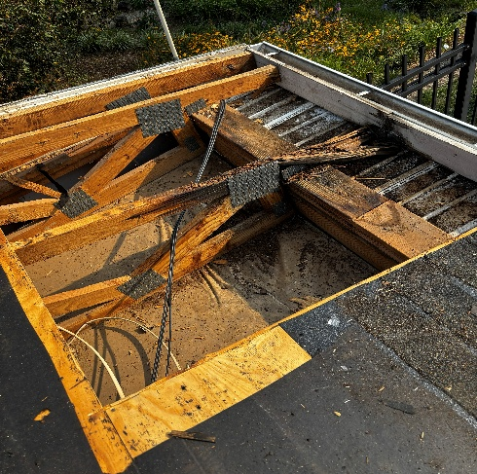
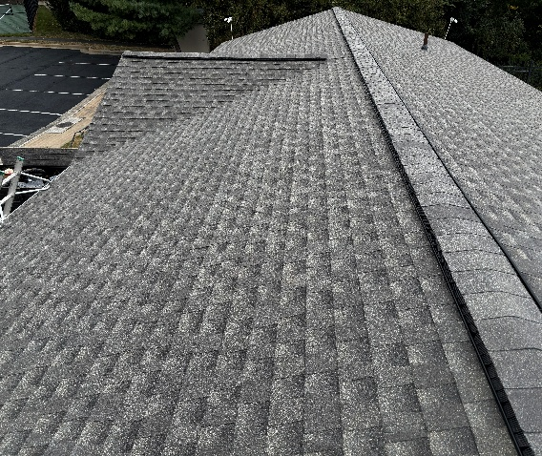
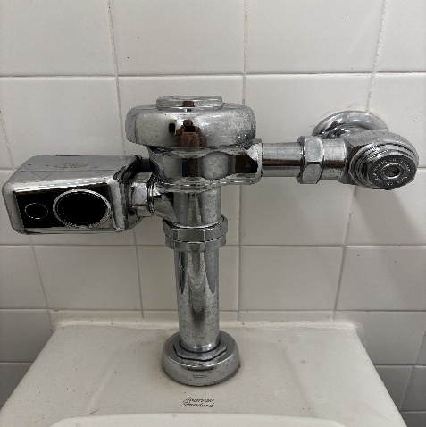
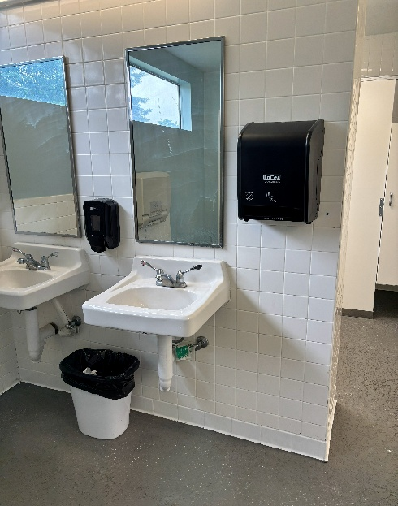
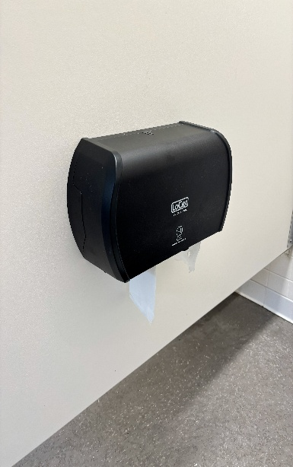
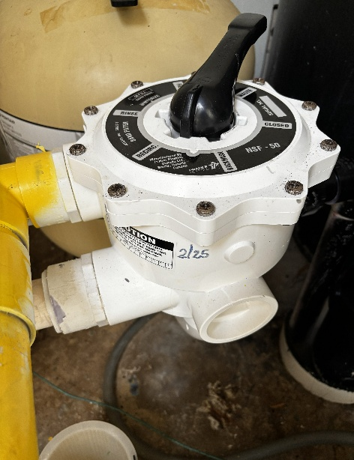
2025 POOL REPAIRS & IMPROVEMENTS VISUALS
Bathhouse water damage
New 50-year roof installed
5 Toilet Sloan valves installed
New paper dispensers installed by NV, No charge to KCC
Baby pool backwash valve installed

Slide 12
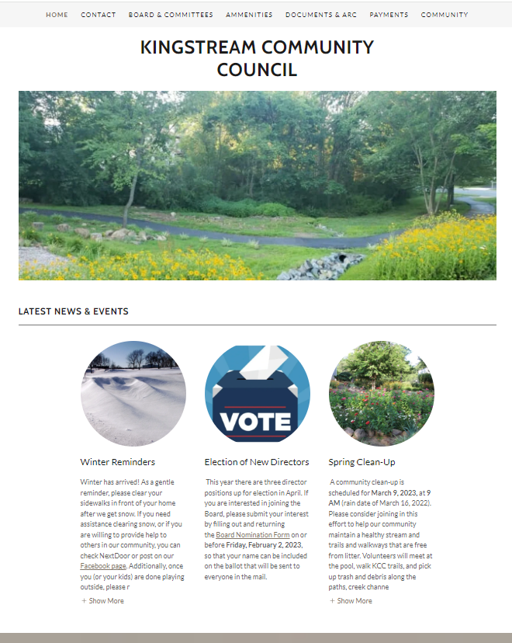
Communications
Stephanie Palmer, Chris Bollerer
Current Communications
Website: www.KCCHerndon.org
Official communication method
Regularly updated with the latest news and events
Information includes governing documents, details about our amenities (e.g., pool, tennis courts), committee descriptions, architecture review process, and a resale packet
Email Newsletters
Sign up on website to get periodic email updates, including brief summaries of board meetings, upcoming important events
Facebook
Follow Kingstream Community Council for regular updates

Slide 13
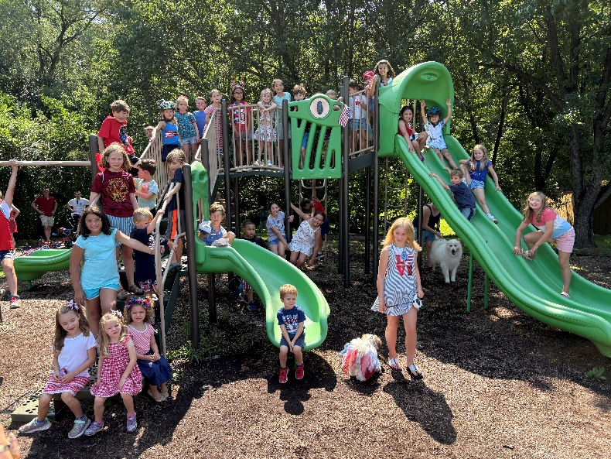
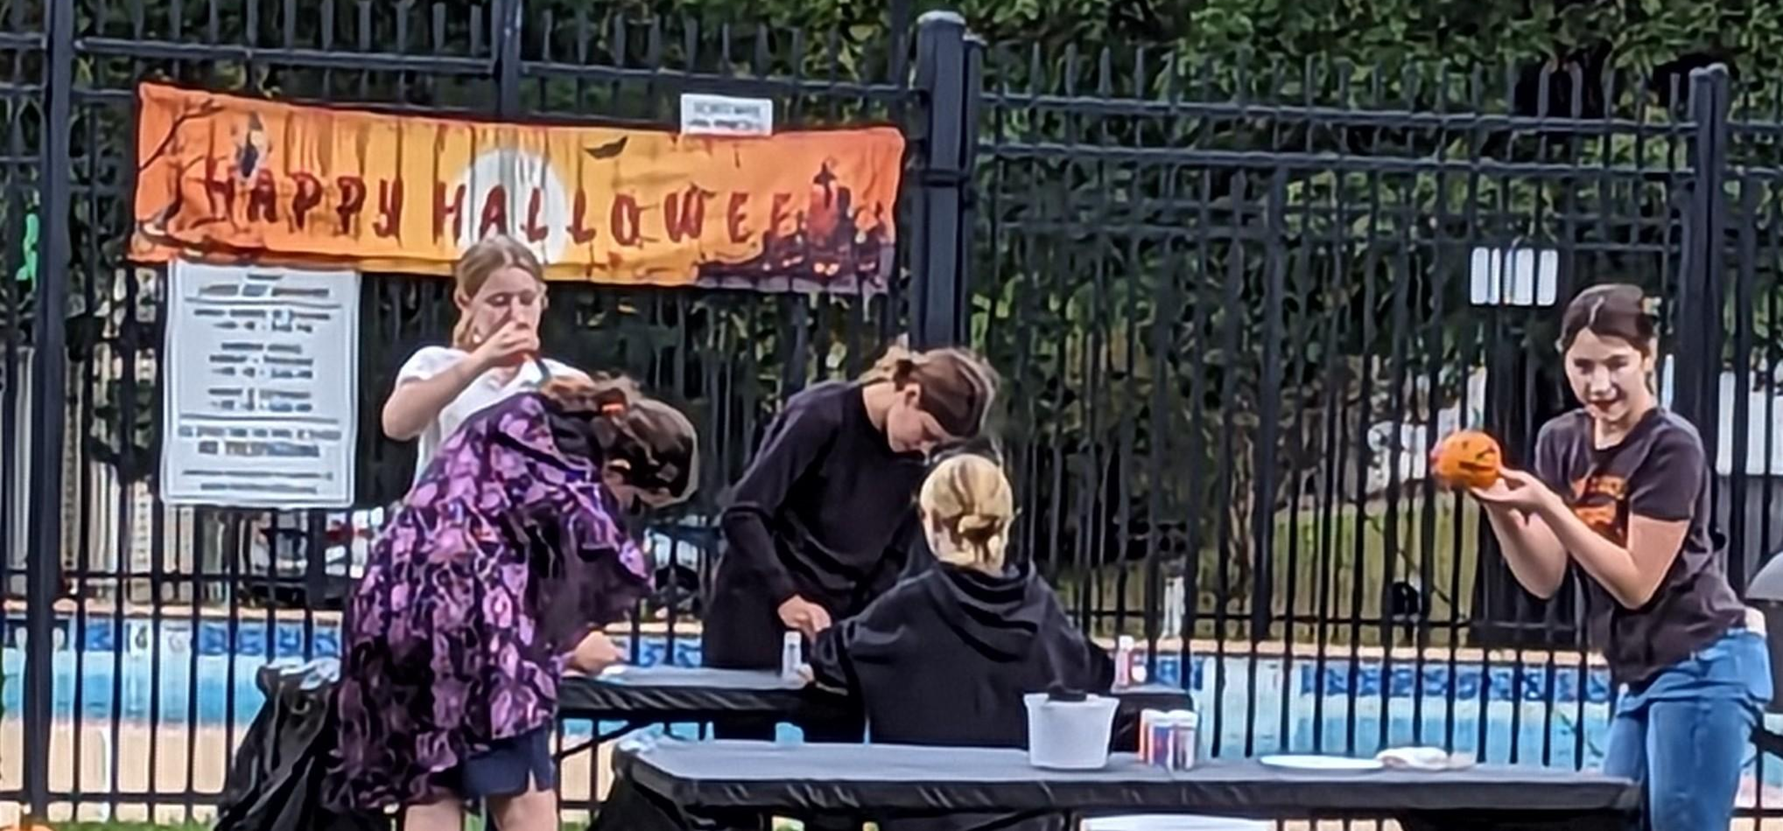
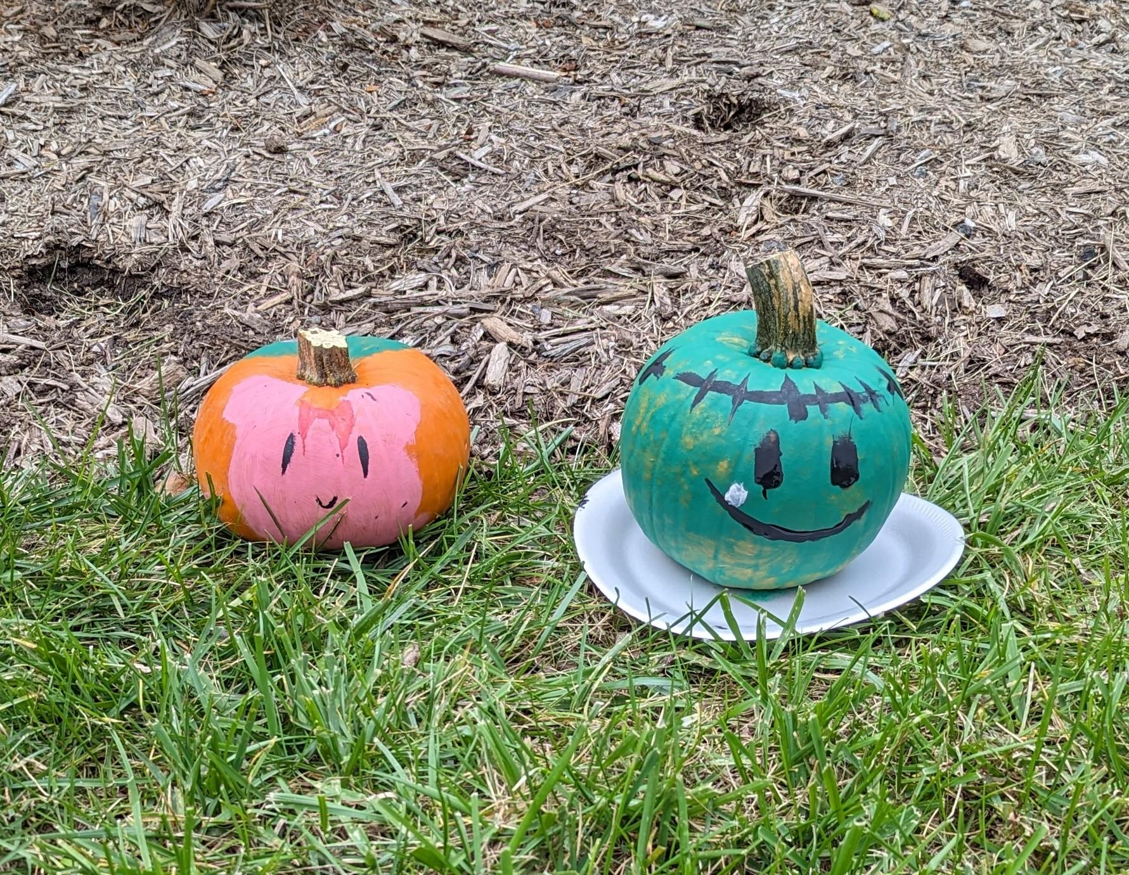
Outreach Committee Sharon Llewellyn, Scott Graff, Sharon Kessler, and Linda Propst
Outreach Committee Sharon Kessler - volunteer
In 2025 Kingstream Outreach Committee hosted the following KCC community events:
Community Clean Up
Memorial Day Potluck
Adult Swim Party
End of Summer Potluck
Dog Swim
Chili Cook Off
Halloween Decoration Contest
Winter Decoration Contest
“Alone, we can do so little; together, we can do so much.” ~ Helen Keller
Thank you to everyone that volunteered at the 2025 community events. The success of these events is dependent on the community involvement.
The Outreach committee is always looking for Volunteers to help with the events. Please contact Sharon or any Board member for more information.

Slide 14
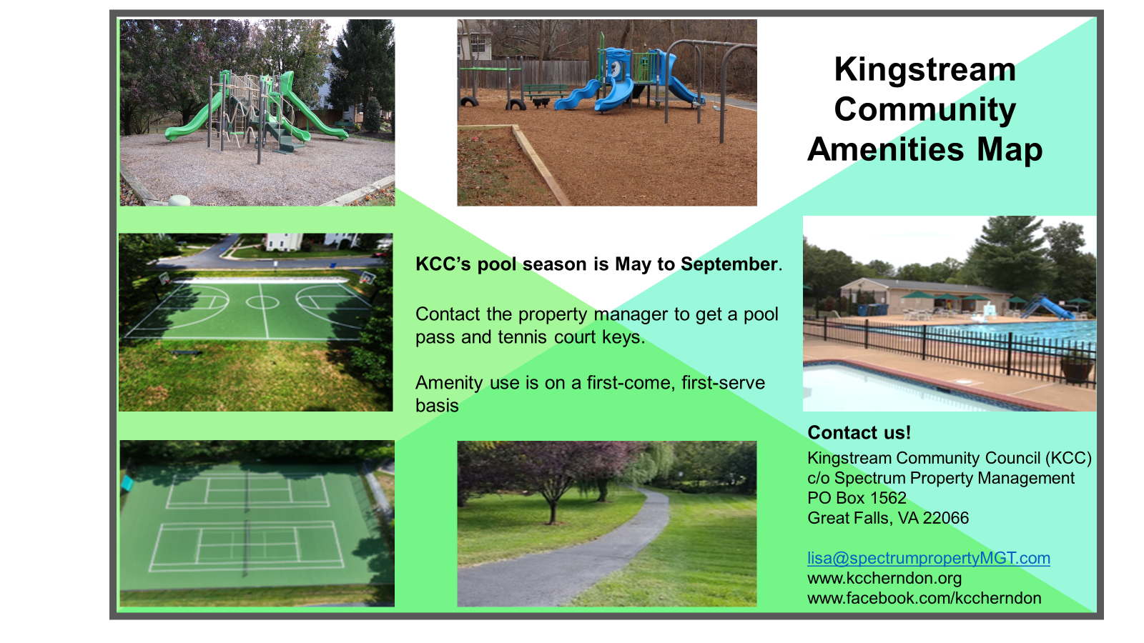
Outreach
New Kingstream (KCC) residents receive a welcome gift along with information on the KCC Community.
15 New KCC Residents moved to the neighborhood in 2025

Slide 15
Financial Goal
FINANCES
Larry Kaplan, Steven Fast, Ken Neumann, Chris Bollerer
Our financial goal is to manage and conserve financial assets in order to improve community assets for the enjoyment of the homeowners.
Operating Account- Includes all recurring annual expenses & dues.
Reserve Account- Includes all savings for expenses to repair and replace capital assets:
Pool, pool facilities & parking lot, tennis & basketball courts & drainage features, two playgrounds & trails. (Legal Requirement)

Slide 16
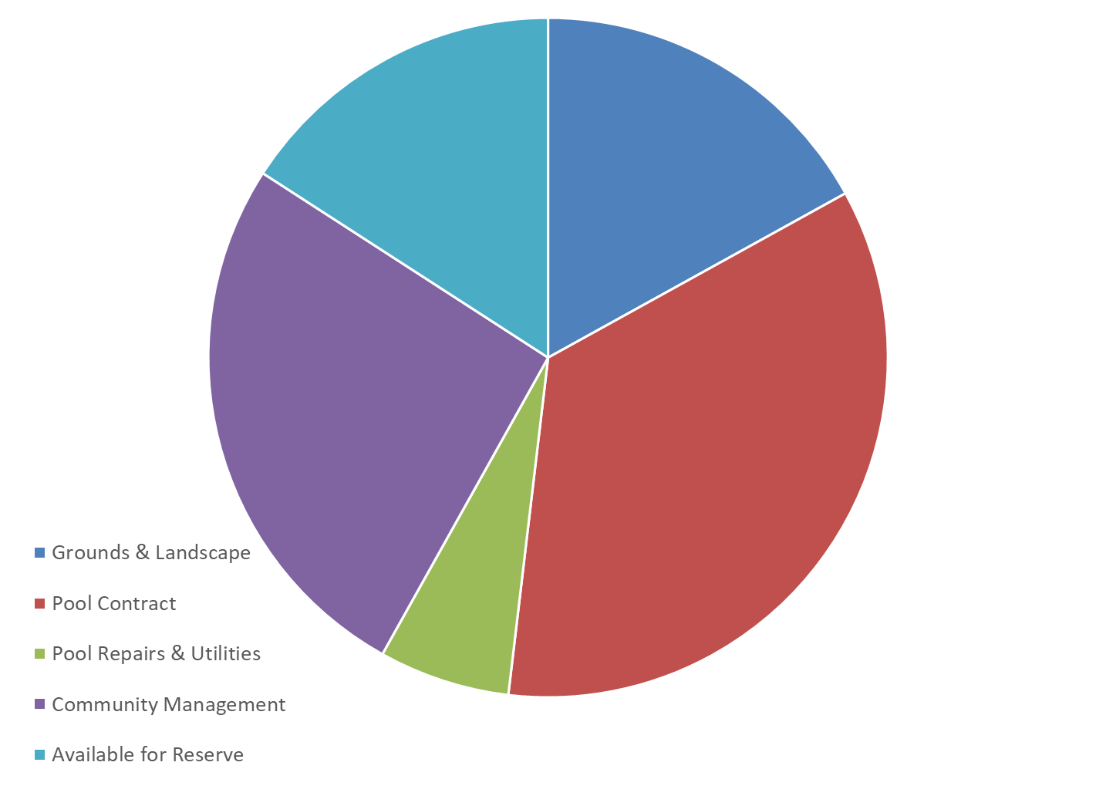
How we spend the annual dues
KINGSTREAM COMMUNITY 2025 EXPENSE BUDGET ($ k)
Total Revenue Budget
$202,980 (dues only)
$32.2k
16%
$34.4k
17%
$52.8k
26%
$70.8k
35%
$12.7k
6%
Total pool costs – 41%
Expenses include offsets for legal fee reimbursement, HOA transfer fee, pool passes, tennis court keys.

Slide 17
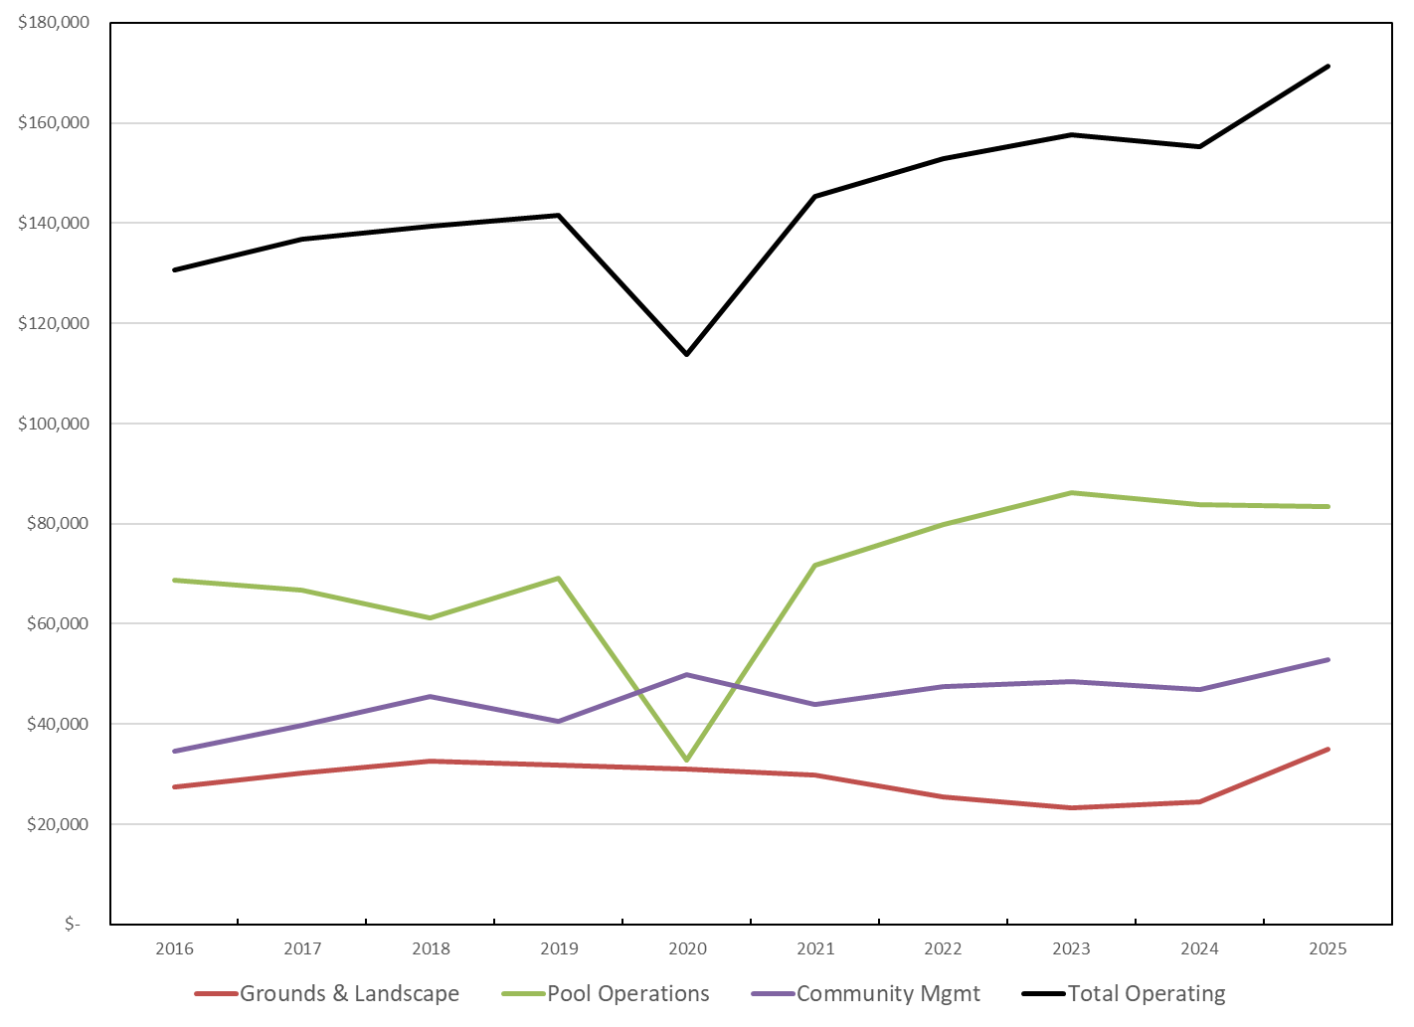
Operating Expenses
Expenses continue to be well managed
Operating Expenses
Expenses increased by 10.4% overall due to contract increases.
2024: $ 155,185 2025: $171,270
Pool Operations
Pool repairs & supplies expenses decreased by $4k.
2024: $ 86,788 2025: $83,514
2024: $ 46,895 2025: $52,816
Community Management
Expenses were up due to reserve study expense.
Grounds and Landscaping
Expenses were up due to an increase in the landscape contract and tree removals.
2024: $ 24,502 2025: $34,940
Expenses include offsets for legal fee reimbursement, HOA transfer fee, pool passes, tennis court keys.

Slide 18
Reserve Account Major Repairs Completed
During 2025, $75.1k spent for:
Resurfaced tennis courts
Replaced pool house roof
Minor pool equipment repairs
Basketball court caulk
Soil erosion prevention
Trail repairs
Current reserve savings have been sufficient to finance these repairs without special dues assessments.
During the past 5 years, 30 repairs (23 unplanned) were accomplished vs 16 planned (7 planned executed) repairs. Changes to the reserve study recommendations are based on the Board’s judgement on necessary repairs.
Based on the recent reserve study, there is the potential for $247k of planned repairs during the next five years (color coat courts, pool covers, pool white coat, trails, interior finishes, plumbing, wading pool pump ).
Prior year reserve expenses
2021 - $95.5k
2022 - $9.6k
2023 - $14.7k
2024 - $21.2k
Total for the last 5 years: $216.1k vs planned spending of $196.6

Slide 19
Annual Reserve Savings & Reserve Balance
In 2025:
The cash contribution to the reserves was $32k, compared to the annual target of $51.7, due to increased operating costs.
Over the 5 years 2021 to 2025, the cash contribution totaled $227k, or an average of $45.3k per year.
The 2025 reserve interest was $28.6k and the total interest earned from 2021 – 2025 was $86.5k.
Together, the cash & interest contributions kept the reserve funding at an acceptable level.
The Reserve Balance at the end of 2025 was $724k. The 2025 reserve study considered the reserves as 100% funded in its projections. The Board has reviewed the new study and considers the reserves are in a good position today; but an increase in the annual assessment needs to be considered to maintain that position due to increasing costs.
Both cash and interest contributions are expected to decline due to increased costs and decreasing interest rates.

Slide 20
Kingstream Community Council
In 2025, Kingstream is in good health
Community assets are in excellent condition from ongoing maintenance & modernization spending.
Operating expenses have risen by 3.9% per year since 2021 and are monitored closely by the Board. The current reserve study assumes an inflation rate of 3.5% for future reserve expenses.
The reserves are fully funded today but will be negatively impacted over the next five years due to:
The interest on the reserves is projected to decrease due to declining interest rates
The cash contribution is projected to drop due to increasing operational costs
Reserve expenses are increasing due inflation
The Board is going to recommend an increase in the annual assessment for 2027 to address this risk. Long term, the Board believes more frequent increases will be needed to sustain our operating & reserve expenses.

Slide 21
Board of Directors Terms
2026
Larry Kaplan
Jim Roewer
Peter Mech
2027
Steve Fast
Ken Neumann
Stephanie Palmer
2028
Vacant
Chris Bollerer
Mike Wei
Thank you to our volunteers! Spectrum Property Management
Lisa Cornaire, CMCA, AMS

