Slide 1
KCC Special Meeting Financial Outlook 2026 to 2030
16 April 2026
8pm, Herndon United Methodist Church

Slide 2
Agenda
Call to order
Establish Quorum
Board Presentation
Homeowner Open Forum/Questions
Members in attendance vote
Count vote & announce results

Slide 3
Purpose
The Board is recommending an increase in the annual assessment.
Recommendation rationale:
The Board has reviewed the 2025 reserve study results which showed increased costs for maintaining the community’s assets. This increases the recommended reserve contribution by $5.7k/year (26-30) to be 100% funded. The Board believes staying above 90% funded is in the best interest of the community.
All operating costs have increased due to past inflation and prior minimum wage changes. This reduces the cash available for the reserve contribution.
The cash contribution (net income) to the reserve fund is projected to decrease from 2026 to 2030 with no change to the annual assessment.
Reserve interest is projected to decrease as interest rates fall and will be insufficient to cover the decreasing cash contribution.
With no increase to the assessment, the reserve funding level will drop below 90% by 2029.
Without this increase the Board will need to consider cuts to services, maintenance and possible pool hours.
The Board is recommending an increase of $60, from $510 to $570 to maintain the reserve funding above 90%.

Slide 4
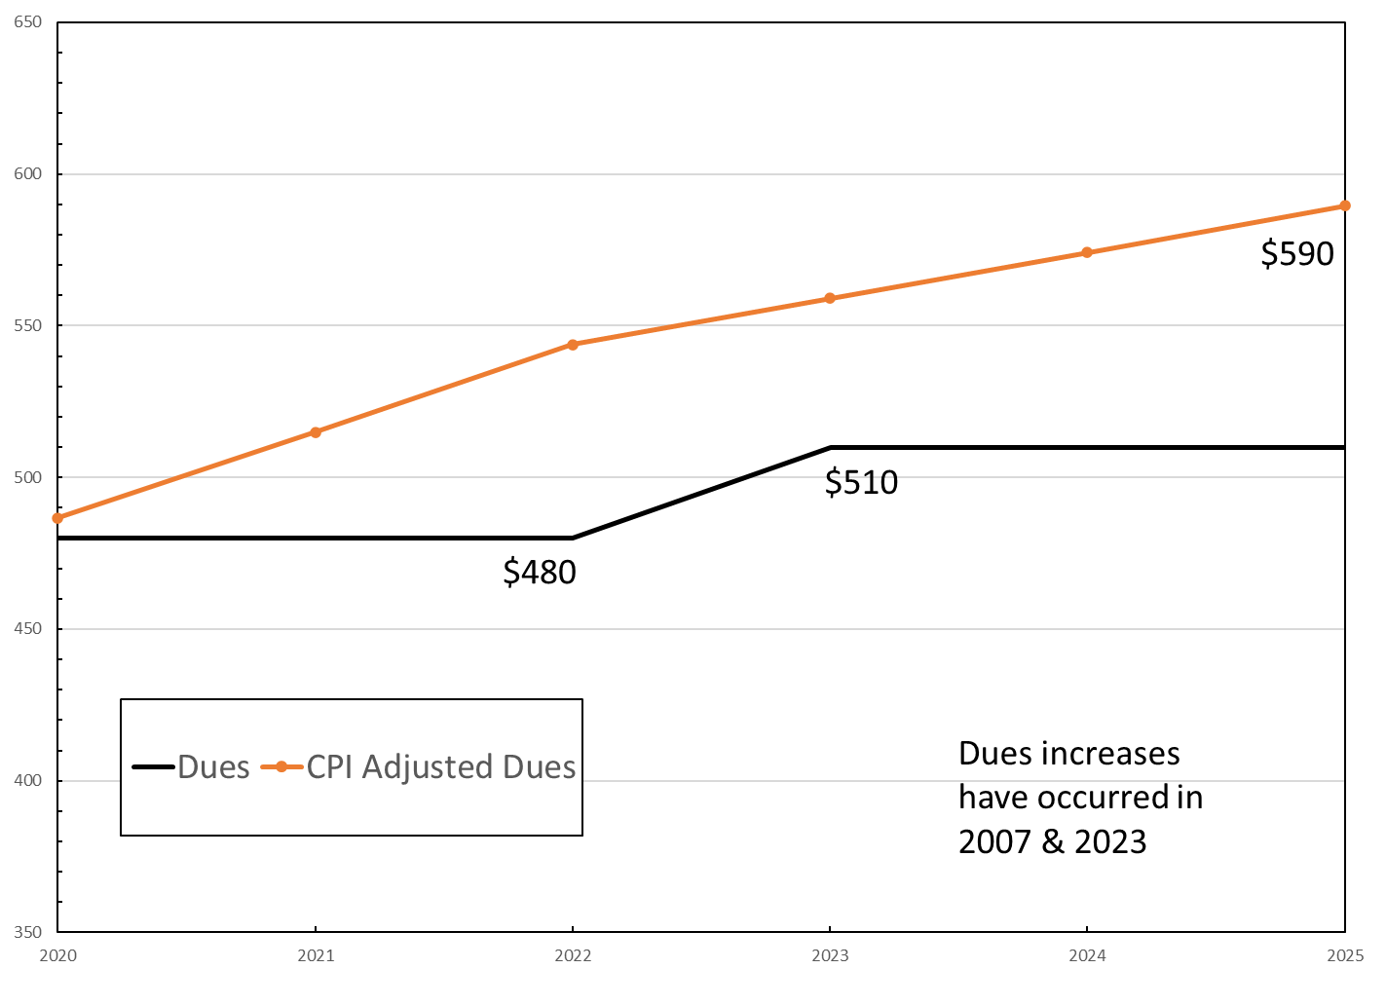
Rationale
Income (Dues)
The community’s income comes from your homeowner dues. If the dues had tracked the CPI over the last five years, dues would have been $590 in 2025.
Reserve Interest Income
Interest income is projected to decrease as interest rates fall.
This interest has covered the cash contribution shortfall over the last 5 years keeping the reserves fully funded.

Slide 5
Rationale
Operating Expenses
New contracts have been signed for landscaping, 2025-30; and pool contract, 2026-28 which have captured increased costs due to inflation and previous minimum wage increases. The property management contract has a fixed increase of 3% annually. All other operating expenses have been increasing as well.
The pool expenses may be impacted in 2028 and 2029 by the increase in the minimum wage to $13.50 (2028) & $15.00 (2029) due to recent action by the Virginia legislature which was not included in the baseline pool contract for 2026-28 or accounted for in the reserve study. This minimum wage increase will impact future expenses.
Reserve Expenses
The reserve study used a rate of 3.5% for inflation to project costs for future reserve expenditures.
The community assets are the pool & pool facilities, parking lot, tennis & basketball courts & drainage features, two playgrounds & trails.

Slide 6
Rationale
Projections
The reserve study annual contribution is designed to keep the reserve fund fully (100%) funded. The Board’s proposal keeps the reserve fund at least at 90% (93% in 2030).

Slide 7
Conclusion
The Board is strongly recommending a $60 increase to the annual assessment for 2027 in order to prevent us from requesting a larger increase in the future and assisting us in avoiding negative effects to the community’s reserve fund & planned amenity maintenance.
The Board believes this increase is in the best interest of the whole community in order to maintain our community assets & continue our sound financial outlook and strongly recommends the community approve this request.
The Board would like to thank everyone for attending tonight and appreciates your concern for our community.

