Slide 1
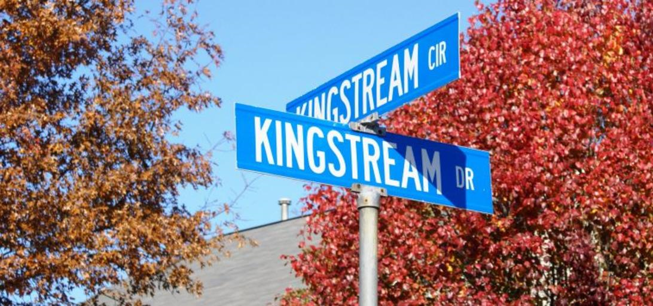
Kingstream Community Council 2023 Annual Meeting
April 20, 2023
7:00 PM

Slide 2
2022 Headline Accomplishments
Dues Increase
Community and Board approved an annual assessment increase from $480 to $510 starting in 2023.
Pool
New pool management contract signed for 2023-25. Contract reflects the changes in minimum wage and inflation.
Open for entire 101 day season, with safe operations, injury and infection free.
Community Asset Repairs
Completed repairs to pool slide and sand filter.
Completed pool parking lot repairs & seal coat.

Slide 3
2023 Headline Goals
Finance
Find a new auditor for the community.
Pool Contract
Implement new three-year contract, expiring end of 2025
Inflation adjustment will need to be monitored closely
Single largest community expense, 2023 at $65k (32% of dues)
Develop Maintenance Program for Community Assets
Align operating expense budget to fund program
Finished 6 years of major capital investments
Routine maintenance key to extending asset lives between major repairs
Community Asset Repairs
Review options for updating the security system (scheduled for 2024)
Review interior pool house condition (scheduled for 2024)
Board Member Development
Ongoing knowledge sharing among board members
Improving documentation for future boards use
Creating standard operational procedures
Developing knowledge turnover process

Slide 4
2022 KCC Committees
ARC – Mike Wei, Ken Neumann, Stephanie Palmer
Landscape – Peter Mech, Ken Neumann, Tyrone Yee
Pool – Katie Schuster, Steve Fast, Scott Graff, Beth Bollerer
Communication – Stephanie Palmer, Katie Schuster
Activities – Sharon Llewellyn, Scott Graff
Outreach – Sharon Llewellyn, Sharon Kessler, Linda Propst
Finance – Steve Fast, Tyrone Yee, Chris Bollerer, Ken Neumann

Slide 5
Community Appearance
Lisa Cornaire
Annual property inspections
Scheduled for April/May timeframe
Violation letters will include a photo when possible
Timeframe to correct will be provided in letter
Periodic follow up inspections will be performed
Reminder of commonly cited items
Trash receptacles stored in view of the street
Power wash dirty/moldy siding
Landscape tools/materials, other items stored in view of the street.
Mailboxes and fences in need of repair.
Wood trim, doors or shutters in need of fresh paint.
Driveways in need of repair. (Reminder, pipestems are a shared driveway and are not HOA common area, homeowners on pipestems as a group, need to maintain their pipestem driveways to support property values)
Landscape maintenance.
Remove low hanging tree branches over sidewalks. Shrubs should also not obstruct sidewalks.
2022 Inspection
98 Letters Sent

Slide 6
Architectural Review Committee (ARC)
Mike Wei, Ken Neumann, Stephanie Palmer
The Architecture Guidelines are a living document with a goal to maintain the aesthetic and architectural harmony within the community.
An ARC application is required for all exterior modifications. The applications should document the scope of work, materials to be used, plat map in some cases, colors of materials, and any other necessary information.
This application is maintained in the community records. When selling a home, this information is released to the purchaser.
In some cases, the ARC committee will conduct a site visit. This past year, site visits to discuss an application with homeowners primarily involved fences.
There were 38 applications in 2022, down from 56 in 2021. There were two retroactive applications.
The most frequent requests involved roofs, siding, fences, and patios. There were two solar projects.
The average number of days to approve an application was 6 days in 2022. Multiple applications required updates with missing details, which extended the approval period to 12 days or more.

Slide 7
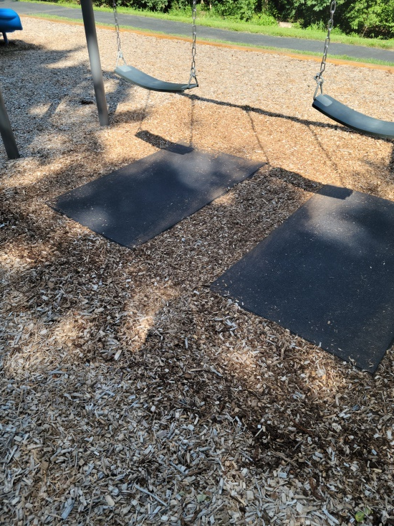
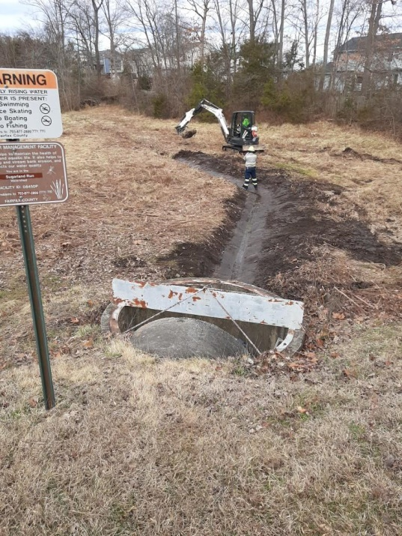
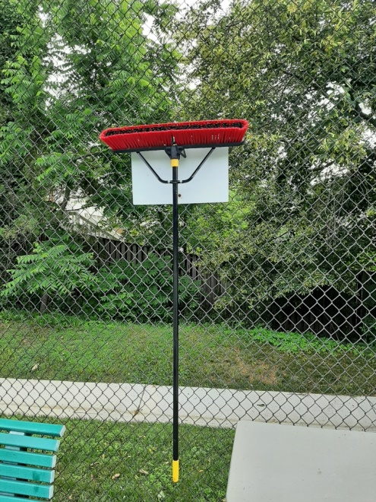
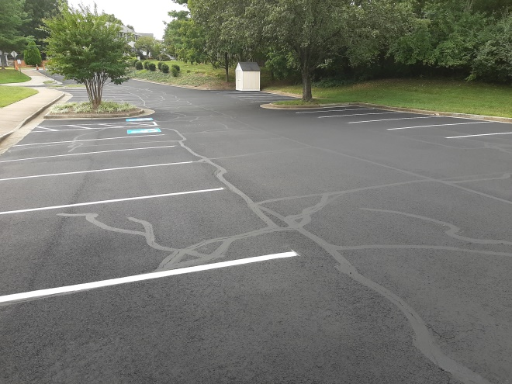
Landscape Committee
Peter Mech, Ken Neumann, Tyrone Yee
Annual Community Clean up (March)
Swing mats installed at tot lot
Parking lot seal coat & repairs (under reserve estimate)
Tennis court water broom and weed control
Downed, dead & damaging tree removal
Coordination with Fairfax County Storm Water Management for mow and cleanout of storm water management ponds

Slide 8
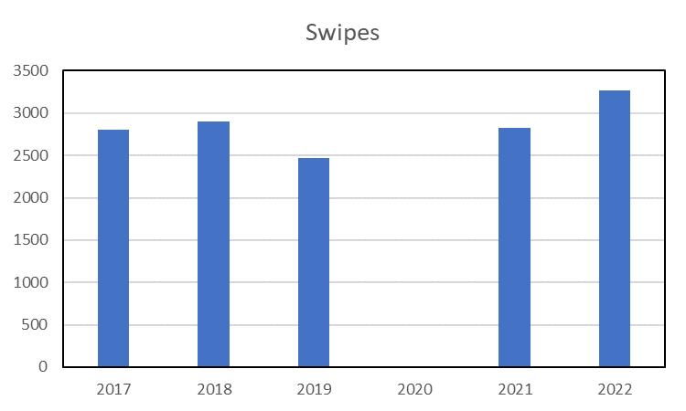
Kingstream Pool
Katie Schuster, Steve Fast, Scott Graff, Beth Bollerer
A new three-year, $202k contract for 2023-2025 was signed with NVPools.
The pool operated successfully and safely this last summer.
Usage (swipes) exceeded the previous year by 15%.
The pool slide was repaired rather than
finding a replacement as a cost savings measure.
The Kahunas swim team had 89 children (50 families)
participating for a successful season. Participation has increased for the last two years.
The Board procured a robot pool cleaner to assist the lifeguards in maintaining a clean pool. Maintenance on the pool sand filter was also accomplished.
Tennis DNA completed a second season of lessons in the community.
It should be noted that Fairfax Water and the county continue to raise their quarterly service charges and usage charges.

Slide 9
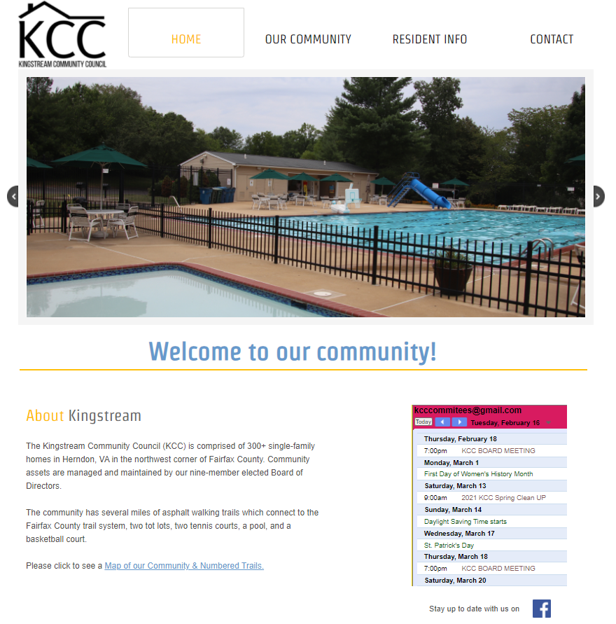
Communications
Stephanie Palmer, Katie Schuster, Chris Bollerer
Current Communications
Visit our website - www.KCCHerndon.org
Official communication method
Regularly updated with the latest news and events
Information includes governing documents, details about our amenities (e.g., pool, tennis courts), committee descriptions, architecture review process, and a resale packet
Designed with great skill by Katie Schuster
Email Newsletters
Sign up on website to get periodic email updates, including brief summaries of board meetings, upcoming important events
Facebook
Follow Kingstream Community Council for regular updates

Slide 10
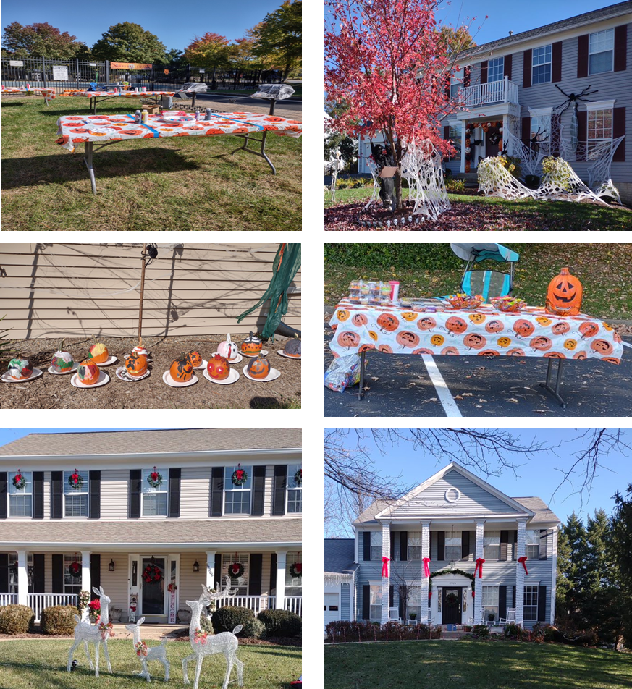
Outreach Committee Sharon Llewellyn, Scott Graff, Sharon Kessler, and Linda Propst
Outreach Committee Sharon Llewellyn, Sharon Kessler, Linda Propst
In 2022 Kingstream Outreach Committee provided the following
Community Clean Up
Summer Splash Party
Dog swim
Halloween Block Party
Halloween Decoration Contest
Christmas Decoration Contest
The Events Committee works with the KCC community to coordinate social gatherings. Volunteers are always welcome to help with any event. Please contact Sharon or any Board member.

Slide 11
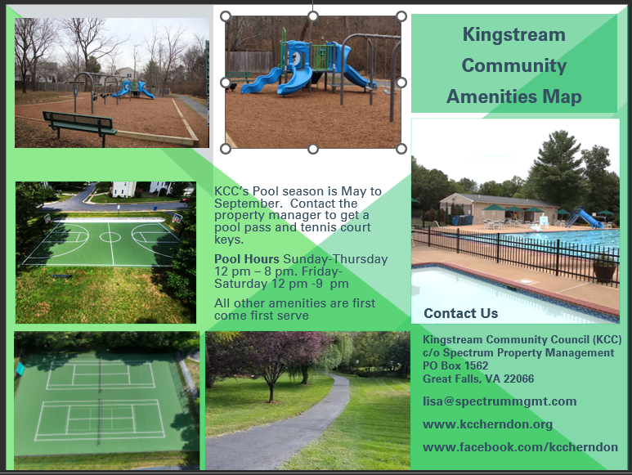
Outreach
New Kingstream (KCC) residents get a welcome gift and an Orientation packet. Information includes: KCC's website, Board committee information, our Facebook page, schools, and transportation.
Homes Welcomed in 2022
Quarters | Q1 | Q2 | Q3 | Q4 | Total
Welcomed | 5 | 4 | 5 | 1 | 16

Slide 12
Financial Goal
FINANCES
Steven Fast & Tyrone Yee
Our financial goal is to manage and conserve financial assets in order to improve community assets for the enjoyment of the homeowners.
Operating Account- Includes all recurring annual expenses & dues.
Reserve Account- Includes all savings & expenses to repair and replace capital assets. (Legal Requirement)

Slide 13
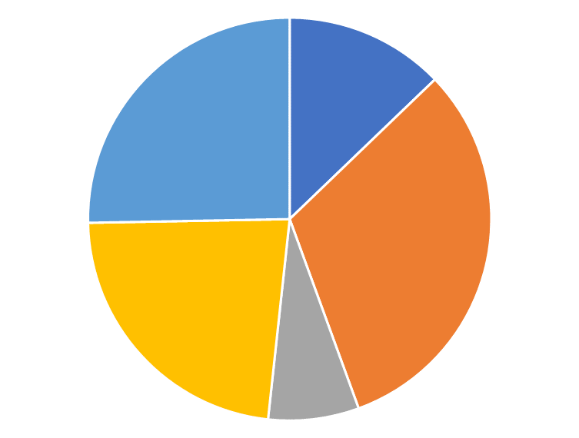
How we spend the annual dues
KINGSTREAM COMMUNITY 2023 EXPENSE BUDGET
Total Revenue Budget
$204,800
This accounts for an increase in income of $11,940 as a result of the assessment increase
Pool contract
64.8
32%
Property
management, Legal,
Audit, & Insurance
47.1
23%

Slide 14
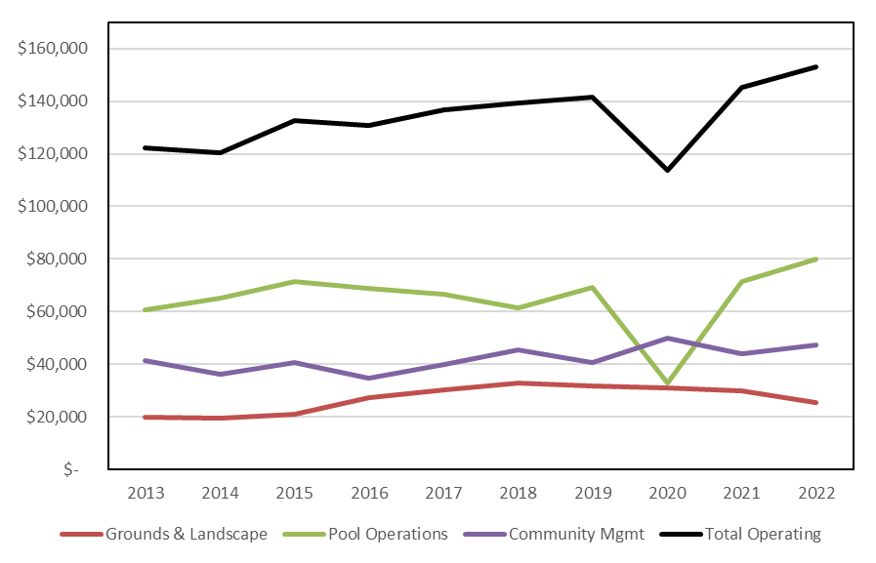
Operating Expenses
Continue to be well managed

Slide 15
Highlights of Operating Expenses
Grounds and Landscaping
Expenses are stable, reflecting a six-year grounds contract with no annual escalation.
2021: $ 29,886 2022: $25,449
Pool Operations
The cost in 2022 included a surcharge of about $2,800 due to the increase in the minimum wage and a one-time cost of about $4,200 for the robotic pool cleaner.
2021: $ 71,613 2022: $79,896
Community Management
Legal fees were above budget in 2022, due to assessment increase planning.
2021: $ 43,824 2022: $47,494

Slide 16
Reserve Account – Tyrone Yee Major Repairs Completed
In 2017, $52k spent on pool white coat & main pump.
In 2018, $46k spent on trail asphalt repairs.
In 2019, $74k spent on trail seal coat, basketball court drainage and pool furniture.
In 2020, $43k spent on tennis and basketball court repairs
In 2021, $93k spent for tennis court drainage, Eddyspark tot lot, trail 12, pool equipment
During 2022, $6k spent for:
Pool slide repair
Pool parking lot repair & seal
2022 capital spending was $11k less than what was saved for these projects.
These savings will be returned to the operating account in 2023.
From 2017 to 2022,
Invested $314k to modernize community assets
Reserve savings were sufficient to finance these repairs without special dues assessments
During the past 6 years, sound project planning & management delivered cost savings on many projects
Looking ahead, less than $11k of repairs are anticipated during the next two years.

Slide 17
Annual Reserve Savings & Reserve Balance are in excellent condition
In 2022:
Reserve contribution was $45k, compared to the annual target of $53k
Included in the $45k contribution was
Interest income of $7k and
Operating account surplus of $36k
(saved as a pre-payment for 2023)
Over the 5 years 2018 to 2022, Reserve contribution (excluding $36k pre-payment) totaled $290k, or $58k per year.
The Reserve Balance at the end of 2022 was $605k (including $36k pre-payment) compared to a target of $570k. The Reserve Balance is in excellent financial condition and fully funded since 2015.
The Reserve Balance investments are well positioned by capturing increases in interest rates.

Slide 18
Kingstream Community Council
In 2023, Kingstream is in excellent health
Community assets are in excellent condition from ongoing modernization investments.
Financial Reserves are fully funded and about $55k higher than the level at the 2017 start of major repairs.
No major repairs are planned for the next two years.
The approved assessment increase will provide funds to cover the minimum wage increases which have impacted pool contract costs.

Slide 19
Board of Directors Terms
2023
Peter Mech
Sharon Llewellyn
Tyrone Yee
2024
Steve Fast
Ken Neumann
Stephanie Palmer
2025
Mike Wei
Chris Bollerer
Open
Thank you to our volunteers! Spectrum Property Management
Lisa Cornaire, CMCA, AMS

