Slide 1
E.A.R.T.H. Project
(Geospatial Script using MS Excel™and ‘Google™-mymaps’)
Richard G. Lugar Center for Renewable Energy
Department of Geography, IUPUI

Slide 2
Questions for Candidate Sites
Here is a possible (not in any way exhaustive) list of location/GIS questions I could think of (the rest we can gather from curated sources): Location/Construction: Where are you located? What is your nearest cross street? Do you have architectural plans for your building? If not, do you know someone who may have such information? Vegetation Cover: What percent of open space is around your building? What percent, if any, is tree cover? What are the types of trees/vegetation? Subsurface: Do you have maps for subsurface pipes, etc.? If not, do you know if any jurisdiction (county, town etc.) keeps it? What is the soil type? Is the structure built on rock?

Slide 3
Data/Map Roster (Google ‘Mymap’)
Use Google ‘MyMaps’(emphasis mine). Online storage and dissemination of location data on solar, geothermal, infrastructure complexity, pollution issues and regulation:
search google, login to your google account or go to: https://www.google.com/search?q=my+maps+google&rlz=1C5GCCM_en&oq=mymaps&gs_lcrp=EgZjaHJvbWUqCwgCEEUYChg7GIAEMgYIABBFGDkyDwgBEAAYChiDARixAxiABDILCAIQRRgKGDsYgAQyBggDEEUYQDIJCAQQABgKGIAEMgYIBRBFGDwyBggGEEUYPDIGCAcQRRg80gEINTY1NGowajSoAgCwAgA&sourceid=chrome&ie=UTF-8 and follow the prompts (you need to login/create google account).
Google “mymaps’ stores everything geospatial related in one online location.
It also stores attribute tables associated with mapped data.
It imports excel files (you need to have an address field for your table)

Slide 4
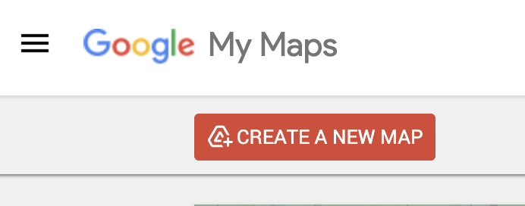
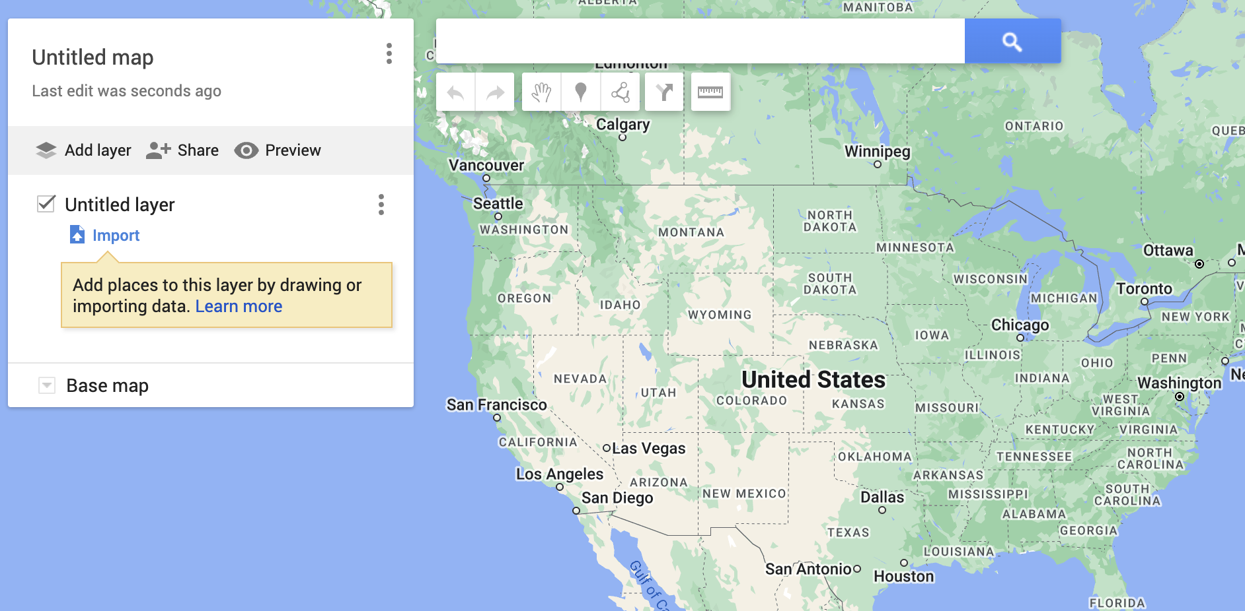
Google my maps example: How to add data
You may add any excel table with text address or latitude, longitude data to google mymaps:
Open mymaps
Create a new map
Click on ‘Import’

Slide 5
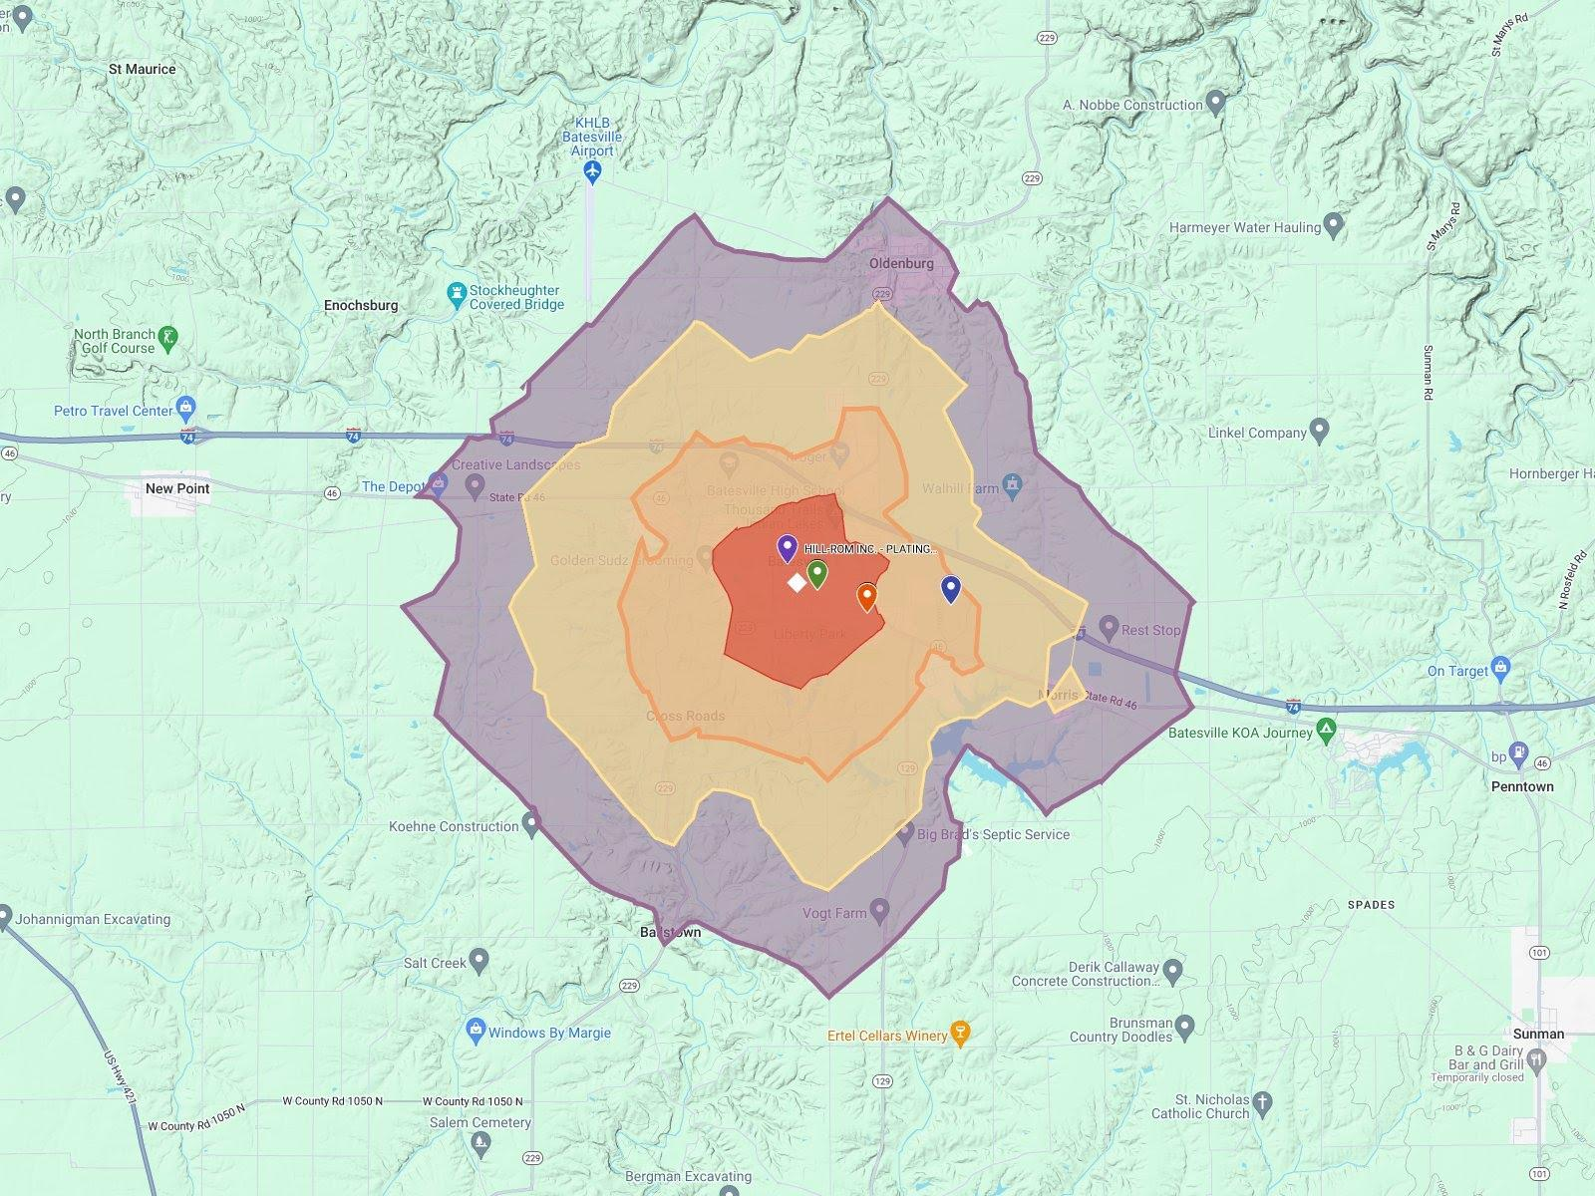
An Example:
https://www.google.com/maps/d/edit?mid=1U4pqQJf10H2JitFCnxQsXRY1Q3y-9IQ&ll=39.32725472022866%2C-85.2031258878595&z=12

Slide 6
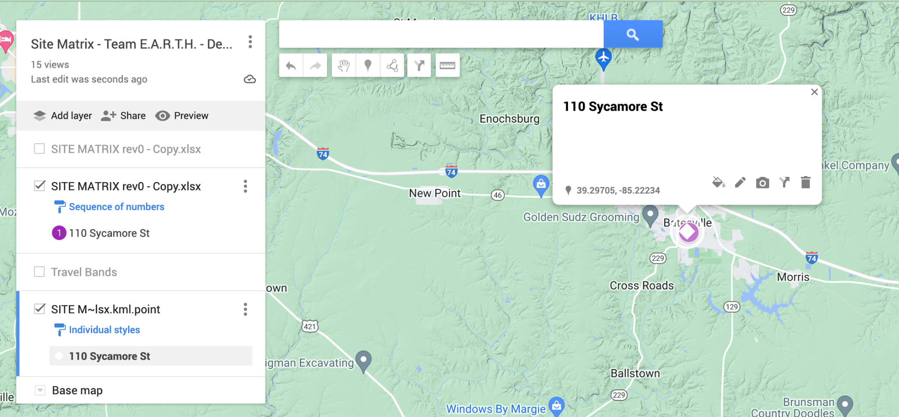
Data/Map Roster (Google ‘Mymap’)
Use the distance tool to measure distance (and area) to water bodies etc.
You may add more data by new layers
You can change base map (depending on whether one wants to change to topography instead of the usual google base map)

Slide 7
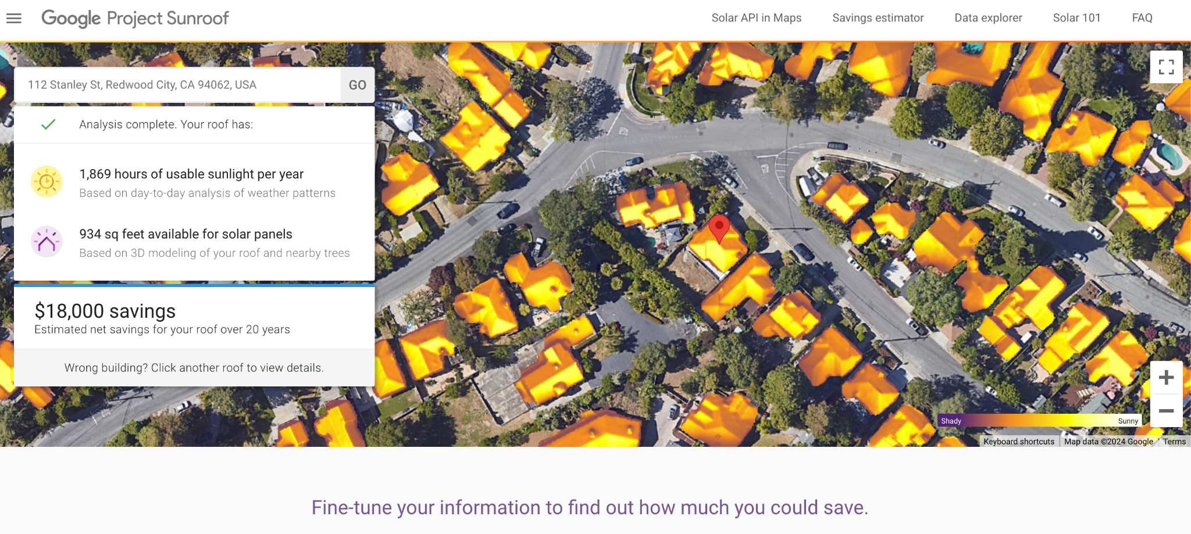
1. Solar potential
https://sunroof.withgoogle.com/building/37.476876/-122.253535/#?f=buy
Just type in your address

Slide 8
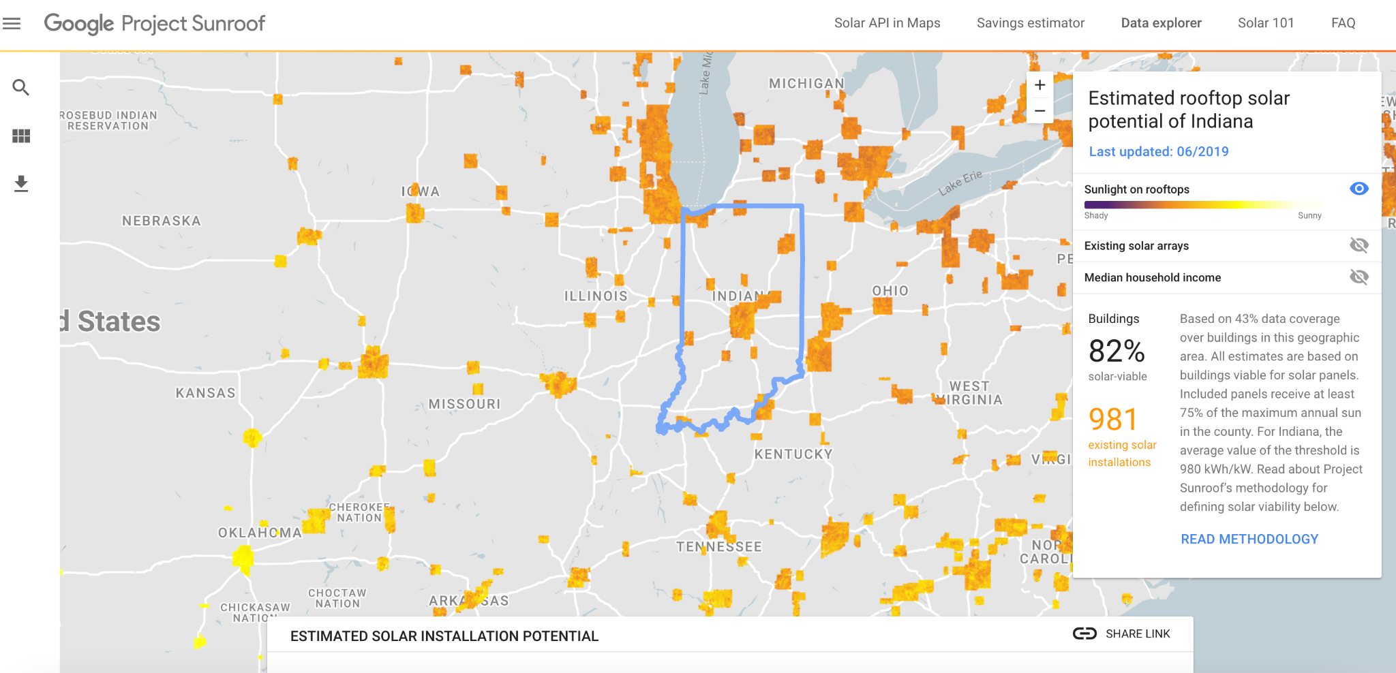
Indiana Solar Potential
https://sunroof.withgoogle.com/data-explorer/place/ChIJHRv42bxQa4gRcuwyy84vEH4/

Slide 9
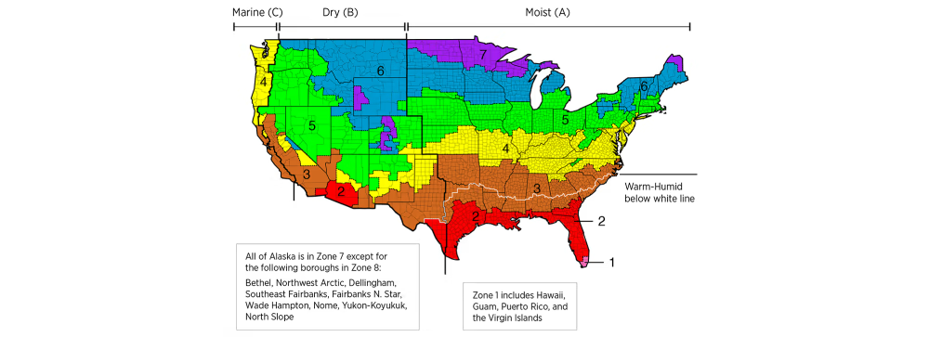
HEAT PUMP POTENTIAL
IECC climate zone map (“Because of how they work, heat pumps produce less heat than furnaces and work best in warmer climates (zones 1-3 on the U.S. Department of Energy climate zone map).”)
https://basc.pnnl.gov/images/iecc-climate-zone-map

Slide 10
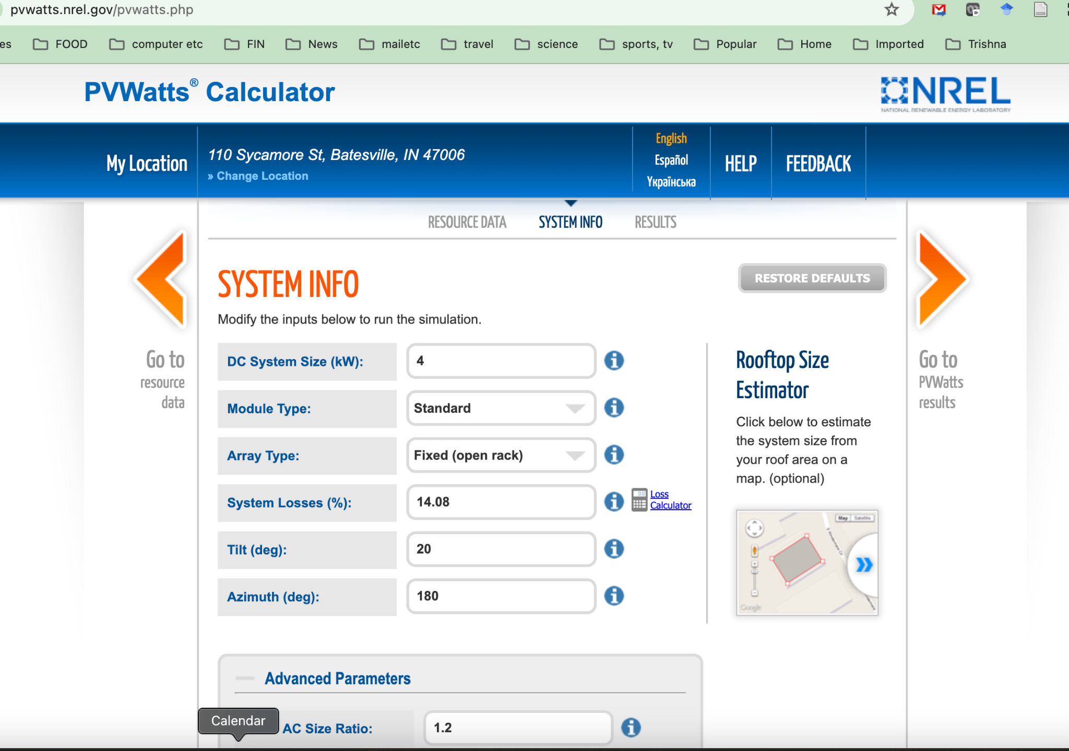
2. Geothermal Potential (NOT HEAT PUMP)
https://maps.nrel.gov/?da=geothermal-prospector
https://pvwatts.nrel.gov/pvwatts.php

Slide 11
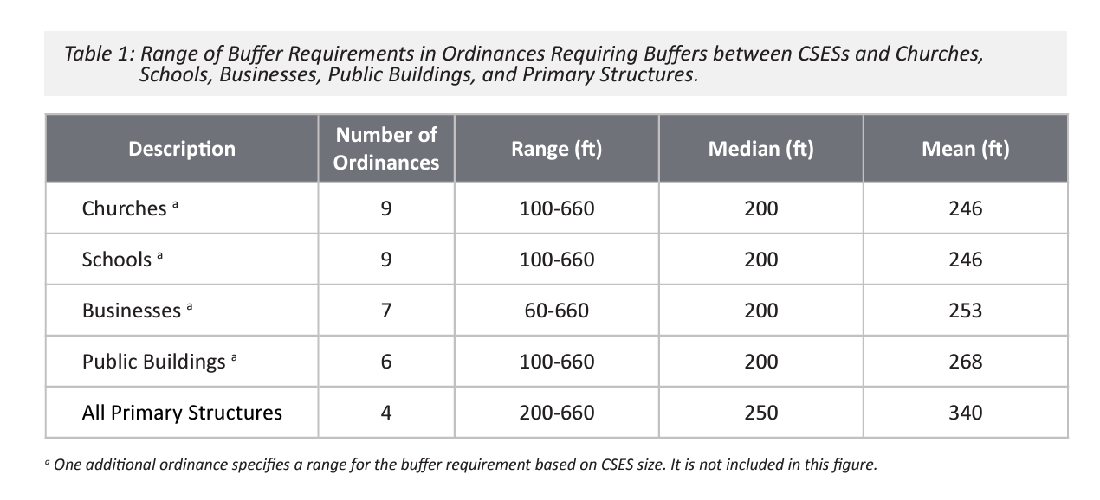
3. Infrastructure Complexity
Work with city/county officials for local geospatial data on underground pipes, wirs etc. (If not available, call utilities for details of ‘no digging’ zones/area)
If local jurisdictions like cities/counties have maps, ask for google kml maps or excel maps with latitude/longitude data (you may import them as layers – see slides 3-6)
INDIANA has a resource @ Purdue Univ. https://extension.purdue.edu/cdext/thematic-areas/community-planning/collaborative-projects/_docs/renewable-energy-report1.pdf

Slide 12
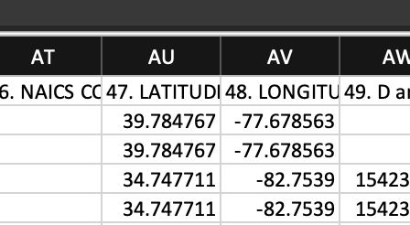
4. Pollution Issues (TRI data from EPA: air, water, ground)
Toxic Release Inventory (TRI) from the US Environmental Protection Agency (EPA) contains excel tables with latitude/longitude point source pollution data based on air, water and soil contaminants
Go to the EPA website basic plus text files data download page (2022 data as of 2024-02-12; approx 3MB text ‘csv’ file): https://www.epa.gov/toxics-release-inventory-tri-program/tri-basic-plus-data-files-calendar-years-1987-present (home page: https://www.epa.gov/toxics-release-inventory-tri-program/tri-data-and-tools )
File-guide:https://www.epa.gov/toxics-release-inventory-tri-program/tri-basic-plus-data-files-guides
Open US_1a_2022.txt into excel and save
Save file as excel (column 47&48 are lat/long)

Slide 13
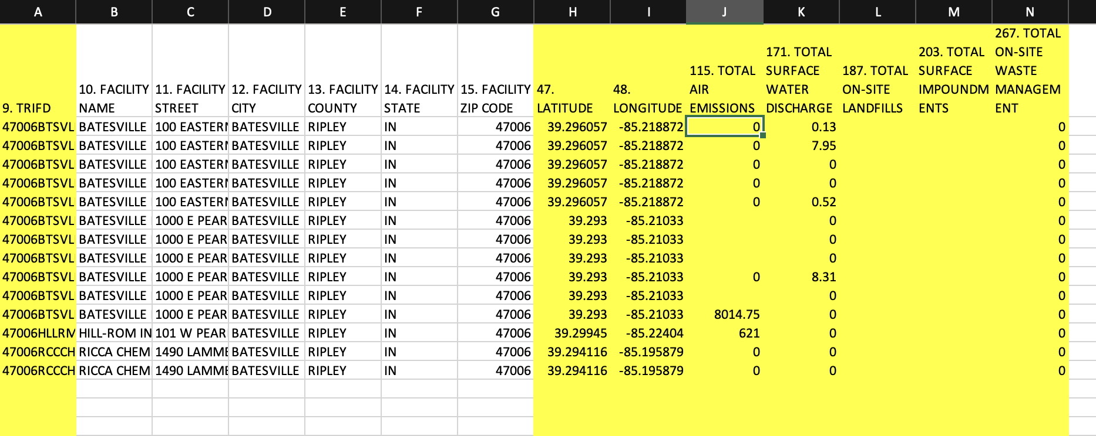
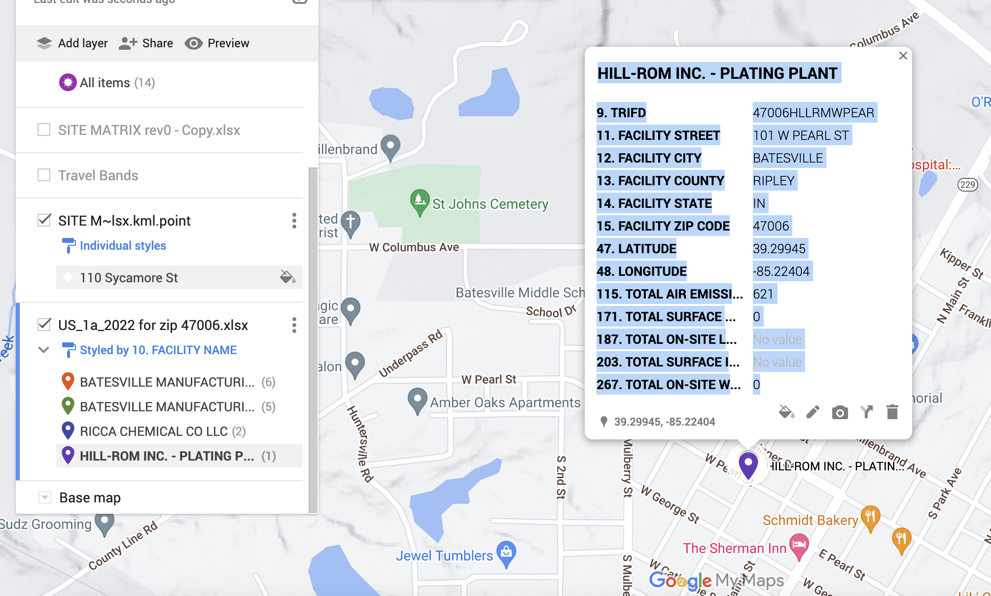
Excel file of TRI facilities from the facility zip code 47006
Filter the excel file to the following columns and rows containing the zipcodes of your interest:
Columns 9, 10-15, 47-48, 115, 171, 187, 293 267 contain interesting pollution totals
Example of one TRI facility mapped

Slide 14
5. Regulations
Work with city/county officials for local regulatory data
If local jurisdictions like cities/counties have maps, ask for google kml maps or excel maps with latitude/longitude data (you may import them as layers – see slides 3-6)

Slide 15
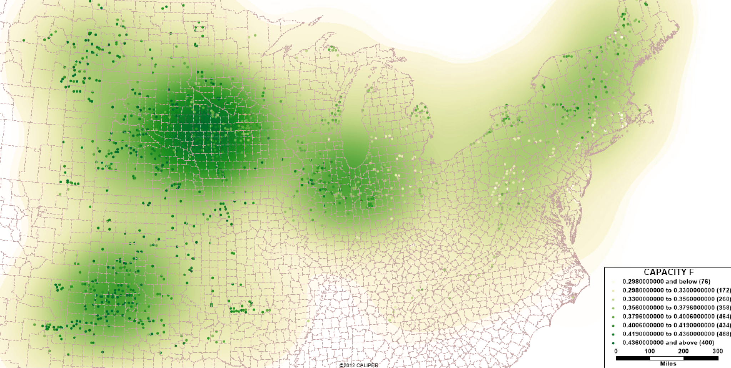
Wind
https://www.ncsl.org/energy/state-approaches-to-wind-facility-siting
Detailed wind map from NSCL granular data …https://maps.nrel.gov/?da=wind-prospector#/?aL=wbDr04%255Bv%255D%3Dt&bL=groad&cE=0&lR=0&mC=41.80407814427234%2C-95.361328125&zL=4

Slide 16
End

