Slide 1

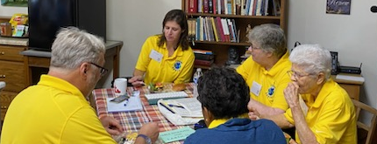






TOOL SUITE
- Site Evaluation
- Design Optimization
- Resource Repository
supported by:
Leadership Team at work
INSTRUCTIONS:
Start Slide Show (either press F5 or click Slide Show..From Beginning, or use screen icon on bottom ribbon ). Then, click here to continue.
These tools are provided free of charge, courtesy of the Energizing Rural Community program administered by the U.S. Department of Energy using funds from the Bipartisan Infrastructure Law, by Team E.A.R.T.H. of Batesville, Indiana (https://teamearth.earth/), developed in cooperation with the Richard G. Lugar Center for Renewable Energy, and managed by Green Fortress Engineering, Inc. (https://greenfortressengineering.com/)

Slide 2
GREEN ENERGY DESIGN TOOLS
click anywhere to learn more
What are my local renewable energy options?
Determine the optimal design and mix of technologies for my situation.
How suitable is my site or building for energy self-sufficiency?
Resources that can make the project more affordable.

Slide 3

LOCAL Renewable Resources
What are my local renewable energy resources?
Click inside this box to launch a tool. Close that tool to return here.
Geographical Info Systems
Geothermal
Solar
Wind
RETURN

Slide 4
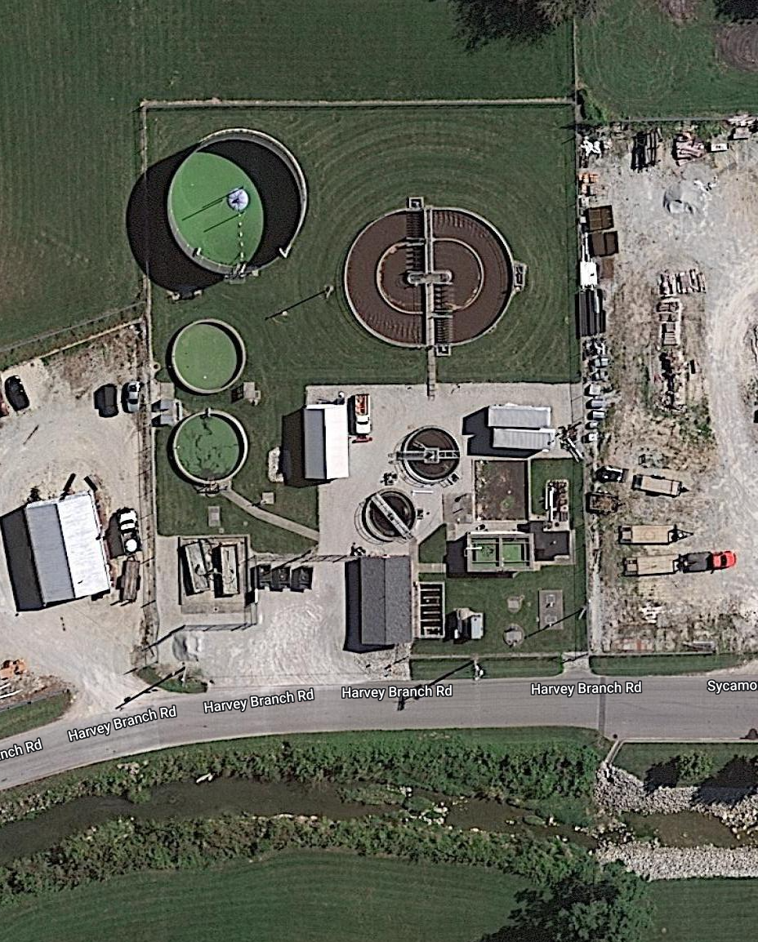
SITE Evaluation
35-question survey
Evaluation matrix
  See bright yellow cells for instructions
  Example included at bottom of list
How suitable is my site or building for energy self-sufficiency?
Click inside this box to launch a tool. Close that tool to return here.
RETURN

Slide 5
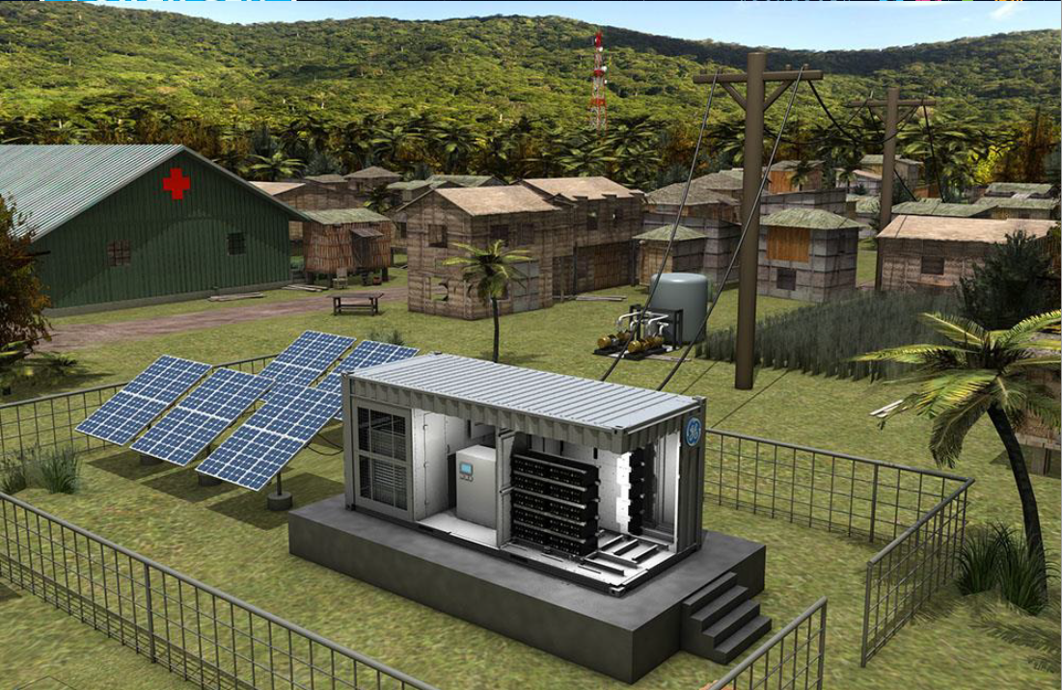
OPTIMAL Design
Determine the optimal design and mix of technologies for my situation.
Click inside this box to launch a tool. Close that tool to return here.
Excel™ Optimization Tool
  Click on the green square
  Follow the instructions
RETURN

Slide 6
FINANCIAL Resources
$$$
NREL
Your State
Solar Financers
Banks
Foundations
Advocacies
Resources that can make the project more affordable.
Click inside this box to launch a tool. Close that tool to return here.
RETURN

Slide 7
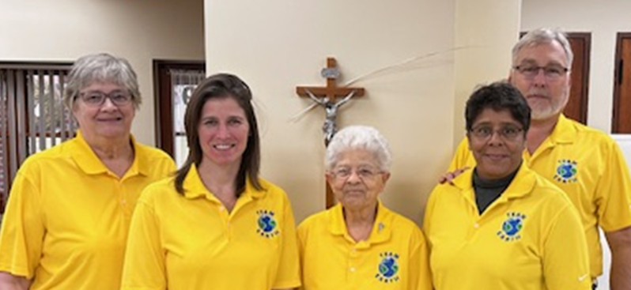
More about TEAM E.A.R.T.H.
Leadership Team (L-R):
Sr. Carolyn Hoff
Ms. Kathryn Lisinicchia
Sr. Claire Whalen
Ms. Yvette Schubert (volunteer)
Prof. Peter Schubert (captain)
Start Over

