Slide 1

How to make a stellar court record
North Texas bench bar
April 2026

Slide 2
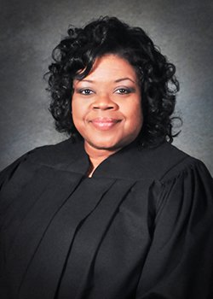
HONORABLE JUDGE
MARGARET JONES-JOHNSON
Graduate of Texas A&M University (formerly Texas Wesleyan University), J.D., University of Arkansas, Little Rock, Arkansas, B.A. Radio, Television & Film with a Minor in Marketing
As an attorney, over 30 years of legal experience handling Family Law, CPS, Criminal, Juvenile, and Probate matters, as well as Sports and Entertainment Law
Presiding Judge of Probate Court No. 3 (2015 to present)
Member of United States Supreme Court Bar, United States Northern District of Texas, State Bar of Texas, Fellow Dallas Bar Foundation, Dallas Bar Association, J.L. Turner Legal Society, Texas Center for the Judiciary, National College of Probate Judges, Texas College of Probate Judges, and National Alliance on Mental Illness
Presiding Judge
Dallas County Probate Court No. 3

Slide 3
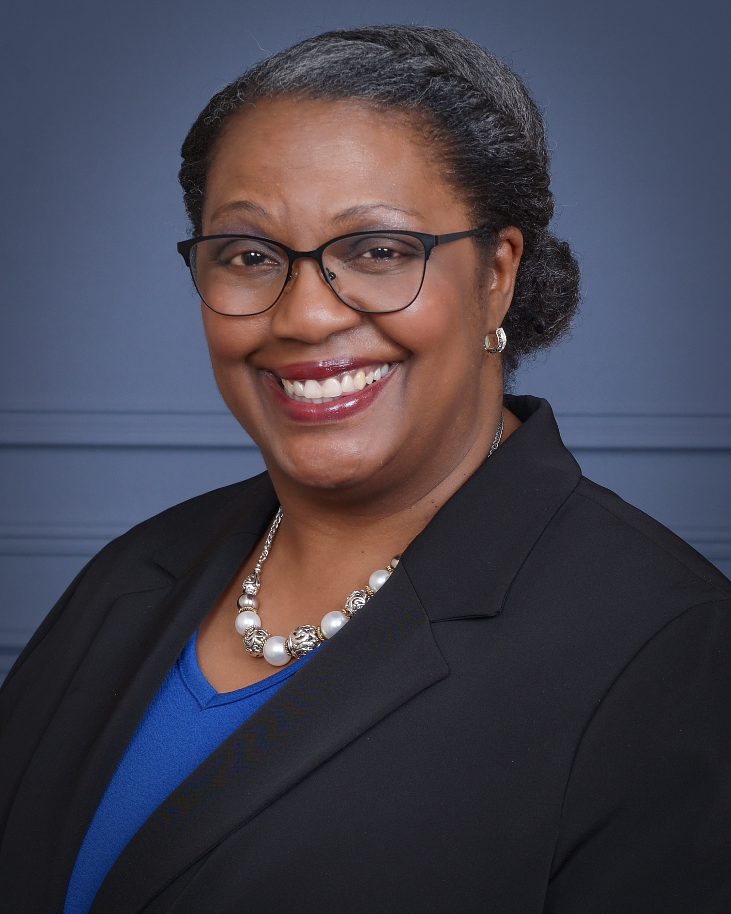
Charletta Breed, CSR, RPR
The Court Reporting Institute of Dallas Graduate – Class of 1999
Official Court Reporter for the Honorable Judge Margaret Jones-Johnson – Probate Court No. 3/Mental Illness Court of Dallas County
Over 25 years of reporting experience and a longstanding member of the National Court Reporters Association, Texas Court Reporters Association (TCRA), Dallas Court Reporters Association, and currently serves as the TCRA Officials Committee Chair and TCRA Fifth Court of Appeals Liaison
2022 Dallas County Leadership & Management Academy Graduate, 2023 National Association of Counties (NACo) High-Performance Leadership Academy Graduate, 2025 NACo AI Academy Graduate

Slide 4

What are we doing?
Our job is to work together to create an accurate record of proceedings that will impact the lives of many individuals for years to come.

Slide 5

Important questions
No.
1
How is the record made?
No.
2
What should I do to help make the record?
No.
3
What rules should I follow?

Slide 6
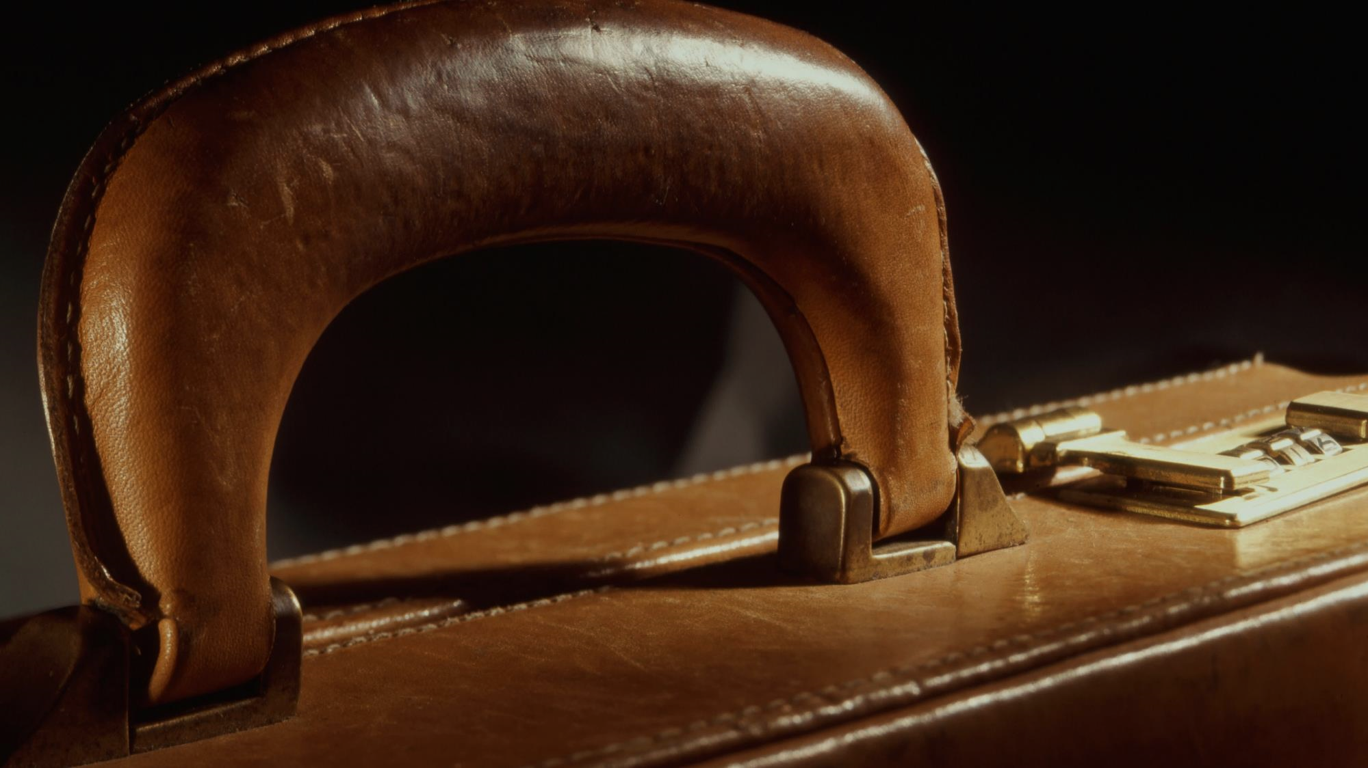
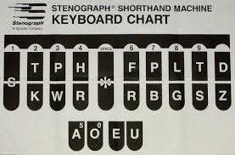
HOW?

Slide 7

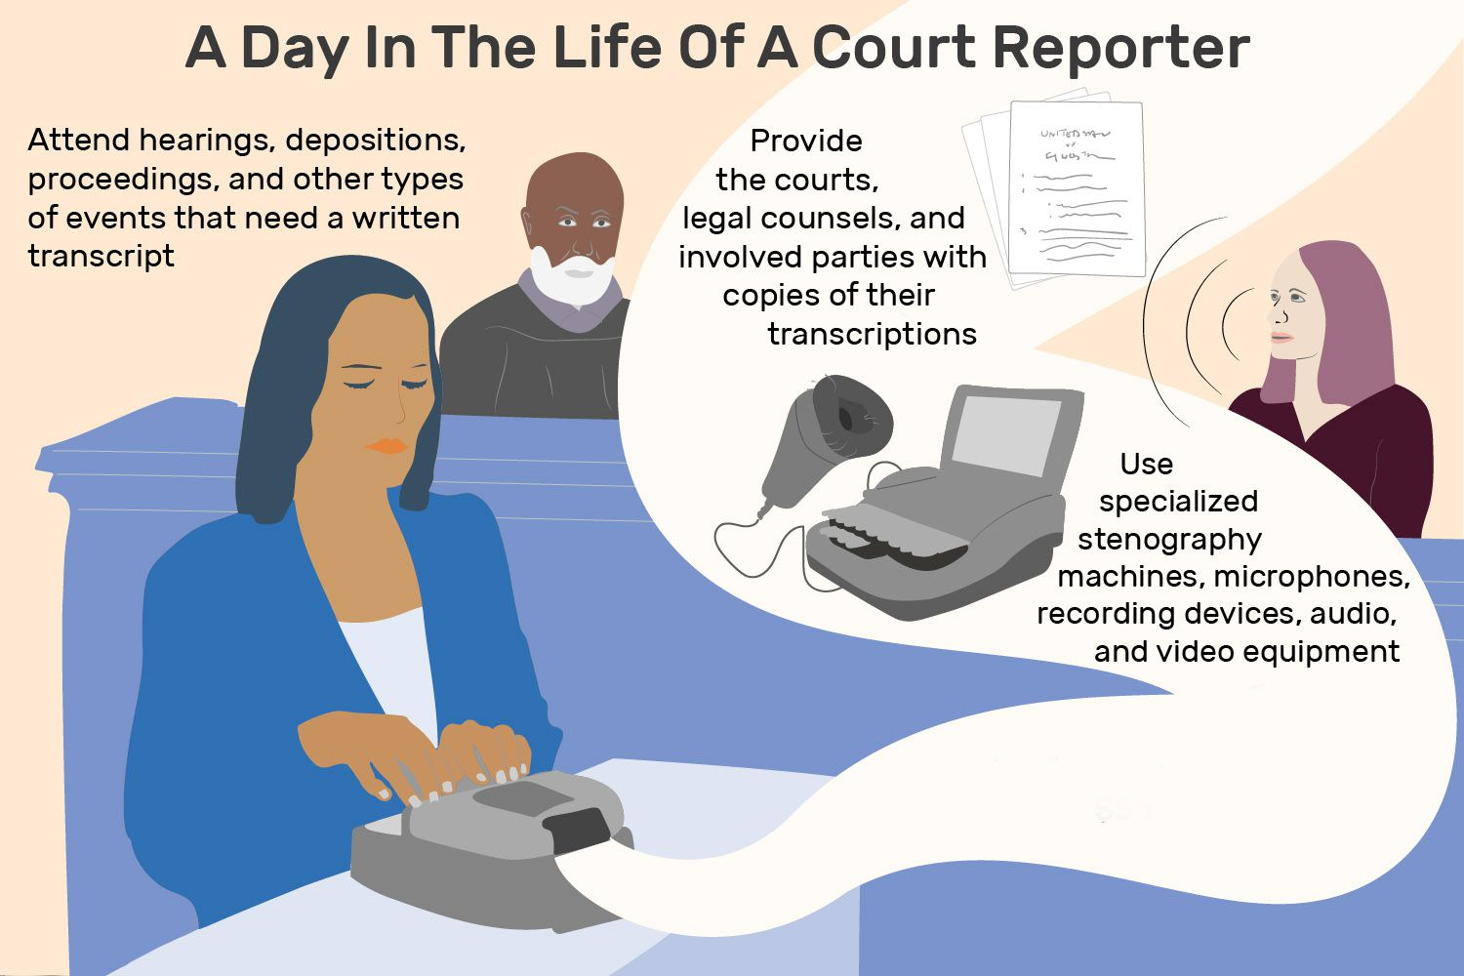
“If you can film an idea in your mind, follow that film idea shot for shot, scene for scene, that idea is worth making.
CRAIG MAPP

Slide 8
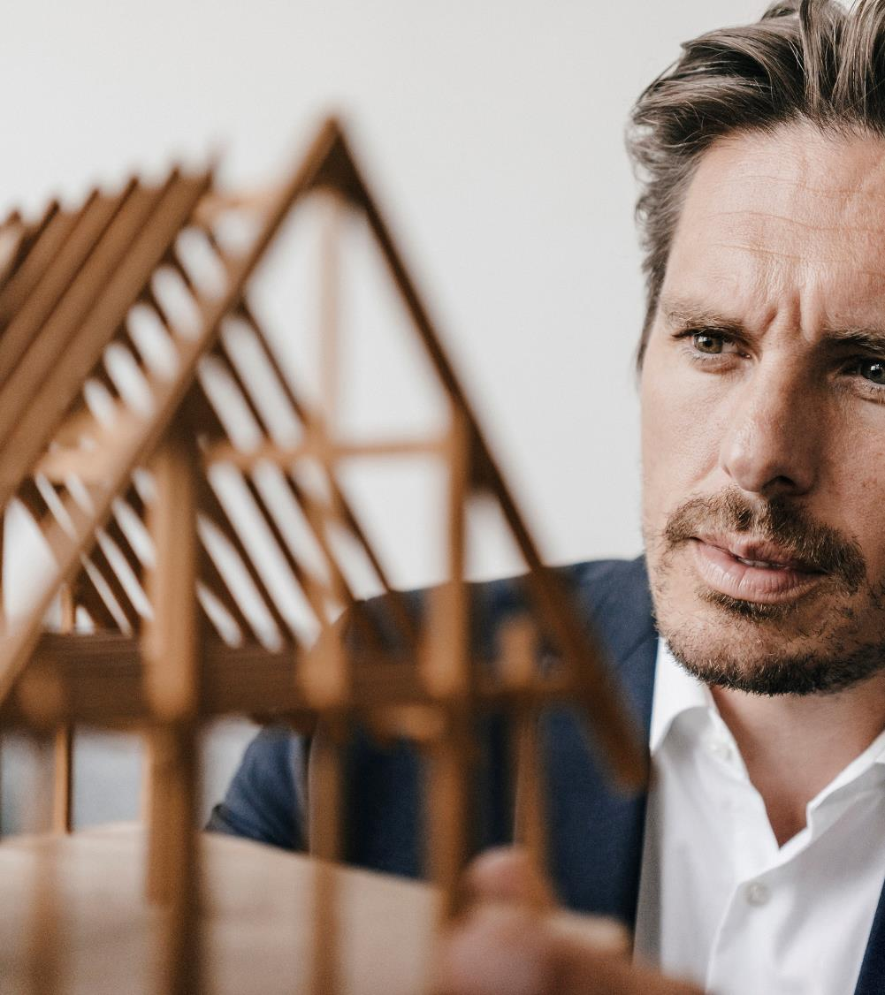
What should I do to help build a great record?
SPEAK SLOWLY, CLEARLY, AND CONCISELY, ESPECIALLY WHEN READING FROM A DOCUMENT
PROVIDE SPELLINGS FOR THE BENEFIT OF THE COURT AND RECORD
PLEASE DO NOT SPEAK OVER ANOTHER SPEAKER!

Slide 9

HELPFUL TIPS
Prior to a hearing, try to provide these things: Copies of pleadings, list of witnesses and exhibits, case citings (if not in pleadings), pre-marked exhibits in conformity with HIPPA and Court of Appeals’ guidance.
REMINDER: When reading from documents, be mindful that the average person reads faster than they can speak. Please read slowly for the benefit of the Court, jury, witnesses, and the court reporter.

Slide 10
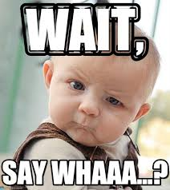
There are RULES??!!??
Texas Government Code, Section 52.046(a)(5) – Duties
Texas Government Code, Section 52.047(a)(1),(2) – Direct Request
Texas Rules of Appellate Procedure 34.6(b)(1) - Payment & 35.3(b)(2), (3) – Designation of Record
9.9(a) – Sensitive Data redaction

Slide 11

Key takeaways
Without a good record, lives are in limbo!
Slow and steady wins the race. Shoot for accuracy over speed!
The quality of the record matters the most!
Teamwork keeps our judicial system in great working order!

Slide 12

QUESTIONS??
No.
What happens when I say, “Strike that?”
No.
2
Should I notify the court reporter directly when I file an appeal?
No.
3
What are the steps to requesting a Reporter’s Record/transcript?

Slide 13

Call to action
Let’s work together to give quality and standout services!
HRET/AOES/TKO/TH/STPH*FPLT
(Translation: Let’s do this!)

Slide 14

Thank you!
​
Charletta Breed
Charletta.breed@dallascounty.org
214-653-7827

