Slide 1

North Texas Bench Bar Conference
April 30, 2026
Squeeze and Freeze Planning with 678 Trusts
John Hunter, JD/CPA
The Blum Firm​, PC
(817) 334-0066 jhunter@theblumfirm.com

Slide 2
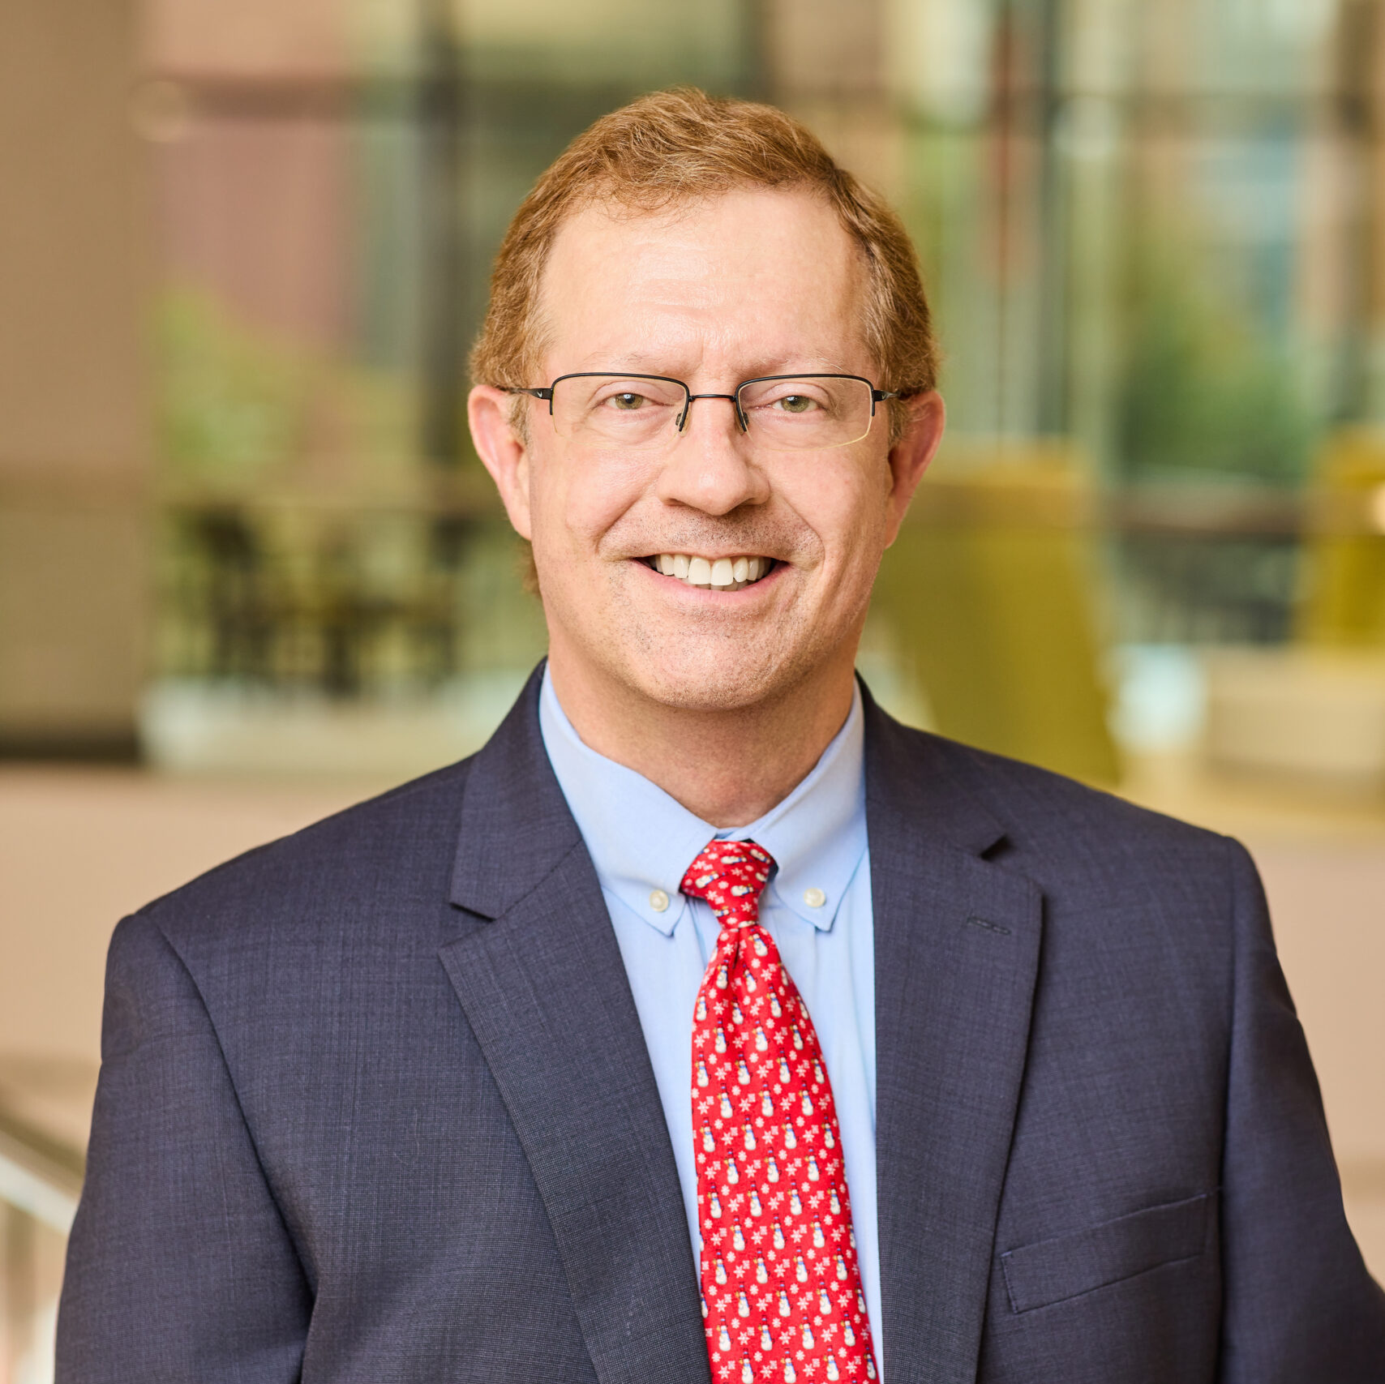
JOHN R. HUNTER is an attorney and CPA based in Fort Worth, Texas. He is Board Certified in Tax Law and focuses his practice on estate planning, tax planning, and related matters involving the transfer and protection of wealth.
Mr. Hunter has practiced in both the private sector and government, where he represented the Commissioner of Internal Revenue before the U.S. Tax Court. He works closely with individuals, families, and business owners on sophisticated income tax and estate planning strategies, helping clients navigate complex planning issues and preserve wealth across generations.
Mr. Hunter has been consistently recognized as a Texas Super Lawyer by Thomson Reuters and has been named one of Tarrant County’s Top Attorneys in Tax Law by Fort Worth, Texas magazine. He was also honored as Planning Professional of the Year by the Community Foundation of North Texas. He formerly served as President of the Fort Worth Business and Estate Council and as Chair of the Professional Advisor Outreach Committee for the Community Foundation of North Texas.
Mr. Hunter earned his J.D., cum laude, from the University of Houston Law Center and his Master of Accounting and B.A. in Economics, cum laude, from Rice University.
John R. Hunter
(817) 334-0066
jhunter@theblumfirm.com
www.theblumfirm.com
THE BLUM FIRM, P.C.
777 Main Street, Suite 550
Fort Worth, Texas 76102

Slide 3
Estate Freeze Sales to a “678” Trust
A 678 Trust (sometimes called a box) is a trust created with the client(s) as a primary beneficiary, as well as the “Grantor” or deemed owner for income tax purposes.
After making discounted gifts to a Defective Grantor Trust (“DGT”) and/or Spousal Lifetime Access Trust (“SLATs”) using a portion of the client’s $15,000,000 lifetime exemption (as of 1/1/2026), minimize estate tax on the rest of a client’s assets by doing “freeze” sales to a 678 Trust that are mathematically identical to a sale to a DGT or a SLAT.
1

Slide 4
Ultimate Goals
Reduce or eliminate estate taxes.
Preserve the use and benefit of the transferred assets for the client.
2

Slide 5
Results After Squeeze, Freeze, & Burn with a 678 Trust
REAL ESTATE
MARKETABLE SECURITIES
OTHER INVESTMENTS
3

Slide 6
Mechanics
Client’s parent/sibling/close friend establishes 678 Trust with an unreimbursed $5,000 gift.
Client sells discounted assets to 678 Trust in exchange for promissory note. (Note will be partially guaranteed.)
Benefits:
Assets owned by 678 Trust not subject to estate or GST taxes for generations.
Assets owned by 678 Trust not subject to client’s creditors.
Client continues to have access, control, and flexibility over assets in 678 Trust.
4

Slide 7
George and Sarah
George and Sarah have a high net-worth, with a very illiquid estate of investment assets worth $75 million and $10 million of other assets (home, bank accounts, cars, personal assets). Without planning, they’re looking at an estate tax bill of $22 million.
Let’s rewind the clock. George and Sarah came to us several years ago to help prepare an estate plan. At the time, their investment assets were worth $60 million, and they had other assets worth $10 million (home, bank accounts, cars, personal assets).
Investment Assets | $75,000,000
Other Assets | 10,000,000
Total Assets | 85,000,000
Less Estate Tax Exemption x 2 | (30,000,000)
Taxable Estate | 55,000,000
x 40% Estate Tax Rate | $22,000,000
5
2

Slide 8
Stage 1: A Family Limited Partnership to “Squeeze” Down the Value of the Assets
Limited partnership interests are less marketable than assets held outright or assets traded on an exchange, such as stock of public companies or bonds.
By virtue of the partnership form and standard restrictions in partnership agreements, a partnership interest is worth less than the interests prorated portion of the partnership’s underlying assets.
For minority, non-controlling interests, discounts for lack of marketability and lack of control are routinely recognized by the courts and the IRS when the partnership is formed and maintained properly.
For example, if a partnership is formed and funded with $1,000,000 in investment assets, the limited partnership interests associated with such assets might be valued at only $650,000 (representing a 35% discount for lack of marketability and lack of control).
6

Slide 9
Create a structure that qualifies for the best possible valuation discount.
If it’s a limited liability company (“LLC”) or limited partnership (“LP”), examine the agreement to ensure the entity will qualify for an optimum valuation discount.
For any entity, transfer non-voting interests or a non-controlling ownership portion.
Consider transferring assets to a limited partnership.
Consider recapitalizing the entity to establish voting and non-voting interests. Then, sell the non-voting interests and a non- controlling portion of the voting interests, which could qualify for a valuation discount.
A recapitalization is particularly useful for S corporations, because S corporation stock may not be owned by a limited partnership.
7

Slide 10
Illustration
George and Sarah put their investment assets into an LP with an LLC as the general partner.
George and Sarah are the initial limited partners of the LP, and they each own 50% of the LLC.
Notice that they put an LLC “wrapper” around the real estate they owned outright before putting the real estate into the FLP to provide an extra layer of protection around a risky asset.
8

Slide 11
Stage 2: A Grantor Trust for the Children Begins the “Freeze”
“Freeze” planning involves gifting and/or selling the limited partnership interests to a trust which is outside of the estate for estate tax purposes, such as an Intentionally Defective Grantor Trust, a 678 Trust, or a Spousal Lifetime Access Trust.
George and Sarah choose to create an Intentionally Defective Grantor Trust to benefit their children (the “Children’s Trust”) and fund it by making gifts to the trust using a portion of each spouse’s lifetime gift tax exemption and GST tax exemption.
With the trust structured as a grantor trust, the gift is “supercharged” because the grantors (George and Sarah) remain liable for the income tax attributable to the trust and pay the trust’s income taxes out of their own funds. This allows the trust assets to grow without being depleted by income taxes.
The grantor trust status can be “toggled” off later if the client no longer wishes to bear the trust’s income tax liability.
9

Slide 12
As beneficiaries of the Children’s Trust, George and Sarah’s children and their descendants would be entitled to distributions from the trust as necessary for their health, education, maintenance, and support (“HEMS”) needs.
At a child’s death, he or she can be given a special power of appointment to direct the disposition of remaining trust assets.
By George and Sarah allocating GST exemption to their gifts, the assets in the trust can pass free of estate taxes from generation to generation so long as law allows.
The assets in the trust are also protected from the children’s creditors and any divorcing spouses.
10

Slide 13
George and Sarah gift 13.5% of their FLP interests to fund the Children’s Trust, resulting in a gift of $2,632,500 from each of George and Sarah ($5,265,000 total).
Underlying Assets | $60,000,000
Less Valuation Discounts of 35% | (21,000,000)
Value of FLP | 39,000,000
Value of 1/6 of FLP Interests | $5,265,000
43.25% LP (separate property)
43.25% LP (separate property)
13.5% LP
11

Slide 14
Disclosing the Gifts to the IRS
George and Sarah file Gift Tax Returns (Forms 709) to disclose the gifts.
The IRS has 3 years from the date a Gift Tax Return is filed to assert a gift tax. (Note: The statute of limitations is 6 years if gift amounts are underreported by more than 25%.)
For the statute of limitations to begin, the disclosure must meet the requirements of Treasury Regulation Section 301.6501(c)-1(f)(2) for “adequate disclosure” which includes a copy of the trust agreement, the trust’s EIN, the identities and relationships of the transferors and transferees, a description of the property, any consideration received in return, and a detailed description of the method and financial data used.
In place of the detailed description of the method and data used, an appraisal report can be attached to the Gift Tax Return.
12

Slide 15
Stage 3: “Freeze” the Taxable Value of the Estate
How do George and Sarah move the remaining 86.5% of the FLP out of their estates?
They sell it to a 678 Trust.
Why did they choose a 678 Trust?
George and Sarah can remain in control as trustees.
George and Sarah can be beneficiaries of the 678 Trust and can continue to have access to the assets for their needs.
The assets in the 678 Trust are not included in George and Sarah’s taxable estates.
George and Sarah can have a special power of appointment to direct where the assets pass either during their lives or upon their deaths.
The assets in the 678 Trust are protected from personal creditors.
13

Slide 16
678 Trust Basics
A 678 Trust is established by a third party (such as the client’s parents, sibling, or close friend) with an unreimbursed gift of $5,000.
The client is the primary beneficiary of the 678 Trust and can receive distributions for HEMS needs.
With careful drafting, the client may also be named as trustee of the 678 Trust.
The client-beneficiary is given a withdrawal right over the initial $5,000 contribution.
The trust agreement provides that a Special Trustee has the power to terminate the trust in favor of the client-beneficiary, even after the client-beneficiary’s withdrawal right over the $5,000 gift lapses.
The 678 Trust technique works because of a “disconnect” between the income tax code and the estate tax code.
14

Slide 17
The “Disconnect”
For estate and gift tax purposes, when the client-beneficiary allows the withdrawal right to lapse, the client-beneficiary is not viewed as the grantor of the trust because of the 5 and 5 exception in the estate tax code IRC sections (Chapter 11, Section 2041 (b) (2)), and so the trust assets are not includable in the client-beneficiary’s estate.
For income tax purposes, when the client-beneficiary is given the withdrawal right and when the withdrawal right lapses, the client-beneficiary is viewed as the grantor of the trust, making the client-beneficiary the owner of the trust assets for income tax purposes. (Note: Although the withdrawal right is limited to $5,000, there is no 5 and 5 income tax exception in the income tax code IRC sections (Chapter 1.)
15

Slide 18
678 Trust Structure
Structure the 678 Trust to be a GST-exempt dynasty trust.
When the initial $5,000 gift is made to the 678 Trust, the third-party who makes the gift should file a Gift Tax Return allocating GST exemption to the gift.
After the initial $5,000 gift to the 678 Trust, no other assets are gifted to the trust. All future transfers to the trust are done by sales for fair market value.
Because all assets gifted to the trust are covered by the third-party donor’s GST exemption, the trust is fully GST-exempt. Therefore, the 678 Trust’s assets can pass to future generations free of transfer taxes, including estate tax at the death of the client-beneficiary or the children of the client-beneficiary.
16

Slide 19
Even if our client-beneficiary is trustee of the 678 Trust, the trust assets are not reachable by the client-beneficiary’s creditors if distributions are limited by a HEMS standard.
Some states, such as Texas, protect the assets from creditors if the client-beneficiary’s distributions are limited to an ascertainable standard.
Texas Trust Code Section 112.035(f)(1)(A) provides that a beneficiary is not treated as a settlor of a trust merely because the beneficiary has the power to “consume, invade, appropriate, or distribute property to or for the benefit of the beneficiary if the power is limited by an ascertainable standard, including health, education, support, or maintenance of the beneficiary.”
Therefore, if the client-beneficiary serves as trustee, include a HEMS standard, not only to prevent the trust from creating a general power of appointment which would cause the assets to be taxed in the client-beneficiary’s estate, but also to protect the trust assets from creditors.
If extremely concerned about creditor reach or if not in Texas, an option is to use an independent trustee. If using an independent trustee, the distributions could be purely discretionary (not limited to an ascertainable standard).
17

Slide 20
Giving the client-beneficiary a withdrawal right does not expose the trust assets to the reach of creditors.
In some states, giving a beneficiary a withdrawal right could make a “spendthrift trust” into a “self-settled spendthrift trust” with no protection against the beneficiary’s creditors.
However, some states (such as Texas) include a 5 and 5 exception in their trust laws, protecting trust assets from creditors as long as the value of the property which could have been withdrawn does not exceed the greater of $5,000 or 5% of the trust assets. [See Texas Trust Code Section 112.035(e).]
To protect the 678 Trust assets from creditors, choose a state that provides such a 5 and 5 exception.
18

Slide 21
Drafting Options
The 678 Trust can be drafted to, upon the clients’ deaths, pour into an existing trust for the children’s benefit or divide into separate trusts for the children.
The 678 Trust can also be drafted to allow the client-beneficiary to exercise a special power of appointment (“SPOA”).
An inter vivos SPOA can give the client-beneficiary the power to provide for trust property to pass to individuals or charitable organizations during the client’s life.
A testamentary SPOA can give the client-beneficiary the power to control how the property will be distributed at death.
The SPOA must be drafted so that assets cannot be appointed to the client-beneficiary, the client-beneficiary’s estate, or the creditors of either.
19

Slide 22
Moving Assets Into the 678 Trust
To move assets into the 678 Trust, the client-beneficiary sells assets to the 678 Trust in exchange for a promissory note. No gifts should be made to the 678 Trust beyond the initial $5,000 gift contributed by a third party. Any additional gifts could alter the income tax and estate tax characteristics of the 678 Trust.
It is important that the sale be structured so that it will be respected as a bona fide sale under IRC Section 2036.
The sales price must be equal to the fair market value. If the IRS later determined the sales price was lower than the fair market value, the IRS would argue that the difference was a gift. Sale documents should include price adjustment clauses to guard against an unintentional gift.
The interest rate on the promissory note should be at least equal to the applicable federal rate for the type and length of the loan.
20

Slide 23
The 678 Trust needs to have sufficient substance to support the sale.
If the 678 Trust has not yet built-up significant value, it can have other trusts or individuals (other than the client-beneficiary) guarantee the note owing to the client-beneficiary in exchange for a guarantee fee.
The assets pledged should equal at least 10% to 20% of the size of the promissory note (the higher, the better).
21

Slide 24
Guarantee Fees
In order to avoid an unintentional gift to the 678 Trust by the guarantor, the 678 Trust needs to pay the guarantor an annual guarantee fee that would be comparable to the fee charged by an unrelated guarantor. The fee would continue to be paid each year as long as the guarantee remains in place.
The rule of thumb for this limited guarantee is 3% of the amount of assets pledged.
For example, if the assets pledged equal 20% of the size of the note, the guarantee fee would be 60 basis points of the size of the entire note (or, the size of the note multiplied by 0.006.)
The few times we have obtained appraisals to support the 3% fee, the appraisals have determined that the fee should be slightly below 3%.
22

Slide 25
George and Sarah’s 678 Trust
George’s brother, Jim, created a 678 Trust to benefit George and Sarah and their descendants and funded it with a $5,000 gift.
George and Sarah sold their remaining 86.5% LP interest and all of their LLC interest (the general partner) to the 678 Trust and each received a 9-year promissory note for $16,867,500 in return (totaling $33,735,000), plus interest at the mid-term applicable federal rate.
Underlying Assets | $60,000,000
Less Valuation Discounts | (21,000,000)
Value of FLP | 39,000,000
Value of 86.5% of FLP Interests | $33,735,000
23

Slide 26
Having 13.5% of the partnership interests, the Children’s Trust had sufficient assets to pledge as the guarantor of 15% of the promissory note amounts (13.5%/ 86.5% = 15.61%).
In return for the guarantees, the 678 Trust executed guarantee fee agreements agreeing to pay the Children’s Trust annual fees equal to 3% of the amount guaranteed.
The annual guarantee fees paid by the 678 Trust to the Children’s Trust are $151,808.
Promissory Notes | $33,735,000
Guaranteed Portion | x 15%
 | $5,060,250
Guarantee Fees | x 3%
 | $151,808
24

Slide 27
Disclosing the Sale to the IRS
The $5,000 gift-maker should file a Gift Tax Return to disclose the gift and to allocate $5,000 of their GST exemption to the gift.
The client-beneficiary should file a Gift Tax Return to disclose the sale.
Why would you want to disclose a transfer that’s not a gift?
Disclosing the sale on a Gift Tax Return starts the 3-year (or 6-year) statute of limitations during which the IRS can asset a gift tax deficiency.
25

Slide 28
Open Up IRS Audit?
Doesn’t disclosing the sale just bring the transfer to the IRS’s attention? If the IRS doesn’t know about the transfer, how can they assert a gift tax?
The transaction will have to be disclosed at some point, assuming the client’s estate will be required to file an Estate Tax Return (Form 706). Part 4, Question 13e asks if the decedent transferred or sold an interest in a partnership, LLC, or closely-held corporation to a trust under which the decedent possessed any power or beneficial interest. Without the statute of limitations running, the IRS could assert a git tax deficiency at any time.
26

Slide 29
How do you disclose a sale transaction on a Gift Tax Return?
Attach a statement to the Gift Tax Return electing to disclose a non-gift completed transfer pursuant to Treasury Regulations Section 301.6501(c)-1(f)(4),
Indicate why the transfer does not constitute a gift, and
Include all the information required to adequately disclose a gift.
The appraisal report already necessary for the earlier gifts can be used to value the assets sold.
27

Slide 30
Appraisal Reports
The appraisal value sought should be on the mid-range of the scale of reasonableness. If the appraisal is too aggressive and results in a value lower than that reasonably determined by the IRS, it is possible that the client will be treated as having made a gift to the trust equal to the difference between the appraised value and the IRS-determined value.
Hiring a qualified appraiser and obtaining a top-quality appraisal report to attach to a Gift Tax Return is money well spent.
28

Slide 31
George and Sarah file Gift Tax Returns disclosing the sale.
If George and Sarah were to die but before the promissory notes were paid down, the estate tax would be $8,408,000.
Estate tax with no planning: $22,808,000
Estate tax with Squeeze & Freeze: $7,600,000
Promissory Notes | $33,735,000
Other Assets | $10,000,000
Total Assets | $43,735,000
Less Remaining Exemptions | ($24,735,000)
Taxable Estate | $19,000,000
x 40% Federal Estate Tax Rate | $7,600,000
29

Slide 32
Stage 4: “Burn” Down the Remaining Assets Subject to Estate Tax
George and Sarah use the assets that remain in their taxable estate for their living expenses and to pay the income taxes generated by the Children’s Trust and the 678 Trust.
As the note payments are “burned” down in order to provide George and Sarah with cash to pay living expenses and income taxes, the estate tax savings will be even greater.
After the notes are paid off, the trustee of the 678 Trust will make distributions to George and Sarah under the HEMS standard to cover their living expenses and income taxes.
30

Slide 33
Results After Squeeze, Freeze, & Burn with a 678 Trust
31

Slide 34
Protect Promissory Notes with a “Note Vault”
With many planning techniques for minimizing estate tax, clients sell assets to a Grantor Trust and end up owning notes receivable.
These notes are exposed to creditors.
We’d like to move the notes receivable into an entity for asset protection, but that would potentially trigger a gain.
To protect notes receivable without potentially triggering sale treatment, utilize the “Separate Note Vault” structure (two limited liability companies).
32

Slide 35
To create a separate Note Vault:
Each spouse contributes their note to a limited liablicty company (“LLC”) that is wholly owned by that spouse as separate property. Because the LLC is wholly owned by the spouse, the LLC is disregarded for income tax purposes. Therefore, the contributions cannot trigger sale treatment, and prevents the note payments from being subject to income tax as they are received.
Under Texas law, a creditor would be limited to a charging order. Therefore, the structure prevents a creditor from seizing either note receivable. This result gives the client a particularly strong bargaining position if the note is a 25-year interest only note.
33

Slide 36
48%
100% MEMBER
100% MEMBER
HUSBAND’S NEW LLC
WIFE’S NEW LLC
28

Slide 37
Consider Implementing a “Cadillac Plan”
After the sale to the 678 Trust, the LP is owned partly by the SLATs/DGTs and partly by the 678 Trust.
Clients can leave the ownership that way (sometimes dubbed by The Blum Firm as a “Toyota Plan”), or they can engage in an additional step to convert it into a “Cadillac Plan.”
34

Slide 38
A “Cadillac Plan” combines a 678 Trust with SLATs and/or DGTs:
Gifts to SLATs/DGTs are necessary to guarantee a sufficient portion of the sales price to create a bona fide sale.
After the gift to the SLATs/DGTs and the sales to the 678 Trust, the SLATs/DGTs may sell their interests to the 678 Trust, taking back notes. This results in an asset freeze for the SLATs/DGTs.
Advantages:
By freezing the SLATs/DGTs, future appreciation occurs in the 678 Trust. At the first spouse’s death, the surviving spouse continues to benefit from 100% of the 678 Trust (whereas the surviving spouse has no access to the DGT and loses access to the deceased spouse’s SLAT).
If the entire LP is owned by the 678 Trust, all LP distributions are paid to the 678 Trust. As Trustees of the 678 Trust, the spouses may decide what portion of each distribution would be used to pay down the promissory notes, pay down the notes to the SLATs/DGTs or make distributions to Trust beneficiaries. This structure maximizes the flexibility enjoyed by the Trustee of the 678 Trust.
35

Slide 39
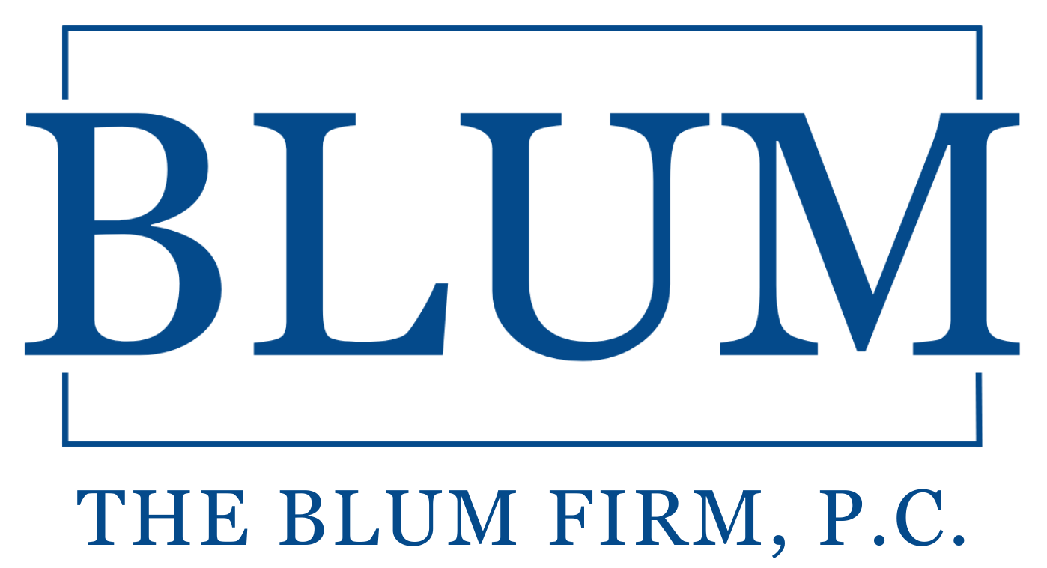
John R. Hunter
Thank You!
(817) 334-0066
jhunter@theblumfirm.com
www.theblumfirm.com
THE BLUM FIRM, P.C.
777 Main Street, Suite 550
Fort Worth, Texas 76102
36

