Slide 1
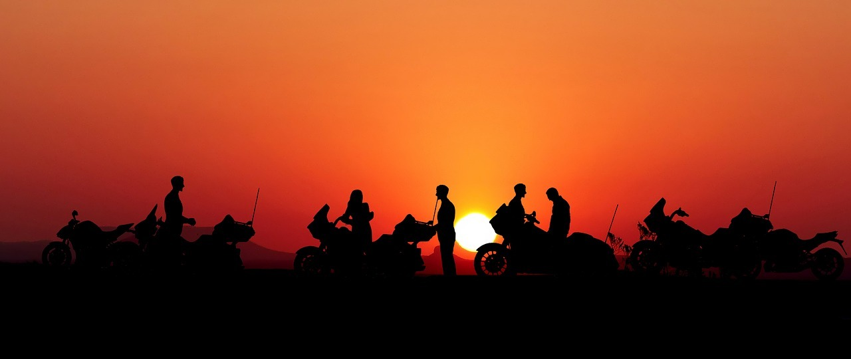
Langley HOG Chapter #9043
April 18, 2023
Barnes Harley Davidson
Spring Riding

Slide 2
Spring Tips for Riding Season
Who can’t wait to ride this year!
Many of us will be out on our bikes as soon as conditions permit. However, potential dangers are amplified in the Spring. It can take some time before drivers become accustomed to seeing motorcycles again after the winter. Here’s a few things to consider:

Slide 3
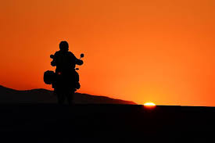
Who Can’t wait to Ride Cont…
Check your tires! Cruiser tires are designed to last longer than Sport bike tires but as a rule of thumb, they will lose substantial grip after 3yrs from the date of manufacture (there is a date code on your tires, a quick google will help you decipher the date your tires were manufactured). NOTE -Your Harley’s tires rubber compound are classified as summer tires and will not grip the road well when the temperature is under 7 degrees even when it’s bright and sunny

Slide 4
Who Can’t wait to Ride Cont…..
Be sure to check the rest of your bike over. It’s a good idea to complete a comprehensive checklist after your bike has been idle all winter. Check out the “T-Clock post for a shortlist. Pro Tip – before hopping on your bike do a quick walk around

Slide 5
T-Clock
T – Tires & Wheels
C – Controls
L – Lights & Electrics
O – Oils and Fluids
C – Chassis
K – Kick Stand

Slide 6
Who Can’t wait to Ride Cont…..
Wear the right gear. Although some of our Spring afternoons are going to be quite warm make sure you bring appropriate gear if you are riding into the evening. Being cold will sap your energy and attention and you can expect your response time will decrease. Also, make sure your boots give you a good grip on cold pavement

Slide 7
Who Can’t wait to Ride Cont…..
Increase your visibility to other drivers. Have a look at your regular gear and consider wearing more visible colours. If you’re in the market for new gear consider adding a highly visible rain jacket to your shopping list. Another idea is to add an emergency vest to an emergency kit (if you carry one

Slide 8
Who Can’t wait to Ride Cont…..
Keep an eye on your surroundings and other motorists. Watching your mirrors when stopped in traffic can give you valuable moments to get away from a bad situation. Flashing your brakes can be a useful attention-getter. Also, when stopped in traffic, don’t stop so close to the car ahead that you can’t make an evasive maneuver

Slide 9
Who Can’t wait to Ride Cont…..
Whenever possible, make eye contact with other drivers; the same holds with pedestrians who may step in front of you

Slide 10
Who Can’t wait to Ride Cont…..
Remember that your skills as a motorcyclist are rusty after a long winter. Consider spending a little time at a parking lot practicing slow-speed manoeuvres and threshold braking and cones

Slide 11
Who Can’t wait to Ride Cont…..
The Spring also brings a few extra road hazards with it
Spring Road Hazards To Watch Out For

Slide 12
Who Can’t wait to Ride Cont…..
Spring brings with it road hazards in greater abundance than other times of the year. Keep a constant eye out and allow plenty of space between you and the car ahead to give you more reaction time. Watch for:

Slide 13
Who Can’t wait to Ride Cont…..
Loose gravel, sand, and salt residue. There can be lots of it before the streets get cleaned up.

Slide 14
Who Can’t wait to Ride Cont…..
Other road debris. Plenty of things end up in those roadside snowbanks (hubcaps, broken tree branches, etc.) over the winter and some make their way onto the roads when the snows melt.

Slide 15
Who Can’t wait to Ride Cont…..
Potholes and cracks in the road. Some winters are harder on the roads than others. Try and avoid these hazards but if you can’t do so safely then don’t try. Slow down at least in those circumstances.

Slide 16
Who Can’t wait to Ride Cont…..
Pools of water and slick roads. The melting snow sometimes causes unexpected slick roads or pools of water to develop, and some of these puddles can be large and deep. You don’t know what kind of hazard may be hidden within. Slow down and proceed cautiously. It’s also a good idea to wear your waterproof boots or gators when riding in the Spring.

Slide 17
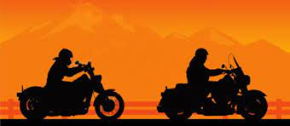
Ride Safe and have fun!
Questions Comments

