Slide 1


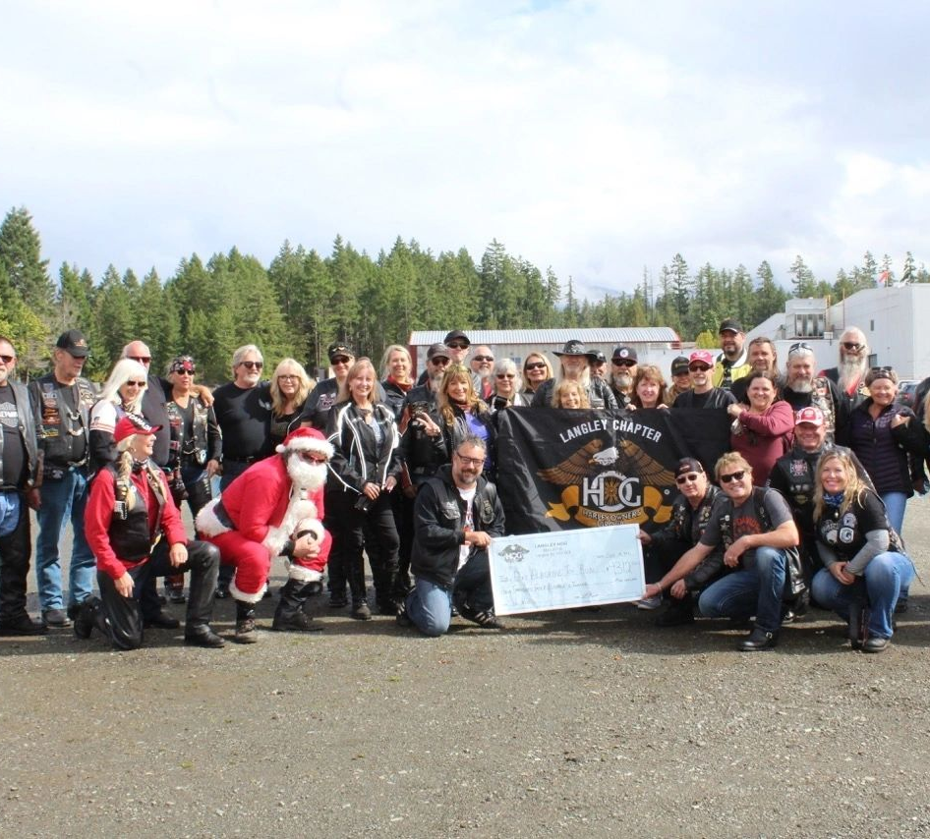
Langley Chapter
BC Canada #9043
Safety Meeting
Barnes Harley Davidson HOGS Nest
April 18th, 2023
6:30 to 8:30pm
Proper Lane positioning

Slide 2
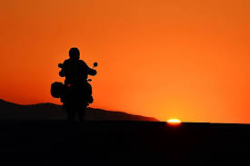

Motorcycle Lane Positions
I hear a lot of people talk about lane position as if there are rules set in stone and there is only one dominant lane position. The standard agreement is that the left third of the lane is Position 1, the center of the lane is Position 2, and the right third of the lane is Position 3.

Slide 3
Motorcycle Lane Positions
Most people seem to think that P1 is THE dominant position, it's the place that you should be all the time when you're riding alone, and the place where odd numbered members of a group ride would be

Slide 4
Motorcycle Lane Positions
P2 is treated like the Forbidden Zone, it's where the grease and oil from cars ends up, so you should never be there.

Slide 5
Motorcycle Lane Positions
P3 seems to be regarded as the place that you should be if you're one of the even numbered riders in a group, or, for some people riding in the left hand lane to block people from taking your lane. Other than that, it's where bicycles are, and a motorcycle shouldn't be there.

Slide 6

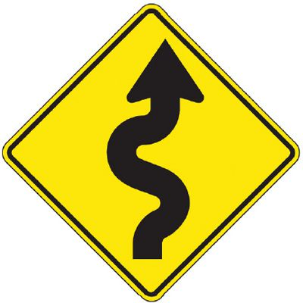
3
2
Forbiden Zone
1
Dominate Lane Position
1
Dominate Lane Position
2
Forbiden Zone
3

Slide 7
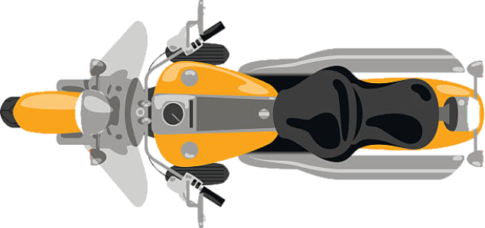
Road Captain
Safety Office
Sweeper

Slide 8
Riding Partners
Riding Partners
Riding Partners
Riding Partners
Every Ride should start out like the above before you leave the parking lot.
Always Know who your riding partner is for the duration of the ride
RC and Safety officer to review Hand Signals with the Group

Slide 9
Safety Office
1 Second Rule
Road Captain
Sweeper
2 Second Rule

Slide 10
Cross over Lane Changing
Other Chapters riding this way

Slide 12

Langley HOG #9043 recommended Lane Changing

Slide 13

Road Captain Signals that the group is going to pass using his Turn Signal and Hand Signal
Make Sure you maintain the 2 Second rule
Sweeper Moves over First once traffic has passed and its Safe to do so, then RC will move over next followed by the dominate lane of bikes.

Slide 14

Once the whole group has passed the vehicle or vehicles, RC will indicate moving into right Lane using Turn signal and Hand Signals
Sweeper Moves over First to keep Lane Clear
2 Second Rule

Slide 15
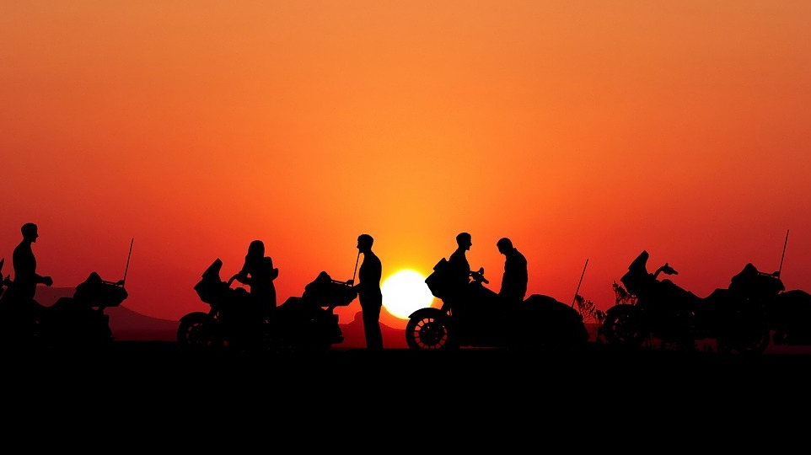
When someone leaves the group

Slide 17
This is what you should do when someone leaves the group

Slide 18
Questions or Comments

