Slide 1

Langley HOG Chapter 9043
Monthly meeting May 28, 2022
Barons Manor Pub
9568 192 Street Surrey, BC

Slide 2
Safety Officer – Peter “Baconator” Rainey
Responsibilities of a HOG Safety Officer
As defined in the H.O.G. Chapter Charter, Safety Officer is a discretionary officer. The official duties and responsibilities of the Safety Officer shall include:

Slide 3
Responsibilities of a HOG Safety Officer cont’d
Provides Motorcycle Safety Foundation or it’s equivalent information to members.
Educates members about the Safe Rider Skills program.
Verify and make pre-ride checks on Motorcycles
Report to Road Captains when a Motorcycle and/or rider should not join the ride

Slide 4
Responsibilities of a HOG Safety Officer cont’d
Assists the Road Captain in planning routes for Chapter rides
Assists the Road Captain in educating members about group riding techniques
Assists the Road Captain in informing Chapter members of any hand signals used by the Chapter
Assists in the collection of signed release forms
Assists in completion of injury reports when accidents occur.

Slide 5
Responsibilities of a HOG Safety Officer cont’d
As a Safety Officer, there are a lot of responsibilities that come with the position, some of which are listed below.
Be proactive
Plan routes and pre-ride the routes whenever possible
Meet and communicate with other riders before and during the ride
Be a positive, enthusiastic and helpful mentor to other riders
Create a fun and safe environment for riding
Look at rides through the eyes of all riders, new and experienced
Understand that there are different riding styles
When working to correct or modify improper or unsafe riding in groups, do so as a privately and quietly as possible
Be a role model for newer riders

Slide 6
Responsibilities of a HOG Safety Officer cont’d
Expectations of Safety officer
Safety Officer will be active participant in group rides
Safety Officer will attend and complete courses in First Aid/CPR.
Final approval of Safety Officer will be made by the Head Road Captain, Road Captains, Primary Officers of the Chapter and/or H.O.G. Manager

Slide 7
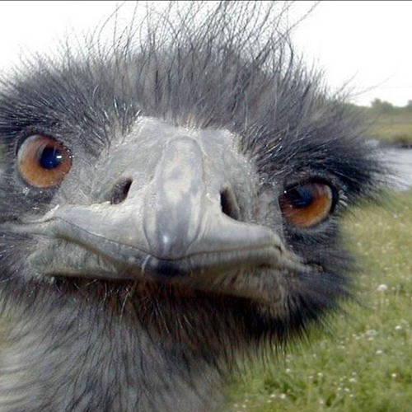
Responsibilities of a HOG Safety Officer cont’d
Thank You
Questions?

