Slide 1
Sliding Contact Bearing
Dr. NILESH PANCHOLI
PH.D
APME
L. D. College of Engineering, Ahmedabad
www.nileshpancholi.com

Slide 2
Introduction
The bearings are classified broadly into two categories based on the type of contact they have between the rotating and the stationary member
a. Sliding contact
b. Rolling contact

Slide 3
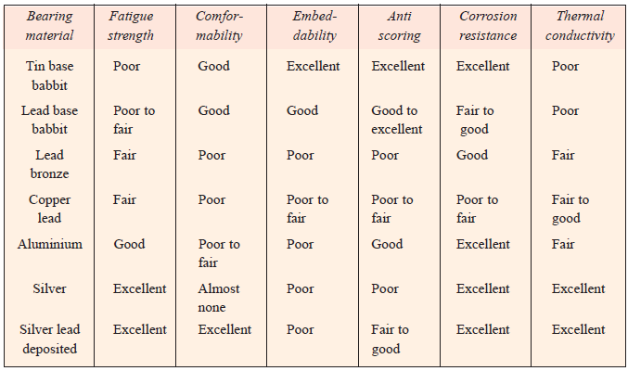
Bearing Materials with Properties

Slide 4
SLIDING CONTACT BEARINGS- ADVANTAGES AND DISADVANTAGES
Advantages over the rolling contact bearings.
The design of the bearing and housing is simple.
They occupy less radial space and are more compact.
They cost less.
The design of shaft is simple.
They operate more silently.
They have good shock load capacity.
They are ideally suited for medium and high speed operation.
The disadvantages are:
The frictional power loss is more.
They required good attention to lubrication.
They are normally designed to carry radial load or axial load only.

Slide 5
SLIDING CONTACT BEARINGS - CLASSIFICATION
Classification of sliding contact bearings:
Based on type of load carried.
a. Radial bearings
b. Thrust bearings or axial bearings
c. Radial – thrust bearings.

Slide 6
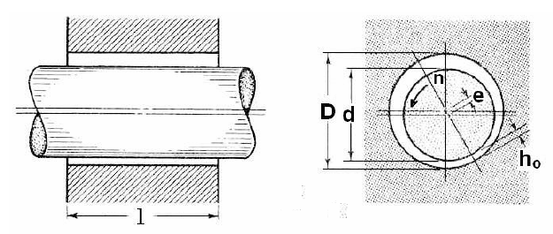
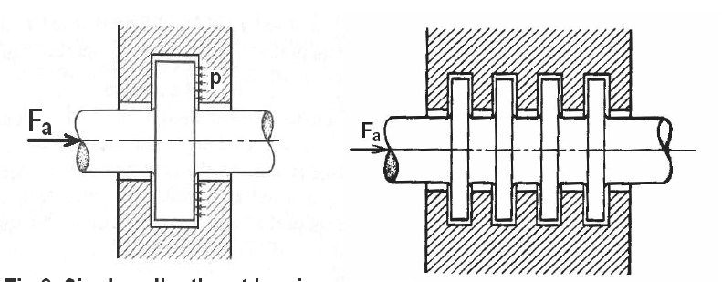
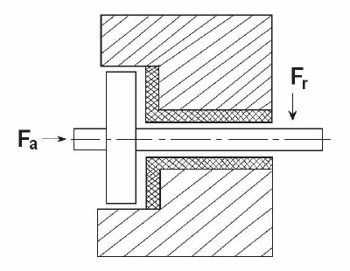
Radial bearings
Thrust bearings or axial bearings
Radial – thrust bearings

Slide 7
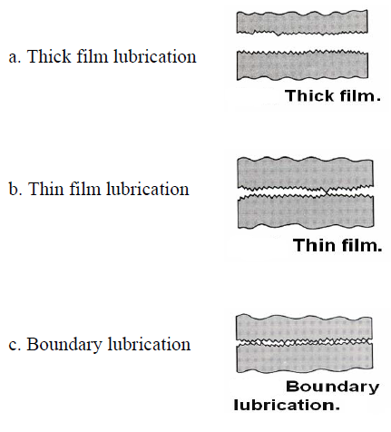
2. Based on type of lubrication.

Slide 8
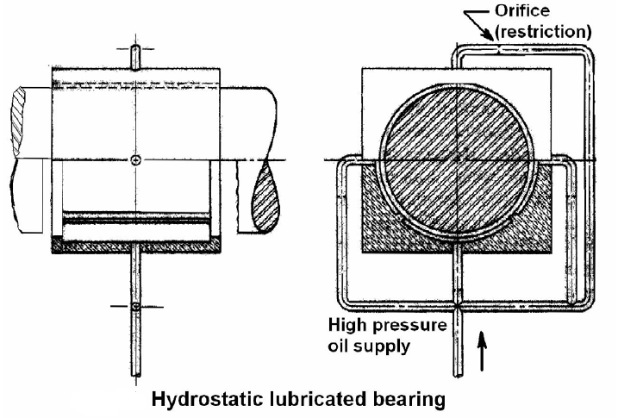
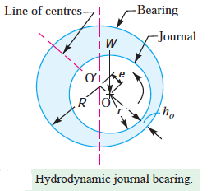
3. Based on lubrication mechanism.
a. Hydrodynamic lubricated bearings.
b. Hydrostatic lubricated bearings.
c. Elasto-hydrodynamic lubricated bearings.
d. Boundary lubricated bearings.
e. Solid film lubricated bearings.

Slide 9
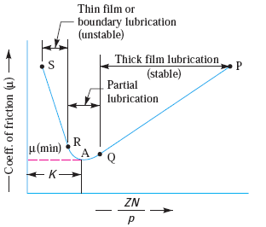
Design Consideration
The value of ZN / p is greater than K, then the bearing will operate with thick film lubrication or under hydrodynamic conditions. On the other hand, when the value of ZN / p is less than K, then the oil film will rupture and there is a metal to metal contact. Min: ZN/p = 3K

Slide 10
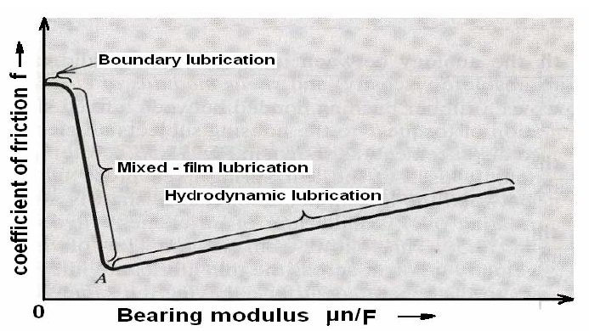
Stribeck Curve

Slide 11
Problem-1
Design a journal bearing for a centrifugal pump from the following data :
Load on the journal = 20 000 N; Speed of the journal = 900 r.p.m.; Type of oil is SAE 10, for which the absolute viscosity at 55°C = 0.017 kg / m-s; Ambient temperature of oil = 15.5°C ; Maximum bearing pressure for the pump = 1.5 N / mm2.
Calculate also mass of the lubricating oil required for artificial cooling, if rise of temperature of oil be limited to 10°C. Heat dissipation coefficient = 1232 W/m2/°C.

Slide 12
Solution-1
Data Given :
W = 20 000 N ;
N = 900 r.p.m. ;
t 0 = 55°C ;
Z = 0.017 kg/m-s ;
t a = 15.5°C ;
p = 1.5 N/mm2 ;
t = 10°C ;
C = 1232 W/m2/°C

Slide 13
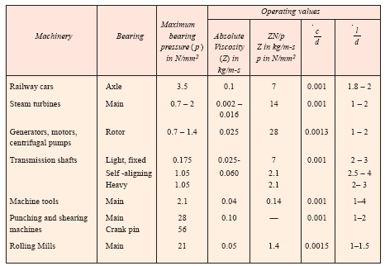
Step-1: Find the length of the journal ( l ). Assume the diameter of the journal ( d ) as 100 mm. From data table, we find that the ratio of l / d for centrifugal pumps varies from 1 to 2. Let us take l/d = 1.6.

Slide 14




Step-2: Calculation of bearing pressure ; BCN and their checking for safe running
Calculated value of p should be less than p(given)
Step-3: Calculation of ZN/p and its checking.
(Calculated)
Its 28 for C.F. Pump
Also select ZN/p from data table (previous slide)
Then, calculate K from following equation;
the calculated value of bearing characteristic number Z N /p should be is more than K for the bearing to operate under hydrodynamic conditions safely

Slide 15




Step-4: Calculation of Amount of lubricating oil required for artificial cooling
heat taken away by the oil (Qt) = Heat generated (Qg) – Heat dissipated (Qd)
k = 0.002
Calculation of Amount of lubricating oil required (m) from equation
Specific heat of oil (S) = 1840 to 2100 J/kg/°C

Slide 16
Thanking You

