Slide 1


Tribal Presentation
Indigenous Youth Services
CareLink & Crisis Support
Start Slide
www.IndigenousYouthServices.org

Slide 2



Tribal Presentation
Hybrid, Holistic, Comprehensive Crisis Support
Through a combination of immediate in-person crisis response, ongoing in-home supports, and 24/7 access through CareLink, we provide fully personalized, wraparound care that meets each youth and family exactly where they are. This hybrid model ensures support is available at every stage of need.
In-Home Supports
  Immediate Crisis Stabilization
  Stability Maintenance
  Essential Skill Building
CareLink
  Personalized Support Plan
  Youth & Caregiver Portal
  24/7 Support

Slide 3
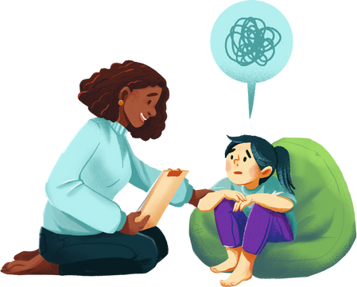
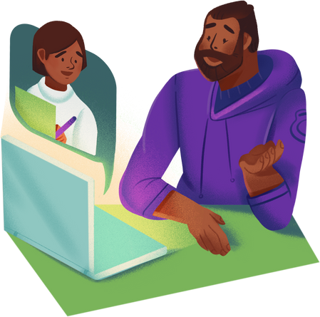


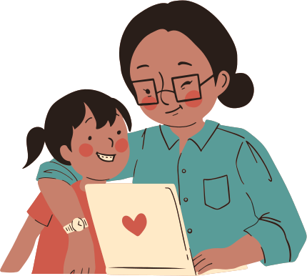
Tribal Presentation
Steps to Crisis Response
Powered by the Three S’s of Successful Interventions
When a crisis occurs, the moments that follow are critical. Our Crisis Response Program provides compassionate, culturally grounded support through every stage of intervention. Using the Three S’s of Successful Interventions (Stabilize, Scaffold, Supersede), we guide youth and families from immediate crisis to long-term independence.
We combine rapid in-person stabilization, structured safety planning, and ongoing CareLink access, which offers 24/7 virtual support and connection to a personalized care team. In-home services further ensure youth receive consistent guidance that aligns with their cultural identity, strengths, and unique needs.
Step #1
Respond & Stabilize
Step #3
CareLink & In-Home
Step #2
Safety Plan & Scaffolding
Step #4
Supersede Support Needs!

Slide 4
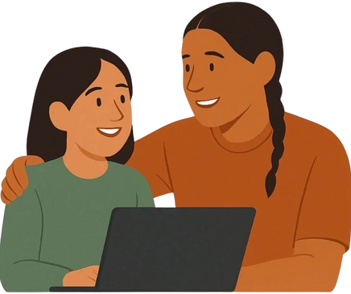
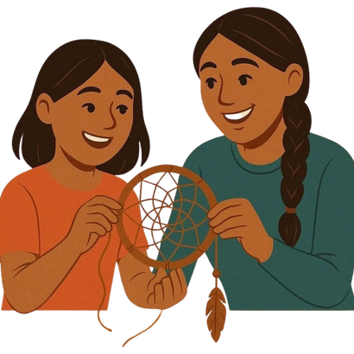
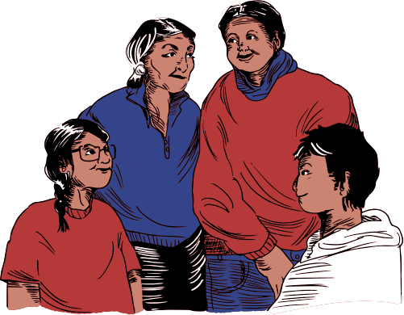
Tribal Presentation
In-Home Support
Powered by the Three S’s of Successful Interventions
Following the initial crisis response, our team develops a needs-based In-Person Support Plan tailored to the unique strengths, challenges, and cultural identity of each youth and their family.
Our approach recognizes that every situation is different, so support is flexible and fully customized. Services can range from a few hours per week to full 24/7 in-home coverage, depending on the level of stability, safety, supervision, and skill development required.
Life Skill Development
Maintaining Stability
Cultural Connection

Slide 5




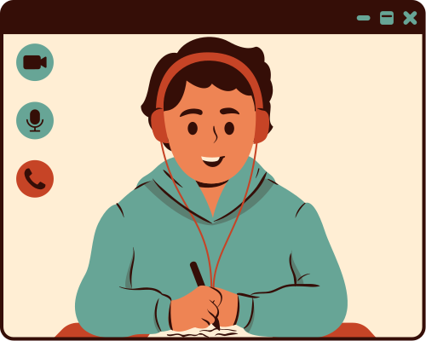
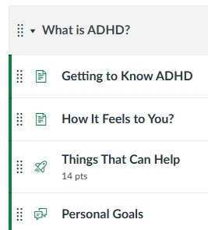
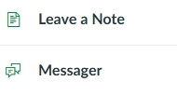
Tribal Presentation
A New Support Approach
CareLink: Virtual Care Support
CareLink integrates seamlessly into existing community supports, amplifying their impact and filling critical gaps by providing 24/7 personalized care tailored to each individual’s unique needs, strengths, and goals. It promotes cultural connection, fosters positive social networks, and enhances overall quality of life. Through individualized guidance and coordinated mentorship, CareLink helps youth develop essential life skills, pursue higher education, and successfully apply for and thrive in employment opportunities. All through a support system they can access directly from their pocket.
Care Plans with 24/7 Support
Downloadable App
Personalized Support Staff

Slide 6


Tribal Presentation
Personalized Support Staff
Team Leads
Every youth deserves consistent, trusted support, especially during moments of crisis. Our Personalized Support Staff Program ensures that each youth remains connected to the same mentor through in-person visits, virtual calls, and secure portal messaging. This approach provides stability, trust, and continuous care, empowering youth and families to navigate challenges effectively, no matter where their journey takes them.
Virtual Calls
Portal Messager
Personalized Support Staff

Slide 7
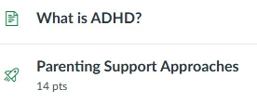
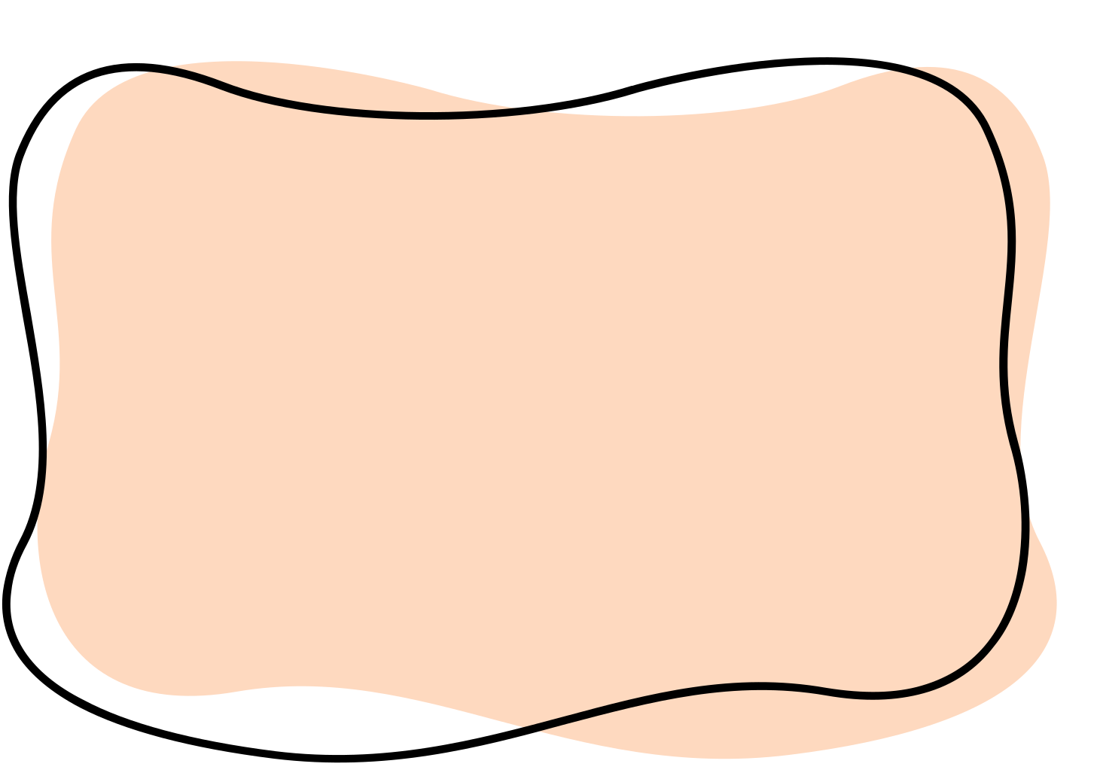
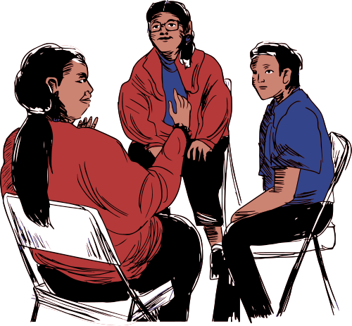

Tribal Presentation
How it Works
Two Integrated Portals
CareLink is built around two integrated portals that work together to provide consistent, comprehensive support for both youth and caregivers. The Youth Portal empowers young people with interactive tools and continuous guidance, while the Caregiver Portal equips families and staff with the insight and strategies needed to offer stable, compassionate care. Together, these portals create a seamless system that grows with the youth and strengthens the entire care network.
Youth Portal
Caregiver Portal

Slide 8
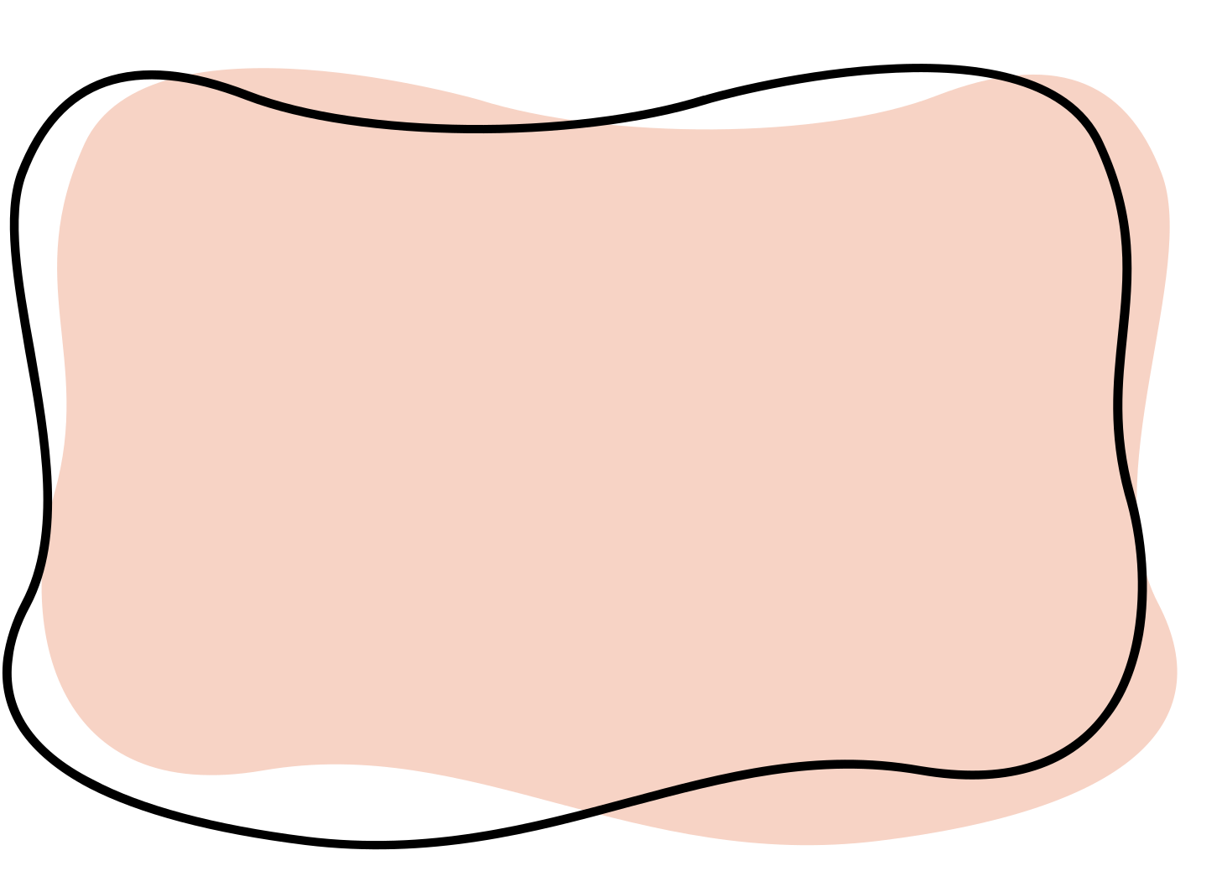

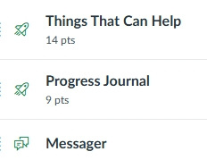
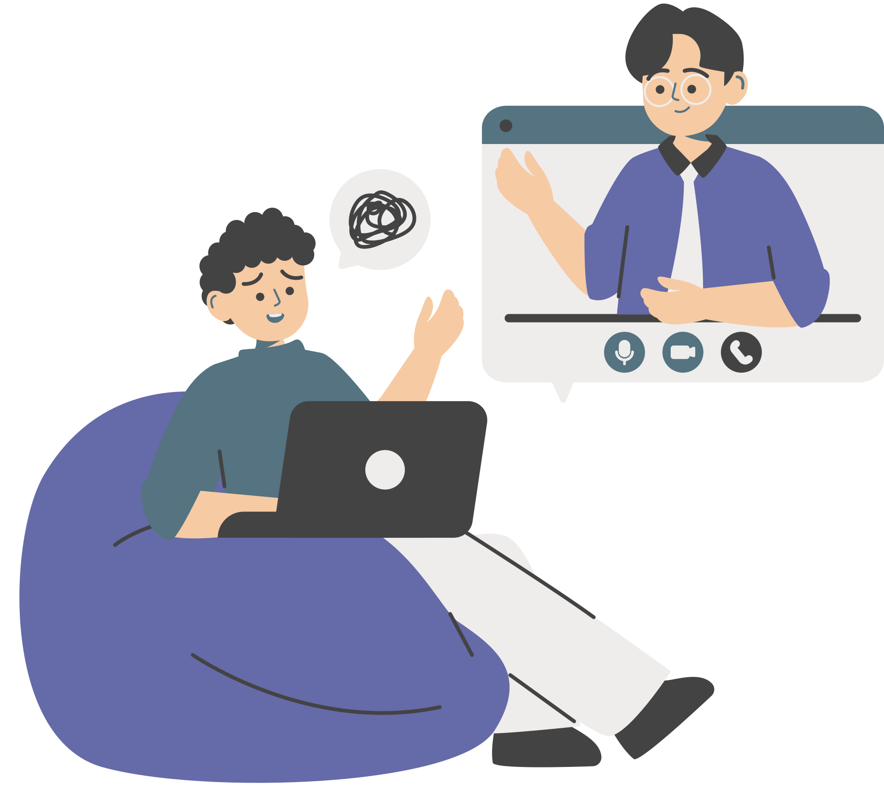
Tribal Presentation
How it Works
Youth Portal
CareLink is built around two integrated portals that work together to provide consistent, comprehensive support for both youth and caregivers. The Youth Portal empowers young people with interactive tools and continuous guidance, while the Caregiver Portal equips families and staff with the insight and strategies needed to offer stable, compassionate care. Together, these portals create a seamless system that grows with the youth and strengthens the entire care network.
Cultural Connections
Success Support
Daily Journal
Support Messager
Virtual Check-Ins

Slide 9
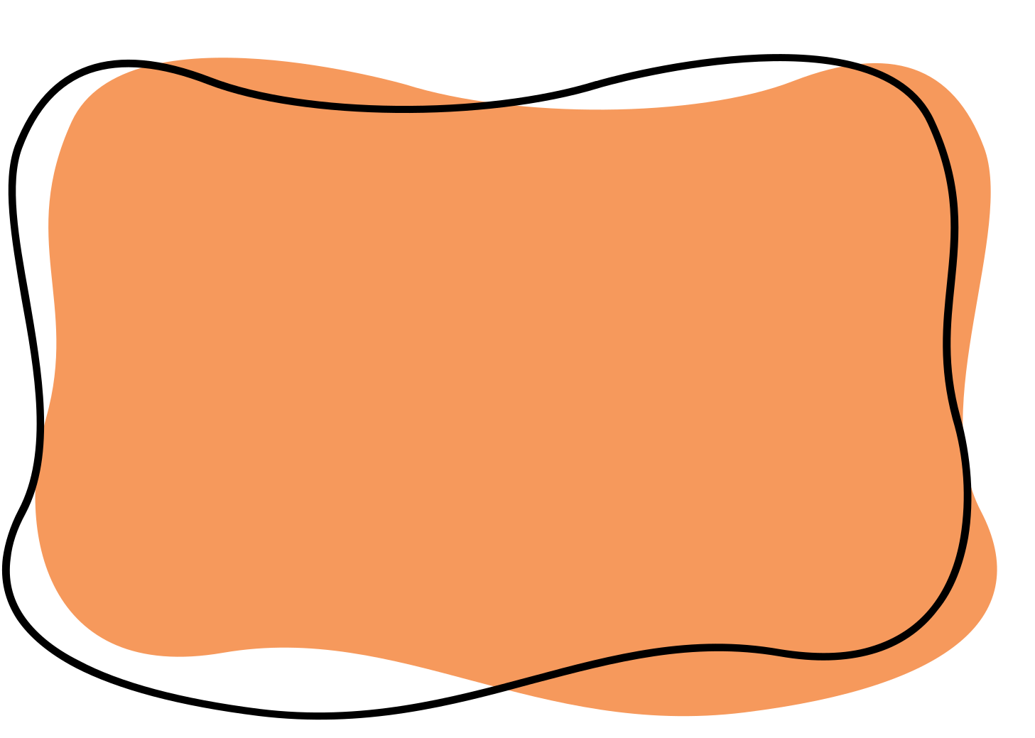
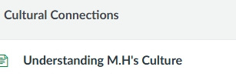
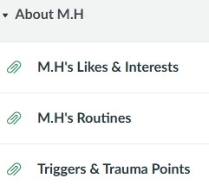



Tribal Presentation
How it Works
Caregiver Portal Features
The Caregiver Portal equips Caregivers, frontline staff, house managers, and behavioral teams with informed tools, cultural guidance, and ongoing support to ensure every youth receives consistent, individualized support. Designed to enhance teamwork and understanding, the portal creates a continuous circle of care that adapts and grows with the youth throughout their care journey.
Cultural Understanding
Success Support
Journal & Tracking
Bi-Weekly Check-In
Support Staff Messager

Slide 10









Tribal Presentation
Consistency
Caregiver Portal Features
The Caregiver Portal equips frontline staff, house managers, and behavioral teams with informed tools, cultural guidance, and ongoing support to ensure every youth receives consistent, individualized support. Designed to enhance teamwork and understanding, the portal creates a continuous circle of care that adapts and grows with the youth throughout their care journey.
Treatment Facilities
Group
Home
Foster Home
Back
Home

Slide 11
Tribal Presentation
Crisis Support Implementation
Options
Individualized Plans
Network Model
Contracts for specific youth/families are provided on a case-by-case basis.
In situations where multiple youth are receiving In-Person Support within the same driving radius, we can extend Crisis Team access to each youth for a small additional daily fee.
This option allows our Crisis Team to provide rapid on-site response, immediate stabilization, and added oversight for all youth within that shared service area. It is a cost-effective way to enhance safety, strengthen continuity of care, and ensure timely support whenever unexpected situations arise.
Community Contracts
We offer the ability to develop Crisis Response Service contracts that are fully customized to the unique needs, priorities, and capacity of each community. These contracts can be established on a quarterly or annual basis and are designed to ensure reliable, on-demand access to high-quality crisis intervention and stabilization services.

Slide 12
Tribal Presentation
Crisis Support Implementation
Options
CareLink Partnership
CareLink Standalone
The CareLink Partnership offers communities the option to integrate CareLink directly into their existing Crisis Response Teams. Through this collaboration, current teams can extend their reach by providing youth and families with continuous, around-the-clock virtual support that strengthens safety, communication, and overall effectiveness.
CareLink enhances any crisis response system by adding 24/7 access to coaching, de-escalation guidance, progress monitoring, and supplementary crisis prevention. Youth and caregivers gain a secure line of support between in-person visits, while crisis teams benefit from real-time updates, improved coordination, and early intervention before situations escalate.
CareLink can be quickly implemented as a standalone solution to provide youth and families with immediate, personalized support when in-person care is unavailable.
It ensures continuous access to professional guidance, de-escalation strategies, crisis prevention, and progress monitoring, helping maintain safety, stability, and well-being at all times.

