Slide 1
Renovate, rehab and be rewarded
WHAT LOAN OPTIONS ARE AVAILABLE FOR HOMES THAT NEED IMPROVEMENT, REPAIR OR ARE JUST PLAIN UGLY ?

Slide 2
Renovation loan types include: VA Repair USDA Repair Conventional Homestyle Renovation FHA 203K Streamline FHA 203K Standard THIS PRESENTATION DESCRIBES THE FHA 203K STREAMLINE LOAN

Slide 3
FHA 203K Standard Renovation Loans
Prepared By: Pam Jackson Home Loan Arrangers 913.538.6535 Office 913.669.0700 Cell 888.433.2110 Fax pam@homeloanarrangers.com www.homeloanarrangers.com NMLS ID#261014 Kansas License #LO.0000584 Kansas Company License #MC.0025594 Nebraska License #NE261014 Missouri Company License #21-2535 Missouri License #MO261014
Home Loan Arrangers, LLC NMLS ID#1848719

Slide 4
What is a FHA 203K Streamline Loan?
A 203k loan allows you to borrow money, using only one loan, for both home improvement (the home improvement portion establishes an escrow account for repairs) and a home purchase. 203k loans are guaranteed by the FHA, which means lenders take less risk when offering this loan which normally translates to lower interest rates and costs.

Slide 5
How do you and I choose the right renovation loan for you and turn a fixer upper into your new home?
1. APPLY FOR PREAPPROVAL FOR RENOVATION LOAN - if you have been pre-approved for another loan type it’s important to have the information updated as some pre-approval guidelines may differ from Non-Renovation loans 2. You and I will speak with your real estate agent and/or contractor and review the list of repairs that we think will be required and list of improvements/repairs that you would like to make to determine a ‘ballpark’ figure for improvements 3. The total cost of the purchase price and expected repair amount will be used to determine total loan amount for preapproval, expected payment and estimated closing costs. The down payment (3.5% for FHA loans) will be determined on the combination of the two figures. 4. Choosing the right loan is based on several factors – down payment, credit score, property type, and type of improvements. My job is to help you choose the best option.

Slide 6
What’s next when we have a contract on your home?
1. Identify the contractor of your choice, ensure they have proper license for your area if required by City, County or State or locality and possess liability insurance 2. Have contractor prepare complete bid itemizing each item to be completed with labor and materials separated for each line item. PLEASE SEE THE SAMPLE BID PROVIDED IN THIS PRESENTATION TO ENSURE IT IS COMPLETED PROPERLY 3. Sign initial loan documents provided and provide documents needed for your loan processing from the checklist I will provide 4. Appraisal is ordered with the contractors bid to provide a future value of the property with the repairs and improvements 5. After receiving your appraisal you may need to contact your contractor with any additional requirements that the property appraiser has identified 6. If additional requirements are required the contractor will need to provide an updated bid with the new items included

Slide 7
What do I need to do for a 203K Loan?
Provide a detailed bid of the work you want to do by a qualified contractor.
Identifying a contractor and obtaining the bid for work to be completed is very important as the appraisal will be based on the future value with improvements. Only 1 contractor is allowed.
Work must be done by a licensed and insured contractor – no self help is allowed unless you can show proof of experience in the trade
Identify and work with a HUD consultant in your area. The consultant will review the bid and property to determine if other work is required and that all costs are in line with expected results. The HUD consultant will prepare work writeups and manage your project through completion.
Provide all income, identity, and assets documents required (just as other loan types)

Slide 8
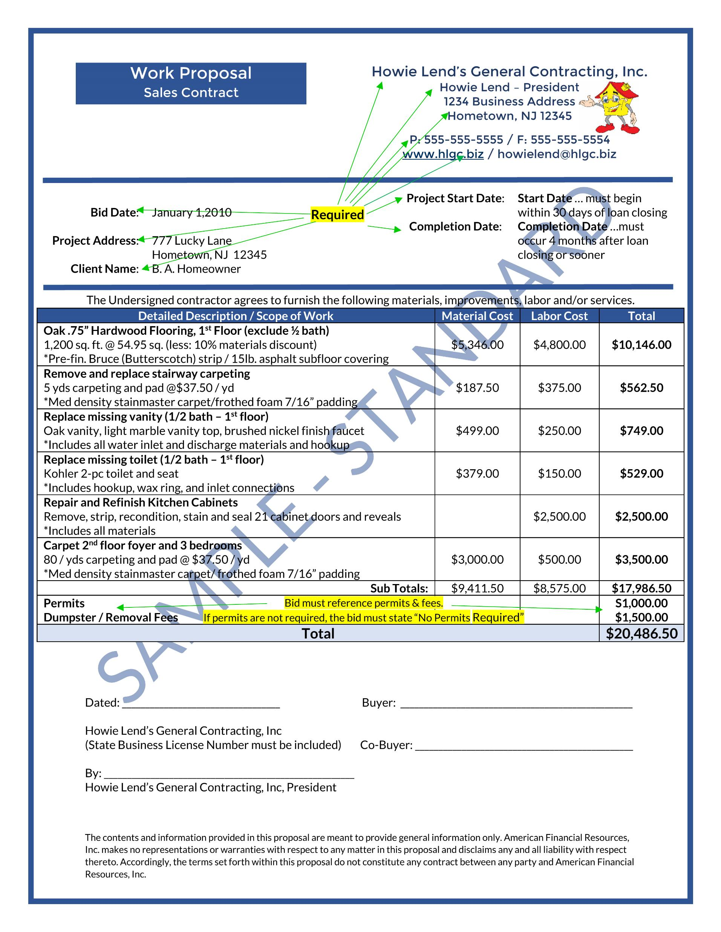
SAMPLE BID
It is required to have all materials that will be used described completely. All materials and labor costs itemized separately.
Complete company information, property address, project start and finish dates and permit requirements.
Contractor and buyers must sign the bid.

Slide 9
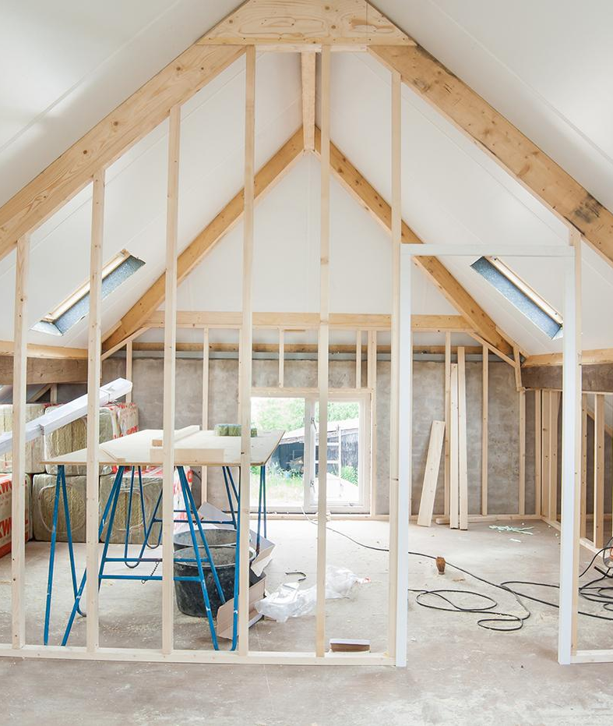
What types of properties Qualify?
Qualifying homes for a FHA 203k loan include:
A one- to four-family stick-built home
A manufactured home permanently attached to a foundation
Some condos are eligible

Slide 10
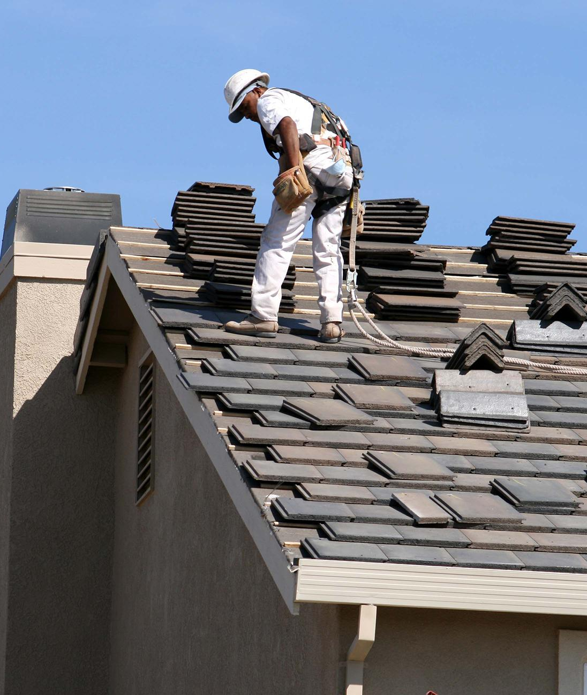
What Repairs Qualify?
A partial list of projects include but not limited to:
HVAC repair or replacement
Roof repair or replacement
Home accessibility improvements for disabled persons
Adding rooms, moving or removing walls
Basement finishing
Kitchen and bath remodel
Flooring
Exterior patio or porch repair or replacement
New cabinets, appliances, paint, flooring
Siding and new windows
Plumbing and electrical repairs or improvements
Landscaping
Repairs of existing inground pool

Slide 11
What Repairs Don’t Qualify?
Partial list includes but not limited to:
Luxury and recreational items such as installing pools or hot tubs
Repair/removal or remediation of Oil Tanks

Slide 12
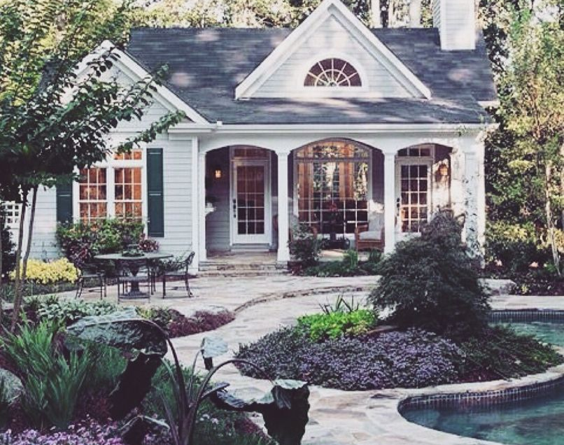
203K Loan Details
Interest Rate – varies on your credit and rates in general
Down payment – you can pay as little as 3.5% down
Most fees associated with your rehabilitation loan are financed making your cash to close similar to a non-rehab loan
Paperwork you will provide is similar to a non-rehab loan with the exception of providing the contractor bid and signing contractor/homeowner documents
Timing for closing depends on location but normal closing times range from 45-60 days
Work to be completed can be a combination of things you as a homeowner want improved or replaced, contractor requirements and FHA requirements the appraiser or HUD consultant may identify
MOST TRANSACTIONS COMPLETED WITH A RENOVATION LOAN ALLOW YOU TO HAVE EQUITY IN THE PROPERTY ABOVE THE AMOUNT YOU CONTRIBUTED TO DOWN PAYMENT

Slide 13
What to Expect and What your contractor needs to know
203K loans can take 45-90 days to close
Licensed contractor and his subcontractors must do all the work (No Self Help Allowed)
Licensed contractors will have paperwork to fill out as well
Appraisal may be more expensive due to appraiser reviewing bid for improvements and projecting a future value but is included in your closing cost estimate
Work begins as soon as you schedule your contractor to begin and must start within 30 days of closing and be completed within 6 months
Contractor cannot be given an advance of funds to start work on the project. They may request periodic draw requests after portions of work are complete. He will coordinate with the HUD consultant to determine when sufficient work is complete to request payment(s).

Slide 14
What to Expect and What your contractor needs to know (continued)
A contingency reserve of 10-20% of the contractors bid amount will be added to the amount of the financed repairs so that if additional costs are incurred there are sufficient funds to cover the overage.
If any additional costs exceed the amount of the contingency reserve the borrowers must pay out of pocket. So, it is important to make sure you obtain the most accurate bid as possible.

Slide 15
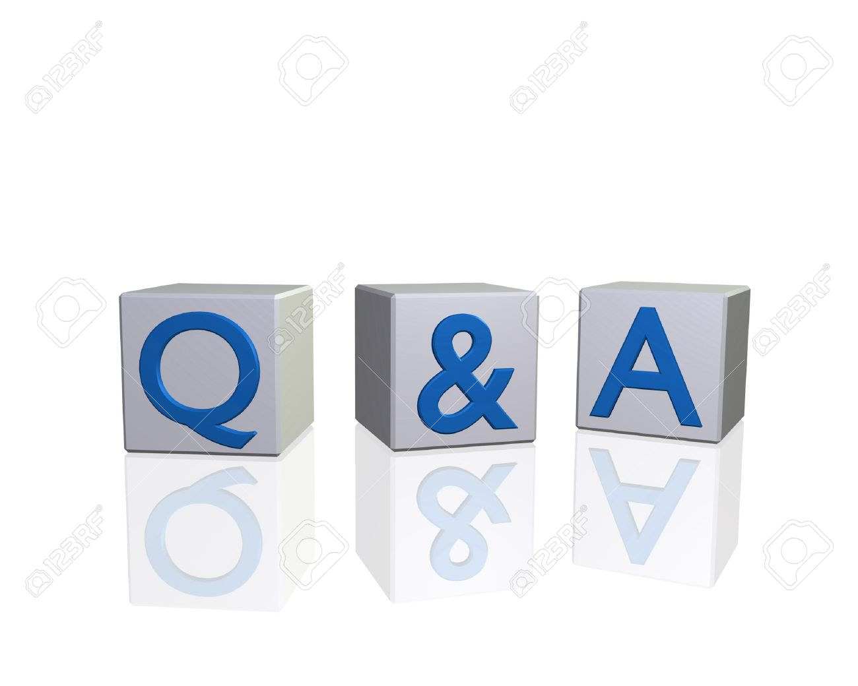
203K Q&A’s
What is an escrow repair holdback?
An escrow holdback is the account established to cover the cost of repairs (from the final bid provided from contractor), allowable fees to be financed and the contingency reserve for unexpected repairs uncovered during the construction project
Who is in charge of the escrow holdback and disbursements?
American Financial Resources (AFR) processes, underwrites, closes your loan and administers the draw requests to the contractor. I will be assisting the process every step of the way.
When can the work start on my new home and when does it have to be finished?
Work can begin as soon as possible after closing on your new home but must commence within 30 days. While most projects are finished much sooner you will have up to 6 months to complete.
What happens if there are additional repairs not listed on the original contractor bid that was approved for closing?
Your contractor will need to provide a new bid for additional items to be approved by the HUD consultant and escrow department before any additional work is to be done. The purpose of the contingency reserve is designed just for this purpose however see next Q&A:

Slide 16
203K Q&A’s (Continued)
What happens if additional repairs exceed my escrow account holdback?
You will be required to pay any overage out of pocket. So, it will be extremely important you receive a reliable bid and choose a reputable contractor.
I want to do work on my future property, is this allowed?
Unfortunately, ‘self help’ is not an option.
I have supplies that I have been given, have purchased or in my possession that I would like to use for the home is this possible?
You may use the items, however the listing of items needs to be provided on the contractor bid with a cost for material of $0.00 as you cannot be reimbursed for those items. The contractor may however charge for labor for installation of the items.
What happens to any money left over in the escrow account after the project is complete?
All remaining funds will be used as a payment to the principle amount of your loan.

Slide 17
Does this sound confusing or too hard?
Benefits: The buy and rehab strategy nets you serious equity
The buy-and-rehab strategy can give home buyers instant equity, and a lot of it.
Homes in need of repair or updating can be had on the cheap, and the fixes may not be very expensive at all.
For instance, a house potentially worth $250,000 may sell for just two hundred thousand, when it needs only twenty thousand dollars in repairs. That leaves $30,000 in potential equity for a buyer with the initiative and drive to manage the fixes.
According to real estate data website Realtytrac, the median home price in a “distressed” sale was 42 percent lower than the price netted in non-distressed situations. That’s a big discount.
The problem comes, however, when the buyer goes to finance the home purchase.
Most mortgage programs require homes to be in near-top shape before the loan is approved.
That’s where the FHA 203k rehab loan comes in.
The Federal Housing Administration’s (FHA) 203k loan allows buyers to finance the home and the repairs with one loan.
It’s possible to have lower payments and higher equity in your home the moment you move in, compared to your friends and neighbors. It’s time to take a closer look at the FHA 203k program.

