Slide 1
Elevating Talent: Your Manpower Connecting Partner
We specialize in connecting top talent with leading firms. Our focus is on Insurance, BPOs, Software, and Banking sectors. We bridge the gap between ambition and opportunity.
By CD. Team MAHAMANE

Slide 2
About Our Manpower Consultancy
We are a leading manpower consultancy. We provide specialized recruitment solutions.
We focus on key sectors. These include Insurance, BPOs, Software, and Banks.
Insurance
BPOs
Software
Connecting talent to the insurance industry.
Providing staff for BPO firms.
Software specialists for tech companies.
Banks
Banking experts for finance roles.

Slide 3
Our Service Offerings
We offer comprehensive manpower solutions. This includes sourcing, screening, and training.
We tailor our services to your needs. We are committed to excellence in every placement.
1
Talent Sourcing
2
Candidate Screening
Identifying top candidates in Karnataka.
Evaluating skills and qualifications.
3
Training Programs
Enhancing candidate readiness.

Slide 4
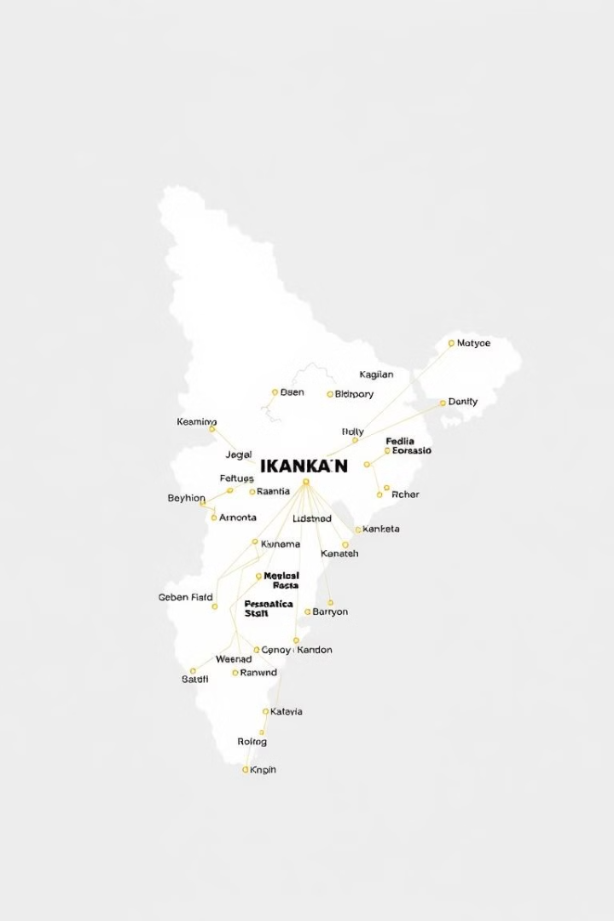
Candidate Sourcing Across Karnataka
We source candidates from all corners of Karnataka. Our network spans the entire state.
We tap into a diverse pool of talent. We ensure a wide range of skills and experiences.
Extensive Reach
Sourcing candidates from every district.
Diverse Talent
Access to a wide range of skills.
Statewide Network
Connecting talent across Karnataka.

Slide 5
Collaborations with Major Colleges
We partner with major colleges across Karnataka. These collaborations provide access to graduates.
We build relationships with academic institutions. This ensures a steady stream of qualified candidates.
College Partnerships
Graduate Access
Talent Pipeline
Ties with leading institutions.
Early access to talented graduates.
Ensuring a steady flow of candidates.

Slide 6
Candidate Identification and Evaluation
We identify candidates based on key criteria. This includes academic performance, interest, and readiness.
Our evaluation process ensures a great fit. We prepare candidates for their ideal roles.
1
Academic Review
Evaluating educational background.
2
Interest Assessment
Matching candidates with suitable roles.
3
Readiness Check
Assessing skills and preparedness.

Slide 7
Our Candidate Training Approach
We nurture candidates through targeted training programs. Our programs enhance their skills.
We ensure candidates are at their best. We make sure they are ready to excel in their chosen fields.
Role Preparation
2
Preparing for specific job requirements.
Skill Enhancement
1
Improving key competencies.
Career Readiness
3
Ensuring candidates are job-ready.

Slide 8
Helping Candidates Find Their Ideal Roles
We connect candidates with ideal roles. We focus on alignment and long-term success.
Our goal is to facilitate lasting placements. We ensure satisfaction for both candidates and companies.
Role Alignment
Career Success
Matching candidates with ideal positions.
Supporting long-term growth.
Lasting Placements
Ensuring mutual satisfaction.

