Slide 1
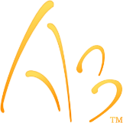
Training Mode A3 2.0.2
Indra Gohil
August 9th, 2019
Critical Handling - Confidential

Slide 2
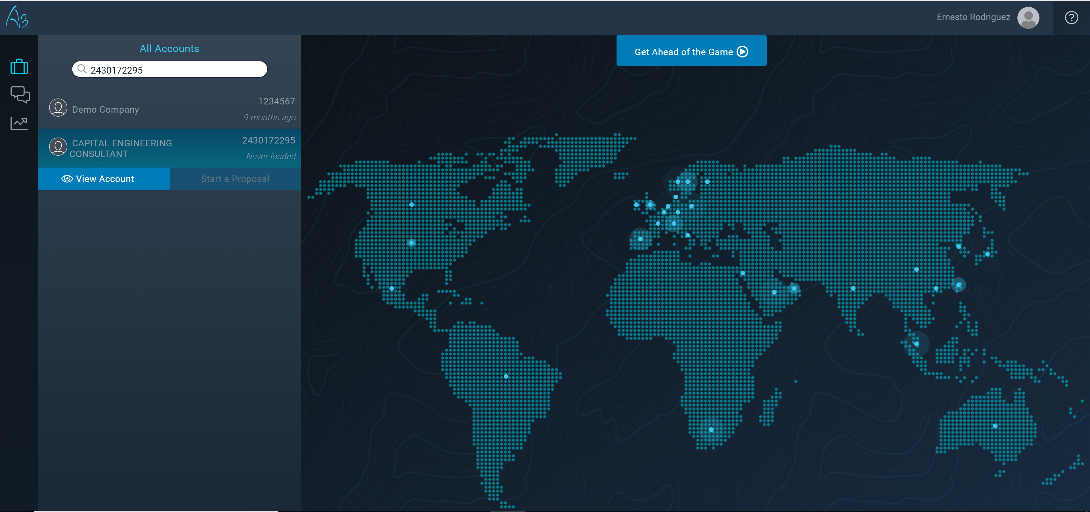
Customer Choice Page
Change user settings (currency default, and localized language) for the most customized experience
3
1
Select Affinity IDs or Account Names using search bar.
2
Account Insights appears for the user, or they can create a new proposal. Select View Account to see A3’s machine learning insights for each unique account.

Slide 3
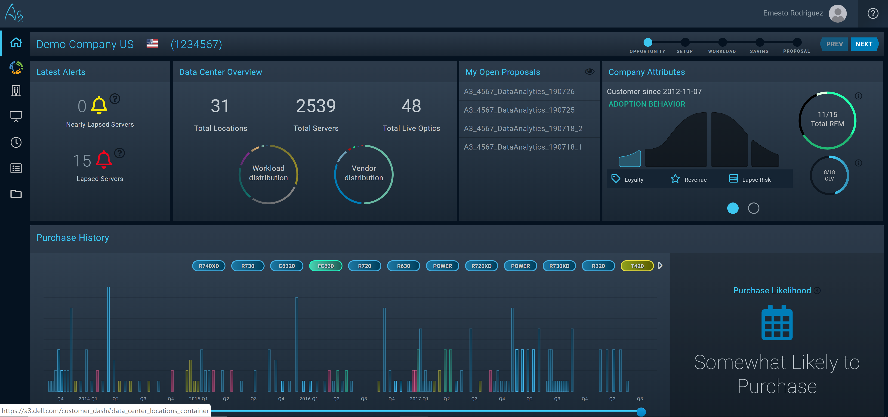
Customer Insights Dashboard Part 1
Overall View of All Data Centers
How many servers in all locations
How many LiveOptics projects uploaded for this account
Vendor distribution of servers across Affinity ID
1
3
Machine learning customer insights.
2
View customers lifetime purchases
from 11G forward.
Machine Learning:
Predicting the customer’s next purchase.
4
Notes:
Machine Learning Insights for Company Attributes:
Adoption behavior – We would like to predict what the customers likely buying pattern is based on previous purchases. If a customer is an early adopter, then we should propose the latest and greatest. Skeptics wait till the server platform has hardened towards the end of the purchase period.
Loyalty – does the customer buy on a pattern for their business from Dell
Revenue – what is the trajectory of revenue for this particular customer compared to past purchase windows
Lapse risk – how many systems are coming off of support entitlements compared to their overall install base from Dell
Cornerstone server – what is the most likely 14G server this customer will purchase based on their previous purchases

Slide 4
Customer Insights Dashboard Part 2
1
View systems in an account that are about to, or have already lapsed.
2
Active drafts that need to be
converted to a PPT Proposal.
Notes:
Machine Learning Insights for Company Attributes:
Adoption behavior – We would like to predict what the customers likely buying pattern is based on previous purchases. If a customer is an early adopter, then we should propose the latest and greatest. Skeptics wait till the server platform has hardened towards the end of the purchase period.
Loyalty – does the customer buy on a pattern for their business from Dell
Revenue – what is the trajectory of revenue for this particular customer compared to past purchase windows
Lapse risk – how many systems are coming off of support entitlements compared to their overall install base from Dell
Cornerstone server – what is the most likely 14G server this customer will purchase based on their previous purchases

Slide 5
How to Upload LiveOptics ID
1
Click the LiveOptics icon in the left Navigation bar to view server environment.
Notes:
Machine Learning Insights for Company Attributes:
Adoption behavior – We would like to predict what the customers likely buying pattern is based on previous purchases. If a customer is an early adopter, then we should propose the latest and greatest. Skeptics wait till the server platform has hardened towards the end of the purchase period.
Loyalty – does the customer buy on a pattern for their business from Dell
Revenue – what is the trajectory of revenue for this particular customer compared to past purchase windows
Lapse risk – how many systems are coming off of support entitlements compared to their overall install base from Dell
Cornerstone server – what is the most likely 14G server this customer will purchase based on their previous purchases

Slide 6
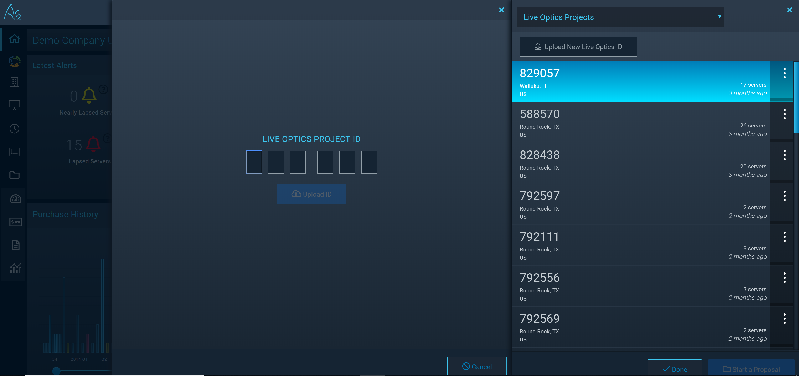
Uploading a LiveOptics ID
1
Enter 6 Digit Project ID in LiveOptics field and upload ID.
Notes:
Machine Learning Insights for Company Attributes:
Adoption behavior – We would like to predict what the customers likely buying pattern is based on previous purchases. If a customer is an early adopter, then we should propose the latest and greatest. Skeptics wait till the server platform has hardened towards the end of the purchase period.
Loyalty – does the customer buy on a pattern for their business from Dell
Revenue – what is the trajectory of revenue for this particular customer compared to past purchase windows
Lapse risk – how many systems are coming off of support entitlements compared to their overall install base from Dell
Cornerstone server – what is the most likely 14G server this customer will purchase based on their previous purchases

Slide 7
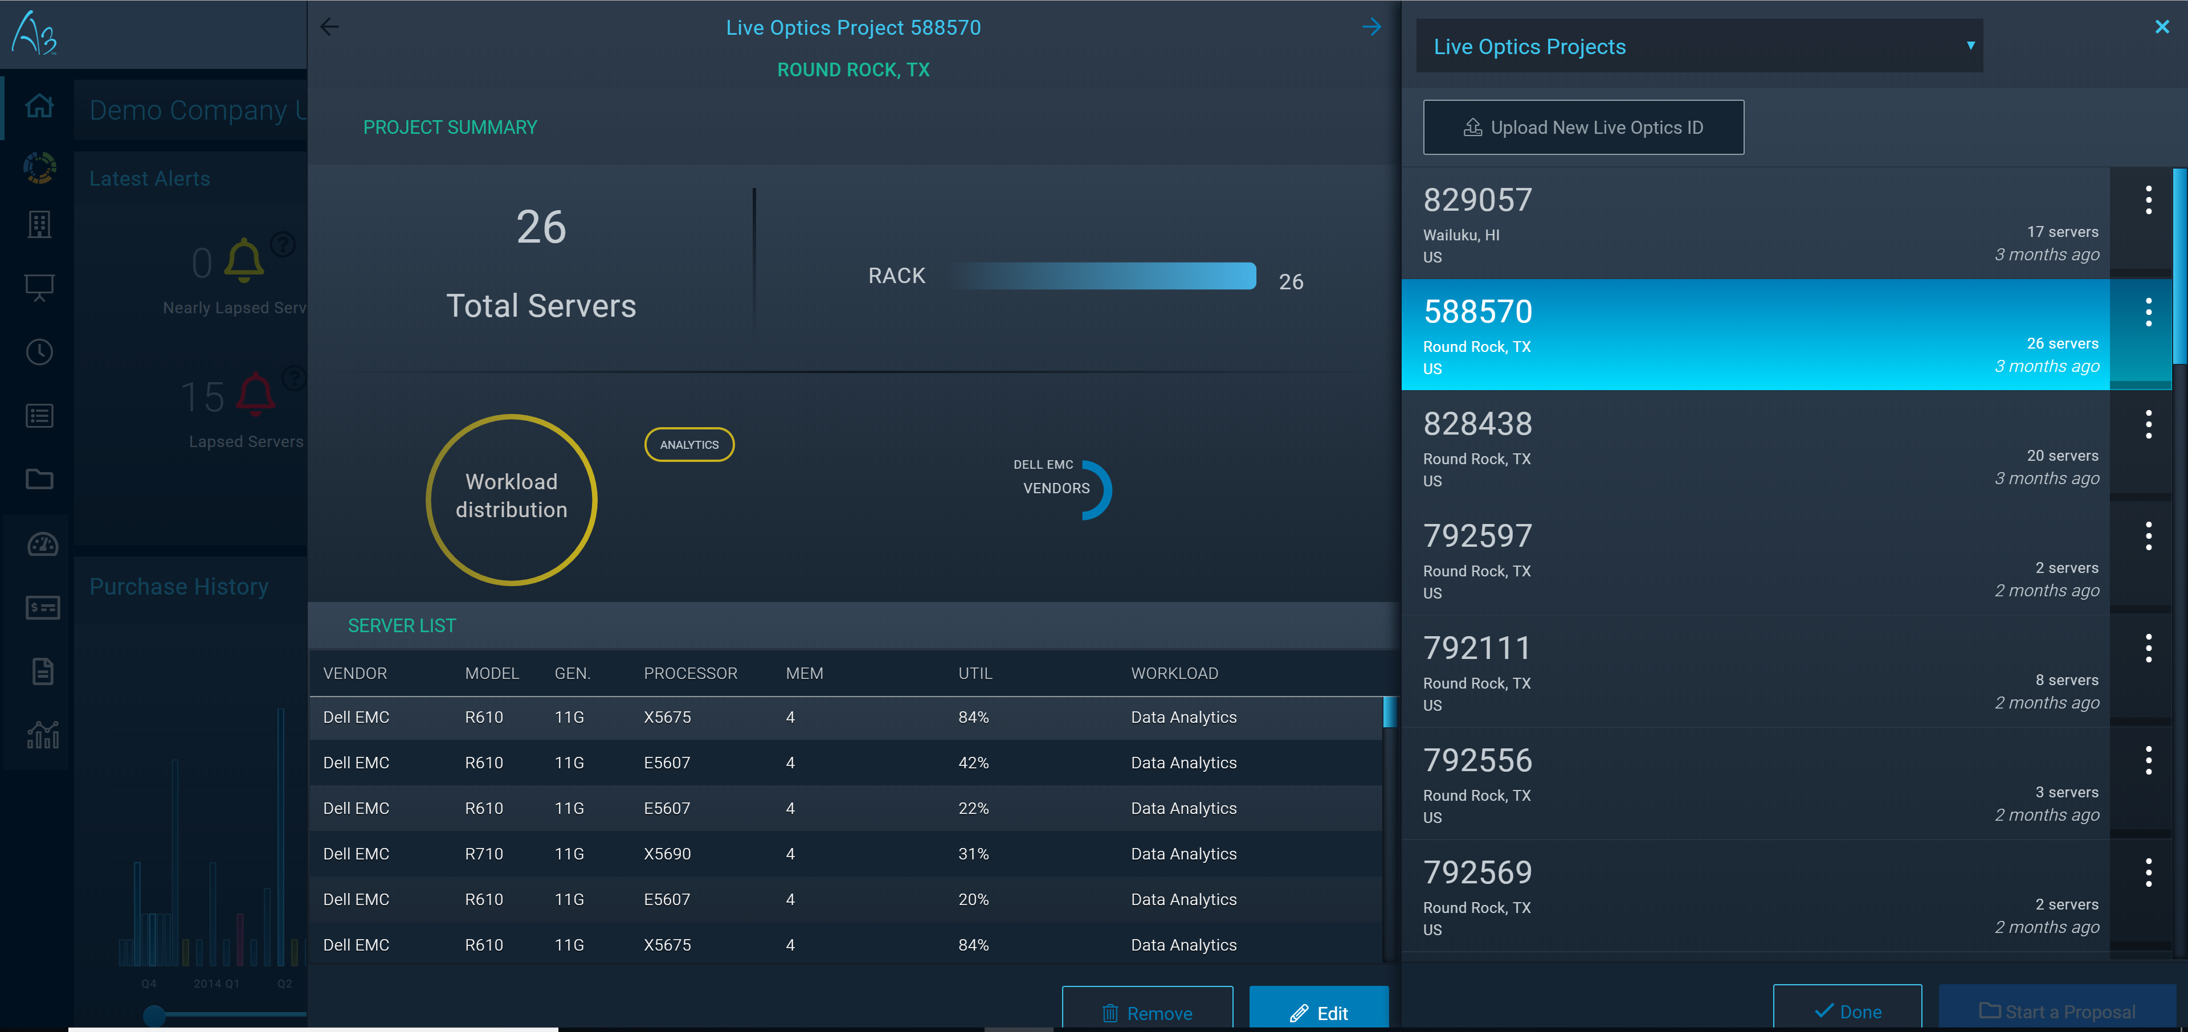
Import a LiveOptics collection
Once loaded set the location and the main
workload running on this LiveOptics collection. Then Start aProposal.
1
Notes:
Machine Learning Insights for Company Attributes:
Adoption behavior – We would like to predict what the customers likely buying pattern is based on previous purchases. If a customer is an early adopter, then we should propose the latest and greatest. Skeptics wait till the server platform has hardened towards the end of the purchase period.
Loyalty – does the customer buy on a pattern for their business from Dell
Revenue – what is the trajectory of revenue for this particular customer compared to past purchase windows
Lapse risk – how many systems are coming off of support entitlements compared to their overall install base from Dell
Cornerstone server – what is the most likely 14G server this customer will purchase based on their previous purchases

Slide 8
How to Start a Proposal
Notes:
Machine Learning Insights for Company Attributes:
Adoption behavior – We would like to predict what the customers likely buying pattern is based on previous purchases. If a customer is an early adopter, then we should propose the latest and greatest. Skeptics wait till the server platform has hardened towards the end of the purchase period.
Loyalty – does the customer buy on a pattern for their business from Dell
Revenue – what is the trajectory of revenue for this particular customer compared to past purchase windows
Lapse risk – how many systems are coming off of support entitlements compared to their overall install base from Dell
Cornerstone server – what is the most likely 14G server this customer will purchase based on their previous purchases

Slide 9
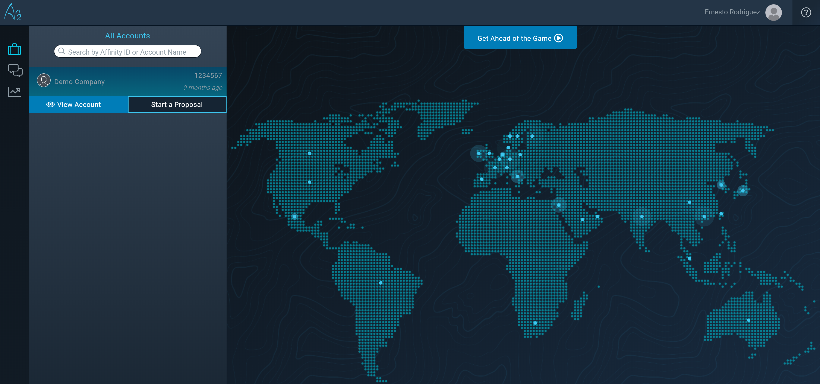
Start the Proposal by saving the name
1
Set the Start a Proposal Name
Notes:
Machine Learning Insights for Company Attributes:
Adoption behavior – We would like to predict what the customers likely buying pattern is based on previous purchases. If a customer is an early adopter, then we should propose the latest and greatest. Skeptics wait till the server platform has hardened towards the end of the purchase period.
Loyalty – does the customer buy on a pattern for their business from Dell
Revenue – what is the trajectory of revenue for this particular customer compared to past purchase windows
Lapse risk – how many systems are coming off of support entitlements compared to their overall install base from Dell
Cornerstone server – what is the most likely 14G server this customer will purchase based on their previous purchases

Slide 10
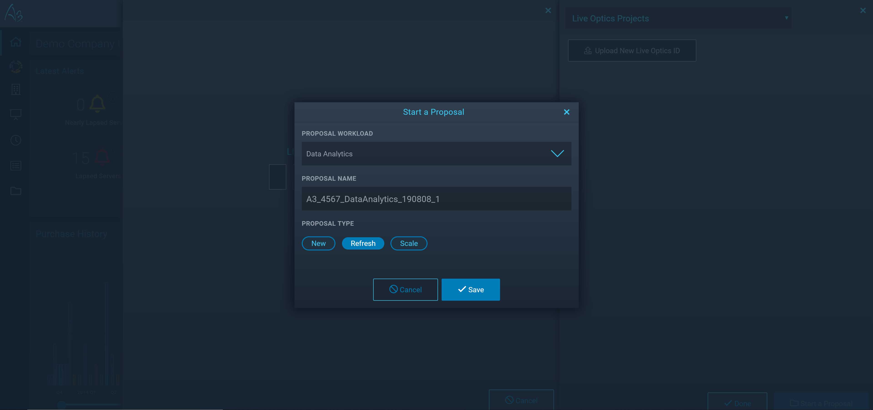
Start the Proposal by saving the name
1
Set the Proposal Name, select Proposal Type.
Select “Refresh” only for now.
2
3
Save proposal to start.
Notes:
Machine Learning Insights for Company Attributes:
Adoption behavior – We would like to predict what the customers likely buying pattern is based on previous purchases. If a customer is an early adopter, then we should propose the latest and greatest. Skeptics wait till the server platform has hardened towards the end of the purchase period.
Loyalty – does the customer buy on a pattern for their business from Dell
Revenue – what is the trajectory of revenue for this particular customer compared to past purchase windows
Lapse risk – how many systems are coming off of support entitlements compared to their overall install base from Dell
Cornerstone server – what is the most likely 14G server this customer will purchase based on their previous purchases

Slide 11
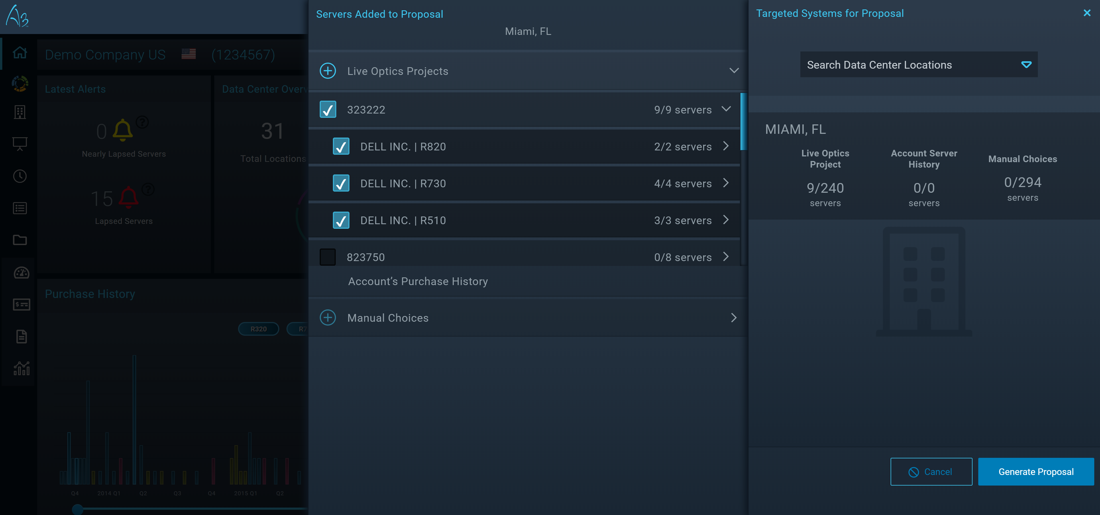
Selecting Your Install Base
1
Choose server category and see available servers to add.
Generate Proposal.
2
Notes:
Machine Learning Insights for Company Attributes:
Adoption behavior – We would like to predict what the customers likely buying pattern is based on previous purchases. If a customer is an early adopter, then we should propose the latest and greatest. Skeptics wait till the server platform has hardened towards the end of the purchase period.
Loyalty – does the customer buy on a pattern for their business from Dell
Revenue – what is the trajectory of revenue for this particular customer compared to past purchase windows
Lapse risk – how many systems are coming off of support entitlements compared to their overall install base from Dell
Cornerstone server – what is the most likely 14G server this customer will purchase based on their previous purchases

Slide 12
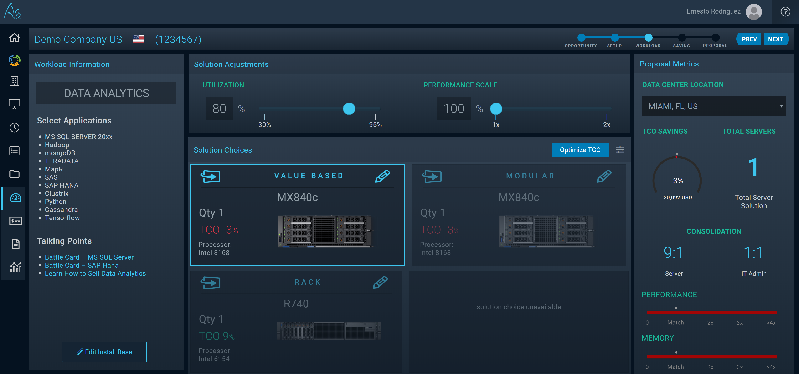
Select One of the Recommended Solutions
Click next to go to proceed to view systems financial comparisons.
4
1
Adjust the sliders to change the solution to accurately match the usage by the client.
2
Choose one of the Recommendations to meet your clients needs.
3
Information to help the client understand the applications for the workloads.
Notes:
Machine Learning Insights for Company Attributes:
Adoption behavior – We would like to predict what the customers likely buying pattern is based on previous purchases. If a customer is an early adopter, then we should propose the latest and greatest. Skeptics wait till the server platform has hardened towards the end of the purchase period.
Loyalty – does the customer buy on a pattern for their business from Dell
Revenue – what is the trajectory of revenue for this particular customer compared to past purchase windows
Lapse risk – how many systems are coming off of support entitlements compared to their overall install base from Dell
Cornerstone server – what is the most likely 14G server this customer will purchase based on their previous purchases

Slide 13
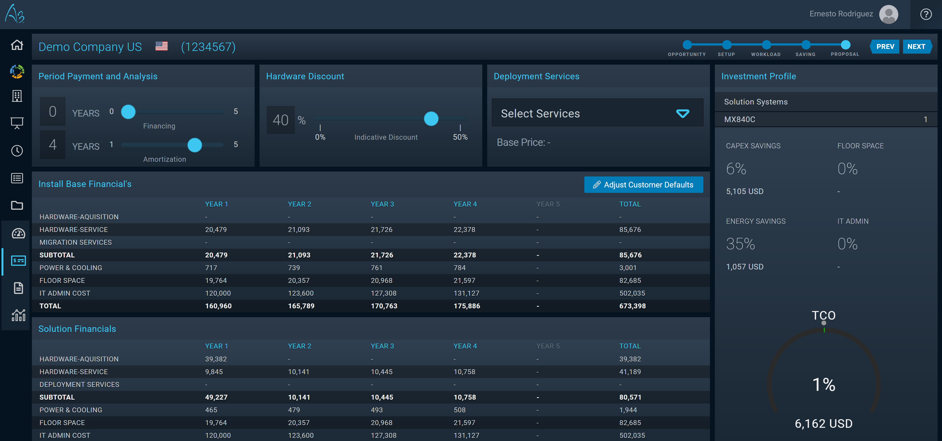
Financial Systems Comparison
Click next to go to proceed to view proposal options.
6
Select deployment type that can be added to the financial projections.
2
3
Set discount rate for your deal to adjust to the customer’s expectations.
1
Set customer finance time in years.
TCO elements and their views Solution vs Install Base.
4
Indicators show how you are matching the server requirements against customer’s Install Base.
5
Notes:
Machine Learning Insights for Company Attributes:
Adoption behavior – We would like to predict what the customers likely buying pattern is based on previous purchases. If a customer is an early adopter, then we should propose the latest and greatest. Skeptics wait till the server platform has hardened towards the end of the purchase period.
Loyalty – does the customer buy on a pattern for their business from Dell
Revenue – what is the trajectory of revenue for this particular customer compared to past purchase windows
Lapse risk – how many systems are coming off of support entitlements compared to their overall install base from Dell
Cornerstone server – what is the most likely 14G server this customer will purchase based on their previous purchases

Slide 14
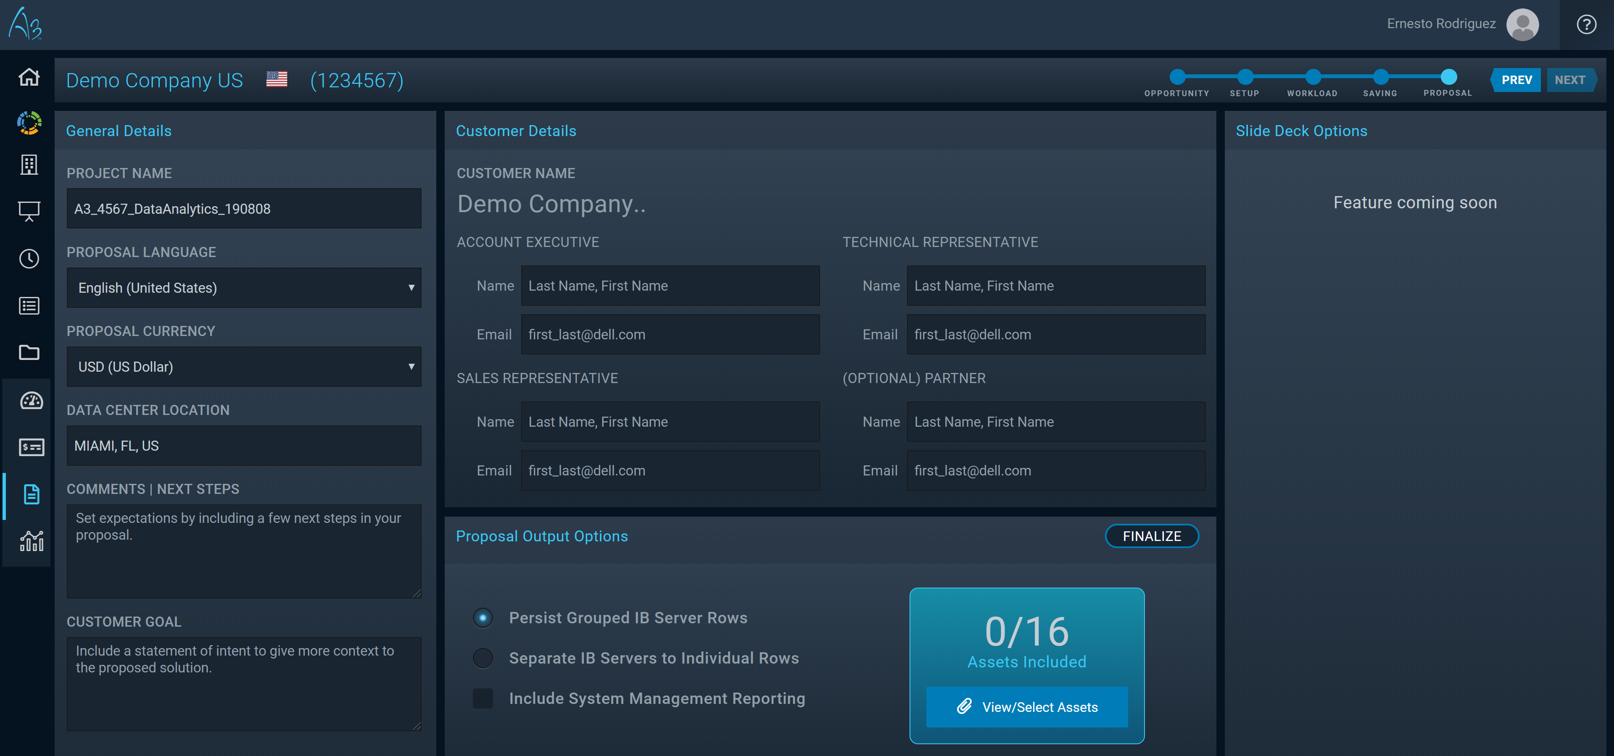
Proposal Options Page
1
Select one of 12 languages to
create the PPT in.
4
Fill in details about the key stakeholders from the Dell Account team point of view.
6
Click for SFDC attach options.
2
Add in details about next steps, and what your goal is with the customer.
Adjust the output files included in the power point.
3
5
Choose pertinent product assets to include in PPT presentation.
Notes:
Machine Learning Insights for Company Attributes:
Adoption behavior – We would like to predict what the customers likely buying pattern is based on previous purchases. If a customer is an early adopter, then we should propose the latest and greatest. Skeptics wait till the server platform has hardened towards the end of the purchase period.
Loyalty – does the customer buy on a pattern for their business from Dell
Revenue – what is the trajectory of revenue for this particular customer compared to past purchase windows
Lapse risk – how many systems are coming off of support entitlements compared to their overall install base from Dell
Cornerstone server – what is the most likely 14G server this customer will purchase based on their previous purchases

Slide 15
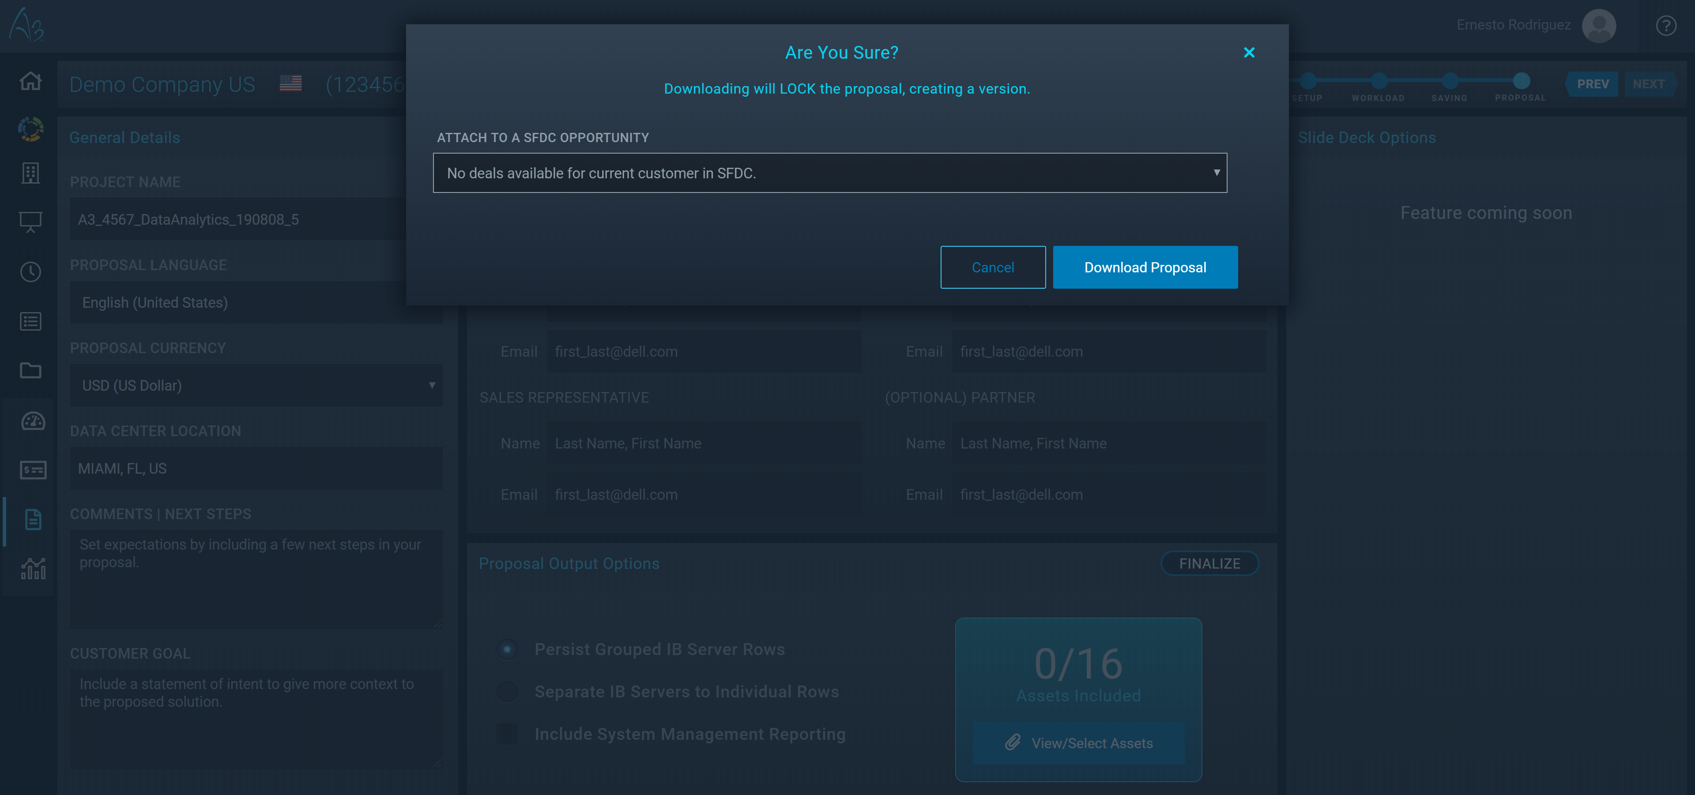
SFDC Deal Attachment
1
Choose from various SFDC Deals to attach the proposal to.
Download Proposal
2
Notes:
Machine Learning Insights for Company Attributes:
Adoption behavior – We would like to predict what the customers likely buying pattern is based on previous purchases. If a customer is an early adopter, then we should propose the latest and greatest. Skeptics wait till the server platform has hardened towards the end of the purchase period.
Loyalty – does the customer buy on a pattern for their business from Dell
Revenue – what is the trajectory of revenue for this particular customer compared to past purchase windows
Lapse risk – how many systems are coming off of support entitlements compared to their overall install base from Dell
Cornerstone server – what is the most likely 14G server this customer will purchase based on their previous purchases

Slide 16
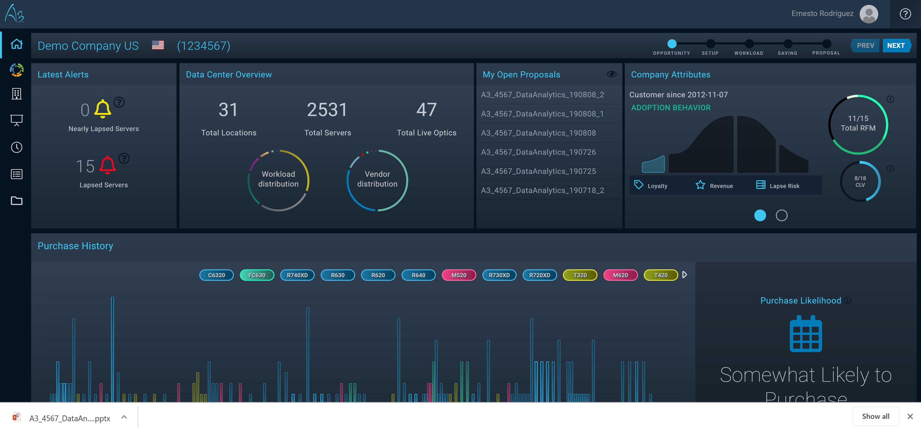
Once complete – you will return to the Dashboard
1
Your proposal is now downloaded to your computer.
Notes:
Machine Learning Insights for Company Attributes:
Adoption behavior – We would like to predict what the customers likely buying pattern is based on previous purchases. If a customer is an early adopter, then we should propose the latest and greatest. Skeptics wait till the server platform has hardened towards the end of the purchase period.
Loyalty – does the customer buy on a pattern for their business from Dell
Revenue – what is the trajectory of revenue for this particular customer compared to past purchase windows
Lapse risk – how many systems are coming off of support entitlements compared to their overall install base from Dell
Cornerstone server – what is the most likely 14G server this customer will purchase based on their previous purchases

