Slide 1

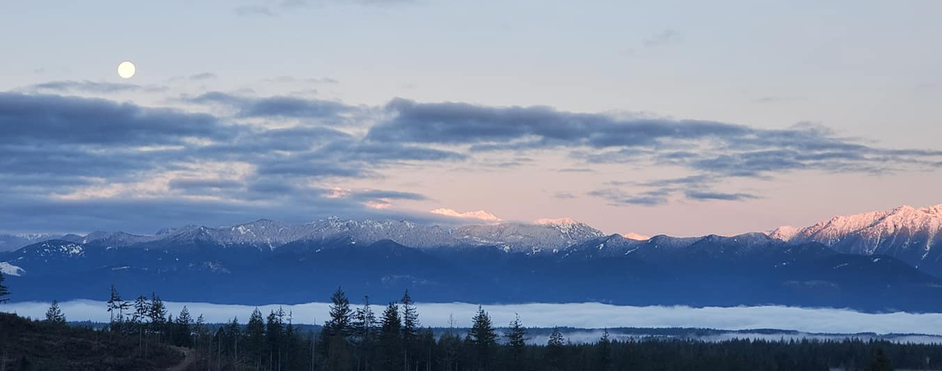
Dirty Turtle 25/50k
Saturday May 16, 2026

Slide 2






Thank you to our sponsors!

Slide 3

Getting Here:
The race starts and finishes at Green Mountain Horse Camp. The directions on Google Maps and maps apps are often incorrect – and will route you up a service road that is closed. Please use the following address to route your GPS –
2575 Tahuyeh Lake Rd NW, Bremerton, WA 98312
This will take you to the home nearest the yellow GM-1 DNR gate (0.4mi away). Once you reach the gate, you will spend another 15-20 minutes driving up the service road to Horse Camp. Please drive respectfully and be courteous. The service road will be marked with arrows to direct you to horse camp.
Click Me!
Map of route to horse camp from road
Google street view of GM1 gate

Slide 4
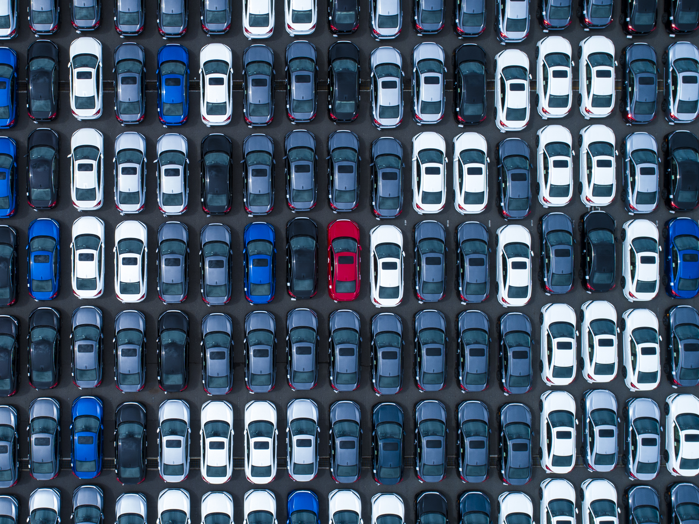
Carpooling is highly recommended!
We have been able to fit plenty of vehicles into the horse camp in the past, but it can be very tight. Please consider carpooling up to horse camp if at all possible.
If you can carpool with a friend, it would help ensure a smooth parking experience for all ☺
Easy spots to park nearby and carpool with friends include nearby trailheads
Wildcat Trailhead
Gold Creek Trailhead

Slide 5
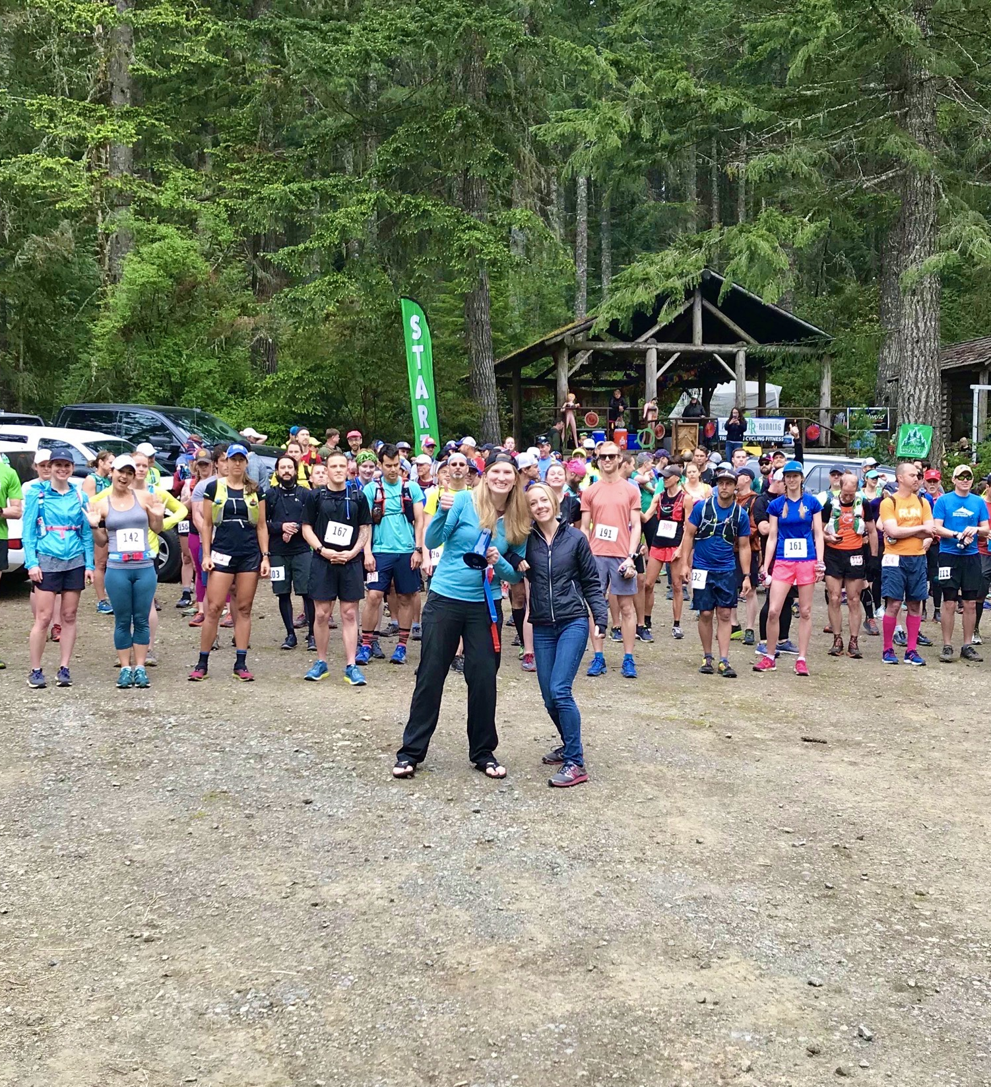
RACE DAY: Saturday May 16, 2026 ALL distances (runners/ruckers) start at 8AM Please allow at least 45-50 minutes to park and pick up bib before race. The road to our parking area is single file, parking is usually a bottleneck – it helps if you arrive early!

Slide 6
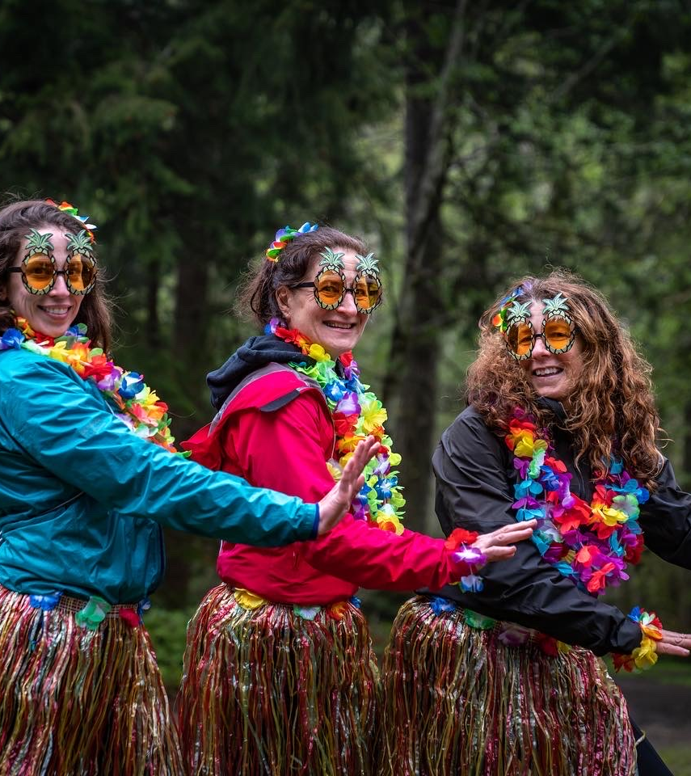
Arrival / Bib Pick Up
Please plan to arrive 45-50 minutes early
There is a 4 mile drive on rough service roads to horse camp, and runners/volunteers may be on the road. Please allow yourself time to drive slowly.
Parking attendants will direct you where to park.
Most parking is AT the horse camp, but some as far as 0.25mi from start/finish. Think of it as your warm up/cool down LOL
Don’t forget your Discover Pass!
Bibs and sign-in will be in the horse camp shelter.
There are some extra first-come, first-serve race hoodies available for purchase ($45+tax, cash/card) at registration table
Previous years’ Patagonia tech shirts ($20)
ETR trucker hats/tees ($15) also available
Custom Kula cloths ($20), and more!
You can leave a drop bag with clothes/camp chair at the shelter (if you don’t want to walk back to your car right after finishing).

Slide 7
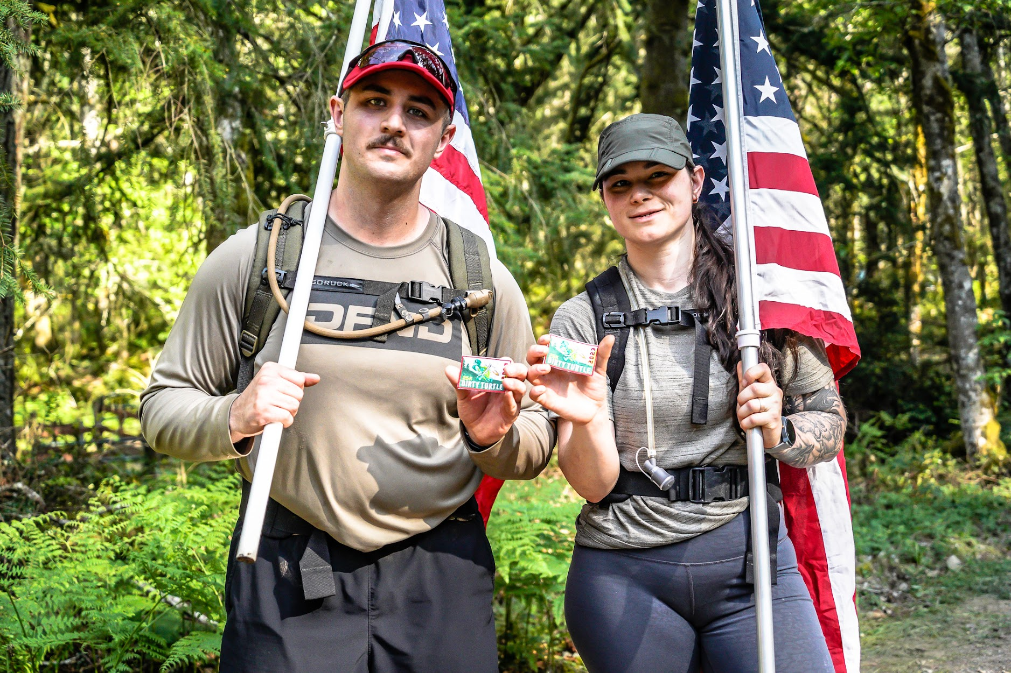
Ruckers
Bring your backpack/rucksack to registration/bib pick up. We will weigh your pack there.
Weighted vests are acceptable.
Packs should contain 20-30 pounds of dry weight (in other words, not including your food and water).
Please make sure your pack contains at least 1L of water to carry between aid stations.
If anyone brings their flag, we would love to have you help for our national anthem before the start of the race!

Slide 8
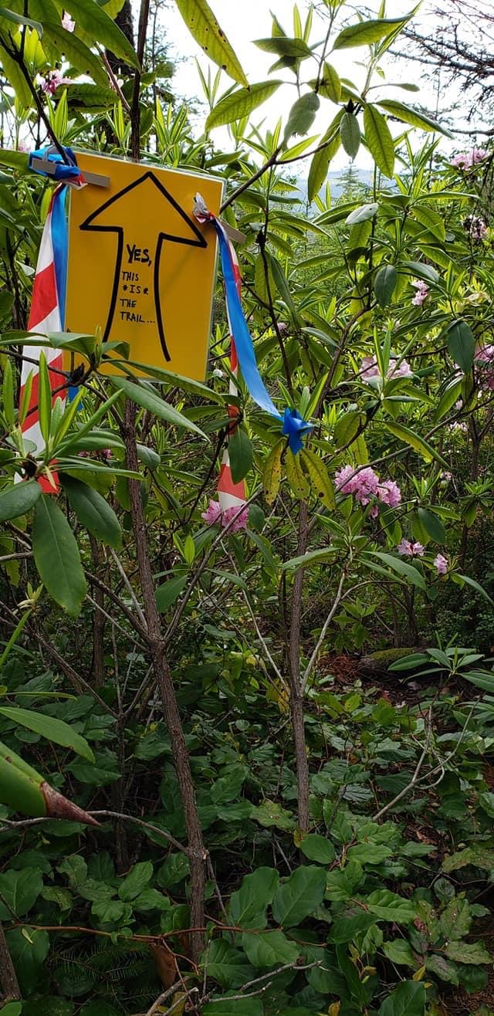
Course Info
Click here to see 25k course.
You can download GPX from the Caltopo map if needed
Click here to see 50k course.
The course is the same as last year. We recommend downloading the GPX files here to your devices, particularly if you are a 50k runner.
25k runners – The 25k loop is roughly 15.6mi with 3700ft of elevation gain.
50k runners – The course follows 2 separate loops. The 50k runners start by running the 25k course. After finishing the 25k loop, you will be sent out on your second loop – a tour of ueland tree farm. The distance of the second loop is about 16 miles with ~3200ft of elevation gain.
Markings: Red White Blue surveyor tape, with yellow arrow signs. Flagging will be placed every quarter mile at a minimum.

Slide 9
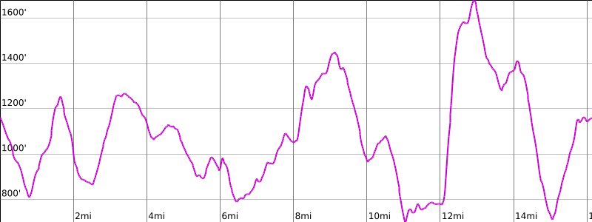
Dirty Turtle 25k Elevation Profile
Look at that beautiful elevation gain!

Slide 10
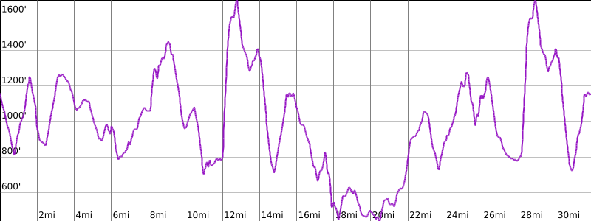
Dirty Turtle 50k Elevation Profile
The 50k is even more beautiful!

Slide 11
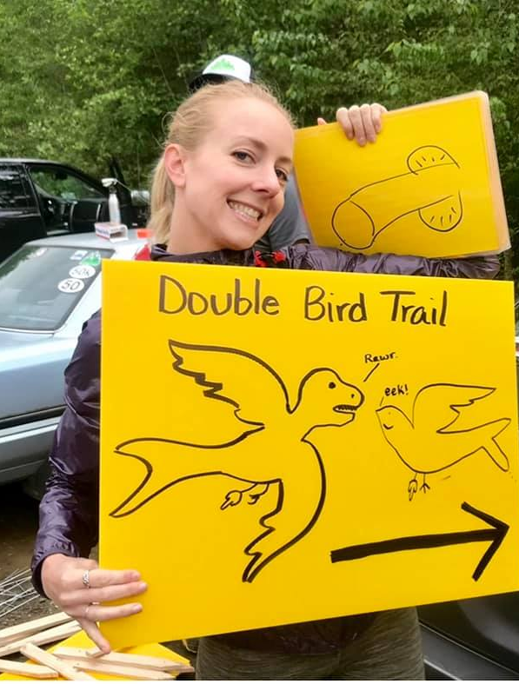
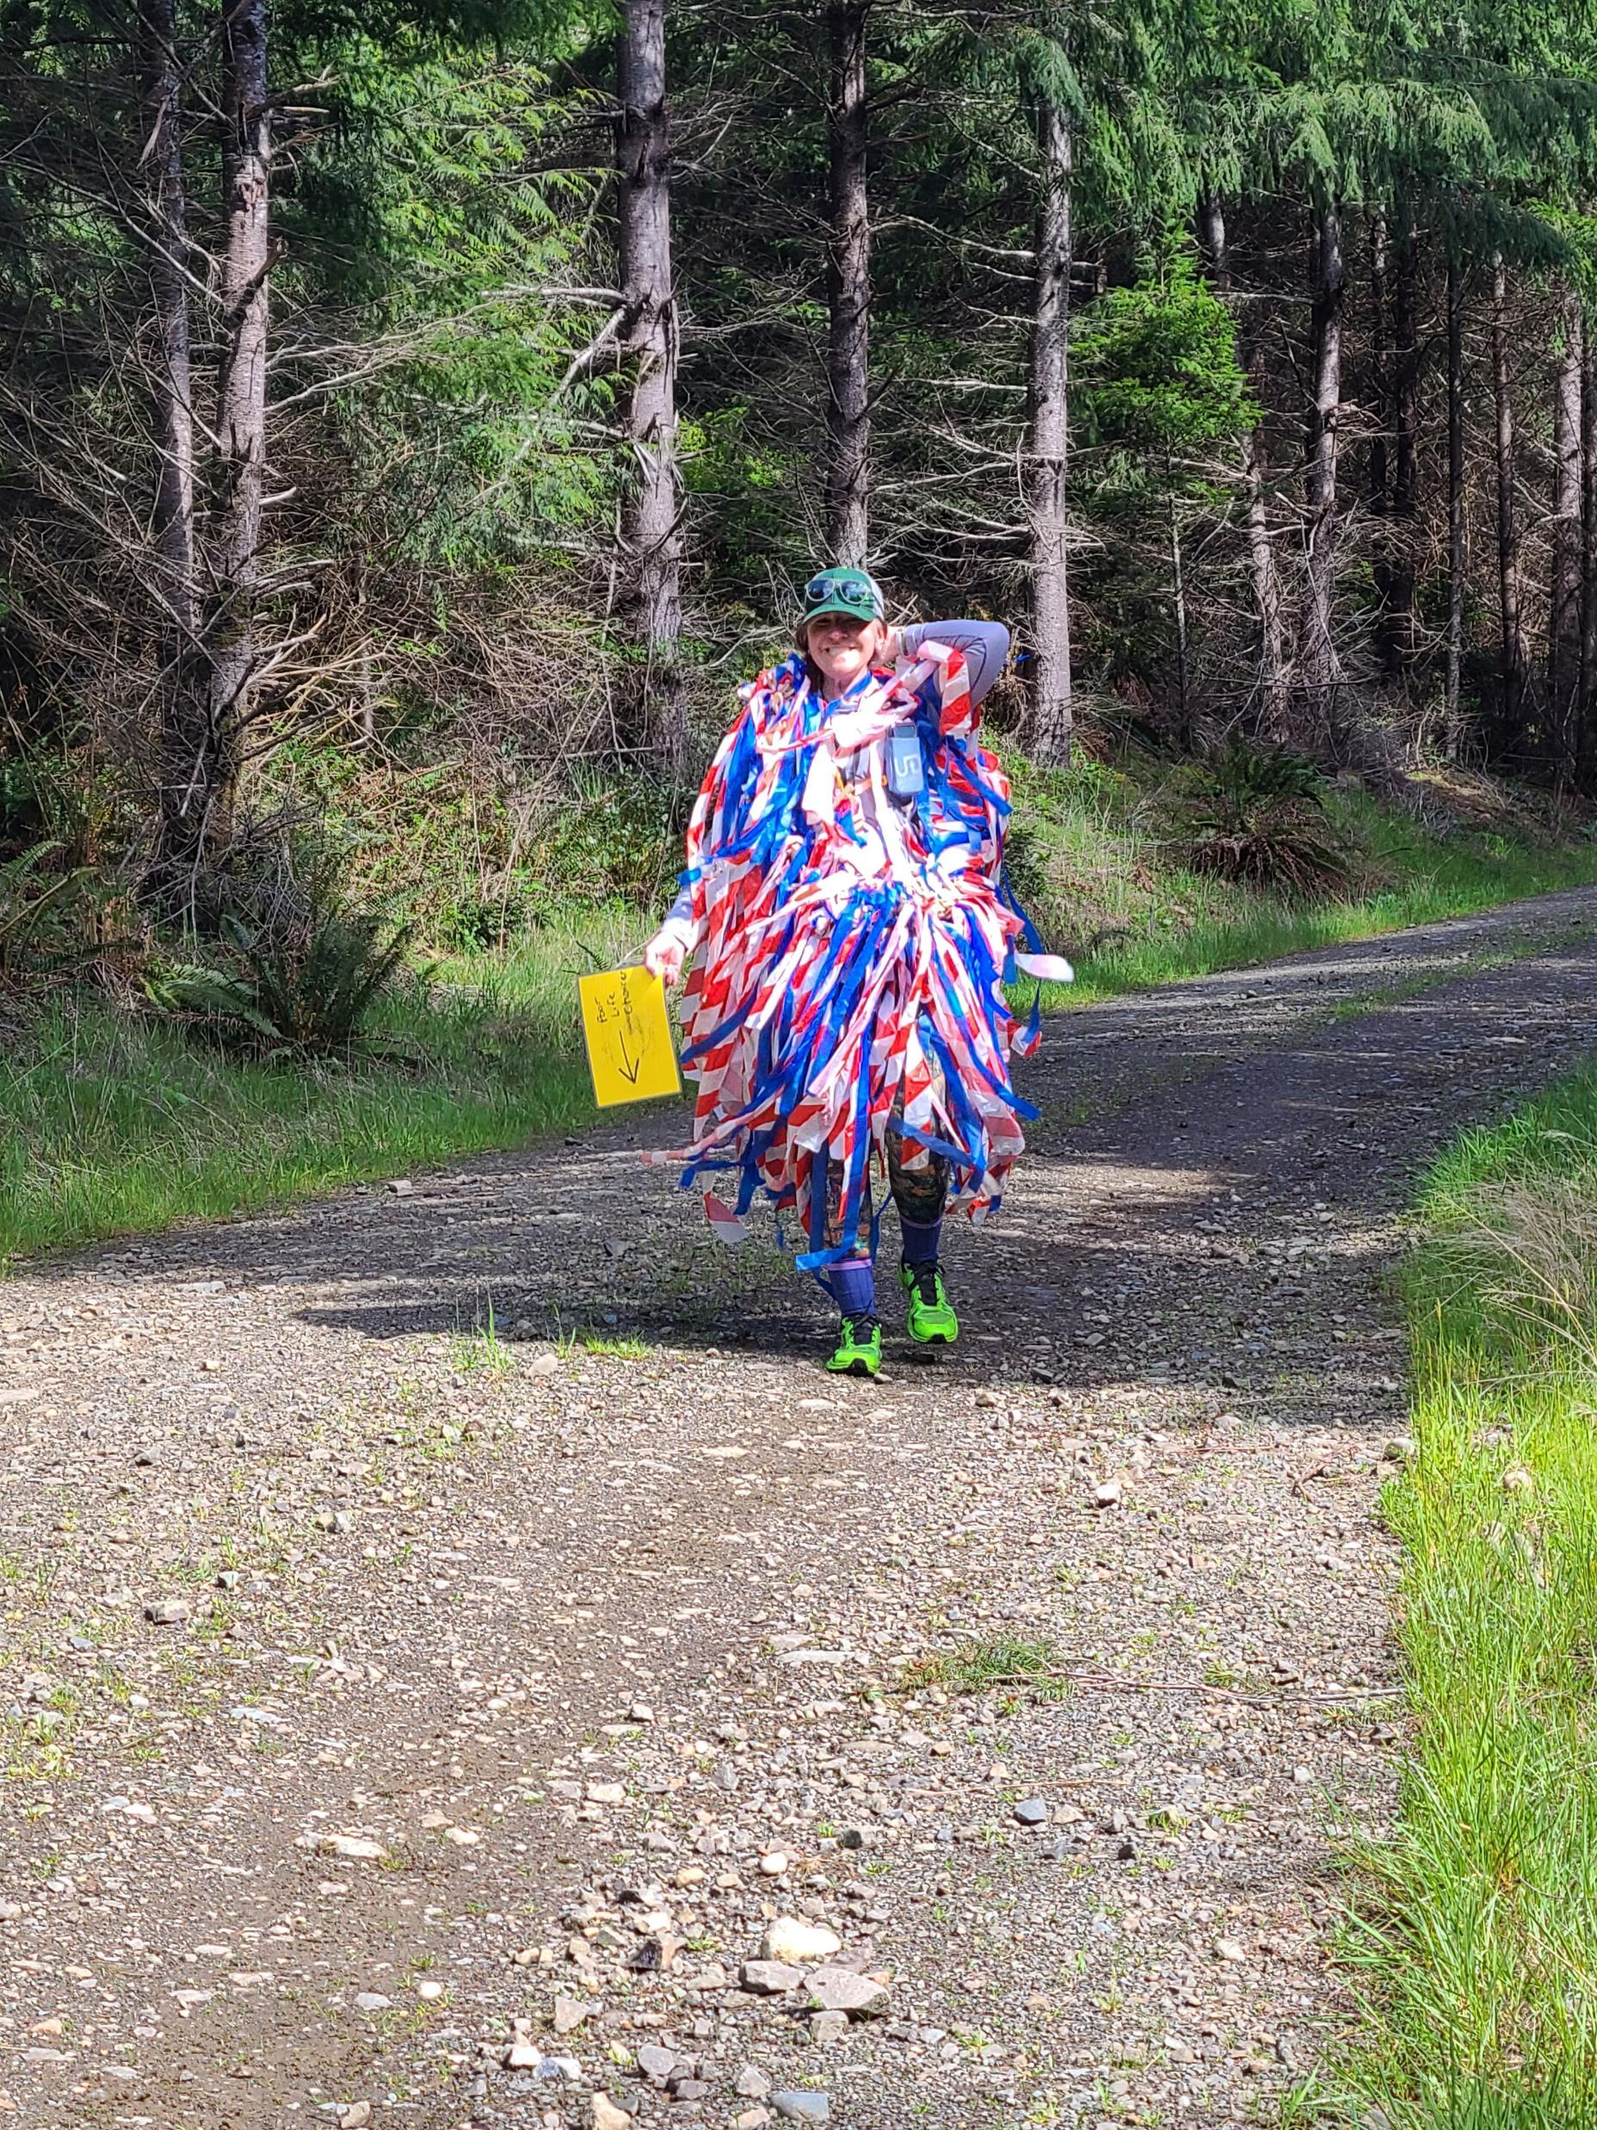
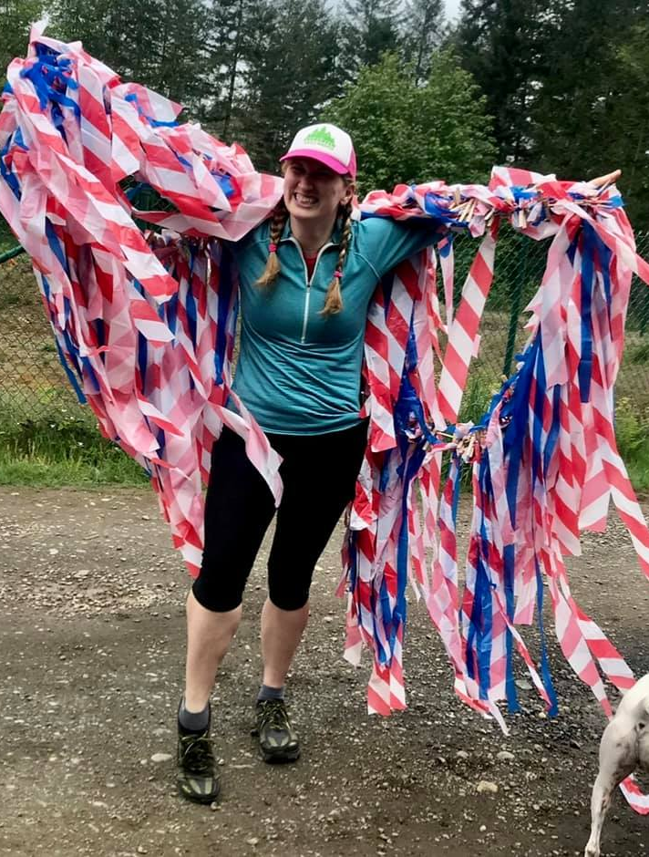
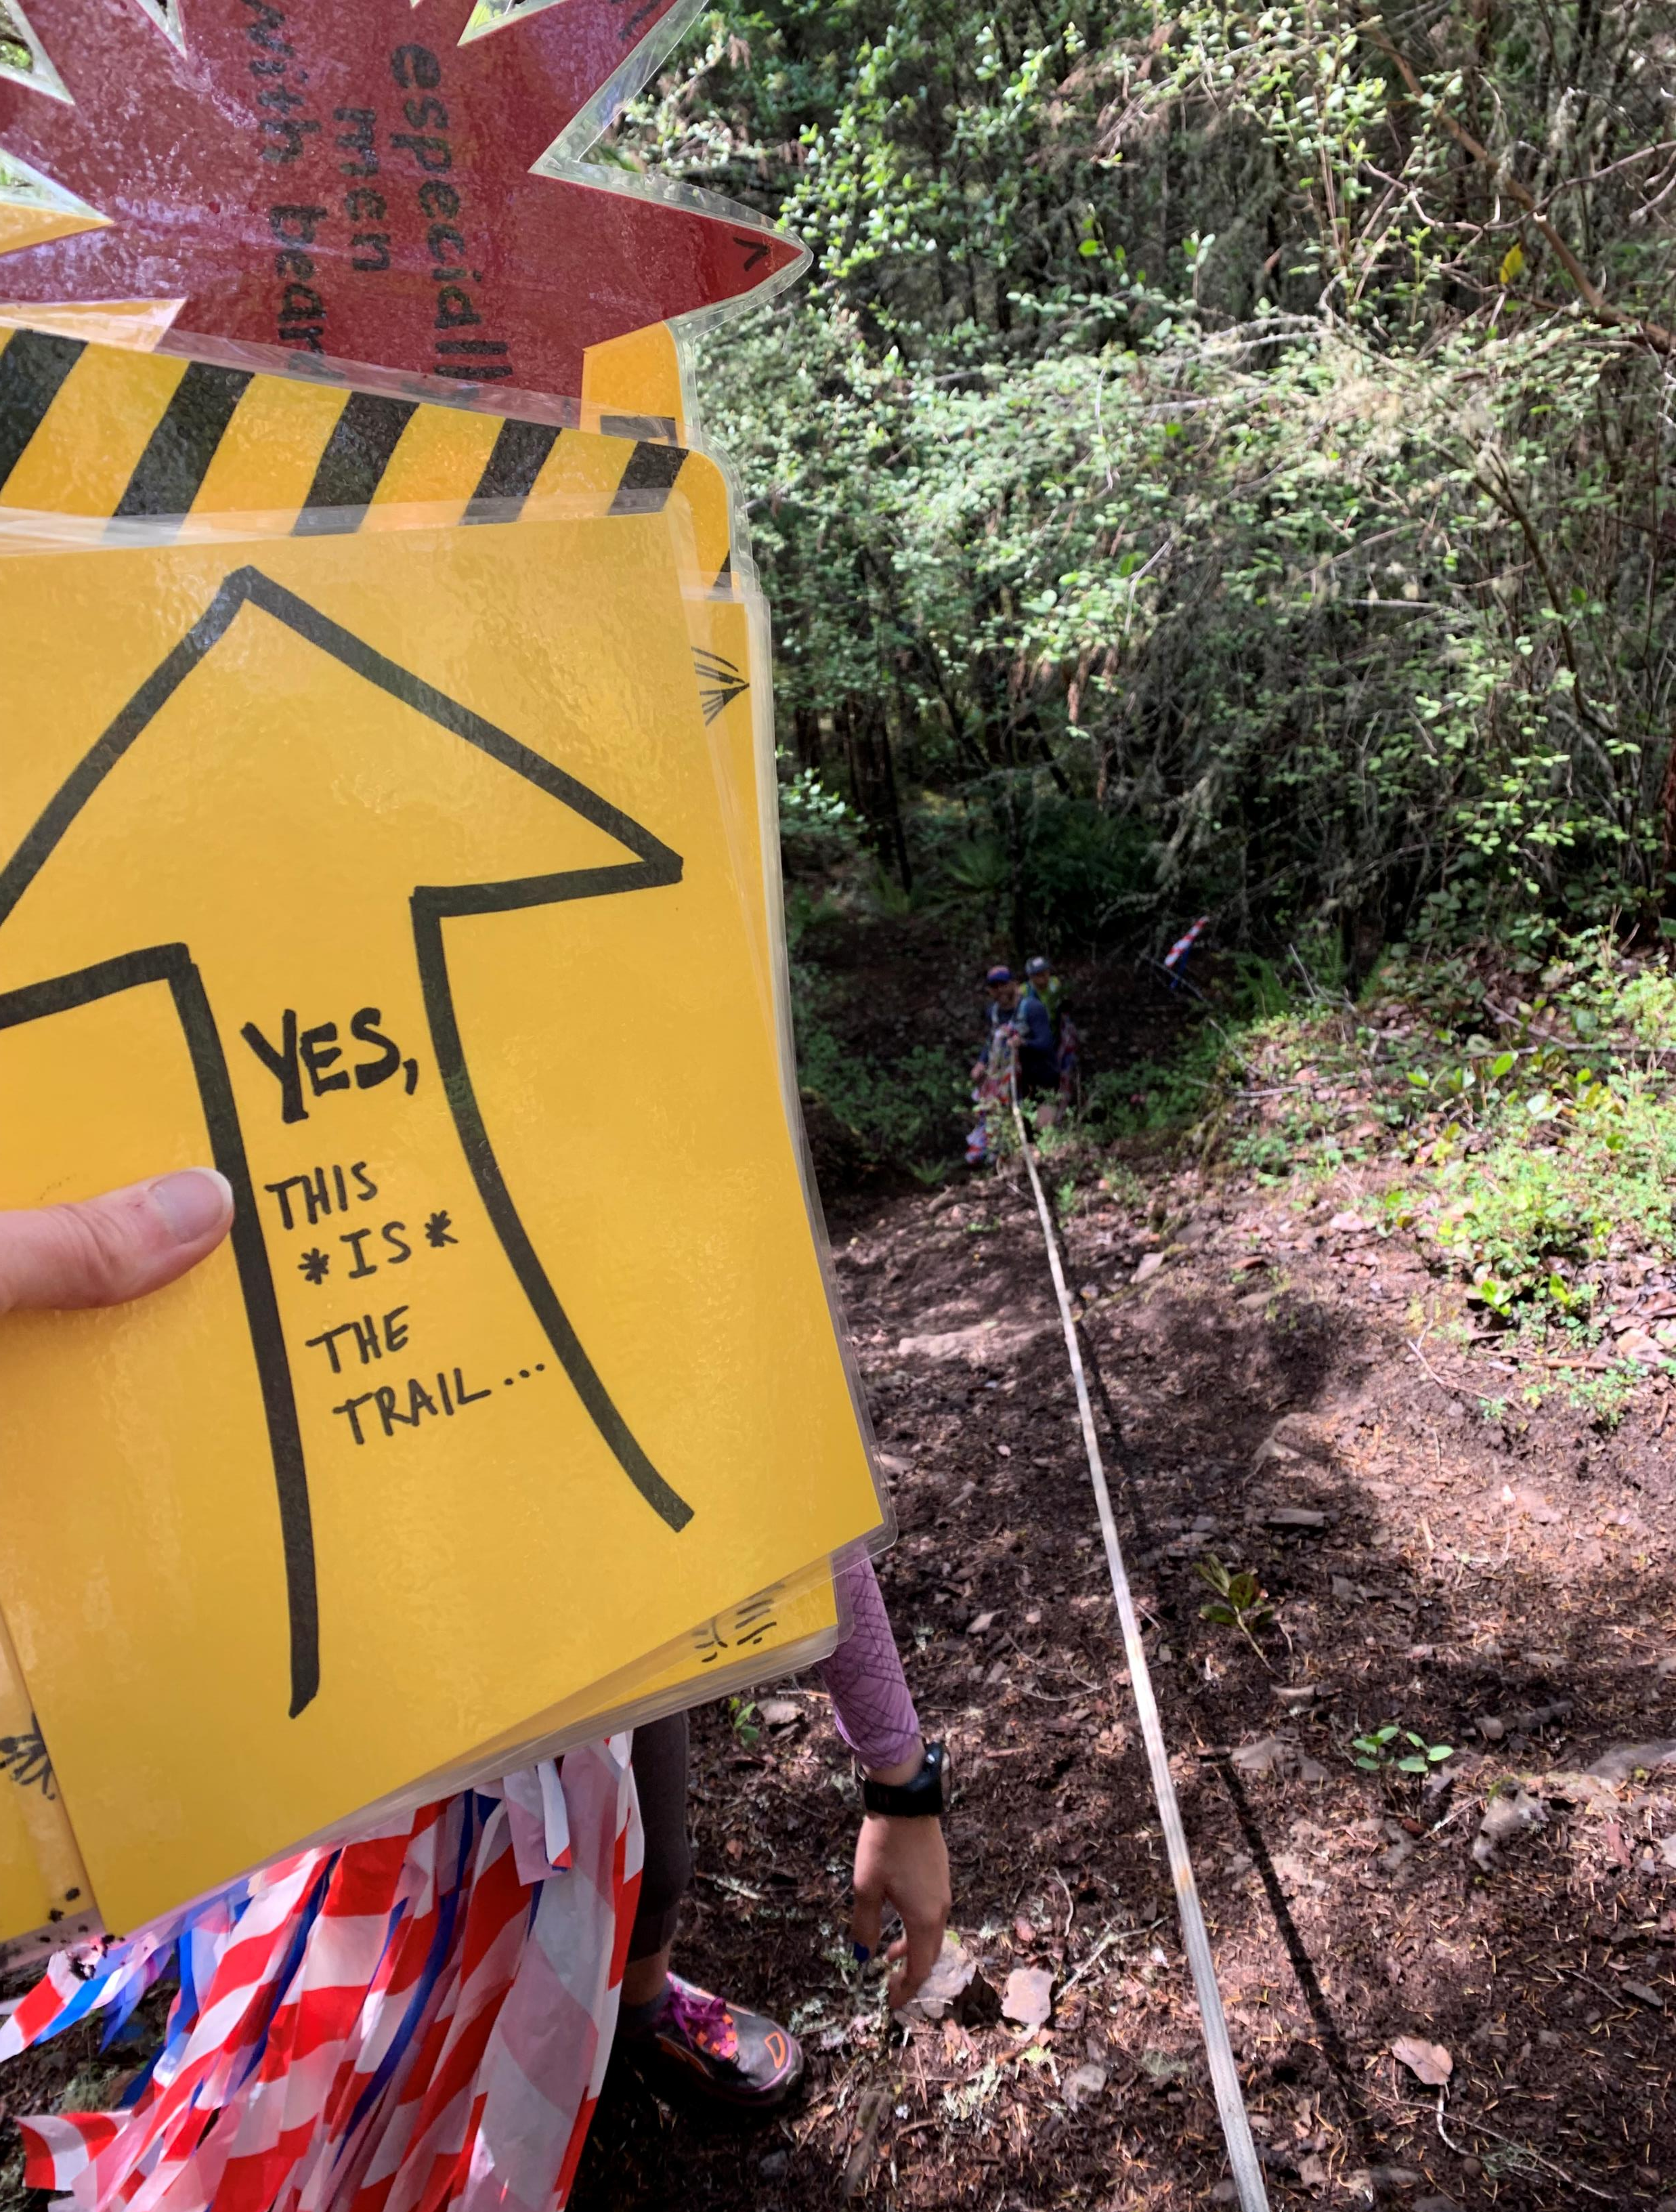
Course Markings
RED/WHITE/BLUE dragon tails, with yellow direction signs at turns/intersections

Slide 12
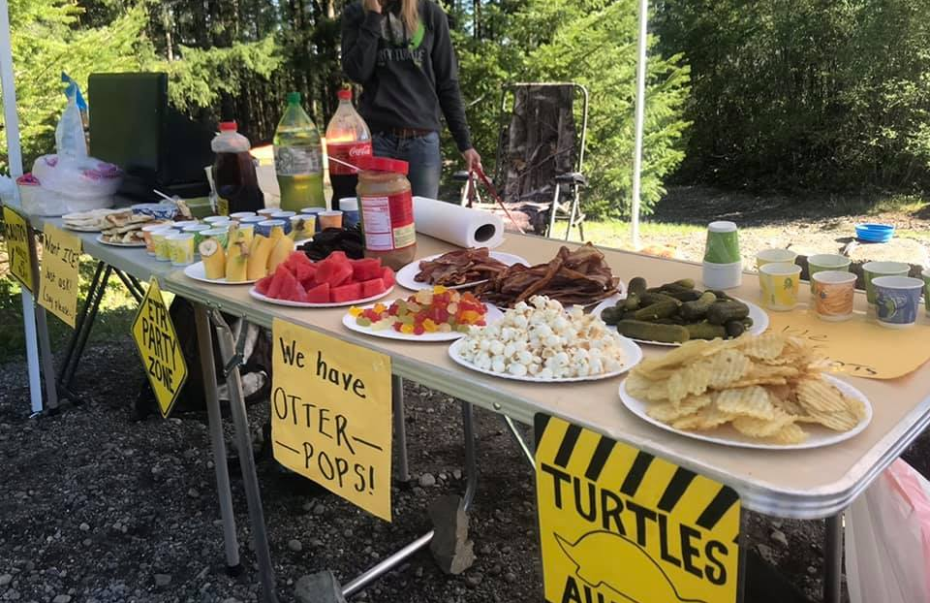
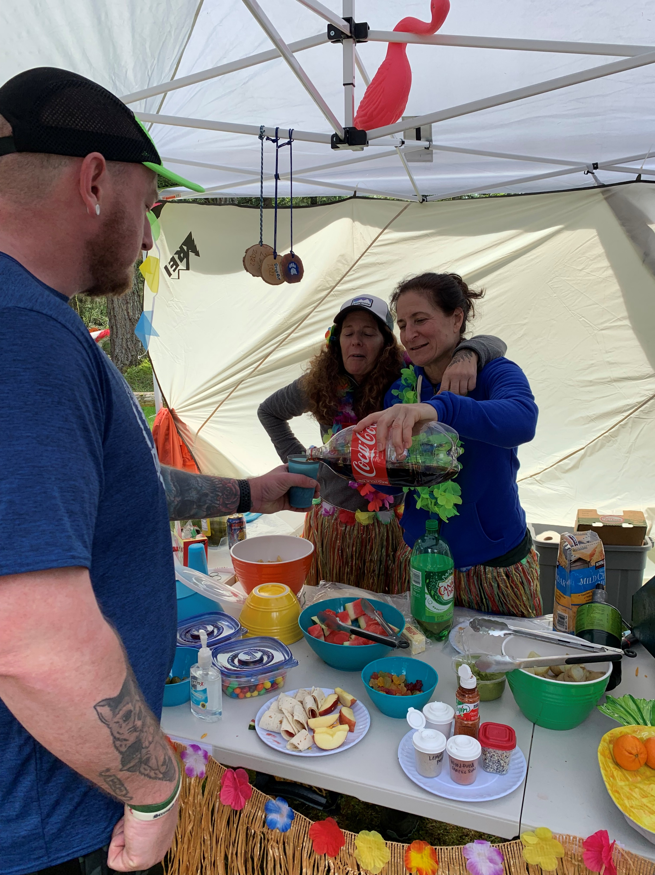

Aid Stations
Horse Camp/Start/Finish Fully Stocked
GM-1 Fully Stocked
Turtle Rock Limited aid
Ueland (50k only) Fully Stocked
-------------------------------------------------
Distance between aid stations is 2-6 miles. 50k runners have some longer gaps between aid on second loop.
Runners and ruckers must carry 1 liter of water minimum.
Aid station foods will include candy, chips, soda, quesadillas, potatoes, fruit, etc.
Water and electrolyte (Skratch) will be available
If you have a reusable cup from prior races, bring it for fireball shots! ☺
**IMPORTANT: Every runner MUST check in at aid stations before leaving **

Slide 13
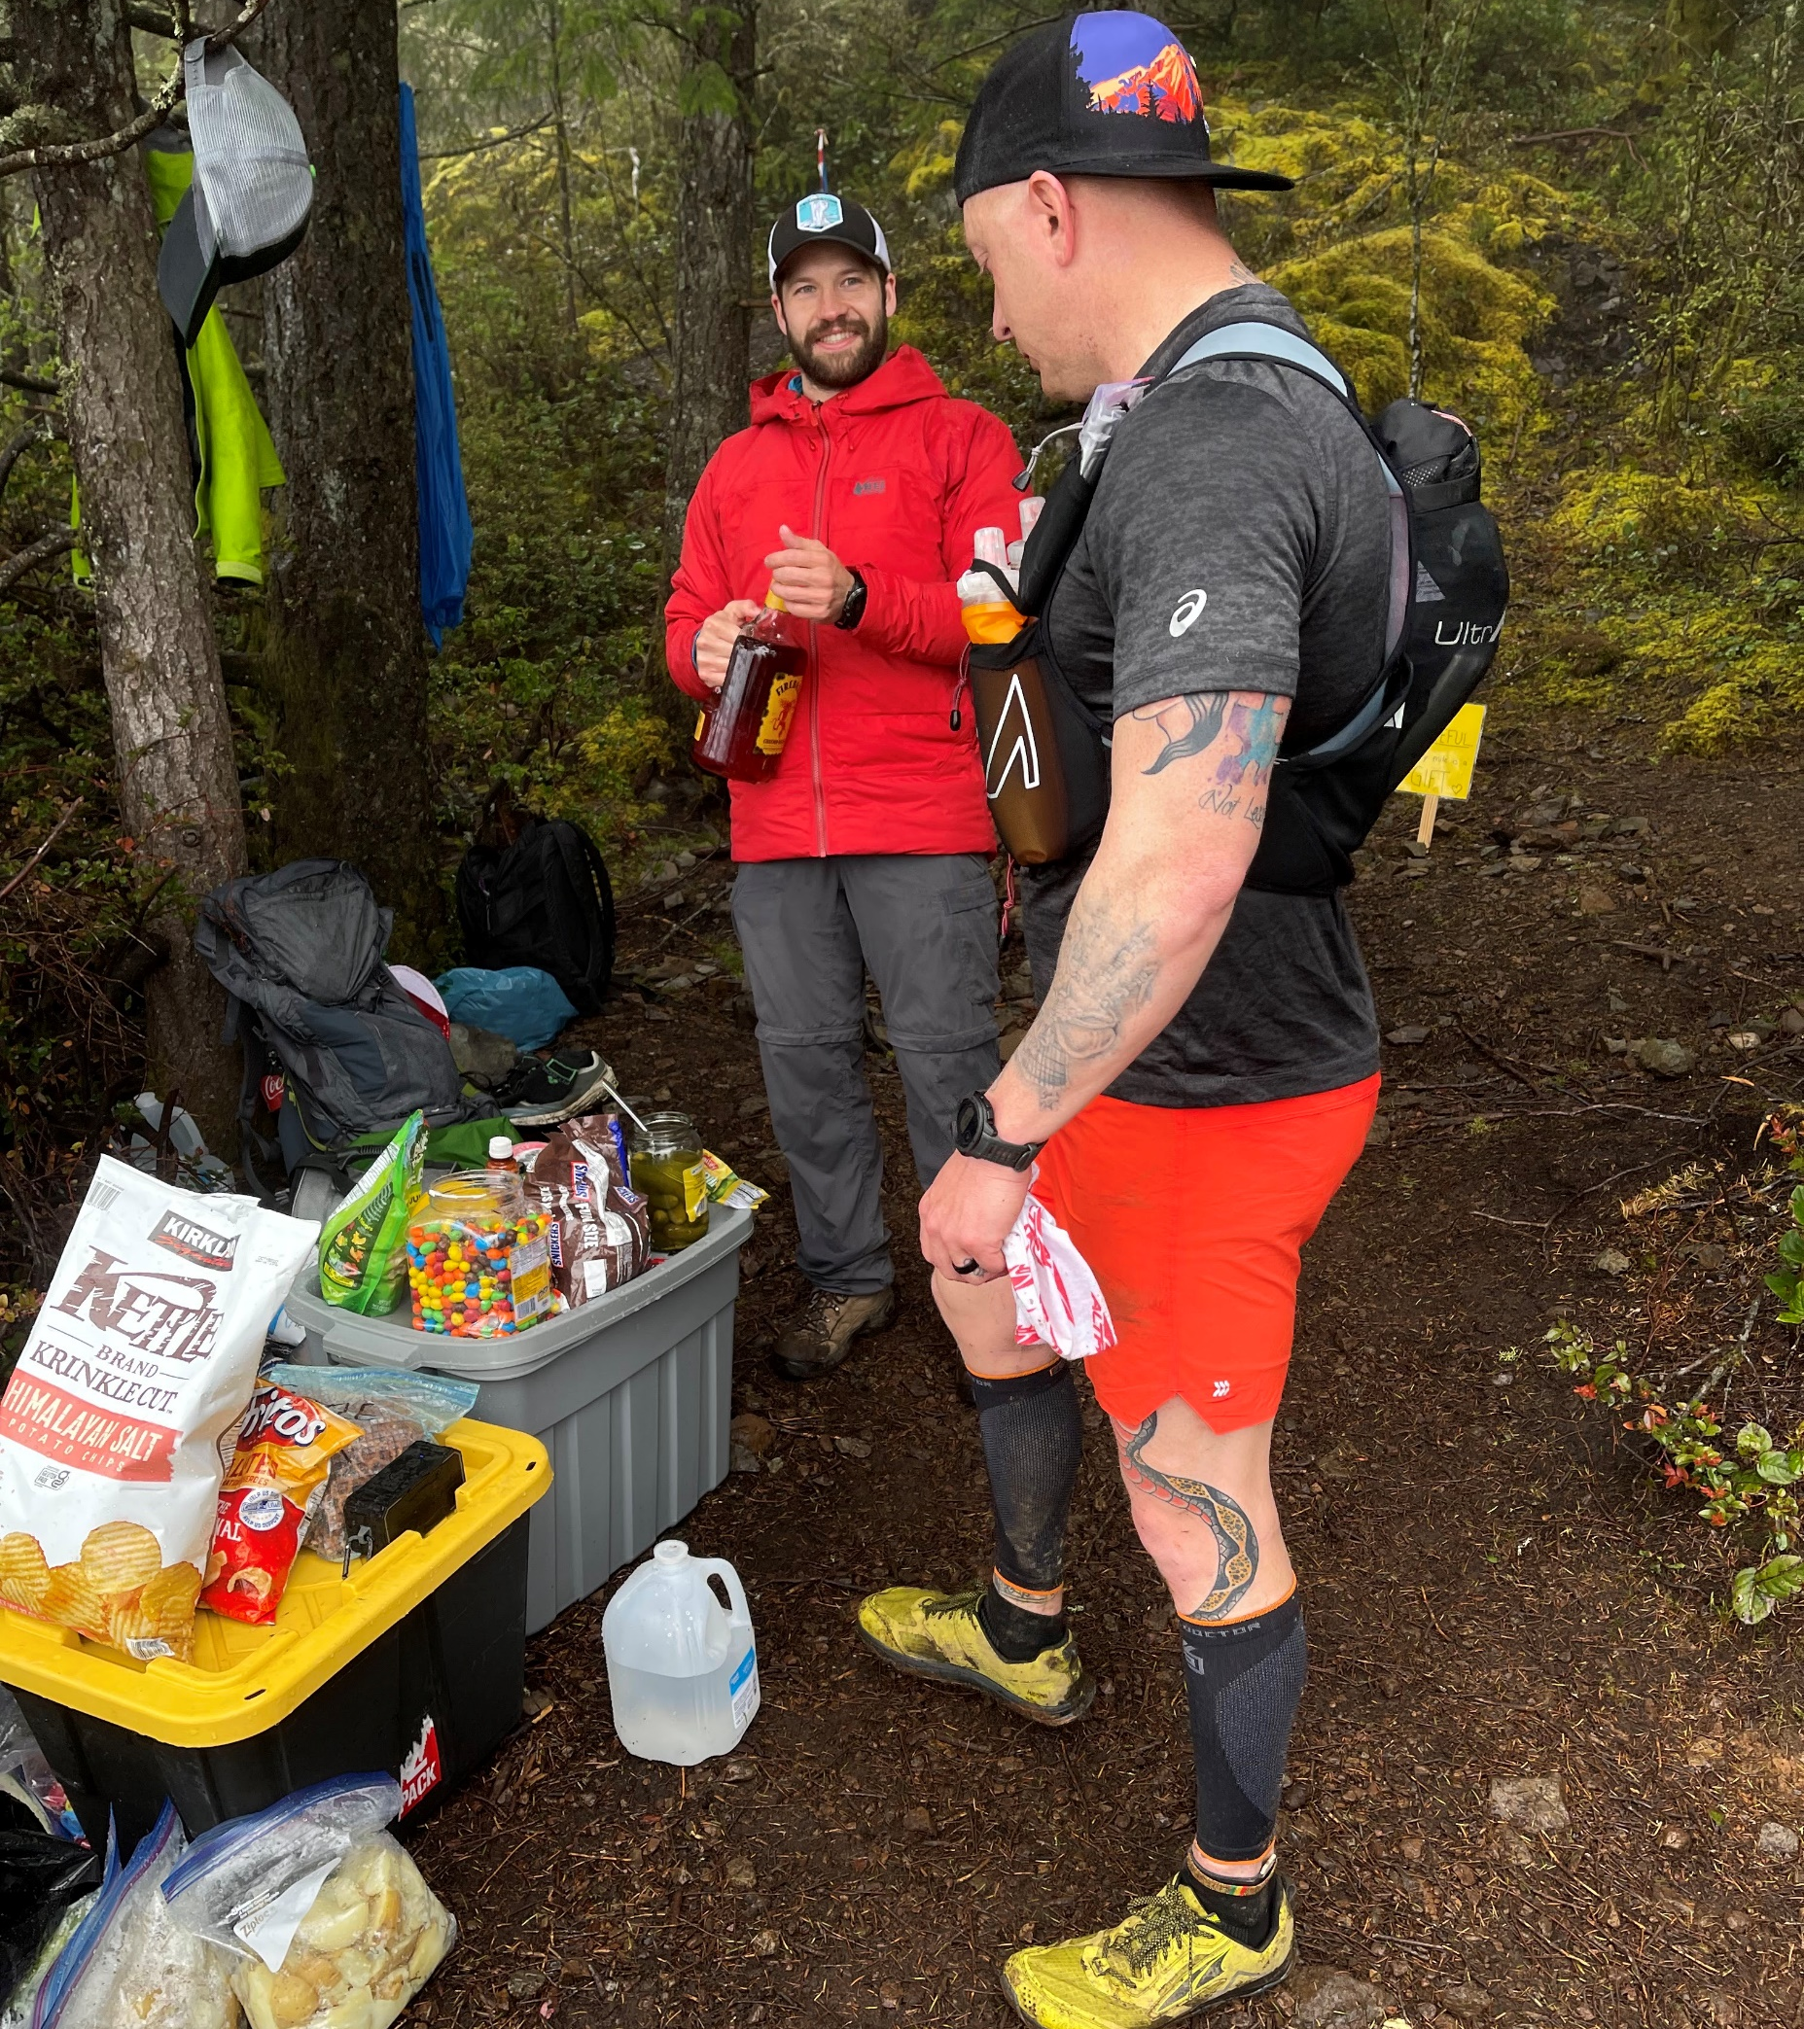

Aid Stations (cont). Start Mile 3 – Horse camp Mile 8.9 – GM1 Mile 12.5 – Turtle Rock Mile 13.5 – GM1 Mile 15.5 – Horse camp Mile 23ish – Ueland Mile 28ish – Turtle Rock Mile 30ish – GM1 Somewhere after mile 31, depending on your watch…Finish

Slide 14
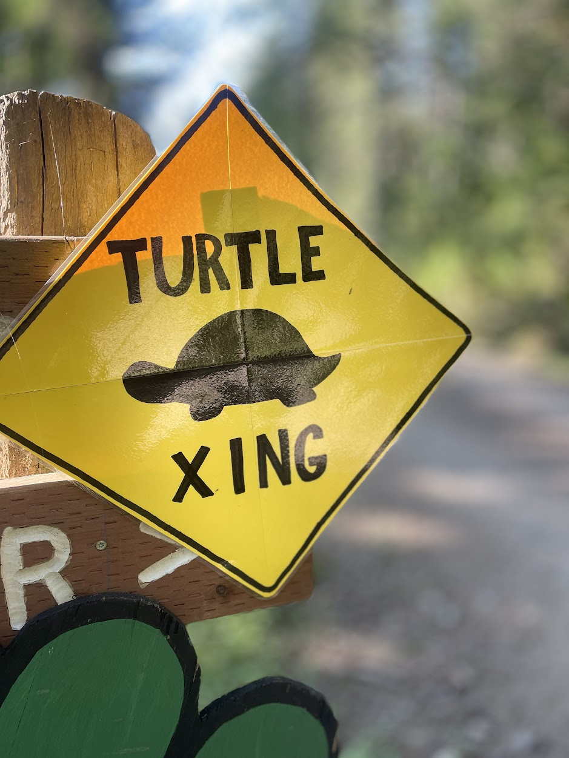
Safety
Course safety: This is not a “closed” course, there is a short section of the course ON the road to horse camp.
All runners/ruckers are required to carry their own hydration and spare food. We require all to carry 1L of water minimum. This is NOT a road race --- it may take you an hour or longer in between aid stations.
If you have medical concerns, or if another runner has injured themselves, please notify aid station staff.
For any medical emergency, first call 911, then notify Gretchen (619) 750-1443. Please save this number to your phone, or take a screen shot of this to have on hand.
We have medical kits at several aid stations to patch up your boo-boos as well.

Slide 15
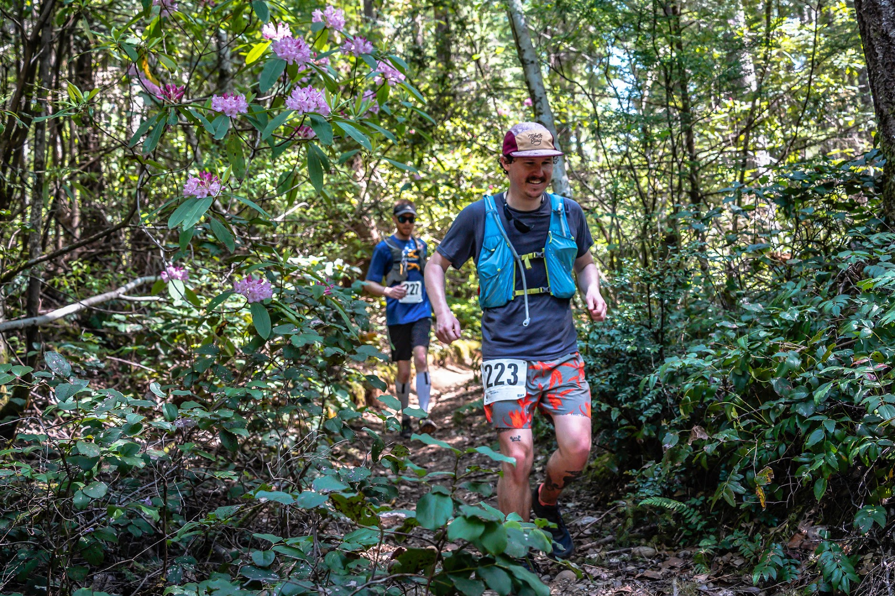
Trail Etiquette
Please be courteous of other trail users, other runners, and volunteers. If you come across other hikers or trail users, please alert them of your presence and give them a chance to move over for you to pass. Please yield to faster runners when feasible. Pushing or injuring other runners will result in you being disqualified. Please treat our running family with respect. <3
One Ear Bud Only:
If you must wear headphones, they may only be in one ear, and the volume must be low enough that you can hear others around you.

Slide 16
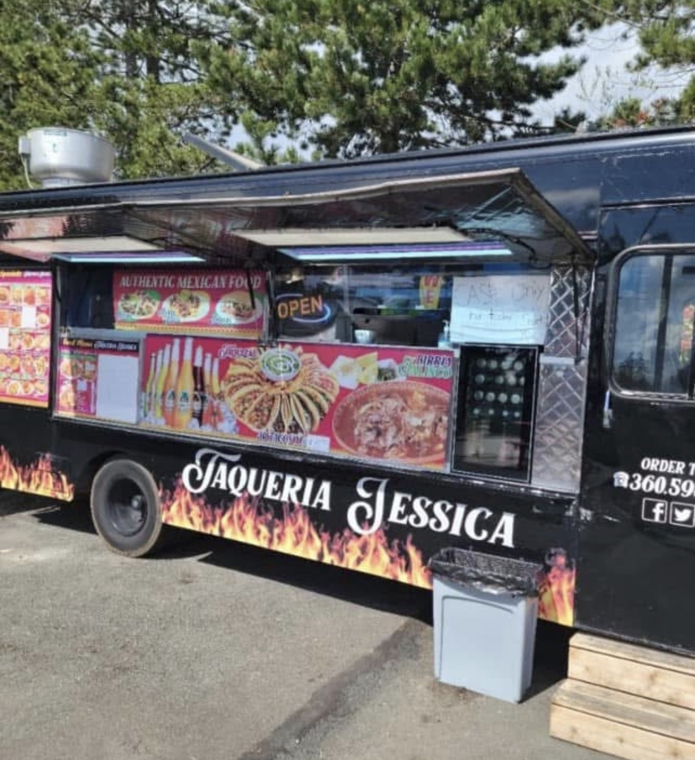
Post Race Grub!
Our post race food truck is Taqueria Jessica!
They will be serving burritos – with several options for your protein. Vegetarian options available.
Our post race food for runners has been paid for (one meal each), so please stop and grab a bite after you finish the race! Your bib will get you the free meal, so make sure to show it to them!
The food truck will be open for your family and friends to buy from as well!

Slide 17
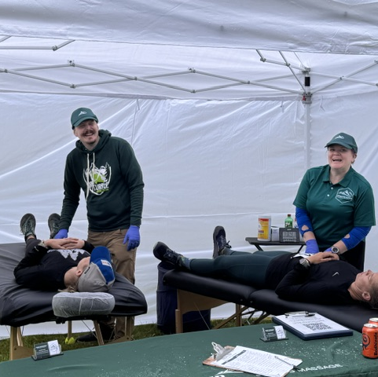
Post race massage for your sore muscles will be available when you finish – big thank you to Trailblazer Sports Massage!

Slide 18
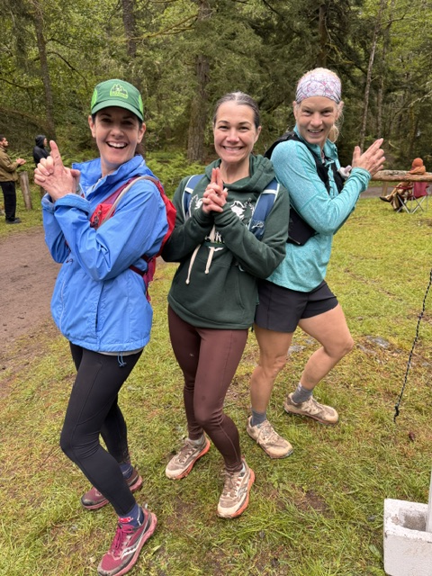
See you SOON!!!

