Slide 1
Introducing Claroty
The Industry’s Leading Industrial Cybersecurity Company

Slide 2










Claroty’s Mission
Our Mission
Your Result
Secure Industrial Control Networks from cyber-attacks to ensure the safe and reliable operation of the world’s most critical infrastructures
Better security and reduced downtime
for your critical OT environments
Notes:
Our mission is clear and focused. We are fixated on protecting industrial control systems from cyber attacks.
We are carrying out this mission with customers in 10 vertical segments with production implementations across 6 continents.
For example we are protecting industrial operations for:
Top 5 Oil&Gas company
The world’s largest pharmaceutical company
The world’s largest beer and soda company
Your Result - Better security and reduced downtime, for your critical OT environments.

Slide 3










Claroty at a Glance
Founded: 2014
Heritage: Team8 Foundry
Total Investment: $93M Employees: 105+ [60 R&D]
Via Aster Capital
Via Next 47
HQ
Unprecedented Investor Syndicate
Global Reach
New York (HQ) | Washington | Houston | Tel Aviv | Paris | Brisbane
Notes:
We began our mission in 2014 and exited ”stealth mode” in September of 2016 with multiple production customers.
With help from an unprecedented syndicate of investors, including Rockwell, Siemens and Schneider Electric, we have built the leading company in industrial cyber today.
We have received $93M in investment and have team of well over 105+ people - more than half of them are in R&D.
We are the most well funded and resourced startup focused on the ICS cybersecurity space today.
{note: This is entirely accurate. there are others that are both IT/OT that may be larger but as far as those focused on ICS we are the big dog.}
Our customers are running global operations and we operate globally as well.

Slide 4








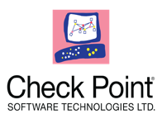







Claroty at a Glance
Unmatched Industry Partners
Technical Ecosystem
Notes:
Our mission is clear and focused. We are fixated on protecting industrial control systems from cyber attacks.
We are carrying out this mission with customers in 10 vertical segments with production implementations across 6 continents.
For example we are protecting industrial operations for:
Top 5 Oil&Gas company
The world’s largest pharmaceutical company
The world’s largest beer and soda company
Your Result - Better security and reduced downtime, for your critical OT environments.

Slide 5

The Perfect Storm
ICS INSECURE BY DESIGN
INCREASINGLY CONNECTED
ACTIVE THREAT LANDSCAPE
Flat networks
Weak authentication
No encryption
Insecure ICS protocols
Difficult/rare patching
Vendor remote access
Shop floor to top floor KPIs
Data analytics programs
Supply chain integration
Predictive Analytics
Nation-State Attacks Target ICS
Repeated Warnings From DHS/FBI, GCHQ, Others
Billions in Collateral Damage from Ransomware Attacks
Zero Visibility into ICS Networks
Notes:
Today, three key factors are driving a “perfect storm” that has raised the importance of protecting industrial systems.
We all know that security was not the primary design principle for OT networks. Many “brown field” systems were commissioned years ago and are inherently insecure.
We also know that “air gap” air gaps have disappeared as OT systems are increasingly interconnected with the IT networks for various important business purposes.
We now have a very active threat landscape impacting ICS. This includes nation-state adversaries who continue to targeted critical infrastructure. This also includes non-targeted attacks like NotPetya and WannaCry that have caused billions of losses to operations from collateral damage. Organizations worldwide now understand that they don’t have to be the target to be a victim of an attack.
Lastly, most organizations have no or very limited visibility into their ICS networks.
{NOTE: GREAT TIME TO ASK WHAT IS DRIVING THEIR INTEREST IN ICS CYBERSECURITY}

Slide 6








How Do You Protect a Network That is Invisible?
Level 4
Corporate Network
Security Operations Center (SOC)
Enterprise
Management Console
Log Mgmt..
SIEM
Analytics
File Servers
ERP
Mail
CRM
Firewall
Secure Remote
Access (Central)
Level 3.5
IT/OT DMZ Zone
Jump Box
Secure Remote
Access (Site)
Repl. Historian
Patching Server
Extreme Visibility
Discover ALL Assets (including nested assets)
What each asset does
How assets are configured (and changing)
Deeply Understand Communications
NetFlow details (who, how often…)
Process automation conversations (layer-7 application)
Switch
SSH Reverse Tunneling
Level 3
Operations
Continuous Threat Detection
Operator Station
DNS
SPAN
Historian
Active Query
Level 2
Process Network
Scada Server
Scada Server
HMI
HMI
Switch
Level 1
Control Network
RTU
RTU
PLC
PLC
Level 0
Field Devices I/O
M
S
Pump
Valve
Sensor
Fan
Actuator
Valve
Pump
Fan
Notes:
Most organizations have no or very limited visibility into their ICS networks.
One of the most fundamental issues preventing many companies from effectively securing their OT environments is a lack of visibility into the structure of their ICS networks. As the handful of organizations that are at the forefront of providing visibility into those networks can attest, deploying purpose-built network monitoring routinely finds connected endpoints that nobody on the security team knew about, or they were not expected to be connected to a particular network, or they are communicating in unexpected ways, etc. Obviously, it’s impossible to protect what you can’t see. So, adopt technologies that provide visibility into all levels of your OT networks, down to serial / fieldbus connectivity, and incorporate that visibility and OT-specific threat detection into your IT SOC.

Slide 7
Claroty Platform Capabilities
Where to Start With ICS Cybersecurity?
Fast
Basic OT Network Visibility
Extreme OT Network Visibility
Virtual OT Network Segmentation
Speed (Time to Value)
Real-Time Threat Monitoring
Secure Remote Access
Vulnerability/Patch Mgmt.
Unidirectional Gateway “Data Diode”
Traditional Virus Protection
Advanced Endpoint Protection
OT Network Segmentation
(micro-segmentation / zones / conduits)
Risk Mitigation
Slow
Low
High
Notes:
Key points on slide:
Power of the platform
Basic visibility does not provide much
Extreme Visibility powers the segmentation, monitoring
Many of our customer are working to build a defense in depth strategy for their OT environments. But where do you start?
{Note: OPTIONAL SLIDE – But be careful. If the audience has not allocated funds for a monitoring solution you will need to make the case of why to start with visibility/monitoring. And this is also a good slide to ask them what they are planning to do, how they approaching the problem and to convince them that visibility and threat monitoring are fundamental components}
We are often asked about the what steps organizations should take to mitigate the risk they face in ICS environments – this typically includes a discussion about which security technologies they should implement and in what order.
The “conventional wisdom”, following the traditional IT Security Playbook is
Do a risk assessment – this includes conducting a thorough asset inventory (we agree and we can help) - It is important to know where you are to build a good road map for risk reduction AND to help communicate the risk to people who control the budget and govern the systems. You will, of course, need their full support. Claroty can help you here.
Next step is to begin a comprehensive network segmentation project. We agree that network segmentation projects – both segments between IT and OT and segmentation within the OT network are very important. Claroty technology can help expedite these projects.
Once that is finished, begin building in your “defense-in-depth” controls – Claroty can help reduce a key risk – insecure remote access that many organizations face with their ICS network.
We believe the starting point should be visibility into your ICS network. Knowing exactly what you have to protect can help expedite important activities such as segmentation projects.
We also believe that threat monitoring is a priority. It does not make sense to wait to add monitoring until all the defense-in-depth capabilities are implemented. You will want very early warning about new threats in your ICS environment so you can detect and stop attacks as you build out your defenses.
There are no silver bullets in security. It will take a comprehensive risk-based approach to provide an acceptable level of security for ICS environments.
But we do believe that gaining visibility and providing ongoing threat monitoring can provide great risk management benefits in a very short timeframe and very cost effectively.

Slide 8
What Sets Claroty Apart
Most Comprehensive Protection, Detection, and Response
  Integrated Claroty Platform for defense in-depth
  Streamlined deployment and management for reduced TCO
Best-in-Class Threat Detection and Response
  Near 100% “extreme visibility” yields advanced anomaly detection
  Rapid triage and shortened remediation for reduced downtime
Proven, Scalable Enterprise-class Software
  Battle-tested in very-large deployments across 6 continents
  Validated by Rockwell, Siemens, Schneider, Belden/TripWire
Leverage Your Existing Network & Security Infrastructure
  Out-of-Box integrations with: SIEM/Analytics, Firewalls, NAC, etc.
  Proactive protection and automated response
  Efficient IT/OT SOC performance

Slide 9


Claroty Platform – Reference Architecture
Level 4
Corporate Network
Security Operations Center (SOC)
Enterprise
Management Console
Log Mgmt..
SIEM
Analytics
File Servers
ERP
Mail
CRM
Firewall
Secure Remote
Access (Central)
Level 3.5
IT/OT DMZ Zone
Jump Box
Secure Remote
Access (Site)
Repl. Historian
Patching Server
Switch
SSH Reverse Tunneling
Level 3
Operations
Continuous Threat Detection
Operator Station
DNS
SPAN
Historian
PCAP
Active Query
Level 2
Process Network
Scada Server
HMI
Scada Server
HMI
Security Posture Assessment
Switch
Level 1
Control Network
RTU
RTU
PLC
PLC
Level 0
Field Devices I/O
M
S
Pump
Valve
Sensor
Fan
Actuator
Valve
Pump
Fan
Notes:
This reference architecture shows a sample industrial network and where the Claroty Platform products fit into the picture. I will give a brief overview and then we will take a deeper dive into each product.
Our Flagship product, Continuous Threat Detection, provides visibility and real-time threat and vulnerability monitoring. This product sits “out of band” on the SPAN port of a switch, safely and passively monitoring the network. There is no actual “footprint” on the ICS network so you don’t need plant downtime to install or update agents.
Secure Remote Access provides policy-based controlled and monitored access to into your ICS network and removes an important attack vector. Is it typically used by employees and contractors to safely access and manage the assets in the ICS network from outside the plant or operations.
Lastly, our Enterprise Management Console, provides an enterprise-wide view that supports our customers who have distributed plants or operations and want a consolidated view and also need to integrate this data with existing SOC tools.

Slide 10
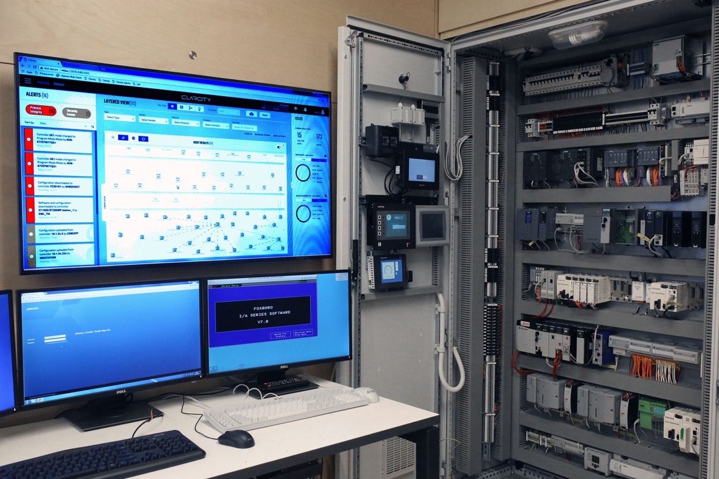
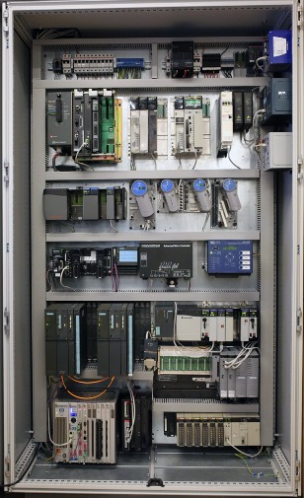
Claroty CoreX Engine
Claroty Research + Multi-million Dollar ICS Lab = Advanced Technology
Notes:
Claroty Platform is powered by Claroty’s advanced CoreX engine
It was specifically designed to ensure safe, secure and reliable operations in large, complex industrial networks.
The base of our CoreX engine is comprised of proprietary dissectors for all major IT and industrial network protocols–both open and proprietary.
The dissectors leverage deep packet inspection to safely extract information from both serial and IP-based networks. These dissectors extract precise details about each asset on the network, capturing exactly how assets are communicating across the network and leverage this information to build a high-fidelity baseline model.
Claroty has made a multi-million dollar investment into the most extensive ICS lab in the industry and has by far the largest research team dedicated to building and maintaining protocol dissectors. Our heavy investment ensures your systems will continue to have the best protection available.

Slide 11
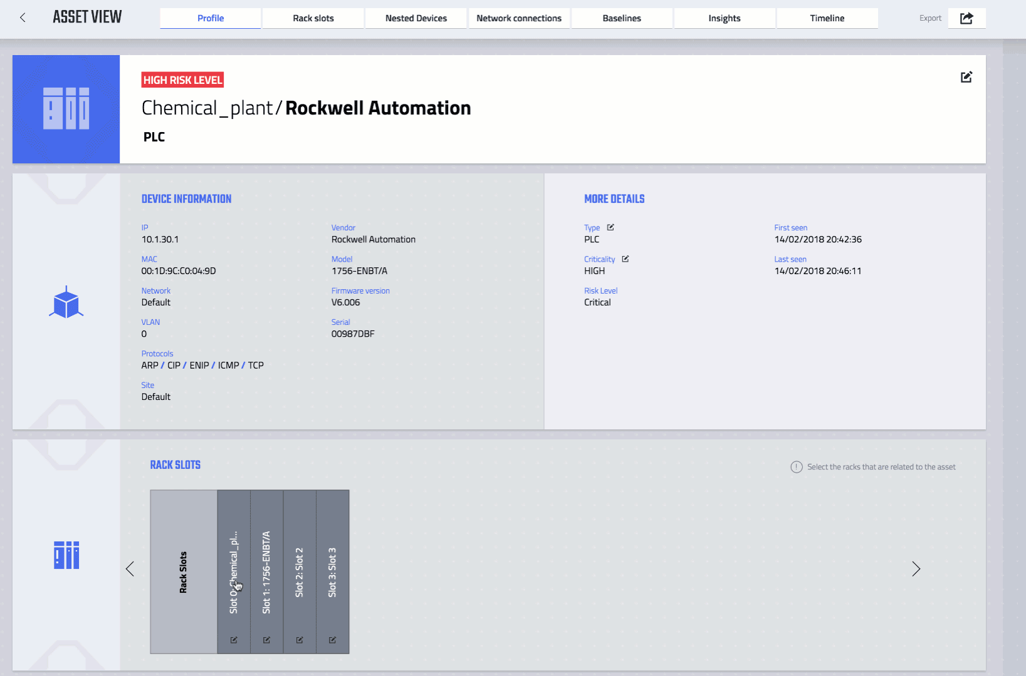
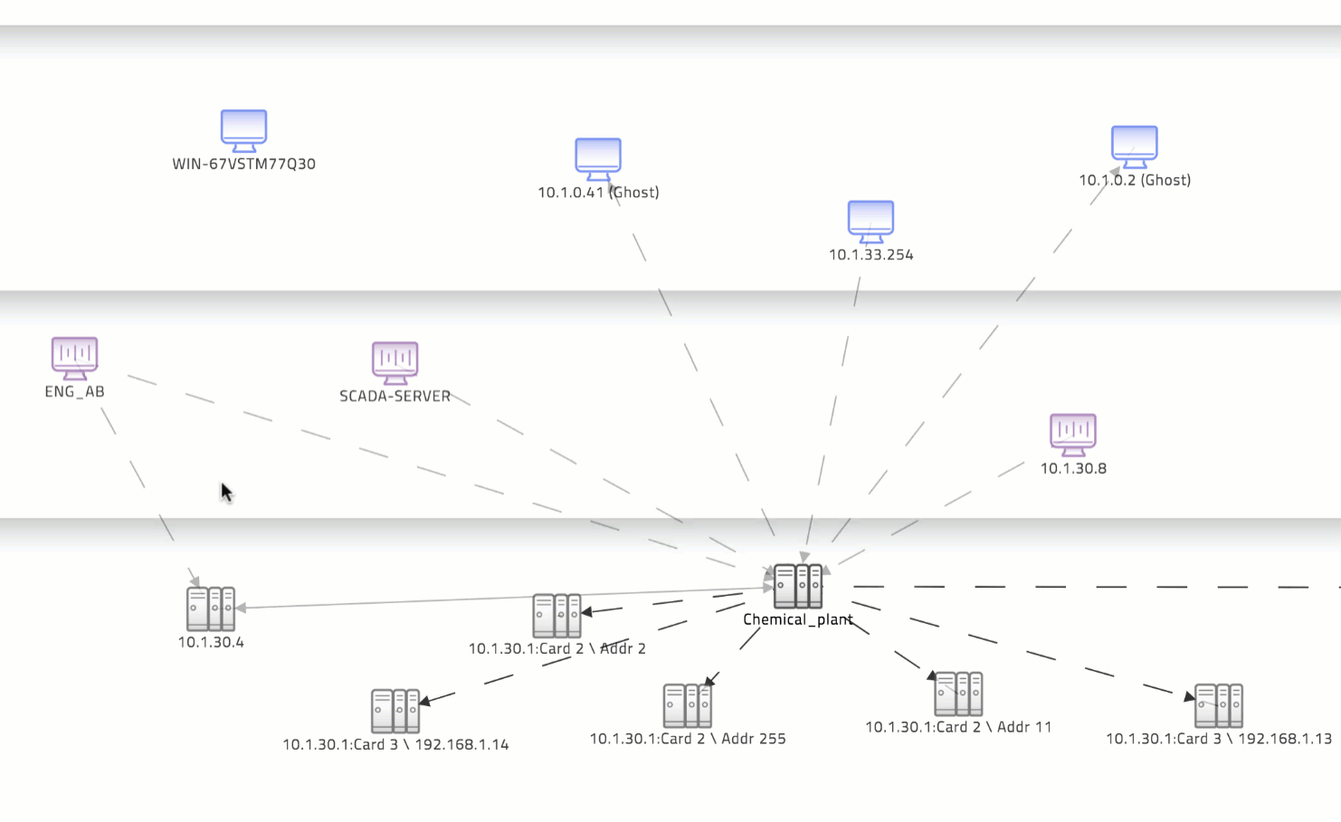
Continuous Threat Detection
Automatically Discover Assets and Communication Patterns
Notes:
Claroty provides what we call “extreme visibility” into your industrial network.
This includes visibility across all layers of your ICS network and deep visibility into the ICS assets – such as the PLC on the left. As you can see, PLC is a card/slot architecture with multiple cards in it. Even with our safe/passive monitoring we are able to detail about the cards
Extreme visibility also means understanding all the conversations going on across the ICS network. On the right you will se that CTD understands which assets are actually communicating with each other. More importantly, we also understand what these conversations are about. For example, we understand the difference between a HMI requesting data from a PLC (a read request) and an engineering workstation downloading a new configuration file to a PLC or sending a write command to change a set point in the PLC memory and the different risk involved in each.
This is ”Extreme Visibility”

Slide 12
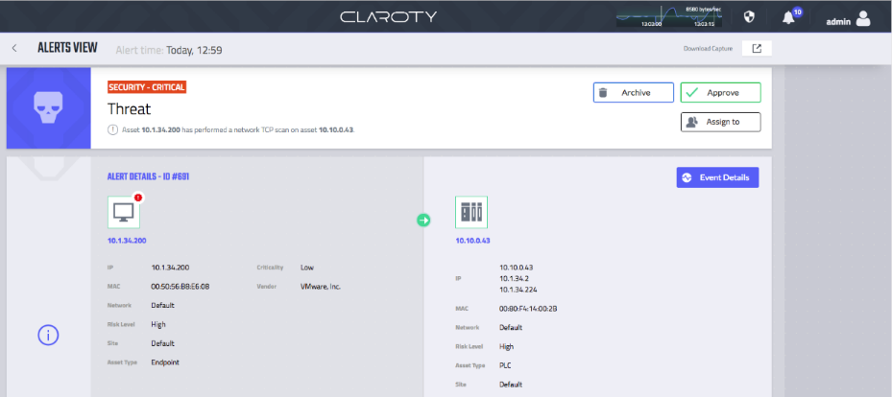
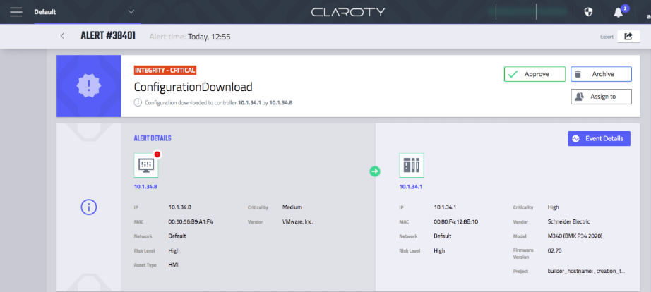
Continuous Threat Detection
Early Warning | Detect Known & Unknown Threats Across Cyber Kill Chain
Cyber Kill Chain
Recon
Weaponization
Delivery
Exploitation
Installation
C&C
Actions
Notes:
We alert you to threats as early as possible so you can stop attacks.
We detect known threats and other anomalous behavior across the full cyber kill chain. It is important to be able to spot adversary activity early in the kill chain so that you have time to remediate the issue before the adversary can carry out the damage. In contrast to other who just monitor PLC configuration changes, Claroty can spot anomalous behavior early so you can avoid damage.
Of course, we also monitor later stage activities like a PLC code changes as these could indicate malicious activity that was not previously seen, human errors or even an insider threat who is authorized to make changes. This is how we were able to detect the Triton attack on the Triconex safety system. Schneider Electric validated that we detected Triton this in their lab.

Slide 13
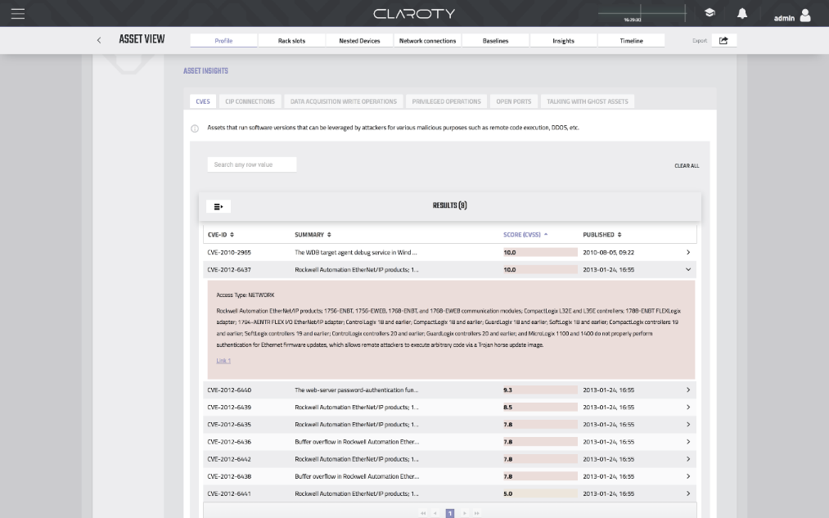
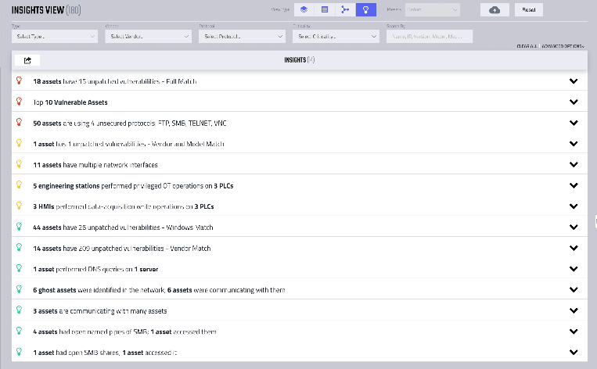
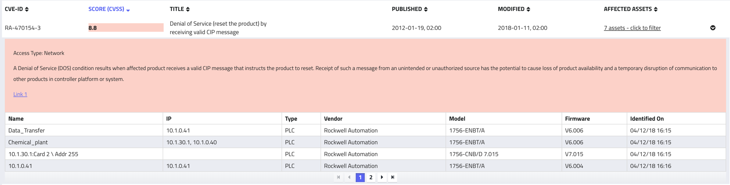
Continuous Vulnerability Monitoring
Exact CVE Matching
Network Configuration
& Security Issues
Notes:
Claroty provides deep insights into ICS environments – enabling to proactively identify and fix configuration and other network hygiene issues that can leave ICS networks vulnerable to attacks or lead to operational issues. Claroty continuously monitors the network for new known vulnerabilities including:
“Network hygiene” or network configuration issues that can leave you exposed to an attack or issues that can lead to an future network failure that can impact the process
Insights into your ICS environment-enabling you to proactively identify and fix issues that can leave your network vulnerable to attack
A key differentiator is the system’s ability to provide precise CVE matching – down to firmware versions for industrial devices.

Slide 14
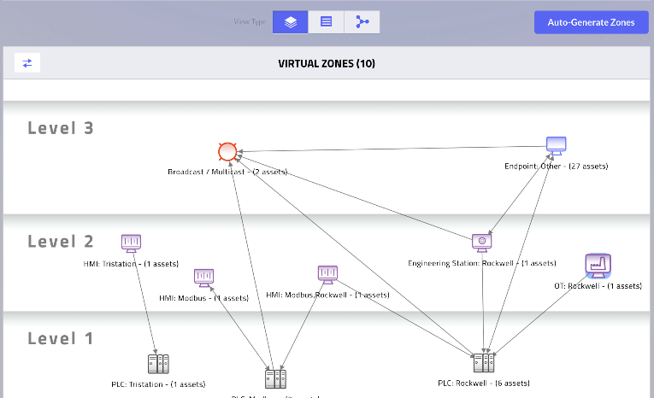
OT Network Segmentation
Virtual and Policy-based Segmentation for OT Networks
Automatically generate current state of OT process communications
Present ideal network segmentation strategy
Expose and Alert on Cross-segment Violations
Automate OT segmentation with existing network infrastructure integrations

Slide 15




Virtual Zones & Network Segmentation
Security Operations Center (SOC)
File Servers
ERP
Mail
CRM
Level 4
Corporate Network
Log Mgmt..
SIEM
Analytics
Policy & Alert-based Segmentation
Jump Box
Repl. Historian
Patching Server
Level 3.5
IT/OT DMZ Zone
Switch
Historian
Operator Station
DNS
Level 3
Operations
HMI
Scada Server
HMI
Scada Server
Level 2
Process Network
Enforce Policy
Virtual Zone
Virtual Segmentation
Switch
Micro-Segmentation
Level 1
Control Network
RTU
RTU
PLC
PLC
Level 0
Field Devices I/O
S
M
Pump
Valve
Sensor
Fan
Valve
Pump
Actuator
Fan
Notes:
Create one slide for Virtual Segmentation (Claroty Alone)
Create one slide for Policy Based Segmentation
Add the Alert-based isolation/quarantine to the Threat Detection/Alerting area.

Slide 16




Secure Remote Access – Before Claroty
3rd Party Technicians
3rd Party Technicians
Remote Employees
Remote Employees
SSH
RDP
VNC
HTTP/S
FW Open Ports
SSH – 22
RDP – 4389
VNC – 5800 / 5900
HTTP/S – 80 / 443
Firewall
Historian
SCADA
Server
Engineering
Workstation
HMI
OT Network
PLC
PLC
PLC
PLC
Valve
Drill
Valve
Drill
Valve
Drill
Valve
Drill
Notes:
One important attack vector that organizations need to mitigate is remote access. Many organizations have multiple employees and contractors that need access into the OT network from a remote location. The scenario often looks like this picture where various individuals have access and there is no way to control who has access to what. Even worse, many contractors share VPN credentials to you network with colleagues via email and other easily hacked sources.

Slide 17


Secure Remote Access – After Claroty
3rd Party Technicians
3rd Party Technicians
Remote Employees
Remote Employees
SRA Admin
Granular user/asset access policy
Enforce Auth. Policies (MFA) and Vault Passwords
Manually approve remote connections
HTTPS/443
Control
SRA Central
Real-time ”over the shoulder” video viewing of session
”Red Button” for immediate session termination
DMZ
Firewall
Monitor
Audit video session recordings
Session integrity validation using CTD activity timeline
Firewall
SSH Reverse Tunneling
Audit
SRA Site
SSH/22
HTTP/80,443
OT Network
RDP/3389
VNC/5800, 5900
Historian
SCADA
Server
HMI
Engineering
Workstation
PLC
PLC
PLC
PLC
Valve
Drill
Valve
Drill
Valve
Drill
Valve
Drill
Notes:
Secure Remote Access acts as a security middleman between remote users and industrial network assets.
When remote users login into the web console, the system fetches a replica of the requested asset’s interface, accepts the user’s input and forwards it only to the authorized asset.
This provide the following capabilities – depending on the use case and system user:
Network administrators have full visibility and control over 3rd party and employee accesses before, during and after a remote session takes place.
Security Teams and Auditors can validate that remote access control policies are being consistently implemented in industrial environments, watch active sessions, and review recorded sessions based on a risk assessment.
OT Plant/Operation can monitor and review remote sessions and validate that the user’s stated purpose aligns with the actual session activity.

Slide 18
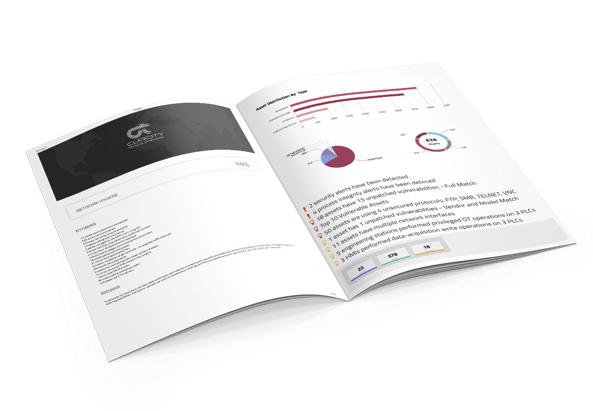
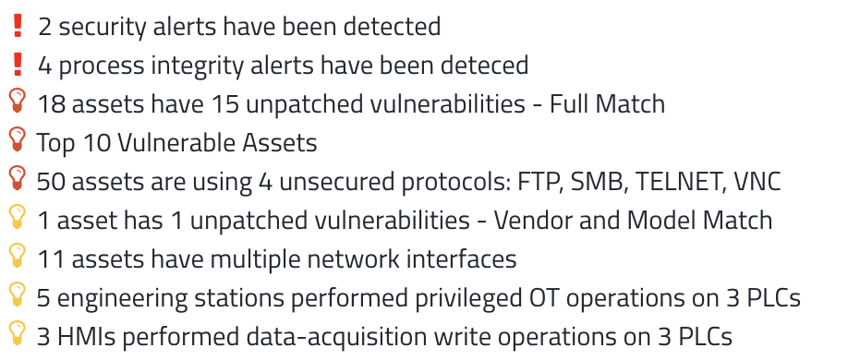
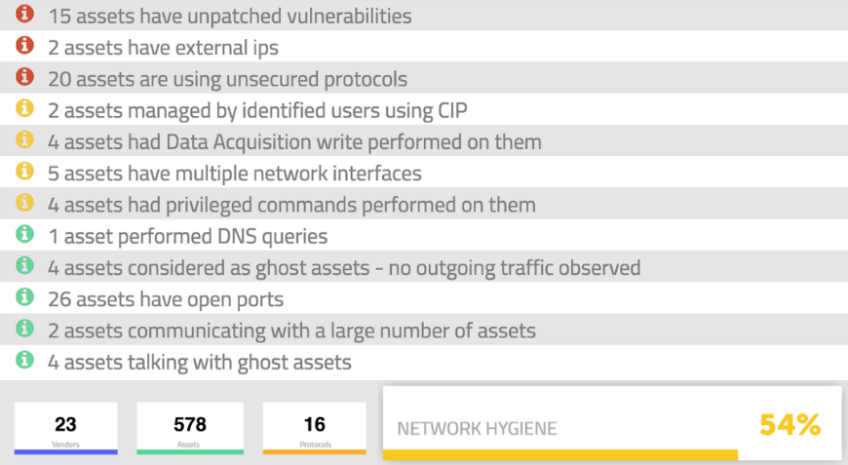
Security Posture Assessment
Ingest Network PCAP –> Output Comprehensive Assessment Report
Notes:
Claroty provides security teams with insights into the security risk posture of your OT network by running a comprehensive analysis of a packet capture (PCAP) file. With a detailed analysis of the assets and network communication patterns discovered and deep insights about weaknesses in your OT network, your teams have the information they need to fix hidden issues that may give an attacker a foothold or impact critical processes.
Asset Inventory
Automatically identify and classify assets across the entire ICS network so you have an in-depth picture of the network and can address regulatory and internal audit requirements.
Detailed Network Analysis
Includes detailed analysis of the various industrial control devices and how they communicate within and across the network, including specific visibility into their communication paths and associated devices.
Comprehensive Vulnerability Insights
The system generates a summary score and detailed analysis of the weaknesses in your ICS environment. The report includes known vulnerabilities (CVE matching) for the devices in your network and a list of network hygiene and other configuration issues that can provide a potential attack pathway.

Slide 19
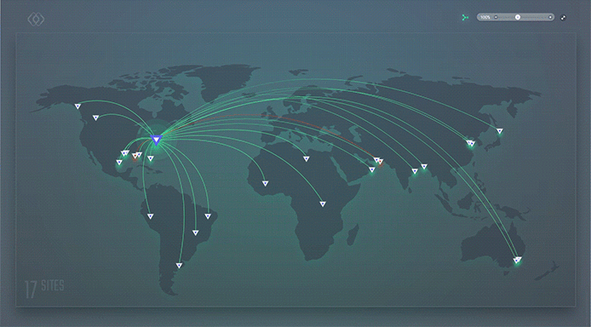
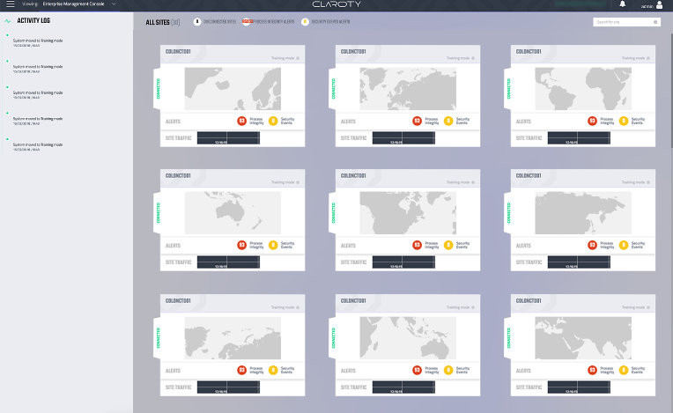
Enterprise Management Console
Global Visibility | Drill-Down View
Notes:
The Claroty platform was designed to operate in real-world enterprises who have large complex networks and multiple plants or sites.
The Enterprise manager provides a centralized SOC or Engineering team with a consolidated roll up view across multiple plants and locations – providing the following benefits:
Consolidated Management
Claroty Enterprise Management Console is a centralized management interface that consolidates data from Claroty products across multiple sites, and displays a unified view of assets, activities and alerts, making it highly suitable for security operations center (SOC) deployments.
Multi-site View of Traffic, Assets and Activities
Receive consolidated cross-site asset, alert and activity data – filtered and analyzed to proactively highlight operational issues and spot important security trends.
Comprehensive View for Your SOC Teams
Consolidated view providing your SOC teams with enterprise visibility, actionable alerts, and the context to rapidly and collaboratively investigate and resolve threats across your entire ICS system.

Slide 20
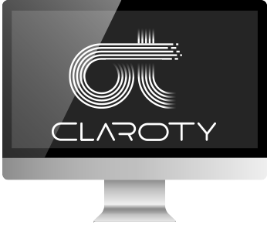
Comprehensive Functionality
Support for Multiple Teams & Use Cases
Security Operations Center (SOC)
IT Operations
Level 1 Threat Monitoring
Level 2 Analysis
Level 3 Investigations and Threat Hunting
Asset Management
Change and Configuration Management
OT - Plant/Operations Teams
Security Audit
Real-Time Asset Inventory
Standards Compliance
Audit Remote Access Sessions – Validate Changes
Audit Remote Access Rights
Audit of Remote Access Sessions
Regulatory Compliance
Security Policy & Risk Management
Vulnerability and Patch Management
Manage Employee and 3rd party Remote Access Policies
Process Remote Access Requests
Notes:
The Claroty platform includes unique capability specifically tailored to the needs of a variety of roles within and across the organization.
As we discussed up at the top of the presentation, the Claroty platform capabilities across the products – CTD, SRA, enterprise console and our Security Posture Assessment -- enable multiple use cases across different IT/OT teams. This summarizes some of the key use cases. I am sure you may have others that apply as well.

Slide 21
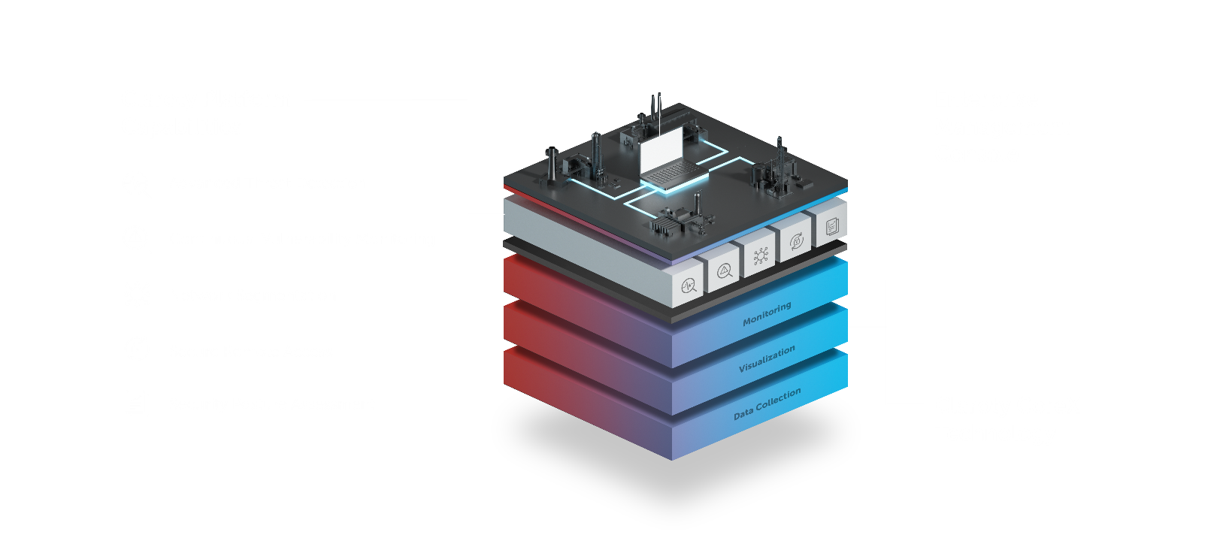
Claroty Platform – Extreme Visibility and More
Protect | Control | Detect | Respond

Slide 23























Elite Management Team
Dave DeWalt
Chairman
Yuval Tzeiri
COO
Yaron Shalom
CFO
Patrick McBride
CMO
Colin Blou
VP Sales
Nadav Zafrir
Team8 Founder
Claroty President
Benny Porat
Founder, Chief
Technology Officer
8200
Yuval Ofir
VP R&D
Guilad Regev
VP Tech OPS
Yaron Paryanty
VP Product
8200
Amir Zilberstein
Founder, Chief
Executive Officer
Galina Antova
Founder, Chief Business
Development Officer
8200
Dave Weinstein
VP Threat Research
Jonathan Shapira
VP and General Counsel
Amir Preminger
VP Research
Ramse Rogers
Sr. Director, Global Channels
Notes:
Claroty has assembled an unprecedented executive team and attracted a premier interdisciplinary team of cybersecurity and industrial control system experts.
We have some of the brightest minds in industrial cyber security on the planet on our team.
We have a very experienced management team and our research team is the top 1% of the 1%.
{Other details below if asked. No need to say more}
Chairman, Dave Dewalt led some of the most important Cybersecurity companies in the world – MacAfee, FireEye, Mandiant
CEO Amir Zilberstein is a pioneer in the industry and co-found Waterfall – the company that created the first major ”purpose built” ICS security product in the market – a one-way diode for critical infrastructure environments. He ran an elite cyber unit of the IDF.
Galina – was the global head of industrial security services at Siemens
Benny – ran an elite cyber unite in IDF and, at the ripe old age of 27 has finished his coursework and submitted his PHD thesis. He has published several journal papers on pattern matching – which is quite relevant to the development of our advanced anomaly detection capability.
Nadav Zafrir, is our President and the co-founder and CEO of the famous Israeli cyber security foundry–Team8. Nadav is globally connected and ran the famed 8200 Unit of the IDF (the NSA of Israel). With this management team we are able to attract the top 1% of the 1% in the industry.
The rest of the team also has extensive experience building innovative tech companies

Slide 24






Awards
Winner
ICS Threat Detection Challenge
2018 North American OT
Network Protection Platform:
Entrepreneurial Company of the Year
Top 25 Tech Companies to Watch 2018
Cool Vendors in Smart City Application Solutions 2016
RSAC 2017 Innovation Sandbox Highlights Top 10 Cyber Startups
Finalist in the Best Cybersecurity Startup (50 or fewer employees)
Notes:
Our technology has been recognized across the industry.
In addition to industry awards and validation from key automaton vendors, Claroty won the ICS threat detection challenge in the S4 in Miami in January 2018
This was a head-to-head competition against competitors and used actual PCAP data from an oil/gas pipeline company to test the competitors in real world scenarios.
Tested asset identification and threat/anomaly detection capabilities Claroty won both section (asset identification and threat) and was the overall winner
{ONLY IF ASKED…}
Competitors that actually had the guts to compete:
Nozomi Networks, SecurityMatters, Gravwell

Slide 25


Continuous Threat Detection
Behavior-Based Anomaly Detection & Signature-Based Intrusion Detection
(Detect Known and Unknown Threats)
Production Mode
Alerts:
Security Threats Process Integrity Issues
Changes to Environment and New Vulnerabilities
Generate Actionable Alerts
Monitor: Anomalies/Changes/Intrusions
Training Mode
Generate High-Fidelity Baseline Model
Insights:
Network Hygiene Issues
Known Vulnerabilities (CVEs)
Profile All Network Communications
Automatically Discover Assets
Notes:
In addition to extreme visibility we leverage sophisticated behavioral analysis techniques to provide ongoing, real-time threat detection. Let’s discuss how our Real-Time Threat Detection works.
(click) First, we discover your entire industrial network:
This is fully automated, completely safe/passive discovery of all assets across all layers of the OT network
This yields detailed asset information, network topology, communications pathways and protocols in use, and more.
We have visibility across IP AND serial nodes
We even discover assets on other side of a gateway (e.g., PLC with a network card)
(click) Next, we deeply profile all the communication on the network. Which assets are talking, who they are talking to, which protocols they are speaking, and most importantly what are they “saying” to each other. What sorts of commands are being issued, what types of changes are being made—including changes that can be process impacting.
(click) We use this detailed information to build a very high-fidelity baseline model. Think of the “baseline model” as a “known good” or “whitelist” view of the ICS environment and communications. We learn how the network should act and leverage this information to detect anomalies.
With this information you gain Immediate INSIGHTS into your ICS network – we reveal important configuration and network hygiene/configuration issues that may provide an attack vector or could break the process.
This initial phase is “training mode” and typically lasts for a few weeks to a few months depending on the site.
(click) Our real-time threat detection system then use behavioral analysis to monitor for baseline deviations. Because we build very detailed model we are able to spot anomalies and high-risk changes better than anyone. This makes our ICS threat detection the best on the market.
(click) We alert on any operation that could have an adverse impact on the process and provide the context your team needs to understand the implication of the change.
We alert for both security threats or other high risk changes that can adversely impact the process.
Because of the depth of the information we collect, and our knowledge of ICS systems, we are able to give clear, actionable, context rich alerts for both security and process integrity issues. This is a significant differentiator for Claroty.

Slide 26
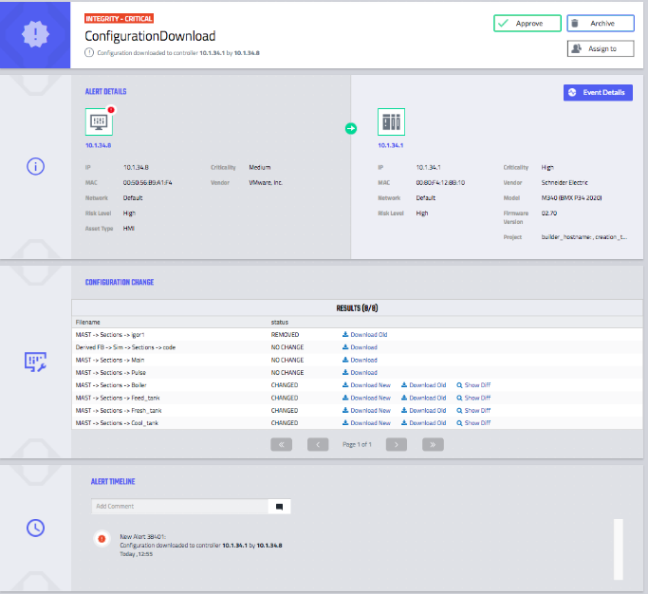
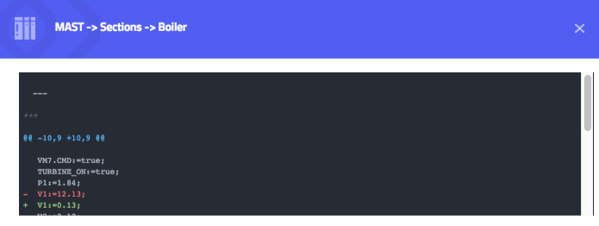
Continuous Threat Detection
Actionable Alerts: Clear | Consolidated | Context-Rich Alerts = Reduced Time to Remediate
Asset Details
Actual PLC Code Diffs!
Configuration
Changes
Alert Timeline
Notes:
We provide clear, concise human understandable alerts that provide immediate situational awareness (what happened)
The alerts are consolidated, unlike other systems that provide a long stream of events the SOC team has to try and make sense out of (if they can can)
Most importantly we provide the context necessary for security teams to rapidly and efficiently investigate security related events AND the context necessary for the security team to collaborate with the shop floor team to investigate and remediate issues.
(click) Fox example we can provide the security team with the name of the PLC that was changed, and even provide a diff that they can share with the shop floor to pinpoint exactly what change were made so the plant team can quickly understand whether the process is impacted and how.
This collaboration between IT and Shop Floor is essential.

Slide 27
Advanced CoreX Technology
Extreme Operational Visibility | Best Threat Detection | Improved Triage/Remediation
Monitoring
  Employ advanced, behavior-based anomaly detection to discover known and unknown threats
  Continuously monitors OT environments for changes and analyzes the network to uncover vulnerabilities
  Advanced filtering combined with active animations delivers a complete picture of the network and how nodes are communicating
Visualization Engine
  Depicts network nodes and communications pathways down to the lowest levels of the OT network
  Advanced filtering combined with active animations delivers a complete picture of the network and how nodes are communicating
Multispectral Data Collection:
  100% Visibility Into OT Network Communications and Assets
  Flexible pre-packaged deployment options for various OT environments
  Cost-effective hardware options for reduced deployment time/cost
Notes:
Multispectral Data Collection:
100% visibility into OT environment assets and network communications
Visualization:
Depicts network nodes and communications pathways down to the lowest levels of the OT network
Advanced filtering combined with active animations delivers a complete picture of the network and how nodes are communicating
Monitoring:
Employ advanced, behavior-based anomaly detection + IDS engine to discover known and unknown threats
Continuously monitors OT environments for changes and analyzes the network to uncover vulnerabilities

Slide 28
Appendix B: Latest Release

Slide 29
Winter Release 2018
Virtual Zones and Network Segmentation
Multispectral Data Acquisition
Technology Partner Ecosystem

Slide 30



Multispectral Data Collection Capabilities
Extreme Visibility Enhanced
Passive
Continuous, Real-time Monitoring of OT Networks
  Rapidly discover network communications and asset details down to the I/O level
  Field Proven and 100% safe for OT networks
Active
Precise, Periodic Queries of OT and IT Assets
  Safely query ICS and non-ICS assets for enhanced visibility into asset configurations
  Enhanced context for alerts and vulnerabilities
App DB
Offline Enrichment of OT Asset Data
  Ingest and parse PLC/RTU project and other configuration files and binaries
  Gain nearly 100% asset coverage and enhanced asset configuration details

Slide 31
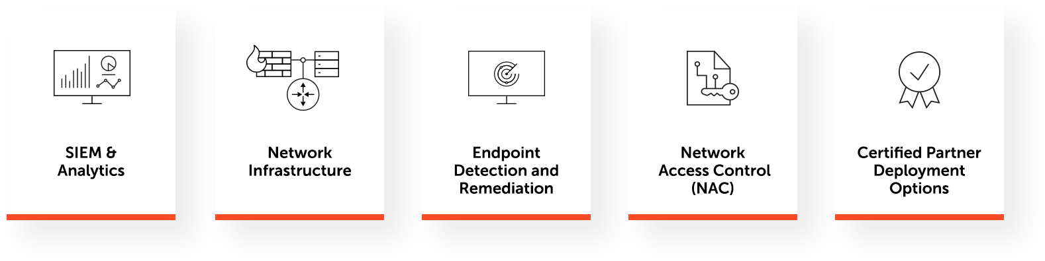








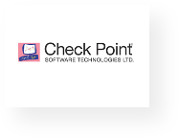
Technology Ecosystem Integrations & Deployment Options
Claroty Derived Integrations and Validated Deployment Options
Notes:
The Claroty Platform integrates with a wide range of partners, from security operations center (SOC) tools, to important IT and OT infrastructure, enabling you to leverage the investments you already made in technology, process development, and training.

Slide 32
Appendix B: Claroty Coverage

Slide 33
Claroty Platform
Deepest Coverage Available
Communication we monitor
Asset connections within the ecosystem
Open/Proprietary protocols utilized (CIP, S7,S7+,Ovation,Modbus, Vnet/IP, etc.)
Commands the asset sends and receives:
  Data Acquisition
  Programming
  Operation
  Diagnosis
  Alarm & Events
  Authentication
  And More
Asset Information we discover
IP Address
MAC Address
Equipment vendor
Equipment type (PLC, HMI, Engineering
Workstation, Switch, etc.)
Asset model number
Asset serial number
Firmware version running on the asset
Physical data (rack slots)
And more

Slide 34
Supported Protocols – Passive
Continuous, Real-time Monitoring of OT Networks
ABB Bailey
ABB DMS system
ABB HC800 (Infininet)
ABB Spirit
ABB Symphony Plus
Alstom E-Terra
BACNET
NetBIOS Browser (UDP 138)
Cisco Discovery Protocol (CDP)
Control Technologies Inc. (CTI)
Microsoft DCE RPC
Microsoft DCE RPC - ABB DCS Service Manager
Emerson DeltaV
DACP
DHCP
DNP3
Emerson Ovation
Emerson ROC Plus
ETHERNET/IP
Foundation Fieldbus (FF)
Foxboro LLC
FTP – SEL
Siemens FWL LOAD (firmware upload)
GE-ALM
GE Bentley Nevada (BNC3500)
GE-EGD
GE-EGD-CMP
GE PAC8000 (AXE)
GE QuickPanel (TRAPI+HTTP)
GE SDI (MarkVie)
GE SDI Classic (MarkVie)
GE SRTP
HART-IP
HiDiscovery – Hirschmann LLC
Honeywell C200 – Ftebcip
Honeywell Experion - CeeNTComm (C300, EHPM)
Honeywell EpicMo (C300 management)
Honeywell Firewall CF9
HTTP
HTTP-XML (specific schemes)
IEC101
IEC103
IEC104
Lantronix Serial GW
LLDP
Mitsubishi Melsec
MMS
Modbus
Modbus Modsoft
Modbus Concept
Modbus Eltec
Modbus Execload
Modbus Schneider
NetBios Datagram Service
Niagara Tridium (BMS)
Microsoft NTLMSSP (Auth protocol)
Omniflow Flow computer
OPTO
OPTO MMP
OSISoft PI
Siemens P2
POP3
ProConoS (TCP 20547)
Profinet DCP
Profinet I/O
Microsoft RDP
MQTT
RCDP
Redlion Crimson
Rockwell CIP
Rockwell PCCC
S7Comm Plus
S7Comm Plus
Microsoft SAMR
Microsoft CIFS (SMB)
SNMP
SSH
Synchrophasor
Telnet- DeltaV
Telnet- Moxa
Telnet- Omniflow
Telnet - Hirschmann
Telnet- SEL
ABB Totalflow
Triconex Tristation
Triconex TSAA
Yokogawa VNET (VHF)
Yokogawa odeq
^{Newly Added}
Beckhoff AMS
Cognex Discovery
Kongsberg
Profinet Real-Time
Portwell
HSRP
Full list of Supported Protocols see here

Slide 35
Supported Protocols – Active
Precise, Periodic Queries of OT and IT Assets
DNP3
Hirschmann Discovery Query
Modbus Information Object
Net Bios
Profinet-DCP Query
S7comm Query
Siprotec Query
Telnet
SNMP Query
ENIP Query
CIP Query
WMI Query
TCP Port Scan
Beckhoff Query
BACnet Query
Full list of Supported Protocols see here

Slide 36
Supported Protocols – App DB
Offline Enrichment of OT Asset Data
Rockwell – MicroLogix
Rockwell – Aadvance
Rockwell – ICSTriplex
Schneider – Modicon, Quantum
Schneider – Concept
Schneider Triconex – Tristation
Yokogawa – CentumVP/CS3000
Yokogawa – Prosafe
Honeywell – Experion
Honeywell – EHPM
GE – rx3i,9030
GE – Bently Nevada
ABB – AC800M
Full list of Supported Protocols see here

