Slide 1
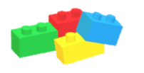
Maths
SMART Targets will be set at the beginning of each block of lessons. These targets will be generated using assessment data.
Target: By January, Maisie will be able to convert between fractions, decimals and percentages with 90% accuracy.

Slide 2
LO: Recognise decimals as parts of a whole and represent them using numerals.
Lesson objective – what we are planning to achieve in this session.

Slide 3
Purple slides review the learning from previous lessons. This is an essential step which supports children to convert new learning from their short to long term memory. Regular practise at home will also be set to support this.

Slide 4
0
1
What numbers come between zero and one?
Green slides are for teaching. Learning is broken down into small manageable steps that follow an I do, we do, you do cycle. This pattern of teaching promotes independence and ensures success by the end of the lesson .

Slide 5
Between 0 and 1 are decimals.
A decimal is a part of a whole.

Slide 6
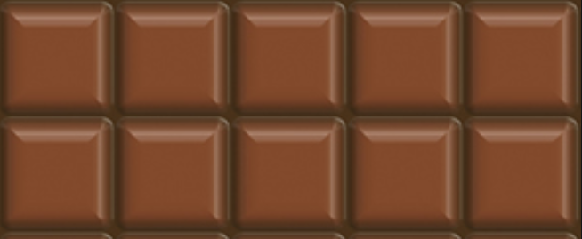
Concrete resources and visual representations are used at this stage of the lesson. Using physical items that can be manipulated helps children to understand a new concept being introduced. Pictures can also help children to visualise the maths processes being taught.
How many parts has the whole been broken into?
Notes:
This is 1 whole bar of chocolate. Children to repeat – how many bars of chocolate are there? 1 whole. This is 1 whole – YT this is 1 whole. I wanted to share my 1 whole bar of chocolate with 10 people. Break the bar of chocolate into 10 pieces.

Slide 7
This is a decimal.
Our whole is split into 10 equal parts. I have ________ part.
I have _________ tenth.
Notes:
Children to chant back. This is a decimal. A decimal is a part of a whole. Our whole is split into 10 equal parts. I have 1 part. I have 1 tenth.

Slide 8
This is a decimal.
Our whole is split into 10 equal parts. I have ________ part.
I have _________ tenth.
Notes:
Children to chant back. This is a decimal. A decimal is a part of a whole. Our whole is split into 10 equal parts. I have 1 part. I have 1 tenth.

Slide 9
This is a decimal.
Our whole is split into 10 equal parts. I have ________ part.
I have _________ tenth.
Notes:
Children to chant back. This is a decimal. A decimal is a part of a whole. Our whole is split into 10 equal parts. I have 1 part. I have 1 tenth.

Slide 10
Sam says this is a decimal. Do you agree?
Reasoning is an important part of the maths curriculum for all year groups. Children need to clearly share their understanding by explaining ‘why’. Although opportunities of reasoning are embedded throughout the lesson yellow slides provide an opportunity to dive deeper!
Our whole is split into 10 equal parts. I have ________ parts.
I have _________ tenths.
Notes:
This is not a decimal. We have ten tenths. We have a whole.

Slide 11
This is 1 whole.
?
Here the representation has been varied (the chocolate bar replaced by rods). Variation is an essential component of maths lessons used to deepen understanding and avoid misconceptions.
Notes:
Physically hold up the Cuisenaire rods. Discuss how we can’t break the Cuisenaire rod so we are going to have to represent tenths in a different way. Pick up the white Cuisenaire rod. Ask the children what could this represent?

Slide 12
This is 1 whole.
This is a decimal.
Our whole is split into 10 equal parts. I have ________ part.
I have _________ tenth.
Notes:
This is a decimal. A decimal is a part of a whole. Our whole has been split into 10 equal parts. I have 1 equal part. I have 1 tenth.

Slide 13
This is 1 whole.
v
v
v
v
v
v
v
v
This is a decimal.
Do you agree?
Our whole is split into 10 equal parts. I have ________ equal parts.
I have _________ tenth.
Notes:
Children to challenge – this is not a decimal because I have 10 parts of 10. I have a whole.

Slide 14
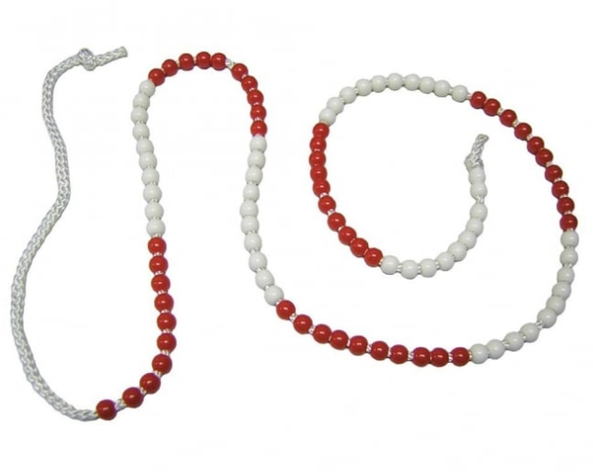
Here are some wholes and some decimals. Circle all the decimals.
This is 1 whole.
Blue slides are for independent practise. They offer opportunities for the tutor to assess the student’s understanding of what has been taught so far. There will be multiple opportunities for independent practise throughout a lesson.

Slide 15
Thousands | Hundreds | Tens | Ones | ?
Here the representation has been varied. We are starting to move away from the use of pictorial representations to work with more abstract concepts. The Place Value grid is a key visual that is used across KS1 and KS2.

Slide 16
Thousands | Hundreds | Tens | Ones | .
A decimal is part of a whole.
This is a decimal point. I tells us that any digit to the right of this point is less than 1 and is part of 1 whole.

Slide 17
Thousands | Hundreds | Tens | Ones | . | Tenths
Beyond the decimal point is the tenths column.
A tenth is less than 1. It is part of 1 whole that has been split into 10 equal parts.

Slide 18
Thousands | Hundreds | Tens | Ones | . | Tenths
Where would I write 1 whole on the place value grid?
Notes:
Write the number and draw it.

Slide 19
Thousands | Hundreds | Tens | Ones | . | Tenths
How would I represent one tenth using numerals?
Notes:
A whole has been split into 10 equal parts. I have 1 equal part. I have 1 tenth. Put the number 1 in the tenths column and repeat I have 1 tenth. Then say, I don’t have any wholes. I don’t have any ones but I can’t leave my ones column empty. Put a zero in the ones column. Place the decimal point in underneath. I don’t have any wholes so I have 0 ones. I have 1 one tenth of a whole. I have 1 tenth. I have 0.1. Write the number and draw it.

Slide 20
Thousands | Hundreds | Tens | Ones | . | Tenths
How would represent three tenths using numerals?
Notes:
A whole has been split into 10 equal parts. I have 3 equal part. I have 3 tenths. Put the number 3 in the tenths column and repeat I have 3 tenths. Then say, I don’t have any wholes. I don’t have any ones. But I can’t leave my ones column empty. Put a zero in the ones column. Place the decimal point in underneath. I don’t have any wholes so I have 0 ones. I have 3 tenths of a whole. I have 3 tenths. I have 0.3. Write the number and draw it.

Slide 21
Do you agree?
Thousands | Hundreds | Tens | Ones | . | Tenths
.
9
John has written 9 tenths as a decimal.
He says 9 tenths = .9

Slide 22
0.1 0.2 0.3 0.4 0.5 0.6 0.7 0.8 0.9
What would come next?

Slide 23
0.1 0.2 0.3 0.4 0.5 0.6 0.7 0.8 0.9 1
Which is larger 0.7 or 0.8?

Slide 24
Fractions and decimals are both parts of a whole represented differently.
1 whole
0.1
=
1/10
Notes:
Chant this – My turn your turn.

Slide 25
Thousands | Hundreds | Tens | Ones | . | 1/10
How could I write this using numerals?
How would I write this as a fraction?

Slide 26
TH | H | T | O | . | 1/10
A number greater than 1 is being represented. How could we represent this number in numerals?
Wizard challenges (represented by a wizard hat) provide stretch and challenge and require a deeper level of understanding.
If I increased my number by 1 whole. What would my number be?
Notes:
Discuss how we have 1 whole AND 2 tenth.

Slide 27
TH | H | T | O | . | 1/10
A number greater than 1 is being represented. How could we represent this number in numerals?
Notes:
Discuss how we have 1 whole AND 2 tenth.

Slide 28
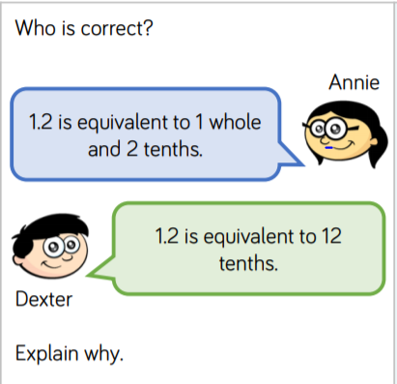
TH | H | T | O | . | 1/10
Use the place value chart to help represent these decimal numbers using numerals:
1.)
2.)
3.)
4.)

Slide 29
David is comparing 2 numbers. He thinks that the first representation is greater than the second representation because it has more red rods. Is David correct? Prove it.
>

Slide 30
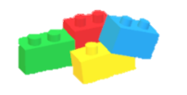
I now know …
This provides children with an opportunity to reflect upon what they have learnt in this session and the tutor to once again assess the learning.

Slide 31
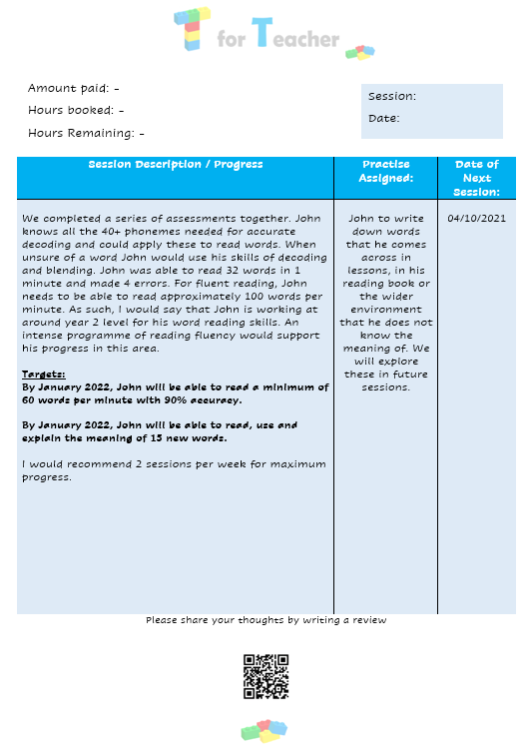
Session Report:
At the end of each lesson a session report will be sent to you. This will provide a brief description of the work completed during the lesson and will reflect upon your child’s progress towards their current target. Additional practise assigned during the lesson will also be stated here.

