Slide 1
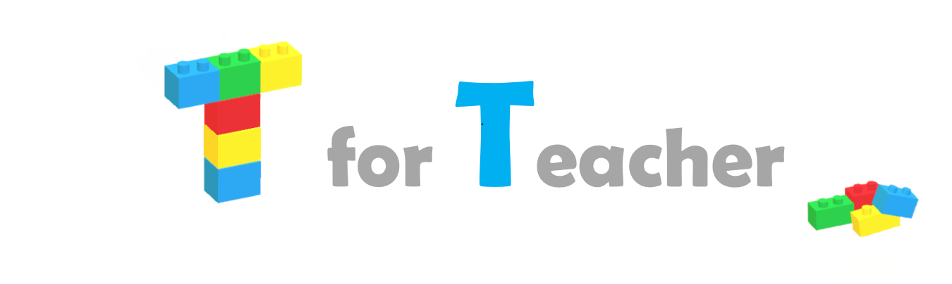
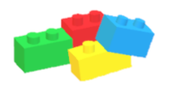
Maths
SMART Targets will be set at the beginning of each block of lessons. These targets will be generated using assessment data.
Target: By October James will understand the cardinality of numbers 1-5. He will able to find the total within a group of up to 5 objects by counting with 100% accuracy.

Slide 2

LO: Understand the cardinality of the number 2
Lesson objective – what we are planning to achieve in this session.
A key objective of the Early Years and Foundation Stage is for children to understand the cardinality of numbers (know what a number means in terms of how many things they refer to). Many children can rote count (say the numbers in sequence) but are unable to use counting as a tool to work out how many there are within a group.

Slide 3
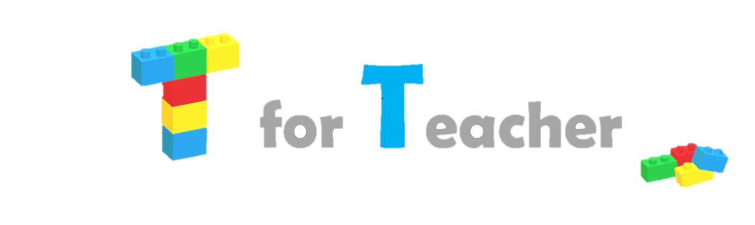


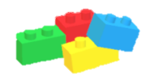
Which is the odd one out? Which is different?
Purple slides review the learning from the previous lesson. This is an essential step which supports children to convert new learning from their short to long term memory. Regular practise at home will also be set to support this.

Slide 4
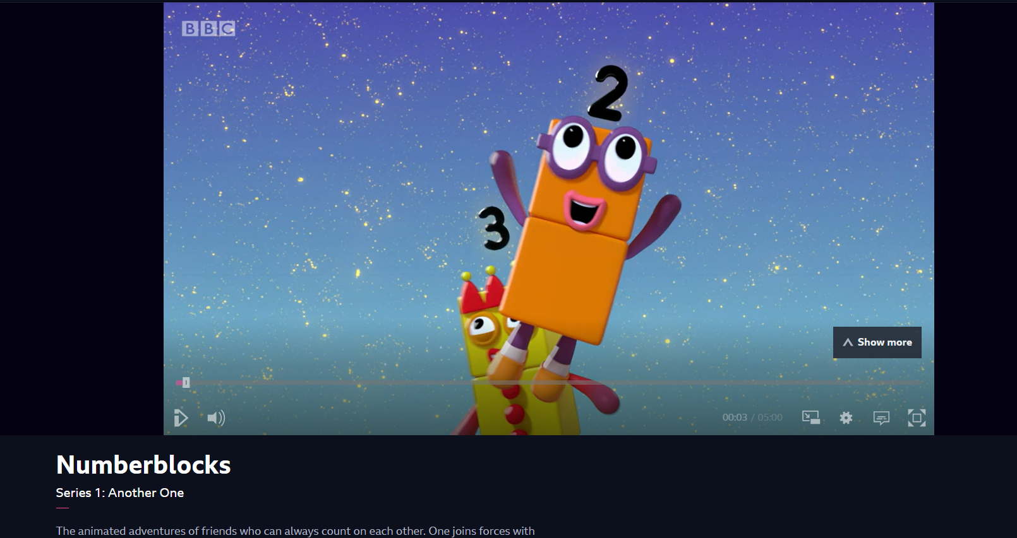
BBC iPlayer - Numberblocks - Series 1: Another One
I do
Green slides are for teaching. Learning is broken down into small manageable steps that follow an I do, we do, you do cycle. This pattern of teaching promotes independence and ensures success by the end of the lesson .
Notes:
Follow the link to watch the first Numberblocks episode introducing the number 2. Pause the video at various intervals and ask your child how many there are.

Slide 5
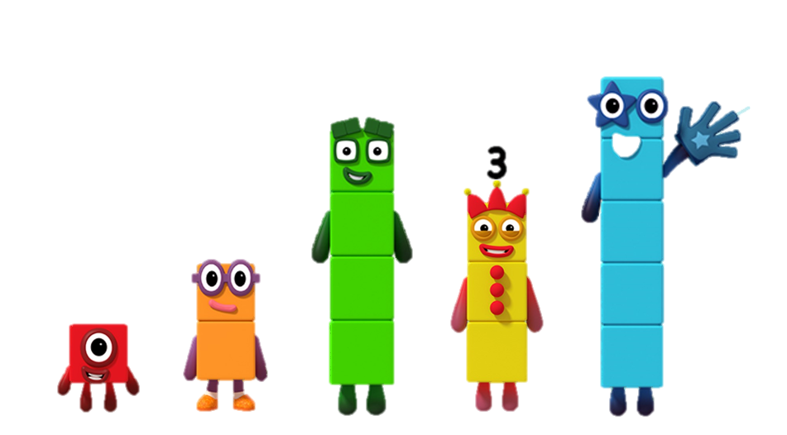
We do
Can you find me?
Concrete resources (physical blocks) would be used at this stage of the lesson. Using physical items that can be manipulated helps children to understand a new concept being introduced.

Slide 6
We do
Can you build me?
Concrete resources (physical blocks) would be used at this stage of the lesson. Using physical items that can be manipulated helps children to understand a new concept being introduced.

Slide 7
We do
What’s different about me?
Reasoning is an important part of the maths curriculum for all year groups. Children need to clearly share their understanding by explaining ‘why’. Although opportunities of reasoning are embedded throughout the lesson yellow slides provide an opportunity to dive deeper!

Slide 8
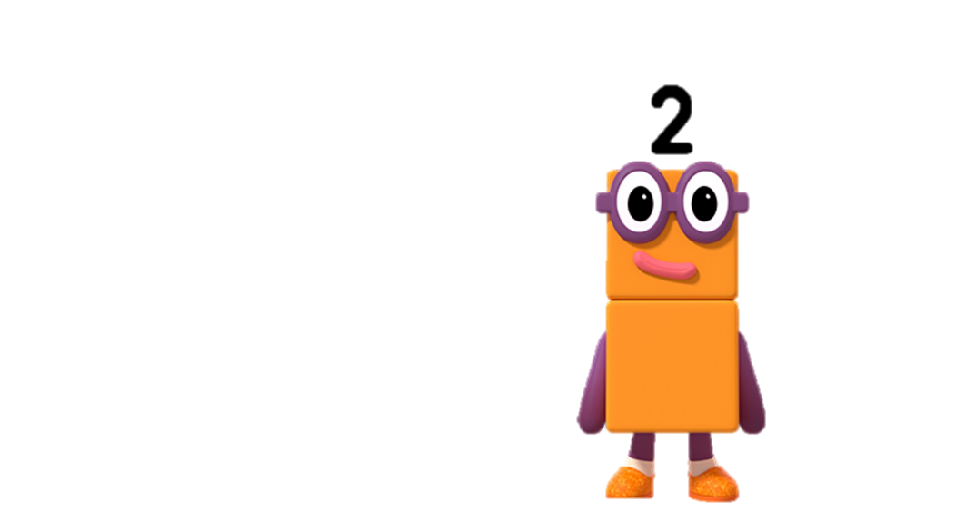
I do
One and another one is two

Slide 9
We do
One and another one is ____
Here the representation of 2 has been varied. Variation is an essential component of maths lessons used to deeper understanding and avoid misconceptions.

Slide 10
We do
One and another one is ___
Here the representation of 2 has been varied. Variation is an essential component of maths lessons used to deeper understanding and avoid misconceptions.

Slide 11
We do
One and another one is ___
Here the representation of 2 has been varied. Variation is an essential component of maths lessons used to deeper understanding and avoid misconceptions.

Slide 12
Let’s write the number 2!
_
_
2
2
2
Here we have moved away from concrete and pictorial representations. This is an abstract representation of the number 2. Children need to be able to recognise the numerals for given numbers.

Slide 13


You do
Circle 2
2
Blue slides are where children independently practise their learning. This provides an opportunity for the tutor to assess their understanding at different intervals throughout the lesson.
Notes:
Circle 2

Slide 14
Two is the same as one and another one.
I do
Here the representation of 2 has been varied. Variation is an essential component of maths lessons used to deeper understanding and avoid misconceptions.

Slide 15
I do
Here the representation of 2 has been varied. This ‘part whole’ or ‘cherry model’ introduces children to the concept of addition, that two parts can combine to make a whole.
One and another one makes two

Slide 16
We do
2
1
1
1
1
One and another one makes two

Slide 17
We do
1
1
+
=
One and another one makes two

Slide 18
You do
1
=
+
1
One and another one makes _____

Slide 19
=
Two is the same as one and another one

Slide 20
1
1
=
+
Two is the same as one and another one

Slide 21
Here the representation of 2 has been varied. This ‘part whole’ or ‘cherry model’ introduces children to the concept of subtraction, that a whole can be partitioned into two parts.
Here the representation of 2 has been varied. This ‘part whole’ or ‘cherry model’ introduces children to the concept of subtraction, that a whole can be partitioned into two parts.
2
1
1
1
1
Two is the same as one and another one

Slide 22
Simon says 2 times …
step
clap
jump
hop
skip
To complete this abstract slide children will be need to be secure in their understanding that 2 is made up of 1 and another 1 in order to clap twice.

Slide 23
I now know …
This provides children with an opportunity to reflect upon what they have learnt in this session and the tutor to once again assess the learning.

Slide 24
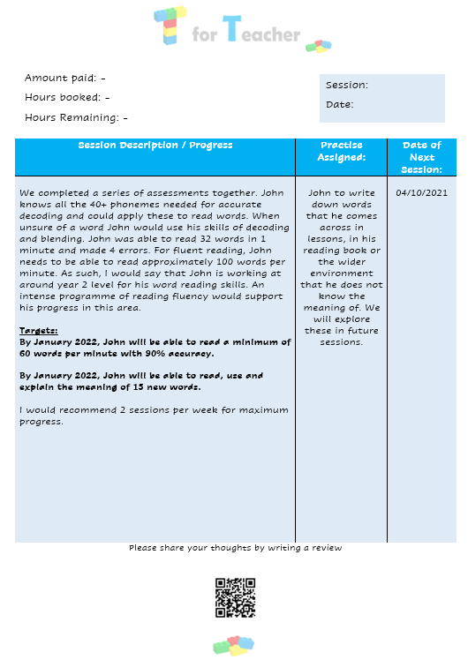
Session Report:
At the end of each lesson a session report will be sent to you. This will provide a brief description of the work completed during the lesson and will reflect upon your child’s progress towards their current target. Additional practise assigned during the lesson will also be stated here.

